Slide 1
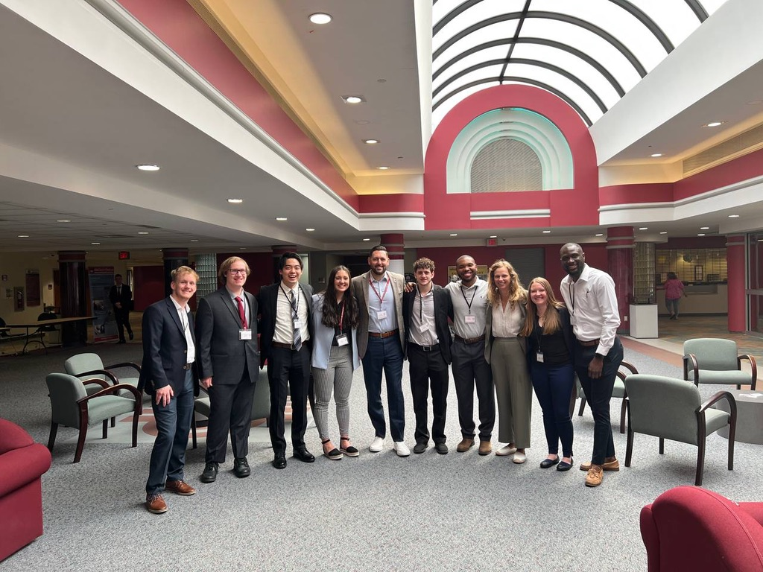
IUP Kinesiology, Health, & Sport Science Department Newsletter
May 2023
In this Issue:
Student Showcase: Maurice House
Faculty Spotlight: Professor Jose E. Rivera
Featured Alumni: Autumn Bolton
Event Recap: 2023 Sports Business Conference
@iup_khss
@iupkhss
@IUP KHSS
Notes:
Single Event with Picture

Slide 2
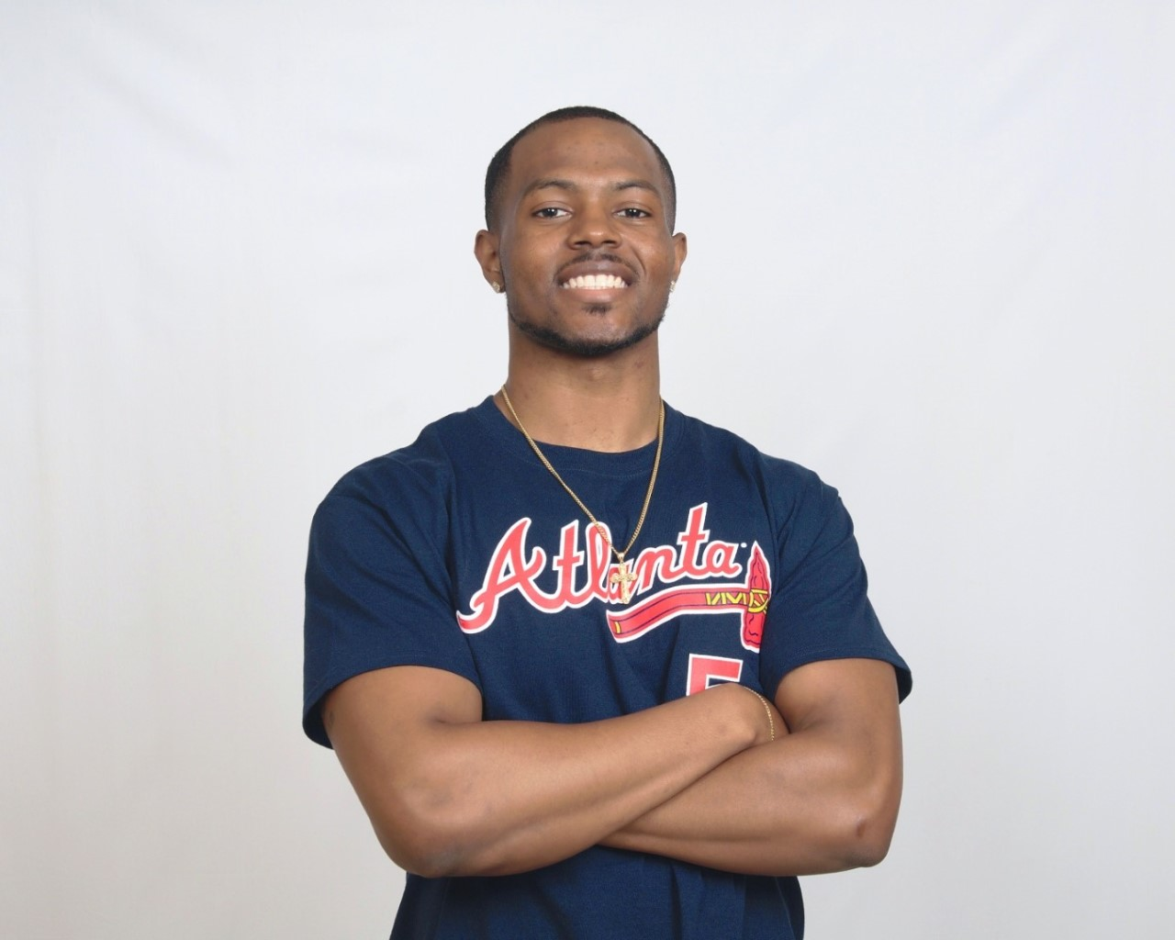
Student Showcase: Maurice House
Maurice House ('23) is originally from Erie, PA and attended Cathedral Preparatory School. He's a graduate student in the Exercise Science program. "I grew up an athlete for most of my life with a high passion for exercise and fitness. I wanted to learn more about how the body responds to exercise, so I could eventually help others live healthier lives."
Maurice has enjoyed his major classes, especially exercise prescription, and aging. "Exercise Prescription allowed me to learn how to create a program for individuals, who suffer from chronic diseases, and allowed me to work one-on-one with a member of the James G. Mill fitness center, so the practical experience was extremely valuable." House had a lot of fun, but the class experience gave him a perspective of other population's daily lives. For example, pregnant women and older adults.
This past year, Maurice was a graduate assistant in the exercise science department. "I mostly helped manage the human performance lab and helped the professors with various lab exercises for undergraduate students. It was very helpful and allowed me to strengthen a lot of skills that are needed for my field.
Throughout his time in undergrad, Maurice was a student-athlete for all 4 years. He played on the IUP Football team. "It was a memorable experience and gained a lot of life lessons that I still hold on to me to this day.
Student Advice to Prospective Students: "Reach out to the professors and ask for a tour of the lab that the exercise science department has to offer. Research what exercise science is and how it aligns with what you would want to do as a career."

Slide 3
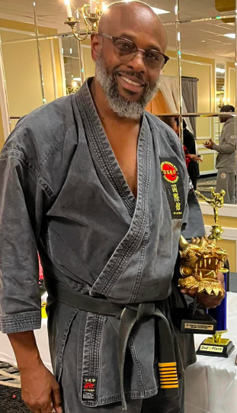
Faculty Focus: Professor Jose E. Rivera
Professor Jose E. Rivera, Curriculum Coordinator for the Athletic Training Program at IUP
In addition to a Master of Science in Athletic Training from Old Dominion University in 1987, Mr. Rivera holds a Bachelor of Science in Health, Physical Education, and Athletic Training from the University of Pittsburgh. Additionally, he has earned graduate degrees in massage therapy from the Muscular Therapy Institute in Boston, orthopedic physical therapy from the University of Pittsburgh School of Health and Rehabilitation Sciences, and administration and leadership studies from Indiana University of Pennsylvania.
Since 1986, Mr. Rivera has been a certified athletic trainer (ATC); since 1994, he has taught at a college. Before becoming a college professor, he had ten years of professional experience dealing with high school, college, and professional athletes. His experience includes working as a company therapist for the Pittsburgh Ballet Theater as well as a clinical athletic trainer for the Massachusetts Institute of Technology Athletic Department, the Puerto Rico Olympic Training Center, the P.R. National Wrestling, Tae Kwon Do, and Baseball Teams, the Puerto Rico Professional Baseball League, and the Center for Sports Medicine of the University of Pittsburgh Medical Center.
Interested in giving to the IUP KHSS Department?
The Kinesiology, Health, and Sport Science Department is happy to announce that we have decided to establish a KHSS Freshman Scholarship. We are looking forward to providing financial support to incoming freshmen to show commitment to our discipline and our belief in the talent of incoming freshmen who have chosen fields and future careers in KHSS.
Anyone wishing to help fund this scholarship can donate using the link:
http://www.iup.edu/givetoKHSS
(Please share this link with alumni, student organizations, and all in the IUP community!)

Slide 4
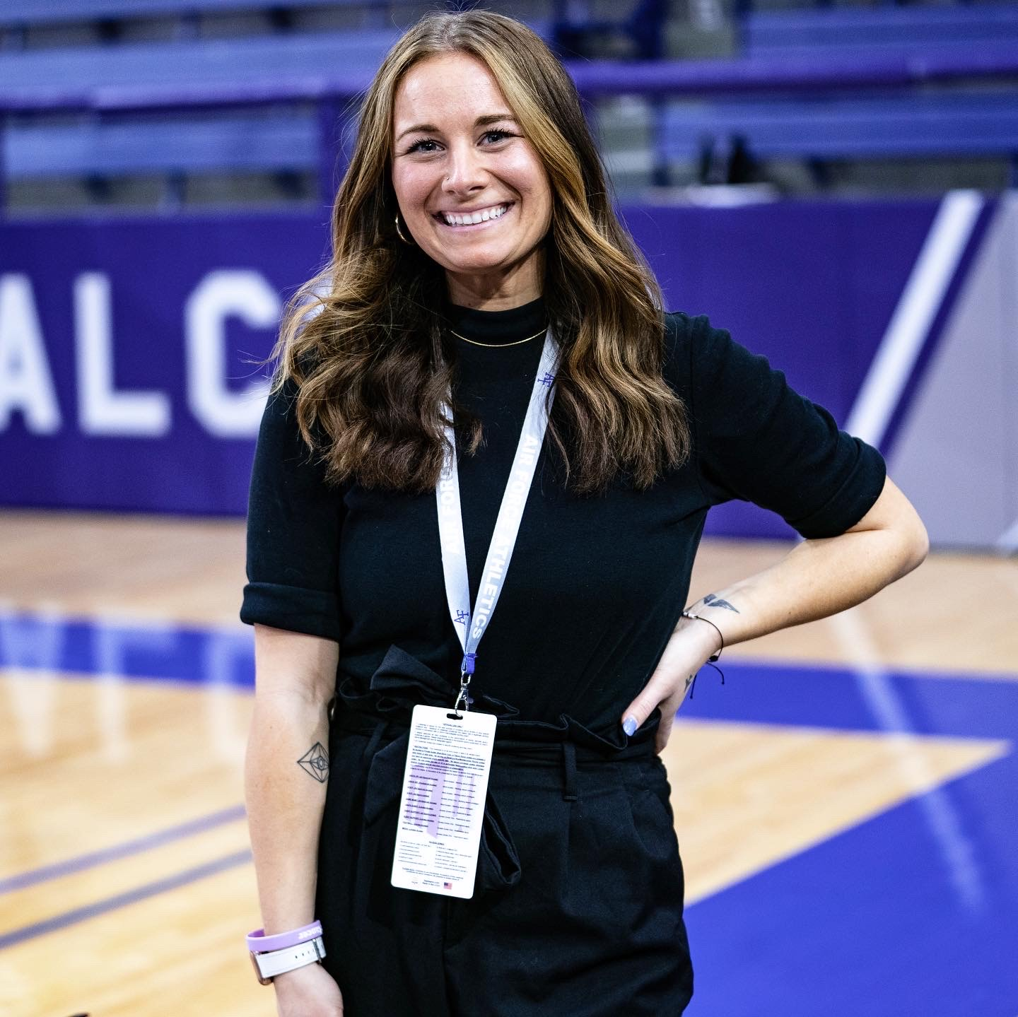
Featured Alumni: Autumn Bolton
Autumn Bolton ('18), Assistant Director of Marketing for Air Force Academy Athletics
Autumn Bolton is originally from Bucks County, PA, and attended Quakertown High School. Before attending IUP, Bolton always had an interest in sports. While growing up, she loved playing softball and volleyball, and enjoyed attending sporting events with her father. "[I] didn’t realize you could get a degree in sports. I wanted to be a math teacher for a short time but then realized sports was the path for me." With the influence of a few friends and her father, Bolton chose to attend IUP, so that she could major in sports management. "Once I decided I wanted to major in sports, my dad suggested IUP because he knew about their sports program." During her time at IUP, Bolton enjoyed classes such as ports Marketing, Facility Management, and Sponsorships. She was able to make connections with her professors, which helped her find an internship at the Kovalchick Convention and Athletics Complex. "That was my first sports internship and how I got started in my career. My main job was working the basketball games and handling the student giveaways and any promotions we had on the court.
"When it came time for applying to graduate school, he [Dr. Castle] was a big help. He had contacts at Coastal Carolina, where I was accepted and visited the campus. I ended up choosing Temple University, but he helped me have options for graduate school." While attending Temple University, Bolton was a graduate assistant in athletics, where she learned marketing and fan experience strategies. Also, Bolton interned for the Philadelphia Eagles and Flyers, and NBC Sports. While in graduate school and after graduating, Bolton connected with her current boss at the Air Force Academy, where she received her first position and her current position in sports. "I was interested in this position (Assistant Director of Marketing) one for the location. Colorado is beautiful and where I want to stay for a while. Another is that it is an academy and not like another college. Our athletes are cadet-athletes and are going to serve our country after graduation. My final reason was that I work for the Air Force Hockey team. My goal is to work in the NHL so working for the hockey team at the Air Force Academy is giving me the experience I need to grow in the sports industry."
Alumni Advice to Students: "Make sure you network and make those connections. Most of my internships I got by going to conferences and networking. Also, with that, make genuine connections. Once you meet someone at a conference or connect on LinkedIn, make sure you stay connected with them. You never know who someone might know. ht know. Working in the sports industry is a grind. We work a lot of hours and must miss events in our lives but if you are passionate about sports and are ready to put in the work, working in the sports industry is an amazing opportunity. Don’t give up if you are not getting internships or jobs. You will have to get 100 no’s before you get that 1 yes and I know that from experience. I was turned down for over 50 jobs before getting my job at the Air Force Academy. Just keep pushing and don’t give up!"

Slide 5
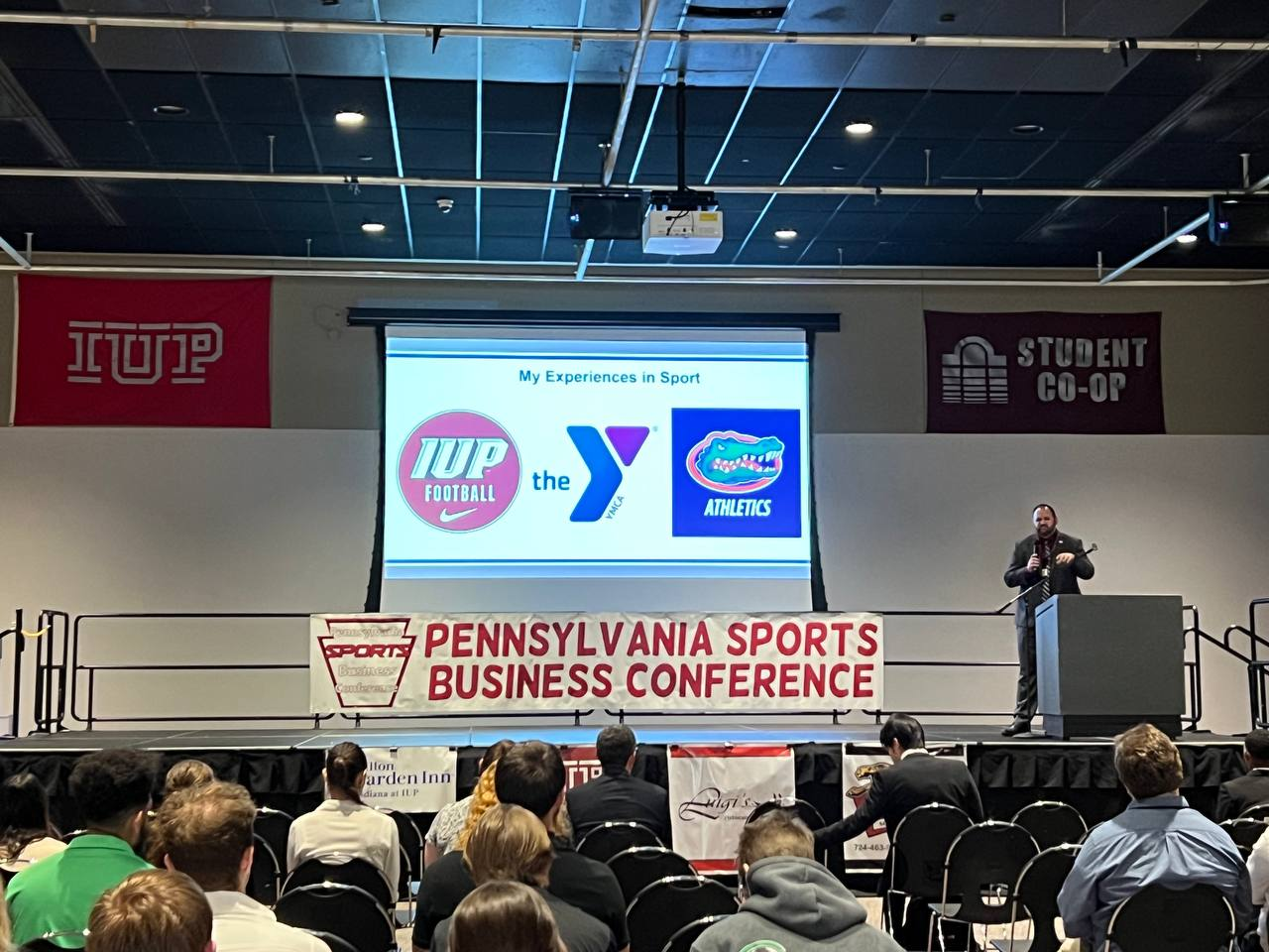
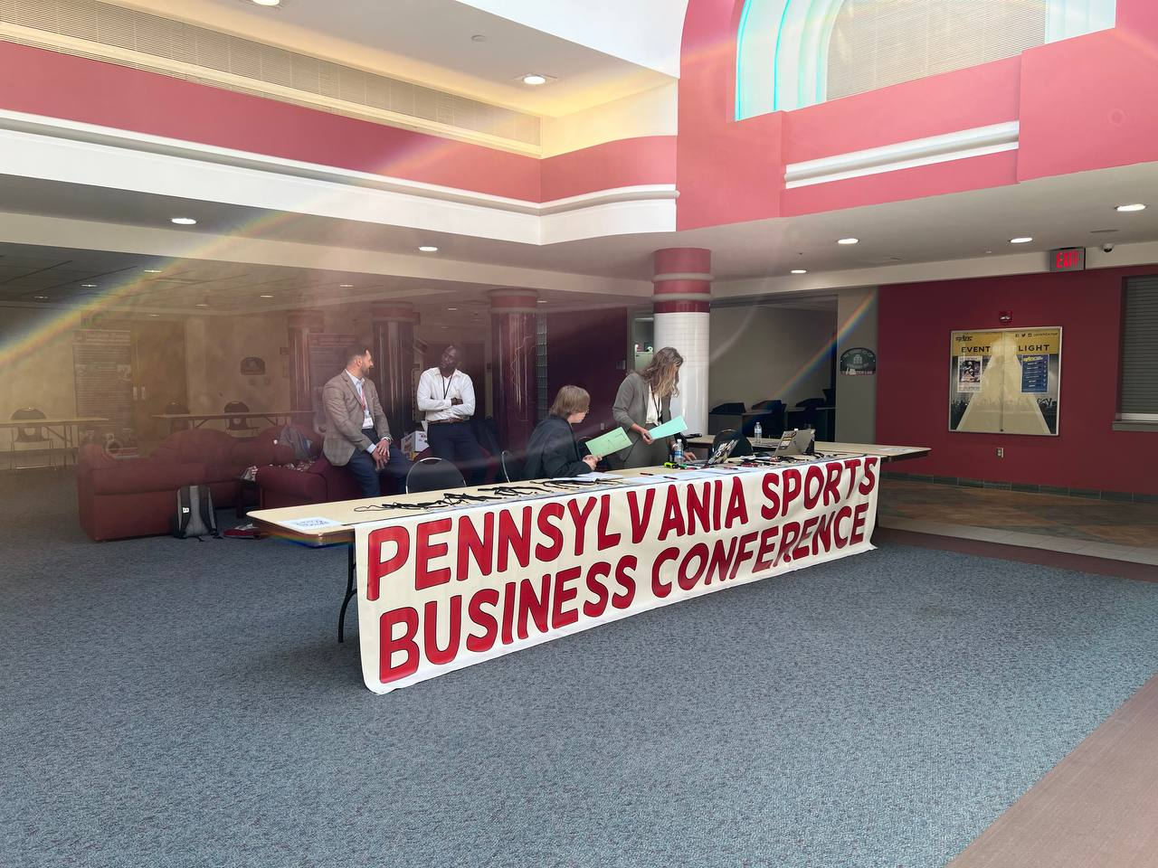
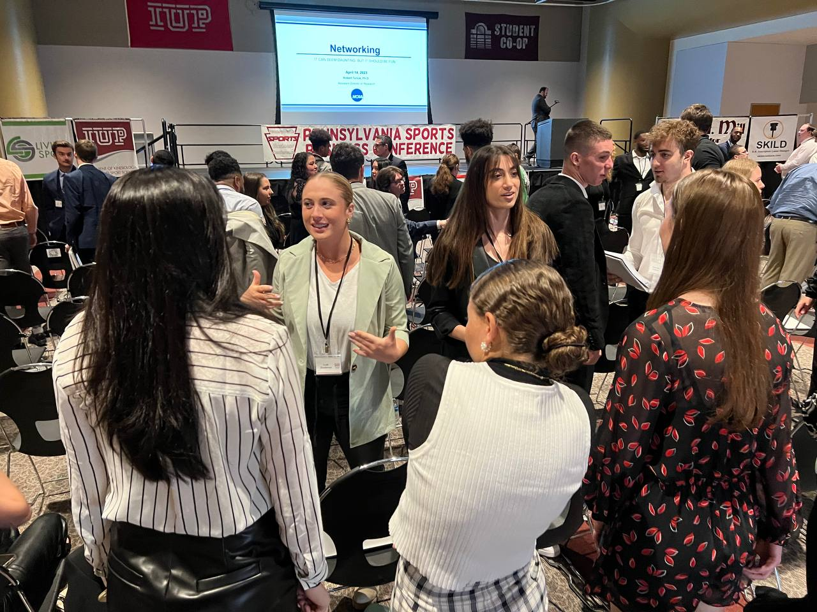
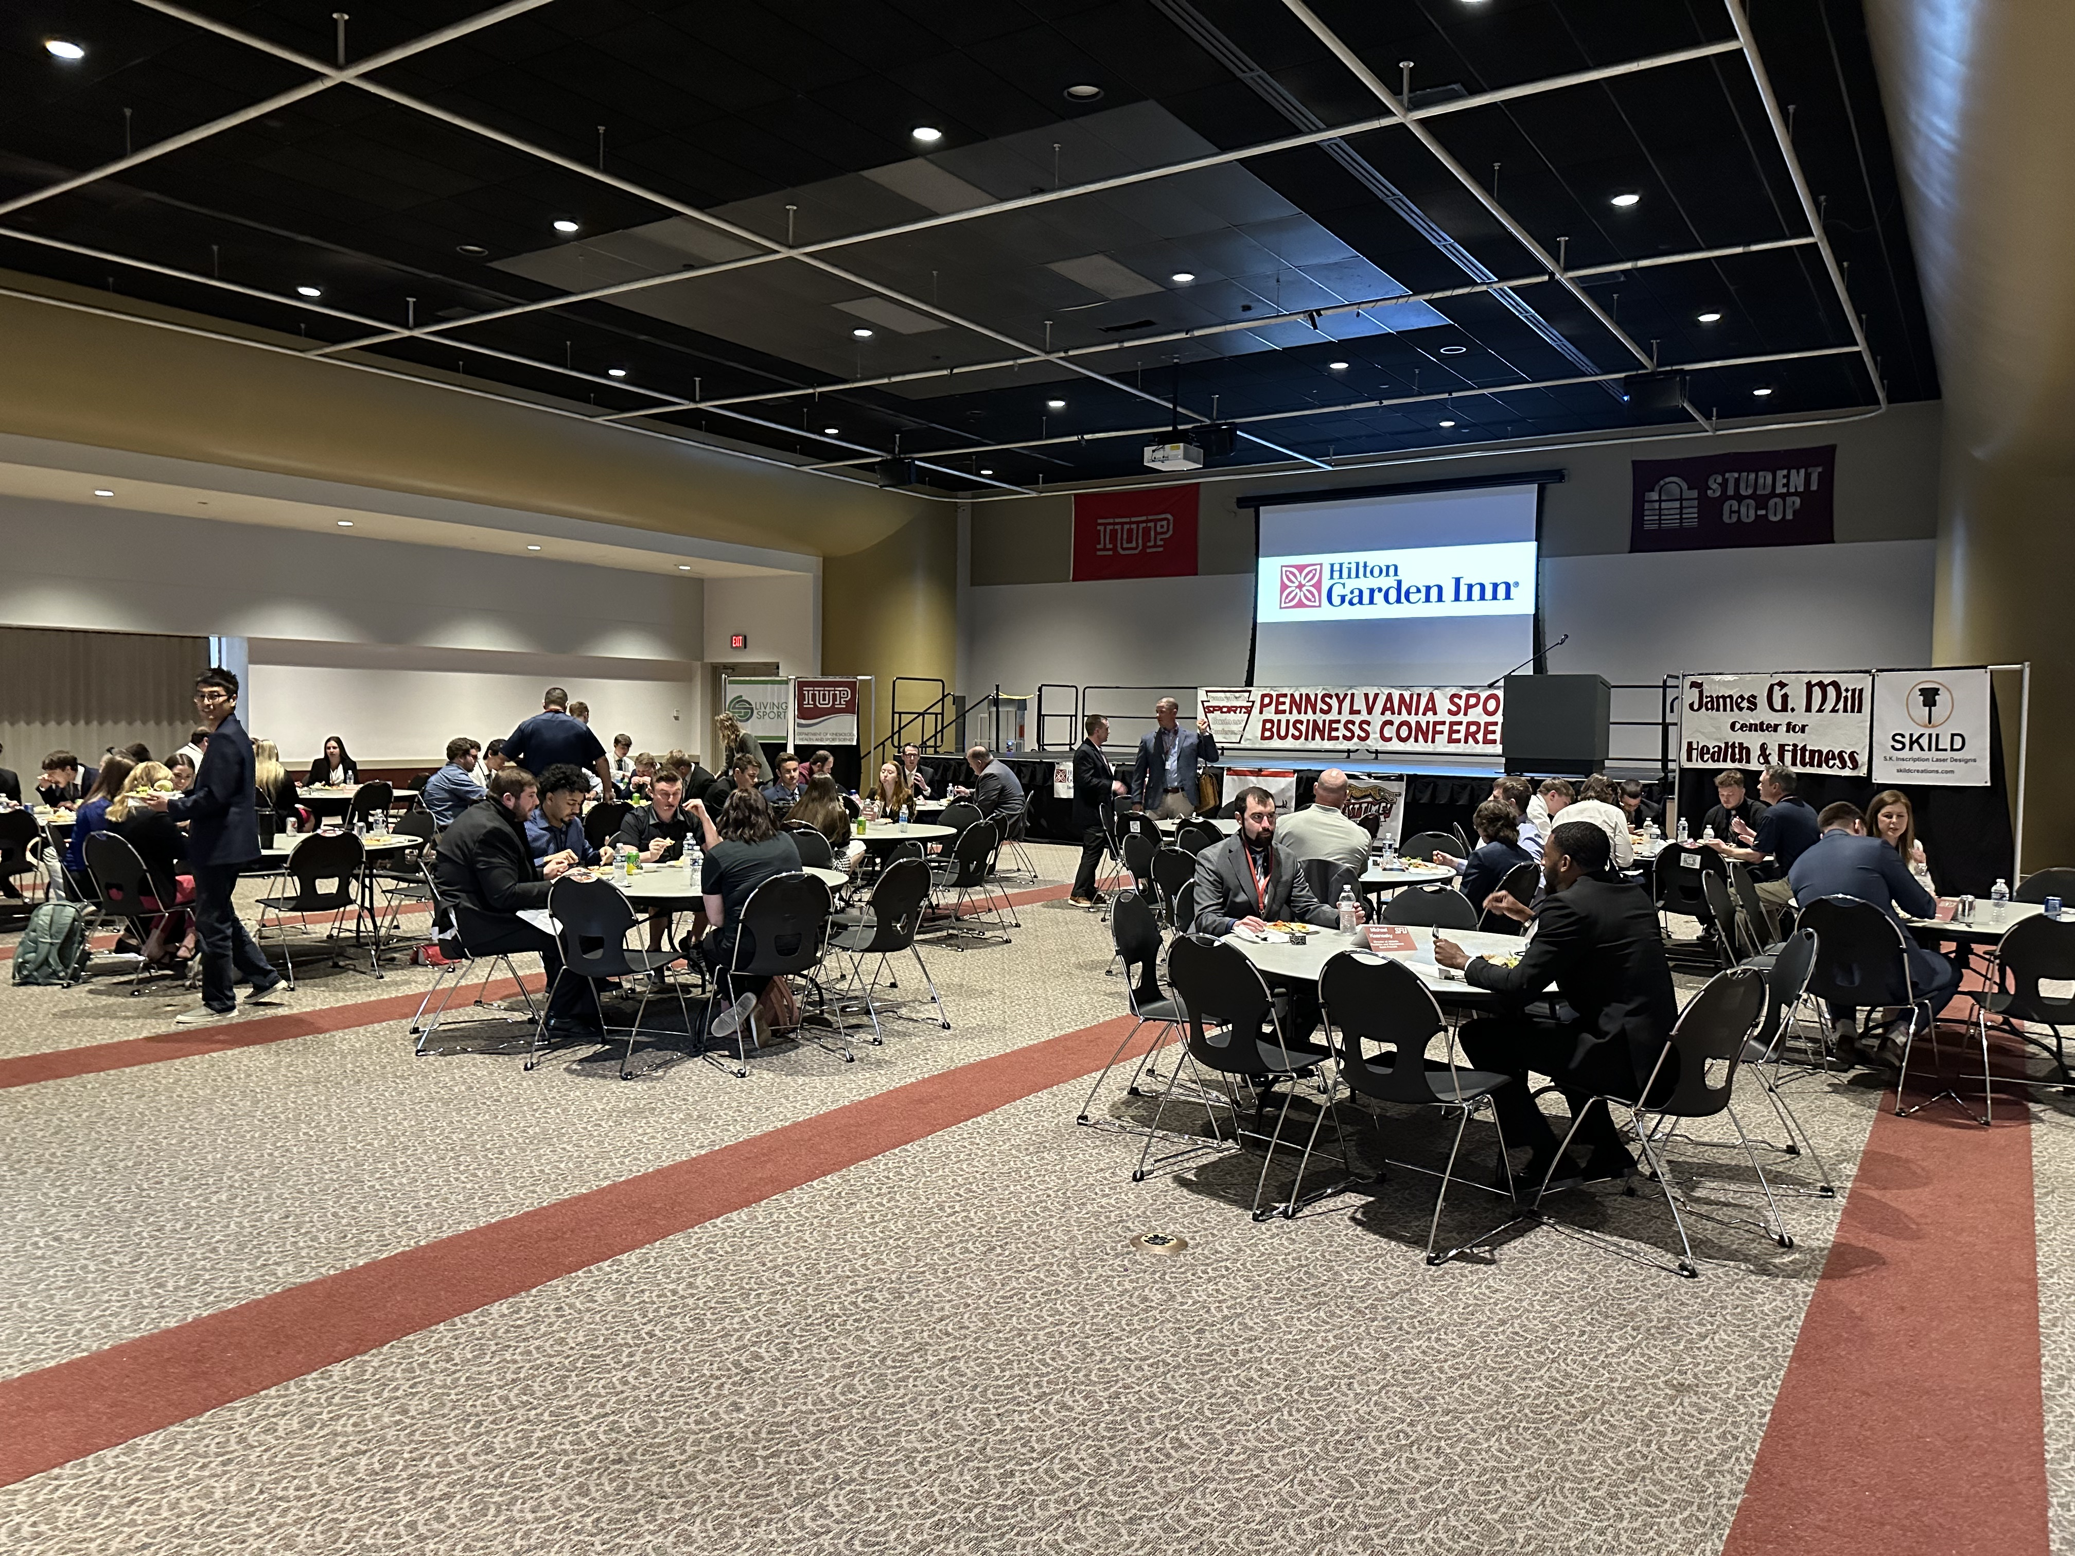
The 2023 Sports Business Conference
The 2023 Sports Business Conference was a huge success. There were a lot of passionate students to connect with each other and professionals that came to visit and present. This event occurred on April 14th, 2023, and it was jammed packed with the different sports industry professionals speaking in front of students, which helped them gain knowledge in various career paths in sports. There were speakers from the Pittsburgh Penguins, Indianapolis Colts, NCAA, PPG Arena, Johnstown Tomahawks, Pittsburgh Steelers, Saint Francis University, Altoona Curve, YCMA, Oakmont Country Club, Bloomsburg University, and Michigan State University.
@iupsportmgt
@iup_khss
@IUPExsci
@IUP KHSS
@HpeIup
@iupsportmgt
@iupkhss

