Slide 1
Veterans: Their Transition to College and the Challenges Veterans Face

Slide 2
Military life to civilian life
As veterans transition to civilian life, they face many challenges and issues.

Slide 3
Topics Click on the Topic to Learn More
Benefits
Loss of identity
College life vs. military life
Sense of disconnection

Slide 4
Benefits
TAPS programs (debriefings given to soldiers leaving active duty) often do a poor job explaining to veterans the benefits they are entitled to receive.
Lack of knowledge about VA Benefits (health care, disability services, unemployment, etc.)
Lack of knowledge about education benefits and how to obtain them.
At the Military and Veterans Resource Center (MVRC) our #1 job is to educate students about their benefits and to help them obtain the benefits to which they are entitled.
IUP students bring with them over 7 million dollars in education benefits, 2.5 million of which are directly paid to IUP for tuition and fees.

Slide 5
Loss of Identity
In the military, a veteran:
Had a sense of who they were
Was part of team with which they identified
Was likely in a leadership role
Had a purpose, a job, and knew exactly what they were doing
As they transition to civilian life/college life, they lose this identity

Slide 6
Dealing with different cultures
Many veterans bond with other veterans to create the comradery they had in the military.
Many veterans create a military-style structure in their life
They plan not only day to day activities, but also month to month activities.
Mentality: they rationalize that being a college student is now a job because they receive VA benefits to be a college student.

Slide 7
Sense of disconnection
One of the biggest issues veterans face in college
Disconnection with traditional students
Maturity level: traditional vs. non-traditional
Tend to be older
Many were forced to mature in the military
Experience level: traditional vs. non-traditional
Feel traditional students will not understand military experiences
This sense of disconnection is felt by reservists and National Guard members who were deployed while in college and returned to college after deployment.

Slide 8
Dealing with disconnection
Veterans seek out other veterans in their classes and on campus, including faculty and staff who are veterans
Some use their experiences to mentor traditional students
Some veterans take on leadership roles in the classroom and in co-curricular experiences

Slide 9
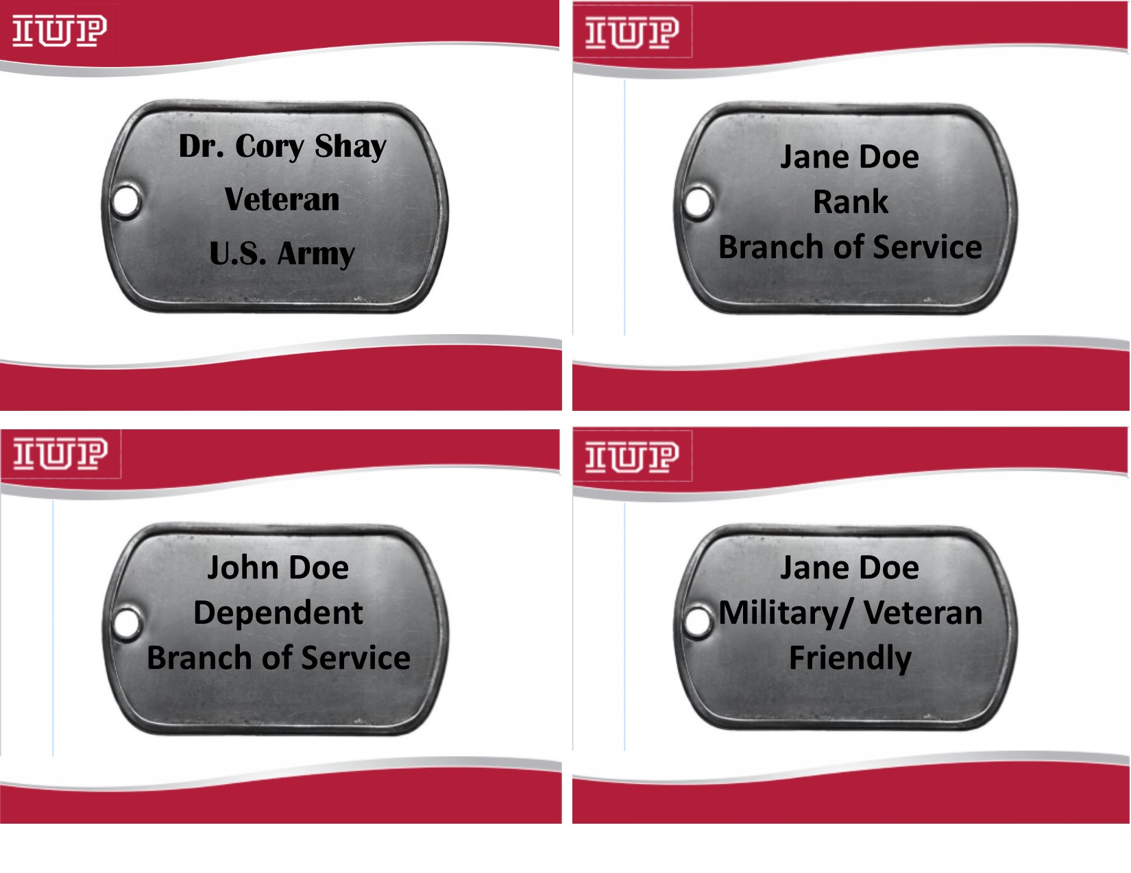
How You Can Help
Show your support for IUP’s military-affiliated students with the MVRC’s “Dog Tag Program.”

Slide 10
How You Can Help
If students are considering dropping classes or doing a university withdrawl, please advise them to visit the MRC.
Changes to a student’s enrollment can negatively affect their benefits and will result in the student or the university owing money to the VA.

Slide 11
How You Can Help
Help ease the stress that veterans feel transitioning from the military to IUP by outlining exactly who they need to see for which service.
Refer/encourage military-affiliated students to visit the Military and Veterans Resource Center (MVRC)
The MVRC provides each military-affiliated student with a 1-1 session. During the 1-1 session, we educate students about:
Their education benefits and how to obtain their education benefits
Other benefits such as healthcare
Organizations (outside of IUP) that provide grants and scholarships for veterans and dependents
Community resources they can turn to for assistance
The MVRC will help students navigate the college bureaucracy

Slide 12
How You Can Help
Understand that students in the National Guard and reserves may have to miss class due to military/duty (the students should provide evidence like orders or drill schedule).
IUP policies allow students a chance to make up time missed in class or to complete assignments after they return from duty.
Ask the MVRC to provide training for your department, staff, and/or student workers
The MVRC staff is available 8:00 a.m. to 4:30 p.m., Monday through Friday and will provide training to faculty, staff, and students on issues facing our military-affiliated students

Slide 13
How You Can Help
Create a welcoming environment that allows military-affiliated students to form connections with others.
Use the leadership and unique experiences of veterans and military-affiliated students to enhance the learning environment.

Slide 14
How You Can Help
If you notice a military-affiliated student that is struggling, encourage them to seek help by contacting the MVRC at 724-357-3008
Follow up with the student to see if they visited the MVRC
Other resources outside of the MVRC
IUP Center for Health and Well-Being, 724-357-4799
Indiana County Department of Veteran Affairs, 724-465-3815
Indiana County Regional VA Clinic, 724-349-8900

Slide 15
Additional Readings
https://books.google.com/books?hl=en&lr=&id=8vU1taZ47LIC&oi=fnd&pg=PA5&dq=Veterans+Transitioning+to+College&ots=gjPJP0Dpi-&sig=cNJd47vlu2H-o6myKB92loRhAes#v=onepage&q=Veterans%20Transitioning%20to%20College&f=false
https://books.google.com/books?hl=en&lr=&id=8vU1taZ47LIC&oi=fnd&pg=PA25&dq=Veterans+Transitioning+to+College&ots=gjPJP0DsbW&sig=CsjxUUbEPoTnwBusJo-FmZqnsmo#v=onepage&q=Veterans%20Transitioning%20to%20College&f=false
http://www.tandfonline.com/doi/abs/10.2202/1949-6605.1908?src=recsys

