Slide 1
Long-Range Facilities Master Plan Update
FY 2023-2028
President’s Cabinet Overview
April 3, 2023

Slide 2
What is a Master Plan?
  The IUP Campus Plan Update will provide guidance for the physical development of the Indiana campus.
  A Campus Plan is a long-range document that engages all constituencies including leadership, decision-makers, students, the Indiana campus, and surrounding communities in identifying and prioritizing physical improvements.
  The plan will improve how IUP is using its current space and make recommendations on right sizing the Indiana campus facility footprint.

Slide 3
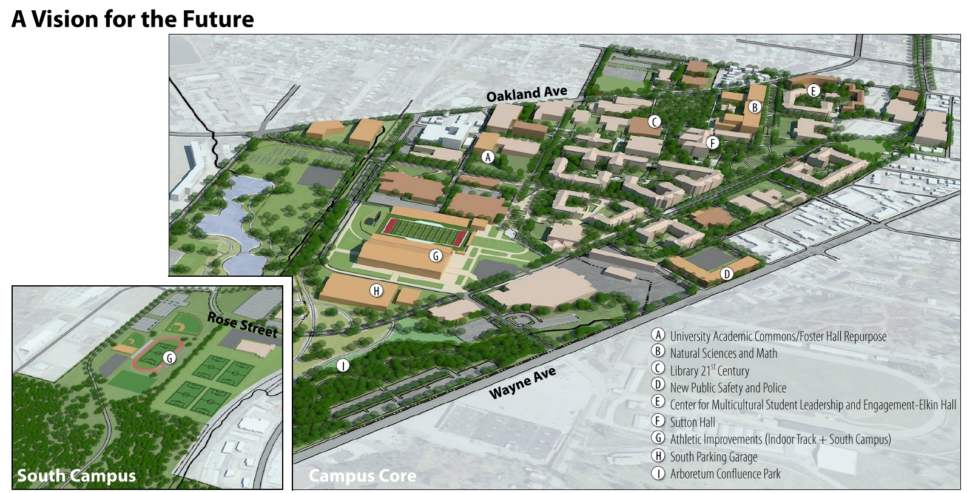
Long-Term Planning from the 2017 Update

Slide 4
  SmithGroup
  SmithGroup completed the original IUP Long-Range Facilities Master Plan for the Indiana Campus in 2011, with updates in 2014, and 2017.
  Focused on academic and facilities related studies for almost 40 years.
  SmithGroup performed planning projects at over 700 college campuses worldwide.

Slide 5
LRFMP Executive Steering Committee
  Co-Chairs:
  Debra Fitzsimons, Vice President for Administration and Finance
  Lara Luetkehans, Provost and Vice President for Academic Affairs
  Members:
Thomas Segar, Vice President for Student Affairs
Chris Kitas, Executive Director of Institutional Research, Planning, and Assessment
Sam Phillips, Associate Vice President for University Operations and Administrative Services
Steve Markiewicz, Associate Director for Planning and Construction
Mitch Peffer, Director of Planning and Construction
Project Manager and Liaison to the SmithGroup:
Steve Markiewicz

Slide 6
LRFMP Executive Steering Committee Charge
  The 2023 Long-Range Facilities Master Plan Update organization structure will include an executive steering committee to provide oversight. This committee will be co-chaired by the Provost and Vice President for Academic Affairs and the Vice President for Administration and Finance. There will also be eight additional members from different University entities included on the committee.
  The executive steering committee provides guiding principles and parameters to the design professional, responds to informational reports and alternative concepts, and influences final decisions about the long-range facilities master plan for the Indiana campus to be presented to the President and the Council of Trustees for approval. The executive steering committee will work, through assigned project managers, with academic, administrative, student, athletic and community groups to provide information about programmatic needs which includes amount and type of space needed or desired and consolidated programmatic relocation based on functional compatibilities. The design professional will develop site concepts, plans for space use optimization and facilities use recommendations.
  The goal of the executive steering committee is to provide support, guidance and oversight of progress so that the professional can present the completed Master Plan to the Council of Trustees in December of 2023.

Slide 7
IUP Council Of Trustees LRFMP Focus Group
Mr. Tim Cejka, Mrs. Jennifer Baker,
Mrs. Susan Delaney, and Ms. Maura King will act as a focus group representing the Council of Trustees during development of the Master
Plan Update. This group will be scheduled to meet with SmithGroup
by zoom in April.

Slide 8
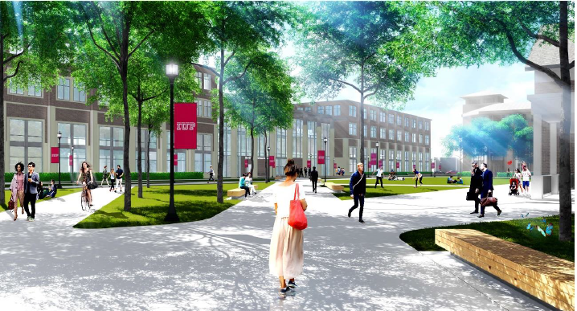
Why do we need Your Involvement in the LRFMP process?
Student experience is a driving factor for all decisions at IUP.
Faculty and staff are key to our campus community and will have valuable input to share regarding instructional, administrative, student and other spaces.
Your opportunity to share your input on the future of IUP.
Changes can include campus edges and gateways, property acquisition and disposition, building construction/renovation/demolition, parking, pedestrian and vehicle circulation, classroom use, etc.

Slide 9
LRFMP Plan Goals
The SmithGroup will prepare two alternative development scenarios for the Indiana campus that portray practical options for future development and change including: campus footprint reduction, optimal usage of existing space, location of school of medicine facilities, outdoor athletic facilities, student gathering areas, and other areas.
Benchmark IUP to a select group of similar “Peer” institutions through metrics such as space per student, space per faculty, and instructional space per student.
Develop dashboard visualizations that incorporate the outcomes of space utilization and comprehensive space needs.

Slide 10
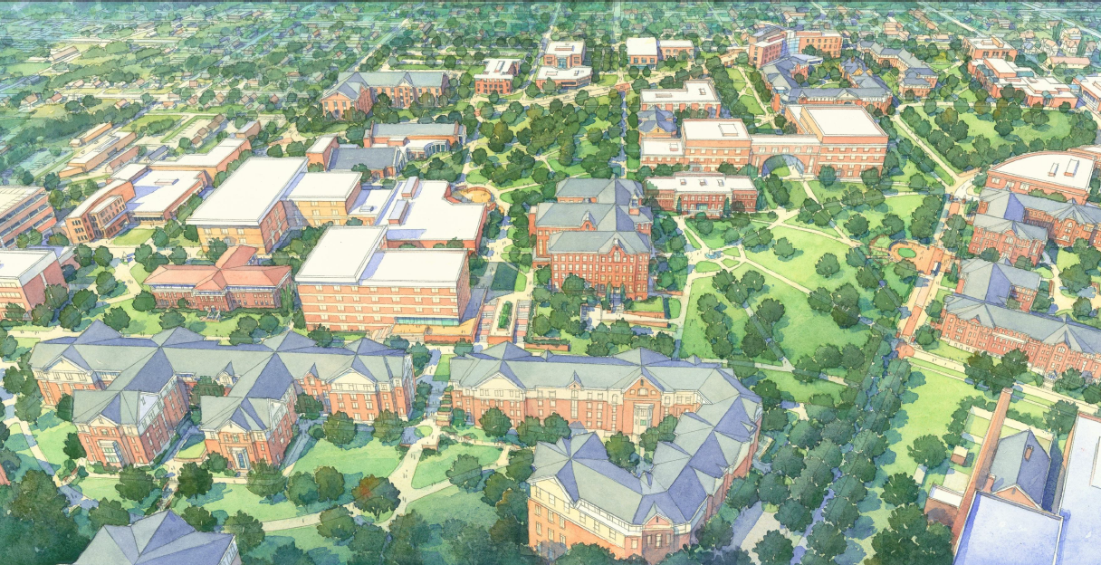
IUP Objectives
  The SmithGroup will develop ways to optimize space usage. This will help right size the Indiana campus facility footprint.
  SmithGroup will identify existing spaces to locate the new school of medicine and required housing and optional space for other growth programs.
  Align the long-range facilities master plan update with IUP’s student centered strategic plan and the University’s strategic priorities.

Slide 11
LRFMP Schedule
  Phase 1.0: Understand
▪ Project Kick-Off (Videoconference) …………………………….……………………………………….………… April 2023
▪ Steering Committee (Videoconference) ………………………………………………………….……………… April 2023
▪ Data Collection, Digital Model, Benchmarking …………………………………………………….. March-May 2023
▪ Steering Committee Workshop, Focus Groups, Open Forum, Tours (Campus Visit 1) ……..….. April 2023
  Phase 2.0: Explore
▪ Space Need Projections and Campus Analysis Findings (Videoconference) ………………………. May 2023
▪ Alternative Scenario Development Review (Campus Visit 2) ………………………………………… August 2023
▪ Preliminary Plan Update Review (Videoconference) …………………………………………………… October 2023
▪ Revised Campus Plan Review and Prioritization Workshop (Videoconference) …………….. October 2023
  Phase 3.0: Realize
▪ Draft Report Review ……………………………………………………………………………………………. November 2023
▪ Final Campus Plan Update Documents (Campus Visit 3) ……………………………………….. December 2023

Slide 12
Groups and Individuals Identified to Provide Input Throughout the LRFMP Process
Executive Steering Committee
Student Government Association (SGA) and Graduate Student Assembly (GSA)
Open Student Session
Open Faculty and Staff Session
Academic Affairs Council
University Planning Council (UPC)
University Budget Advisory Committee (UBAC)
Administration and Finance Management Team
All Campus and Community Open House Sessions
Student Affairs Leadership Team (SALT)
Facilities Department
Affiliate Session (to include all affiliates – IUP Alumni Association, Foundation for IUP, IUP Research
Institute, Residential Revival Indiana, and Student Cooperative Association)
Dr. Michael Driscoll, President
Dr. Lara Luetkehans, Provost and Vice President for Academic Affairs
Dr. Debra Fitzsimons, Vice President for Administration and Finance
Dr. Tom Segar, Vice President for Student Affairs
Dr. Patricia McCarthy, Vice President for Enrollment Management
Dr. Hilliary Creely, Dean, Graduate Studies and Research
Ms. Elise Glenn, Acting Assistant to the President for Social Equity
Mr. Bill Balint, Chief Information Officer
Police and Parking
Intercollegiate Athletics Department
COT Focus Group
Community Focus Group (identified by the president)
Marketing and Communications (MARCOM) and Enrollment Management
Ms. Khatmeh Osseiran-Hanna, Vice President for University Advancement and Staff
Senate Development and Finance Committee
Health Science Cluster

Slide 13
Immediate Next Steps in LRFMP process: In April 2023
SGA Meeting held on March 28, informative meeting and gaining student involvement.
Email communication to be developed to be from LRFMP Executive Steering Committee co-chairs to be sent the week of April 3.
LRFMP IUP Survey will be available for public input in April, 2023. This survey will allow faculty, staff, and students to share their opinions. Executive Steering Committee will review the survey prior to it being sent.
Virtual/Zoom meetings and on-site meetings will be scheduled in April with all of the groups and individuals identified across the Indiana campus that will provide input to the consultants.
SmithGroup is scheduled for an on-site visit April 24, 25, and 26. This visit will include a tour of the Indiana campus and stakeholder engagement. SmithGroup will have priority meetings with the groups and individuals providing input. Logistical meeting with facilities staff and others the week of April 3 to plan the on-site visit of SmithGroup and to to develop publicity and scheduling events.

Slide 14
Q & A

Slide 15

Thank you

