Slide 1
Shake Things Up With Diverse In-Class Activities
Mimi Benjamin - Assistant Professor, Department of Student Affairs in Higher Education
Erin Conlin - Assistant Professor, Department of History
Pao Ying Hsiao - Assistant Professor, Department of Food and Nutrition
Brooke Mathna - Temporary Faculty, Department of Criminology and Criminal Justice

Slide 2
Active learning is “anything that involves students in doing things and thinking about the things they are doing” (Bonwell & Eison, 1991, p. 2).
  - Bonwell, C.C. & Eison, J.A. (1991) Active learning: Creating excitement in the classroom. ASHE-ERIC Higher Education Reports. Washington, DC: ERIC Clearinghouse on Higher Education, The George Washington University.

Slide 3
Active Learning
Use ice breakers and warm-ups
Polls/i-clickers
One-minute paper/quick reflection
Think-Pair-Share/Write-Pair-Share/TTYP (Turn To Your Partner)
Use technology – video, Skype, etc.
Journaling
Role Plays
Case studies/scenarios/debate
Evaluating each other’s work/presentation
Student/group presentations
Simulations
Inner/outer circle activity with questions/topics
Designated expert
Gallery Walk
Games
Continuums
Brainstorming
Learning Cell
Jigsaw Group Projects
Sociogram

Slide 4
Flipped Classroom:
How it Works
Students watch one (or several) pre-recorded, short lectures
Students can watch these videos at their own speed
  This is important because we know EVERYONE learns DIFFERENTLY
Now students have a grasp on the material before they come into class

Slide 5
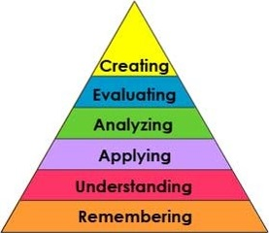
Bloom’s Taxonomy
Class Time
Video Lectures

Slide 6
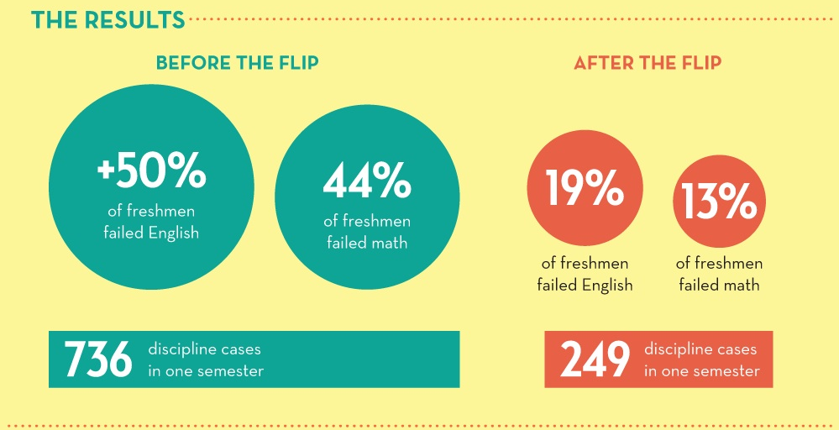
Why Flipping the
Classroom Matters

Slide 7
Flipping the Classroom: Pros and Cons
Pros
Cons
Helps busy and/or struggling students
Helps ALL student excel
Students take charge of their education
Students can pause and rewind the teacher
Increases student-teacher interaction
Applied learning in the classroom
Changes classroom management
Educates parents
Makes your class transparent
Not everyone has internet/computer access
Technological problems
Students cannot ask questions during lecture for clarity of information
Flipped homework is still homework
Students may not watch videos
Lecturing doesn’t equal learning

Slide 8
Flipped Classroom:
How To Do It
To record lectures:
  iPod/iPad/computer
  Screen Cast O Matic
  Quicktime
  Microsoft office Mix
  Ink to go
  Explain everything
  (app for ISO devices)
To upload lectures:
  Youtube
  Google Drive
  Teacher Tube
  Screen Cast
  D2L

Slide 9
Resources for
The Flipped Classroom
General Instructions and “How To”:
http://flippedinstitute.org/how-to-flip
Software to create/record videos & websites to upload videos:
http://flippedclass.com/tools/

Slide 10


Allows students to process information
  Especially useful for difficult concepts
Fosters trust and communication
Presents ‘teachable moments’
  “Any questions?”
No preparation or materials required
Can be used with any size class
Icon can be used on PPT slide as a prompt/reminder
Short answer/essay questions make good T-P-S prompts

Slide 11
Digestion activity
Announce ‘group quiz’ activity
Assign each student a part of the digestive system (organ, enzyme, etc.)
Responsible for knowing their part
Students line up in order of digestive tract
  Digestion ambassadors
Take turns telling classmates about their importance
Follow-up questions are asked
End with a “One-minute paper”

Slide 12

Considerations for activity
Moderate preparation required
  Assign parts to students
  Randomly selection of the Digestion ambassadors
Materials needed
  Index cards for each part
  Handout for students to take notes (optional)
  Space to line up
May be more challenging with large classes (>50 students)
Gives student a change to practice public speaking and ‘thinking on their feet’
Useful for auditory, visual, and kinesthetic learners

Slide 13
Alternative to “curving” exam grades:
Post-exam learning activity
Use “Condensed Item Analysis Report”
Choose set of questions
Can allow use of notes/book
Add points earned to exam grade
Allows another opportunity to review difficult concepts

Slide 14
Shared Techniques
Think, Pair, Share to discuss primary resources
“Expert for a Day” students supplement lecture content with material they researched & prepared
  I review it ahead of time as a written assignment; provide feedback; assess

Slide 15
Incorporating
Oral History
Making and understanding history
&
developing marketable technical skills

Slide 16
Understanding the lived experiences of “average people”
Connecting the personal to the national
Why does history matter?
What role do we play in history?
How are historical narratives crafted?

Slide 17
The Project
Conduct an interview (ideally with someone 50+ years old)
Identify a theme from his/her life
  Try to relate it to what we’ve talked about in class
Create a podcast, mini-film, or other multi-media project

Slide 18
Project Overview
15 week semester
Week 1-8 introduce students to aspects of oral history:
Week 5 Interview Proposal due
Week 6 Interview Guide due
        Week 8 Interview due
    Week 9 Audacity workshop
    Week 12 First draft project due + peer evaluation
Week 15 Final Oral History Project due

Slide 19
Sample Projects
Podcast:
Family History & the Vietnam War

Slide 20
The End of Coal Mining in Germany – video

Slide 21
Why incorporate oral history projects?
Apply historical knowledge
Connect the past and present
Link personal, local, and national histories
Engage students in “doing” history
Develop marketable technological skills

Slide 22
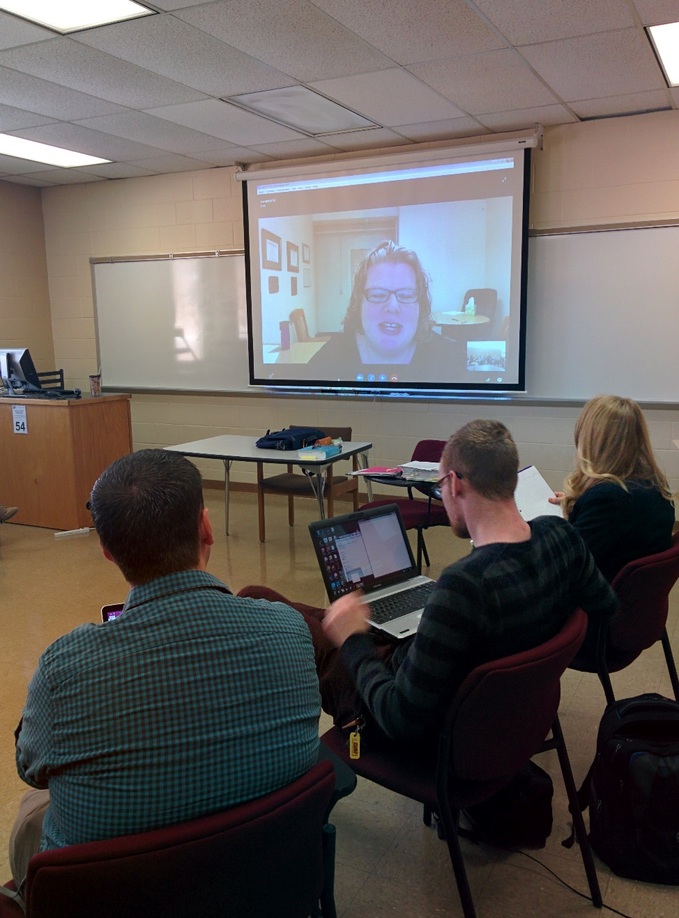
Guest Speakers
Bringing in individuals students typically don’t have access to
Ask them to speak to the group for 10-15 minutes at the beginning of class (or when their schedules permit during the 2.5 hour class)
Skills, knowledge, experiences, attitudes needed from new professionals
Tips
  Check your equipment in advance
  Identify ways to trouble-shoot if equipment fails

Slide 23
Ideas gallery
Materials needed:
  Large post-its/large sheets of paper (and tape)
  Markers
Ask students to respond to something on the paper
As they go around the room responding, they also view each other’s comments
Process as a large group
Type up and give to students
Tips
  You need a space where people can move around
  Be sure that the markers won’t bleed onto the walls!
  Can ask them to generate ideas at their seats before moving around.

Slide 24
Additional tips
& strategies

Slide 25
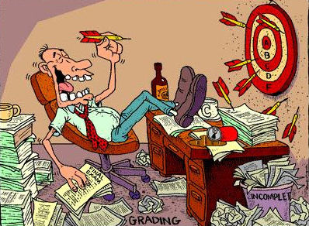
Random grading
Random number generator
  http://www.randomizer.org/form.htm
Example
  Assigned Learning Checks for each chapter/topic
  Students had to complete 10 of 12
  5 of the 10 were randomly selected for grading
  50% less grading

Slide 26
Questions?

