Slide 1
Why Use Technology in Your Classes?
Reflective Practice
Presentation
October 11, 2007
by
Dr. Mindy L. Wygonik

Slide 2
20th Century Generations
Greatest Generation, 1901-1924
Traditionalists, 1925-1945
Baby Boomers, 1946-1960
Generation X, 1961-1981 (Rivera & Huertas)

Slide 3
Know Your Students’ Generation
The first step with any acceptable Instructional Design model is to assess your audience.
This is a must before creating your courses.

Slide 4
So, Who are Your Students?
Labeled as Millennials
Born between 1982 and 2002 [dates vary slightly depending on reference]
Also known as the ‘Net Generation,’ they have grown up with information technology

Slide 5
Characteristics of Millennials
Optimistic/Confident
Collaborative; they enjoy cooperative activities
Used to clear structure from adults;
in fact, they expect it
Have strong parent advocates (Newburn)
Multicultural

Slide 6
Characteristics, Cont’d
Civic-minded
Goal-oriented/Multitaskers (Newburn)
No brand loyalty (Carlson)
Accept as their right the ability to make choices and customize the things they choose
Not identified by one music genre
Tech-savvy, digital natives

Slide 7
Optimistic/Confident
Today’s college students have grown up hearing . . .
You are special
You are smart
You can do it! (Rivera & Huertas)
They are being raised at the most child-centric time in our history. They are showered with attention and high expectations from parents resulting in self-confidence that can almost seem like cockiness. (Thielfoldt and Sheef)

Slide 8
Optimistic/Confident, cont’d
Today’s students have been more protected than any other generation:
Wearing head gear, elbow pads, and/or
knee pads when riding bikes/skating
Using car seats
Sitting in the back seat (Walker)
How did we ‘Boomers’ ever survive childhood!?

Slide 9
Collaborative
Team-oriented; prefer to both learn
and work in teams (Newburn)
Gravitate toward group activities, perhaps because they have participated in so many from a young age; i.e., sports, dance classes, music lessons, etc.
Enjoy peer-to-peer activities

Slide 10
Collaborative, Cont’d
Sweeney shares his observations from the New Jersey Institute of Technology:
“More and more students gather in groups to study. They pass around information from their laptops, pull information from the Internet, and learn together. In some cases, the students elect to work together in a group rather than go to class.”

Slide 11
Clear Structure from Adults
Because adults have scheduled cooperative learning opportunities via sports, music lessons, and/or the classroom, Millennials have come to expect that type of environment. (Newburn) They have no tolerance for classes that are unstructured, which they deem to be wasting their time.

Slide 12
Clear Structure from Adults, cont’d
According to Prensky (2005), each student we teach today has something in his/her life that is really engaging – something that they do, that they are good at, that has an engaging, creative component to it. These may include downloading songs, playing video games, making movies, playing extreme sports. Whatever the activity, the students all do something engaging.
From this comes the motto of this group, “Engage Me or Enrage Me.”

Slide 13
Strong Parent Advocates
Millennials are very close to their parents
As they in many cases are children of divorce, they tend to compensate with
closer attachment to families and friends
Because of the divorce, parents may tend to overcompensate by being involved
Millennials feel the need to please their parents and have a deep love for them

Slide 14
Strong Parent Advocates, cont’d
They report feeling pressure from parents
to go to the top schools, participate in many activities, and to excel
Many more Millennials are going to college and graduate school than any previous generation (Sweeney and Carlson)
Parents of Millennials are often referred to as “hoverers.” (Walker)
These parents are also referred to as ‘helicopter parents.’

Slide 15
Multicultural
They are racially and ethnically diverse
According to Bhargava, 40% of Millennials describe themselves as being non-white
One in five has at least one immigrant parent
They have grown up in a world of interracial relationships and see themselves as products
of this world
Millennials are more likely to be aligned
by interests rather than ethnicity

Slide 16
Multicultural, Cont’d
The alignment by interests rather than by ethnicity is enhanced by students’ access to social networks offered via the Internet such as MySpace, Facebook, blogs, etc.
Close friendships are no longer limited by geography. (Bhargava) As a result, ethnicity is less important than finding common pursuits.

Slide 17
Civic-minded
Many Millennials, during their high school years, were engaged in community service projects to meet graduation requirements.
This has left them wanting a focus on ‘the universal community’ in their classrooms. (McMillan) The universal aspect is also related to the social networking found in collaborative efforts.

Slide 18
Goal-oriented/Multitasking
Millennials seem to shift mental functions (the major requirement for multitasking) easier, faster, more efficiently, and more comfortably than earlier generations
Vast majority believe they are better at multitasking than older generations. Their visual, interactive, and experiential practices, such as with video and online games, reflects a preference for such sensory experiences (Sweeney).

Slide 19
Goal-oriented/Multitasking, Cont’d
To illustrate the gap between the old mind-set and the new,
a true story (Sweeney):
A professor was teaching in a computer lab and saw one of his students sending e-mail messages to someone during the lecture. The professor told him to pay attention.
“I’m listening,” the student said.
“Well, I would like you to turn and look at me,” the professor responded.
"Why?" asked the student. "I have an “A” in your course, and I can recite back what you have said.”
This is a ‘cultural shift.’ To the professor it was rudeness.
To the student it was, “Why shouldn’t I do it in a way that works for me?”

Slide 20
Tech-savvy, Digital Natives
For Millennials – (Rivera and Huertas)
Computers are NOT technology – Why?
The Internet is better than TV
Connectivity is 24/7
Technology and multitasking are a way
of life

Slide 21
Tech-savvy, cont’d
They use blogs, wikis, and/or podcasts
Typing is preferred to handwriting
Staying connected is essential
Things are on-demand; they have
zero tolerance for delays

Slide 22
Tech-savvy, cont’d
Millennials have spent their lives surrounded by and using computers, videogames, digital music players, video cams, cell phones and all the other toys and tools of the digital age (Rivera and Huertas). They have no recollection of these items not existing.

Slide 23
Tech-savvy, cont’d
Simply put, for Millennials technology
is a way of life.
In fact, according to Walker, more than
2 million American 6-17 year olds have their own web sites!

Slide 24
Tech-savvy, cont’d, ECAR Study
The EDUCAUSE Center for Applied Research (ECAR) conducted their fourth annual study of undergraduate students and information technology in March and April of 2007. The web-based survey was administered online to 103 institutions across the country. Demographics of the 27,846 respondents: 62.1% female, 89.5% are full-time students, 57.2% live off campus.

Slide 25
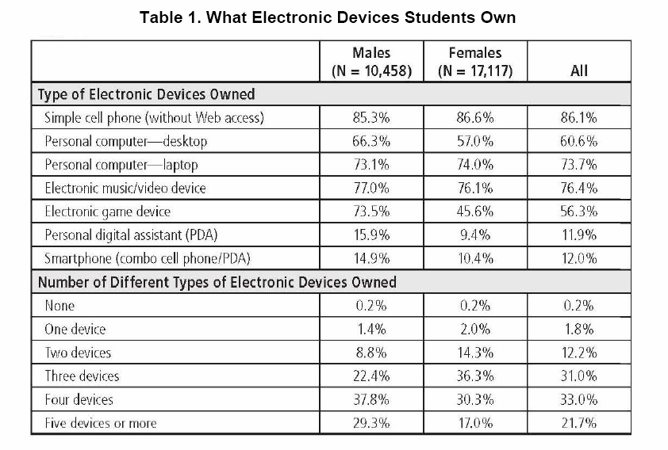
Tech-savvy, cont’d, ECAR Study Results

Slide 26
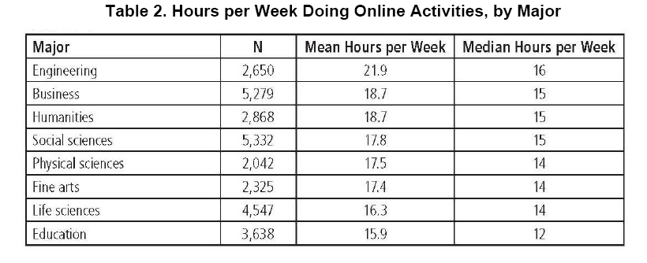
Tech-savvy, cont’d, ECAR Study Results

Slide 27
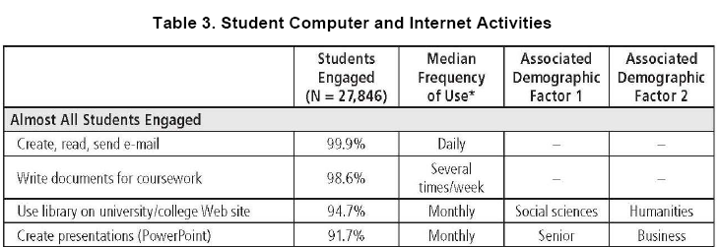
Tech-savvy, cont’d, ECAR Study Results

Slide 28
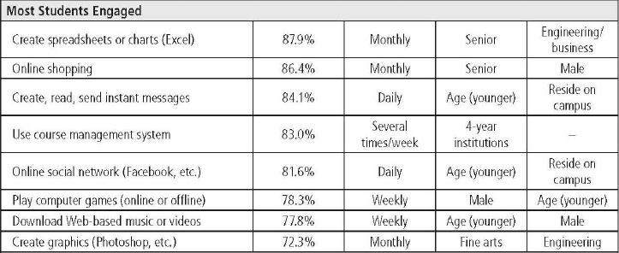
Tech-savvy, cont’d, ECAR Study Results
Table 3. Student Computer and Internet Activities, cont’d

Slide 29
Tech-savvy, cont’d, ECAR Study Results
Table 3. Student Computer and Internet Activities, cont’d

Slide 30
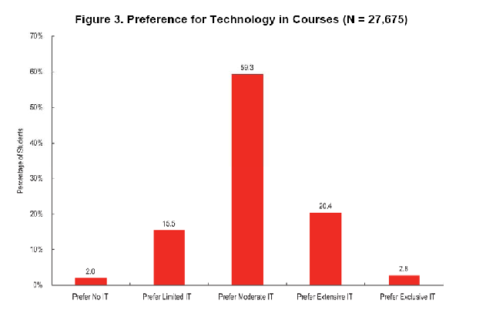
Tech-savvy, cont’d, ECAR Study Results
59.3%
20.4%
15.5%
2.0%
2.8%
Prefer no IT
Prefer limited IT
Prefer Moderate IT
Prefer Extensive IT
Prefer Exclusive IT

Slide 31
IUP IT Support Center Sample Stats
Wireless Setup
Week Ending
31-Aug | 7-Sep | 14-Sep | 21-Sep | 28-Sep | 5-Oct | Total
381 | 83 | 68 | 103 | 76 | 49 | 760

Slide 32
Technology Implications for Faculty
Respondents to The ECAR Study of Undergraduate Students, 2007 (Caruso and Salaway), identified the top five positives
about IT as an enabler of learning:
Technology facilitates organization and control
in the learning environment.
Technology facilitates communication with faculty
and classmates.
Technology can make content more accessible,
including class materials and Internet resources.
Technology in courses is valuable when directly linked
to applications useful to future employment.
Technology is an enabler of learning when professors
use it effectively.

Slide 33
Technology Implications for Faculty, cont’d
Respondents to ECAR’s study also identified
four categories about IT as a barrier to learning:
There are problems with technologies themselves and their institutional implementations and support.
The proliferation of technology has created a more complex learning environment.
Poor use of technology by faculty (underuse, overuse, inappropriate use, or over dependence of technology) detracts from the learning experience.
Instructors sometimes overestimate student comfort with or access to technology resources.

Slide 34
Technology Implications for Faculty, cont’d
Instructor technology skill sets need
to be better developed.
Instructors should be trained on how to effectively integrate technology and pedagogy.
Instructor and administrator awareness about how their students differ in technology savvy and access to technology resources should be heightened. (Caruso and Salaway)

Slide 35
Technology Implications for Faculty, cont’d
Newburn identifies the following as ‘musts’:
Email – if you haven’t started using it
to communicate with your students, do so immediately.
Blog – create a classroom blog
where students can respond to prompts
or to other students’ work
YouTube – consider searching through this site for videos that can enhance your curriculum

Slide 36
Technology Implications for Faculty, cont’d
Marc Prensky, who describes faculty as Digital Immigrants vs our Millennials who are Digital Natives, recommends that educators reconsider both their methodology and their content:
Educators must learn to communicate in the language and style of the students, i.e., going faster, less step-by-step, more in parallel, and with more random access.

Slide 37
Technology Implications for Faculty, cont’d
Prensky continues:
The content of future courses for Millennials is digital and technological but also includes the ethics, politics, sociology, languages,
and other areas that go with them.
Simplified, it means learning new ways to present ‘old’ stuff. This means adapting materials to the language of the Digital Natives.

Slide 38
General Implications for Faculty
Provide many challenges but also the structure to back it up, i.e., breaking down goals into steps and offering necessary resources and information students may need to meet the challenges. (Thielfoldt and Scheef)

Slide 39
General Implications for Faculty, cont’d
According to Rivera and Huertas, faculty need to work on:
Providing a diversity of learning experiences
in the classroom
Conducting continuous research of what works
for students to learn
Providing experiential, interactive, and
authentic learning
Staying connected to their students
Revising curriculum taking into account the Millennial learning styles

Slide 40
General Implications for Faculty, cont’d
Sweeney recommends:
Offering a large number of alternative learning methods and opportunities from which students can select
Utilize case studies, learning games, and interactive projects that are more likely to keep Millennials’ attention

Slide 41
General Implications for Faculty, cont’d
Walker further recommends:
Allow students ample opportunities to work collaboratively and in groups
Present an environment where mutual respect is honestly practiced
Implement a flexible schedule that has timelines, where the work is chunked into small amounts; give feedback in a timely fashion
Permit students to multitask

Slide 42
General Implications for Faculty, cont’d
McMillan makes the following recommendations:
Retool classroom for constant testing, feedback, monitoring skills and mastery
Market a safe, protected, ‘accountable’ environment
Prepare for students who have a lot and expect a lot
Create an expectation of success for all, including special-needs kids
Showcase groups and team skills

Slide 43
Conclusion
Prensky:
“So, if Digital Immigrant educators really want to reach Digital Natives, i.e., their students, they will have to change. It’s high time for them to stop their grousing, and as the Nike motto says, ‘Just do it.’ They will succeed in the long run.”

Slide 44
Conclusion, cont’d
This is where your Instructional and Research Technologies team comes in. Our goal is to assist faculty in any way possible to meet the needs of the Millennials in our classrooms:
redesigning instruction
incorporating technology into curriculum
implementing online components in a course management system

Slide 45
Conclusion, cont’d
You tell us what you need, and we’ll make it happen.
Visit us in G-1 Stright Hall
Collaborate in G-33 Stright Hall
Request individual and/or small group workshops
For more information, phone me at x7-7844 or email me at mlw@iup.edu.

Slide 46
Special Thanks . . .
. . . to Rebecca Sterley for the time and effort she put into critiquing this presentation and for her constructive suggestions.
It is greatly appreciated! ☺

Slide 47
References
Bargava, R. The Multicultural Mindset of the Millennials. (Posted April 18, 2007) at http://blog.ogilvypr.com/?p=160. Retrieved September 22, 2007.
Carlson, S. The Net Generation Goes to College. The Chronicle of Higher Education. October 7, 2005. Retrieved September 21, 2007, from http://chronicle.com/cgi2-bin/printable.cgi?article=http://chronicle.com/free/v52/i07/07a03401.htm
Caruso, J. B. and Salaway, G. The ECAR Study of Undergraduate Students and Information Technology, 2007 (September 2007). EDUCAUSE Center for Applied Research Key Findings. Retrieved September 21, 2007 from http://connect.educause.edu/library/abstract/TheECARStudyofUnderg/45076

Slide 48
References, Cont’d
McMillan, D. From the Middle: The Millennials Are Coming! (April 2007) The Bulletin – Michigan Association of Secondary School Principals at http://mymassp.com/newsletters/2007/04/from-the-middle-the-millennials-are-coming/. Retrieved September 28, 2007.
Newburn, R. Educating Millennials in the Information Age (April 2007). Squidoo How-to & Education. Retrieved September 12, 2007, from http://www.squidoo.com/Educating-Millennials
Oblinger, D. (July/August 2003). Boomers, Genexers, and Millennials: Understanding the New Students. EDUCAUSE Review within Rivera and Huertas article. Retrieved September 19, 2007, from http://www.nyu.edu/frn/publications/millennial.student/network-journal/Articles/Challenges-Riveraa.html

Slide 49
References, Cont’d
Prensky. M. (2001). Digital Natives, Digital Immigrants. On the Horizon. NCB University Press, Vol. 9 No. 5.
Prensky, M. (2005). Engage Me or Enrage Me . . . What Today’s Learners Demand. Retrieved October 5, 2007 from http://www.marcprensky.com/writing/
Rivera, B. and Huertas, M. Millennials: Challenges and Implications to Higher Education (November 17-18, 2006). Faculty Resource Network Journal. Retrieved September 15, 2007, from http://www.nyu.edu/frn/publications/millennial.student/network-journal/Articles/Challenges-Riveraa.html

Slide 50
References, Cont’d
Sweeney, R. and Carlson, S. (October 5, 2005). [discussion] Live discussion sponsored by The Chronicle of Higher Education [Transcript] retrieved September 12, 2007, from http://chronicle.com/colloquy/2005/10/millennial/
Thielfoldt, D. and Scheef, D. Generation X and The Millennials: What You Need to Know About Mentoring the New Generations. (August 2004). Law Practice TODAY. Retrieved September 15, 2007, from http://www.abanet.org/lpm/lpt/articles/mgt08044.html
Walker, K. Millennials & Schools of the Future (November 20, 2006). The Principals’ Partnership. Retrieved September 15, 2007, from http://www.principalspartnership.com/millennials.pdf

