Slide 1
Online Education
Indiana University of Pennsylvania
May 20, 2008
Barbara A. Frey, DEd

Slide 2
Who are YOU?
How many of you teach online?
How many of you have over 3 years of experience teaching online?
Is there anyone who prefers teaching online to teaching F2F?
How many of you have taken an online course?

Slide 3
Goals
To apply the standards associated with effective online course development
To identify best practices in online teaching (and learning)
To manage the workload of online teaching

Slide 4
Quality Matters ™ qualitymatters.org
Faculty-centered quality assurance program for online/blended courses
Began as a FIPSE grant in Maryland
Self-supporting, non-profit organization offering subscriptions, training, and materials for online educators
Based on a rubric of 40 design standards organized into 8 major categories

Slide 5
8 Essential Standards
Course Overview and Introduction
Learning Objectives
Assessment and Measurement
Resources and Materials
Learner Engagement
Course Technology
Learner Support
Accessibility

Slide 6
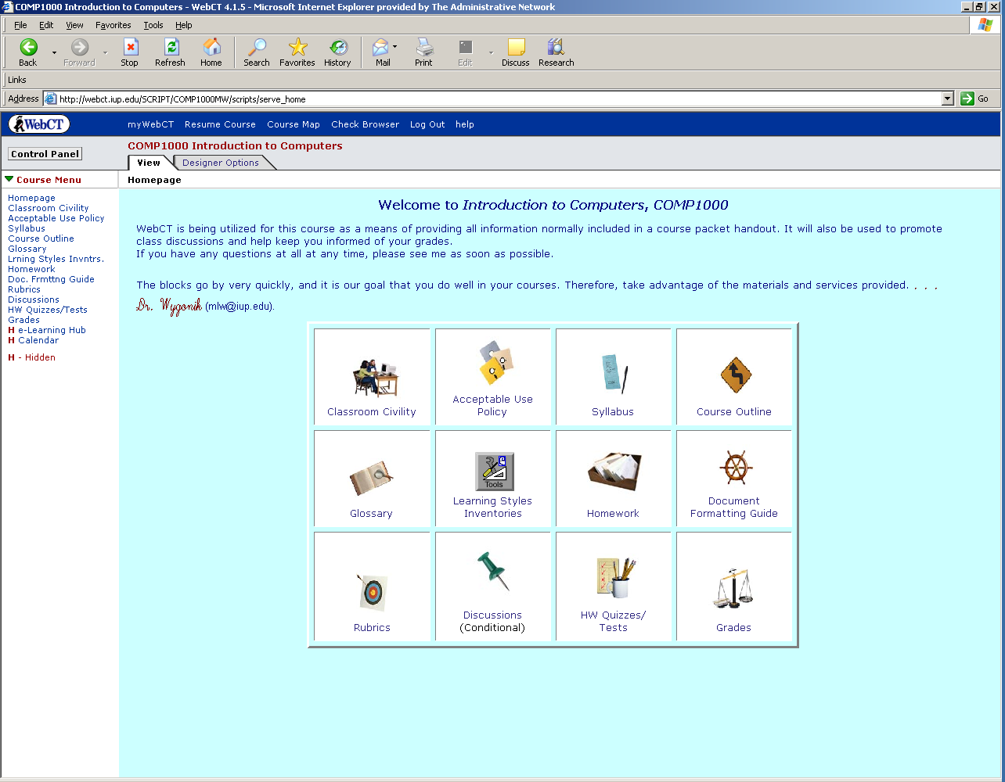
1. Overview and Introduction

Slide 7
Announcement A Activity 1
Welcome to Introduction to Psychology! This online course begins June 10 and ends August 15, 2008. Throughout the semester, we will explore introductory theories and research in the field of psychology.
Please don’t hesitate to contact me if you have any questions or concerns.

Slide 8
Announcement B Activity 1
Welcome to Introduction to Psychology! My name is Dr. Frey and I am your instructor for this course. The best way to contact me is through email at bafrey@university.edu. I check email every morning and usually respond to student messages in less than 24 hours.
You will use the navigation buttons on the left to access all components of this course. The course is organized into 15 lessons located in “Weekly Lessons”. To begin, read the “Instructor Information” and “Getting Started” sections. Then, you will be ready to start Lesson 1.
I’m looking forward to an active and interesting semester!

Slide 9
Course Homepage Course Menu
Resources
Discussions
Homepage
Weekly Lessons
Getting Started
Syllabus
Exams

Slide 10
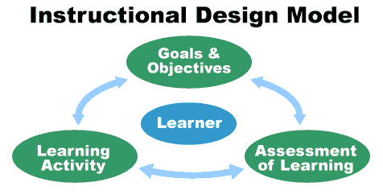
2. Learning Objectives What should students be able to do when they leave your course?

Slide 11
Rewrite Objectives
To become aware of the major psychological approaches to the study of behavior.
To learn how to locate, read, and evaluate psychological resources.
To analyze psychological information presented to consumers.
To explain the basic principles of human thought including how memory works and how people think.

Slide 12
Match Assessments to Objectives
Write a term paper on psychological disorders portrayed in the media
Discuss three ethical issues associated with Genetic Engineering

Slide 13

3. Assessment and Measurement
Formative
Classroom assessment techniques
Midterm evaluation
Summative
Exams
Projects or papers
End of course evaluation
Course statistics

Slide 14
Classroom Assessment Techniques
The One Sentence Summary
Can students concisely summarize the information on a given topic?
2. The Muddiest Point
What do students find least clear or most confusing about a particular topic?
3. One Minute Paper
What was the most important thing students learned during this class? What questions remain unanswered?
4. Student Generated Test Questions
What do students consider the most important?

Slide 15
Sample Quiz Question with Feedback
One of the largest influences on the expansion of the field of clinical psychology was:
A. increased frequency of psychopathology.
*B. World War II.
C. mandatory school attendance for children.
D. the opening of many new graduate programs.
Feedback: America’s involvement in WWII necessitated mass testing of military personnel, a task uniquely appropriate for the field of clinical psychology.

Slide 16
Assessment Security Issues
Vary assessment methods
Create pools of exam items
Use CMS security measures
Design lengthy but timed assessments
Relate to discussions
Proctored exams
Notes:
Anytime you talk about online assessment, the topic of cheating and plagiarism is mentioned.

Slide 17

4. Resources and Materials
Textbook
Articles
CDs and DVDs
Podcasts or videos
PowerPoint files
Web links
Games or simulations
Notes:
What is the format of your course materials? Textbook, videos, PowerPoint, CDs or DVDs, links, articles?
Learning objectives handout

Slide 18
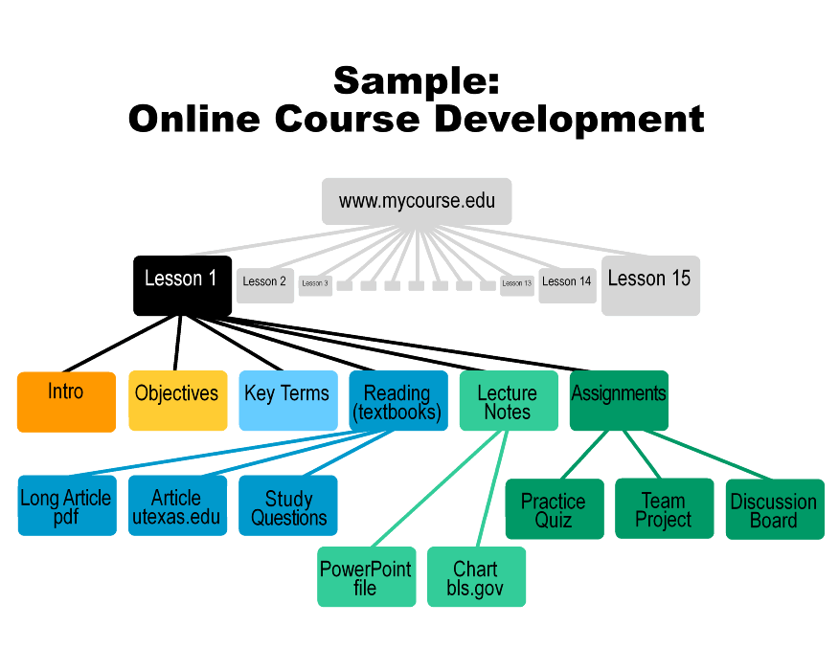
Online Course Development
Notes:
Show a screen capture of the opening page – note the order of buttons and the labeling of buttons.

Slide 19
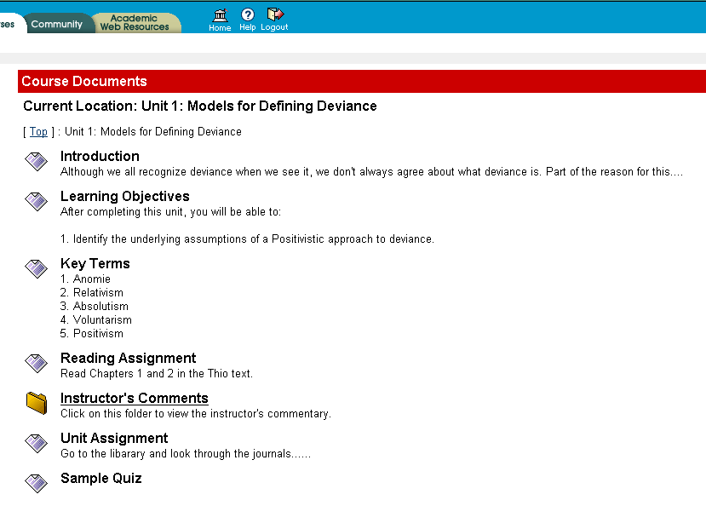
Course Documents
Notes:
Introduction should tell students what they are going to learn, why it is relevant, and it should help them recall prior knowledge.

Slide 20
5. Learner Engagement
Student to instructor
Student to student
Student to content

Slide 21
Strategies to Engage
Case studies
Problem based learning
Debates
Web searches
Presentations
Simulations
Games
Role play
Science labs
Practice quizzes
Surveys
Guest speakers
Web tours
Videos clips
Podcasts
Discussions
Chats
Notes:
http://www.jmu.edu/madison/teacher/jeopardy/jeopardy.htm

Slide 22
Synchronous Discussion
Consider your purpose
Limit the number of participants and time frame
Develop a plan for speaking and participation
Begin with off-topic greeting
Prepare agenda, readings, and activities
Use names and repeat questions

Slide 23
Asynchronous Discussion
Determine your purpose
Post your expectations for student participation
State your role in the discussion
Begin with focused questions or activities that allow for unique responses
Consider a grading rubric
Limit the time frame for discussions
Model the format and style of writing
Summarize discussions

Slide 24
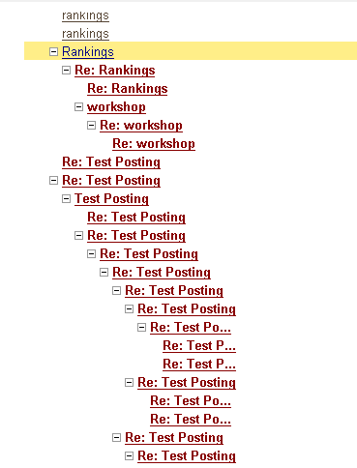
Discussion Interaction

Slide 25
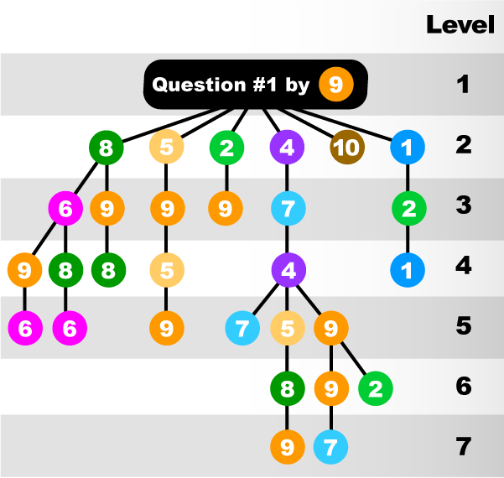
Discussion Map

Slide 26
Which Discussion?
1. There are 8 study questions at the end of Chapter Three. If your last name begins with A-L, complete the ODD number questions (1, 3, 5, and 7). If your last name begins with M-Z, answer the EVEN number questions (2, 4, 6, and 8). Post your responses in the forum “Chapter Three: Study Questions.”
2. After reading the article “Genetic Engineering,” respond to the following questions: (a) What are the assumptions of the germline and somatic approaches to genetic engineering? (b) Where do you fall on the continuum between the two approaches?
3. How useful do you find Malcolm Knowles’ theory of adragogy compared to Patricia Cross’ characteristics of adult learners theory?

Slide 27
6. Course Technology
PowerPoint
Conferencing HorizonLive
Discussion
Blogs
Wikis
Audio or Podcasts
Video
Images
Games Simulations

Slide 28
Match Technology to Objective
Present a persuasive speech
Develop a team presentation on distance education in K-12 schools
Recognize the value of diversity in team lab projects
Describe information technologies that manage clinical data

Slide 29
Powerpoint Jeopardy
PowerPoint Jeopardy
Navigation | Objectives | Media | Tools | Student Engagement
10 | 10 | 10 | 10 | 10
20 | 20 | 20 | 20 | 20
30 | 30 | 30 | 30 | 30
40 | 40 | 40 | 40 | 40
50 | 50 | 50 | 50 | 50

Slide 30
Managing the Workload Authoring Strategies
Use a course development model
Acquire development resources and team
Establish reusable templates
Establish a consistent structure and routine
Finalize one unit or lesson at a time
Provide clear and specific instructions
Develop feedback rubrics
Use a learning object database
Notes:
http://www.ed.psu.edu/ACSDE/Workload_Man.ement_Strat_5.pdf

Slide 31
Managing the Workload Teaching Strategies
Establish students’ technical skills
Provide a detailed syllabus
Define operating parameters and expectations
Begin course with interaction
Build a learning community
Establish consistent communication
Develop a grading and record-keeping system
Conduct multiple evaluations with feedback

Slide 32
Questions?
Barbara Frey
bafrey@pitt.edu
412-624-1330

Slide 33

Text-based navigation that displays a chain of previous Webpages arranged in sequential order

Slide 34
The main page on a
Web site
Notes:
Category 1 - 10

Slide 35
Consistent location for course navigation buttons
Notes:
Category 1 - 20

Slide 36
The act that requires federal agencies to make their electronic information accessible

Slide 37
A way to skip directly to targeted information
on a Web page

Slide 38
Text-based navigation that displays a chain of previous Web pages arranged in sequential order

