Slide 1
The job search: search inside yourself before hitting the internet
Shavonne Arthurs, M.A., M.S.
Jennifer Boyer, J.D., M.A.
John Lewis, PhD

Slide 3
Make a list…
What are your goals?
What kind of school?
Community college/4-year college
Focus
Online teaching/in-person

Slide 4
Make a list…
What are your goals?
What kind of position?
Department
Type/size
Students
Teaching requirements
Course load (full-time, part-time)
Workshops/Meetings
Course creation
Course requirements
Office hours
Service requirements
Research requirements

Slide 5
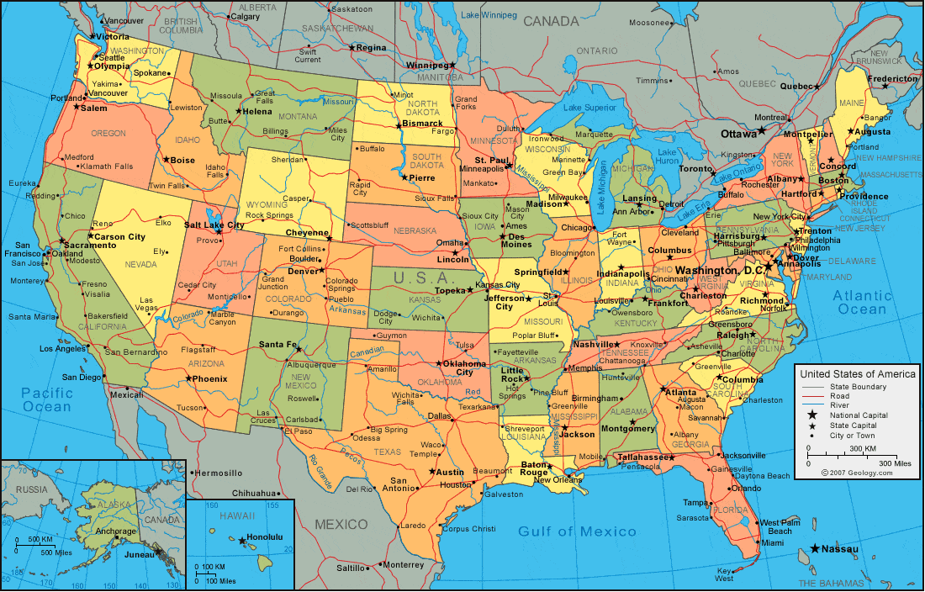
Make a list…
What are your goals?
Location
Family dynamics

Slide 6
Make a list…
What are your goals?
Salary
Cost of living
Commuting costs
Benefits
Health insurance

Slide 7
Start looking…
Think beyond Google!
General higher education websites
Area-specific websites
Network connections/word-of-mouth

Slide 8
Selling yourself
What are your qualifications?
What can you do to get the qualifications?
Organize and revise your resume/CV
Things you believe are unimportant may not be
Things you believe are important may not be
DO NOT oversell!

Slide 9
The application process
Resume/CV
Cover letter
References
Transcripts
Additional items

Slide 10
interviews
Be as accommodating with times as possible!
Prep for the interview
Skype?
Phone?
On campus?
Expect the unexpected
Technology issues
Question types
Regard anything and everything as important

Slide 11
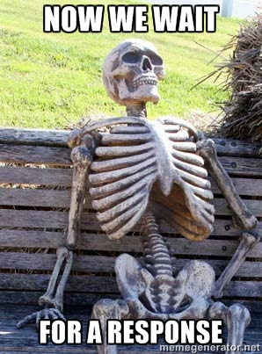
The waiting game
Your life becomes a huge hypothetical
There is NO structured time line
Continue monitoring and applying to jobs until you actually have one
DO NOT take anything personal
Beware you may have tough decisions ahead

