Slide 1
The Scholarship of Teaching and Learning
Beth Dietz
Cathy Bishop-Clark
Miami University
© Beth Dietz and Cathy Bishop-Clark
Notes:
Beth – assuming you still like to start

Slide 2


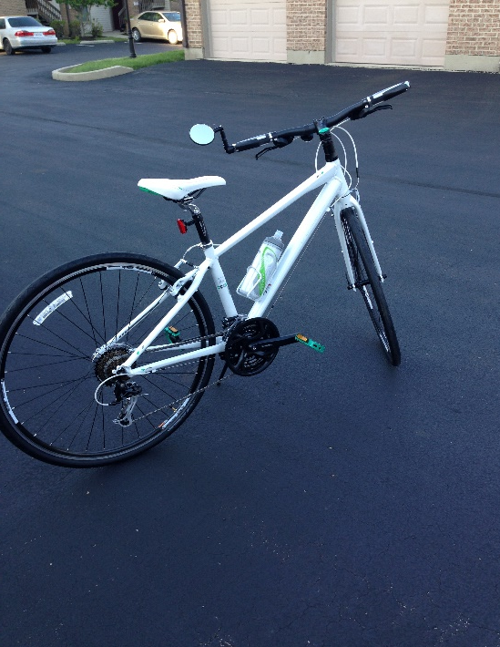
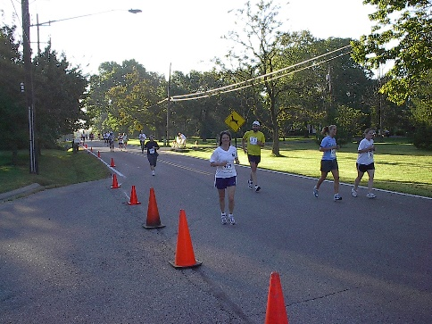




Beth Dietz
Notes:
Beth

Slide 3







Cathy Bishop-Clark

Slide 4
OUTCOMES
Articulate motivations behind SoTL
Demonstrate an understanding of current issues in SoTL
Demonstrate an understanding of the kinds of classroom SoTL projects
Notes:
Cathy

Slide 5
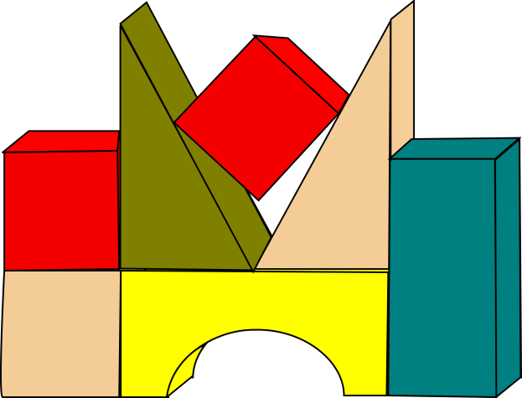


Definition of SoTL
“An act of intelligence or artistic creation becomes scholarship when it possesses at least three attributes: it becomes public, it becomes an object of critical review and evaluation by members of one’s community, and members of one’s community begin to use, build upon, and develop those acts of mind and creation.” (Shulman, 1999)
Notes:
Cathy

Slide 6
Definitions of SoTL
Scholarly Teaching
Teaching informed by research on teaching and learning (“consumers”)
Scholars of teaching and Learning
Creation and dissemination of original work that is peer-reviewed and shared (“producers”)
Notes:
Cathy

Slide 7

Definitions of SoTL
From the definition reviewed above, identify a few key components of SoTL that resonate with you
Notes:
Cathy

Slide 8
Purposes of SoTL
Sense of self-fulfillment, personal interest, and commitment to being the best instructor one can be (Kelly-Kleese, 2003)
To reflect on own teaching (Nelson, 2003)
To Improve Ourselves/Our Teaching
To Improve the Classroom
Assess innovations in the classroom, curriculum, or discipline (Saylor & Harper, 2003)
To understand teaching and learning (Nelson, 2003)
To Improve the Discipline/Education
To produce a formal, peer-reviewed communication (Healey, 2003)
To improve teaching, the program, and the college (Kelly-Kleese, 2003)
Inform policy decisions (Saylor & Harper, 2003)
Notes:
Cathy: share my story of the finishing my first class. I was so pleased with the class and I was convinced that everyone in that room would want to now become a computer scientist. As I watched people leave the room I heard “….” My perceptions were not accurate. Instantly, I wanted to improve my teaching and improve the classroom.

Slide 9
Purposes of SoTL
Identify several of your own reasons/purposes for engaging in the Scholarship of Teaching and Learning
Notes:
Cathy – ask for a few people to share

Slide 10
Evaluating SoTL
Six criteria:
  Clear goals
  Adequate preparation
  Appropriate methods
  Significant results
  Effective presentation
  Reflective critique
Carnegie Foundation
Notes:
Beth

Slide 11

Issues: Is SoTL Rigorous?
“Critics of scholarship about education have charged that much of the research lacks rigor, fails to adhere to widely-accepted principles for the conduct of science, and fails to provide a solid evidence base that can guide real-world decisions ….”
Walters, Lareau, Ranis (2009). Education Research on Trial. New York. Routledge.
Notes:
Beth

Slide 12
The History…..
Teaching, I say, is an art, not a science…in no sense can teaching be said to be a science.
    Floyd Richtmeyer (1933)
Notes:
Beth

Slide 13
“Few faculty members have any awareness of the expanding knowledge about learning from psychology and cognitive science. Almost no one in the academy has mastered or used this knowledge base. One of my colleagues observed that if doctors used science the way college teachers do, they would still be trying to heal with leeches.”
James Duderstadt (2000). President Emeritus U. Michigan
Notes:
Beth

Slide 14
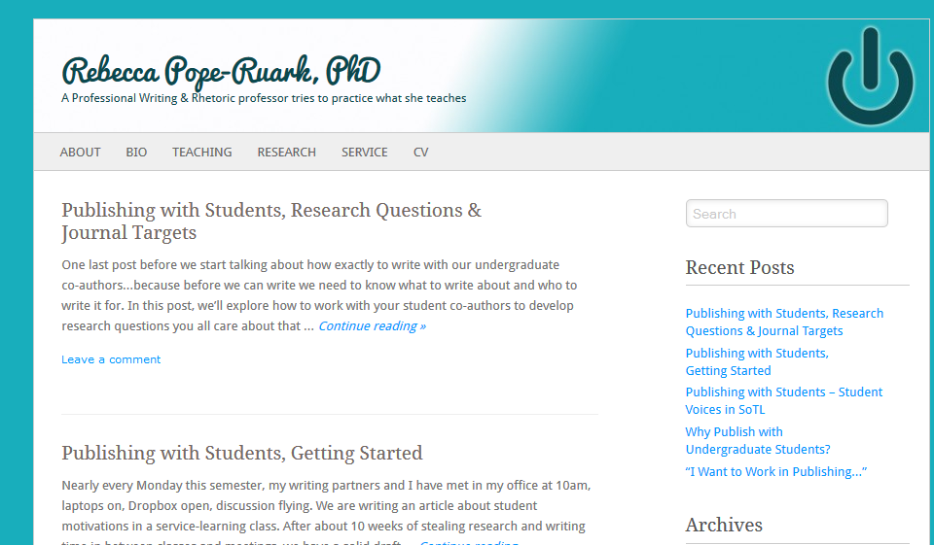

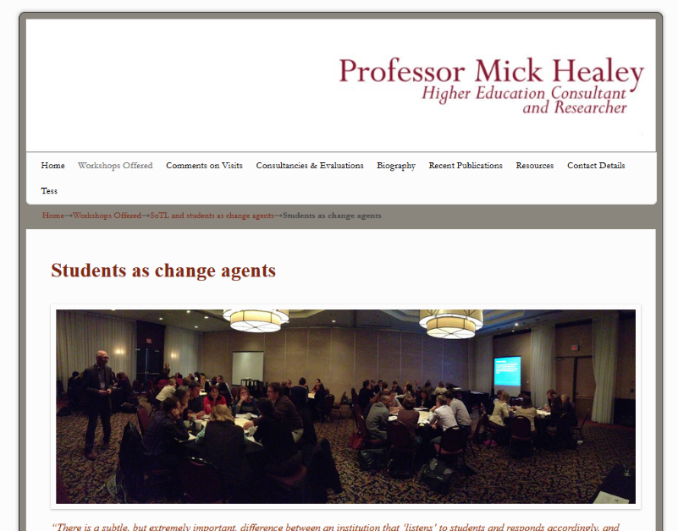
Issues: The Role of the Student
Historically, students have served the role of the subject (literally and figuratively)
Recently, shift to include students in all phases of the SoTL process
Notes:
Beth

Slide 15

Issues: Aligning SoTL with Assessment
As assessment focuses more on actual student learning, so too has SoTL
As assessment and accreditation pressures increase, there is need to combine efforts
Notes:
Beth

Slide 16
Issues
Are there other “issues” about SoTL that you can identify? (The issues might be unique to you or applicable to your department, institution, discipline)
Notes:
Beth

Slide 17

Overview of the Research Process

Slide 18

Another Day in the Classroom
We approach our teaching from a scholarly perspective
      When things go well (e.g., a new activity “seems” to work)…
      When things go poorly (e.g., students did not seem to get the point of the class discussion)…
        …… we ask why
        and we usually produce an answer
On an informal level, we are asking SoTL questions

Slide 19
Steps in the Research Process
Research Question
Design the Study
Collect Data
Analyze Data
Report Findings

Slide 20
Steps in Research Process
Step 1: Identify the Research Question | Will students perform better on exams preceded by a review session than on exams not preceded by a review session?
Step 2: Design the study | In one section of course, have review session prior to exam; in another section, do not hold review session
Step 3: Collect data | Exam scores; attitudes toward review session
Step 4: Analyze the data and draw conclusions | Compare mean exam scores and attitudes for two groups
Step 5: Report the findings | Submit paper to conference and peer-reviewed journal

Slide 21

SoTL – Four Examples
Effectiveness of Classroom Activities
Service Learning
Improving In-Class Discussions
Solving Programming Problems
Notes:
PICK TWO – protocol analysis, experiment

Slide 22
Example 1:
Effectiveness of Classroom Activities
Identify the Research Question: Are classroom activities effective in improving understanding of issues in virtual communication?
Design the Study: Archival records; student and instructor assessment
Collect the Data: Four classroom activities:
  Online friendships (guided discussion board questions)
  Internet versus face-to-face interactions (guided discussion board and in-class discussions)
  Altruism on the Internet (guided discussion board questions)
  Group performance in cyberspace (guided discussion board questions)
Analyze the Data: Coded discussion board entries; summarized instructor and student reflections
Report Findings: Three journal publications; three conference presentations
Notes:
Beth

Slide 23
Example 2:
Service Learning
Identify the Research Question: How does service learning impact a Systems Analysis class?
Design the study: Archival records, questionnaire, behavioral observation, client, student and instructor assessment
Collect the Data: collected data throughout the term, students completed questionnaires and exit surveys, instructor observed classroom behavior
Analyze Data: means, standard deviation, synthesis and summary of written comments
Report Findings: Three conference presentations; One journal article
Notes:
I don’t like this example anymore, let’s get rid of it??? SERVICE LEARNING IS SUCH A BIG DEAL NOW; MIGHT BE GOOD TO SHOW FACULTY HOW THEY CAN TURN SERVICE LEARNING INTO A SOTL PROJECT ok

Slide 24
Example 3:
Improving In-class discussions
Identify the Research Question: Can the quality and quantity of in-class discussion be improved?
Design the Study: Experiment
  Participants randomly assigned to online chat or
  face-to-face group
  Then discussed problem face-to-face
Collect the Data: Comprehension test; Questionnaire administered at end of experiment
Analyze the Data: Descriptive statistics (means, standard deviations, percent correct) and inferential statistics (factor analysis of questionnaire items, analysis of variance)
Report the Findings: Three conference presentations; one journal publication
Notes:
Beth and or Cathy

Slide 25
Example 4:
Novice Programming
Identify the Research Question: How do novice programmer learn to program?
Design the study: Protocol analysis of a single novice programmer solving a simple problem
Collect the Data: Audio taped a student as she talked aloud solving computer program
Analyze the Data: Transcribed the session to text, made observations about her process
Report the Findings: Published in a journal
Notes:
Cathy

Slide 26
Reflection
One-Minute Writing Exercise: Write down what you learned about SoTL and the research process.
One-Minute Writing Exercise: Write down what is still fuzzy to you/what do you want to know more about.
Pair-Share Exercise: Share what you wrote with one other person and discuss.
Notes:
Do we want to have them fill out an exercise after this? I THINK MAYBE JUST GIVE THEM THE WORKSHEET, FOR THEIR INFORMATION

