Slide 1

What is the Center for Teaching Excellence?
Est. 1989 to nurture excellence in teaching that already exists at IUP.
  Achieving the goals and missions of IUP, its faculty, and its students as they relate to teaching
  Facilitating the professional and personal development of faculty through teaching excellence activities
  Defining and providing mechanisms for enhancing and recognizing excellent teaching
  Stimulating thinking, discussion, and research on teaching excellence
  Effective Teaching is a reflective process that incorporates critical
  self-appraisal and hard work

Slide 2
Center for Teaching Excellence
Reflective Practice
Teaching Excellence Awards
Advisory Board
New Faculty Orientation

Slide 3
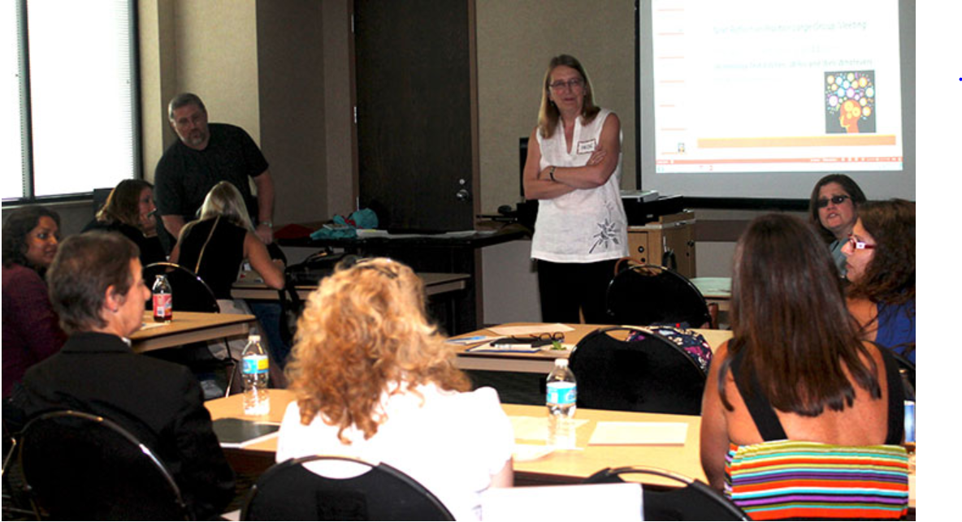

What is the Reflective Practice Project?

Slide 4
Reflective Practice Activities
Monthly Large Group Meetings
Online Learning and Advising
Preparing Future Faculty
Assessment
Teaching Circles and mini-grants

Slide 5

Meet the
Co-Directors

Slide 6
CTE/Reflective Practice Personnel
Stephanie Taylor-Davis, Director
Mimi Benjamin, Reflective Practice Co-Director for Large Group Meetings
Erin Conlin, CTE Associate Director for Academic Advising
Rachel DeSoto Jackson, Reflective Practice Co-Director for Teaching Circles
Christoph Maier, Reflective Practice Co-Director for Portfolio and Assessment
Theresa McDevitt, CTE Associate Director for Reflective Practice
Jacqueline McGinty, Reflective Practice Co-Director for Instructional Design
Veronica Paz, Reflective Practice Co-Director for Online Learning
Ann Marie Schweitzer, CTE Administrative Assistant

Slide 7

Are You Ready for the New Semester?
  Thursday, August 2, 2020.
  3:30 – 4:30 p.m.
  At this session, you can expect to learn about new Center for Teaching Excellence services that can help you during your first days and all semester, ask questions from Hybrid learning and online teaching experts, get a few tips on effective semester planning for productivity and resiliency, and most importantly, you will have the opportunity to share and reflect on your practice with fellow attendees.

