Slide 1
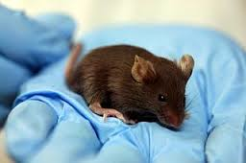
Compliance Institutional Animal Care and Use Committee (IACUC)

Slide 2
IACUC at IUP
By federal law, any institutional uses of vertebrate animals (teaching, research, outreach, other) must be supervised
IUP’s IACUC is here to help any faculty, staff, or student who wishes to use animals in their endeavors
Before animal uses can occur:
all users must submit, and have approved, an IACUC animal use protocol
all student users must complete Animal Care and Use (ACU) on-line training
Forms, guidelines, and other info are available at http://www.iup.edu/iacuc
New users are highly encouraged to meet with the IACUC chair to discuss their plans
Questions? Comments? Concerns? Please contact us at
IACUC Dr. William Farrell
College of Natural Sciences & Mathematics Psychology
305 Weyandt Hall (724) 357-7978
iacuc-info@iup.edu wfarrell@iup.edu

