Slide 1
IUP Liberal Studies
Dr. Edel Reilly
Director of Liberal Studies

Slide 2
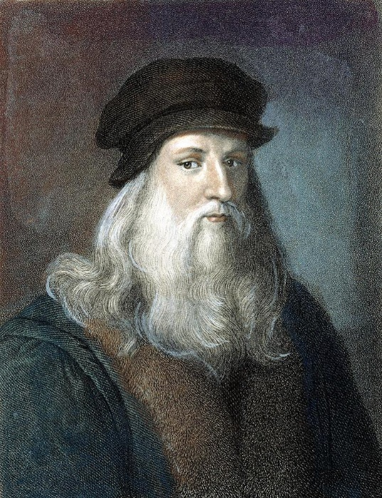
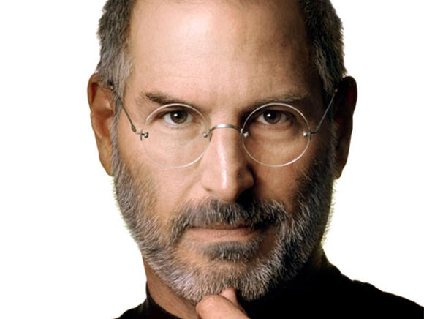
Can you name each individual?
What do they have in common?

Slide 3
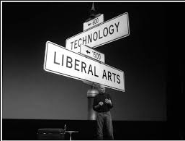
What did they do?
Leonardo studied:
  Biology
  Civil Engineering
  Human Anatomy
Considered a scientist as much as an artist
Do not work in a silo
  Walter Issacson’s “Leonardo da Vinvi”

Slide 4
What is Liberal Studies?
Liberal studies is a common core curriculum required by all undergraduates that include courses related to the humanities, arts, and sciences.
Liberal studies courses allow students to synthesize what they learn into a coherent whole that serves life goals.
Liberal studies courses will allow students to gain marketability using required Liberal Studies coursework.

Slide 5
What does Liberal Studies add to a program?
Professional behavior includes commitment to learning, interpersonal skills, communication skills, effective use of time and resources, use of constructive feedback, problem solving, responsibility, critical thinking, and stress management.
Jette D. U., & Portney, L. G (2003)
Provides the basis for developing essential learning outcomes.

Slide 6
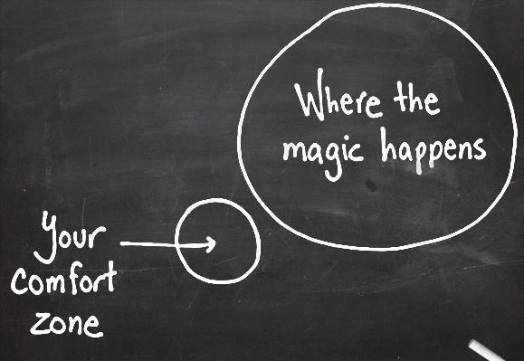

Slide 7
Brief Overview of IUP’s Liberal Studies Curriculum
Students at IUP must take a minimum of 40 credits and a maximum of 48 credits.
PASSHE’s Board of Governors Policy 1990-06A
Divided into three areas:
  Learning Skills English and Math 9-10 cr.
  Knowledge Areas Humanities, Sciences,
  Art, and Wellness 31-32 cr.
  Electives 3 -6 cr.

Slide 8
Writing Across the Curriculum
  effectively communicate in writing, be able to respond critically and analytically to materials and sources relevant to the course, and discuss/critique his or her own writing
  Writing Intensive Versus Writing Plans

Slide 9
What makes a Liberal Studies course different from regular course?
Student Learning Outcomes
versus
EUSLO (pronounced you-slow)

Slide 10
Student Learning Outcomes (SLO)
Every course and program at IUP should have student learning outcomes.
They should focus on a smaller number of essential outcomes.
They should be as specific, focused, and clear as possible—general outcomes are hard to measure.

Slide 11
How to get started:
Ask: What is the most important thing a student should know, be able to do or demonstrate after successfully completing my class/program?
Make a list of these and try to write them as SLO statements.
  The student will be able to…

Slide 12
Action Verbs
Action verbs result in overt behavior that can be observed and measured.
  Bloom’s Taxonomy
Certain verbs are unclear and call for covert, internal behavior which cannot be observed or measured. These types of verbs should be avoided:
  appreciate, become aware of, become familiar with, know, learn, understand

Slide 13
TOO general and VERY HARD to measure.
  … will appreciate the benefits of...
  … will value resources at the ...
  … will understand problem-solving skills.
  … will have more confidence in their abilities.

Slide 14
Comparing Outcomes
Still general and HARD to measure.
Specific and relatively EASY to measure.
  will value exercise as a stress reduction tool.
  will be able to develop and apply effective problem solving skills that would enable one to adequately navigate through the proper resources within the college.
  will demonstrate ability to resolve personal conflicts and assist others in resolving conflicts.
  will demonstrate critical thinking skills, such as problem solving as it relates to social issues.
will be able to explain how exercise affects stress.
will be able to identify the most appropriate resource that is pertinent to their college concern.
will be able to assist classmates in resolving conflicts by helping them negotiate agreements.
will demonstrate the ability to analyze and respond to arguments about racial discrimination.

Slide 15
Some other examples
US History: At the end of this course students will be able to:
  Write an essay defining a pluralistic society and its relationship to our democratic principles
  Outline the structure of the Constitution of the U.S.
Music Appreciation: After completing this course students will be able to:
  Identify the basic elements of Western music
  List the instruments associated with Western music
  Describe the distinct style periods of Western music
  Recognize selected examples of Western music aurally
General Psychology: Students who complete this course will be able to:
  Identify and define basic terms and concepts which are needed for advanced courses in psychology
  Outline the scientific method as it is used by psychologists
  Apply the principles of psychology to practical problems
  Compare and contrast the multiple determinants of behavior (environmental, biological, and genetic)

Slide 16
Characteristics of the Expected Undergraduate Student Learning Outcomes (EUSLO)
Informed Learners understand nature and society through forms of inquiry fundamental to the sciences, the humanities, and the arts. Learners are informed by knowledge and ways of knowing that extend beyond core concepts enabling them to link theory and practice.
Empowered Learners are critical thinkers who demonstrate intellectual agility and creativity and the ability to manage or create change. They are able to derive meaning from experience and observation. They communicate well in diverse settings and employ various strategies to solve problems. They are empowered through mastery of intellectual and practical skills.
Responsible Learners are engaged citizens of a diverse democratic society who have a deep sense of social responsibility and ethical judgment. They are responsible for their personal actions and civic values.

Slide 17
EUSLO Categories
Diversity
Communication
Civic Engagement and Social Justice
Problem Solving
Information Literacy
Critical Thinking and Reasoning Skills
Global Citizenship

Slide 18
What is happening now?
Most Liberal Studies courses do have a syllabi of record that has an explicit discussion of how the learning objectives relate to the EUSLO characteristics.
Departments are currently “mapping” the course outcomes to the EUSLO.
Departments are implementing a tool to measure how the course outcomes are to be met.

Slide 19
DANC 102
Explores dance as communication, ritual, social engagement, entertainment, and as an art form. Dance history, genealogy, aesthetics, critical analysis and response, and the creative process are examined. Class experience includes viewing and critical analysis of professional dance works, attending at least two live productions, and engaging in the creative process in practice and performance.

Slide 20
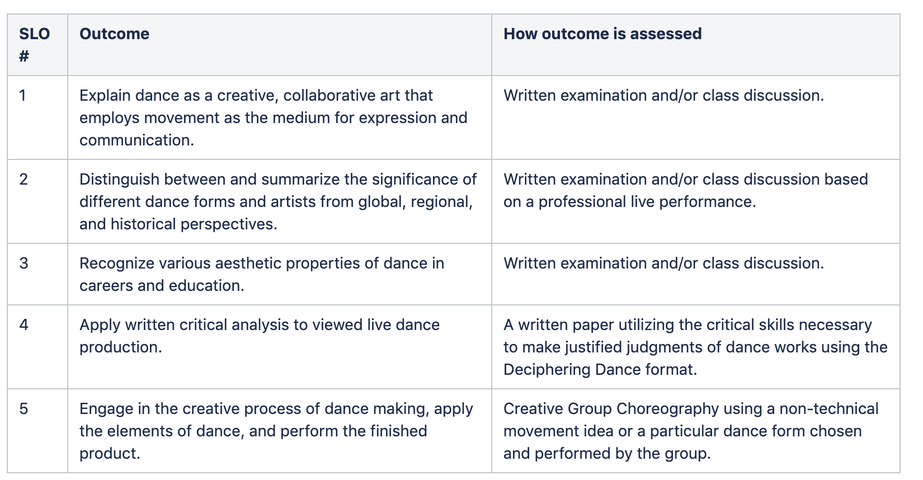
Outcomes with Assessment

Slide 21
Outcomes mapped

Slide 22
Questions?

