Slide 1
Information Technology Services
New Faculty Orientation
Notes:
Good morning. I am David Porter, and I represent IUP’s IT Service. I am the university’s online learning specialist, so you may work with me if you are using instructional technology in your classroom or developing your online course.

Slide 2
What We Can Do For You
Technology Support
Academic Services
(including Test Scoring Services)
Instructional Design - LMS Services
(in partnership with the College of Education)
Multimedia Classroom Setup

Slide 3
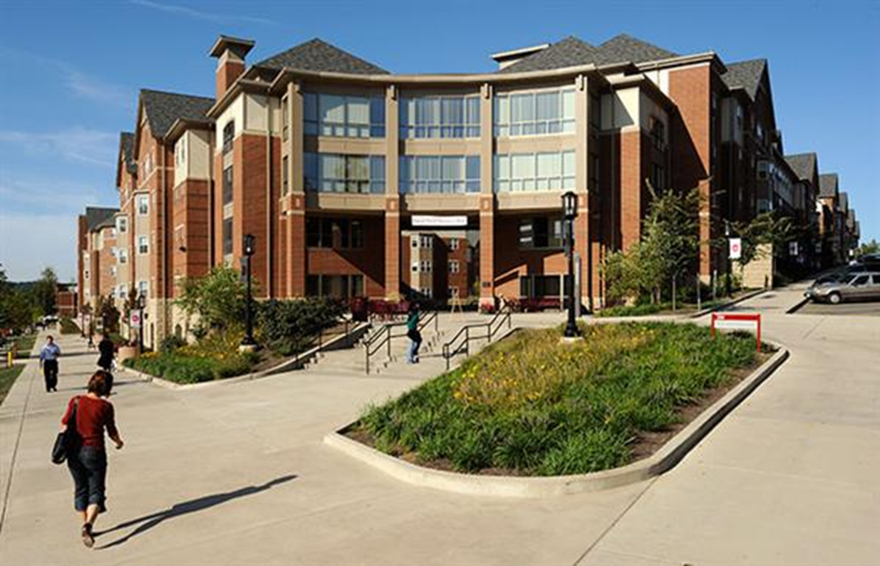
IT Support Center
Delaney Hall
ihelp.iup.edu
724-357-4000
it-support-center@iup.edu
www.iup.edu/itsupportcenter
Monday-Friday 8:00-4:30
Technology Support

Slide 4
Support
IUP owned devices (PCs/Macs, smart devices, printers)
Passwords
Software
Academic Systems
VCL
LMS
MMC
Technology Support
Notes:
Just a note about ihelp. Ihelp is our online help system. Logging a ticket ensures that your questions/help requests get immediate attention. For example, in the instructional design group, we have two and a half staff. When a ticket is logged, we all receive a notification, and the person who is available will pick it up. This gets around the issue of calls not getting answered because people are at meetings, sick, or on vacation, for example. Furthermore, it is a way to ensure that all of the information needed to resolve your issue is logged in one place to be shared among the staff.

Slide 5
ihelp.iup.edu
Online help system
Results in quicker resolution
You can check the status of your ticket
You can see all tickets you have open
* *It is important to use ihelp to communicate with IT staff on your support calls.
Technology Support
Notes:
Just a note about ihelp. Ihelp is our online help system. Logging a ticket ensures that your questions/help requests get immediate attention. For example, in the instructional design group, we have two and a half staff. When a ticket is logged, we all receive a notification, and the person who is available will pick it up. This gets around the issue of calls not getting answered because people are at meetings, sick, or on vacation, for example. Furthermore, it is a way to ensure that all of the information needed to resolve your issue is logged in one place to be shared among the staff.

Slide 6
Technology Committee
Academic Computing Policy Advisory Committee (ACPAC)
  http://www.iup.edu/acpac
  Shall recommend to the appropriate university unit, policy related to technology in support of the academic mission
Technology Support
Notes:
[Show ACPAC web site]
The Academic Computing Policy Advisory Committee is known as ACPAC. There is one faculty representative from each college who participates on this committee. Their role is to make recommendations regarding policies related to technology. For example, a few years ago, we knew that we needed to replace our optical test scoring software and hardware. An action team was created from ACPAC to research and explore possible replacements, and to make a recommendation for the new software. ACPAC has several standing subcommittees that meet throughout the year as well.
The Technology Operations Team is another group that impacts technology on campus, regularly, and its membership consists of the college technology managers, the executive director of IT Services, and other operational IT staff from IT services. This group makes sure that all technology entities on campus are “on the same page”, so to speak.

Slide 7
MYIUP https://www.iup.edu/myiup
Class Lists
Advising
Scheduling
Entering Grades
Course E-mail Lists
Personal Records
Campus Services
Reset passwords (network, e-mail and ESS accounts)
  MyIUP – Personal Info – Password Reset Options
Academic Services

Slide 8
Technology Guide for Employees
  http://www.iup.edu/itsupportcenter/employee
  Computer Accounts
    MyIUP (Network, D2l, Moodle, ihelp, wireless, VPN)
    Email and Calendar (separate account from MyIUP)
  Desire2Learn
    Metacourses
    Zoom
    Respondus
Academic Services
Notes:
[display technology guide for faculty]
Review computer accounts (refer to sheet also)

Slide 9
Technology Guide (Cont’d)
  Test Scoring and Faculty Evaluations
  dispatch.iup.edu
  (test scoring, evaluations, student pictures)
  Project Directory Service (P: drive)
  Course Section E-mail Lists
Academic Services
Notes:
NOTE: Update or remove PDF located http://www.iup.edu/WorkArea/linkit.aspx?LinkIdentifier=id&ItemID=46165
How to address D2L?

Slide 10
Instructional Technologies
IT Services provides support for the research, design, and deployment of enterprise technologies that directly aid the teaching and learning process. These services include, but are not limited to:
Desire2Learn (D2L)
Learning Management System-related services (Zoom, itube, iblog)
In-class multimedia workstations
Course communication services
Course storage services
Support activities
Consulting services
Instructional Design – LMS Services

Slide 11
Multimedia Classroom Overview
Tom Hoover
Jamison Brown

Slide 12
MMC Overview
About 270 multimedia classrooms
Standardized equipment set
Tech Fee funded
Main campus and branches
Upgrade and replacement cycle

Slide 13
Equipment Overview
Projector
PC
Doc Cam
DVD/VCR or Blu-ray
Amplifier
Laptop inputs

Slide 14
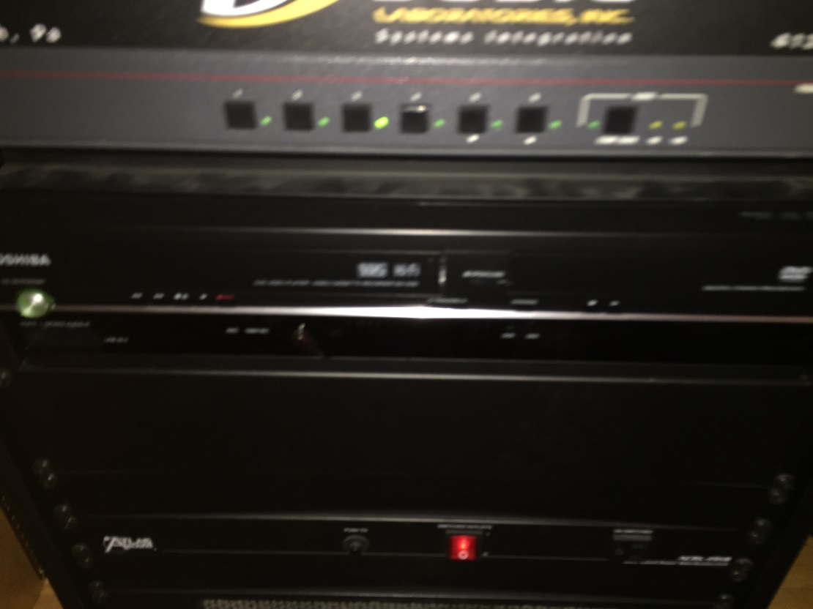
Equipment Overview
DVD/VHS Combo Unit and Switcher

Slide 15
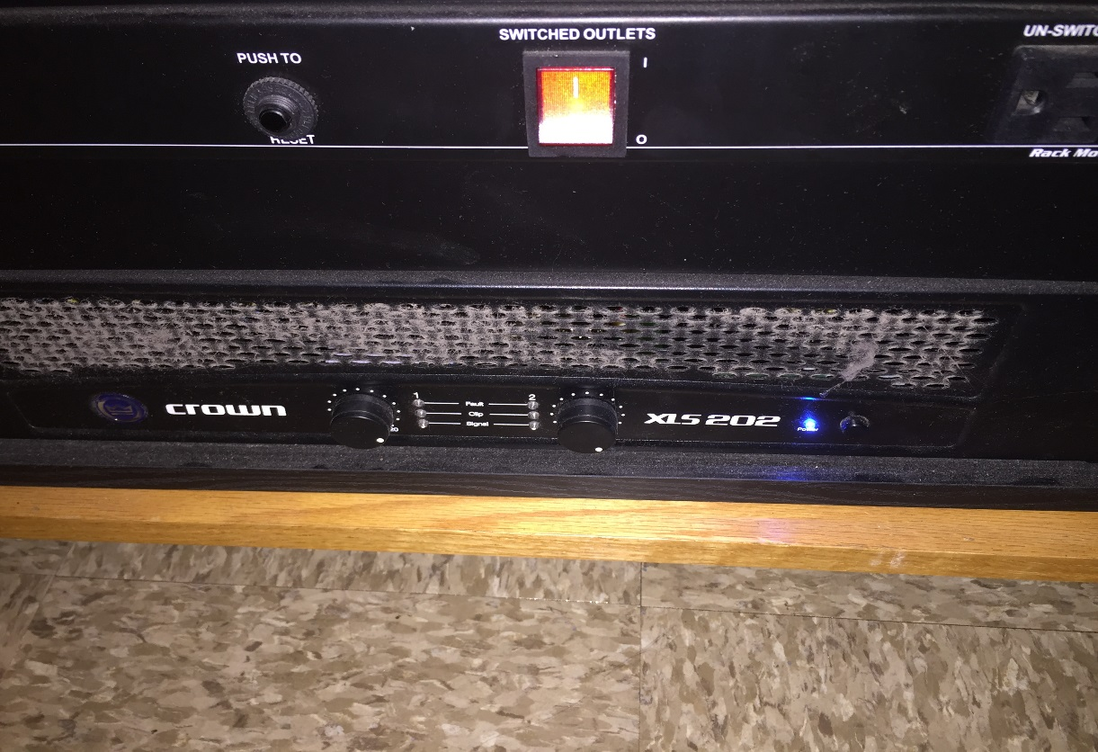
Equipment Overview
Amplifier and Power Distributor

Slide 16
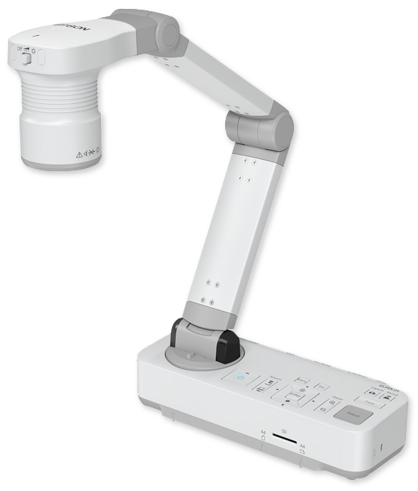
Equipment Overview
Document Camera

Slide 17
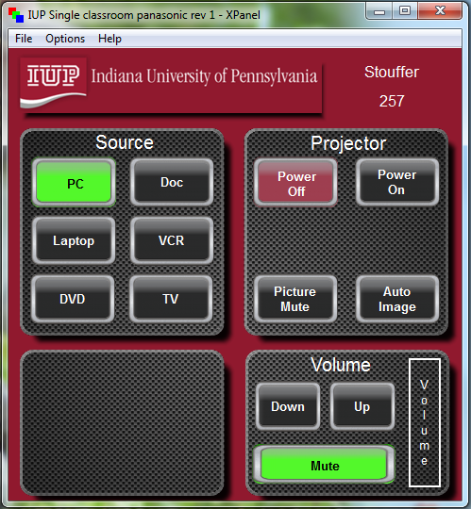
Projector Control Software

Slide 18
Troubleshooting Tips
Projector – picture mute, dull image, resizing display size, keep projector controls open.
Doc Cam – Lens cover, lights, power switch
Audio – amplifier, volume, rack power switch, source volume

Slide 19
Websites of Interest
IT Support Center
  http://www.iup.edu/itsupportcenter/
Technology Guide for Employees
  http://www.iup.edu/itsupportcenter/employee
Lab Information including Map
  https://www.iup.edu/itsupportcenter/get-support/academic-services/labs/
Training
  http://www.iup.edu/itsupportcenter/workshops
Library Services
  http://www.iup.edu/library/services
Like us on Facebook (IUP IT Support Center)
Follow us on Twitter (@IUPITSupport)
Notes:
Note: Review equipment info at Library Technology Services then borrowing equipment

Slide 20

Questions
Notes:
During overviews ask them to only watch not to login

