Slide 1
Supporting Student Writing – Key Concepts
Dana Driscoll, PhD | Director, Jones White Writing Center
Bryna Siegel Finer, PhD | Director, Writing Across the Curriculum

Slide 2
TODAY (in 45 minutes!)
Mission of the WAC program
What is WAC and Writing-to-Learn
Quick overview of some WTL strategies to use in courses that are not focused on teaching writing
Mission of the Kathleen Jones White Writing Center and what we offer to students
Some discussion of how you can use your assignment sheets to help students write better for your classes
Keep in mind, this is VERY REDUCED INFO! We have lots of resources on all of this information. Please contact us to chat more or with any questions.

Slide 3
Writing across the curriculum
Dr. Bryna Siegel Finer Director, Writing Across the Curriculum
Office: HSS 506K Phone: 724-357-2267 E-mail: brynasf@iup.edu
Teach. Write. Teach Writing.

Slide 4
WAC program MISSION
The IUP Writing Across the Curriculum (WAC) program provides support for faculty university-wide as we enrich our courses with writing activities as part of the university strategic plan to implement the use of High Impact Practices (HIPs) in our teaching.
The program aims to create and sustain a community of writers at IUP through:
Professional development: workshops, assistance with course proposals, writing plan development
Consultations: provide individual support to faculty preparing to teach writing and in class
Research: helping individual faculty facilitate publishable research on how students write in their courses
Seminars: Inviting discipline-specific scholars to lead workshops on teaching writing
Community Events: Contests, Social Media, collaborations with WC and others

Slide 5
what is wac?
Teaching writing is the responsibility of all members of a university faculty in all parts of a student’s curriculum.
Students cannot be taught foundational skills in a first-year composition course and then expected to continue developing those skills on their own.
The staple of WAC is writing-to-learn pedagogy, which encourages teachers to use ungraded and exploratory writing to teach course content to students.
Most commonly achieved through journaling, in-class writing or “free-writing,” practice pieces that might be graded in later iterations; writing activities are meant to be student-centered, exploratory, and reflective.
Teach. Write. Teach Writing.
Notes:
Our students take two composition courses – one in their first year, and one which often isn’t taken until junior or senior year

Slide 6
what is writing-to-learn?
Writing is a mode of learning – just like reading, taking notes, doing a worksheet, taking a quiz – we learn through writing. But, we don’t always learn by writing a major term paper.
Low-stakes or no-stakes writing activities that students do in order to learn course content, make new knowledge from what they’re learning in your class, or make course content relevant to them so see why it’s meaningful
WTL emphasizes the process of writing as equally important to the product. Share your own writing process – let students know that writing is hard for everyone – even you!
Teach. Write. Teach Writing.

Slide 7
what is writing-to-learn?
Freewriting/ quick-writes on topics from previous classes or reading assignments
Entrance/ exit tickets asking them to summarize or list questions
Journaling or blogging throughout the writing process about the writing process (reflection leads to transfer)
Offer revision opportunities (revise and resubmit – especially for grammar); revision emphasizes that writing is never really finished, and they can always learn more about their topic (the course content) by re-seeing it.
The motivation for WTL: exploratory, low stakes writing throughout the course improves and builds toward major projects/assignments
Shows students that you value writing, your discipline values writing, writing is something done in your field – they cannot escape it!!
Notes:
Go through these really quickly, but Bryna does an entire workshop on just this topic, so please email me if you want to set one up

Slide 8
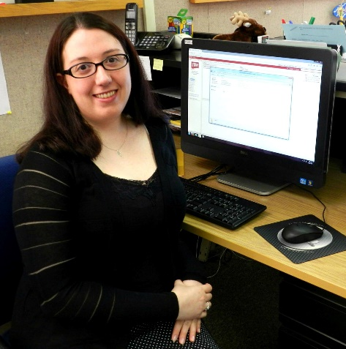
Kathleen jones white writing center
Dr. Dana Driscoll, Director dana.driscoll@iup.edu
Melissa Lutz, Secretary mlutz@iup.edu
web: iup.edu/writingcenter twitter: @IUPWriting Facebook: IUPWritingCenter

Slide 9
Writing center
What do we do?
How can we help your students?

Slide 10
What we do
We offer a wide variety of services to support writing:
Individualized tutoring for your students on all aspects of writing, in person or online
Class Workshops on a wide variety of writing topics, led by experienced tutors. Bring your whole class to the Writing Center’s computer lab classroom.
Quiet space for students to work with computers, printers, and writing resources.
Wednesday workshops for the broader campus community
Graduate Editing Service for graduate students who are completing a thesis or dissertation

Slide 11
Why should I Refer students to the writing Center?
Writing center visits impact learning and retention for all students on campus.
Specifically, writing center visits are tied to:
Higher student retention (Bell & Frost, 2012; Reason, 2009)
Higher grades and better course performance (Sailor, 2016)
Increased self-efficacy for writing and other academic tasks (Williams & Tataku, 2011)
Reduction of procrastination (Fritzsche, Young, & Hickson, 2003).
Intellectual, social, and emotional development (Tinto, 2012)

Slide 12
Tutoring for IUP Students
At IUP, we conduct over 4000 tutorials a year for students of all majors and levels. These tutorials not only help writers, but also retain students at IUP.
Your support matters! 65% of students who visit the IUP Jones White Writing center are referred by faculty.

Slide 13
Writing center
Developing quality writing assignments

Slide 14
How students view writing assignments
Tutors ask students for the assignment sheet.
Assignment sheets help shape the session.
Confusion about assignments can over-power a session.
Let’s look at a few examples. Jot down your immediate impressions.

Slide 15
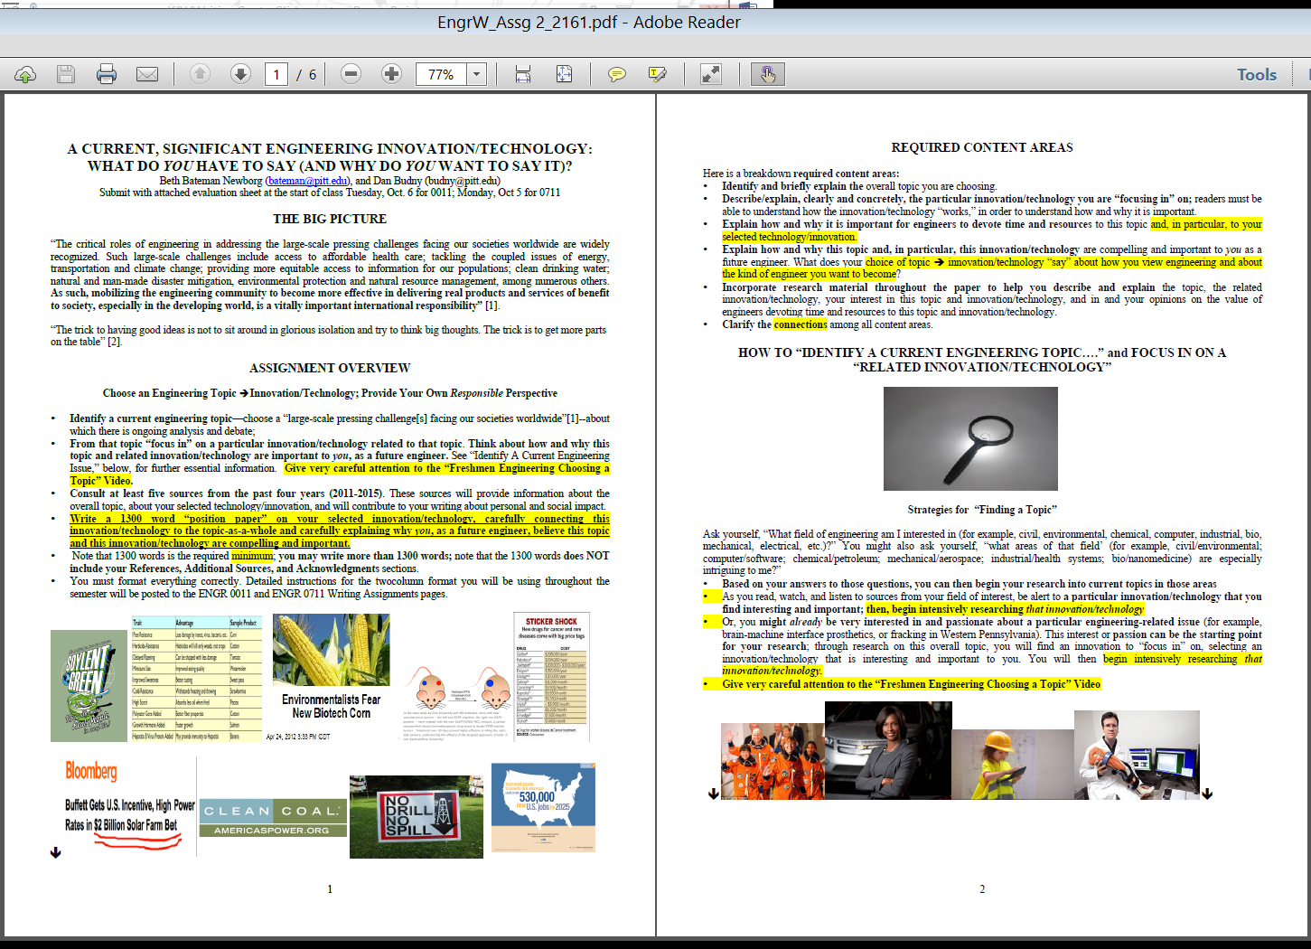
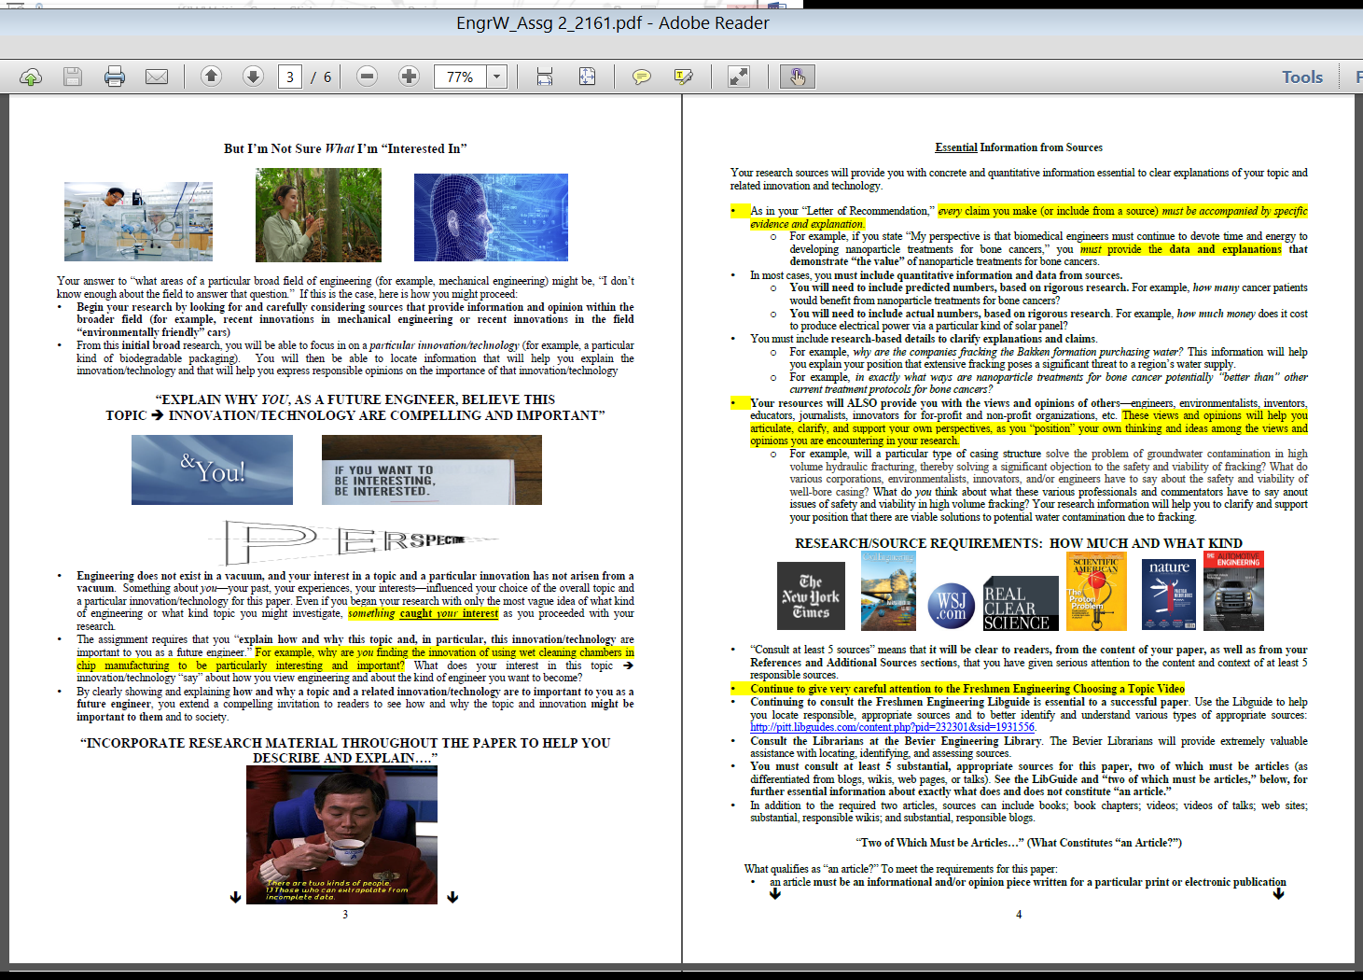
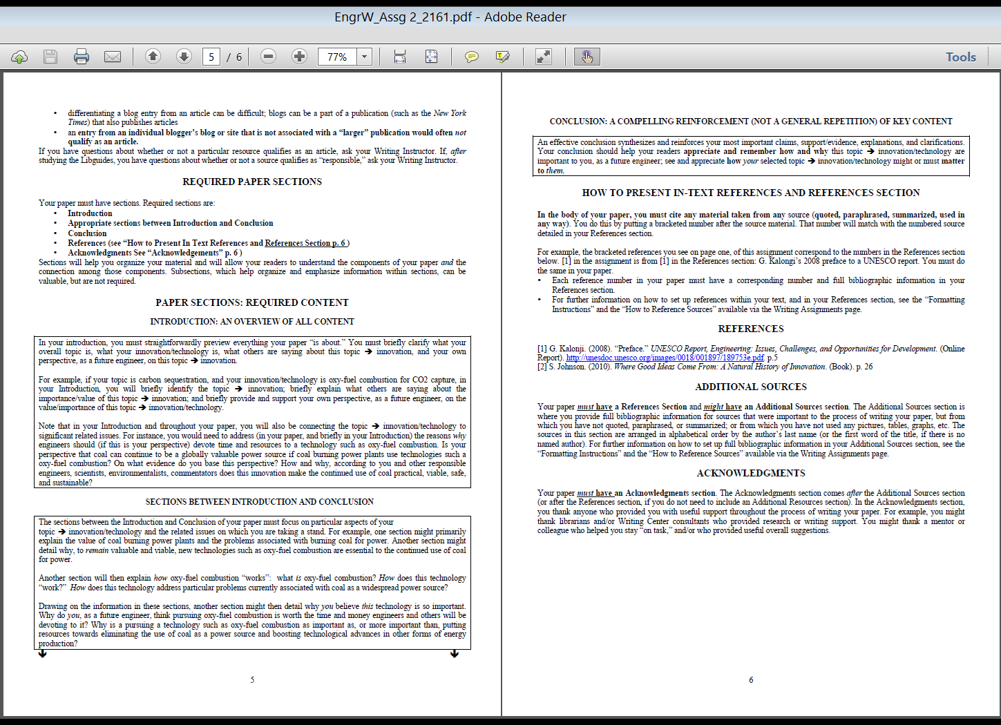
Assignment Sheet from an
Engineering course

Slide 16
How students view assignment sheets
Tutors said…
Sensory overload!
I hope the student can summarize the assignment.
Way too much information at once
This is frustrating because the whole session could easily be taken up with just figuring out the assignment (when the student is hoping to get to other things as well, like writing!).

Slide 17
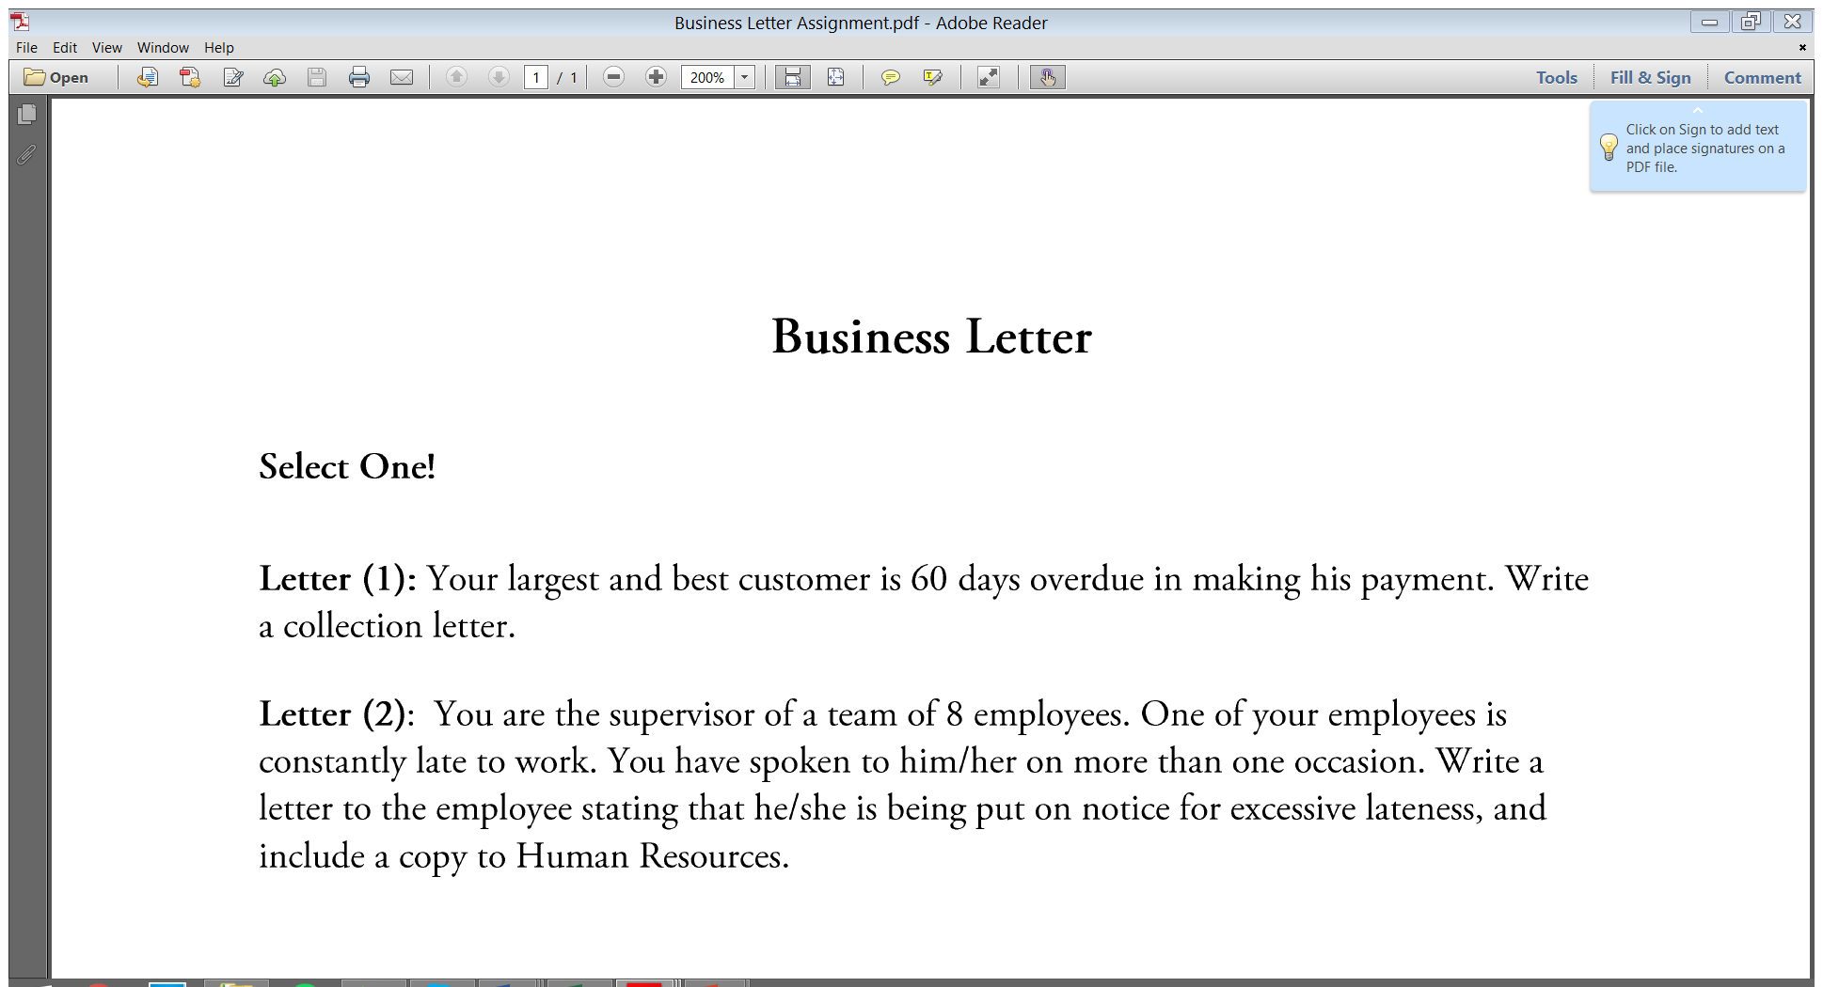
Teach. Write. Teach Writing.

Slide 18
How students view assignment sheets
Tutors said…
What’s a collection letter?
What are the conventions of a business letter?
Professor’s contact information?
How is this assignment going to be evaluated? Is there a rubric?

Slide 19
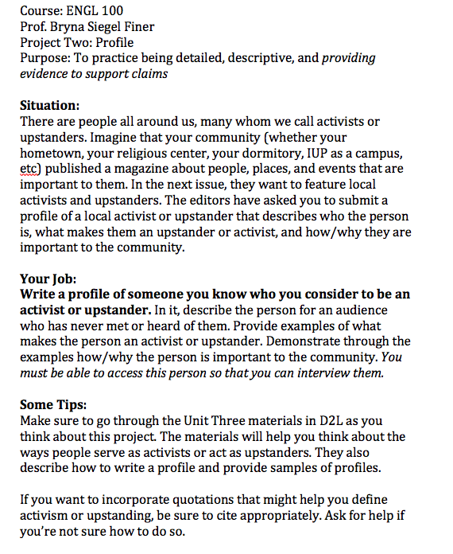
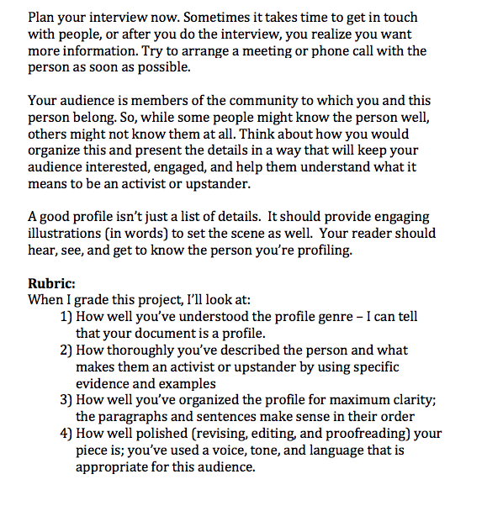

Slide 20
How students view assignment sheets
Tutors said…
Audience is clear
Purpose of assignment is clear
The bullet points are helpful
Manageable length and amount of information (2 pages or under)
Yay! There’s a rubric!

Slide 21
How TUTORS use assignment sheets
Throughout the writing process in:
Understanding assignment
Brainstorming
Planning
Researching
Drafting
Revising
Editing
Evaluation

Slide 22
Assignment Sheet suggestions
Clarify audience and purpose of assignment
Keep assignment sheets under two pages
Offer models for students to follow
Offer clear grading criteria and rubrics
Offer information in a scannable, easy to read format

Slide 23
What we know about student work habits
Some write last minute, but not all (or even most).
Some are really good planners/outliners, but then struggle to compose.
Many are juggling multiple writing assignments at once.
Many students are engaged in writing projects outside of course assignments.
We see students fairly consistently throughout our hours.
Sunday and Wednesday nights are usually busier.
We tend to get busier every 3-4 weeks when papers are due and at the end of the semester.

Slide 24
Common concerns for Student Writing
Talking about writing and terminology shifts between classes
Organization or “how should I set it up?”
MLA, APA, CSE, Chicago, or amended version professor prefers?
Style and Sentence Level Prose
Active vs. passive voice
Third person vs. first person
Grammar
Importance of conciseness
Word choice and clarity

Slide 25
Common concerns for Student Writing
Talking about writing and terminology shifts between classes
Organization or “how should I set it up?”
MLA, APA, CSE, Chicago, or amended version professor prefers?
Style and Sentence Level Prose
Active vs. passive voice
Third person vs. first person
Grammar
Importance of conciseness
Word choice and clarity

Slide 26
Questions or Comments
Please be in touch!
Dana: dana.driscoll@iup.edu
Bryna: brynasf@iup.edu

