Slide 1
Welcome!

Slide 2
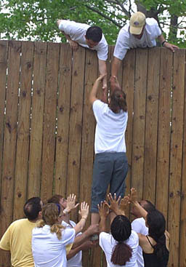
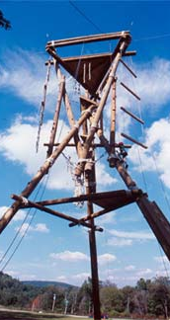
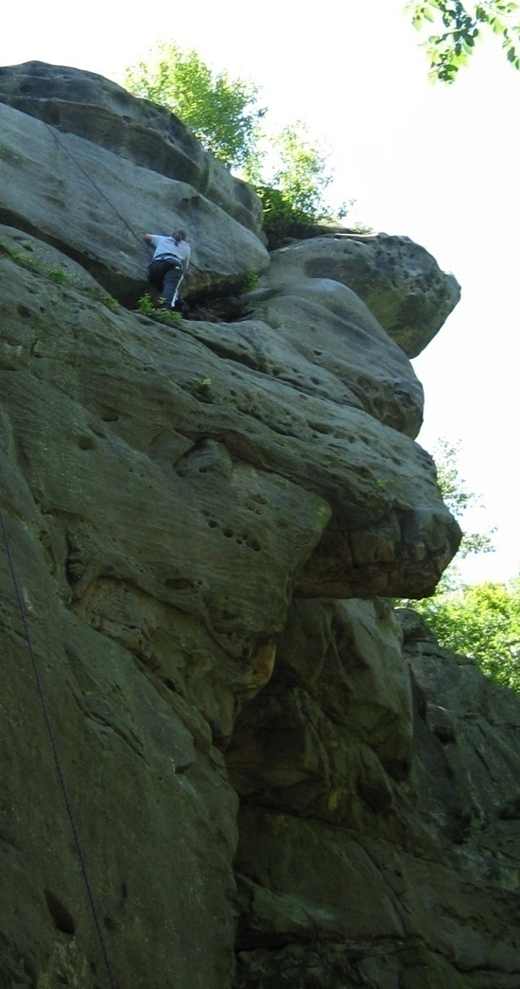
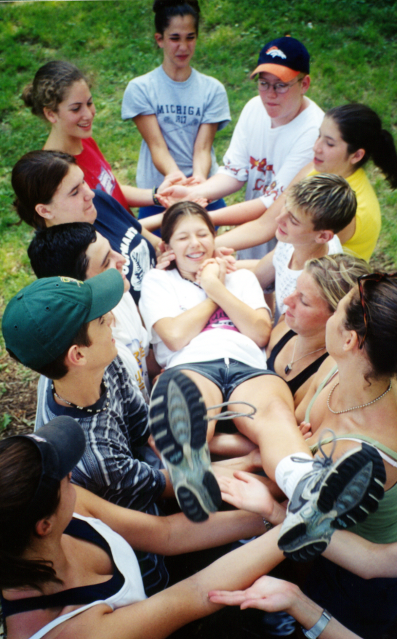

Slide 3

Today’s Agenda
It’s going to be a fast-paced and fun-filled day!
Begin with activities because it’s early and we need to wake up!
PowerPoint presentation on Teams with Discussion
Interpersonal & Leadership Assessments
Lunch!
More activities
Debrief

Slide 4

What is a Circle?

Slide 5

What is a Circle?
Why did we do this activity?

Slide 6
Animal Toss
Name Cards

Slide 7
Get-To-Know-You-Bingo

Slide 8
Communication in Teams
Is a group the same as a team?
A team …
is a unit of two or more people who work together to achieve a goal.

Slide 9


Good or Bad team experiences?

Slide 10
What are the Advantages of Teams?
Increased information and knowledge
Increased diversity of views
Increased acceptance of a solution
Higher performance levels
Synergy & Creativity

Slide 11
What are the Disadvantages?
Unproductive, frustrating, or counterproductive
Hidden agendas
Free riders
Groupthink
How does this happen?
Consensus v. Compromise
How are these words different?

Slide 12
Define a Team Contract
The Five Finger Rules, general

Slide 13
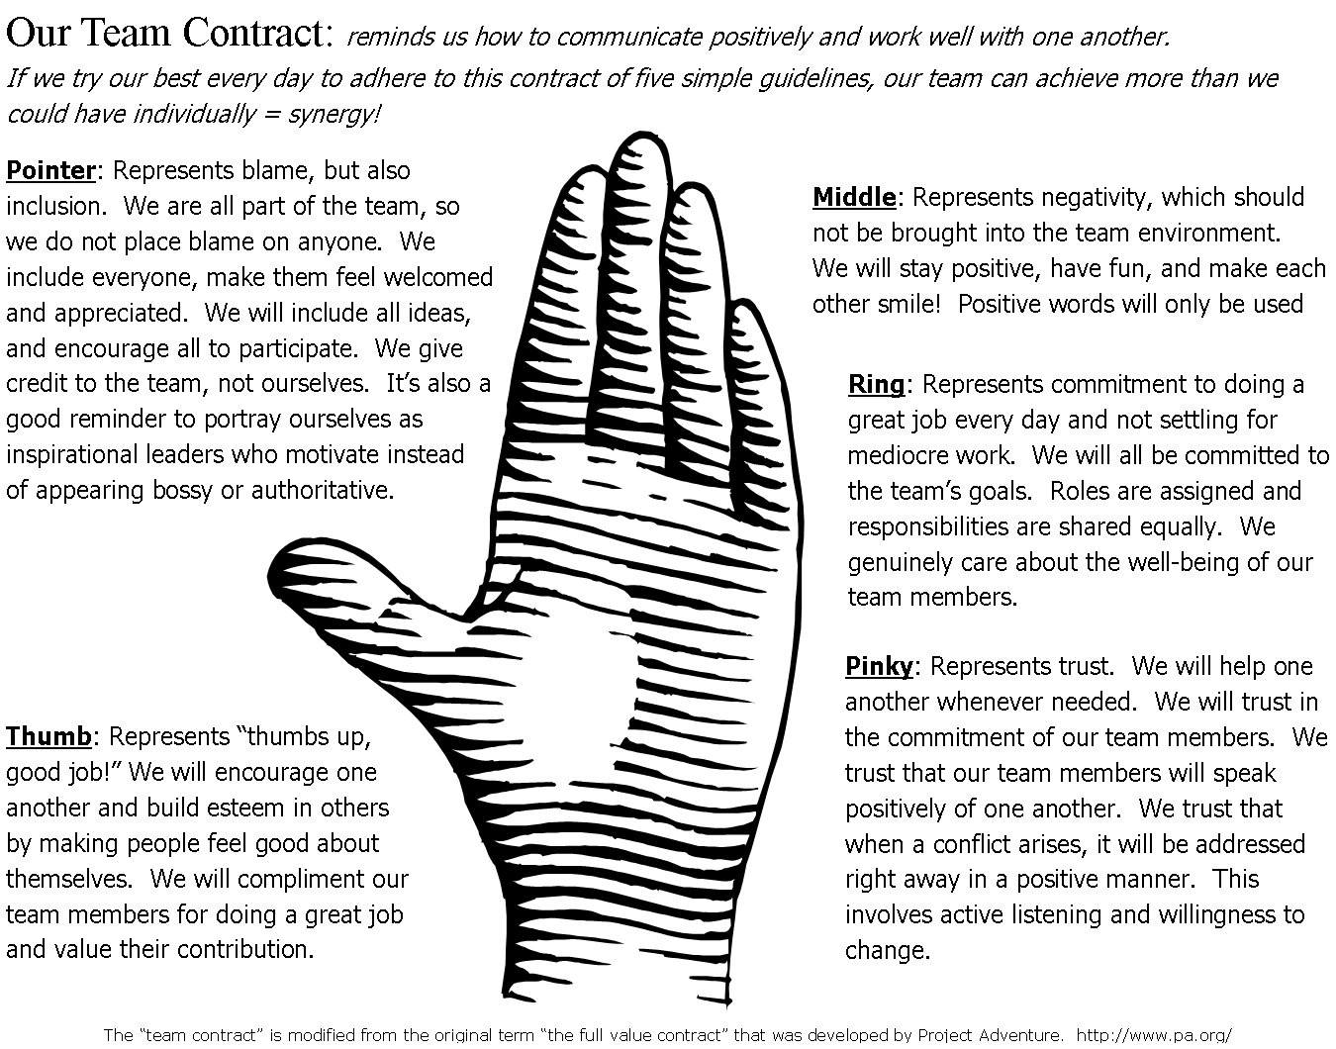

Slide 14
Developing an Effective Team
Clear sense of purpose
Open, honest communication
Decision by consensus
Creative thinking
Focused on core issues
Set Goals
Define Roles
Positive Deviants Encouraged

Slide 15

Effective Teamwork
Create an agenda & assign duties
Keep notes on meetings
Stay on track
Encourage participation
Build esteem in team members
Check whether the team contract is being upheld

Slide 16
Effective Teamwork
How should you treat others?
The golden rule?
Or the platinum rule?
Liebowitz, J., Managing a Diverse Workforce, Employee Training & Development Lecture, Duquesne University: 2004

Slide 17
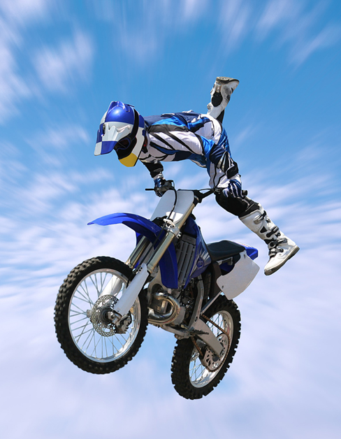
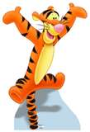
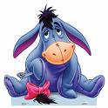
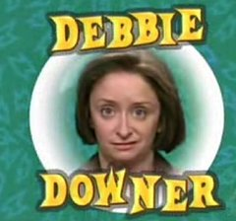
Emotional Intelligence
Be sincere,
Be trustworthy,
Be passionate,
Be dramatic,
Be likable,
Be enthusiastic,
Be energetic,
Be fun,
Be empathic,
Be optimistic,
Be aware of others,
Be a service to others,
Be inspiring,
Be courageous,
Be kind.
Don’t be a Debbie Downer!
Video 1

Slide 18

Team Evolution
Orientation
Conflict
Brainstorming
Emergence
Reinforcement
Forming
Storming
Norming
Performing
Adjourning

Slide 19

Snowflakes
Personal Goal: To Maintain
Intense professional will to achieve team goals (rather than one’s own personal achievement), and
Very high standards, combined with
Personal humility and modesty

Slide 20
Understanding Conflict
Is conflict always bad?
1. No! Conflict brings out new perspectives and can be handled in a positive manner.

Slide 21
Resolving Conflict
Pro-action
Communication
Openness
Research
Flexibility
Fair Play
Alliance

Slide 22
Overcoming Resistance
Express understanding: sympathize
Make people aware of their resistance: without blaming, or causing defensiveness
Evaluate others’ objections fairly: talk it out, discover underlying issues
Hold your arguments until the other person is ready: their needs come first, self blame

Slide 23

Nonverbal Communication
Is the interpersonal process of sending and receiving information, both intentionally and unintentionally, without using written or spoken language
Can strengthen a verbal message, weaken a verbal message, or replace words entirely
Includes facial expression, gestures, posture, personal appearance

Slide 24

Conclusion
If you do not consider yourself a “team player” then you need to create a personal development plan to improve these skills because,
Working effectively in teams is required for success in ANY field;
The first step is self-awareness, the next step is practice. (Pencil Activity)

Slide 25
References
Baker, W. and M. O’Malley. Leading with Kindness, New York, NY: Amacom, 2008.
Blake, R., J. Mouton, et al. Change by Design, Reading MA: Addison-Wesley, 1989.
Collins, J. Good to Great, New York, NY: HarperCollins, 2001.
Goleman, D., R. Boyatzis, et al. Primal Leadership, Boston, MA: Harvard Business School Press, 2004.
Hackman, J. “Why Teams Don’t Work” Harvard Business Review, Vol. 87, No. 5, May 2009.
Miller, B. Quick Team-Building Activities for Busy Managers, New York, NY: Amacom, 2004.
Pausch, R. and J. Zaslow. The Last Lecture, Hyperion, New York, NY: 2008.
Project Adventure. <www.pa.org>
Rohnke, C. Cowstails and Cobras 2: A Guide to Games, Initiatives, Ropes Courses & Adventure Curriculum, Kendall/Hunt, Dubuque, IA:1980
The Adventure Group. <www.theadventuregroup.com>
Thill, J. V. & Bovée, C. L. Excellence in Business Communication (8th ed), United States: Pearson/Prentice Hall, 2008.
Whitney, D., A. Tosten-Bloom, et al. Appreciative Team Building, New York, NY: iUniverse, Inc., 2004.

