Slide 1


Starting Your Best Year Ever: Communicating the Syllabus Clearly to Students
Dr. Veronica Paz
Dr. Evelyn (Lynnan) Mocek

Slide 2
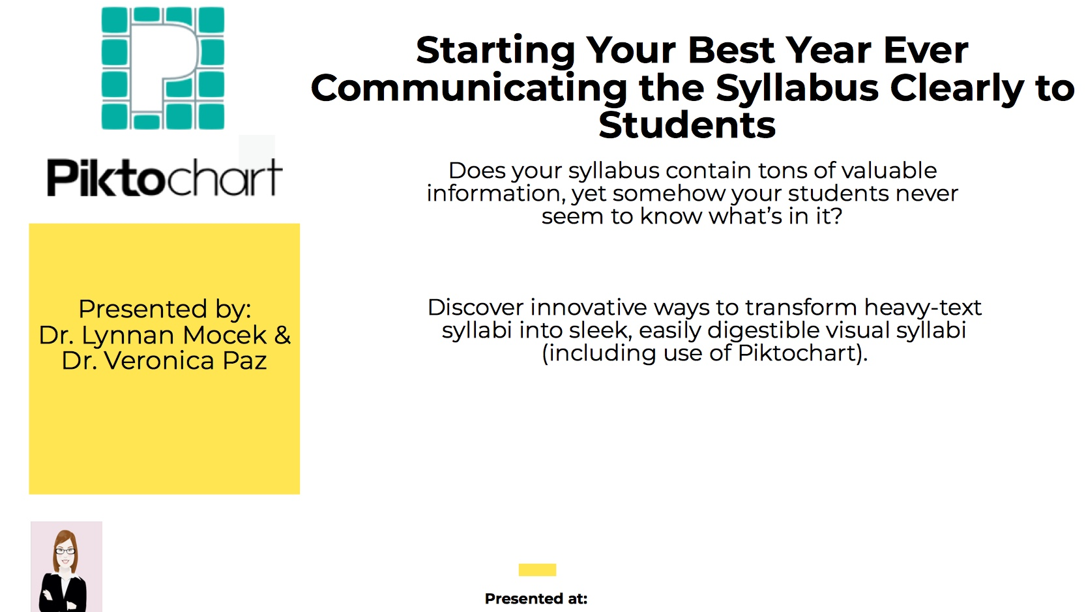

It’s in the SYLLABUS!

Slide 3
What Will We Cover Today
Why Syllabus Infographics
Info Syllabus Template
Sample Accounting
Creation of Infographic

Slide 4
What Will We Cover Today
Why Syllabus Infographics
Info Syllabus Template
Sample Accounting
Creation of Infographic

Slide 5
What Will We Cover Today
Why Syllabus Infographics
Info Syllabus Template
Sample Accounting
Creation of Infographic

Slide 6
What Will We Cover Today
Why Syllabus Infographics
Info Syllabus Template
Sample Accounting
Creation of Infographic

Slide 7
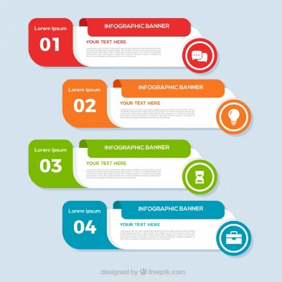
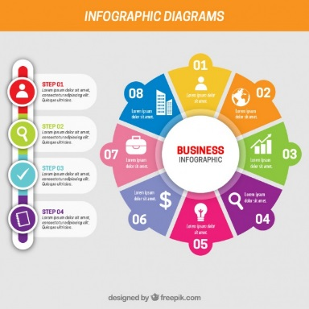

What is an Infographic
Infographics use a visual shorthand which allows individuals to quickly and efficiently gain knowledge. Complex concepts are communicated in a fast and easily understood manner.
We see infographics everyday and throughout history.
  Pioneer Plaque sent into space 1972 designed to be understood by beings with no common language with humans
  Look at any US News and World Report – there are graphs to help understanding of data.
Earliest use to provide information was Florence Nightingale titled Rose - Illustrated death rate of soldiers by poor sanitation vs enemy action during Crimea War.

Slide 8

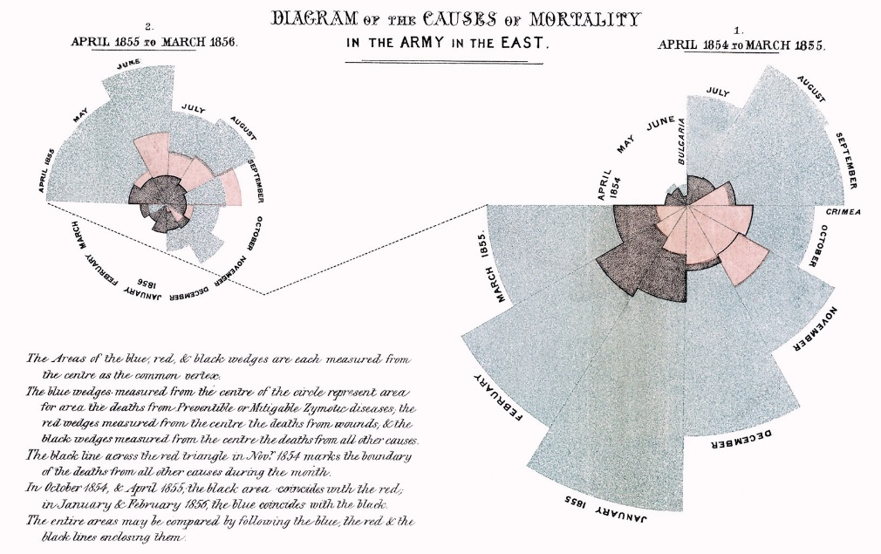

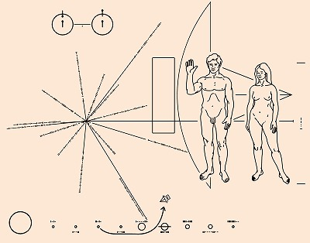
Examples

Slide 9
Three Considerations with Infographics
It must Appeal to the Intended Audience
Information must be Clear and Understandable
Design impacts User perception and how the judge and use the information
Notes:
Current students in HE are “net generation” – expect to be engaged by environment with a participatory, sensory rich activites – more oriented to visual media

Slide 10
Three Considerations with Infographics
It must Appeal to the Intended Audience
Information must be Clear and Understandable
Design impacts User perception and how the judge and use the information
Notes:
Graphic messaging, using visual images, follows similar principles of verbal and textual communication related to message design
Infographics instruct, inform, illuminate, and communicate complex concepts in a manner that is fast and easily understood

Slide 11
Three Considerations with Infographics
It must Appeal to the Intended Audience
Information must be Clear and Understandable
Design impacts User perception and how the judge and use the information
Notes:
A good design communicates the message and ideas in a functional and aesthetically pleasing manner. The point of view within an image can change the emotional response to the presented material. An example of the effective use of point of view can be found in political images of an opponent where the photo is looking down on the subject matter, thus giving the perception of smaller and less important. Aesthetics such as point of view act as the bridge between emotions and the visual image

Slide 12
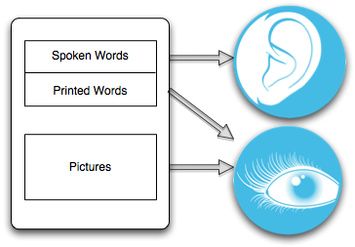
Research Suggests
When considering
how individuals
use graphics to
enhance learning
there are a
number of theories
that apply.

Slide 13
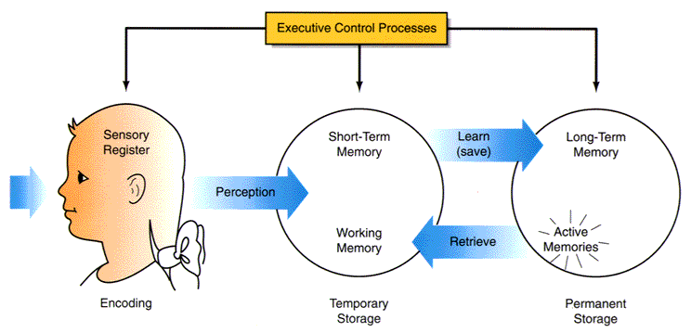
Information Processing Theory
George Miller – 1956 – Individuals can only hold
5–9 pieces of information in short-term memory
Notes:
Information processing theory has become a general theory of human cognition. The concept regarding the limited nature of information processing within short term memory has become a foundational element of subsequent theories of memory.

Slide 14
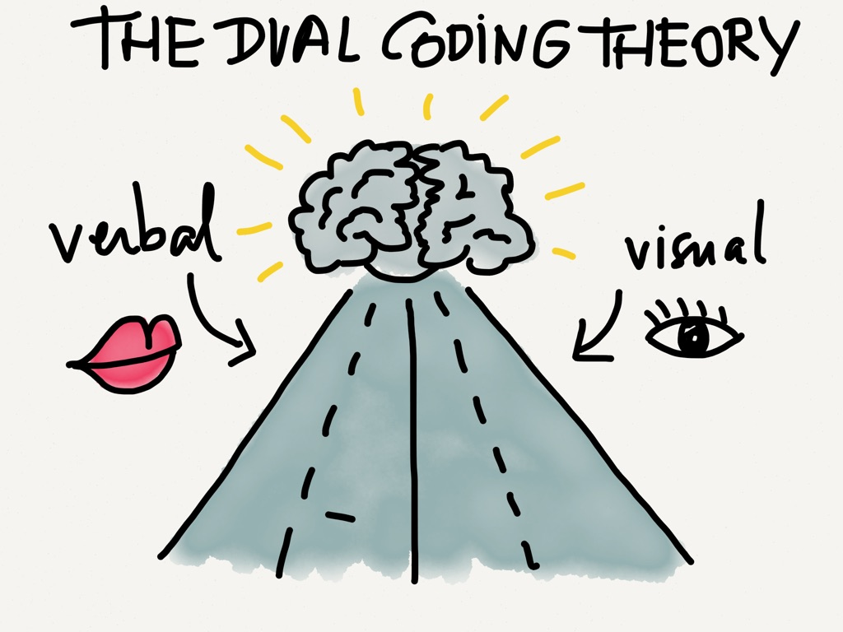
Dual Coding Theory
Alan Pavio – 2014
There are two ways
Individuals receive
messages for learning
Verbal
Visual
Note: theory only
Concerned with
Response to stimulus
Notes:
The focus is upon the representational structures that deal with the verbal and visual stimuli.
Representational units that are generated consciously from words and images are term as:
Logogen – verbal – sequential and hierarchical in nature e.g. progress from letters to words to sentences and beyond.
Imagen – pictorial representation.
This theory is specifically concerned with the way information is learned and how it is presented either visually or verbally, Dual Coding Theory does not take into account that the cognition processing may be impacted by something other than words and images.

Slide 15
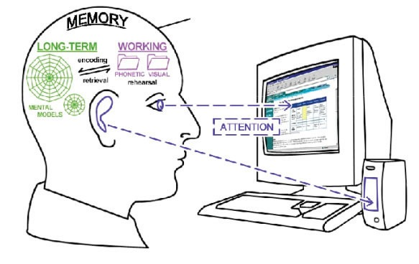
Working Memory Theory
Alan Baddeley &
Graham Hitch – 1974
Focus is on the
Processing of the
Verbal or visual
Information and the
Storage of information
Notes:
Working memory is what was previously termed as short term memory and is very small in capacity. The differences between working memory and long-term memory is that working memory is under conscious control and has limited capacity for storage and the information is maintained only for a finite period of time; whereas long-term memory has unlimited capacity, however, is not under conscious control of the individual.

Slide 16
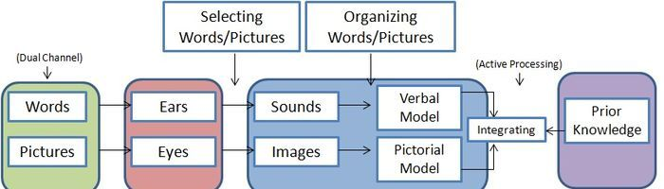
Cognitive Theory of Multimedia Learning
People learn and retain information better when words and pictures are presented together. The theory assumes that the human mind uses two information processing systems, one for visual information and one for verbal.
Presenting materials in both text and pictures allows the brain and learner twice the opportunity and exposure to information.
Notes:
People must create mental associations or representations for the information for multimedia learning to occur. People learn and retain information better when words and pictures are presented together and that learning is measured by the retention of information and transfer of learning to new tasks. CTML assumes that the human mind uses two information processing systems, one for visual information and one for verbal. Presenting materials in both text and pictures allows the brain and learner twice the opportunity and exposure to information. Deeper understanding and learning occurs when students are able to connect information from both verbal and pictorial representations. Thus, students learn deeper from multimedia explanations than one from a single source, specifically verbal.

Slide 17
Example via Newton’s Second Law of Motion
Text based
Newton's second law of motion can be formally stated as follows: The acceleration of an object as produced by a net force is directly proportional to the magnitude of the net force, in the same direction as the net force, and inversely proportional to the mass of the object

Slide 18
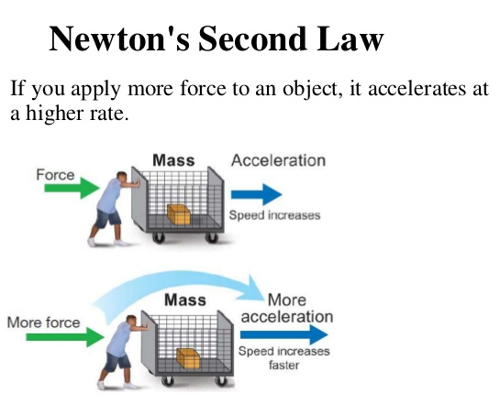
Example via Newton’s Second Law of Motion
Infographic

Slide 19
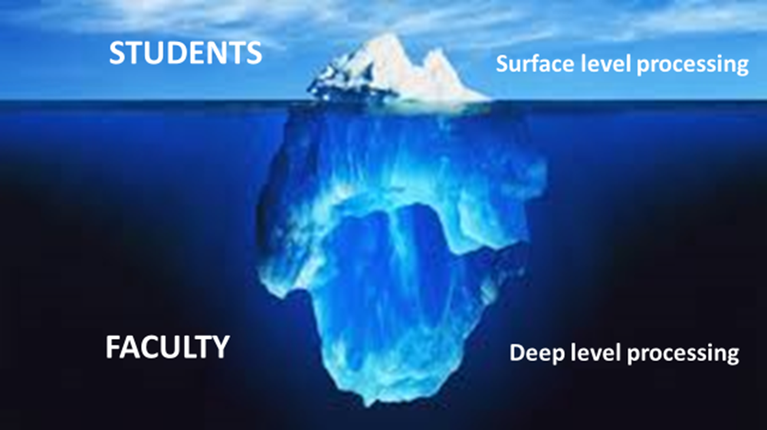

Syllabus Conundrum
Students have different expectations compared to the faculty who teach the class!

Slide 20
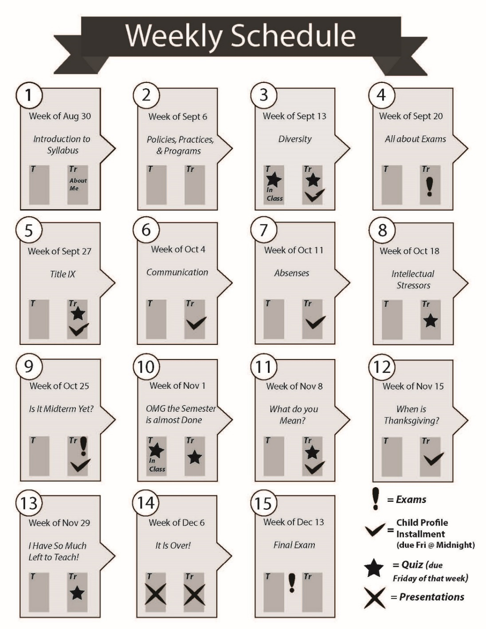

Info Syllabus Template
Notes:
How to do graphs in illustrator
Open new document
Open graph tools – click on arrow on far right of tool bar
Drag and open to the graph on the new sheet
Complete the spread sheet
Copy into document

Slide 21

Access Info Syllabus Templates
Templates are accessible via www.AccountingTeachingTools.com
Notes:
Students expect dynamic interactions with instructor and course material
First impression
Primarily used by students as reference and time management tool
Preferred syllabus design that highlights areas of interest – not information found at other sources
BUT THEY DON’T READ IT

Slide 22
Adobe Ilustrator
Practice Activity with templates
Note – templates are copywritten under Creative Commons, allowing you to change the information but not the format

Slide 23





Free Tools
Free Tools
Visme
https://www.visme.co/
Infographics Online
Canva:
graphics, flyers,
Easy to use infographic and chart maker
Vizualize.me:
Make infographics resume in one click.
Biteable
https://biteable.com/
infographics
https://www.canva.com/
https://infogram.com/
vizualize.me/
1000's of templates & graphics.
PowerPoint Templates
Infogram

Slide 24

Piktochart
Free but $39 a year to access all templates
All of the infographics created by Dr. Paz are done using Piktochart
www.pitkochart.com

Slide 25
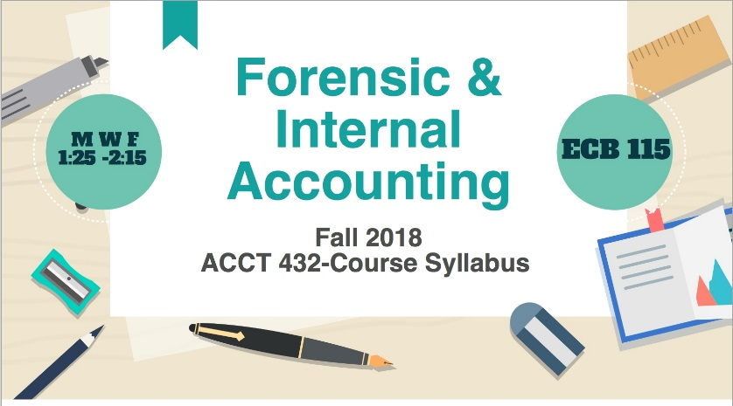

Sample Accounting Infographics
Notes:
Students expect dynamic interactions with instructor and course material
First impression
Primarily used by students as reference and time management tool
Preferred syllabus design that highlights areas of interest – not information found at other sources
BUT THEY DON’T READ IT

Slide 26
Piktochart
Your opportunity to try Piktochart
Note – the infographic will not be printer friendly as it is quite long.
https://piktochart.com/

Slide 27

New Tool Microsoft Sway
Notes:
Students expect dynamic interactions with instructor and course material
First impression
Primarily used by students as reference and time management tool
Preferred syllabus design that highlights areas of interest – not information found at other sources
BUT THEY DON’T READ IT

Slide 28
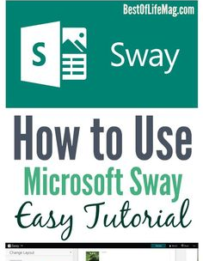
Creation of Sway Infographic
Part of our Office 365 Account
Notes:
Students expect dynamic interactions with instructor and course material
First impression
Primarily used by students as reference and time management tool
Preferred syllabus design that highlights areas of interest – not information found at other sources
BUT THEY DON’T READ IT

Slide 29
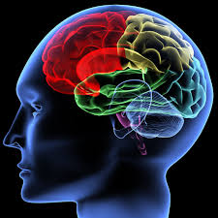
Final Thoughts

Slide 30
Contacting the Presenters
Dr. Veronica Paz Associate Professor of Accounting Email: vpaz@iup.edu Google Scholar: https://scholar.google.com/citations?user=NzMxKv4AAAAJ&hl=en LinkedIn: https://www.linkedin.com/in/drpaz/ Cell: 724-590-9164 | Dr. Lynnan Mocek (Evelyn) Exec. Assistant to Provost (IUP) Email: lmocek@iup.edu Google Scholar: https://scholar.google.com/citations?user=QaXYCj4AAAAJ&hl=en Linkedin: www.linkedin.com/in/lynnan-mocek Office: 203 Sutton Hall Indiana University of PA (o) 724-357-3001 (c) 724-599-6251

