Slide 1
SESSION 5
ALL GROUPS

Slide 2
E-Session 5 All Groups-Static Slides
Identifying All Groups
Static Slides
Questions

Slide 3
Session 5 – All Groups
Session Objectives
Identify vehicle condition and performance clues to better predict the actions of other drivers;
Identify clues to changes in vehicle movement;
Identify driver clues that enable one to predict their probable actions;
Identify motorcyclist clues in regard to their probable actions;
Identify bicyclist clues in regard to their probable actions; and
Identify pedestrian clues in regard to their probable actions.
Notes:
Session Objectives
Identify vehicle condition and performance clues to better predict the actions of other drivers;
Identify clues to changes in vehicle movement;
Identify driver clues that enable one to predict their probable actions;
Identify motorcyclist clues in regard to their probable actions;
Identify bicyclist clues in regard to their probable actions; and
Identify pedestrian clues in regard to their probable actions.

Slide 4
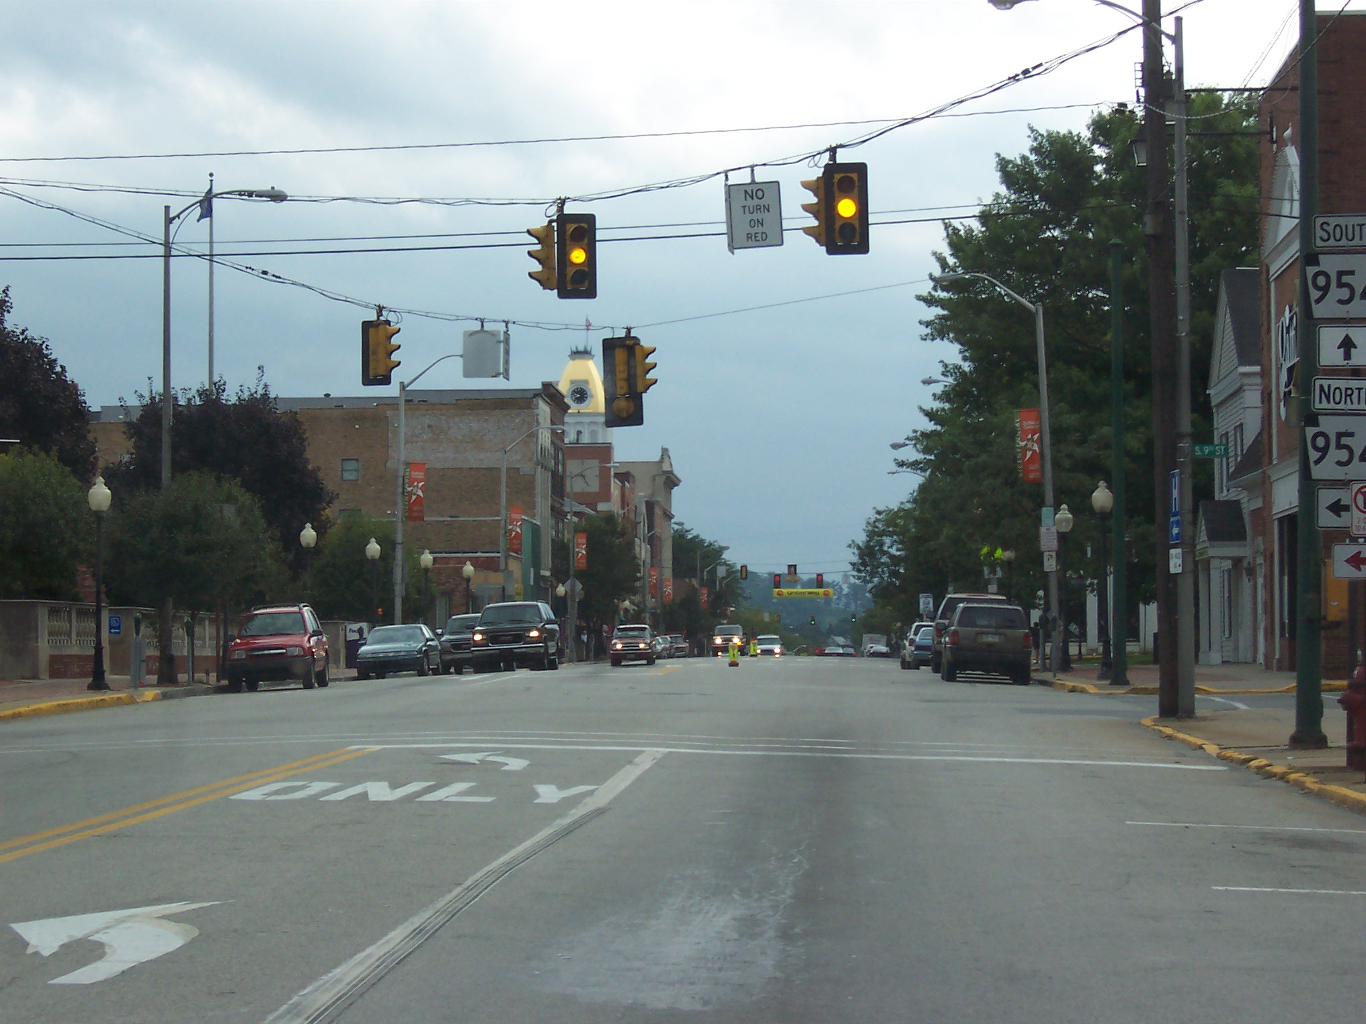
AG-1
Notes:
AG-1 Search for All Groups . . . Ready?

Slide 5
AG – 1 Questions
The traffic light is turning to green? T/F
There is a pedestrian crosswalk ahead? T/F
There is a motorcyclists in your lane? T/F
Notes:
After the slide is on the screen, select individuals to identify the various groups, e.g.
There are stop lines at this intersection.
There is a left turning lane only at this intersection.
Your sighting distance is good.
Once all the groups are identified, ask the following questions:
The traffic light is turning to green? F
There is a pedestrian crosswalk ahead? T
There is a motorcyclist in your lane? F

Slide 6
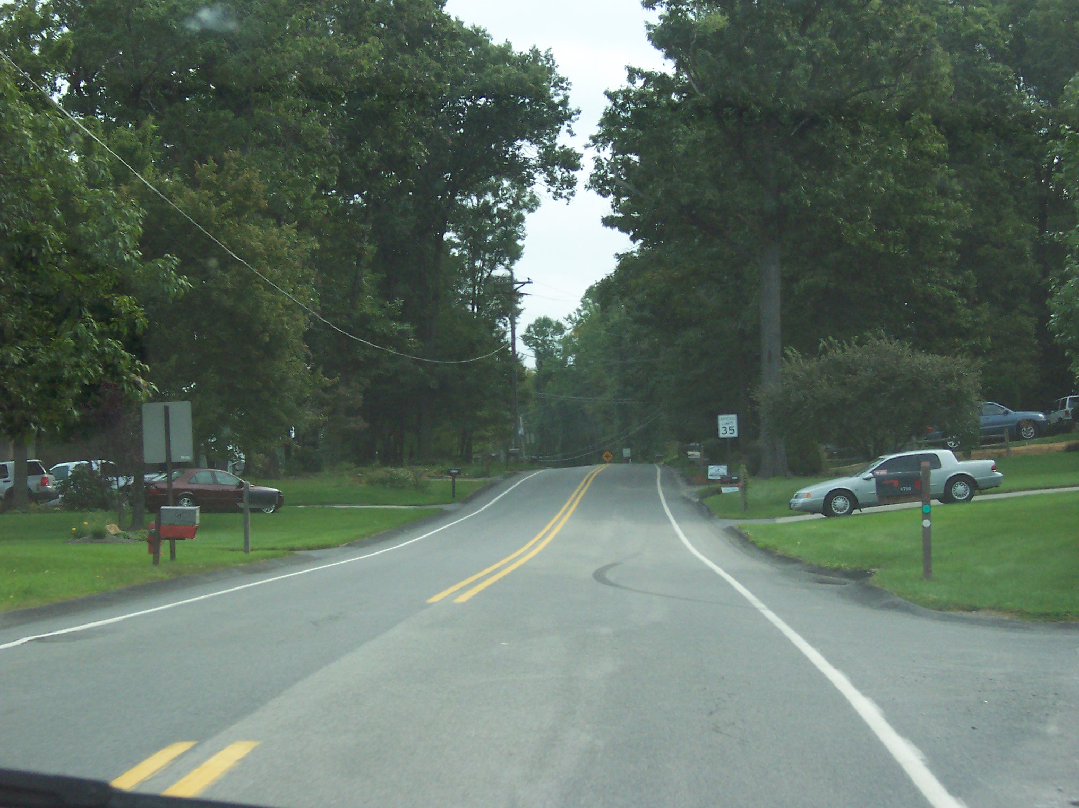
AG-2
Notes:
AG-2 Search for all groups . . . Ready?

Slide 7
AG–2 Questions
You have a good sighting distance? T/F
There is a car pulling out of a driveway ahead? T/F
The roadway is level with the shoulder? T/F
Notes:
After the slide is on the screen, select students to identify the categories
Sighting distance is reduced.
There are driveways to your left and right.
View to the sides is adequate.
Once all the groups are identified, ask the following questions:
You have a good sighting distance?
There is a car pulling out of a driveway ahead?
The roadway is level with the shoulder?

Slide 8
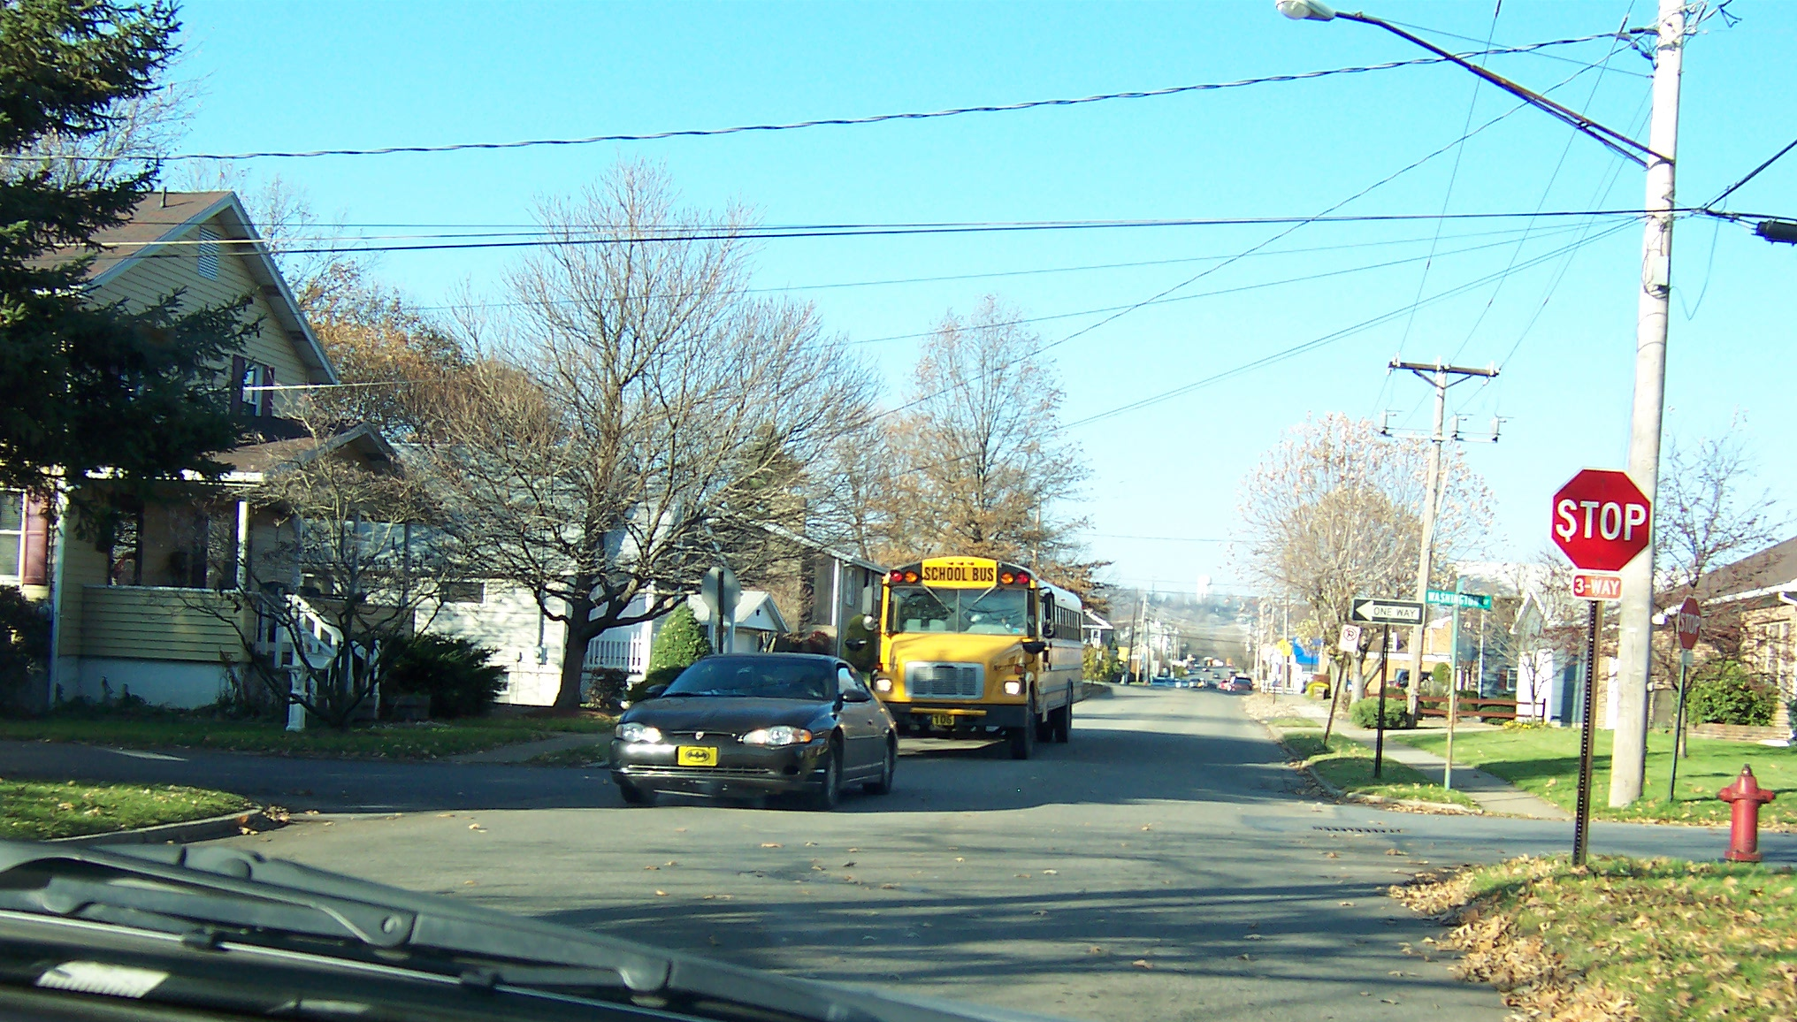
AG-3
Notes:
AG-3
Search for all groups . . . Ready?

Slide 9
AG-3 Questions
There are children standing at the intersection? T/F
The school bus has its lights activated? T/F
The intersection is a three way stop? T/F
Notes:
There are children standing at the intersection? F
The school bus has its lights activated? F
The intersection is a three way stop? T
Put A-3 back on screen for scoring and discussion.
False, there are no children in this scene.
False, the school bus lights are not activated but caution should be given.
True, underneath the stop sign indicates a three way stop.

Slide 10
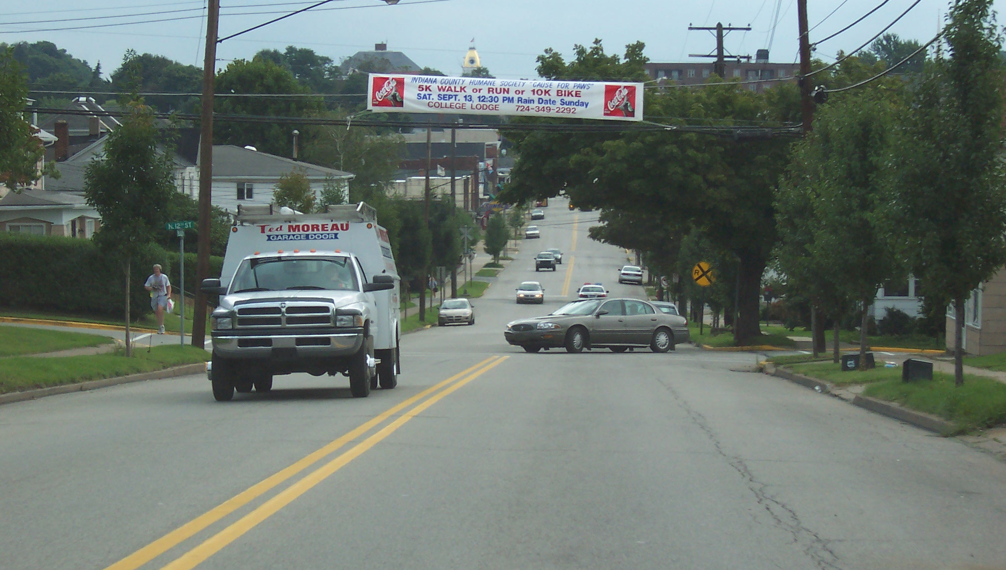
AG-4
Notes:
AG-4
Search for all groups . . . Ready?

Slide 11
AG-4 Questions
There is a pedestrian standing along the right side of the roadway? T/F
The oncoming vehicle has it’s left turn signal on? T/F
The car in your lane ahead is making a left turn? T/F
Notes:
There is a pedestrian standing along the right side of the roadway?
The oncoming vehicle has its left turn signal on?
The car in your lane ahead is making a left turn?
Put A-4 back on screen for scoring and discussion.
False, the pedestrian is standing along the left side of the roadway.
False, the oncoming vehicle is not signaling.
True, the vehicle in your lane is completing a left turn from the side street.

Slide 12
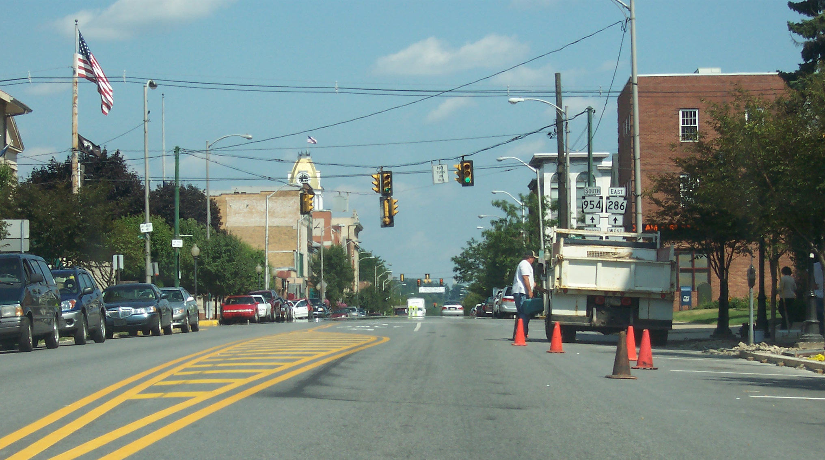
AG -5
Notes:
AG-5
Search for all groups . . . Ready?

Slide 13
AG-5 Questions
The traffic light ahead is turning to red? T/F
You have limited space ahead? T/F
There is a pedestrian standing on the roadway ahead? T/F
Notes:
The traffic light ahead is turning to red? False
You have limited space ahead? True
There is a pedestrian standing on the roadway ahead? True
Put A-5 back on screen for scoring and discussion.
False, the traffic light is green.
True, the space to the side is reduced ahead because of the pedestrian.
True, he is standing next to the parked truck.

Slide 14
End Part 5A
Next: Session 5B
All Groups Videos

