Slide 1
Session Four
Identifying Vehicle Clues and Other Users

Slide 2
D-Session 4B Slides OU 1,2,3,4,
Identifying Vehicle Clues and Other Users
Perception Slides & Videos
Other User Questions

Slide 3
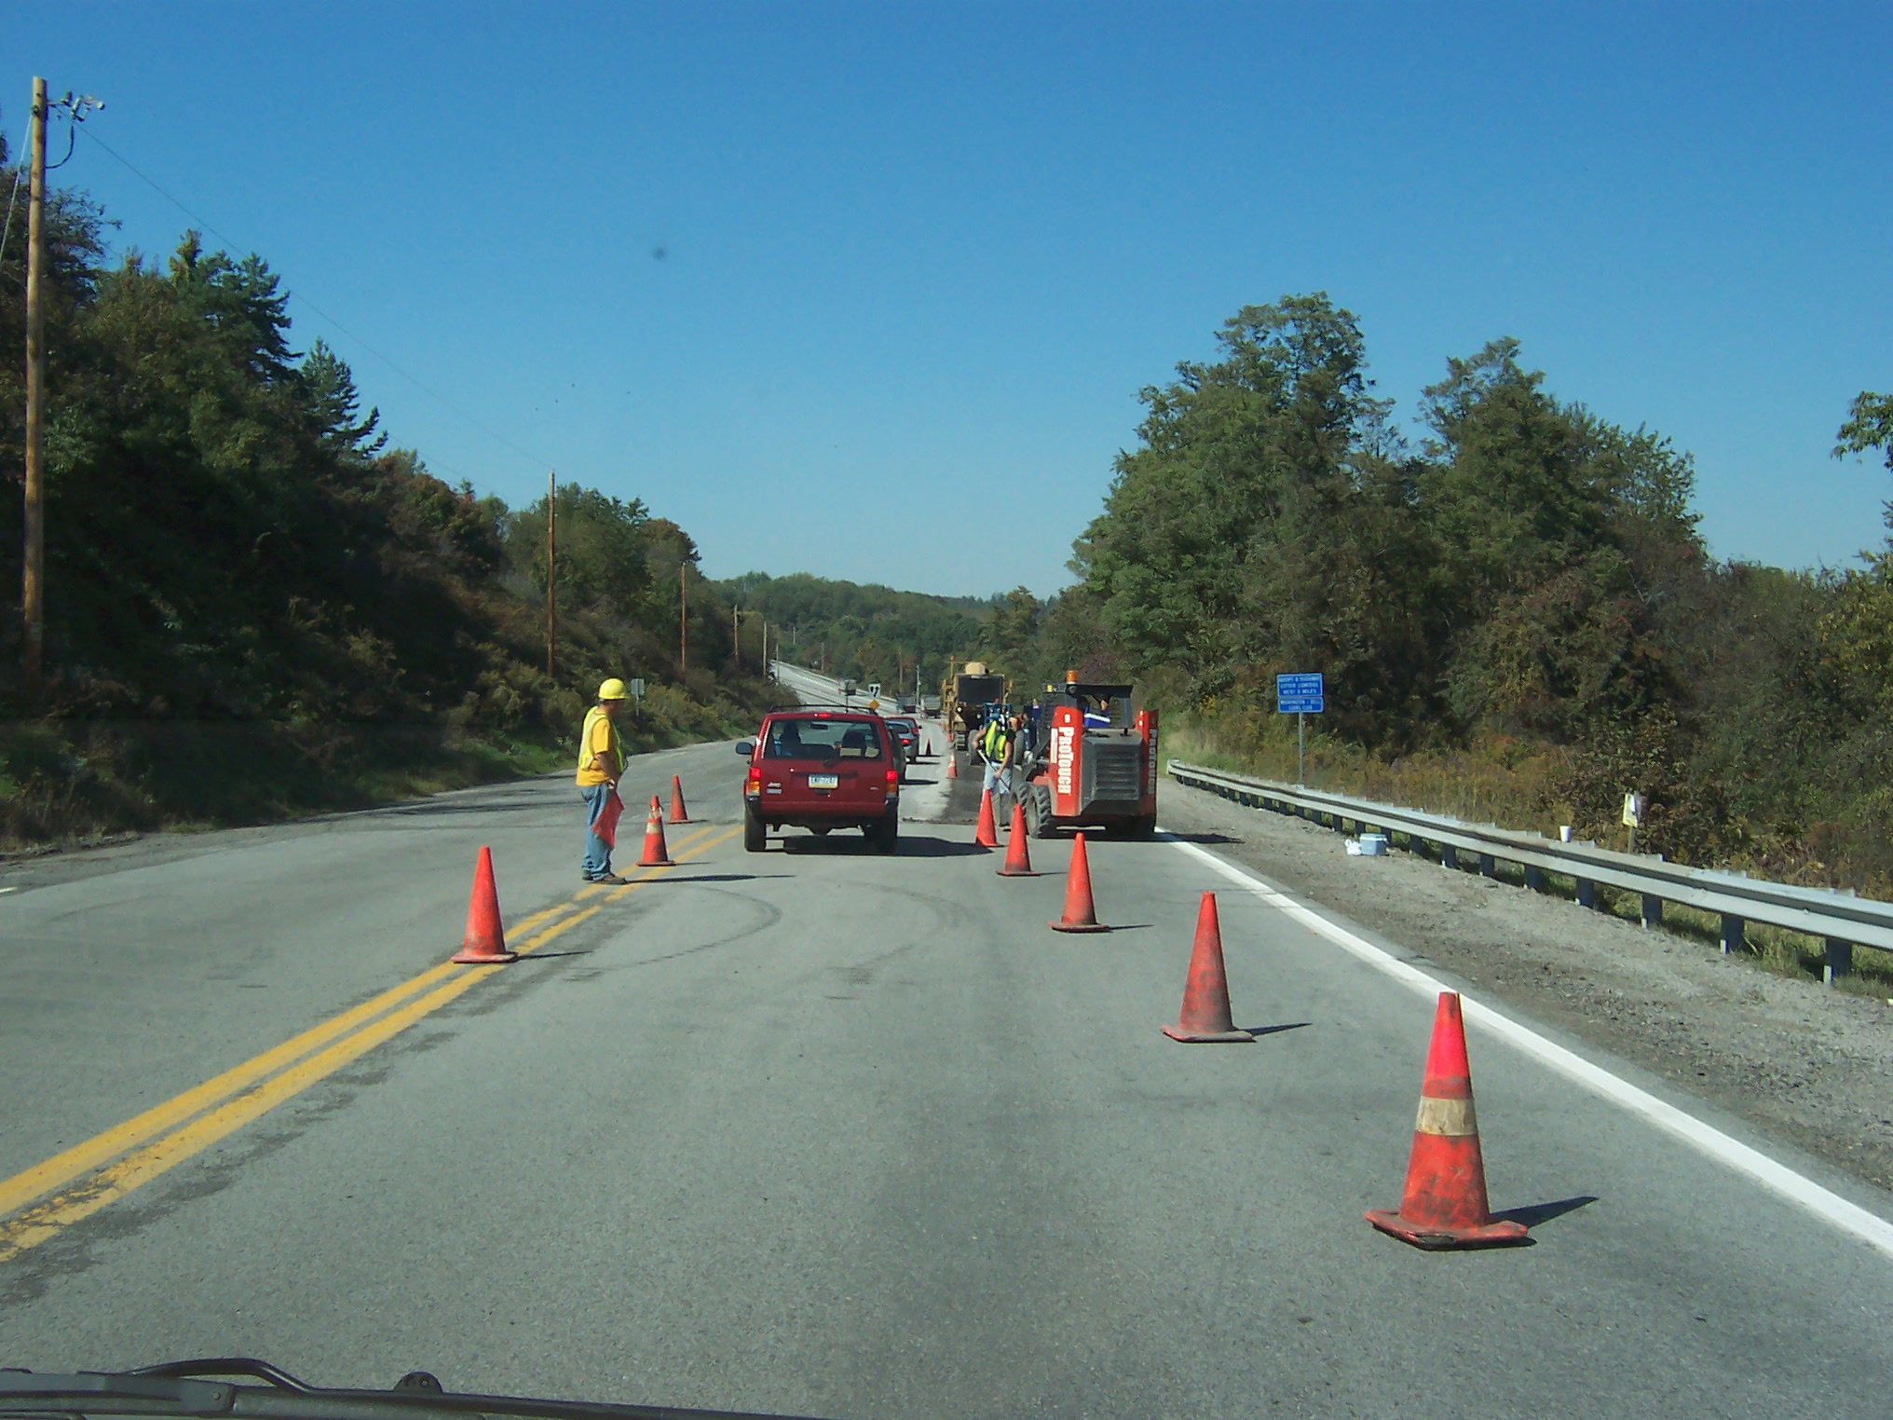
OU-1
Notes:
Look for Clues-Other Users

Slide 4
OU-1 Questions
There are two constructions workers ahead? T/F
The vehicle ahead is braking? T/F
There is a construction vehicle ahead? T/F
Notes:
OU-1 Questions
There are two constructions workers ahead? T/F True-Two are immediately seen
The vehicle ahead is braking? T/F True-Brake lights are visible
There is a construction vehicle ahead? T/F True- There are several to the right.

Slide 5
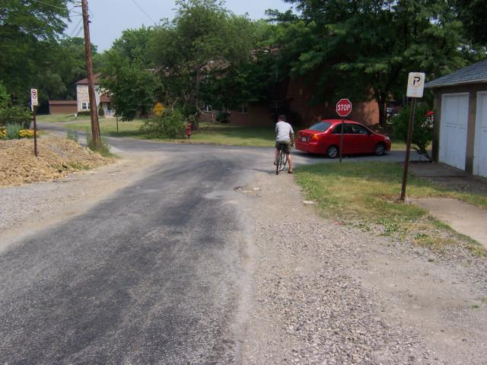
OU-2
Notes:
Search for clues to other users-Ready? Go

Slide 6
OU-2 Questions
There is a pedestrian walking along the side street ahead? T/F
There is a bicyclist coming towards you? T/F
There is a motorcycle at the intersection ahead? T/F
Notes:
OU-2 Questions
There is a pedestrian walking along the side street ahead? T/F False-No pedestrian
There is a bicyclist coming towards you? T/F False-Cyclist is travelling in same direction
There is a motorcycle at the intersection ahead? T/F False-No motorcycle

Slide 7
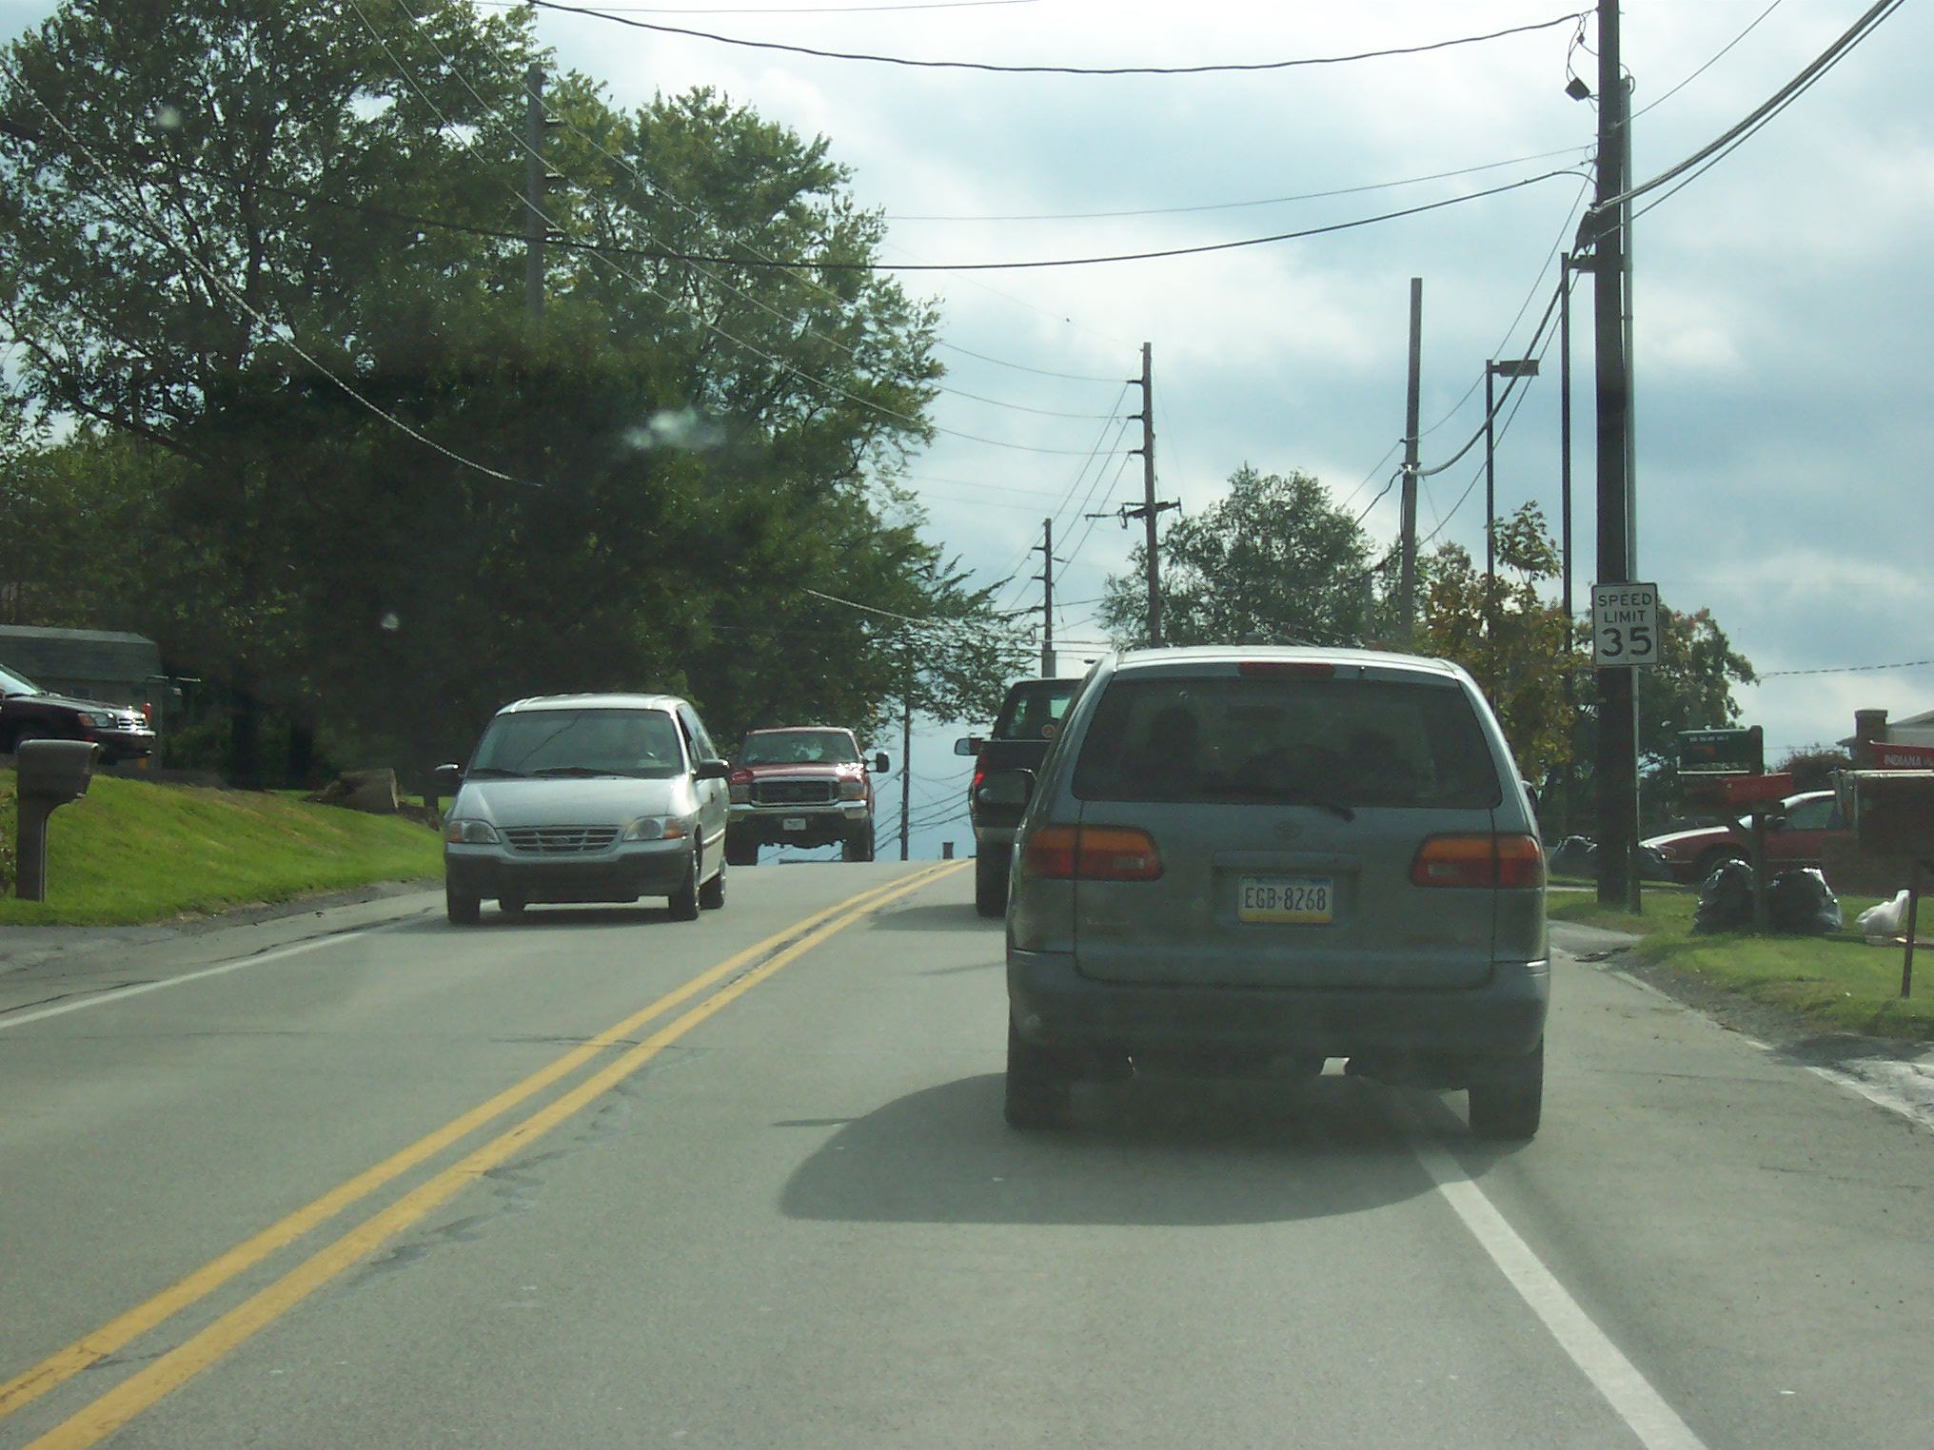
OU-3

Slide 8
OU-3 Questions
There is an oncoming motorcyclists? T/F
The vehicle ahead is centered in their lane? T/F
There is a pedestrian walking along the right side of the roadway? T/F

Slide 9
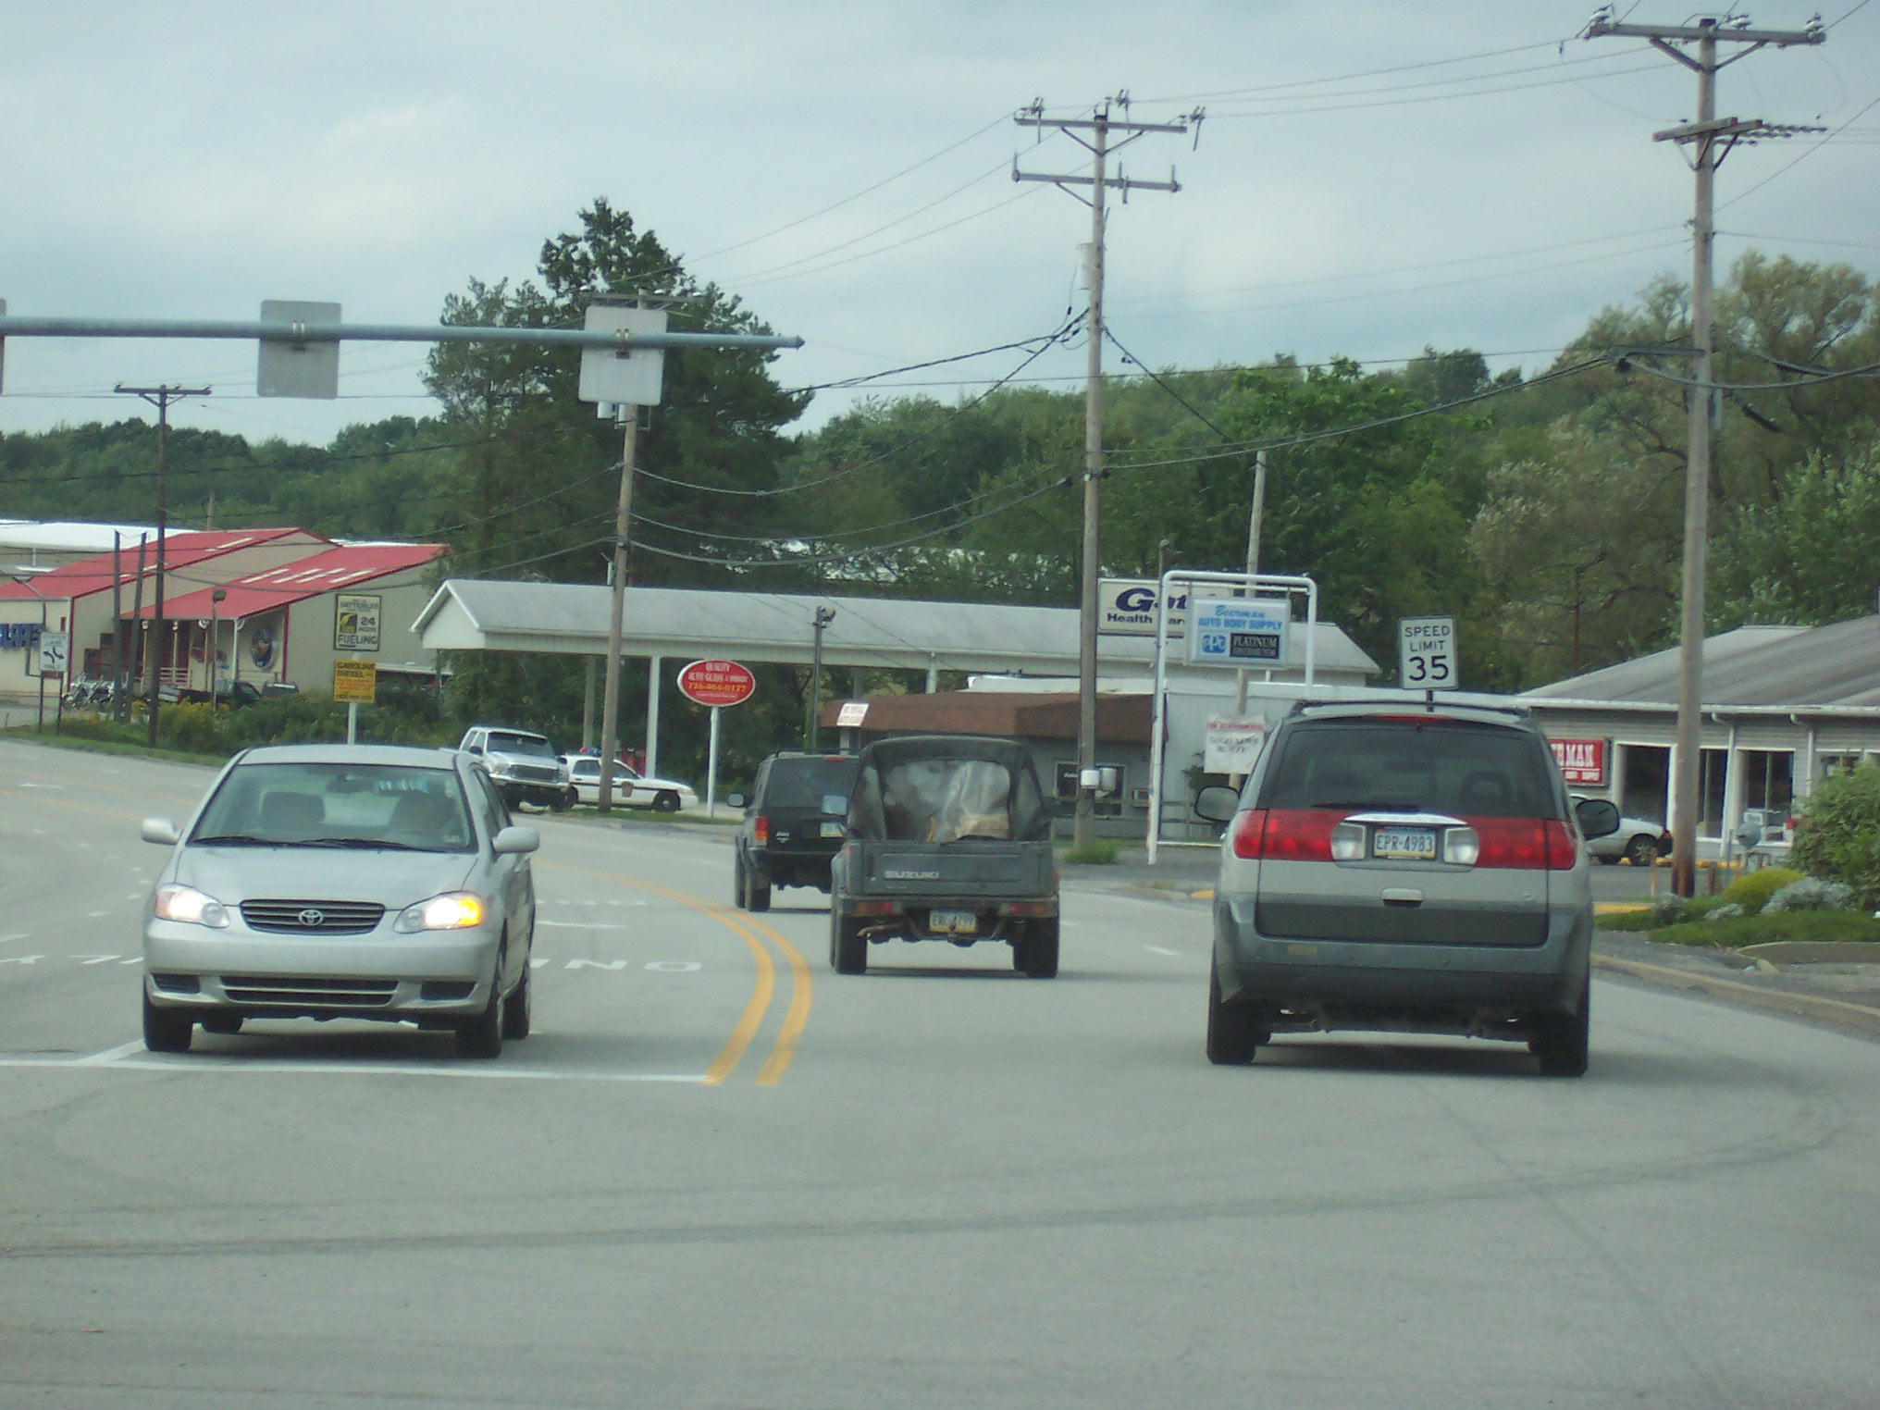
OU-4
Notes:
0U-4
Search for Other User Clues...Ready?

Slide 10
OU-4 Questions
The vehicle coming towards you is getting ready to turn left? T/F
The vehicle ahead is centered in their lane? T/F
There is motorcyclists in your lane? T/F
Notes:
The vehicle coming towards you is getting ready to turn left? True
The vehicle ahead is centered in their lane? False
There is a motorcyclist in your lane? False
Put 0-4 back on the screen for scoring and discussion.
True, the vehicle is in a left turning lane only with their left turn signal on.
False, the vehicle ahead is straddling the center lane marking.
False, there are no motorcyclists in this scene.

Slide 11
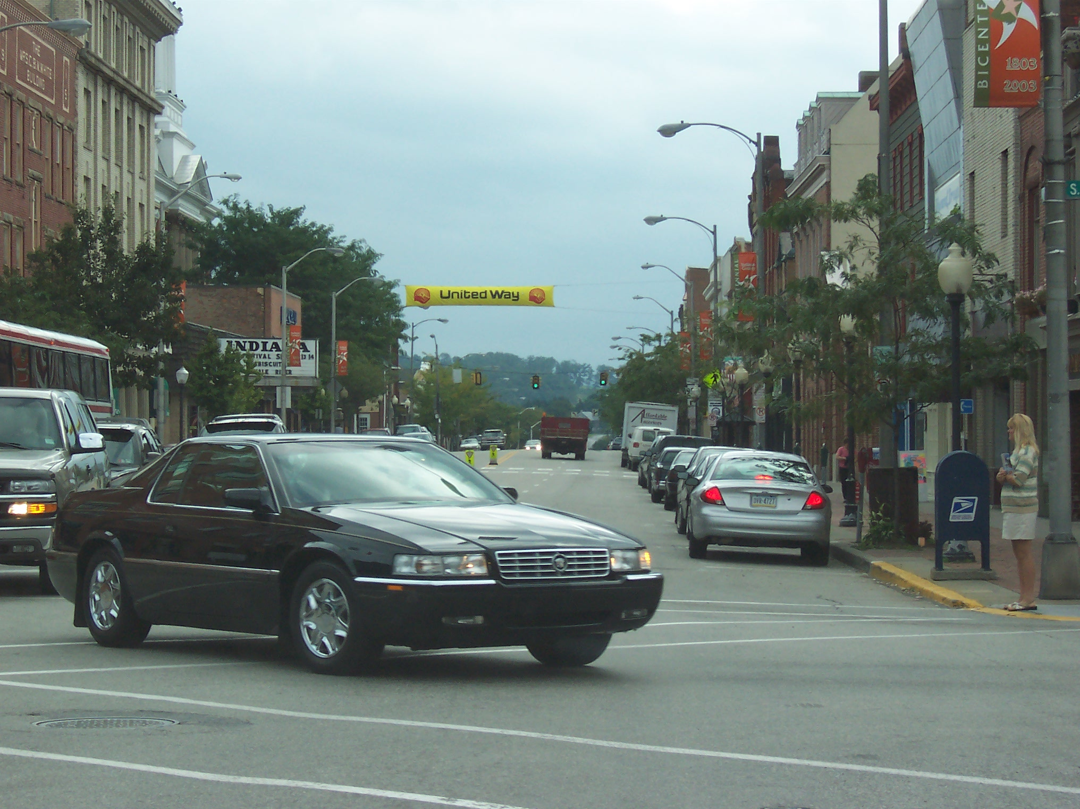
OU-5
Notes:
Search for Other User Clues. . . Ready

Slide 12
OU-5 Questions
The parked vehicle on the right has it’s brake lights on? T/F
There is a pedestrian standing along the right side of the roadway? T/F
The first parked car on your right has it’s driver side door open? T/F
Notes:
The parked vehicle on the right has its brake lights on? True
There is a pedestrian standing along the right side of the roadway? True
The first parked car your right has its driver side door open? False
Put 0-5 back on screen for scoring and discussion
True, the vehicle in the parallel parking space has its brakes activated.
True, there is a lady standing on the corner of the intersection.
False, there are no vehicle doors opening in this scene.

Slide 13
End Session 4B
Next: Session C

