Slide 1
Session Four
Identifying Vehicle Clues and Other Users
D-Session 4 A Objectives

Slide 2
Session Four Objectives
Identify
Vehicle condition and performance clues to better predict the actions of other drivers
Identify
Drivers clues to predict probable actions
Identify
Motorcyclist clues in regard to probable actions
Identify
Bicyclist clues in regard to probable actions
Identify
Pedestrian clues in regard to probable actions
Clues to changes in vehicle movement
Identify

Slide 3
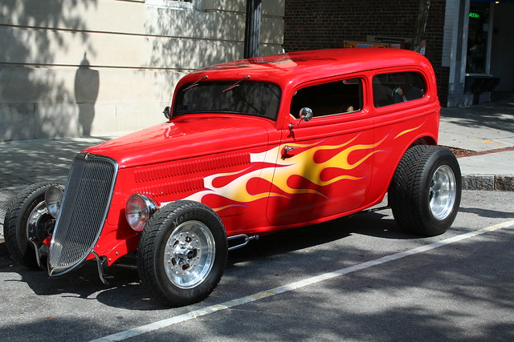
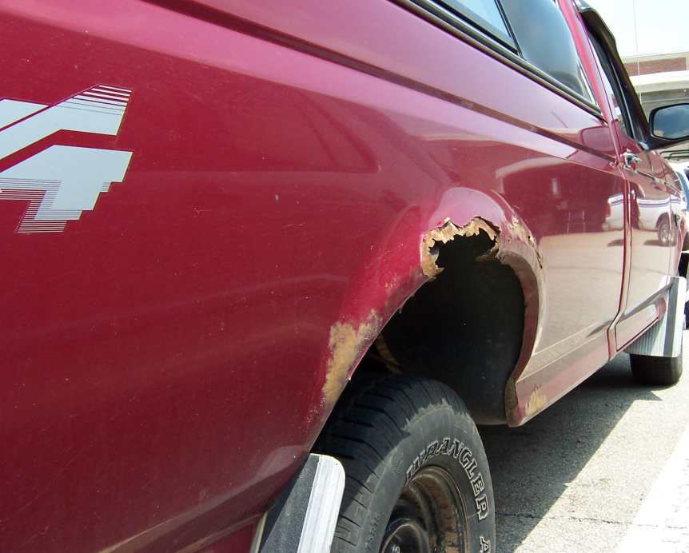
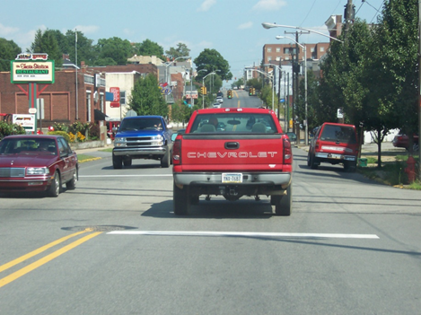
Vehicle Condition and Performance
IDENTIFYING OTHER USER ACTIONS
Body Condition or Out-of-state License
High or Low Performance
This Photo by Unknown Author is licensed under CC BY-NC-ND
Notes:
Body Style and Size
Large trucks, buses and motor homes take up more space when turning. They have reduced pickup and longer braking distances.
City buses and taxis may be in a hurry and will expect and take the right-of-way.
Drivers of sport models and high performance cars may make quick stops, starts and turns.
Small economy compacts may have less pickup and less braking capability.

Slide 4
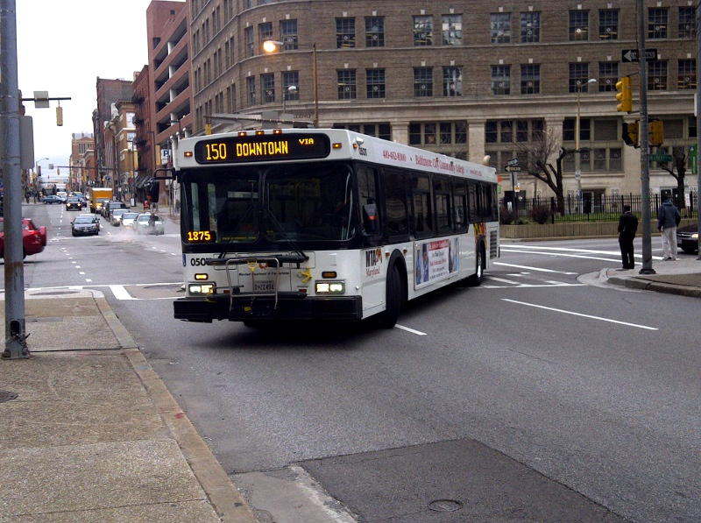
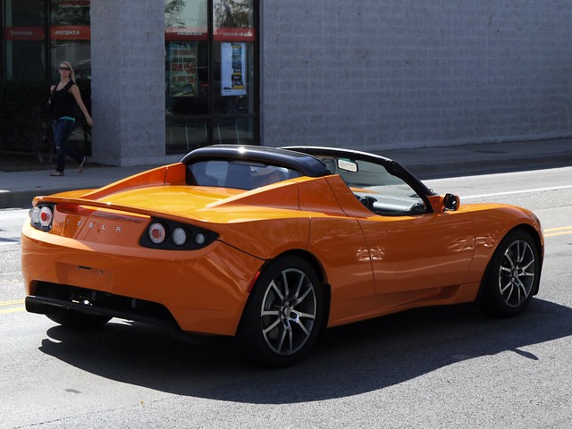
Vehicle Condition and Performance
IDENTIFYING OTHER USER ACTIONS
Body Style and Size
High or Low Performance
This Photo by Unknown Author is licensed under CC BY
This Photo by Unknown Author is licensed under CC BY-SA
This Photo by Unknown Author is licensed under CC BY-NC-ND
Notes:
Body Style and Size
Large trucks, buses and motor homes take up more space when turning. They have reduced pickup and longer braking distances.
City buses and taxis may be in a hurry and will expect and take the right-of-way.
Drivers of sport models and high performance cars may make quick stops, starts and turns.
Small economy compacts may have less pickup and less braking capability.

Slide 5
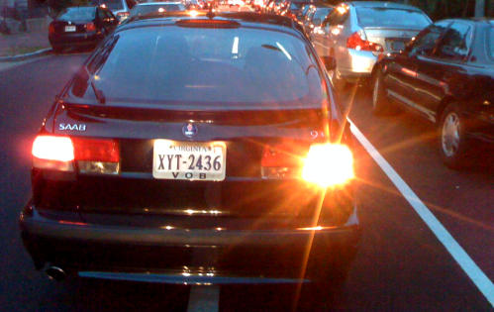
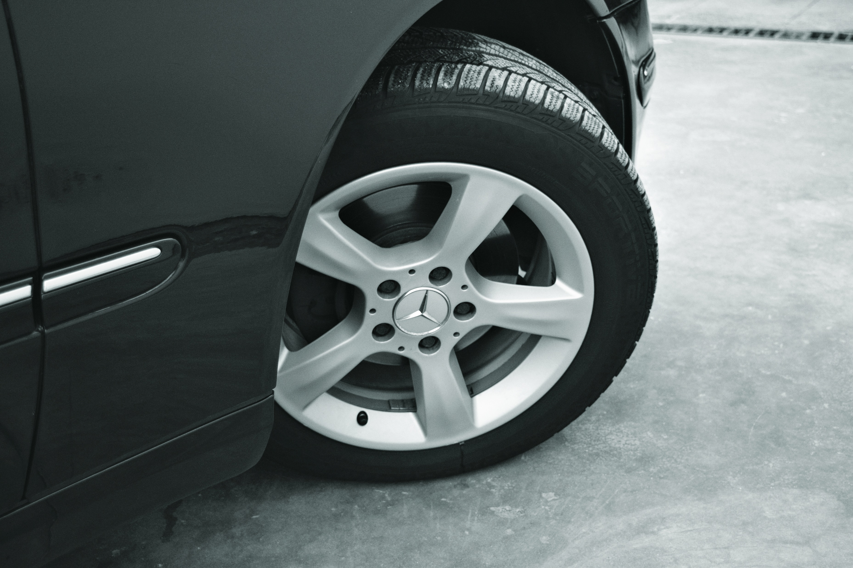
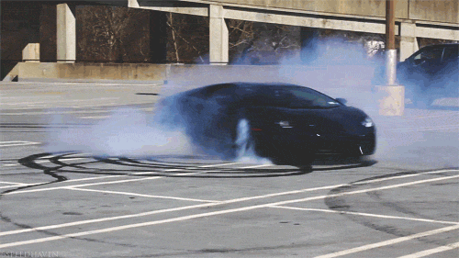
Clues to Change in Vehicle Movement
IDENTIFYING OTHER USER ACTIONS
High or Low Performance
SIGNALS AND FRONT WHEEL DIRECTION
This Photo by Unknown Author is licensed under CC BY-ND
Notes:
Signals and Front Wheels
Are turn signals, back-up lights or horn being used?
How long have the signal lights been activated?
What is the direction of the front wheels?

Slide 6
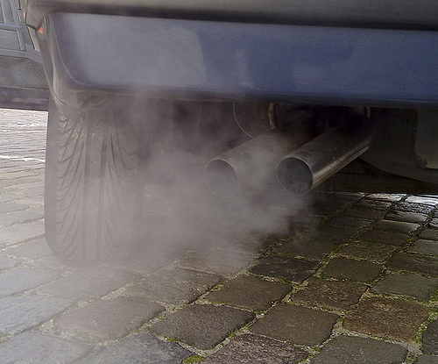
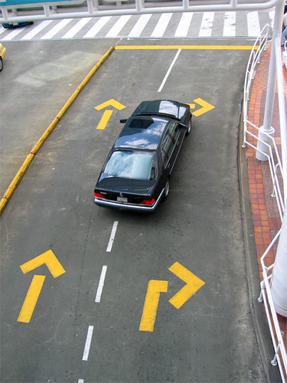
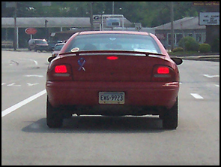
Clues to Change in Vehicle Movement
IDENTIFYING OTHER USER ACTIONS
Changes in Direction
Changes in Deceleration
Change in Acceleration
This Photo by Unknown Author is licensed under CC BY
This Photo by Unknown Author is licensed under CC BY-SA
This Photo by Unknown Author is licensed under CC BY
This Photo by Unknown Author is licensed under CC BY-ND
Notes:
Location and Attempted Maneuver
Is the vehicle in the turning lane, in the passing lane, next to curb or on the shoulder?
Is the vehicle centered in the lane or drifting to one side of it?
Is the car tailgating or driving in your blind spot?
Is there time and space for completion of the maneuver? Do you detect an error?
Lights and Exhaust
Are the brake lights or four-way flashers on?
Are puffs of smoke coming from a moving car or the exhaust coming from a parked car?
Body Angle and Tire Squeals
Does the front end nose down?
Does the back end squat or the tires squeal?
What does the body lean of the oncoming vehicle in the curve tell you?

Slide 7
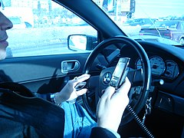
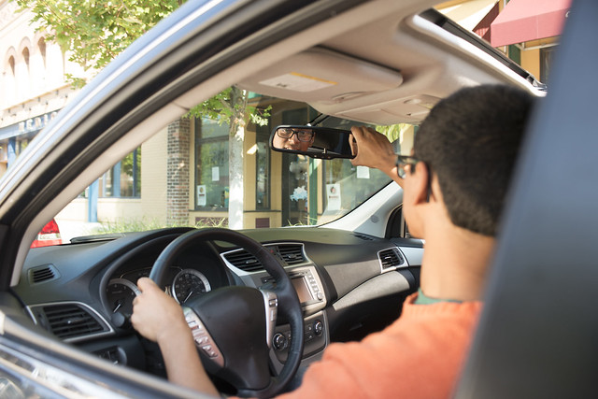
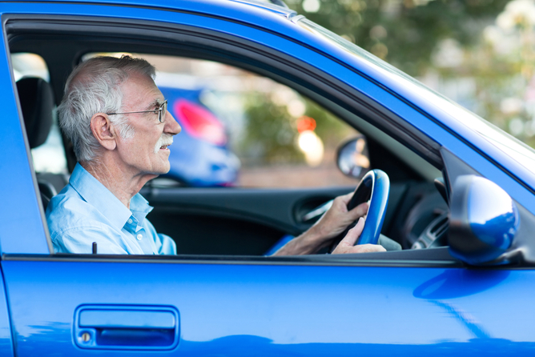
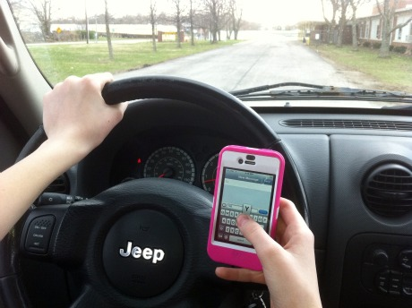
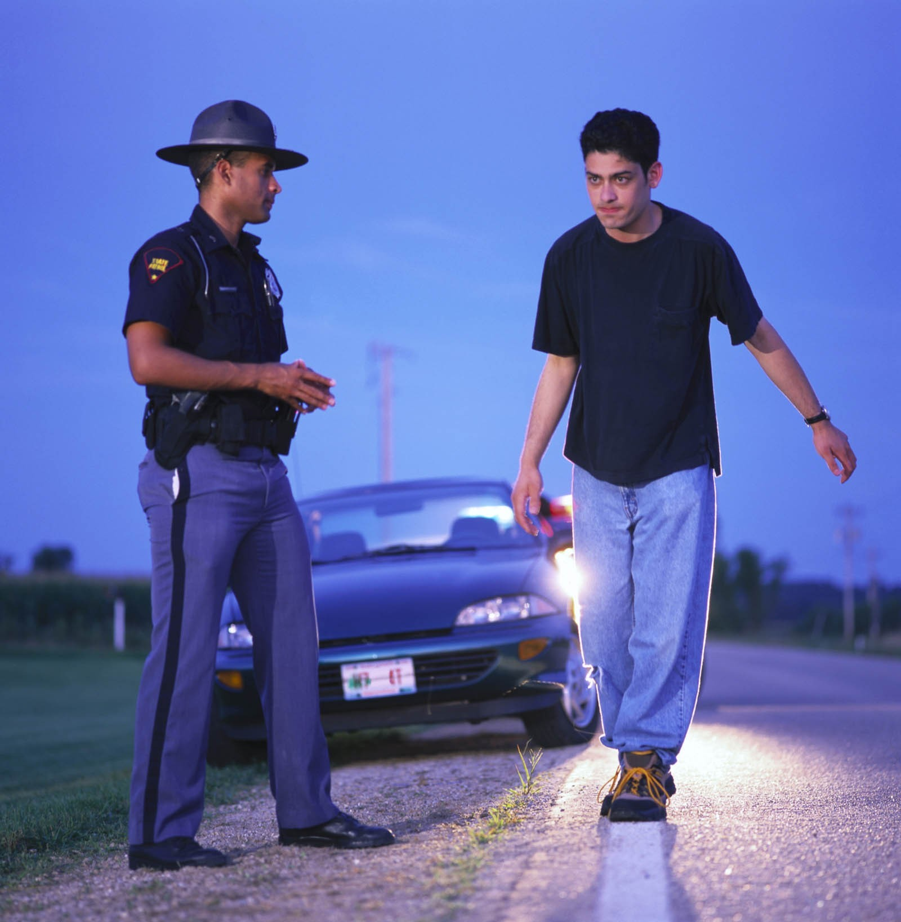
Driver Clues to Probable Actions
IDENTIFYING OTHER USER ACTIONS
Activity of Driver
Age of Driver
Condition of Driver
This Photo by Unknown Author is licensed under CC BY-NC-ND
This Photo by Unknown Author is licensed under CC BY
This Photo by Unknown Author is licensed under CC BY
This Photo by Unknown Author is licensed under CC BY
This Photo by Unknown Author is licensed under CC BY
This Photo by Unknown Author is licensed under CC BY-SA
This Photo by Unknown Author is licensed under CC BY-ND
This Photo by Unknown Author is licensed under CC BY-SA
Notes:
Age and Condition of Driver
An older person may be slow to react.
A younger person may be inexperienced and take risks.
A short person could have sight problems.
Does driver appear confused, sleepy or impaired?
Activity of a Driver
Does the driver make eye contact?
Is the driver distracted by talking, smoking, eating, map reading, scenic viewing, or tending to children
Age and Condition of Operator
Is the driver young or old?
Is the driver impaired?
Is there a passenger?
How are they dressed?
Is the bike overloaded?

Slide 8
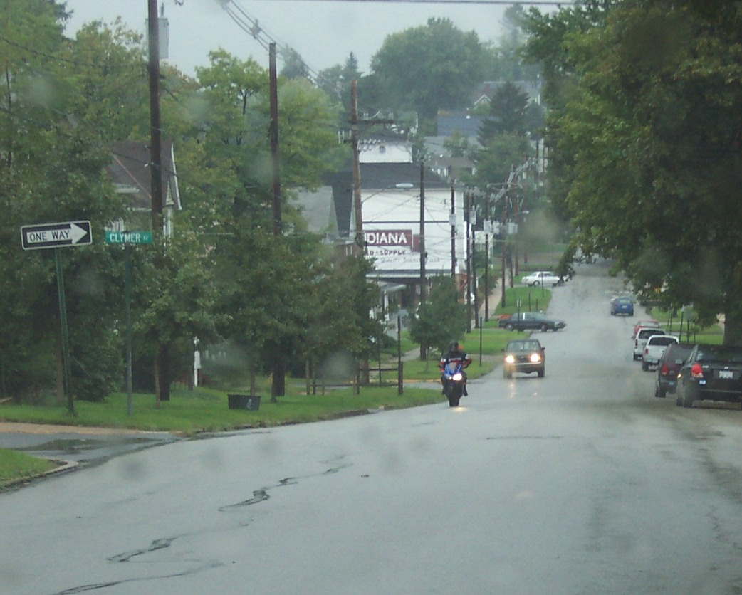
Clues to Motorcyclist Actions
Age and Way Dressed
Activity – Learning
Location as Related to Condition of Pavement Ahead

Slide 9
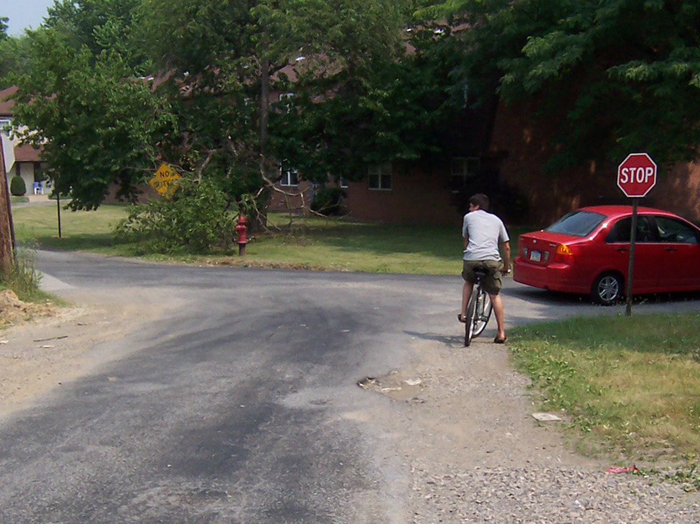
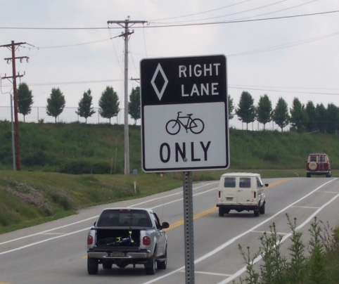
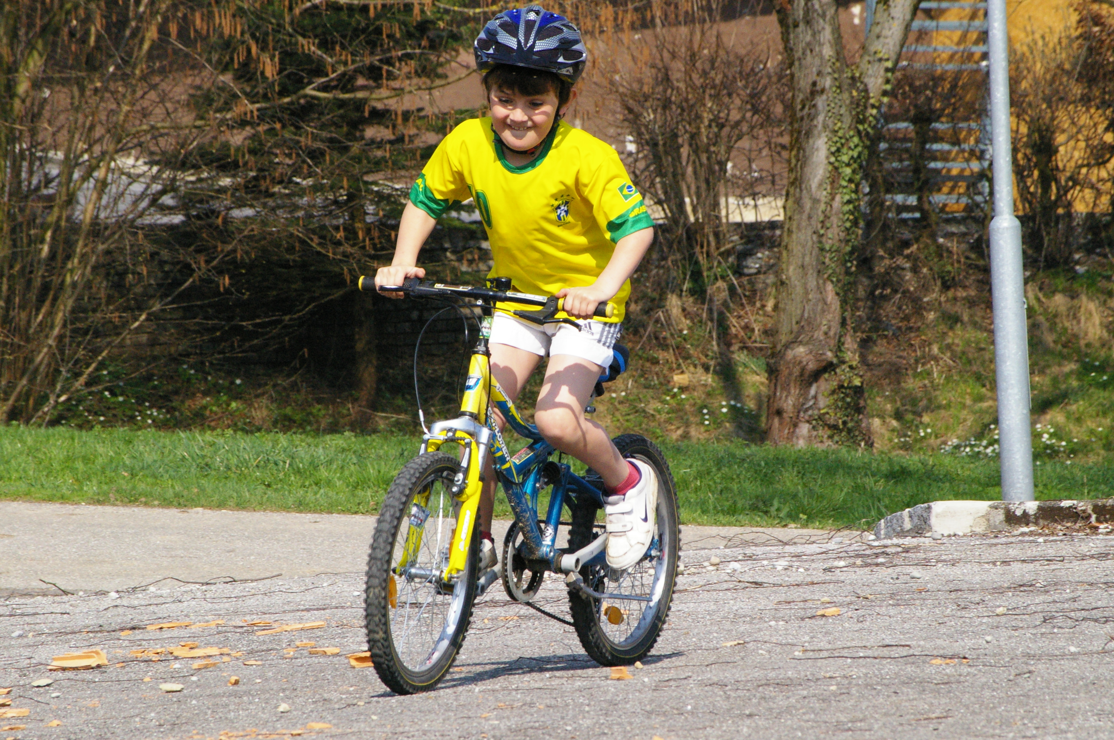
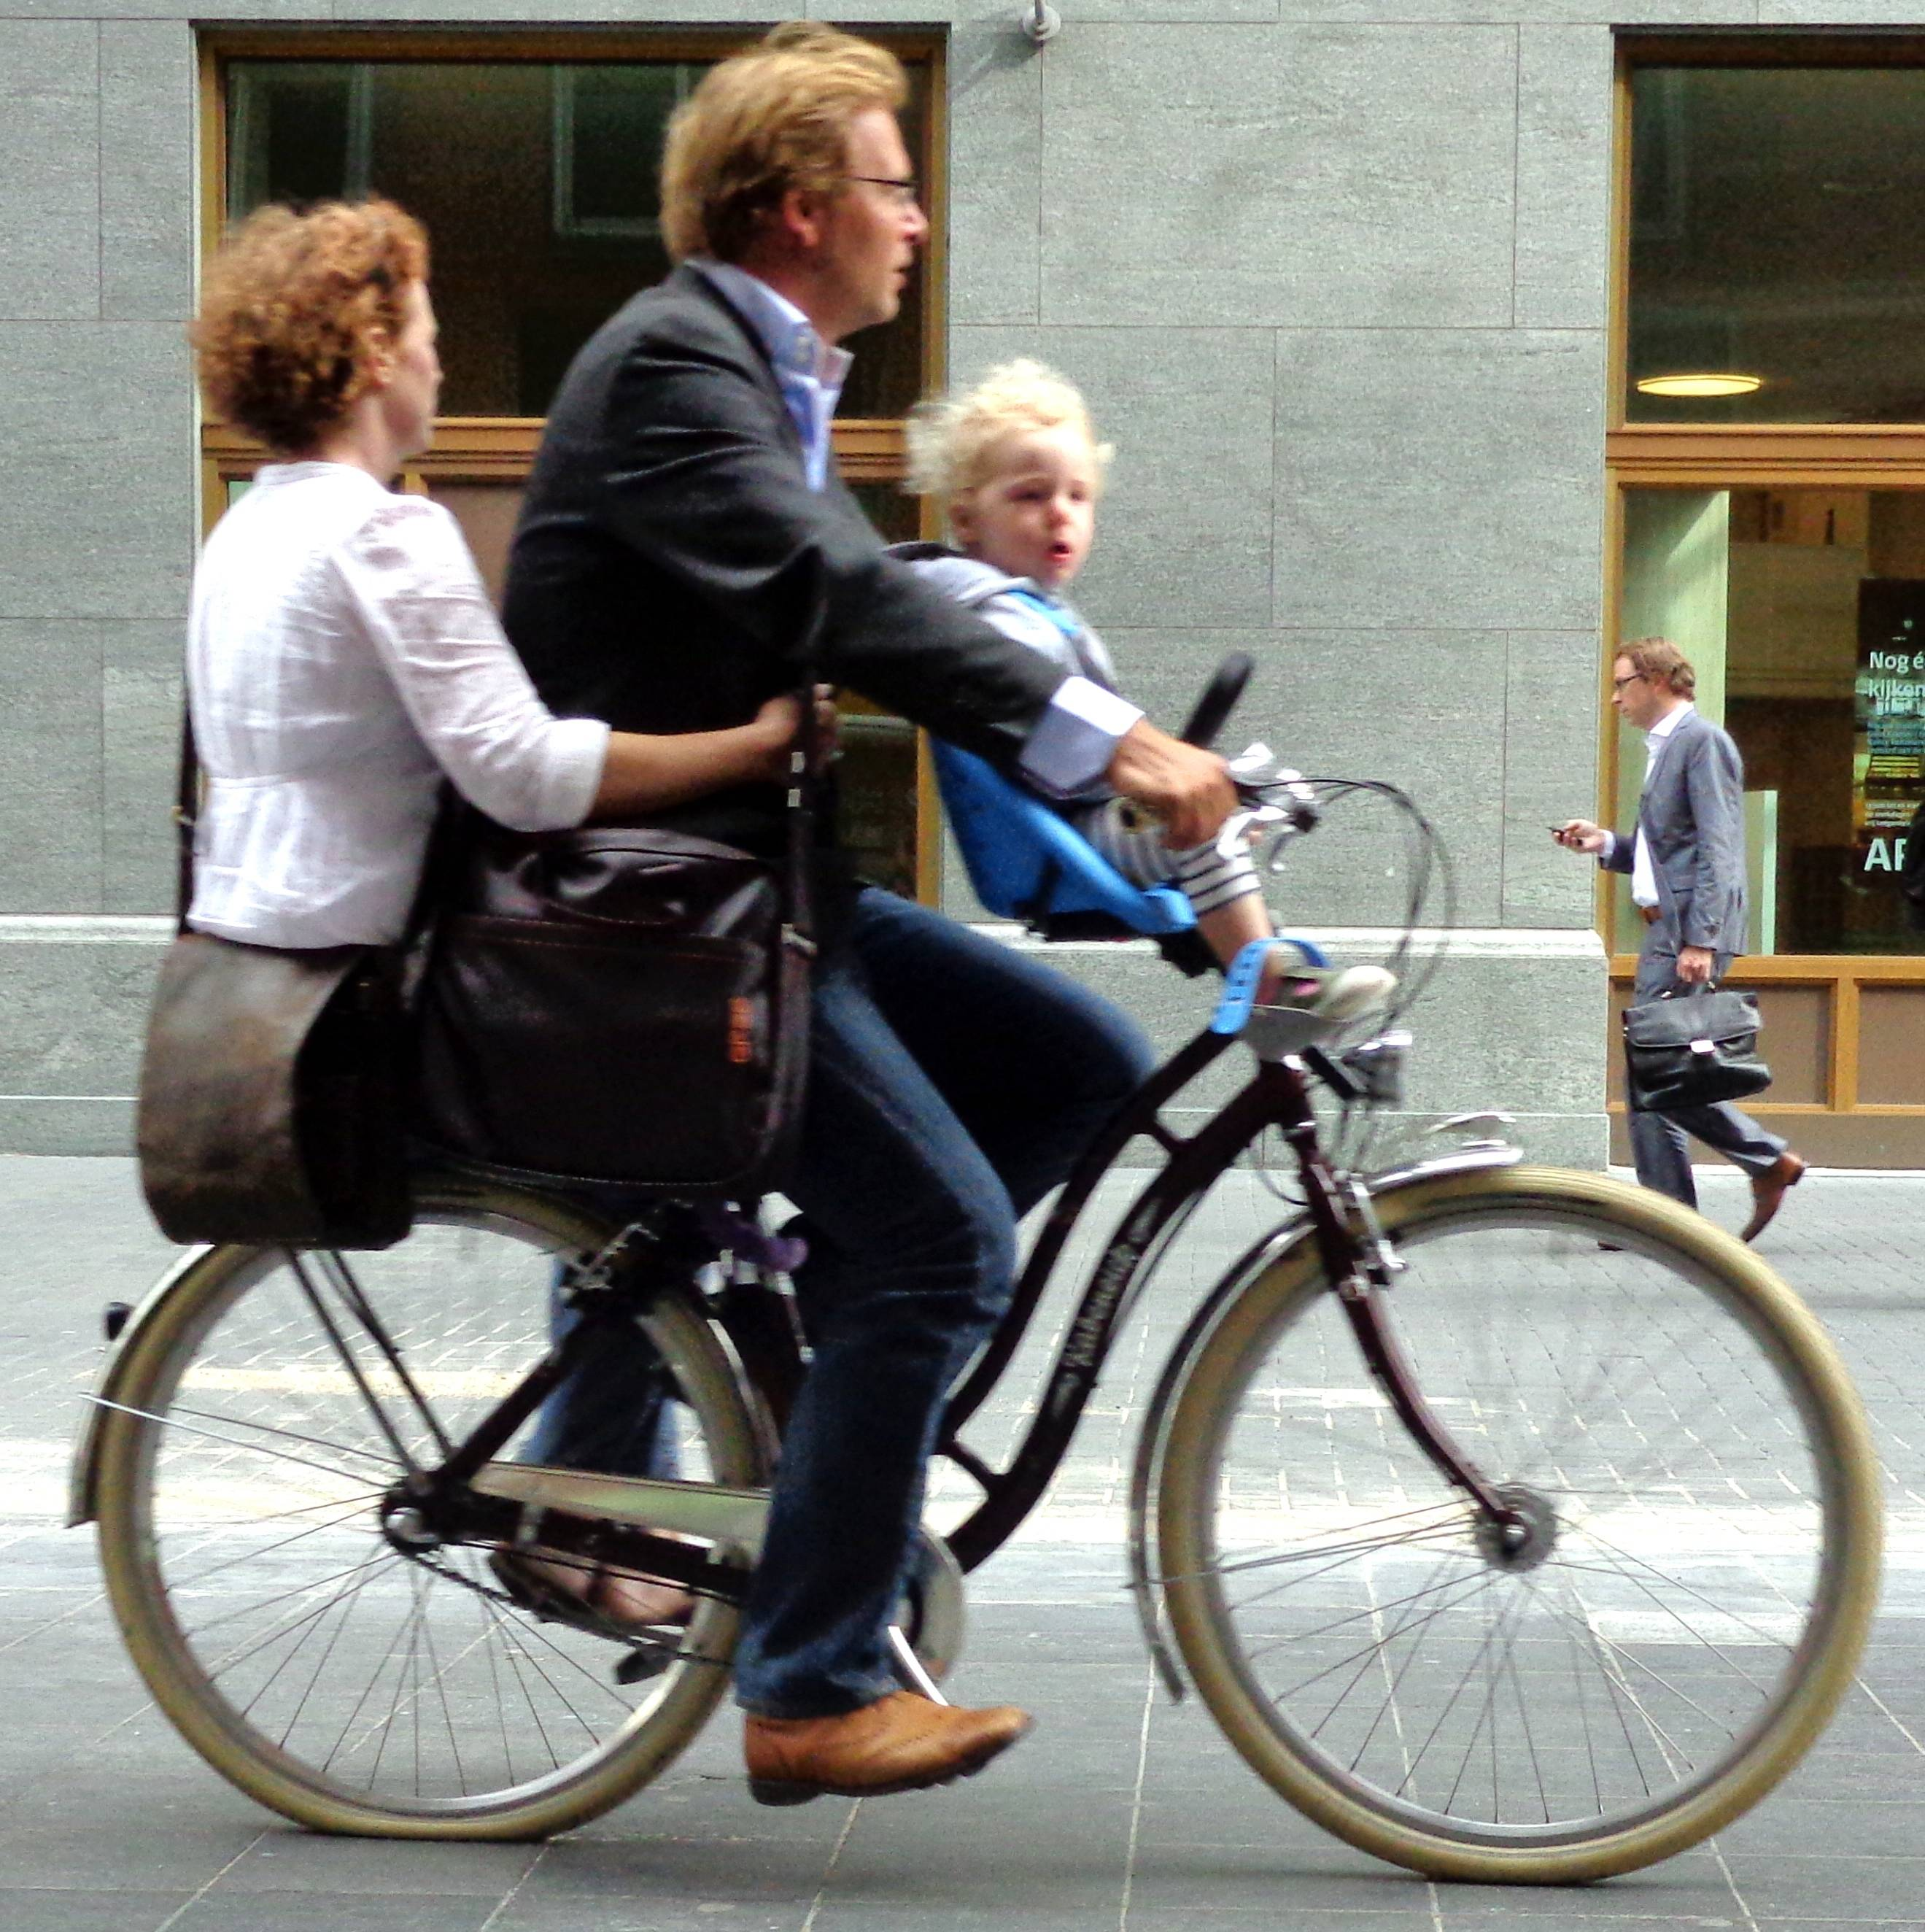
Clues to Bicyclist Actions
IDENTIFYING OTHER USER ACTIONS
Roadway Condition Ahead of Bicyclist
Type of Rider
Location of Bicycle
This Photo by Unknown Author is licensed under CC BY-SA
This Photo by Unknown Author is licensed under CC BY-ND
Notes:
Age and Condition of Operator
Is the driver young or old?
Is the driver impaired?
Is there a passenger?
How are they dressed?
Is the bike overloaded?

Slide 10
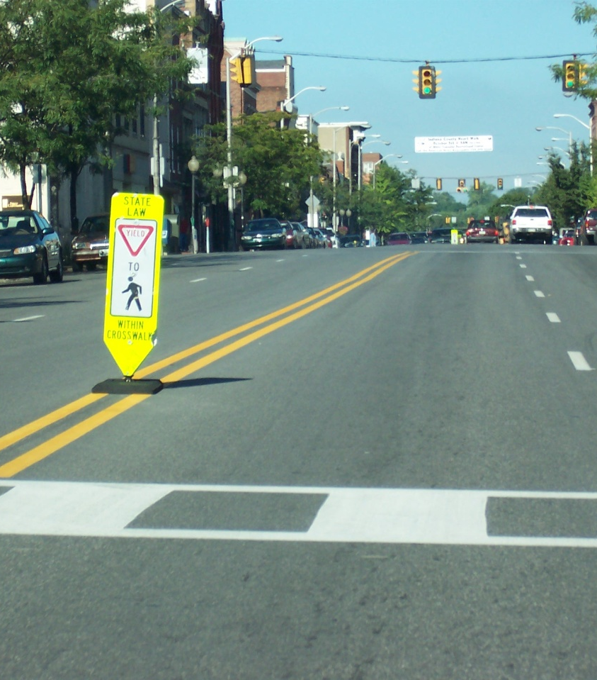
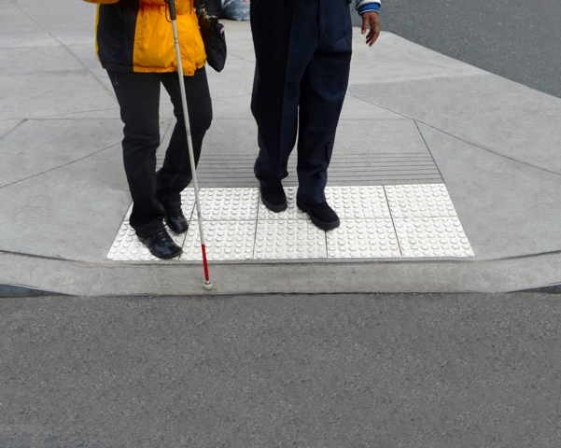
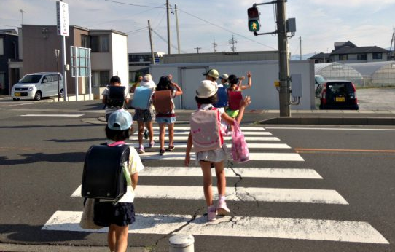
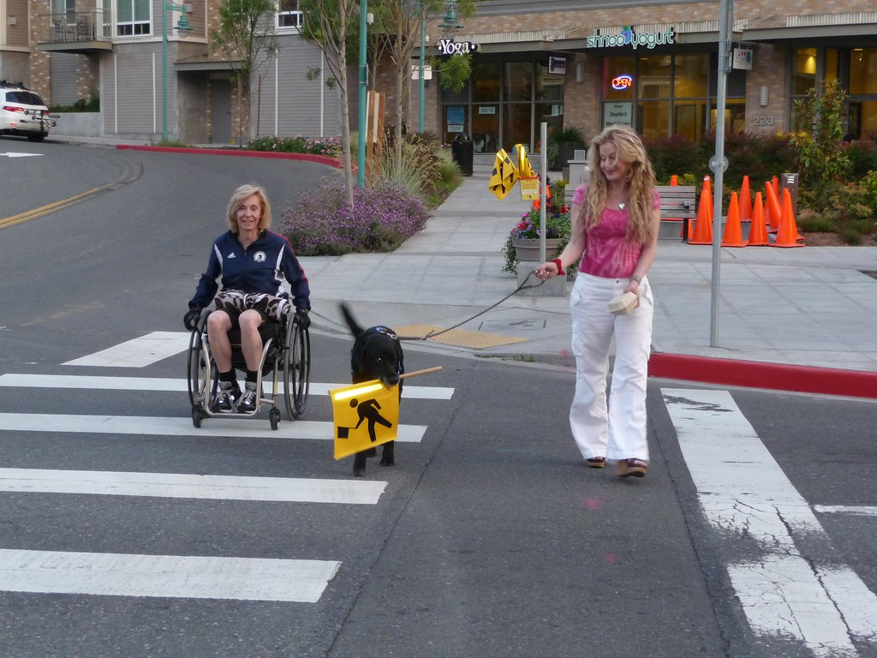
Clues to Pedestrian Actions
IDENTIFYING OTHER USER ACTIONS
Age and Condition
Location
Activities
This Photo by Unknown Author is licensed under CC BY-NC
This Photo by Unknown Author is licensed under CC BY-SA
This Photo by Unknown Author is licensed under CC BY-NC-ND

Slide 11
End Session 4 A
Next: Session 4 B

