Slide 1
SESSION THREE
C-Session 3 B Identifying Highway Conditions
Problem Slides & Video & Questions
Slide HC-1

Slide 2
C-Session 3B IHC Slides & Videos Questions
Identifying Highway Conditions

Slide 3
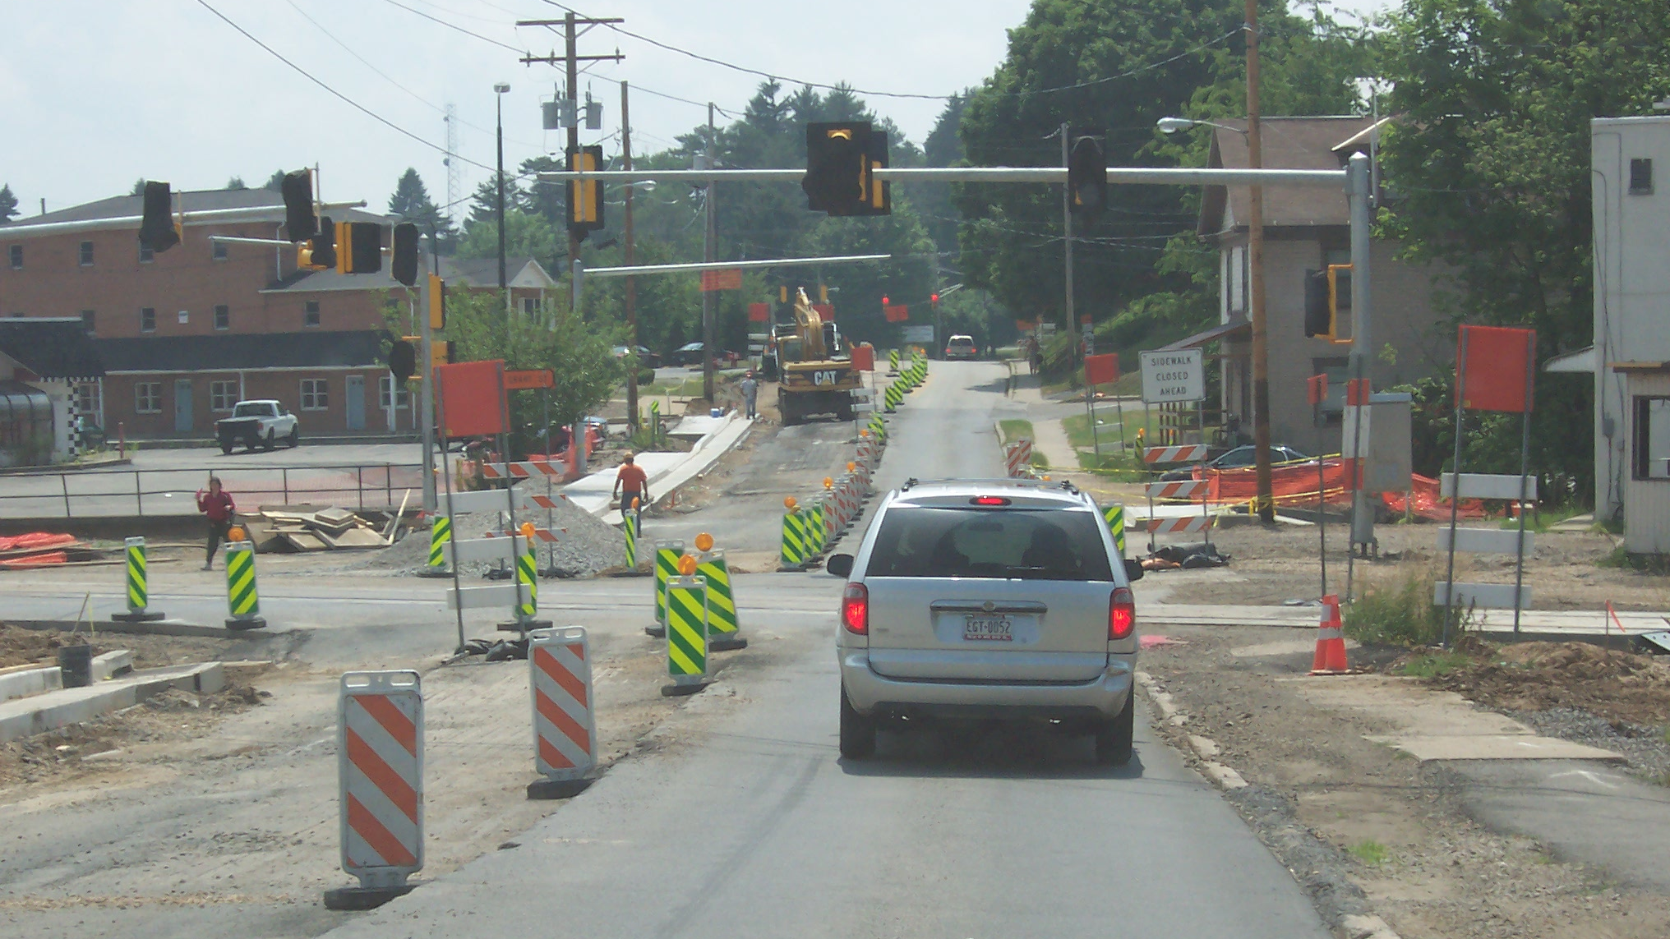
HC-1
Notes:
Search for Highway Conditions . . . Ready?
After the slide is on the screen, select individual students to identify any highway conditions that
affect the driver's projected path of travel, e.g.
• Space is affected by construction signs and curb.
• View to the sides is not reduced but caution should be taken when approaching construction
zones.
• Sight distance is not reduced because you can see clearly to the traffic light ahead.
Once these conditions are identified, ask the following questions:
A. The shoulder to the left is level with the roadway?
B. You are in an area of limited space?
C. You have a good sighting distance?

Slide 4
HC-1 Questions
The shoulder to the left is level with the roadway? T/F
You are in an area of limited space? T/F
You have a good sighting distance ahead? T/F
Notes:
A. The shoulder to the left is level with the roadway? False
B. You are in an area of limited space? True
C. You have a good sighting distance? True

Slide 5
C-Session 1- 3B
Move on to
3 B
Slide HC-2

