Slide 1
Support for Research & Scholarship at IUP
Internal (IUP) Funding, External Funding, Compliance, Intellectual Property, Dissemination and Recognition

Slide 2

What is “research?”
IUP supports and encourages all forms of research, scholarship, and creative endeavor, in all disciplines.
The term “Research” is just short-hand for the very broad suite of activities that lead to knowledge production.

Slide 3
Introductions
We’re Here to Help You!
Hilliary Creely, Assistant Dean for Research
  Internal Funding, Compliance, IP
Tracy Eisenhower, IUP Research Institute
  External Funding
Jen Roberts, IRB Chair
  Protection of human subjects
Paul Nealen, IACUC Chair
  Working with animals
Jenn Gossett, USRC and USF/GSF
  University Senate, Research Week

Slide 4

Roadmap for the next hour
Internal Funding
External Funding
Compliance
Intellectual Property
Dissemination & Recognition
Other Resources

Slide 5
Internal Funding
University Senate Research Committee (USRC)
www.iup.edu/research/senateresearchgrants/default.aspx
  Small grants for conference travel (up to $1000) and research (up to $2000) offered via eight yearly competitions
  Senate Grants (up to $3500) once yearly
  Application, deadlines, funding rates, etc available online

Slide 6
Internal Funding
School of Graduate Studies & Research
http://www.iup.edu/page.aspx?id=98048
  Incidental Research (up to $500)
  Publication expenses (typically up to $500)
  Equipment maintenance
  Matching funds for external grants
  Travel in pursuit of external funding

Slide 7
Internal Funding
Faculty Professional Development Committee (FPDC)
http://www.iup.edu/facultyprofessionaldevelopment/default.aspx
  Two PASSHE-wide competitions:
    Annual grant competition (up to $10,000) in areas like faculty research, student-faculty research, creative & performing arts, etc
    Special topic competition (up to $10,000)—last year was Innovation in Teaching and Improvement of Student Learning Outcomes
  IUP is limited to 16 submissions for each of the above

Slide 8
Internal Funding
Other Opportunities?
Center for Teaching Excellence
Academic Computing Policy Advisory Committee
Taskforce on Disability Guidelines
Look for announcements via e-mail and the IUP Daily!

Slide 9

  External Funding
  How to participate in External Grants and Contracts at IUP

Slide 10
What is the IUP RI?
Serves as the “Office of Sponsored Research”
The IUP Research Institute was established by IUP in 2002 to increase, enhance and streamline sponsored activity at and for IUP.
Separate Non-Profit Corporation
1179 Grant Street, Suite One
Indiana, PA 15701
(at the point of Oakland & Grant)
724-357-2223
Research-institute@iup.edu
http://www.iup.edu/researchinstitute

Slide 11
Mark Berezansky
Executive Director
724/357-3110 or mberezan@iup.edu
Tracy Eisenhower, CRA Ute Lowery
Sr. Grant & Contract Specialist Post-Award Grant & Contract Specialist
724/357-1915 or tracye@iup.edu 724/357-3241 or ulowery@iup.edu
Sadie Hauck Janis Nichols
Pre-Award Grant & Contract Specialist Accountant
724/357-4033 or s.l.hauck@iup.edu 724/357-3351 or jnichols@iup.edu
Heather Hess Bernard Piwinsky
Pre-Award Grant & Contract Specialist Sr. Accountant
724/357-1344 or heatherh@iup.edu 724/357-7843 or bmp@iup.edu
Peter Luetkehans Amber Shaffer
Post-Award Grant & Contract Specialist Grant & Contract Coordinator
724//357-2054 or peter.luetkehans@iup.edu 724/357-2223 or ashaffer@iup.edu

Slide 12
Mission & Vision
Our Mission is to advance the research agenda and educational objectives of Indiana University of Pennsylvania.
Our Vision is to enhance the culture of research at IUP and to be recognized as a leading research institution.

Slide 13
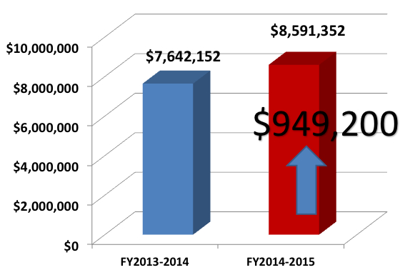
IUP Sponsored Activity

Slide 14
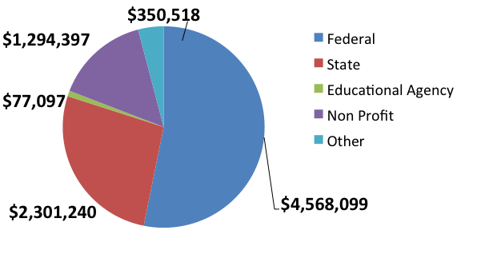
FY 14-15 Awards by Agency Type

Slide 15
We assist you with the entire process!
Funding searches
Proposal & budget development
Contract negotiation & execution (including subawards & consulting agreements)
Award implementation & facilitation
Award modifications, no-cost extensions, etc.
Hire of externally funded RI project employees
Purchase of materials & supplies
Fiscal/account management
Activity & fiscal reporting
Final reports & project close-out
Advise you of regulatory compliance requirements
Research-related presentations

Slide 16
Why We Do It…
Ensure proper university authorizations
Assistance with budget development to help ensure smooth implementation of award
Experience in proposal development, contract negotiations, IP language, export controls, university procedures
Liability – legal liabilities….
Recognition – tenure/promotion, publicize, announce…
…. It’s required ….. For compliance/audit

Slide 17
THANK YOU!
Please contact your
IUP Research Institute
with any questions.
We will gladly meet with you to discuss
our services in greater detail and assist you with your sponsored research!
724/357-2223 or
www.iup.edu/researchinstitute

Slide 18

Compliance
Institutional Review Board for the Protection of Human Subjects (IRB)

Slide 19
IRB at IUP
Faculty led
Goal is to help you do your research ethically and within the Federal and institutional guidelines
  FWA with OHRP
Meant to be a constructive process

Slide 20
Finding Us
Website: www.iup.edu/irb
Email address: irb-research@iup.edu
Your department

Slide 21
When Do I Need IRB Approval?
Anytime doing research with human subjects
Before you begin your research
For any project that meets the criteria for exempt, expedited, or full board

Slide 22
How Do I Get Started?
Download our protocol forms from our website
Follow the instructions!
Exempt & expedited protocols may be submitted at any time.
Full board protocols need to be submitted by specific dates
Email your protocol to irb-research@iup.edu

Slide 23
What Next?
You WILL receive verification from us that your protocol has been received. [IUP email]
If your protocol meets the criteria for exempt or expedited review, you will hear from us within 2 weeks.
If your project requires full board review, use the dates listed on the web for submission deadline and meeting times.

Slide 24

What If I’m Working With Students?
All students engaged in research required to have a faculty sponsor
CITI requirement for all students engaged in human subjects research (e.g., GA, independent research)
    Feel free to use as a classroom activity
Classroom research policy

Slide 25
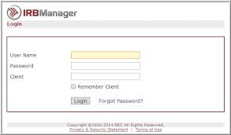
Coming Soon…
On-line IRB tool

Slide 26
What If I Have A Question?
Check the webpage: www.iup.edu/irb
Send us an email: irb-research@iup.edu

Slide 27
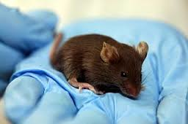
Compliance
Institutional Animal Care and Use Committee (IACUC)

Slide 28
IACUC at IUP
By federal law, any institutional uses of vertebrate animals (teaching, research, outreach, other) must be supervised
IUP’s IACUC is here to help any faculty, staff, or student who wishes to use animals in their endeavors
Before animal uses can occur:
all users must submit, and have approved, an IACUC animal use protocol
all student users must complete Animal Care and Use (ACU) on-line training
Forms, guidelines, and other info are available at http://www.iup.edu/iacuc
New users are highly encouraged to meet with the IACUC chair to discuss their plans
Questions? Comments? Concerns? Please contact us at
IACUC Dr. Paul Nealen
College of Natural Sciences & Mathematics Biology
305 Weyandt Hall 7-1325
iacuc-info@iup.edu pnealen@iup.edu

Slide 29

Other Compliance Areas
Not an Exhaustive List…
Expenditure of Public Funds
Agreements
Financial Conflict of Interest
Research Misconduct
Export Control
Procurement
Compensation
Training – CITI

Slide 30

Intellectual Property &
Technology Transfer http://www.iup.edu/page.aspx?id=86754
Protecting your rights and respecting the rights of others
  Patent
    Invention disclosure
    PASSHE/PSRF
  Copyright
    See also IUP Library / Fair Use
  Trademark/Trade Secret

Slide 31
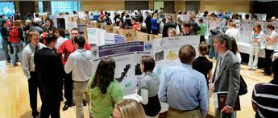
Dissemination & Recognition
Research Week! April 4-8, 2016
  Undergraduate & Graduate Scholars Fora
  Research Awards Luncheon
  Seminars, Workshops, Women in Science
Office of the Provost
  Recognition for
  publications

Slide 32

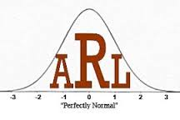
Other Resources
Vehicles
Poster Printing
Core equipment
Statistical consulting via the Applied Research Lab (ARL)

Slide 33
THANK YOU!
Questions?

