Slide 1
How to Register for CITI Online Ethics Training Courses

Slide 2
Why is responsible research important? Ethical conduct of research is important for maintaining the public trust and adhering to research requirements and best practices. What is CITI? IUP provides training through the Collaborative Institutional Training Initiative (CITI), which offers web-based training materials for millions of learners at academic institutions

Slide 3
Access the course at http://www.citiprogram.org. Once there, click on the Register button to create a new account.

Slide 4
Go to the Organization Affiliation drop‐box. In the drop‐box, select Indiana University of Pennsylvania.

Slide 5
Enter your first and last name, then enter your IUP email address along with a secondary email, if desired. Next, hit the Continue button to go to Step 3

Slide 6
Choose a Log‐In ID and a password that will be easy for you to remember, yet secure. (The password must be 8‐50 characters, and is case sensitive.) You will also be prompted for a security question in case you forget your password.
If your preferred User ID has already been taken, you will be prompted to choose another User ID. Be sure to write down or otherwise record your ID and password. Keep them in a secure location.

Slide 7
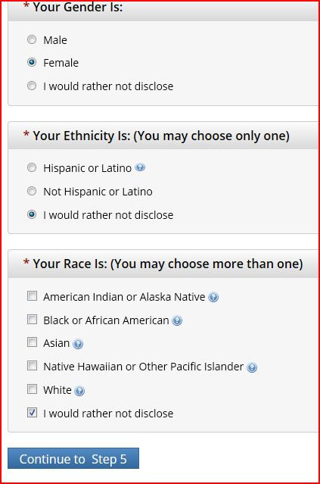
CITI will ask three more personal identification questions, but you can elect not to disclose the information. After you have answered these questions (or indicated your preference not to disclose), click the button at the bottom to continue to Step 5.

Slide 8
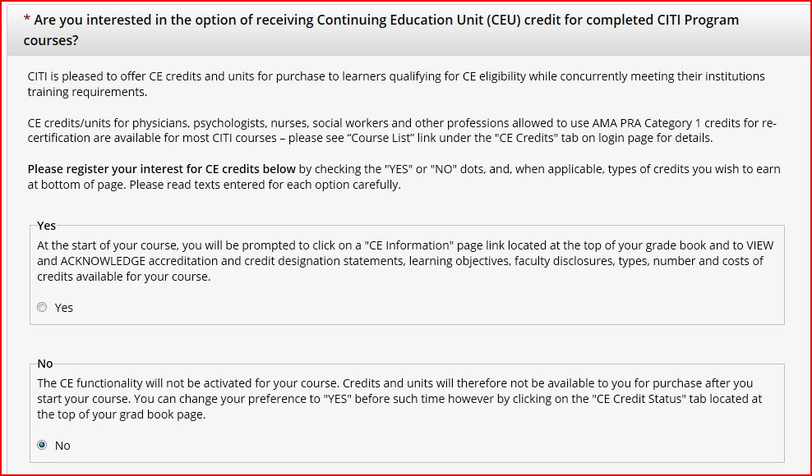
The first half of the next step is to answer questions regarding whether or not you want to receive a Continuing Education Unit credit for the courses that you complete in the CITI program. You must answer either yes or no.

Slide 9
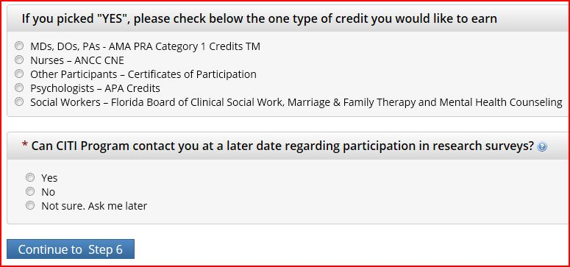
If you answered yes to receive a CEU credit for the courses completed in CITI you must also check he type of credit you want to earn from the choices below. Finally, you must answer if CITI can contact you in the future about taking surveys. Continue to Step 6 after pressing the button.

Slide 10
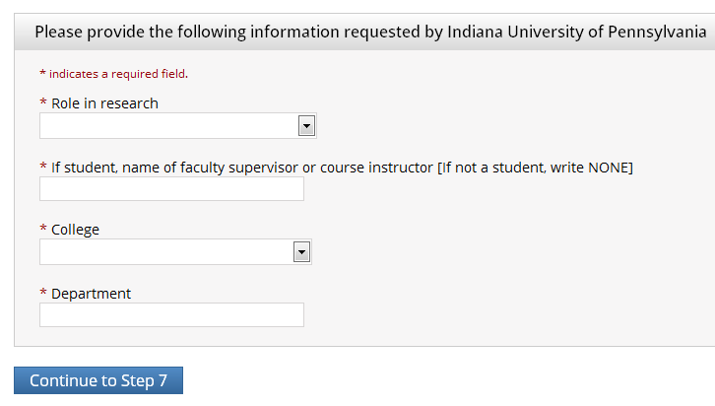
Enter information required by IUP into all required fields below. You can choose your “Role in research” and “College” from a drop-box. Continue to Step 7 after pressing the button.

Slide 11
Step 7 begins with a series of questions about the type of courses that you would like to enroll in. Along with Human Subject (IRB) Research, there is also Responsible Conduct of Research, Financial Conflict of Interest, Animal Care and Use (IACUC), and Export Control. There is also a hyperlink to review the CITI instructions page should you need further guidance about enrollment.
*Remember: You may not need to register for all these offerings. Consult with your advisor or A-Dean for guidance. You can also add/remove courses later, after registration*
If you are not sure which course is most applicable to your area, ask your faculty advisor or contact the Assistant Dean for Research at grad-research@iup.edu. Once you’ve chosen the appropriate selection, scroll to the bottom of the page and click “Continue”

Slide 12
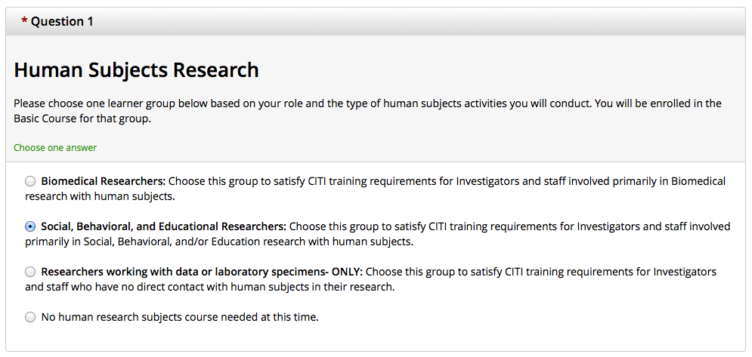
Now you’re at the course curriculum screen. Scroll through the questions and choose the course (or courses) that are most closely related to your discipline and/or research project. First up is the Human Subjects/IRB course offerings question.
If you are not working with human subjects, click this option

Slide 13
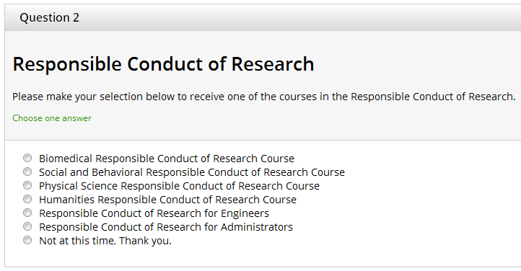
The next two questions deal with Responsible Conduct of Research and the Conflict of Interest courses.
If this course is not needed, click this option
If this course is not needed, click this option

Slide 14
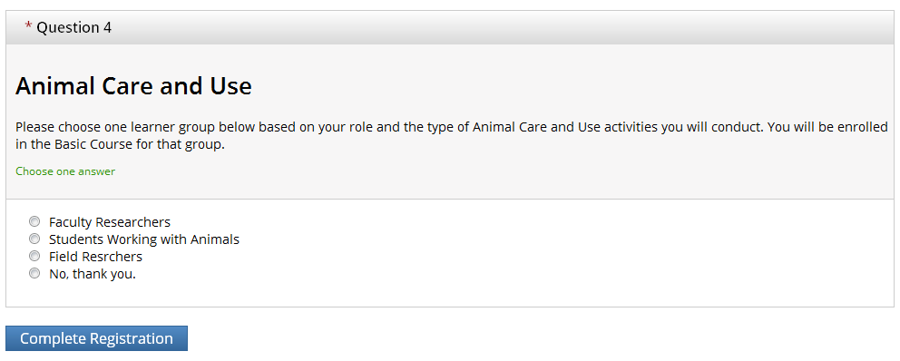
The next question is for the Animal Care and Use (IACUC) courses.
If you are not working with animal subjects, click this option

Slide 15
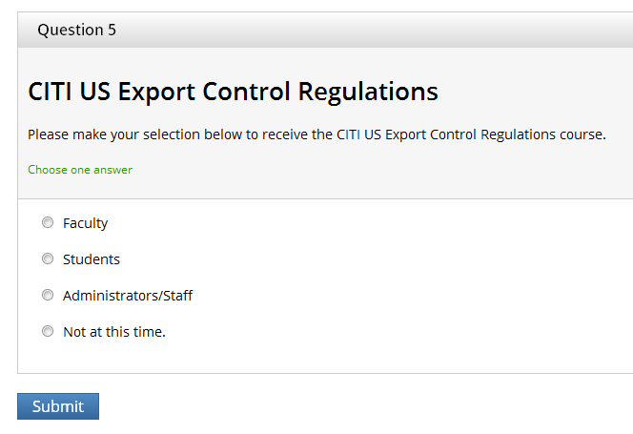
The next question is on Export Control.
If this course is not needed, click this option

Slide 16
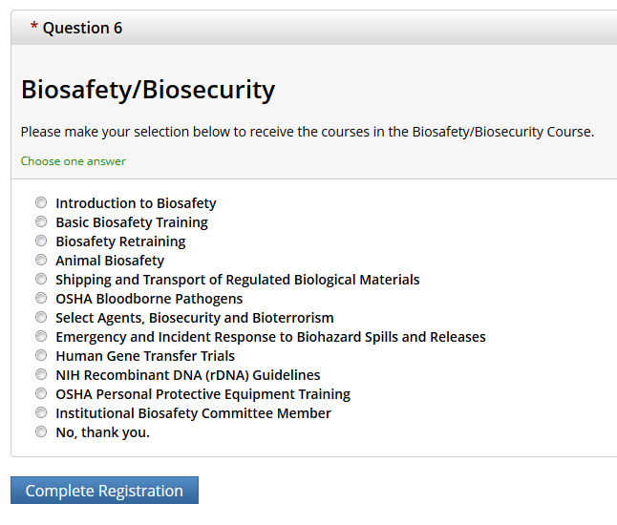
The last question is on Biosafety/Biosecurity. Once you have made your selection, click on the “Complete Registration” button at the bottom of the screen.
If this course is not needed, click this option

Slide 17
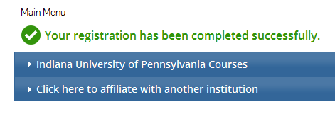
Congratulations! You have successfully completed registration for the CITI training program. Click on the “Finalize registration” hyperlink to view your course modules and start completing the courses.
Here is the main menu page for the course modules

Slide 18
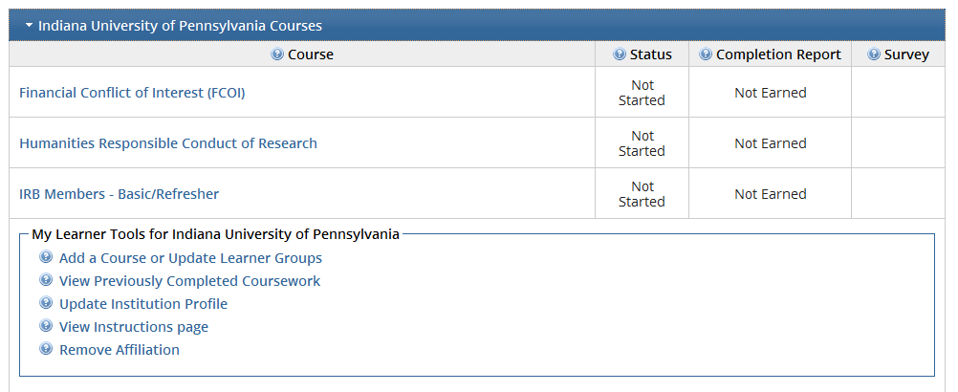
Once you have clicked on the IUP courses tab, you can then click on any one of the courses for which you’ve registered to get started on the modules for that course.
* Note: at the bottom of the page that there are “learner tools” where you can add courses, view instructions, change affiliations, etc. *

Slide 19
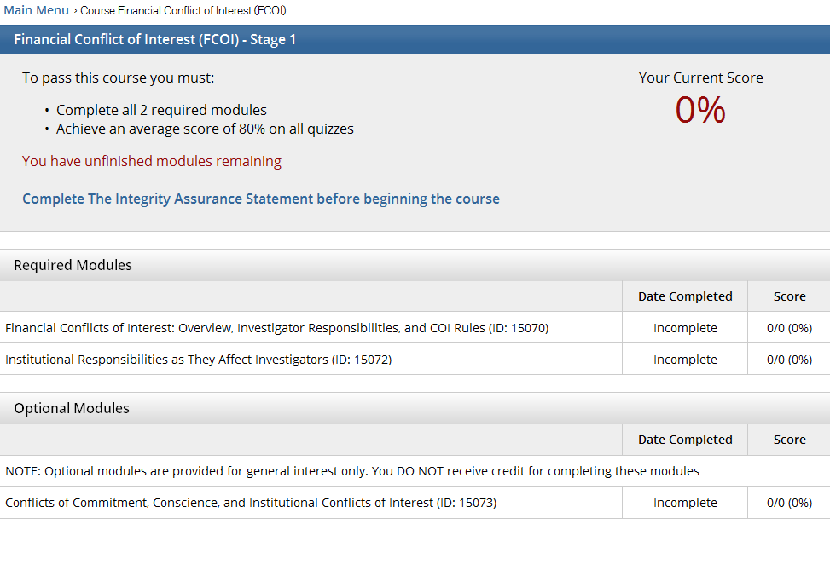
Once you have clicked on a course to begin, this page will tell you how many modules you need to complete, your score on the quizzes, and which modules are required vs. optional so that you can track your progress

Slide 20
Questions?
Contact the Assistant Dean For Research
Dr. Hilliary Creely at
grad-research@iup.edu

