Slide 1
Welcome OSHA’s Safe and Sound Campaign Will begin at 10:30am Presented by: Annette Olesen, CIH, CIT Pennsylvania OSHA Consultation Office Phone: 800-382-1241 or 724-357-4095 Website: www.iup.edu/pa-oshaconsultation

Slide 2
OSHA’s Safe and Sound Campaign
Webinar General Info PowerPoint Presentation Q&A Questions Chat is open to submit questions. We will be answering questions through this chat feature. If due to the technical nature of the question a more thorough response is required, we will post the answer on our website within seven days of the webinar.
www.iup.edu/pa-oshaconsultation

Slide 3
OSHA’s Safe and Sound Campaign Webinar Agenda
Focus of the Campaign
Components
Management Leadership
Worker Participation
Find & Fix
Tools Available
https://www.osha.gov/safeandsound/
www.iup.edu/pa-oshaconsultation

Slide 4
Nationwide Event every August
Helps get your program started, energize an existing one, or provides a chance to recognize your safety successes.
Last year, more than 3,300 businesses helped to raise awareness about workers' health and safety.
www.iup.edu/pa-oshaconsultation

Slide 5
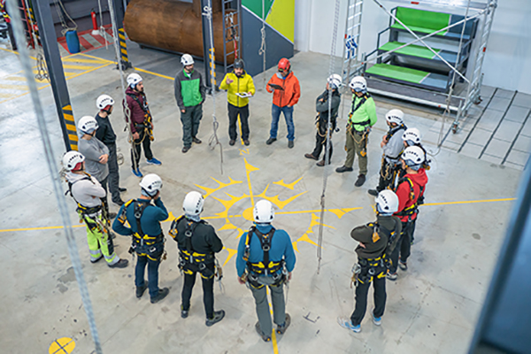
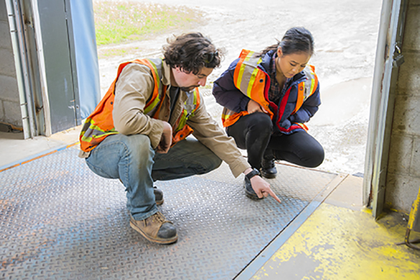
Safe and Sound Campaign What’s It all About?
A year-round program to encourage every workplace to have a safety and health program. Utilizing
Management Leadership
Worker Participation
Finding and Fixing hazards
www.iup.edu/pa-oshaconsultation

Slide 6
Safe and Sound Campaign Toolbox Kit
Challenges
Worksheets and other activities
Resources
www.iup.edu/pa-oshaconsultation

Slide 7
Management Leadership
Commitment from the top to implementing a program and using it to drive continuous improvement in safety and health.
This commitment can be demonstrated in many different ways, including:
Developing and communicating a safety and health policy statement.
Providing the resources needed to implement and operate the program.
Factoring safety and health into operational planning and decisions.
Recognizing or rewarding safety and health contributions and achievements.
Leading by example, by practicing safe behaviors and making safety part of daily conversations.
www.iup.edu/pa-oshaconsultation

Slide 8
Management Leadership Take the Challenge
Take 3 actions in 30 days and share with workplace.
For example, management commits to being present for a least three safety meeting in one month.
Share using company newsletter.
Identify a safety or health issue and take steps to address it.
Employees are not wearing their safety glasses.
Survey employees to determine the roadblocks for them to not wear safety glasses. Implement ways to remove roadblocks i.e. provide more comfortable and better fitting glasses.
Recognize employees, managers, and supervisor for their safety efforts.
Employee of the month gets special parking spot.
www.iup.edu/pa-oshaconsultation

Slide 9
Management Leadership Worksheets and Other Activities
Building a Case for Safety
Form a small team to help form your safety and health program
Assess the reasons your business needs safety and health programs.
Develop a Company Policy
Example questions and language to help write the company policy.
Make a Management Pledge
Example Pledges
Have a visible presence in the workplace conduct regular safety walkthroughs.
Make worker safety and health a core value how safety can impact us personally.
www.iup.edu/pa-oshaconsultation

Slide 10
Management Leadership Resources
www.iup.edu/pa-oshaconsultation

Slide 11
Worker Participation
Workers often know the most about potential hazards associated with their jobs. When they are involved in finding solutions, they feel invested in the program.
Workers can participate in many ways, including:
Developing the initial program design.
Reporting incidents (including near misses) so they can be investigated.
Analyzing hazards associated with routine and nonroutine jobs, tasks, and processes.
Defining and documenting safe work practices.
Conducting site inspections and incident investigations.
Training current coworkers and new hires.
Evaluating program performance and identifying ways to improve it.
www.iup.edu/pa-oshaconsultation

Slide 12
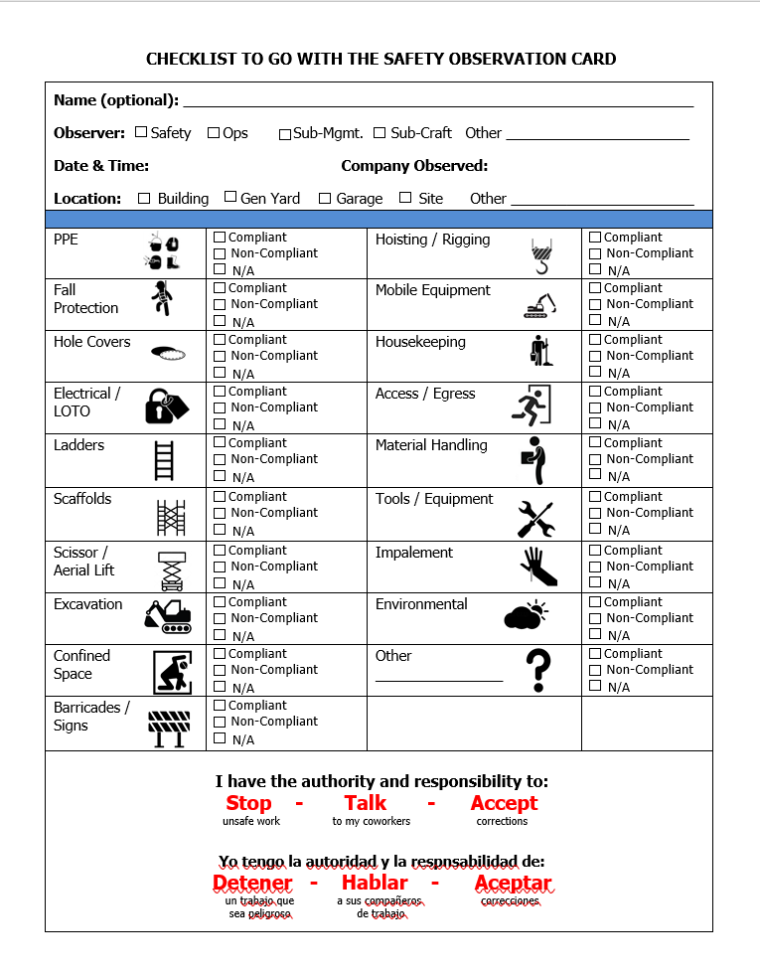
Worker Participation Take the Challenge
Create an environment where all workers feel included, heard, and respected.
The 5-Worker Lunch, Safety Observation Report and Checklist
Review safety reports with the team i.e. inspections, near miss reports, safety observations.
www.iup.edu/pa-oshaconsultation

Slide 13
Worker Participation Worksheets and Other Activities
Make worker participation part of the company policy.
Inform workers of their rights and identify how and when you will inform them.
Use the Safety Climate Assessment Tool developed by CPWR.
Can use free of charge.
Testimonials
“The assessment tool was an excellent opportunity for us to really dive into safety perceptions across our organizational levels and determine improvement opportunities that may not have been identifiable prior to the survey. We learned that although we thought we were rewarding safe behaviors we have an opportunity to better recognize team members for “doing the right thing.” We selected some of the great safety management resources from the large repository and will be developing action plans to implement them and then conduct a twelve-month assessment of the same groups to determine if items implemented improved our safety climate.” (Medium-size General Contractor, Ohio)
“This is a great resource and I hope it stays available with even more to come. I can see us using this ongoing in the future. I’ve told peers about it and will continue to do so!” (Small Specialty Subcontractor, Indiana)
Two videos on overview of tool and how to use it.
www.iup.edu/pa-oshaconsultation

Slide 14
Worker Participation Resources
www.iup.edu/pa-oshaconsultation

Slide 15
Find & Fix Hazards
At the core of every effective safety and health program is a systematic process for identifying and controlling (i.e., finding and fixing) workplace hazards.
Traditional approaches to finding and fixing workplace hazards are often reactive. Finding and fixing hazards using a proactive approach, before they cause injury or illness, is far more effective.
A systematic find and fix approach means:
Involving workers, who often have the best understanding of the conditions that create hazards and insights into how they can be controlled.
Reviewing all available information about hazards that might be present.
Conducting inspections to identify new or emerging hazards.
Investigating incidents to identify root causes and potential solutions.
Evaluating options using the "hierarchy of controls."
Considering how to protect workers during emergencies and nonroutine activities.
Checking that existing controls are intact and remain effective.
www.iup.edu/pa-oshaconsultation

Slide 16
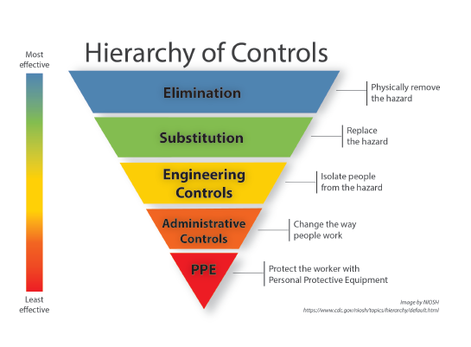
Find & Fix Hazards Take the Challenge
Identify where your hazards are by conducting walkthrough inspection, review injury logs.
Involve workers by establishing way to report hazards.
Plan to control hazards.
Control hazards with permanent and effective methods.
Conduct workplace inspections on a regular basis.
Follow up on what you found.
Brainstorm one hazard to control.
Identify a control
using the “Hierarchy of Controls”
www.iup.edu/pa-oshaconsultation

Slide 17
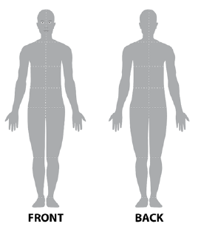
Find & Fix Hazards Worksheets and Other Activities
Involve Workers in Hazard Identification
Draw a large outline sketch of a person on butcher paper or a white board.
Include a front side and back side.
Ask workers to identify parts of the body that have been (or could be) injured or stressed by their job by placing a dot on the drawing. They should include things that have happened (or might happen) to them when something goes wrong on the job.
Record what workers have identified (body part affected, hazard, activity involved, work area/location).
Review other sources of hazard information
SDSs, Injury and Near Miss Reporting
Employer Checklist for Heat Illness Prevention
www.iup.edu/pa-oshaconsultation

Slide 18
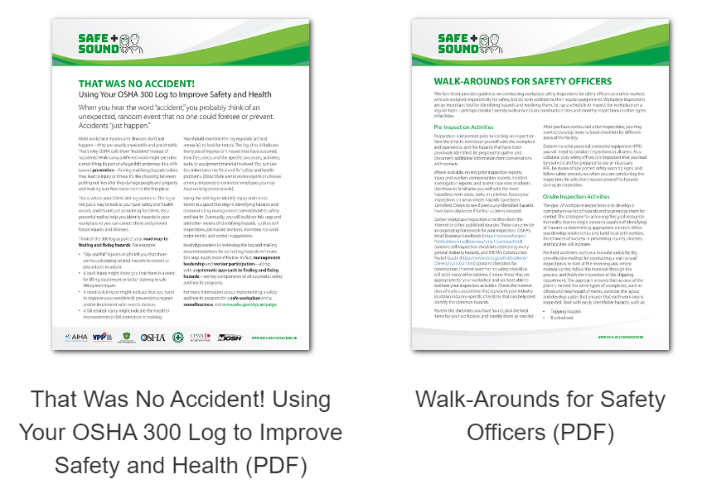
Find and Fix Hazards Resources
www.iup.edu/pa-oshaconsultation

Slide 19
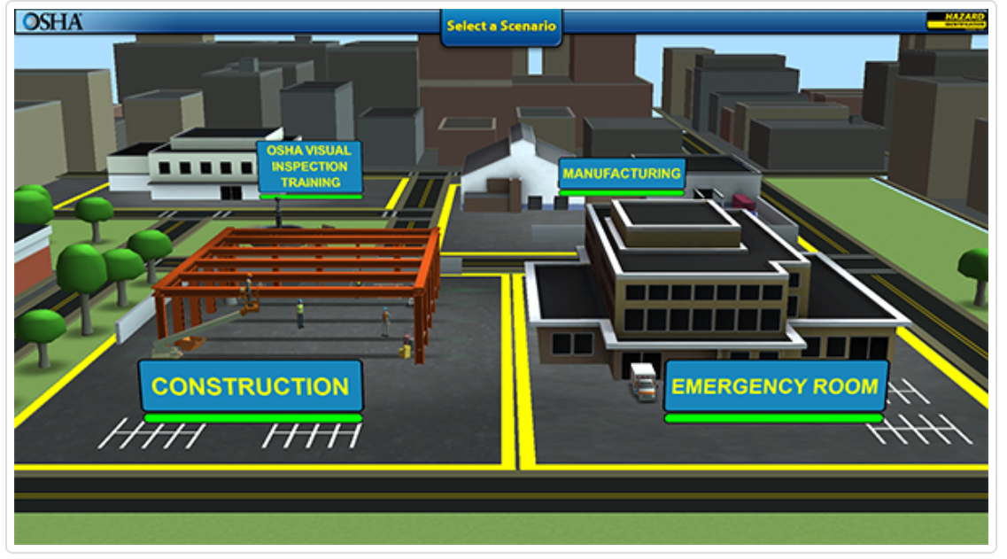
Find and Fix Hazards OSHA Hazard Identification Training Tool
Interactive, online, game-based training tool for small business owners, workers and others interested in learning the core concepts of hazard identification.
This tool is intended to:
Teach small business owners and their workers the process for finding hazards in their workplace
Raise awareness on the types of information and resources about workplace hazards available on OSHA's website.
www.iup.edu/pa-oshaconsultation

Slide 20
Safe and Sound Week MicroLearning Video
www.iup.edu/pa-oshaconsultation

Slide 21
Sign Up for Safe + Sound Week
Join businesses around the country in pledging your commitment to workplace safety and health
Take the Pledge: https://www.osha.gov/safeandsoundweek
Notes:
Safe + Sound Week is a time to take action and reflect on and recognize the efforts you have made to improve workplace safety and health throughout the year. This year we are asking you to reaffirm your commitment to safety and health, including making safety a core value, and taking action to improve your safety and health program during Safe + Sound Week by taking the Safe + Sound Week pledge.

Slide 22
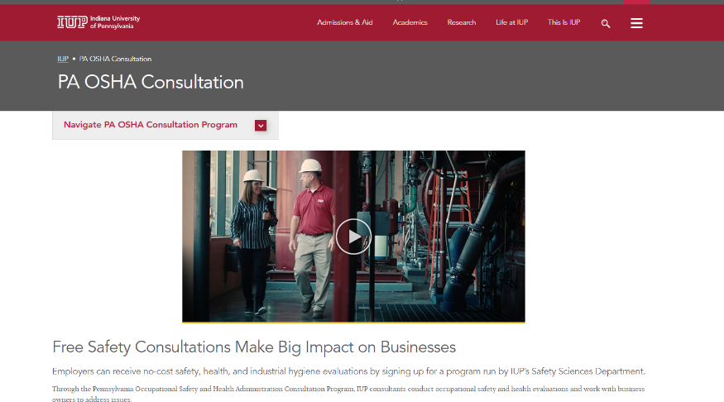
www.iup.edu/pa-oshaconsultation
www.iup.edu/pa-oshaconsultation

Slide 23
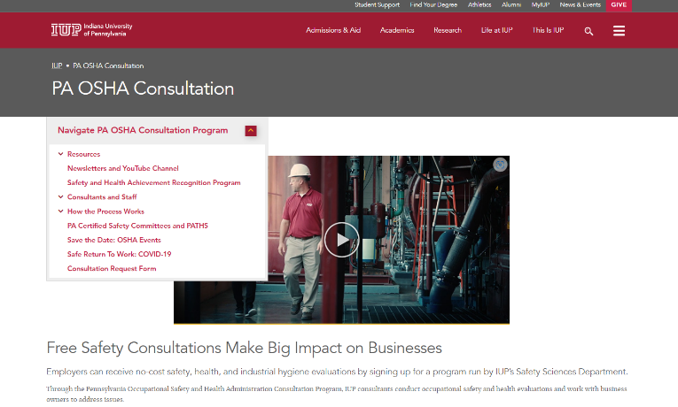
www.iup.edu/pa-oshaconsultation
www.iup.edu/pa-oshaconsultation

Slide 24
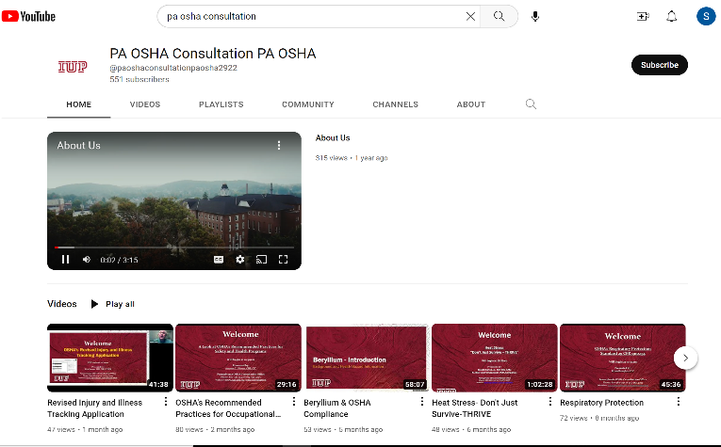
Please consider subscribing to our youtube channel to be notified of new webinars: https://www.youtube.com/@paoshaconsultationpaosha2922
www.iup.edu/pa-oshaconsultation

Slide 25
Contact us
Annette Olesen, CIH, CIT
aolesen@iup.edu
Pennsylvania OSHA Consultation Office
Phone: 800-382-1241
Website: www.iup.edu/pa-oshaconsultation/
Facebook: https://www.facebook.com/Pennsylvania-OSHA-Consultation-Program-548810235234647/
Twitter: https://twitter.com/search?q=PA%20OSHA%20Consultation&src=savs
www.iup.edu/pa-oshaconsultation

Slide 26
Thank You
Upcoming Webinar:
Mental Wellness and the Impact on Employee Safety
July 19, 2023@ 10:30am
Pennsylvania OSHA Consultation Office
Phone: 800-382-1241 or 724-357-4095
Website: www.iup.edu/pa-oshaconsultation
www.iup.edu/pa-oshaconsultation

