Slide 1
Welcome
OSHA’s Respiratory Protection Standard 29 CFR 1910.134
Will begin at 10:30am
Presented by:
Bryan Brougher, CSP
Pennsylvania OSHA Consultation Office
Phone: 800-382-1241 or 724-357-4095
Website: www.iup.edu/pa-oshaconsultation

Slide 2
OSHA’s Respiratory Protection Standard 29 CFR 1910.134
Webinar General Info
PowerPoint Presentation
Q&A
Questions
Chat is open to submit questions.
We will be answering questions through this chat feature. If due to the technical nature of the question a more thorough response is required, we will post the answer on our website within seven days of the webinar.
www.iup.edu/pa-oshaconsultation

Slide 3
Scope
This standard applies to:
General Industry (Part 1910),
Shipyards (Part 1915),
Marine Terminals (Part 1917),
Longshoring (Part 1918), and
Construction (Part 1926).

Slide 4
Scope
Revisions to Specific OSHA Standards
Respirator-related provisions of OSHA’s existing standards are revised to conform to each other and covered in 29 CFR 1910.134
All provisions addressing respirator use, selection, and fit testing are deleted from OSHA’s substance-specific standards

Slide 5
Organization of Standard
(f) Fit testing
(g) Use of respirators
(h) Maintenance and care
(i) Breathing air quality and use
(j) Identification of filters, cartridges, and canisters
(a) Permissible practice
(b) Definitions
(c) Respirator program
(d) Selection of respirators
(e) Medical evaluation

Slide 6
Organization of Standard
(k) Training and information
(l) Program evaluation
(m) Recordkeeping
(n) Dates
(o) Appendices (mandatory)
A: Fit Testing Procedures
B-1: User Seal Checks
B-2: Cleaning Procedures
C: Medical Questionnaire
D: Information for Employees Wearing Respirators When Not Required Under the Standard

Slide 7
Permissible Practice
The primary means to control - feasible engineering controls
Not feasible or while being instituted - Respiratory protection
Employer provided respirators - applicable and suitable
Employer responsible for establishment and maintenance of a respirator program

Slide 8
Definitions
Employee Exposure
Exposure to a concentration of an airborne contaminant that would occur if the employee were not using respiratory protection.

Slide 9
Definitions
Respiratory Inlet Covering
Portion of respirator that forms the protective barrier between user’s respiratory tract and an air-purifying device or breathing air source, or both.

Slide 10
Tight-Fitting Coverings
Quarter Mask
Half Mask
Full Facepiece
Mouthpiece/Nose Clamp
(no fit test required)

Slide 11
Loose-Fitting Coverings
Hood
Helmet
Loose-Fitting
Facepiece
Full Body Suit

Slide 12
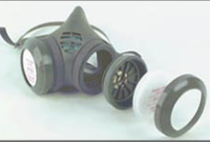
Definitions
Filter or air purifying element
A component used in respirators to remove solid or liquid aerosols from the inspired air.

Slide 13
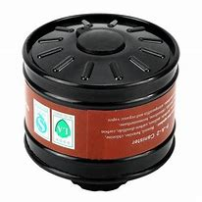
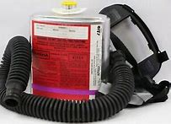
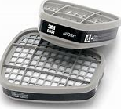
Definitions
Canister or Cartridge
A container with a filter, sorbent, or catalyst, or combination of these items, which removes specific contaminants from the air passed through the container.

Slide 14
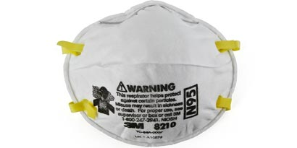
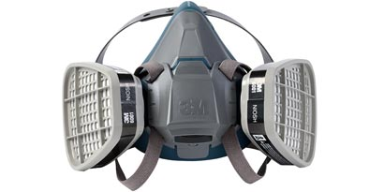
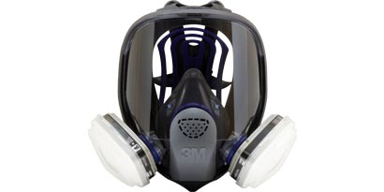
Definitions
Negative Pressure Respirator
A respirator in which the air pressure inside the facepiece is negative during inhalation with respect to the ambient air pressure outside the respirator.

Slide 15
Definitions
Filtering Facepiece (Dust Mask)
A negative pressure particulate respirator with a filter as an integral part of the facepiece or with the entire facepiece composed of the filtering medium.

Slide 16
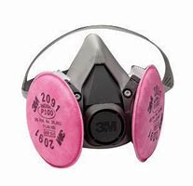
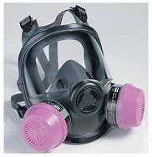
Definitions
Air-Purifying Respirator (APR)
A respirator with an air-purifying filter, cartridge, or canister that removes specific air contaminants by passing ambient air through the air-purifying element.

Slide 17
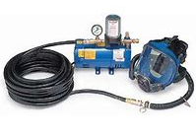
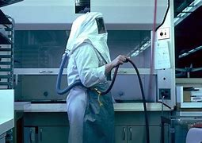
Definitions
Positive Pressure Respirator
A respirator in which the pressure inside the respiratory inlet covering exceeds the ambient air pressure outside the respirator.

Slide 18
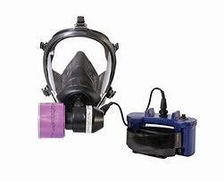
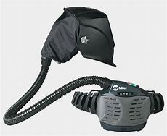
Definitions
Powered Air-Purifying Respirator (PAPR)
An air-purifying respirator that uses a blower to force the ambient air through air-purifying elements to the inlet covering.

Slide 19
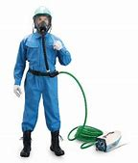
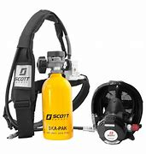
Definitions
Atmosphere-Supplying Respirator
A respirator that supplies the user with breathing air from a source independent of the ambient atmosphere
Includes supplied-air respirators (SARs) and self-contained breathing apparatus (SCBA) units

Slide 20
Definitions
Classes of Atmosphere- Supplying Respirators
Continuous Flow
Demand
Pressure Demand

Slide 21
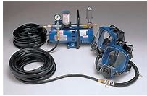
Definitions
Supplied Air Respirator (SAR) or Airline Respirator
An atmosphere-supplying respirator for which the source of breathing air is not designed to be carried by the user.

Slide 22
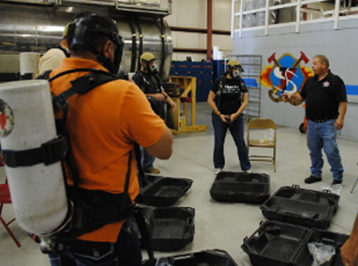
Definitions
Self-Contained Breathing Apparatus (SCBA)
An atmosphere-supplying respirator for which the breathing air source is designed to be carried by the user.

Slide 23
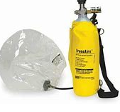
Definitions
Escape-Only Respirator
A respirator intended to be used only for emergency exit

Slide 24
Respirator Program
Written program - worksite-specific procedures
Must update program as necessary
Program administrator qualified person to administer the program
Must provide:
  Respirators
  Training
  Medical evaluations
  ……at no cost to the employee
Note: See Small Entity Compliance Guide

Slide 25
Respirator Program
Where Respirator Use is Not Required
Provide at employee’s request or permit employees to use their own respirators, if such use in itself will not create a hazard
Voluntary - provide users with the information contained in Appendix D
Establish and implement minimal elements of written program … ensure that:
  Medically able to use the respirator
  cleaned
  stored
  maintained so it does not present a health hazard to the user
Exception: Voluntary use of filtering facepieces (dust masks), are not required to be included in written program.

Slide 26
Respirator Program Elements
1. Selection
2. Medical evaluation
3. Fit testing
4. Use
5. Maintenance and care
6. Breathing air quality and use
7. Training
8. Program evaluation

Slide 27
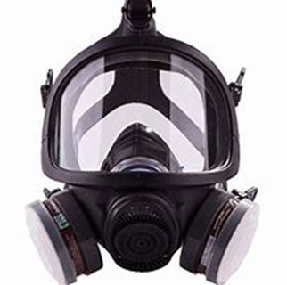
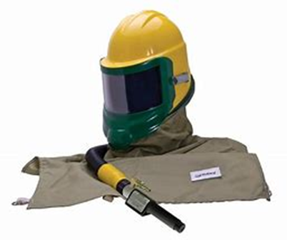
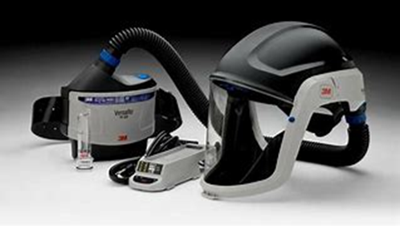
Selection of Respirators
Selection based on hazards and factors that affect respirator performance and reliability

Slide 28
Selection of Respirators
Types of Respirators
Facepiece (quarter, half, full)
Positive and Negative Pressure
Loose and Tight Fitting
Air Purifying (APR) and Air Supplied (SAR)

Slide 29
Selection of Respirators
Types of Respirators
Half Mask Negative APR
Full Face Negative APR
PAPR Positive APR
SAR Positive SAR
  - SCBA
  - Bottled Air
  - Compressor

Slide 30
Selection of Respirators
NIOSH-certified respirator - in compliance with the conditions of its certification
Identify and evaluate the respiratory hazards
Immediately Dangerous to Life or Health (IDLH)
Select respirators from a sufficient number of models and sizes

Slide 31
Selection of Respirators
Immediately Dangerous to Life and Health (IDLH)
An atmosphere that poses an immediate threat to life, would cause irreversible adverse health effects, or would impair an individual’s ability to escape from a dangerous atmosphere.

Slide 32
Selection of Respirators
Oxygen Deficient Atmosphere
An atmosphere with an oxygen content below 19.5% by volume
All oxygen deficient atmospheres are considered IDLH

Slide 33
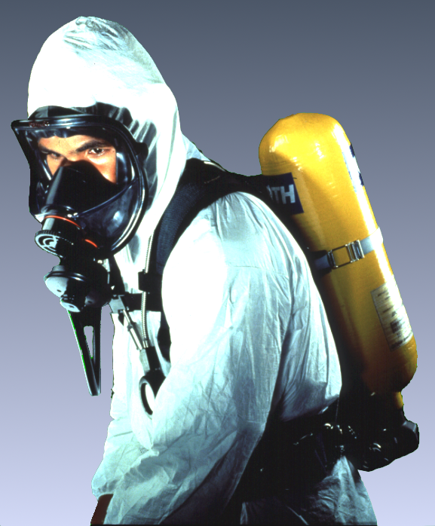
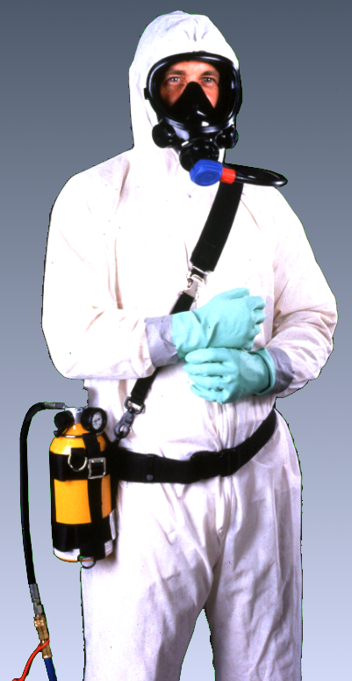
Selection of Respirators
Respirators for IDLH Atmospheres
Full Facepiece Pressure Demand SCBA certified by NIOSH for a minimum service life of 30 minutes
Full Facepiece Pressure Demand SAR with Auxiliary Combination Self-Contained Air Supply

Slide 34
Respirators for IDLH Atmospheres (cont’d)
Selection of Respirators
Respirators only for escape from IDLH atmospheres: NIOSH-certified for escape from the atmosphere in which they will be used.
Exception: Employers may use any atmosphere-supplying respirator, provided they can demonstrate, under all foreseeable conditions, that oxygen levels in the work area can be maintained between 19.5% and a lower value that corresponds to an altitude-adjusted oxygen partial pressure equivalent to 16% oxygen at sea level).

Slide 35
Selection of Respirators
Assigned Protection Factor (APF) - DEFINITION:
The workplace level of respiratory protection that a respirator or class of respirators is expected to provide to employees when the employer implements a continuing, effective respiratory protection program as specified in this section.

Slide 36
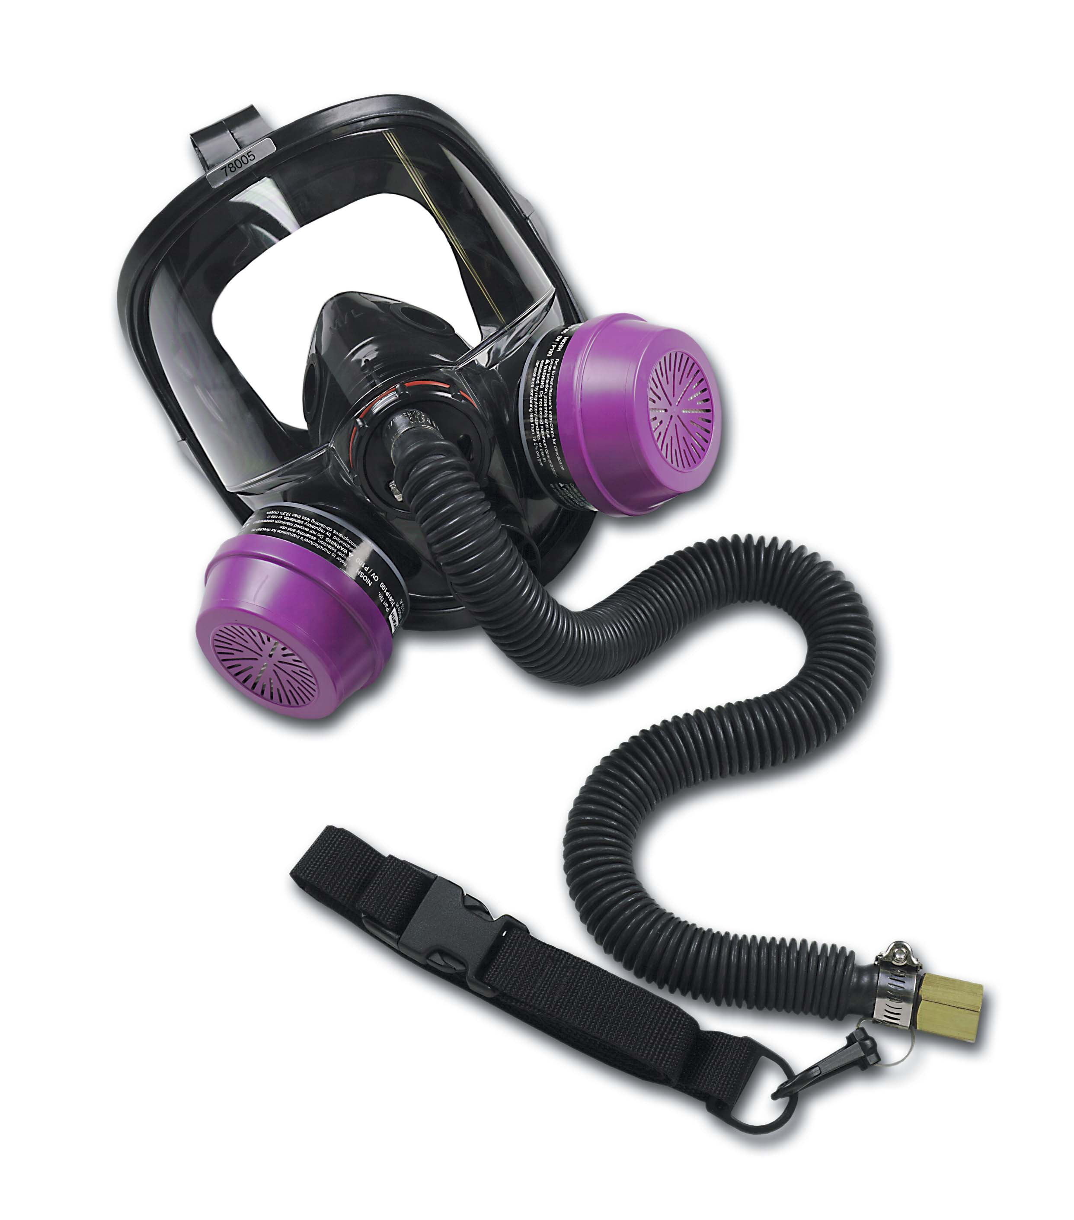
Selection of Respirators
Assigned Protection Factors (APF’s)
Must use the APF’s listed in Table 1 (next slide)
Combination respirator (e.g., airline with an air-purifying filter), ensure APF is appropriate to the mode of operation

Slide 37
TABLE 1 – ASSIGNED PROTECTION FACTORS⁵
Respirator Type^{1, 2} | Quarter Mask | Half Mask | Full Face | Helmet/Hood | Loose-Fitting
Air Purifying | 5 | ³10 | 50 | ----------------- | -----------------
PAPR | -------------------- | 50 | 1,000 | ⁴25/1,000 | 25
SAR Demand Continuous Flow Pressure Demand/ other (+) pressure | -------------------- -------------------- -------------------- | 10 50 50 | 50 1,000 1,000 | --------------------- ⁴25/1,000 --------------------- | -------------------- 25 --------------------
SCBA Demand Pressure Demand/ other (+) pressure | -------------------- -------------------- | 10 ------------------ | 50 10,000 | 50 10,000 | ----------------------------------------
¹May use respirators assigned for higher concentrations in lower concentrations or when required use is independent of concentration.
²These APF’s are only effective when employer has a continuing, effective respirator program per 1910.134.
³This APF category includes filtering facepieces and elastomeric facepieces.
⁴Must have manufacturer test evidence to support an APF of 1,000 or else these respirators receive an APF of 25.
⁵These APFs do not apply to escape-only respirators. Escape respirators must conform to 1910.134(d)(2)(ii) or OSHA’s substance specific standards, if used with those substances.

Slide 38
Selection of Respirators
Maximum Use Concentration (MUC) - DEFINITION:
The maximum atmospheric concentration of a hazardous substance from which an employee can be expected to be protected when wearing a respirator, and is determined by the assigned protection factor of the respirator or class of respirators and the exposure limit of the hazardous substance
MUC = APF x OSHA Exposure Limit¹
¹ When an OSHA exposure limit is NOT available for a hazardous substance, the employer must determine an MUC on the basis of relevant available information and informed professional judgment.

Slide 39
Selection of Respirators
Maximum Use Concentration (MUC)
Maintain exposure to the hazardous substance, when measured outside the respirator, at or below the MUC
MUCs do not apply to IDLH.
When calculated MUC exceeds the IDLH or the performance limits of the cartridge or canister, set maximum MUC at that lower limit
Select a respirator appropriate for the chemical state and physical form of the contaminant

Slide 40
Selection of Respirators
Maximum Use Concentration - Example
What is the MUC for an employee wearing a half-mask air purifying respirator (APF=10) in an atmosphere of sulfur dioxide gas (PEL=5 ppm)?
MUC = APF x OSHA Exposure Limit
MUC = 10 x 5 ppm = 50 ppm
Note that this calculated value does not exceed the IDLH level for sulfur dioxide (100 ppm), so that the MUC for this example would be 50 ppm.

Slide 41
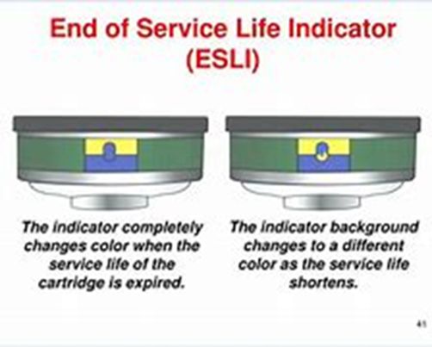
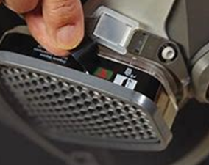
Selection of Respirators
Respirators for Atmospheres NOT IDLH
Gases and Vapors
Atmosphere-supplying respirator, or
Air-purifying respirator, if:
  End-of-Service-Life Indicator (ESLI)
  No ESLI create a change schedule based on objective information or data ensuring changed before the end of their service life
    Describe the information and data relied upon and basis for the change schedule and reliance on the data

Slide 42
Selection of Respirators
For Particulate Exposures that are NOT IDLH
Employer must provide:
  an atmosphere-supplying respirator; or
  Air-purifying respirator equipped with HEPA filters certified by NIOSH under 30 CFR Part 11 or with filters certified for particulates under 42 CFR Part 84; or
  Air-purifying respirator equipped with any filter certified for particulates by NIOSH for contaminants consisting primarily of particles with mass median aerodynamic diameters of at least 2 micrometers

Slide 43
Selection of Respirators
Classes of Nonpowered Air-Purifying Particulate Filters:
Nine classes: Three levels of filter efficiency (%), each with three categories of resistance to filter efficiency degradation due to the presence of oil aerosols (NRP).
N R P
100 100
99 99 99
95 95 95
N for Not resistant to oil
R for Resistant to oil
P for oil Proof
Notes:
- While Part 11 classifications were substance-specific (dust, fume, mist, etc.), Part 84 classifies particulate filters by efficiency and performance characteristics against non-oil and oil-containing hazards.
- There are nine classes of filters (three levels of filter efficiency, each with three categories of resistance to filter efficiency degradation).
- Levels of filter efficiency are 95%, 99%, and 99.97%.
- Categories of resistance to filter efficiency degradation are labeled N, R, and P.
- Use of the filter will be clearly marked on the filter, filter package, or respirator box (e.g., N95 means N-series filter at least 95% efficient).

Slide 44
Selection of Respirators
N, R, P 100 is 99.7% efficient – N, R, P 95/99/100 clearly marked on box
If no oil particles are present, use any series (N, R, or P)
If oil particles are present, use only R or P series
If oil particles are present and the filter is to be used for more than one work shift, use only P series
Follow the respirator filter manufacturer’s service-time-limit recommendations

Slide 45
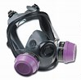
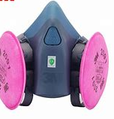
Selection of Respirators
High Efficiency Filters
Filter >99.97% efficient - removing monodisperse particles of 0.3 micrometers in diameter.
(HEPA filter per NIOSH 30 CFR 11)
Equivalent NIOSH 42 CFR 84 particulate filters are the N100, R100, and P100 filters.
Notes:
NIOSH no longer uses the term “HEPA filter” in its new respirator certification standard (42 CFR 84). However, OSHA has retained this definition because it is used in many of the existing substance-specific standards. When HEPA filters are required by an OSHA standard, N100, R100, and P100 filters can be used to replace them.

Slide 46

Medical Evaluation
Procedures
Must provide, before fit testing and use to determine employee’s ability to use a respirator
Must identify a PLHCP to perform medical evaluations
  medical questionnaire or
  an initial medical examination that obtains the same information

Slide 47
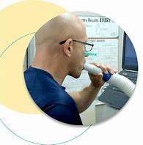
Medical Evaluation
Procedures (c0n’t)
Medical evaluation must obtain the information requested by the questionnaire in Sections 1 and 2, Part A of App. C
Follow-up medical examination is required with
  Positive response to ANY question 1 through 8 in Section 2, Part A of App. C
  Initial medical examination demonstrates the need for a follow-up medical examination

Slide 48
Medical Evaluation
Additional Medical Evaluations
Annual review of medical status is not required
At a minimum, employer must provide additional medical evaluations if:
  Employee reports medical signs or symptoms
  PLHCP, supervisor, or program administrator determines reevaluation needed
  Observations made during fit testing and program evaluation, indicates a need
  Change occurs in workplace conditions that may substantially increase the physiological burden on an employee

Slide 49
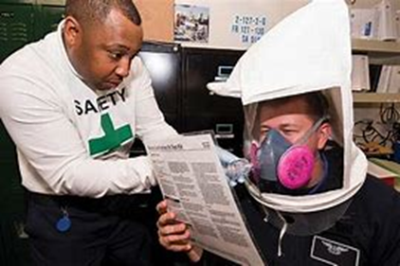
Fit Testing
Before use of negative or positive pressure tight-fitting facepiece employee must be fit tested
- same make, model, style, and size of respirator that will be used.
The fit test must be administered using an OSHA-accepted Qualitative Fit Test (QLFT) or Quantitative Fit Test (QNFT) protocol contained in Appendix A

Slide 50
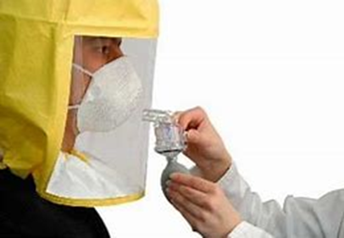
Fit Testing
Qualitative Fit Test (QLFT) - A pass/fail fit test to assess the adequacy of respirator fit that relies on the individual’s response to the test agent.
  QLFT Protocols:
    Isoamyl acetate
    Saccharin
    Bitrex
    Irritant smoke

Slide 51
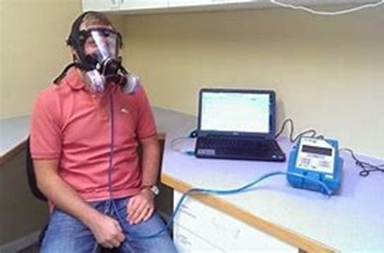
Fit Testing
Quantitative Fit Test (QNFT) - An assessment of the adequacy of respirator fit by numerically measuring the amount of leakage into the respirator.
  QNFT Protocols:
    Generated Aerosol (corn oil, salt, DEHP)
    Condensation Nuclei Counter (CNC - PortaCount)
    Modified Condensed Nuclei Counter for Full/half mask elastomeric respirators (CNC – PortaCount) – different exercises
    Modified Condensed Nuclei Counter for Full/half mask elastomeric respirators (CNC – PortaCount) – different exercises
    Controlled Negative Pressure (Dynatech FitTester 3000)
    Controlled Negative Pressure (CNP) REDON

Slide 52
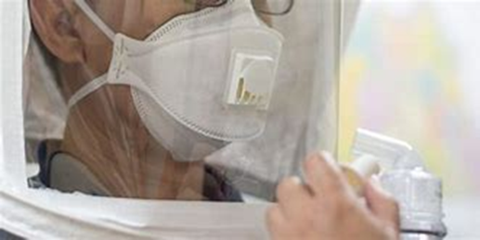
Fit Testing
Employees using tight-fitting facepiece respirators must pass an appropriate (QLFT) or (QNFT):
  prior to initial use,
  whenever a different respirator facepiece is used, and
  at least annually thereafter
Additional fit test
  whenever the employee reports, or
  employer or PLHCP makes visual observations of, changes in the employee’s physical condition that could affect respirator fit

Slide 53
Fit Testing
Fit Factor - A quantitative estimate of the fit of a particular respirator to a specific individual, and typically estimates the ratio:
Concentration of a substance in ambient air
Concentration inside the respirator when worn

Slide 54
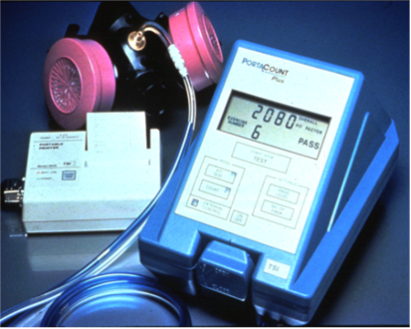
Fit Testing
QLFT may only be used to fit test negative pressure APRs that must achieve a fit factor < 100
The QNFT has been passed if the fit factor is
  >100 for tight-fitting half facepieces or
  > 500 for tight-fitting full facepieces,

Slide 55
Use of Respirators
Facepiece Seal Protection – Tight-fitting respirators
NO facial hair or any condition that interferes with the face-to-facepiece seal or valve function
Corrective glasses or goggles or other PPE CANNOT interfere with the face-to-facepiece seal
Perform user seal check each time they put on the respirator – Follow Appendix B-1 or equivalent

Slide 56
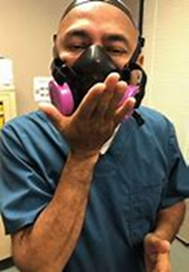
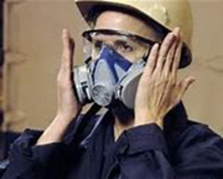
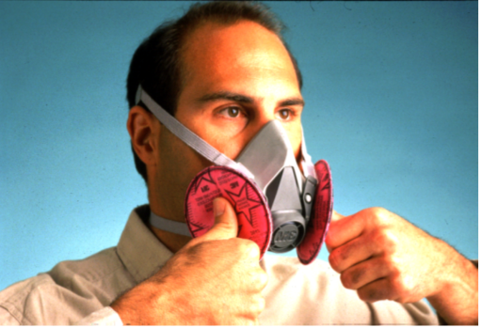


Use of Respirators
User Seal Check - An action conducted by the respirator user to determine if the respirator is properly seated to the face.

Slide 57
Use of Respirators
Continuing Respirator Effectiveness
Survey work area conditions and degree of exposure or stress - reevaluate effectiveness if affected by changes
Employees must leave the respirator use area:
  to wash their faces and respirator facepieces as necessary
  to replace the respirator or filter, cartridge, or canister
  If vapor or gas breakthrough, changes in breathing resistance, or leakage of the facepiece
  …. And employer must replace or repair the respirator before allowing employee to return to the work area

Slide 58
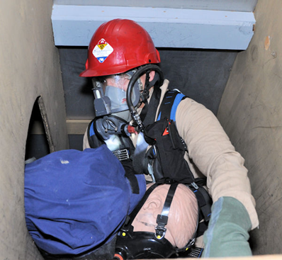
Use of Respirators
Procedures for IDLH Atmospheres
One or more employee(s) must be located outside the IDLH atmosphere
Maintain communication inside to outside - Visual, voice, or signal line
Effective emergency rescue - outside employee must be trained and equipped
Before emergency rescue – notify Employer or authorized designee
Employer or authorized designee, once notified, must provide necessary assistance appropriate to the situation

Slide 59
Use of Respirators
Procedures for IDLH Atmospheres
Equip employees located outside the IDLH atmosphere with:
  a pressure demand or other positive pressure SCBA or SAR with auxiliary SCBA; and either
  appropriate retrieval equipment, where equipment would contribute to the rescue of employees and would not increase the overall risk resulting from entry; or
  equivalent means for rescue where retrieval equipment is not required per above

Slide 60
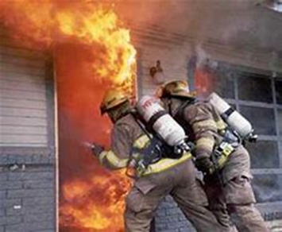
Use of Respirators
Procedures for Interior Structural Firefighting:
> 2 employees must enter and remain in visual or voice contact with one another at all times
> 2 employees outside
Must use SCBAs
additional role (e.g., incident commander) - 1 employee located outside may be assigned but cannot interfere assistance or rescue activities
Does not preclude firefighters from performing emergency rescue before an entire team has assembled

Slide 61
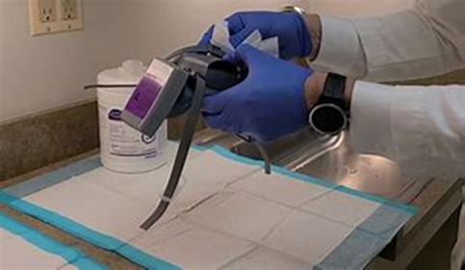
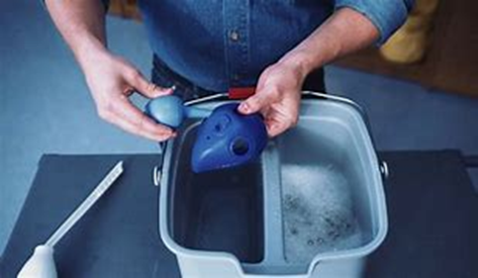
Maintenance and Care
Respirator must be clean, sanitary and good
working order
Follow Appendix B-2 or equivalent
manufacturer’s recommendations
Clean and disinfect:
  Exclusive use - as often as necessary
  Multiple users - before being worn by different user
  Emergency respirators - after each use
  Fit testing and training- after each use

Slide 62
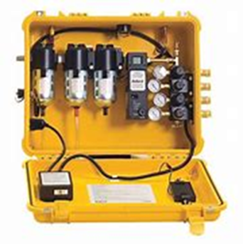
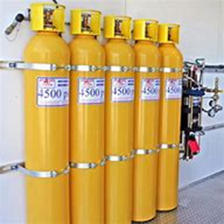
Breathing Air Quality and Use
Compressed breathing air must > ANSI/CGA G-7.1-1989. Type 1 - Grade D breathing:
  Oxygen content of 19.5 - 23.5%
  Hydrocarbon (condensed) content of 5 milligrams per cubic meter (mg/m³) of air or less
  CO < 10 parts per million (ppm)
  CO₂ < 1,000 ppm
  Lack of noticeable odor

Slide 63
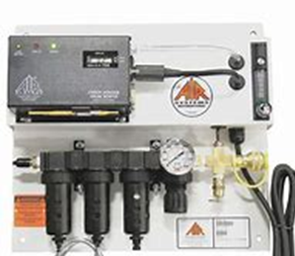
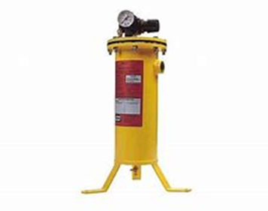
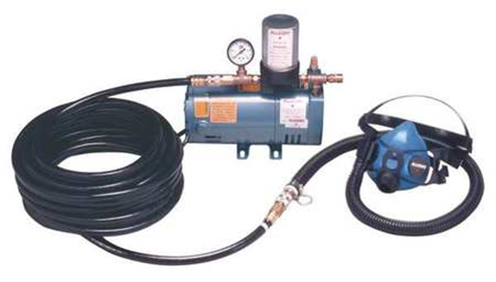
Breathing Air Quality and Use
Compressors supplying breathing air equipped with:
  Suitable in-line air-purifying sorbent beds
  Filters that are maintained and replaced or refurbished per manufacturer’s instructions
Compressors not oil lubricated – Breathing air CO levels > 10 ppm
Oil-lubricated compressors require an alarmto monitor CO levels
  High-temperature or
  CO alarm, or both,
  NOTE: if only high-temperature alarms are used, the air supply must be monitored at sufficient intervals to prevent CO levels from exceeding 10 ppm

Slide 64
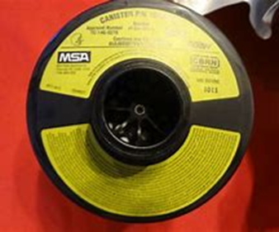
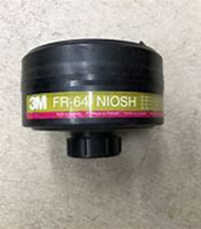
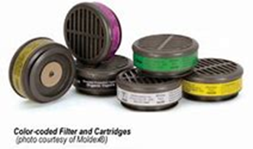
Identification of Filters, Cartridges, and Canisters
Must be color-coded and labeled with NIOSH
approval label
Label must not be removed and must remain
legible
“TC number” is no longer on cartridges or filters
(Part 84)
Marked with “NIOSH”, manufacturer’s name and part number, and an abbreviation to indicate cartridge or filter type (e.g., N95, P100, etc.)
Matrix approval label supplied, usually as insert in box

Slide 65
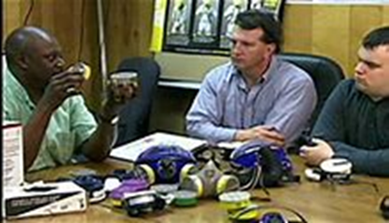
Training and Information
Employers must provide effective training to employees who are required to use respirators.

Slide 66
Training and Information
Must be able to demonstrate knowledge of at least:
  Why the respirator is necessary and how improper fit, use, or maintenance can compromise its protective effect
  Limitations and capabilities of the respirator
  Effective use in emergency situations
  How to inspect, put on and remove, use and check the seals
  Maintenance and storage
  Recognition of medical signs and symptoms that may limit or prevent effective use
  General requirements of this standard

Slide 67

Training and Information
When to perform training:
Prior to use, unless acceptable training has been provided by another employer within the past 12 months
Retraining required annually, and when:
  changes in the workplace or type of respirator render previous training obsolete
  inadequacies in the employee’s knowledge or use
  any other situation arises in which retraining appears necessary
Voluntary use - Basic advisory information in Appendix D – provide to when use is not required by this standard or by the employer

Slide 68
Program Evaluation
Conduct evaluations of the workplace as necessary to ensure effective implementation of the program
Must regularly consult employees required to use respirators to assess their views on program effectiveness and to identify and correct any problems
  factors to be assessed include, but are not limited to:
    respirator fit (including effect on workplace performance)
    appropriate selection
    proper use
    proper maintenance

Slide 69


Recordkeeping
Records of medical evaluations must be retained and made available per 29 CFR 1910.1020
A record of fit tests must be established and retained until the next fit test is administered
A written copy of the current program must be retained
Written materials required to be retained must be made available upon request to affected employees and OSHA

Slide 70
References
OSHA’s 1910.134 standard - https://www.osha.gov/laws-regs/regulations/standardnumber/1910/1910.134
OSHA’s Safety and Health Topics - Respiratory Protection - https://www.osha.gov/respiratory-protection
OSHA Small Entity Compliance Guide for the Respiratory Protection Standard – OSHA 3384-2011
NIOSH Respirator Selection Logic – U. S. Department of Health and Human Services, Centers for Disease Control and Prevention, National Institute for Occupational Safety and Health. October 2004
IUP, PA/OSHA Consultation Resources – Respiratory Protection 29 CFR 1910.134 Safety Training Presentation 2020
3M Occupational Health and Safety Division, MSA, North Safety Products and TSI for high contributing some of the graphics used in this program. Appearance of their products does not imply endorsement by IUP, PA/OSHA Consultation Program.
National Resource Center (Consortium), West Virginia University, Safety and Health Extension (Lead Organization). 3604 Collins Ferry Road P.O. Box 6615, Morgantown, WV www.wvusafetyandhealth.org
www.iup.edu/pa-oshaconsultation

Slide 71

www.iup.edu/pa-oshaconsultation

Slide 72
Contact us
Bryan B. Brougher
Brougher@iup.edu
Pennsylvania OSHA Consultation Office
Phone: 800-382-1241
Website: www.iup.edu/pa-oshaconsultation/
Facebook: https://www.facebook.com/Pennsylvania-OSHA-Consultation-Program-548810235234647/
Twitter: https://twitter.com/search?q=PA%20OSHA%20Consultation&src=savs
www.iup.edu/pa-oshaconsultation

Slide 73
Thank You
Upcoming Webinar:
Beryllium & the OSHA Standard
October 5, 2022 @ 10:30am
Pennsylvania OSHA Consultation Office
Phone: 800-382-1241 or 724-357-4095
Website: www.iup.edu/pa-oshaconsultation
www.iup.edu/pa-oshaconsultation

