Slide 1
Welcome PATHS Overview Webinar will begin at 10:00am Presented by: Juan M. Mayo, Health & Safety Training Specialist
Pennsylvania Department of Labor & Industry
Bureau of Workers’ Compensation Pennsylvania OSHA Consultation Office Phone: 724-357-4095 Website: www.iup.edu/pa-oshaconsultation

Slide 2
PATHS
PA Bureau of Workers’ Compensation
Health & Safety Division
PennsylvaniA Training for Health & Safety
Notes:
The Pennsylvania Training for Health & Safety (PATHS) program was developed and is administered by the Pennsylvania Department of Labor & Industry, Bureau of Workers’ Comp, Health & Safety Division.

Slide 3
What PATHS is
A statewide service established by PA Department of Labor & Industry (L&I), Bureau of Workers’ Compensation (BWC), Health & Safety Division.
Provides employers and employees with easy access to cost-effective health & safety resources.
PennsylvaniA Training for Health & Safety
REV 02/2025
Notes:
PATHS is a “no-fee” service available to all employers and employees within the Commonwealth of Pennsylvania and since its development and launching in 2012 has provided training to approximately 100,000 employees some of whom are not within Pennsylvania but have participated in our programs through webinars.

Slide 4
What PATHS is continued
Services offered enable WC system participants to achieve greater efficiencies in their WC cost-containment efforts by creating safer workplaces.
Provides employers with a single, comprehensive website to view all health & safety related materials available.
PennsylvaniA Training for Health & Safety

Slide 5
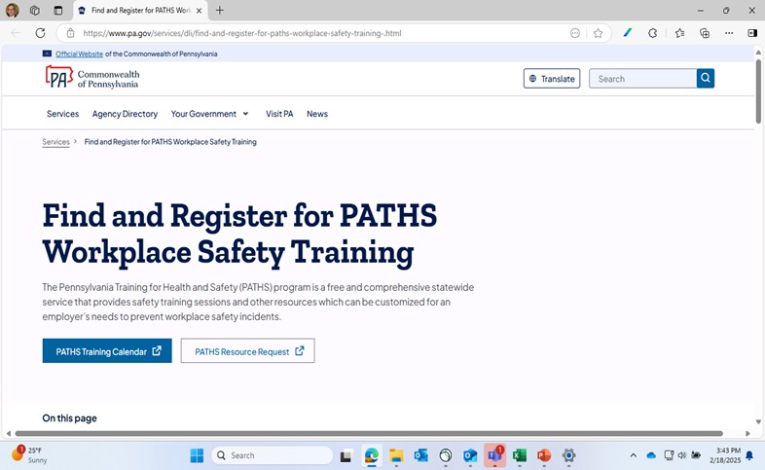
PATHS Website
PATHS | Department of Labor and Industry | Commonwealth of Pennsylvania
PennsylvaniA Training for Health & Safety
Notes:
The PATHS website was updated in 2016 to be more “user friendly.” The website has been used by employers both within and outside Pennsylvania to assist in providing education as well as injury prevention within their workplace.
PATHS website:
https://www.pa.gov/agencies/dli/resources/for-employers-and-educators/workers--compensation-for-employers/workers--compensation-compliance/health-and-safety-division/paths.html#accordion-25d6a25e93-item-ca51cd594e

Slide 6
On the PATHS Website
A person can access the following:
Training Calendar
Training Resources including PowerPoints, Posters, Toolbox Talks, etc.
Safety Forms
Safety Publications
Safety related links
Contact Information
PennsylvaniA Training for Health & Safety
Notes:
A user of the PATHS website has access to many different types of safety related products such as training, safety forms and publications as well as being able to see what types of training is being offered in the future. In addition, users can register for webinars on-line.

Slide 7
Training Topics
There are currently over 200 different safety and health related topics that can be presented on site or by webinar and this number is constantly growing. Here are some examples of the training that can be provided:
Active Shooter
Bloodborne Pathogens
Confined Space
Distracted Driving
Emergency Action Plans
Fall Protection
Grilling Safety
Near Miss
Opioid Use Disorder
Poison Ivy
Return to Work
Right to Know
PennsylvaniA Training for Health & Safety
Notes:
Currently there are 220 different safety and health topics that can be presented by one of the trainers either on-site or by webinar. The topics include both on and off the job safety as well as home fire prevention and information on how to deal with angry people, workplace harassment, and difficult co-workers.

Slide 8
No Fees - Exceptions
There is normally no cost associated with the training provided with the exception of the following topics:
CPR/First Aid (Cost of Books and training devices)
OSHA 10 & 30 Hour (Cost of Course Completion Cards)
The National Safety Council’s four-hour Defensive Driving Course (DDC 4) is offered free of charge and includes a Student Guide each attendee is issued as well as a course completion certificate and wallet card.
PennsylvaniA Training for Health & Safety
Notes:
Most of the training offered is free with the exception of the courses listed due to the cost associated with materials provided.

Slide 9
Criteria for Training
For on-site training we require at least twenty-five (25) people to attend, whether that’s achieved during one session or several throughout the day.
An on-site visit also requires a training location/area that is “conducive to learning” (e.g. climate controlled, adequate space, etc.)
On-site training also requires a requesting employer to complete a “Pre-Training Questionnaire.”
PennsylvaniA Training for Health & Safety
Notes:
While instructors do their best to accommodate a training request, there is certain criteria that needs to be met before training can be scheduled.

Slide 10
Criteria for Training continued
To provide training by webinar only ten (10) individuals are required.
Webinar training requires the employer to have:
A computer with internet capabilities
Projector if using one computer for all involved
PennsylvaniA Training for Health & Safety

Slide 11
Statistics
Attendees from 49 out of 50 states.
Attendees from other locations include: Canada, Puerto Rico, Mexico, Washington D.C, China and Germany
PATHS has over 200 safety related PowerPoints.
PennsylvaniA Training for Health & Safety
Notes:
PATHS Webinars have included attendees from 49 out of the 50 states in the United States, Paths has not had attendees from Hawaii. Paths Training Webinars have also reached out to other locations which include Canada, Puerto Rico, Mexico , China and Germany.

Slide 12
Summary
There are very few, if any, states that have a program similar to PATHS.
PATHS is a no-fee program that provides safety and health related training to any and all employers and employees within Pennsylvania.
The PATHS website provides safety and health related training presentations, posters, forms, publications and training schedules.
PennsylvaniA Training for Health & Safety
Notes:
The BWC is very proud of the PATHS program and the instructors associated with it; with the addition of more competent instructors the program will only continue to grow and provide training and incident prevention services to employers and employees within the state of Pennsylvania.

Slide 13
Training Team
Trainers pictured left to right: Joseph Zinobile, Juan Mayo, Dara Deroiste, and Linda Quinby.
PennsylvaniA Training for Health & Safety

Slide 14
Contact Information
Health & Safety Training Specialists
(717) 772-1635
RA-LI-BWC-PATHS@pa.gov
Upcoming PATHS Webinars
Request for Topic Resources
PennsylvaniA Training for Health & Safety
Notes:
Upcoming PATHS Webinars available from: https://www.pa.gov/en/services/dli/find-and-register-for-paths-workplace-safety-training-.html
Request for Topic Resources: https://forms.office.com/Pages/ResponsePage.aspx?id=QSiOQSgB1U2bbEf8Wpob3mV1QUieF2dOqe6x_REn8adUMVg5UFJGNERQOUVGVDBEMzBRRUVLT0dMUC4u

Slide 15
Questions
PennsylvaniA Training for Health & Safety

Slide 16
PennOSHS Program
Link to website for
additional
information
PennsylvaniA Training for Health & Safety
Notes:
Website for additional information on the Pennsylvania Department of Health’s Occupational Safety & Health Surveillance Program: https://www.health.pa.gov/topics/envirohealth/Pages/PennOSHS.aspx

Slide 17
Pennsylvania’s GASE Award
Are you proud of your safety program?
Does it go above and beyond?
If so, we want to
hear from you.
Apply from
January 1st to May 1st to be recognized for our state’s highest safety honor.
Link for additional information
PennsylvaniA Training for Health & Safety
Notes:
Website for additional information on the Pennsylvania Governor’s Award for Safety Excellence:
https://www.pa.gov/en/agencies/dli/resources/for-employers-and-educators/workers--compensation-for-employers/governor-s-award-for-safety-excellence--gase-.html

Slide 18
Request an onsite consultation visit:
www.iup.edu/pa-oshaconsultation
www.iup.edu/pa-oshaconsultation

Slide 19
Contact us
Pennsylvania OSHA Consultation Office
Phone: 724-357-4095
Website: www.iup.edu/pa-oshaconsultation/
Facebook: https://www.facebook.com/Pennsylvania-OSHA-Consultation-Program-548810235234647/
YouTube channel: https://www.youtube.com/@paoshaconsultationpaosha2922
www.iup.edu/pa-oshaconsultation

