Slide 1
Welcome Pennsylvania’s Certified Workplace Safety Committee Program Webinar will begin at 10:00am Presented by: Juan M. Mayo Pennsylvania OSHA Consultation Office Phone: 724-357-4095 Website: www.iup.edu/pa-oshaconsultation

Slide 2
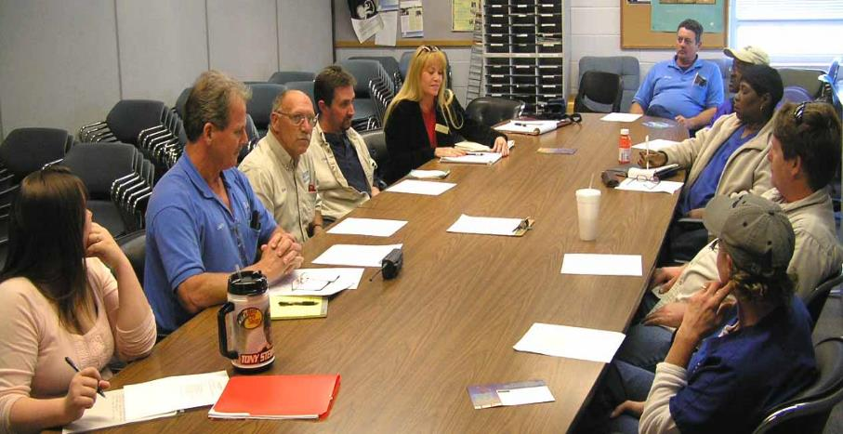
Introduction
Pennsylvania’s Certified Workplace Safety Committee Program
Pennsylvania's Certified Workplace Safety Committee Program
REV 05/2025
Notes:
A Workplace Safety Committee is a joint employer and employee committee established at a workplace for the purpose of hazard detection and accident and illness prevention activities. More and more employers are discovering that safety really does pay. Employers who follow Pennsylvania’s workplace safety committee requirements and regulations can apply for state certification and receive annual 5 percent discounts on workers’ compensation insurance premiums. Application is made through the Pennsylvania Department of Labor & Industry, Bureau of Workers’ Compensation, Health & Safety Division.

Slide 3
Topics
History
Cost Savings
Benefits
Starting a Committee
Committee Requirements
Submitting applications
Rules and Bylaws
Yearly Requirements
Monthly Meetings
Audit Overview
Online Help
PATHS Safety Trainings
Pennsylvania's Certified Workplace Safety Committee Program
REV 05/2025

Slide 4
History
1993 Workers’ Compensation Act amended to add: 5% policy premium discount for creating a Certified Workplace Safety Committee (CWSC).
1996 Premium discount extended for 4 renewal years.
2002 Amended to allow unlimited discount periods.*
* Assuming all mandated compliance requirements are maintained.
Pennsylvania's Certified Workplace Safety Committee Program
REV 05/2025
Notes:
With the passage of the Pennsylvania Workers’ Compensation Act of 1915, employees became protected by employer-financed workers’ compensation insurance when injury, death, or disease resulted directly from employment. Under workers’ compensation, an employer accepts liability for work injuries, regardless of fault (so the defenses of contributory negligence, assumption of risk, and the fellow-servant rule are not available to the employer). In exchange, employers are protected from civil damage suits and the payment of sizeable settlements, even if there was negligence. Periodically the Pennsylvania Legislature amends the Workers’ Compensation Act.
2002: Employers with certified safety committees may renew certification for an unlimited number of times as long as they:
1) continue to meet all requirements for certification;
(2) submit the properly completed certification renewal forms between 90 and 15 days in advance of their workers’ compensation policy renewal date; and
(3) maintain workers’ compensation insurance with a carrier licensed in Pennsylvania.
[Updated per Act 202, Pa State Bill 813, Section 1002 (December 9, 2002)].

Slide 5
Savings
Employer cumulative total premium savings: Over $936,000,000 Reflects 5% premium savings.
Pennsylvania's Certified Workplace Safety Committee Program
REV 05/2025
Notes:
More than 13,000 workplace safety committees already certified in Pennsylvania and representing over 1.6 million employees have accumulated more than nine hundred thirty-six million cumulative total premium savings through April 2025 - Reflects 5% premium savings. That’s money that is being reinvested in expanding businesses along with implementation of further safety and prevention efforts – but it’s no longer going toward insurance premiums! In an increasingly competitive business climate, any opportunity to save money is welcomed.

Slide 6
Cost Benefits
5% reduction in Workers’ Comp. insurance premium.
Reduces injuries, claims, and lost work time.
Potential to reduce EMR.
PCRB 29% lower claim severity (cost per claim).
Pennsylvania's Certified Workplace Safety Committee Program
REV 05/2025
Notes:
In addition to the 5 percent workers’ compensation insurance premium discount, certified workplace safety committees help reduce the employer’s cost of workers’ compensation insurance by identifying workplace hazards, reducing injuries, reducing claims, and reducing lost work time.
In general, the amount of premium a company pays depends on its injury and illness record. The fewer claims, the lower the premium that is paid.
There is potential to reduce EMR – Experience Modification Rating. The employer’s loss experience is measured against the average for the industry and a factor called the Experience Modification Rate (EMR) is developed. The experience modification system averages claims costs over a 3-year period. An EMR average of 1.00 is average. An EMR lower than 1.00 is better than average and a discount would be applied to the premium. Alternatively, an EMR greater than 1.00 results in a surcharge. A company’s EMR directly affects the cost of their Workers’ Comp premium.
Potential savings from reducing the Workers Comp Experience Modifier are FAR GREATER THAN just 5% !!! According to the PA Compensation Rating Bureau, companies with mature, effective safety committees experience about 29% fewer claims than their similar-industry-counterparts that don’t have safety committees.
Source: Pennsylvania Compensation Rating Bureau. (2021). Analysis of experience under the Pennsylvania certified safety committee program (PCSCP). http://www.pcrb.com/media/gijchpxh/pa-cscp-analysis-2023.pdf

Slide 7
Other Benefits
Reduction in the number of incidents.
Improve employee morale.
Reduce employee turnover.
Creates a safer work environment.
Increase safety awareness at all levels.
Improves employee-employer communication.
Pennsylvania's Certified Workplace Safety Committee Program
REV 05/2025
Notes:
The effective committee has a positive impact on the safety management system providing direction and a systematic method of addressing concerns. All levels of the organization are included in the safety mission.
It is the bridge between employees and management.

Slide 8
Ready to Start a Workplace Safety Committee?
Sounds promising!
Where to go from here?
Pennsylvania's Certified Workplace Safety Committee Program
REV 05/2025

Slide 9
Starting a Workplace Safety Committee
Review the regulations: Title 34/Chapter 129/Subchapter F.
Get buy-in from management/safety personnel.
Decide on type of committee that represents everyone. Single – One workplace, one committee.
Centralized – One committee representing all locations.
Multiple – Separate committee at each location.
Decide on size of your committee…….
Pennsylvania's Certified Workplace Safety Committee Program
REV 05/2025
Notes:
Link for online version of Workplace Safety Committee Regulations: https://www.pacodeandbulletin.gov/Display/pacode?file=/secure/pacode/data/034/chapter129/chap129toc.htmlxyz
Types of committees :
§ 129.1004. Committee formation and membership.
(a) An applicant-employer who has only one workplace within this Commonwealth shall form a single workplace safety committee at that workplace within this Commonwealth for certification.
(b) An applicant-employer who has more than one workplace within this Commonwealth may form either a single, centralized workplace safety committee representing each of its workplaces within this Commonwealth or separate and individual safety committees at each workplace within this Commonwealth for certification.

Slide 10
Committee Requirements
An applicant-employer’s committees shall be located with the Commonwealth of Pennsylvania.
At least 2 employer and 2 employee members.
Employer representatives < employee representatives.
All primary workplace operations represented.
Core group: experienced members; others rotate annually.
Duties outlined in rules/by-laws.
Decisions made by majority vote.
Documentation shall be retained for 5 years. ( From Bureau’s receipt of application)
Pennsylvania's Certified Workplace Safety Committee Program
REV 05/2025
Notes:
§ 129.1003. Minimum eligibility requirements.
(a) An applicant-employer’s committees shall be located within this Commonwealth.
(b) The committee shall be in existence and operating according to the requirements of this subchapter for 6 full, consecutive calendar months prior to the signing, dating and submission of the application.
(c) The committee membership shall represent all primary operations of the workplace.
(d) The committees shall be composed of a minimum of two employer-representatives and a minimum of two employee-representatives.
(e) Employer-representatives are individuals who, regardless of job title or labor organization affiliation, and based upon an examination of that individual’s authority or responsibility, do one or more of the following:
(1) Select or hire an employee.
(2) Remove or terminate an employee. ‘EMPLOYER’ = HIRE – FIRE – DIRECT THE MANNER (SUPERVISE)
(3) Direct the manner of employee performance.
(4) Control the employee.
(f) Employee-representatives are individuals who perform services for an employer for valuable consideration and do not possess any authority or responsibility described in subsection (e).
(g) A person may not function as both an employer-representative and an employee-representative.
§ 129.1004. Committee formation and membership.
(c) The committee shall be composed of at least an equal number of applicant-employer and employee-representatives unless otherwise agreed upon by both parties. An applicant-employer shall provide a satisfactory, written explanation to the Bureau when a committee is not composed of an equal number of applicant-employer and employee-representatives and a majority of applicant-employer representatives exists. The explanation shall be signed by one employer and one employee committee representative.
(d) Workplace safety committees shall establish procedures that retain a core group of experienced members to serve on the committee at all times.
(e) Employee-representatives of the committees shall:
(1) Be permitted to take reasonable time from work to perform committee duties, without loss of pay or benefits.
(2) Join the committee for a continuous term of 1 year from the date of the first meeting attended. Records of member rotation shall be maintained by the applicant-employer for 5 years from the date of the Bureau’s receipt of the application.

Slide 11
Meeting Requirements
MUST meet at least once every calendar month.
MUST have a quorum of committee members.
MUST create for every meeting:
Agenda (before)
Meeting attendance (during)
Minutes (during/after)
Pennsylvania's Certified Workplace Safety Committee Program
REV 05/2025
Notes:
§ 129.2. Definitions.
Quorum—A majority of permanent workplace safety committee members. [more than half]

Slide 12
Safety Concerns
Review safety programs & formulate written proposals.
Review incidents, illnesses & complaints of hazards.
Perform periodic workplace inspections.
Identify hazards and propose corrections to management.
Evaluate effectiveness: new safety equipment & procedures.
Have access to learn safety concerns directly from workers.
Pennsylvania's Certified Workplace Safety Committee Program
REV 05/2025
Notes:
§ 129.1005. Committee responsibilities.
(a) To qualify for certification, workplace safety committees shall have responsibilities including:
(1) Representing the accident and illness prevention concerns of employees at every applicant-employer workplace.
(2) Reviewing the applicant-employer’s hazard detection and accident and illness prevention programs and formulating written proposals.
(3) Establishing procedures for periodic workplace inspections by the safety committees for the purpose of locating and identifying health and safety hazards. The locations and identity of hazards shall be documented in writing, and the committees shall make proposals to the applicant-employer regarding correction of the hazards.
(4) Conducting review of incidents resulting in work-related deaths, injuries and illnesses and of complaints regarding health and safety hazards made by committee members or other employees.
(5) Conducting follow-up evaluations of newly implemented health and safety equipment or health and safety procedures to assess their effectiveness.
(6) Establishing a system to allow the committee members to obtain safety-related proposals, reports of hazards or other information directly from persons involved in the operation of the workplace.
Good OSHA website on Incident Investigations: www.osha.gov/incident-investigation

Slide 13
Meeting Documentation
Maintain copies of all documents for 5 years.
Meeting minutes to include information on:
Inspection reports
Reports on specific hazards & corrective measures
Reports on workplace injuries or illnesses
Management responses to committee reports
Send minutes to each member & employer for review.
Copies of minutes must be posted/made available to all.
Pennsylvania's Certified Workplace Safety Committee Program
REV 05/2025
Notes:
§ 129.1005. Committee responsibilities.
(b) A quorum of committee members shall meet at least monthly.
(c) The committees shall additionally:
(1) Develop operating procedures, such as rules or bylaws, prescribing the committees’ duties.
(2) Develop and maintain membership lists.
(3) Develop a written agenda for each committee meeting.
(4) Maintain committee meeting attendance lists.
(5) Take and maintain minutes of each committee meeting, which the applicant-employer shall review. Copies of minutes shall be posted or made available for all employees and shall be sent to each committee member.
(6) Ensure that the reports, evaluations and proposals of the committees become part of the minutes of the meeting which shall include:
(i) Inspection reports.
(ii) Reports on specific hazards and corrective measures taken.
(iii) Reports on workplace injuries or illnesses.
(iv) Management responses to committee reports.
(7) Make decisions by majority vote.

Slide 14
Yearly Training
All members MUST complete annual training during your insurance policy year.
Trainers must be approved and copies of credentials maintained.
Details of training must be kept.
Topics to be trained on include:
WSC structure & operation
Hazard detection and inspection
Incident investigation and prevention
Substance abuse awareness / opioid painkiller use
Pennsylvania's Certified Workplace Safety Committee Program
REV 05/2025
Notes:
§ 129.1006. Committee member training.
(a) The applicant-employer shall, itself or through its insurer, provide adequate, annual training programs for each committee member listed in the application.
(b) Annually required committee member training shall at a minimum address:
(1) Hazard detection and inspection.
(2) Accident and illness prevention and investigation (including substance abuse awareness and prevention training*), safety committee structure and operation.
(3) Other health and safety concerns specific to the business of the applicant-employer.
(c) Prior to submitting an application to the Bureau and annually thereafter, all committee members shall receive training in the topics listed in subsection (b) from individuals who meet Bureau requirements for accident and illness prevention services providers as defined in Subchapter E (relating to accident and illness prevention services providers requirements) or who have been recognized by the Bureau as qualified trainers.
(d) Applicant-employers are responsible for providing verification of trainer qualifications to the Bureau and supplying, as necessary, documentation supporting individual trainer qualifications.
(e) The applicant-employer shall maintain written records of safety committee training including:
(1) The names of committee members trained.
(2) The dates of training.
(3) The training time period.
(4) The training methodology.
(5) The names and credentials of personnel conducting the training.
(6) The names of training organizations sponsoring training, if applicable.
(7) The training location.
(8) The training topics.
* Opioid painkiller use added to training topics per P.L.258, No.57, June 30, 2021.

Slide 15
Submitting Initial Application
Prior to submitting the application:
Committee existing for at least 6 FULL consecutive months.
All requirements for certification must be met.
Application submitted to BWC HandS system.
No earlier than 90 days before policy due date.
No later than 30 days before policy due date.
Initial application will request copies of documents.
Pennsylvania's Certified Workplace Safety Committee Program
REV 05/2025
Notes:
Examples of Timing of Certification Application
Workers’ Compensation Insurance Premium Renewal Date: July 1
Initial application: Apply between April 2 and May 31 (90 and 30 days)
Renewal application: Apply between April 2 and June 15 (90 and 15 days)
§ 129.1002. Application for initial certification.
(a) An applicant-employer desiring to apply for certification of its workplace safety committee shall file form LIBC-372, Application for Certification of Workplace Safety Committee, with the Bureau. An application shall be filed for each legal entity of the applicant-employer and shall include all information and documentation requested in form LIBC-372.
(b) An applicant-employer shall file one application which shall incorporate all of the applicable applicant-employer workplaces within this Commonwealth.
(c) Applications shall be submitted to the Bureau between 90- and 30-calendar days prior to the annual renewal of a workers’ compensation policy, self-insurance renewal year or group self-insurance fund year.
§ 129.1003. Minimum eligibility requirements.
(a) An applicant-employer’s committees shall be located within this Commonwealth.
(b) The committee shall be in existence and operating according to the requirements of this subchapter for 6 full, consecutive calendar months prior to the signing, dating and submission of the application.

Slide 16
Renewal Applications
Committee in existence for full year prior to submitting.
Application submitted to BWC HandS system.
No earlier than 90 days before premium due date
No later than 15 days before premium due date
Renewal application will not request copies of documents.
Attest that WSC is continuing to operate by requirements.
Pennsylvania's Certified Workplace Safety Committee Program
REV 05/2025
Notes:
Examples of Timing of Certification Application
Workers’ Compensation Insurance Premium Renewal Date: July 1
Initial application: Apply between April 2 and May 31 (90 and 30 days)
Renewal application: Apply between April 2 and June 15 (90 and 15 days)
§ 129.1008. Certification renewal affidavit.
(a) After initial certification, the applicant-employer may, using form LIBC-372R, Certification Renewal Affidavit of Workplace Safety Committee, apply to the Bureau for renewal of its initial safety committee certification. Affidavits will be generated by the Bureau and provided to eligible applicant-employers for submission. Affidavits shall be submitted to the Bureau between 90 and 15 calendar days prior to the annual renewal of a workers’ compensation policy, self-insurance renewal year or group self-insurance fund year. Certification may be renewed for a total of 4 remaining years after the initial certification.
(b) If an applicant-employer has established additional safety committees which have not previously been certified, an Application for Certification of Workplace Safety Committee shall be completed and approved by the Bureau before certification renewal may be granted. Certification renewal approval is granted to an applicant-employer who, by signing the acknowledgements and agreements page of the affidavit, attests that the certified workplace safety committee has continued to operate according to the requirements upon which initial certification approval was based. Employers will not disband committees except for valid business reasons.
* Updated per Act 202, Pa State Bill 813, Section 1002 (December 9, 2002): Employers with certified safety committees may renew certification for an unlimited number of times as long as they: 1) continue to meet all requirements for certification; (2) submit the properly completed certification renewal forms between 90 and 15 days in advance of their workers’ compensation policy renewal date; and (3) maintain workers’ compensation insurance with a carrier licensed in Pennsylvania

Slide 17
Application Approval
Applications reviewed by BWC within the HandS System.
If approved……..
Letter of certification approval is sent to contact person.
Employer sends letter to insurer for 5% premium reduction.
BWC will notify the PCRB of approved applicants.
If disapproved…..
BWC will send letter explaining reasons for disapproval.
Applicant may resubmit corrected application by policy date.
Applicant may challenge final disapproval at a hearing.
Pennsylvania's Certified Workplace Safety Committee Program
REV 05/2025
Notes:
§ 129.1007. Certification.
(a) If the Bureau determines that the applicant-employer’s committees meets the requirements, it will send a letter of certification approval to the applicant-employer. The Bureau will grant certification approval to an applicant-employer who, by signing the acknowledgements and agreements page of the application, agrees to continue to operate the workplace safety committee according to all requirements upon which initial certification is based. The employer may not disband committees except for valid business reasons.
(b) The insured applicant-employer shall submit a copy of the letter of certification approval to its insurer to receive an initial 5% reduction of its workers’ compensation premium. The reduction will be effective upon the commencement of the policy renewal period next following the date of Bureau certification. An applicant-employer who is a member of a group self-insurance fund established to grant a 5% reduction in annual member contributions, shall submit a copy of the letter of certification to its group self-insurance fund administrator to receive the initial 5% contribution reduction. The reduction will be effective at the commencement of the next group self-insurance fund year following certification.
(c) The Bureau will notify the Pennsylvania Compensation Rating Bureau of approved insured applicant-employers.
(d) If an application is disapproved, the applicant-employer will receive written notification listing specific reasons for disapproval. The applicant-employer may resubmit a corrected application for reconsideration prior to the renewal of its workers’ compensation policy, self-insurance renewal year or group self-insurance fund year. The applicant-employer may challenge the disapproval determination under Subchapter G (relating to hearings).
§ 129.1008. Certification renewal affidavit.
(a) After initial certification, the applicant-employer may, using form LIBC-372R, Certification Renewal Affidavit of Workplace Safety Committee, apply to the Bureau for renewal of its initial safety committee certification. Affidavits will be generated by the Bureau and provided to eligible applicant-employers for submission. Affidavits shall be submitted to the Bureau between 90 and 15 calendar days prior to the annual renewal of a workers’ compensation policy, self-insurance renewal year or group self-insurance fund year. Certification may be renewed for a total of 4 remaining years after the initial certification.
(b) If an applicant-employer has established additional safety committees which have not previously been certified, an Application for Certification of Workplace Safety Committee shall be completed and approved by the Bureau before certification renewal may be granted. Certification renewal approval is granted to an applicant-employer who, by signing the acknowledgements and agreements page of the affidavit, attests that the certified workplace safety committee has continued to operate according to the requirements upon which initial certification approval was based. Employers will not disband committees except for valid business reasons.
(c) If the Bureau determines that the applicant-employer has met certification renewal requirements, it will send a letter of certification renewal approval to the applicant-employer.
(d) An insured applicant-employer shall submit a copy of the letter of certification renewal to its insurer to receive a 5% premium reduction of its workers’ compensation insurance premium at the next renewal premium period following the date of Bureau certification renewal. An applicant-employer who is a member of a group self-insurance fund established to grant a 5% reduction in annual member contributions, shall submit a copy of the letter of certification renewal approval to its group self-insurance fund administrator to receive the renewal 5% contribution reduction. The reduction will be effective at the commencement of the next group self-insurance fund year following certification renewal.
(e) The Bureau will notify the Pennsylvania Compensation Rating Bureau of all approved insured applicant-employers.
(f) If a renewal affidavit is disapproved, the Bureau will notify the applicant-employer of the specific reasons for disapproval. The applicant-employer may resubmit a corrected renewal affidavit for reconsideration prior to the renewal of its workers’ compensation policy, self-insurance renewal year or group self-insurance fund year. The applicant-employer may challenge the disapproval under Subchapter G (relating to hearings).

Slide 18
Rules / By-Laws, 1 of 2
Document written operating procedures & list of committee’s duties.
Decisions made by majority vote.
Committee Composition:
All primary operations of the workplace are represented.
Members given time off from work without loss of pay/benefits.
Minimum of 4 members on the committee
No more than ½ of members may have supervisory role
(hire/fire/direct employee performance)
Pennsylvania's Certified Workplace Safety Committee Program
REV 05/2025

Slide 19
Rules / By-Laws, 2 of 2
Membership tenure:
- Members join committee for a minimum term of 1 year.
- Develop procedure to retain core group of experienced members
to serve on committee.
Record retention: maintain list of committee membership and all
written documentation for 5 years.
Pennsylvania's Certified Workplace Safety Committee Program
REV 05/2025

Slide 20
Yearly Requirements, 1 of 2
Training:
- Completed by all members by a trainer who is approved by BWC.
- Topics: WSC structure/operation, hazard detection, incident investigation, substance abuse awareness/opioid painkiller use
Hazard inspections:
- Conducted by member(s) of committee, reviewed at monthly meeting(s), documented in minutes.
- Make written proposals to management regarding correction of identified hazards.
Pennsylvania's Certified Workplace Safety Committee Program
REV 05/2025

Slide 21
Yearly Requirements, 2 of 2
Review company’s hazard detection, accident & illness prevention program/recommend improvements.
Safety & health hazard detection/incident prevention:
- Review company’s program and employee complaints.
- Propose correction of hazards.
- Follow-up on newly implemented safety equipment or procedures to determine effectiveness.
- Develop system for committee to be informed of S&H concerns/proposals from employees.
Pennsylvania's Certified Workplace Safety Committee Program
REV 05/2025

Slide 22
Monthly Meetings, 1 of 2
Frequency: must meet at least once every month.
Agenda: issued before meeting
Attendance:
Quorum required (over ½ of permanent members),
keep record of attendance including guest speakers.
Incident investigations & hazard complaints:
Review and recommend corrections (honor privacy of victims)
Pennsylvania's Certified Workplace Safety Committee Program
REV 05/2025

Slide 23
Monthly Meetings, 2 of 2
Minutes:
- issued after meeting, sent to management, committee members, made available to all employees
- Include reports, evaluations, proposals of committee such as:
Inspection reports
Reports of specific hazards and corrective measures taken
Reports on workplace injuries or illnesses
Management responses to committee reports
Pennsylvania's Certified Workplace Safety Committee Program
REV 05/2025

Slide 24
Audit Overview
Purpose: To ensure committees receiving the 5% safety credit from their insurers are meeting all compliance requirements
Random / Target Audits
30-day notification
Opening conference
Table top “On-site” audit
Information verification
Closing conference
Issue Compliance / Non-compliance Rating
Non-Compliance issues explained
Pennsylvania's Certified Workplace Safety Committee Program
REV 05/2025

Slide 25
Online Help
PA WSC Certification Resources: https://www.dli.pa.gov/Businesses/Compensation/WC/safety/committee/Pages/default.aspx
PA BWC HandS system for application submissions:
https://www.dli.pa.gov/Businesses/Compensation/WC/safety/committee/hands/Pages/default.aspx
WSC Technical Assistance Manual:
https://www.dli.pa.gov/Businesses/Compensation/WC/safety/Documents/LIBC-55.pdf
Contact information for assistance at the BWC
Email: RA-LI-BWC-Safety@pa.gov Telephone: 717-772-1635
Pennsylvania's Certified Workplace Safety Committee Program
REV 05/2025

Slide 26
PATHS Safety Training
Free webinars given weekly, including……
WSC Training – Initial Hazard Identification
WSC Training – Renewal Effective Safety Communication
Walkthrough Surveys Effective Safety Training
Safety for Supervisors Effective Safety Inspection Reports
Incident Investigations Creating Effective WSCs
Safety Committee Leadership
https://www.pa.gov/services/dli/find-and-register-for-paths-workplace-safety-training-.html
Pennsylvania's Certified Workplace Safety Committee Program
REV 05/2025

Slide 27
Summary
In an increasingly competitive business climate, any opportunity to save money is welcomed. A certified workplace safety committee not only improves the safety of your operations, but it also adds to the bottom line and clearly shows employees that management cares about their well-being. When that’s the case, everybody wins.
Pennsylvania's Certified Workplace Safety Committee Program
REV 05/2025

Slide 28
Contact Information
Health & Safety Training Specialists
(717) 772-1635
RA-LI-BWC-PATHS@pa.gov
Upcoming PATHS Webinars
Request for Topic Resources
Pennsylvania's Certified Workplace Safety Committee Program
Notes:
Upcoming PATHS Webinars available from: https://www.pa.gov/en/services/dli/find-and-register-for-paths-workplace-safety-training-.html
Request for Topic Resources: https://forms.office.com/Pages/ResponsePage.aspx?id=QSiOQSgB1U2bbEf8Wpob3mV1QUieF2dOqe6x_REn8adUMVg5UFJGNERQOUVGVDBEMzBRRUVLT0dMUC4u

Slide 29
Questions

Slide 30
PennOSHS Program
Link to website for
additional
information
Notes:
Website for additional information on the Pennsylvania Department of Health’s Occupational Safety & Health Surveillance Program: https://www.health.pa.gov/topics/envirohealth/Pages/PennOSHS.aspx

Slide 31
Pennsylvania’s GASE Award
Are you proud of your safety program?
Does it go above and beyond?
If so, we want to
hear from you.
Apply from
January 1st to May 1st to be recognized for our state’s highest safety honor.
Link for additional information
Notes:
Website for additional information on the Pennsylvania Governor’s Award for Safety Excellence:
https://www.pa.gov/en/agencies/dli/resources/for-employers-and-educators/workers--compensation-for-employers/governor-s-award-for-safety-excellence--gase-.html

Slide 32
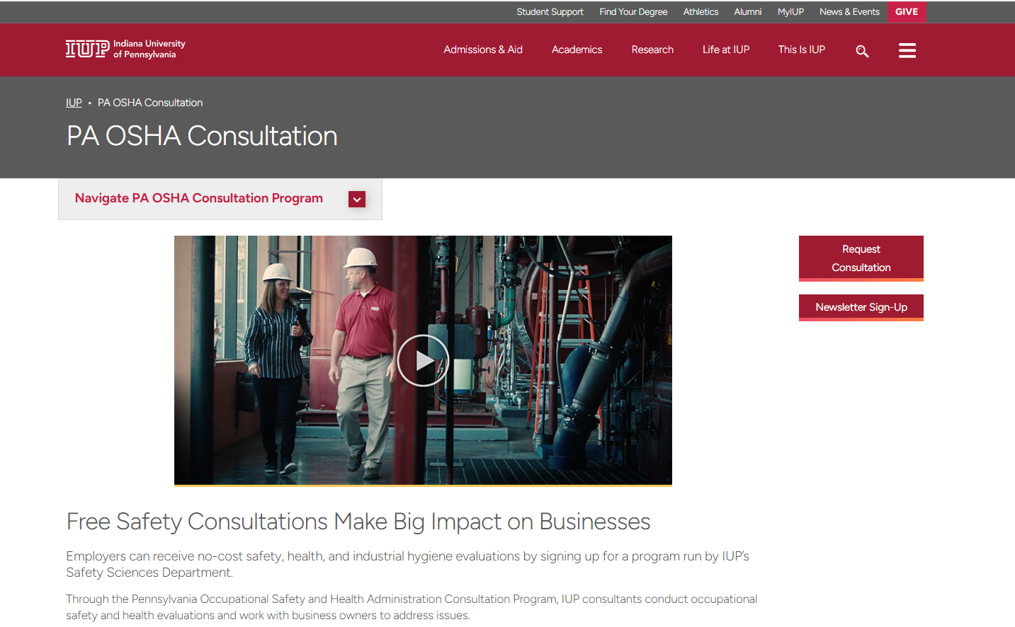
Request an onsite consultation visit:
www.iup.edu/pa-oshaconsultation
www.iup.edu/pa-oshaconsultation

Slide 33
Contact us
Pennsylvania OSHA Consultation Office
Phone: 724-357-4095
Website: www.iup.edu/pa-oshaconsultation/
Facebook: https://www.facebook.com/Pennsylvania-OSHA-Consultation-Program-548810235234647/
YouTube channel: https://www.youtube.com/@paoshaconsultationpaosha2922
www.iup.edu/pa-oshaconsultation

