Slide 1
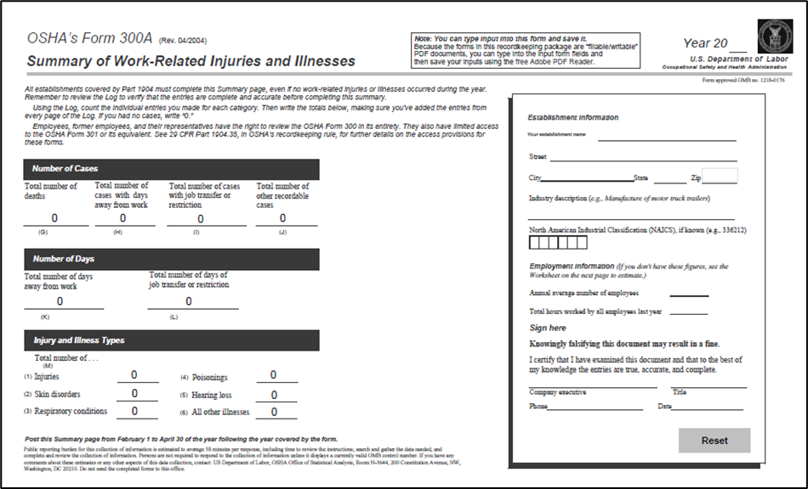
Welcome OSHA’s Revised Injury and Illness
Tracking Application
Will begin at 10:30am Presented by: Rick Mason, CIH, CSP, CHMM Pennsylvania OSHA Consultation Office Phone: 800-382-1241 or 724-357-4095 Website: www.iup.edu/pa-oshaconsultation

Slide 2
OSHA’s Revised Injury & Illness Tracking Application
Webinar General Info PowerPoint Presentation Q&A Questions Chat is open to submit questions. We will be answering questions through this chat feature. If due to the technical nature of the question a more thorough response is required, we will post the answer on our website within seven days of the webinar.
www.iup.edu/pa-oshaconsultation

Slide 3
OUTLINE:
Revised Process for Online ITA
Data Submittal Requirements Overview
Recording Injuries and Illnesses and Common Errors
www.iup.edu/pa-oshaconsultation
Notes:
Injury Tracking Application

Slide 4
New Process of Online Data Submittal
The OSHA Injury Tracking Application (ITA) has transitioned its login procedure to the public's one account access to government applications, Login.gov.
All current and new account holders must connect their ITA account to a Login.gov account with the same email address to access the application for the 2023 collection of Calendar Year 2022 Form 300A data.
Guidance Document on how to connect your accounts: Create a Login.gov Account
If you have questions:
Visit the FAQs.
If none of the FAQs address your question, a Help Request Form is available from that page.
www.iup.edu/pa-oshaconsultation

Slide 5
Create a Login.gov Account
The OSHA Injury Tracking Application (ITA) requires you to create an ITA account and then a Login.gov account to report your establishment’s injury and illness data.
Login.gov allows the public to access participating government agency applications using one account and password.
You must use the same email address for your Login.gov account that you use to access ITA to connect the two accounts.
If you already have a Login.gov account with the same email address as your ITA account, select the “Sign in with Login.gov” button on the Injury Tracking Login Application screen and login to the ITA application.
www.iup.edu/pa-oshaconsultation

Slide 6
9 steps to Create a Login.gov Account
Select the “Sign in with Login.gov” button on the “Injury Tracking Application Login” screen. https://www.osha.gov/injuryreporting/ita
You will be redirected to the OSHA ITA Login.gov sign-in screen.
Select the “Create an account” button.
Note: You must use the same email address for your Login.gov account that you use to access ITA to connect the OSHA ITA application with the account on Login.gov.
www.iup.edu/pa-oshaconsultation

Slide 7
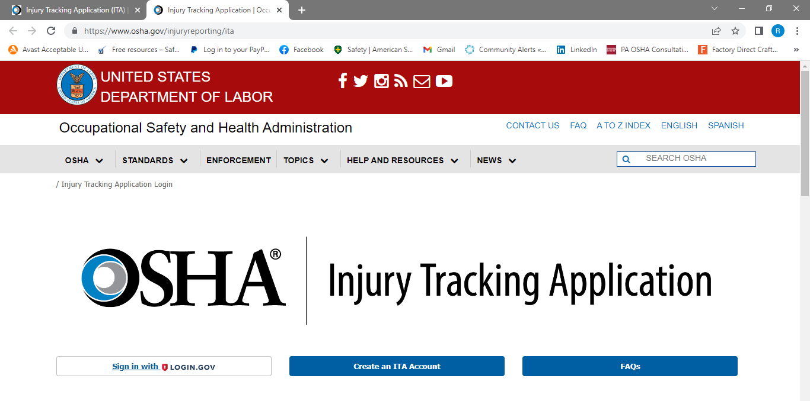
Create a Login.gov Account
The OSHA Injury Tracking Application (ITA) requires you to create an ITA account and then a Login.gov account to report your establishment’s injury and illness data.
Login.gov allows the public to access participating government agency applications using one account and password.
You must use the same email address for your Login.gov account that you use to access ITA to connect the two accounts.
If you already have a Login.gov account with the same email address as your ITA account, select the “Sign in with Login.gov” button on the Injury Tracking Login Application screen and login to the ITA application.
www.iup.edu/pa-oshaconsultation

Slide 8
9 steps to Create a Login.gov Account
On the “Create Account” screen:
Enter your email address
Select your email language preference
Read, and acknowledge the Rules of Use by selecting the checkbox, then “Submit” button.
5. Login.gov automatically emails you a hyperlink to continue creating your account. Use the hyperlink to confirm your email and create a password.
On the “Authentication Method” screen, select the method(s) that is most appropriate for you, then select the “Continue” button.
Note: Two-factor authentication will help keep your account secure.
You are encouraged to have more than one authentication method on your account.
www.iup.edu/pa-oshaconsultation

Slide 9
9 steps to Create a Login.gov Account
7. Follow the steps on the screen to provide the necessary information to complete establishing the two-factor authentication.
8. Once completed, your Login.gov account will be created. Select the “Agree and Continue” button.
9. You will be redirected to the ITA Login.gov entry screen. Select the “Continue” button. This will connect your ITA and Login.gov accounts and automatically log you into the ITA application.
www.iup.edu/pa-oshaconsultation

Slide 10
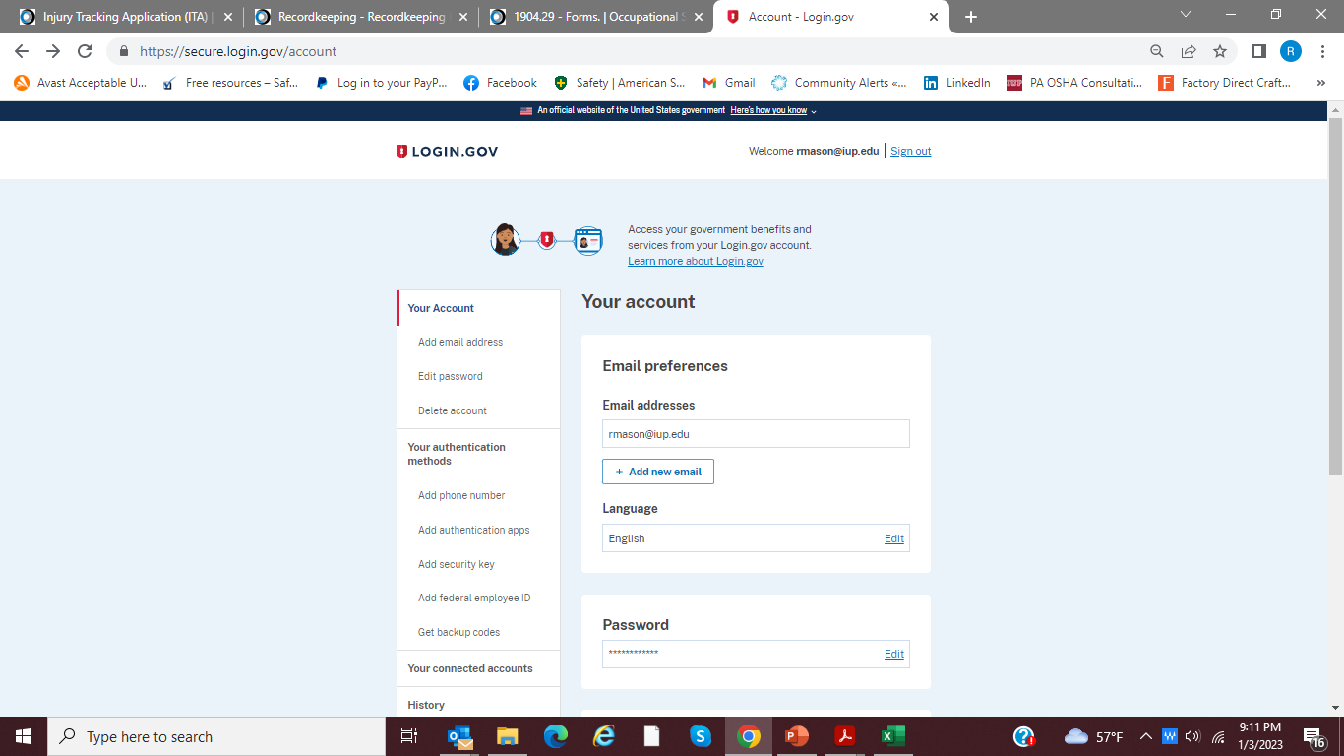
OPEN “CONNECTED ACCOUNTS”:
www.iup.edu/pa-oshaconsultation

Slide 11
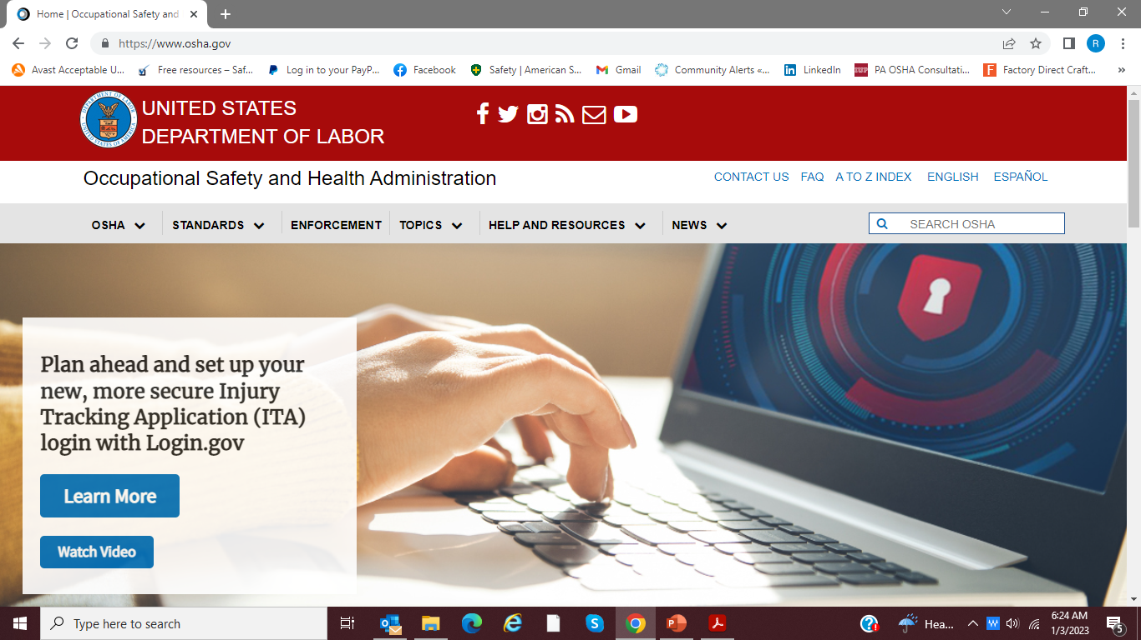
DIRECT ACCESS ON OSHA.GOV HOME PAGE
New Process for Online 300 Reporting
Reporting Requirements Overview
Recording Injuries and Illnesses
Common Errors
www.iup.edu/pa-oshaconsultation

Slide 12
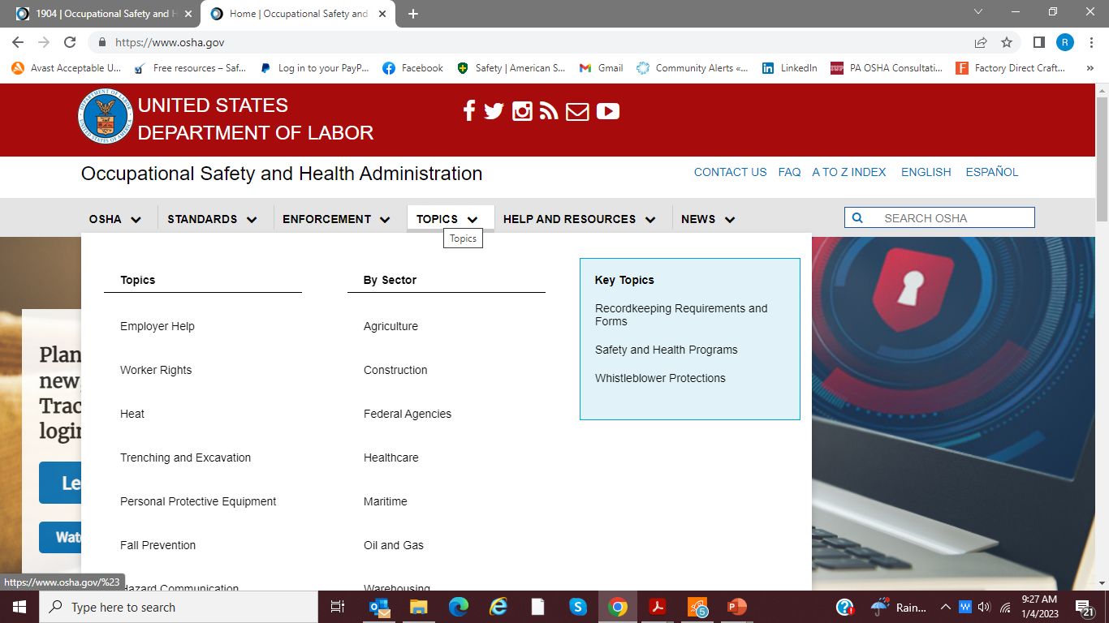
ALTERNATE ACCESS ON OSHA.GOV:
New Process for Online 300 Reporting
Reporting Requirements Overview
Recording Injuries and Illnesses
Common Errors
www.iup.edu/pa-oshaconsultation

Slide 13
ALTERNATE ACCESS ON OSHA.GOV:
New Process for Online 300 Reporting
Reporting Requirements Overview
Recording Injuries and Illnesses
Common Errors
www.iup.edu/pa-oshaconsultation

Slide 14
OUTLINE:
Revised Process for Online ITA
Data Submittal Requirements Overview
Recording Injuries and Illnesses and Common Errors
www.iup.edu/pa-oshaconsultation
Notes:
Injury Tracking Application

Slide 15
Data Submittal Requirements
Who is covered by this reporting requirement?
When must covered establishments submit their completed Form 300A?
What must covered establishments submit?
How to submit establishment data?
www.iup.edu/pa-oshaconsultation

Slide 16
Who is covered?
These facilities are NOT required to submit:
Peak employment during the previous calendar year was 19 or fewer.
Establishment's industry is on Appendix A to Subpart B of OSHA’s recordkeeping regulation, regardless of the size of the establishment.
Establishment had a peak employment between 20 and 249 employees during the previous calendar year, AND the establishment's industry is NOT on Appendix A to Subpart E of OSHA’s recordkeeping regulation.
Notes:
These criteria apply at the establishment level, not to the firm as a whole.
State Plan jurisdiction should directly contact their State Plan.
Use the ITA Coverage Application: https://www.osha.gov/itareportapp
www.iup.edu/pa-oshaconsultation
Notes:
Peak employment 10 or fewer, for the enterprise as a whole, not required to report. BUT YOU ARE STILL COVERED BY OSHA

Slide 17
NAICS Codes Exempt from Reporting Requirements*
82 NAICS codes exempted from reporting
Exempted are enterprises such as clothing stores, gasoline stations, various services, schools, and physician’s offices.
There are no exemptions for:
Manufacturing
Construction
Agriculture and Forestry
Utilities
Wholesale Trade
The complete list is found in Appendix A to Subpart B of OSHA’s recordkeeping regulation: https://www.osha.gov/laws-regs/regulations/standardnumber/1904/1904SubpartBAppA
*unless asked in writing by OSHA, the Bureau of Labor Statistics (BLS), or a state agency operating under the authority of OSHA or the BLS.
All employers must report to OSHA any employee's fatality, in-patient hospitalization, amputation, or loss of an eye.
www.iup.edu/pa-oshaconsultation
Notes:
The following are all required to reports– 1100s Agriculture, Forestry, Fishing and Hunting; 2100s Mining, Quarrying, and Oil and Gas Extraction; 2200s Utilities;
2300s Construction; 3100-3300s Manufacturing

Slide 18
Designated Industries for Annual Electronic Reporting - Establishments With 20 or More but Fewer Than 250 Employees
11 Agriculture, forestry, fishing, hunting.
22 Utilities.
23 Construction.
31-33 Manufacturing.
42 Wholesale trade.
There are 61 additional codes that are required to report ranging from grocery stores to department stores, trucking, warehousing, hospitals, and residential care facilities.
See the list at Appendix A to Subpart E of OSHA’s recordkeeping regulation: https://www.osha.gov/laws-regs/regulations/standardnumber/1904/1904.41AppA
www.iup.edu/pa-oshaconsultation
Notes:
The following are all required to reports – 1100s Agriculture, Forestry, Fishing and Hunting; 2100s Mining, Quarrying, and Oil and Gas Extraction; 2200s Utilities;
2300s Construction; 3100-3300s Manufacturing

Slide 19
When must covered establishments submit their completed Form 300A?
March 2 of the year after the calendar year covered by the forms
(March 2, 2023 for the forms covering calendar year 2022).
If March 2 has passed, 300A data must still be reported until December 31.
Other important dates/timeframes:
The 300A annual summary must still be posted no later than February 1 and posted until April 30.
Within seven (7) calendar days, enter each recordable injury or illness on the OSHA 300 Log and 301 Incident Report (or equivalent).
Report within eight (8) hours after the death of any employee as a result of a work-related incident.
Report within twenty-four (24) hours after the in-patient hospitalization of one or more employees or an employee's amputation or an employee's loss of an eye, as a result of a work-related incident.
www.iup.edu/pa-oshaconsultation
Notes:
OK – that was the who must report.
Now for the when.

Slide 20
What must covered establishments submit?
Covered establishments must electronically submit information from their OSHA Form 300A.
www.iup.edu/pa-oshaconsultation
Notes:
OK – that was the who must report.
Now for the when.

Slide 21
How do I submit my establishment data?
OSHA secure website offers three options:
1. EASIEST to enter data into a web form.
Click on "Create Establishment"
Fill out two web forms for each establishment and you're finished.
Once establishment information is entered, you only need to click on “View establishment list” and provide the new 300A summary data.
Users can upload a CSV file to process multiple establishments at the same time.
Users of automated recordkeeping systems will have the ability to transmit data electronically via an API (application programming interface).
www.iup.edu/pa-oshaconsultation
Notes:
OK – that was the who must report.
Now for the when.

Slide 22
OUTLINE:
Revised Process Online ITA
Data Submittal Requirements Overview
Recording Injuries and Illnesses and Common Errors
www.iup.edu/pa-oshaconsultation

Slide 23
RECORDING INJURIES & ILLNESSES:
Injury and Illness Incident Report – Form 301
Often replaced by Workers’ Compensation Insurance Form
Complete within 7 days of recognizing incident is recordable
Log of Work-Related Injuries and Illnesses – Form 300
Update within 7 days of recognizing incident is recordable
Summary of Work-Related Injuries and Illnesses – Form 300A
Instructions and Forms available in Excel or PDF Fillable Format:
https://www.osha.gov/recordkeeping/forms
www.iup.edu/pa-oshaconsultation

Slide 24
RECORDING INJURIES & ILLNESSES:
Death
Loss of consciousness
Days away from work
Restricted work activity or job transfer, or
Medical treatment beyond first aid
Also, significant work-related injury or illness diagnosed by a physician or other licensed health care professional, work-related case involving cancer, chronic irreversible disease, a fractured or cracked bone, or a punctured eardrum, contaminated needlestick, removal under the requirements of an OSHA health standard, tuberculosis infection, or a Standard Threshold Shift (STS) in hearing.
Specific questions – see Standard Interpretations of the Recordkeeping Standard: https://www.osha.gov/recordkeeping/interpretations
www.iup.edu/pa-oshaconsultation
Notes:
Workers comp determination.

Slide 25
300 LOG:
www.iup.edu/pa-oshaconsultation

Slide 26
300 LOG:
Privacy concern cases:
Injury or illness to an intimate body part or to the reproductive system
Injury or illness resulting from a sexual assault,
Mental illness,
HIV infection, hepatitis, or tuberculosis,
Needlestick injury
Employee independently and voluntarily requests his/her name not be entered.
Enter “privacy case” and keep a separate, confidential list of the case numbers and employee name(s).
www.iup.edu/pa-oshaconsultation
Notes:
If you information describing the privacy concern case may be personally identifiable even though the employee’s name has been omitted, you may use discretion in describing the injury or illness on both the OSHA 300 and 301 forms. You must enter enough information to identify the cause of the incident and the general severity of the injury or illness, but you do not need to include details of an intimate or private nature.

Slide 27
300 LOG:
Most serious classification only
In case of Days Away AND Job Transfer/Restriction, enter days for both
www.iup.edu/pa-oshaconsultation

Slide 28
300A ANNUAL SUMMARY
Enter year
Proper NAICS Code
Signed by highest ranking company official working at the establishment
Or his/her supervisor
Or an officer of the Corp.
Or the owner
No blank spaces
Total Cases=Total Types
www.iup.edu/pa-oshaconsultation

Slide 29
Total Recordable Case (TRC) Rate Days, Away, Restricted or Transferred (DART) Rate
www.iup.edu/pa-oshaconsultation
Notes:
And Finally

Slide 30
OUTLINE:
Revised Process for Online ITA
Data Submittal Requirements Overview
Recording Injuries and Illnesses and Common Errors
www.iup.edu/pa-oshaconsultation

Slide 31
Helpful Links:
Log in at https://www.osha.gov/injuryreporting/ita
Instructional video https://www.youtube.com/watch?v=-e6i7xHuv7Y
NAICS Code Manual: https://www.census.gov/naics/reference_files_tools/2022_NAICS_Manual.pdf
Appendix A to Subpart B of OSHA’s recordkeeping regulation: https://www.osha.gov/laws-regs/regulations/standardnumber/1904/1904SubpartBAppA
Appendix A to Subpart E of OSHA’s recordkeeping regulation: https://www.osha.gov/laws-regs/regulations/standardnumber/1904/1904.41AppA
Are you included? _ See ITA Coverage App: https://www.osha.gov/itareportapp
300 Forms and Instructions are available in Excel or PDF Fillable Format: https://www.osha.gov/recordkeeping/forms
Standard Interpretations of the Recordkeeping Standard: https://www.osha.gov/recordkeeping/interpretations
PA Safety Committee Certification/Technical Assistance Manual https://www.dli.pa.gov/Businesses/Compensation/WC/safety/committee/Pages/default.aspx
www.iup.edu/pa-oshaconsultation

Slide 32
www.iup.edu/pa-oshaconsultation
www.iup.edu/pa-oshaconsultation

Slide 33
Contact us
Rick Mason, CIH, CSP, CHMM
rmason@iup.edu
Pennsylvania OSHA Consultation Office
Phone: 800-382-1241
Website: www.iup.edu/pa-oshaconsultation/
Facebook: https://www.facebook.com/Pennsylvania-OSHA-Consultation-Program-548810235234647/
Twitter: https://twitter.com/search?q=PA%20OSHA%20Consultation&src=savs
www.iup.edu/pa-oshaconsultation

Slide 34
Thank You
Upcoming Webinar:
Common but often Unrecognized Electrical Hazards in the Workplace
3/15/2023 @ 10:30am
Pennsylvania OSHA Consultation Office
Phone: 800-382-1241 or 724-357-4095
Website: www.iup.edu/pa-oshaconsultation
www.iup.edu/pa-oshaconsultation

