Slide 1
Welcome
Lyme Disease & Ticks in PA
Will begin at 10:30am
Presented by:
Dane Sprankle
Pennsylvania OSHA Consultation Office
Phone: 800-382-1241 or 724-357-4095
Website: www.iup.edu/pa-oshaconsultation

Slide 2
Lyme Disease & Ticks in PA
Webinar General Info
PowerPoint Presentation
Q&A
Questions
Chat is open to submit questions.
We will be answering questions through this chat feature. If due to the technical nature of the question a more thorough response is required, we will post the answer on our website within seven days of the webinar.
www.iup.edu/pa-oshaconsultation

Slide 3
Webinar Overview
Scope and statistics
Regulations
Tick identification
Where
When
Illnesses
Prevention and Treatment
Resources
www.iup.edu/pa-oshaconsultation

Slide 4
Scope and Stats
Pennsylvania leads the nation in Lyme disease
All PA counties
Disease carrying ticks present through lower 48 states
Approximately 3700 reported cases of tickborne disease in PA in 2021 (most recent data)
>50,000 tickborne disease cases reported nationwide annually
CDC estimates total cases of Lyme disease nationwide annually (reported and unreported) may be as high as 476,000
www.iup.edu/pa-oshaconsultation

Slide 5
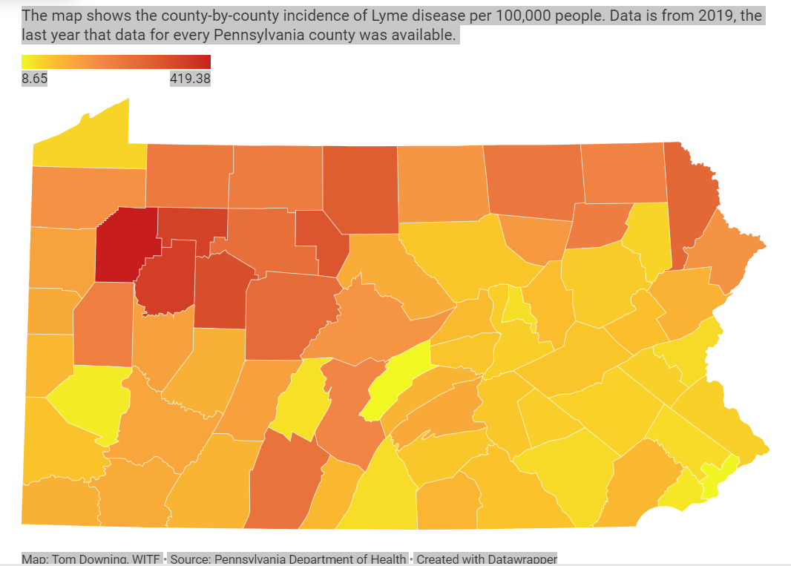
Scope and Stats, cont’d
www.iup.edu/pa-oshaconsultation

Slide 6
Regulations
First Aid (29 CFR 1910.151)
  29 CFR 1910.151(b)
  “…Adequate first aid supplies shall be readily available”.
General Duty Clause
  Section 5(a)(1) of act
  “Each employer…shall furnish to each of his employees employment and a place of employment which are free from recognized hazards that are causing or are likely to cause death or serious physical harm to his employees.”
www.iup.edu/pa-oshaconsultation

Slide 7
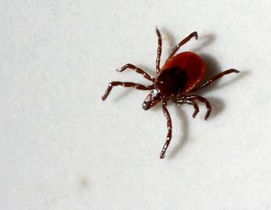
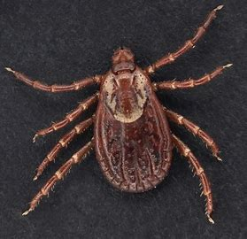
Types of Ticks
Deer Tick
  AKA “blacklegged tick”
  Most common type
  Only tick that spreads Lyme disease
American Dog Tick
  AKA “wood tick”
www.iup.edu/pa-oshaconsultation

Slide 8
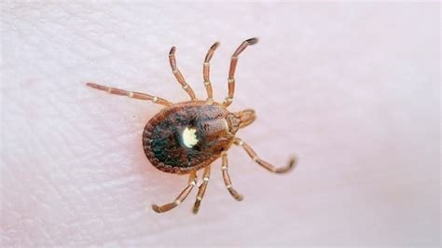
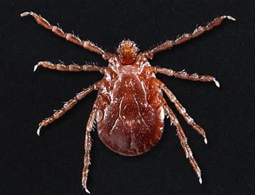
Types of Ticks, Cont’d
Lone Star Tick
  Associated with alpha gal syndrome
  (aka “red meat allergy”)
Asian Longhorned Tick
www.iup.edu/pa-oshaconsultation

Slide 9
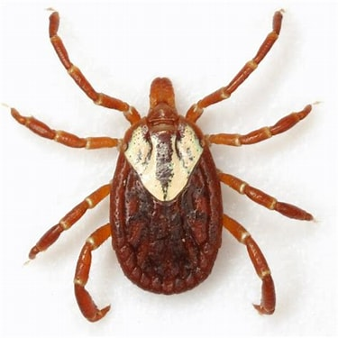
Types of Ticks, Cont’d
Gulf Coast Tick
www.iup.edu/pa-oshaconsultation

Slide 10
Where
Occupational
  Construction
  Landscaping
  Logging
  Utilities
  Parks management
  Other outdoor occupations
Non-occupational
  Outdoor chores and projects
  Outdoor recreational activities (e.g., camping, fishing, hunting, hiking, etc.)
www.iup.edu/pa-oshaconsultation

Slide 11
When
Highest risk in late spring, summer, and late fall
Lowest risk in winter, but ticks remain active when
temperatures are above freezing
Moderate risk remainder of year
* Image from PA Department of Health Brochure: “TICKS OF PENNSYLVANIA & THE DISEASES THEY CARRY”
www.iup.edu/pa-oshaconsultation

Slide 12
Tickborne Illnesses
Lyme disease
  Most common tickborne disease in PA
  Transmitted by deer tick
  Many cases due to bite of nymphal deer tick, which is very small (about the size of a poppyseed)
Anaplasmosis
  Second most common in PA
  Transmitted by deer tick
Rocky Mountain Spotted Fever
  Uncommon in PA
  Transmitted by dog tick
www.iup.edu/pa-oshaconsultation

Slide 13
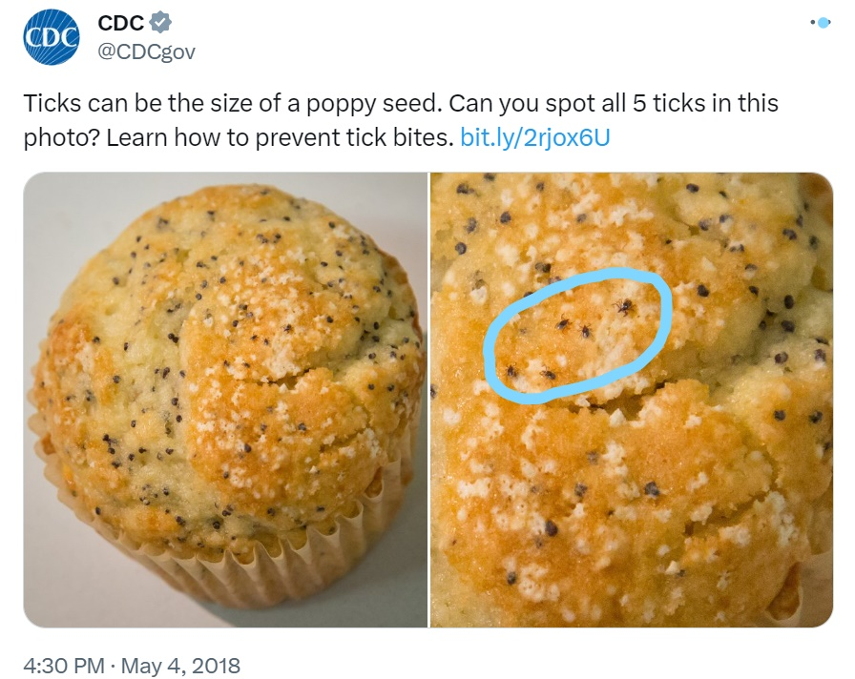
Tickborne Illnesses, cont’d
Relative size of nymphal
deer ticks:
www.iup.edu/pa-oshaconsultation

Slide 14
Tickborne Illnesses, cont’d
Ehrlichiosis
  Uncommon in PA
  Transmitted by lone star tick
Babesiosis
  Uncommon in PA
  Transmitted by deer tick
Powassan virus
  Uncommon in PA
  Transmitted by deer tick
www.iup.edu/pa-oshaconsultation

Slide 15
Prevention
Clothing
  Long sleeves
  Light colored – easier to see ticks
  Tuck pants into boots or socks
  Wear a hat and tie back long hair
Repellants
  Use on exposed skin before going out
  Most effective contain DEET or Picaridin
Permethrin
  Insecticide that is available at most hardware stores, commercial supply stores, and department stores
  Use on outer clothing and gear (not on skin)
  Kills ticks and other insects
www.iup.edu/pa-oshaconsultation

Slide 16
Prevention, cont’d
After being outdoors
  Check clothing – if in doubt, place clothing in dryer for at least 30 minutes to kill any missed ticks
  Check gear and equipment
  Shower
  Check body
    Feet
    Armpits
    Behind knees
    Elbows
    Hair and behind ears
    Waist
    Groin
  Properly remove any ticks found
www.iup.edu/pa-oshaconsultation

Slide 17
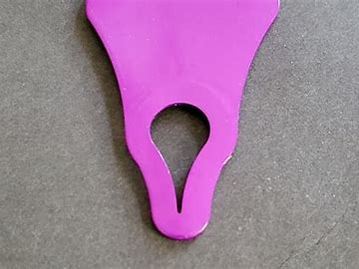
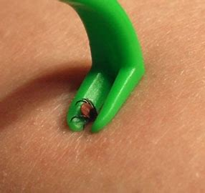
Tick Removal – Do’s and Don’ts
Do
  Clean area around tick with rubbing alcohol
  Grasp tick as close to skin as possible with tweezers or tick removal tool
  Pull straight up slowly and steadily
  Once tick is removed, place it in rubbing alcohol to kill it
  Dispose of tick in sealed plastic bag or flush it
  Clean area where tick was removed with rubbing alcohol or soap and water
  If tick breaks off, remove as much as possible with tweezers. Stop and
  allow skin to heal if this cannot be done easily.
www.iup.edu/pa-oshaconsultation

Slide 18
Tick Removal – Do’s and Don’ts cont’d
Do Not
  Burn the tick
  Smother the tick with petroleum jelly or similar products
  Paint the tick with nail polish
  Crush the tick
  Jerk or twist the tick during removal
www.iup.edu/pa-oshaconsultation

Slide 19
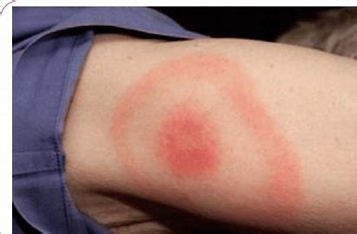
Symptoms and Treatments
Acute symptoms
  Rash near bite location is most common symptom – Erythema Migrans (“bullseye”) associated with Lyme disease
  Joint pain/swelling (second most common symptom)
  Fever/chills
  Headache
  Muscle pain
  Vomiting
  Diarrhea
  General fatigue
  Alpha-gal syndrome (“red meat allergy”) – associated with
  lone star tick bite
  Powassan virus often symptom free
www.iup.edu/pa-oshaconsultation

Slide 20
Symptoms and Treatments, cont’d
Chronic Symptoms (>30 days following tick bite)
  Arthritis
  Nerve pain/paralysis
  Cardiac symptoms
  Meningitis symptoms
  Organ damage or death in severe cases
Treatment
  Seek medical treatment if any of the acute or chronic symptoms above appear following a tick bite
  Most tickborne illnesses are treated with antibiotics
  Antiparasitic medications are used for Babesiosis
  Supportive care is only option for Powassan virus
www.iup.edu/pa-oshaconsultation

Slide 21
Prevention Acronym
Image from PA Department of Health Brochure: “TICKS OF PENNSYLVANIA & THE DISEASES THEY CARRY”
www.iup.edu/pa-oshaconsultation

Slide 22
Resources
eTool : Logging - Manual Operations - Tick Borne Disease | Occupational Safety and Health Administration (osha.gov)
Reducing the Risk of Worker Exposure to Disease-Carrying Ticks (osha.gov)
Ticks | Ticks | CDC
Tick Diseases (pa.gov)
Ticks (pa.gov)
2021 Lyme and Other Tickborne Diseases Annual Report (pa.gov)
https://stateimpact.npr.org/pennsylvania/2023/05/09/pennsylvania-leads-the-nation-in-lyme-disease-the-state-is-responding-with-new-tick-testing-research-and-education/
www.iup.edu/pa-oshaconsultation

Slide 23

www.iup.edu/pa-oshaconsultation
www.iup.edu/pa-oshaconsultation

Slide 24

www.iup.edu/pa-oshaconsultation
www.iup.edu/pa-oshaconsultation

Slide 25

Please consider subscribing to our youtube channel to be notified of new webinars: https://www.youtube.com/@paoshaconsultationpaosha2922
www.iup.edu/pa-oshaconsultation

Slide 26
Contact us
Dane Sprankle
sprankle@iup.edu
Pennsylvania OSHA Consultation Office
Phone: 800-382-1241
Website: www.iup.edu/pa-oshaconsultation/
Facebook: https://www.facebook.com/Pennsylvania-OSHA-Consultation-Program-548810235234647/
Twitter: https://twitter.com/search?q=PA%20OSHA%20Consultation&src=savs
www.iup.edu/pa-oshaconsultation

Slide 27
Thank You
Pennsylvania OSHA Consultation Office
Phone: 800-382-1241 or 724-357-4095
Website: www.iup.edu/pa-oshaconsultation
www.iup.edu/pa-oshaconsultation

