Slide 1
Welcome
Beryllium & OSHA Compliance
Will begin at 10:30am
Presented by:
Daniel J. Larson, CIH
Pennsylvania OSHA Consultation Office
Phone: 800-382-1241 or 724-357-4095
Website: www.iup.edu/pa-oshaconsultation

Slide 2
Beryllium & OSHA Compliance
29 CFR 1910.1024
Webinar General Info
PowerPoint Presentation
Q&A
Questions
Chat is open to submit questions.
We will be answering questions through this chat feature. If due to the technical nature of the question a more thorough response is required, we will post the answer on our website within seven days of the webinar.
www.iup.edu/pa-oshaconsultation

Slide 3
Beryllium - Introduction
Background and Health Hazard Information

Slide 4
Susan B. Harwood Training Grants
OSHA awards grants to nonprofit organizations on a competitive basis through its Susan Harwood Training Grant Program
Beryllium Training Grant
  Grantee Name: National Jewish Health
  The grantee developed training on the hazards of working with beryllium that targeted workers and employers in the beryllium industry. The training covers health effects, methods of exposure, high-risk processes and jobs, and protective measures. Training materials include PowerPoint presentations, training instructions and tests.
  Grantee Materials - By Topic | Occupational Safety and Health Administration (osha.gov)
www.iup.edu/pa-oshaconsultation

Slide 5
Preventing Chronic Beryllium Disease through
Exposure Recognition and Control
Training for Beryllium Exposed Workers
Training Developed by:
Notes:
Welcome to our training entitled “Be Informed: Preventing Chronic Beryllium Disease through Exposure Recognition and Control.” This training was developed specifically for beryllium exposed workers by National Jewish Health in Denver, CO. Funding for these training materials was provided by a grant from the U.S. Department of Labor OSHA Susan Harwood Targeted Topic Training Grant Program.

Slide 6
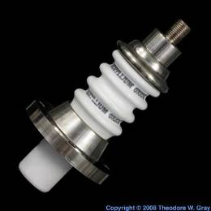
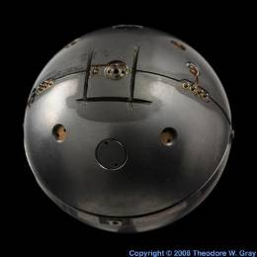

What is Beryllium?
Forms
  Metal
  Ceramic (Beryllia)
  Alloys (BeCu, AlBeMet)
  Contaminant in bauxite, alumina, recycled metals
Properties
  3X lighter than aluminum
  6X stiffer than steel
  Conducts heat well
  Dimensionally stable
  Transparent to X-Rays
  Reflects neutrons
All Photos © 2011 periodictable.com
Used with written permission for
non-commerical use
Notes:
Beryllium is found in many different forms. The two forms that are associated with the highest exposures to beryllium in the workplace are pure beryllium metal, which you can see a picture of a pure beryllium middle part on the right in the middle of the slide, or beryllium ceramic or beryllia, which you can see a part made out of beryllia on the top right part of the slide. Most commonly, beryllium is found in alloys. The most common beryllium alloy is beryllium copper. It’s usually 2-4% beryllium mixed with copper. The other main alloy of beryllium is aluminum beryllium, or AlBeMet. This is usually 40-60% beryllium mixed with aluminum. Beryllium can also be found as a contaminant in bauxite, which is the ore that is used to make aluminum and it gets concentrated in the alumina as the bauxite is refined to alumina. For this reason, people who make aluminum or primary aluminum workers are also exposed to beryllium. Beryllium can also be found in mixed streams of recycled metals because some things with beryllium metal get recycled with other metals.
The reason beryllium is used is because it has some very desirable properties for use in industry, properties like it is 3 times lighter than aluminum and 6 times stiffer than steel. It conducts heat well which makes it very well suited for use as a heat sink. It’s also dimensionally stable, meaning it does not shrink or expand with cold or heat. It’s also transparent to x-rays and reflects neutrons, which makes it very important both in nuclear medicine and in the manufacturing of nuclear weapons.

Slide 7
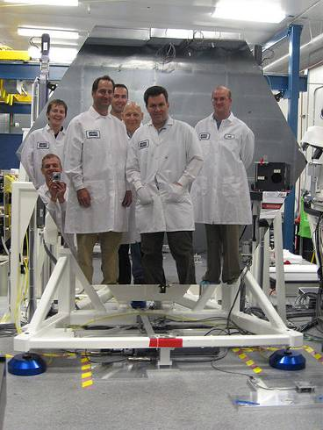
Beryllium Uses
Airplane and Space Industries
Nuclear Reactors
Computers, Phones
Automobile Industry
Dental alloys
Contaminant in aluminum smelting and metal recycling
Photo by NASA available under public domain from Wikimedia Commons
Notes:
As you can imagine with all these desirable properties, beryllium has found a number of uses in industry. Beryllium is used extensively in the airplane and space industries. It’s also used in nuclear reactors and extensively in nuclear weapons. Beryllium copper and sometimes beryllium ceramic can be found in computers. Beryllium copper is often found in cell phones and other electronics. Beryllium is also used in the automotive industry, and surprisingly, beryllium was used in some dental alloys that are used to make crowns and bridges. As we talked about before, beryllium is also a contaminant in the aluminum smelting process and can be a contaminant in the metal recycling process. The picture on the right shows one of the largest uses of pure beryllium metal in industry in recent years. This picture shows one of the mirrors from the James Webb Space Telescope. These mirrors were made of pure beryllium and the space telescope actually has 18 of these mirrors. In 2010, the estimated consumption of beryllium was around 620 metric tons.

Slide 8
Health Effects of Beryllium
Notes:
The health effects section of this presentation describes why training on beryllium exposure recognition and control is so important. If it was not for the health effects caused by beryllium, we would not be so concerned about trying to minimize beryllium exposure.

Slide 9
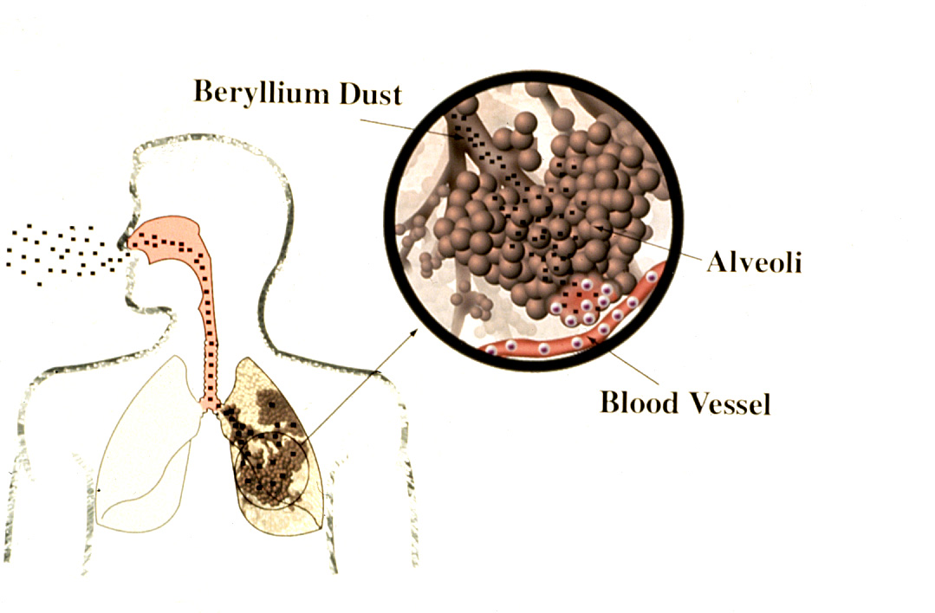
Health Effects of Beryllium
Routes of Exposure
Health Effects
Lungs
  Acute beryllium disease
  Lung cancer
  Beryllium sensitization (BeS)
  Chronic beryllium disease (CBD)
Skin
  Several skin effects
  BeS
Breathing
Skin
Illustration by National Jewish Health
Notes:
The diagram on the left shows the two main routes of exposure, breathing beryllium into the lungs and contact with the skin. It is the smallest particles of beryllium that can be inhaled all the way down into the deepest part of the lungs, into the air sacs where oxygen travels into the bloodstream.
The health effects of beryllium in the lungs and the skin will be described. I will start by briefly describing acute beryllium disease and lung cancer, but will focus on the more common health effects of beryllium sensitization (BeS), the allergy to beryllium, and chronic beryllium disease (CBD). I will also briefly describe several skin effects, including risk of BeS.

Slide 10
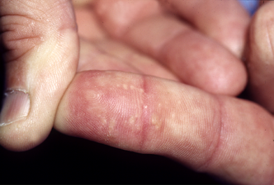
Skin Effects
Slow wound healing
Nodules
  Response to beryllium under the skin
Allergic rash
  Beryllium salts
BeS
  Broken skin & cuts
  Rash
  Even unbroken skin may not be a complete barrier
Nodules
Photo by National Jewish Health
All broken skin and cuts should be covered
Covering the skin may reduce the risk of BeS
Notes:
There are several different effects of beryllium on the skin, which can vary depending on the form of beryllium. Slow wound healing is seen when cuts are contaminated with the pure metal. If beryllium gets under the skin, it can cause inflammation and the development of small hard nodules as shown in the picture. An allergic rash, similar to poison ivy, can be seen primarily with exposure to beryllium salts, the soluble forms of beryllium. But the greatest concern about skin exposure is the possible development of sensitization to beryllium (BeS). It has been known for a while that beryllium can enter non-intact skin, such as cuts and even rashes, but there is increasing evidence that even unbroken skin may not be a complete barrier, particularly from the tiniest particles. Therefore, we recommend that all broken skin and cuts be covered and covering the skin may reduce the risk of BeS.

Slide 11
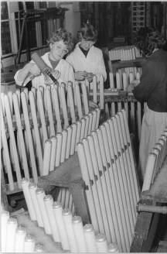
Lung Effects: Acute Beryllium Disease
First recognized disease from beryllium
Severe lung disease soon after exposure
  Similar to pneumonia
  5-10% died
  Most of the others recovered in < 1 year
    Many later developed CBD
Due to very high level exposures
  50-1,000 µg/m³
  very uncommon in recent years
  possible after extremely high release
Elevated risk of lung cancer
Photo by BArchBotavailable under public domain from Wikimedia Commons
Notes:
Acute beryllium disease was the first lung disease recognized to be caused by beryllium. It is a disease similar to pneumonia and occurred soon after high levels of exposure. The disease was often very severe, and about 5-10% of people with the disease died from it. The others eventually recovered, although it could take up to a year; and many of them later developed chronic beryllium disease (CBD). The picture on the right shows workers in a fluorescent light bulb factory from back in the 1930s or 1940s. This type of workplace had very high levels of airborne beryllium. We spoke before about the current exposure limits of 2 micrograms per cubic meter and 0.2 micrograms per cubic meter, but in these workplaces historic levels of 50 micrograms per cubic meter and up to 1,000 micrograms per cubic meter were measured. In addition to acute beryllium disease, increased risk of lung cancer was seen. Fortunately such high levels of beryllium have been very uncommon in recent years, but could be possible after an uncontrolled release or major control failure.

Slide 12
Lung Effects: BeS & CBD
BeS (Beryllium Sensitization)
  An allergy to beryllium
  BeS causes no symptoms
  2 abnormal beryllium tests (BeLPTs)
  Workers with BeS can develop CBD
CBD (Chronic Beryllium Disease)
  Inflammation
  Possibly scarring in the lungs
Most exposed workers will not get BeS or CBD
Low levels of exposure decrease but do not eliminate the risk of BeS and CBD
Notes:
From this slide forward, we will focus on beryllium sensitization (BeS) and chronic beryllium disease (CBD). As mentioned earlier, BeS is an allergy to beryllium, meaning that your immune cells react to beryllium. It is not an allergy like hay fever; it causes no symptoms. A person would never know he or she has BeS unless a beryllium blood test called the BeLPT is performed, which measures how your immune cells react to beryllium. I will describe this test in detail shortly. We define BeS as two abnormal BeLPTs. The reason we want to identify workers with BeS is because BeS places them at risk of developing chronic beryllium disease. Chronic beryllium disease occurs when immune cells don’t just react to beryllium when a blood test is done, but the immune cells start to react to beryllium that is in the lungs. It causes inflammation and possibly scarring. It is important to emphasize that most workers who are exposed to beryllium will not get BeS or CBD; however, while low levels of exposure decrease the risk, they do not eliminate the risk of BeS and CBD.

Slide 13

Are YOU at Risk for BeS & CBD?
→
Be
Be
Be
Be
Be
No immune response
+
Be
Be
Be
Be
Be
Be
→
Exposed, Non-sensitized
Illustration by National Jewish Health
Immune response
Illustration by US DOE available under public domain from Wikimedia Commons
Beryllium
Exposure
Your Genes
Beryllium Sensitized
CBD
Illustration by National Jewish Health
Less than 1% to 16% of workers tested have BeS
  The number depends on level of exposure and industry
  Some workers with BeS had very low exposure
  Some workers who are not sensitized on the first test later become BeS
Notes:
13
The question you may be asking is how you know if you are at risk for beryllium sensitization (BeS) and chronic beryllium disease (CBD). The risk is determined by your genes (DNA) and exposure to beryllium. The diagram on the right shows the important point that most workers who are exposed to beryllium will not get BeS or CBD. A small percentage will develop an immune response, or allergy, to beryllium (BeS) and some of those with BeS will develop CBD. We have identified some of the genes that determine risk, but not all of them. When testing has been done in workplaces to see how many workers have BeS, the percentage has ranged from less than 1% to over 16% of workers. The percentage depends on the level of exposure and the industry. The higher the exposure, the higher percentage of workers are found with BeS. The highest percentages have been seen in groups such as machinists, who have the highest exposures to beryllium. The lowest percentages have been reported in aluminum smelter workers. In many workplaces today, the number with BeS or CBD is 1-2%. Some of the workers with BeS have had very low levels exposure to beryllium. Some workers who are not sensitized on their first test are later found to have BeS. Not everyone with BeS develops CBD, and this has been found to range between 10 and 100% in different groups of workers. Just as higher levels of exposure increase the risk of BeS, and the same appears to be true for the risk of BeS progressing to CBD. The 100% risk of CBD was reported in a group of machinists and the 10% with CBD in workers with low level exposure. Most workers have exposures somewhere in between these two extremes, and in general we estimate that up to 50% of workers with BeS have CBD when they have their first medical evaluation or will develop it in the future.

Slide 14


Beryllium Sensitization
Normal Response
Be
Be
+
Be
=
No Response
Be
Be
Be
Be
Be
Immune cell
Be
Be
Be
Illustration by National Jewish Health
Abnormal Response
Be
Be
+
Be
Be
Be
=
Immune cells
multiply
Be
Be
Be
Immune cell
Be
Be
Be
Illustration by National Jewish Health
Beryllium Sensitization
Determined by exposure and your genes
Notes:
This slide demonstrates what we mean by beryllium sensitization (BeS), the allergy to beryllium. The diagram at the top of the slide shows the normal response of an immune cell from the blood; there is no response when the cell comes into contact with beryllium. The diagram on the bottom demonstrates an abnormal response, where contact with beryllium causes the immune cell to multiply. Again, the risk of BeS is determined by having exposure to beryllium and your genes.

Slide 15
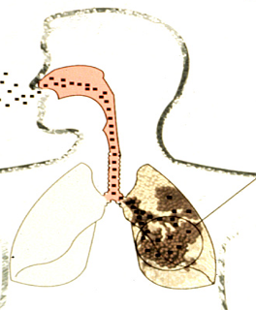
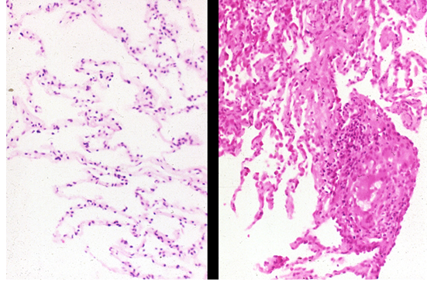

CBD
Normal
CBD
→
Illustration by National Jewish Health
Photo by National Jewish Health
Normal
Oxygen
Oxygen
CBD
Illustration by National Jewish Health
Illustration by National Jewish Health
Oxygen easily passes into blood
Limited oxygen passes into blood
Notes:
This slide demonstrates what happens in the lungs when people with BeS develop CBD. The diagram on the left shows beryllium being inhaled into the lungs, with the tiniest particles getting down into the air sacs. The picture at the center-right is a photograph of what normal air sacs look like under the microscope. The air-filled sacs are lined by a single layer of cells, which makes it easy for oxygen to travel from the air sacs into the blood stream. The picture on the far right shows what happens in CBD. Immune cells begin to multiply in response to beryllium in the lungs. This causes inflammation, including the development of abnormal collections of cells called granulomas. The round cluster of cells in the lower right of the picture is a granuloma. The inflammation and extra cells make it harder for oxygen to travel into the blood stream, and limited oxygen passes into the blood. When you’re sitting at rest, like you probably are now, your body doesn’t need that much oxygen. When you start to exercise, your body needs more oxygen and shortness of breath is first noted during exercise in the early stages of the disease.

Slide 16
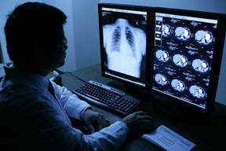
Symptoms of Chronic Beryllium Disease
No symptoms initially
Gradually worsening
  Cough, usually dry
  Shortness of breath
    First noticed with physical activity
  Sweating at night
  Feeling tired all the time
In some cases, severe shortness of breath
Can be mistaken for other lung diseases
  May be misdiagnosed if BeLPT not done
If you have these symptoms, tell your doctor that you are exposed to beryllium
Photo by National Jewish Health
Notes:
Symptoms of chronic beryllium disease (CBD) range from no symptoms at all to severe breathing problems. When the disease first starts, there are no symptoms. Typically, there is the gradual development of cough, usually a dry cough; shortness of breath, usually first noticed during physical activity; sweating at night; and feeling tired all the time. In some cases the shortness of breath can be severe, typically in workers who have had very high levels of beryllium exposure. These same symptoms can be seen in many other diseases. In fact, CBD can be mistaken for other lung disease if a beryllium test (BeLPT) is not done. If you have these symptoms, tell your doctor that you’re exposed to beryllium.

Slide 17
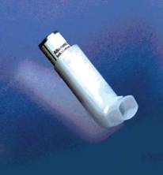
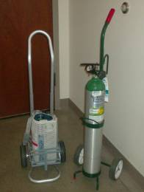
Treatment of CBD
THERE IS NO CURE
No symptoms
  No treatment
Mild symptoms
  Inhaled medication
Increasing symptoms/worsening lung tests
  Steroid pills (ex. Prednisone)
Worsening disease and lung function
  Other medications
Severe disease
  Use of oxygen
Photo by National Jewish Health
Photo by National Jewish Health
Notes:
There is no cure for beryllium disease (CBD). Treatment of CBD is based on symptoms and lung function tests. When there are no symptoms, no treatment is recommended. With mild symptoms, inhaled steroid medications are recommended to help decrease inflammation. When there are symptoms and worsening lung function tests, stronger anti-inflammatory medication is needed, and steroid pills like Prednisone are prescribed. If disease continues to worsen, there are other anti-inflammatory medications that can be used. In severe disease, use of supplemental oxygen may be needed to keep oxygen levels high enough in the blood.

Slide 18
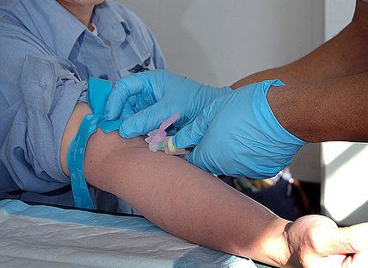
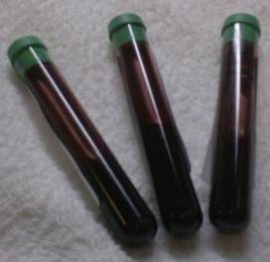
How do we test for BeS and CBD?
Photo by US Navy available under public domain from Wikimedia Commons
Photo by National Jewish Health
Illustration by National Jewish Health
Beryllium Lymphocyte Proliferation Test (BeLPT)
Means immune cells multiply (proliferate) when exposed to beryllium
Abnormal immune response seen in both BeS and CBD
Test does not mean high exposure to beryllium
  A medical evaluation is needed to know if you have CBD
Notes:
18
The blood test for BeS and CBD is the beryllium lymphocyte proliferation test (BeLPT), which measures if your immune cells multiply (proliferate) when exposed to beryllium. An abnormal (positive) response is seen in both BeS and CBD. The BeLPT does not distinguish between BeS and CBD. A medical evaluation is needed to determine if someone with an abnormal BeLPT just has BeS or has CBD. CBD can also develop over time, which is why medical follow up for patients with BeS is recommended. It is important to remember that while a high level of exposure increases the risk of BeS and CBD, an abnormal BeLPT does not mean high exposure. Most workers with high beryllium exposure do not get BeS or CBD. An abnormal BeLPT means that your immune cells multiply in response to beryllium, i.e. you have developed an allergy to it.

Slide 19
BeLPT: Blood Test for BeS and CBD
Be
Be
Be
Be
Be
Normal
Be
Be
Be
Be
Be
Be
Blood cells
Illustration by National Jewish Health
Be
Be
Be
Be
Be
Be
Be
Abnormal
Be
Be
Be
Be
Blood cells
Blood cells multiply
Illustration by National Jewish Health
Notes:
This is a diagram of the BeLPT, the blood test for BeS and CBD. Immune cells from your blood are put into a container and beryllium is added. The normal response of the immune cells is do nothing at all. The diagram on the bottom shows an abnormal response, where the immune cells multiply in response to the added beryllium.

Slide 20
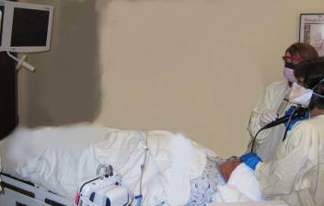
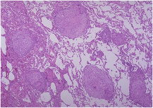
Medical Evaluation
History and examination
Pulmonary function tests
  Breathing tests
Exercise tolerance test
  Includes tests for oxygen
CT (CAT) scan/chest x-ray
Bronchoscopy
  Collect immune cells from the lung
    Examine type of immune cells present
    Perform BeLPT
  Biopsy of lung tissue
    Granulomas: Abnormal collections of cells
Photo by National Jewish Health
Photo by National Jewish Health
Notes:
A medical evaluation for possible CBD consists of the following components: History and physical examination; pulmonary function tests, which are breathing tests to look at lung function; exercise tolerance test, which measures heart and lung function while riding a bicycle. One of the most important parts of the bike test is to look for a drop in the level of oxygen in the blood during exercise. We also get a CT (CAT) scan or chest x-ray. But the way we conclusively make the diagnosis of CBD is through a procedure called bronchoscopy, where a tiny scope is inserted into one side of the lungs. We collect immune cells to look at the type of immune cells present, specifically the percentage of cells called lymphocytes, and we perform a BeLPT to see if the immune cells in the lung also respond to beryllium. We take little tissue samples from the lung to examine under a microscope, looking for abnormal collections of cells called granulomas.

Slide 21
When can you get BeS and CBD?
Within 3 months
After many years
Many years after last exposure
  Beryllium stays in the lungs
Even after a normal BeLPT
Any time after first exposure to beryllium
Notes:
When can you get BeS and CBD? The bottom line is you can get Bes and CBD anytime after your first exposure to beryllium. It has been reported as early as three months after first exposure; it can happen after many years later, including many years after your last exposure to it because beryllium stays in the lungs. An abnormal BeLPT can occur on the first test you have, but an abnormal results can also be seen after one or more normal BeLPTs. This is why periodic follow up testing is recommended.

Slide 22
Beryllium
Exposure Recognition & Control
Notes:
The “Exposure Recognition and Control” section of this presentation describes routes of exposure to beryllium particles in the workplace and methods to reduce or prevent exposure to beryllium particles.

Slide 23
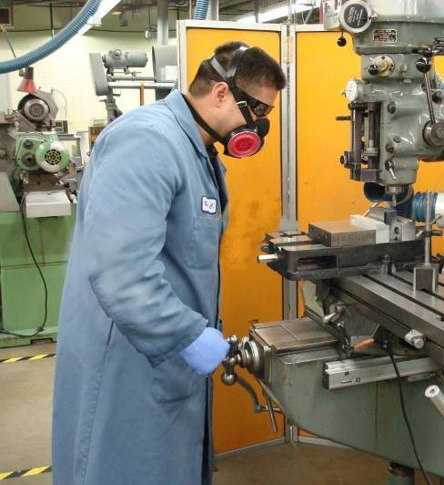
How can I be exposed to beryllium at work?
Particles produced by work processes
Particles blown from:
  Work surfaces
  Clothing
  Floor
Particles from nearby work processes
Skin contact with:
  Be parts
  Contaminated surfaces
Photo used by National Jewish Health with written permission
23
Notes:
Normally when we think about exposure to beryllium in the workplace, we think about particles, beryllium particles that are produced by work processes. These particles are produced by grinding or cutting on beryllium parts, get suspended into the air and can be breathed in by a worker. However, since we are talking about micrograms of exposure being important in the risk of BeS and CBD, it is also necessary to consider other exposures in the workplace such as particles blown from work surfaces, clothing or floor that can get back into the air and into a worker’s breathing zone. It’s also important to consider particles from nearby processes, as these processes may produce sufficient exposure to increase the risk of beryllium sensitization. As we talked about earlier, we believe that skin contact with beryllium is important in the risk of BeS. Therefore, it’s also necessary to consider skin contact with beryllium parts and skin contact with beryllium-contaminated surfaces as important routes of exposure.

Slide 24
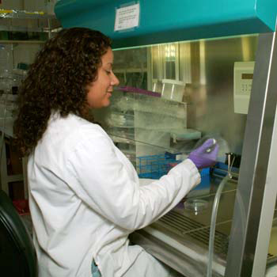
How do I know if I could be exposed?
If beryllium is used in your workplace you might be exposed
Workers likely exposed:
  Machinists
  Production workers
  Maintenance workers
  Cleaning personnel
  Laboratory
  Shipping & Receiving
Others that might be exposed:
  Front office workers
  Security guards
  Family members of workers
Photo by National Jewish Health
Notes:
The most important first step in reducing your exposure to beryllium is knowing if you are exposed to beryllium in your workplace. Typically, if beryllium is used in your workplace, you might be exposed to beryllium. Usually we consider workers at the highest risk of beryllium sensitization and chronic beryllium disease are those workers in production operations. Those workers like machinists and production workers. Other workers exposed to beryllium dust on floors and equipment like maintenance workers and cleaning personnel are also at risk, as are laboratory personnel working with beryllium materials, and shipping and receiving personnel who handle and ship beryllium or beryllium contaminated parts. However, it’s also important to consider other workers in the facility. As we keep saying, microgram quantities are important and beryllium can easily spread throughout a facility and expose other workers that you might not consider. So it’s also important to consider workers like front office workers in a beryllium facility, security guards who may just occasionally walk through a beryllium facility, and family members of workers who may be exposed by beryllium taken home on workers’ clothes. We list all of these classes of workers on the bottom of the slide here because we’ve seen cases of beryllium sensitization and chronic beryllium disease in front office workers, security guards, and family members of workers.

Slide 25
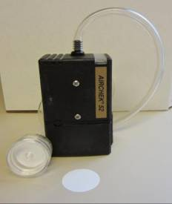
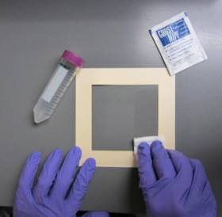
How is beryllium measured?
Air samples
  Measure the amount of beryllium in air
  Estimate the amount a worker might inhale into their lungs
  Different types of air samples:
    Personal samples
    Area samples
Surface or Wipe Samples
  Measure the amount of beryllium on a surface
  No consistent relationship to airborne beryllium exposure
Photo by National Jewish Health
Photo by National Jewish Health
Notes:
As workers possibly exposed to beryllium in the workplace, it’s important for you to know how we measure beryllium in the workplace. We measure beryllium using two different sampling methods. We use air samples to measure the amount of beryllium in the air to determine how much beryllium a worker could inhale into their lungs. Since CBD is a lung disease, it makes sense that the amount of beryllium in the air is important in determining your risk of CBD. There are different kinds of air samples, air samples called “personal samples” and air samples called “area samples”, which we’ll talk about in a few minutes. The other kind of samples we collect for beryllium in the workplace are “surface samples”. These surface samples measure the amount of beryllium on a surface. The picture at the bottom right of the slide shows a surface sample being collected. Basically, a wetted wipe is used to wipe a certain surface area, this wipe is sent to a laboratory, it gets analyzed for beryllium, and the result tells you how much beryllium is on the surface. Surface samples are a good way to determine how well a facility has been cleaned, how far beryllium contamination spreads in the workplace, and where there might be a risk of skin exposure to beryllium. However, it is important to remember that there is no consistent relationship between the amount of beryllium on a surface and the amount of beryllium in the air. The only way to determine the amount of beryllium in the air is to use an air sample.

Slide 26
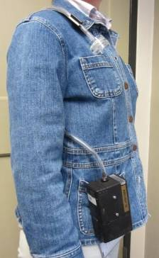

How is beryllium exposure measured?
Filter in “breathing zone”
Personal samples measure exposure
  Workers wear sampling pump for entire work shift
  Best estimate of worker exposure
  Meets OSHA requirements
Area samples: Sampler placed in work area
  Measure air levels in non-beryllium areas
  Check control measures
  Area samples DO NOT measure worker exposure
Worker “wears” sampling pump
Photos by National Jewish Health
Beryllium collected on filter and tested by laboratory
Notes:
In the previous slide, we talked about “personal” and “area” air samples. Personal samples are the best measure of a worker’s beryllium exposure. The picture on the left of the slide shows how a personal sample is collected. Basically, a worker wears a sampling pump on their belt, the pump is connected to a tube, and the tube is connected to a filter that is put in the worker’s breathing zone. The worker “wears” this pump and filter set-up for the entire workshift. The pump sucks air through the filter, the beryllium collects on the filter, and the filter is sent to the laboratory for analysis to determine how much beryllium is on the filter. Since we know how much air was sucked through the filter and how much beryllium was on the filter, we can calculate the worker’s exposure in micrograms of beryllium per cubic meter of air. This is the only way to measure a person’s exposure to beryllium in the workplace and it is required that a worker wears this sampling pump for an entire work shift. Personal samples are the ONLY method that meets OSHA requirements for exposure sampling. Area samples are also a way that we measure the amount of beryllium in workplace air. However, area samples DO NOT measure a person’s exposure. Area samples are useful for measuring the amount of beryllium in the air in a non-beryllium work area to determine whether beryllium is migrating from one area to another or for checking how well control measures are working in the workplace. Area samples are not a substitute for personal samples and DO NOT meet OSHA requirements for exposure monitoring.

Slide 27
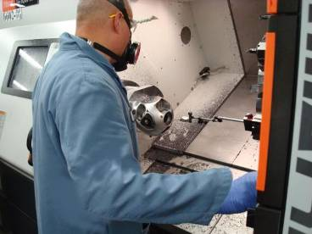
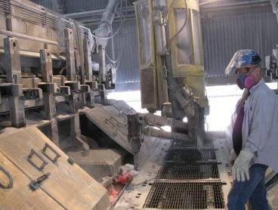
Does chemical form of beryllium matter?
No known differences in CBD risk
  Pure beryllium metal
  Beryllium alloys
    Beryllium copper, AlBeMet
  Beryllium composites (E-materials)
Possibly lower CBD risk
  Beryllium silicates
    Beryllium in soil and rocks
  Soluble beryllium (salts)
    Beryllium fluorides and sulfates
Possibly higher CBD risk
  Beryllium ceramic
  Beryllium oxide
Photo used by National Jewish Health with written permission
Photo used by National Jewish Health with written permission
Notes:
We’ve spent a lot of time over the last few slides describing how to measure the amount of beryllium in the air. The amount of beryllium in the air is one of the factors that determines your risk of beryllium sensitization and chronic beryllium disease, likely one of the most important factors. However, there are also other exposure factors that are important in the risk of beryllium sensitization and chronic beryllium disease. One of those is the chemical form of beryllium that workers are exposed to. When we talk about chemical form, we are talking about whether a worker is exposed to something like a beryllium alloy or a soluble beryllium salt, such as a beryllium fluoride or beryllium sulfate, or something like a beryllium ceramic material. What we know is with similar exposures, people exposed to things like pure beryllium metal, beryllium alloys, and beryllium composites seem to have a similar risk of chronic beryllium disease and beryllium sensitization. That is not to say that people working with these materials usually have similar exposures. A worker machining a pure beryllium part will have a much higher exposure in micrograms per cubic meter than somebody doing the same machining operation on a beryllium alloy. We also know that people exposed to things like beryllium silicate, which is a beryllium we find in rocks and soil in the natural environment, and people exposed to solid beryllium salts, things like beryllium fluorides and beryllium sulfates, are at a much lower risk of beryllium sensitization and chronic beryllium disease, as compared to those people who are exposed to beryllium metal or alloy. On the other hand, people exposed to the less soluble beryllium forms, things like beryllium ceramic and beryllium oxide, are likely at a higher risk of beryllium sensitization and chronic beryllium disease as compared to those people exposed to beryllium metal and beryllium alloys.

Slide 28
Is particle size important?
Sizes not actual, Relative size comparison
Particle size effects where beryllium settles in the lung
Most industrial processes produce many particles less than 1 µm (invisible to unaided eye)
Processes with smaller particles have higher rates of CBD/BeS
  Lapping
  Machining
Small particles can spread throughout the building
  Settling time (still air – 2 m)
    100 µm – 8 seconds
    10 µm – 10 minutes
    1 µm – 15 days
Figure by National Jewish Health
Notes:
Another important factor that determines your risk of beryllium sensitization and chronic beryllium disease is the particle size of the beryllium exposure. Particle size is important because particle size affects where the beryllium settles in the lung. This is important since chronic beryllium disease is a lung disease and the deepest regions of the lung or the gas exchange regions that can only be penetrated by very small particles are the regions of the lung where we normally see chronic beryllium disease. We know that many industrial processes produce a large number of particles less than 1 micron in size. A one micron particle is very small, invisible to the unaided eye, and just to give you a frame of reference, the average human hair is around 100 microns in diameter. We know that workers that work in processes with large numbers of these very small particles have a higher risk of chronic beryllium disease and beryllium sensitization. Some of these processes include things like lapping of beryllium parts or machining of beryllium parts.
Particle size is also important because it determines how long a particle will stay suspended in the air. Small particles that stay suspended in the air can spread throughout a facility and expose additional people to beryllium. Just to give an example, if we have 100 micron particle, and we drop that particle in still air from the height of around 6 feet, that 100 micron particle takes about 8 seconds to hit the ground. Compare this to a 10 micron particle dropped from about 6 feet that takes about 10 minutes to hit the ground and a 1 micron particle that will stay suspended in still air for over 15 days when dropped from a height of 6 feet. In a normal workplace, you never have “still air” and these particles get attached to other surfaces in the work environment or exhausted through the ventilation system. However, this illustrates the point that these small particles can stay in the air for a very long time. This allows many opportunities for workers directly working in beryllium operations to be exposed to these small particles and many opportunities for these small particles to migrate to other areas where workers not directly working in beryllium operations can be exposed.

Slide 29
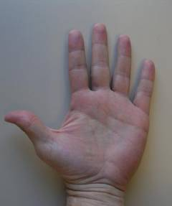
Is skin exposure important?
Beryllium Hand Wipe Samples
Assembly/Deburr 270 µg
Machinists 220 µg
Maintenance 74 µg
Administration 0.44 µg
After hand washing
Up to 220 µg
Photo by National Jewish Health
Beryllium can enter damaged or cut skin
Beryllium dissolves in sweat and may get through skin
Very small particles may get through skin with force or pressure
Cover the skin to reduce the risk of beryllium sensitization (BeS)
Notes:
Now that we’ve spent a lot of time talking about exposure to beryllium in the air, we’re going to switch gears and talk about exposure to beryllium on your skin. We’ve spent a lot of time in the health effects section trying to make the point that skin exposure is important in the risk of beryllium sensitization. What we know is that beryllium can enter through damaged or cut skin and increase the risk of beryllium sensitization. More recent evidence suggests that beryllium can actually dissolve in sweat and make it through intact skin. This means that if you’re holding a beryllium part or a beryllium tool, some beryllium may dissolve in the sweat on your hands and get through your skin and increase your risk of beryllium sensitization. Some other evidence suggests that very small particles, particles much smaller than 1 micron in diameter, may get through intact skin with force or pressure, meaning that if you have really small beryllium particles on your hand and you apply pressure to that hand, those particles may be able to get through your skin and increase your risk of beryllium sensitization. The bottom line is that we believe covering the skin is very important to reduce your risk of beryllium sensitization.
To illustrate that people who work with beryllium get beryllium on their hands, a few years back we did a study in a beryllium machine shop and we measured the amount of beryllium on workers hands. As you can see on the left, people working closely with beryllium, workers in operations such as assembly and machining, have a large amount of beryllium on their hands, 270 to 220 micrograms that we can measure using a wipe sample. On the other hand, people who do not work directly with beryllium, but have contact with beryllium contaminated surfaces during maintenance activities also have beryllium on their hands, but not as much as those directly working with beryllium. Even workers in administrative areas of the facility who hadn’t handled beryllium parts had measurable amounts of beryllium on their hand. Equally important was that even after hand-washing, we were able to measure significant amounts of beryllium on many peoples’ hands. This emphasizes the point that good hand-washing is important and even more important that covering the skin is important to reduce the risk of beryllium sensitization when working with or around beryllium.

Slide 30

Is “take-home” exposure important?
Beryllium in wipe samples from workers’ personal vehicles
Steering Wheel:
Up to 5.3 µg/100 cm²
Driver’s armrest:
Up to 39.7 µg/100 cm²
Driver’s seat:
Up to 15.9 µg/100 cm²
Driver’s floor:
Up to 76.8 µg/100 cm²
Photo by National Jewish Health
Airborne beryllium has been measured while washing work clothes at home
Cases of BeS and CBD have been seen in family members of beryllium workers
Changing clothes, changing shoes and showering is important to prevent take-home exposure.
30
Notes:
30
Take-home exposure or beryllium that you take home or into your vehicle from the work site is very important in making sure that you reduce the risk of your family members developing beryllium sensitization and chronic beryllium disease. We worked with other researchers on a study several years ago in a beryllium machine shop where we wanted to see how much beryllium workers were getting into their cars when they were going home from work. We collected wipe samples from several different locations in workers’ cars and as you can see from the picture, we were able to see large amounts of beryllium in places like the driver’s floor, the driver’s seat, the driver’s arm rest and smaller but still significant amounts of beryllium on the driver’s steering wheel. What this tells us is that beryllium workers who don’t change their clothes and shower are actually taking beryllium contamination home and exposing their family members to beryllium. We also know that in years past, people have been able to measure airborne beryllium while washing contaminated work clothes at home. This is very important in considering the risk to your family members. We have seen cases of both beryllium sensitization and chronic beryllium disease in family members of beryllium workers. For all of these reasons, we believe it’s very important to make sure that workers change clothes, change shoes, and shower before going home.

Slide 31
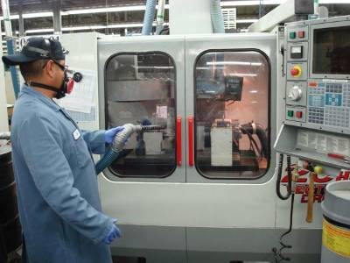
How are beryllium exposures controlled in the workplace?
Combined efforts needed to prevent and control beryllium exposure
  Engineering controls
  Work practice controls
  Administrative controls
  Personal protective equipment (PPE)
  Medical surveillance
Photo used by National Jewish Health with written permission
Notes:
We have spent a lot of time talking about how to recognize exposure to beryllium and how to measure exposure to beryllium. However, the most important thing we can talk about is how to control and prevent beryllium exposure at the workplace. Since we are talking about very low airborne levels of beryllium, microgram quantities, combined efforts are needed to prevent and control beryllium exposure. These combined efforts include such things as engineering controls, work practice controls, administrative controls, personal protective equipment, and medical surveillance. We will talk about each one of these in more detail now.

Slide 32
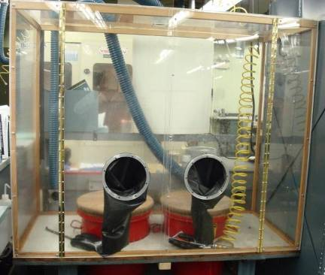
What are engineering controls?
Wet methods
  Machining fluids
Ventilation
  Local Exhaust Ventilation (suction)
Enclosures
Facility design
  Hard cleanable surfaces
  Separation of beryllium and non-beryllium processes
  Separate ventilation systems
Photo used by National Jewish Health with written permission
Notes:
Engineering controls are controls that prevent beryllium exposure. Typically, engineering controls remove beryllium particles at their source of generation and prevent the particles from getting into the worker’s breathing zone. For beryllium machining operations, these controls include using wet methods or machining fluids to reduce the number of particles that get airborne. The most important control for most beryllium processes is to use a special kind of ventilation called local exhaust ventilation or suction which removes beryllium particles from the point of generation similar to a vacuum cleaner. Enclosures, which surround beryllium operations and don’t allow beryllium particles to escape can also be effective in preventing beryllium exposure. The design of a facility can also be considered an engineering control. These design features include making sure that the surfaces in a beryllium facility are hard cleanable surfaces, making sure that beryllium and non-beryllium processes are in separate rooms to minimize the number of exposed workers, and making sure that separate general ventilation (heating and air conditioning) systems are provided for beryllium and non-beryllium areas of the facility. You can see an example on the left side of the slide showing beryllium operation with engineering controls including an enclosure and local exhaust to reduce exposure from activities conducted in the enclosure.

Slide 33
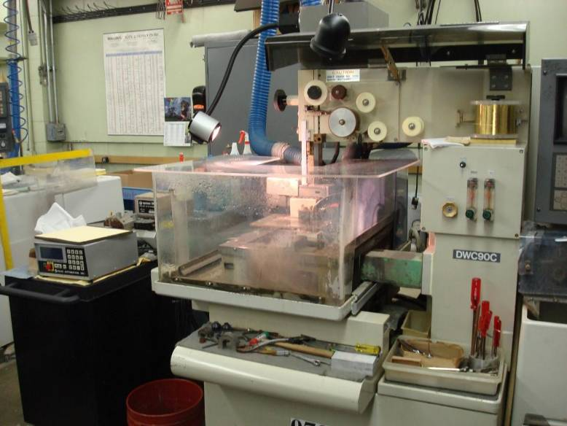
Wet Methods + Local Exhaust Ventilation
Photo used by National Jewish Health with written permission
Notes:
This slide shows another example of an engineering control on a beryllium machining operation. As you can see in the picture, this is a beryllium machining operation that is done using wet methods, so that wet methods reduce the number of the particles that are generated. The process is also enclosed, so the machine has an enclosure as well. In the background, you can see a blue piece of ductwork that extends from the machine. That is the local exhaust for that machine. So this particular engineering control is actually a combination of three controls, wet methods, local exhaust, and an enclosure.

Slide 34
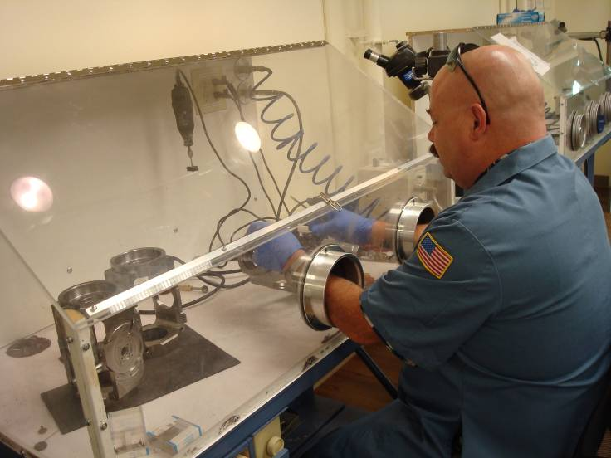
Enclosure + local exhaust ventilation
Photo used by National Jewish Health with written permission
Notes:
This slide again shows a combination of methods that are used to control beryllium exposure. This is a beryllium “deburring” operation and as you can see, the worker is deburring parts inside an enclosure. This enclosure also has local exhaust ventilation attached to it. This serves to capture the beryllium particles at the source of generation and prevent exposure to the worker.

Slide 35
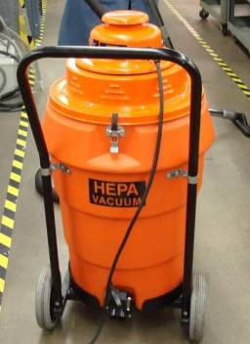
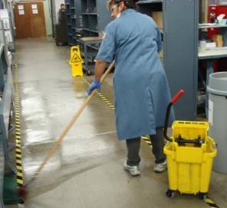
What are work practice controls?
Proper use of engineering controls (all the time)
Labeling of all beryllium materials
Use industrial HEPA vacuums
NO compressed air for cleaning
Wet wiping and mopping only
NO dry sweeping
No eating or drinking in beryllium contaminated areas
Education is critical for success
Photos used by National Jewish Health with written permission
Notes:
Work practice controls are also very important in controlling beryllium exposure. Work practice controls are procedures that are established to make sure that workers know when they are working with beryllium and how to properly work with beryllium. The most important work practice controls at a facility are to make sure that workers know exactly how to use the engineering controls that are provided and to make sure that the workers use these controls all of the time when they’re working with beryllium. Another important work practice control is to make sure that all beryllium materials are labeled, so that workers know when they’re working with beryllium materials. Established and closely controlled cleaning procedures are critical in making sure that exposures to beryllium are minimized in a facility. This means that cleaning should be done using only industrial-grade HEPA vacuums and wet wiping and mopping rather than dry sweeping. Compressed air should never be used for cleaning outside a full enclosure at a beryllium facility. Work practice controls also include making sure that employees do not eat or drink in beryllium contaminated areas and that areas provided for employees to eat or drink are maintained as free as possible of beryllium contamination. For all work practice controls, education is critical for success.

Slide 36
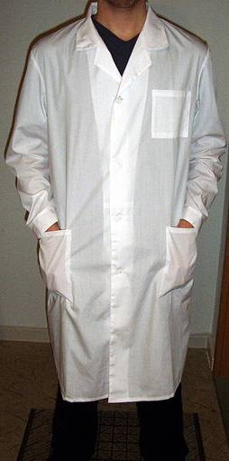
What are administrative controls?
Restrict entry to beryllium areas
    Limit number of exposed workers
    Make sure contractors understand work practice controls
Limit spread of beryllium
    Work uniforms
    Shoe covers
    Sticky mats
    Designated change areas
    Clean break area
Changing clothes, changing shoes and showering is important to prevent take-home exposure.
Dennis Myts, Wikimedia Commons – CC-BY-SA-2.5
Notes:
Administrative controls are controls that limit the number of beryllium exposed workers or limit the amount of time a worker is exposed to beryllium. In order to limit the number of exposed workers, entry into beryllium processing areas should be restricted to only those employees who are necessary to do the job. Control of contractors is also important. Contractors must be educated on beryllium hazards and work practice controls in your facility. Another important administrative control is to limit the spread of beryllium contamination at your facility. This also helps limit the number of beryllium-exposed workers at your facility. One of the methods used to limit the spread of beryllium contamination is to have work uniforms that are only used in beryllium-contaminated areas and are changed before going into non-contaminated areas. Shoe covers can also be used to prevent tracking of beryllium contamination from dirty areas to clean areas. Sticky mats are used in some facilities to clean the soles of shoes before entering a non-contaminated area. With work uniforms, it is important to have a designated change area, where dirty clothes can be stored and clean clothes can be changed into. Finally, making sure that employees have clean break areas where they can eat and drink can also reduce exposure. As we stated earlier, changing clothes, changing shoes and showering is extremely important to make sure that workers are not taking beryllium contamination home to their families.

Slide 37
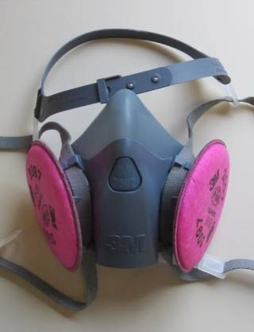
What is personal protective equipment?
Skin protection
  Long sleeve work uniforms of tightly woven material
  Gloves required when skin contact with beryllium possible
Respirators
  Required for exposures that cannot be controlled to at least below the PEL or STEL with engineering controls or to keep exposures as low as possible
    Must be used correctly (no facial hair)
    Must be used when required
    Must be medically cleared and fit-tested
    Proper training is necessary
PPE is only effective when used properly
Photo by National Jewish Health
Notes:
Personal protective equipment is very important for preventing skin exposure to beryllium materials. Workers should wear long sleeve work uniforms of a tightly woven material such as cotton when working around beryllium processes. Workers handling beryllium parts or in contact with beryllium-contaminated surfaces should wear impermeable gloves when skin contact is possible. Respirators can be important when exposures cannot be maintained below exposure target levels with engineering controls or to reduce exposure to as low as possible. However, it’s important to realize that respirators are only effective when they’re used correctly. This means that workers cannot have facial hair and that the respirators must be used all the time when they’re required. As per OSHA requirements, workers must be medically cleared to wear respirators and must be fit-tested in the respirator that they’re going to use annually. Proper training is crucial for proper respirator use. The bottom line with personal protective equipment is that it’s only effective when it’s used properly, so both enforcement and training is critical to the success of personal protective equipment as a control measure.

Slide 38


Why do medical surveillance?
To determine if exposure controls are working
“Safety net” for exposure control
If no BeS is identified in your workplace
    Helps confirm that your exposure controls are working
If BeS is identified in your workplace
    Suggests your exposure controls need to be improved
    That other workers in similar jobs may be at risk
Notes:
Medical surveillance helps verify that exposure controls in the facility are currently working. It serves as a “safety net” for exposure control. When a workforce undergoes medical surveillance with the BeLPT, there are two situations that can be identified. The first situation is when a number of workers are tested in the workplace, and no cases of beryllium sensitization are identified. This helps confirm that the exposure controls are currently working. The other situation is when a number of workers are tested, and one or more cases of beryllium sensitization are identified. This identification of beryllium sensitization suggests that exposure controls in the workplace may need to be improved. It also suggests that other workers in similar jobs to those who were identified as beryllium sensitized might also be at risk of beryllium sensitization.

Slide 39
OSHA Compliance – 1910.1024

Slide 40
OSHA Compliance – Standard Timeline
Standard Timeline
  Pre-2017 Beryllium PEL was considered too high and did not adequately protect employees
  1/9/17 – Final Rule Issued. Confusing and received a lot of push back from industry
  5/7/18 – OSHA adopted clarifying amendments regarding trace amounts of beryllium
  5/11/18 – OSHA begins enforcing PELs in general industry
  12/12/18, OSHA begins enforcing general industry provisions for beryllium work areas and regulated areas, written exposure control plan, personal protective clothing and equipment, hygiene, housekeeping, communication of hazards, and recordkeeping.
www.iup.edu/pa-oshaconsultation

Slide 41
OSHA Compliance - Standard Timeline
  3/11/19 OSHA begins enforcing general industry requirements for change rooms and showers.
  3/10/20 OSHA enforces general industry engineering control requirements
  7/14/20 – OSHA amends existing general industry standard to clarify provisions and simplify compliance. 2017 Appendix A was replaced with a new Appendix A to better define the definition of “Beryllium Work Area”
  9/14/20 – 7/14/20 Final Rule Effective
www.iup.edu/pa-oshaconsultation

Slide 42
Scope and Application - 1910.1024(a)(3)
This standard does not apply to materials
Containing less than 0.1% beryllium by weight and;
Where the employer has objective data demonstrating that employee exposure to beryllium will remain below the action level as an 8-hour TWA under any foreseeable conditions
Must Meet Both Criteria
www.iup.edu/pa-oshaconsultation

Slide 43
Exposure Limits (c)
Action Level
  8-hr TWA exposure
  0.1 μg/m³
Permissible Exposure Limit (PEL)
  8-hr TWA exposure
  >0.2 μg/m³
Short Term Exposure Limit
  15-minute TWA exposure
  >2.0 μg/m³
www.iup.edu/pa-oshaconsultation

Slide 44
Exposure Assessment (d)
Employer must assess airborne exposure of employees who have exposure to beryllium
  Assessment based on any combination of air monitoring data and objective data sufficient to accurately characterize exposure
  Must assess employee exposure compared to AL, PEL and STEL
  Breathing zone samples
  May do representative sampling
  If employees are in same area and do same tasks – Sample employee expected to have highest exposure
  Reassess employee airborne exposure if changes occur (e.g., change in production or operation)
www.iup.edu/pa-oshaconsultation

Slide 45
Initial Monitoring
Employee exposure below AL and at or below STEL – No additional monitoring required unless operations change
Employee exposure at or above AL but at or below the PEL – Repeat air monitoring every six (6) months
Employee exposure above the PEL or STEL – Repeat air monitoring every three (3) months
Can discontinue exposure monitoring when two (2) consecutive measurements taken more than seven (7) days apart are below STEL and AL.
Must notify employees of results within 15 working days after completing assessment
www.iup.edu/pa-oshaconsultation

Slide 46
Beryllium Work Areas and Regulated Areas (e)
Establish a “Beryllium Work Area”:
  Beryllium work area means any work area where materials that contain at least 0.1 percent beryllium by weight are processed either:
    During any of the operations listed in Appendix A of this standard; or
    Where employees are, or can reasonably be expected to be, exposed to airborne beryllium at or above the action level
Establish a “Regulated Area”
  Wherever employees are, or can reasonably be expected to be, exposed to airborne beryllium at levels above the TWA PEL or STEL.
www.iup.edu/pa-oshaconsultation

Slide 47
Beryllium Work Areas and Regulated Areas
Identify areas with signs and establish boundaries of areas
Limit access to authorized persons
Provide personal protective equipment (PPE) including respirators
www.iup.edu/pa-oshaconsultation

Slide 48
Methods of Compliance (f)
Employer must establish a written exposure control plan (ECP)
  List of operations and job titles with airborne or dermal exposure to beryllium
  List of operations and job titles with exposure at or above AL, PEL or STEL
  Procedures for keeping surfaces as clean as practicable
  Procedures for handling beryllium-contaminated PPE
ECP must be reviewed and updated at least annually
Copy of ECP must be made available to employees
Employer must utilize engineering/work practice controls to reduce and maintain exposure to below the PEL/STEL as much as feasible
May not rotate employees to different jobs to achieve compliance with PELs
www.iup.edu/pa-oshaconsultation

Slide 49
Respiratory Protection (g) & PPE (h)
Respirator required if exposure exceeds PEL or STEL
Employer must provide respirator at no cost to employee if respiratory protection is required
Must provide a PAPR if requested by employee in areas where respiratory protection is required
Must implement a respiratory protection program in accordance with 1910.134
  Selection & Training
  Fit Testing
  Medical Evaluation
www.iup.edu/pa-oshaconsultation

Slide 50
Respiratory Protection & PPE
Employer must provide PPE at no cost to employee
Beryllium-contaminated PPE and clothing
  Must be removed at end of work shift
  Stored separately from street clothes
  May not be removed from workplace
  Must be stored and transported in sealed bags or other closed containers and labeled. Notify outside contractors that PPE and clothing is contaminated with beryllium
  May not blow or shake off PPE and clothing to remove beryllium contaminated dirt and debris
www.iup.edu/pa-oshaconsultation

Slide 51
Hygiene Areas (i), Practices & Housekeeping (k)
For each employee working in beryllium work areas or who are expected to have dermal contact
  Readily accessible washing facilities must be provided
  Wash exposed skin at end of process, activity or shift and prior to eating, smoking, drinking, chewing tobacco, gum or applying cosmetics
  Must be provided a designated change room if required to use PPE/equipment
  Showers required if employee exposures exceed the PEL or STEL and the employee's hair or body parts other than hands, neck and face area expected to be contaminated with beryllium
  Employee’s may not enter eating or drinking area wearing beryllium-contaminated PPE or clothing
All areas including eating and drinking areas must be maintained as clean as practicable from surface beryllium contamination
www.iup.edu/pa-oshaconsultation

Slide 52
Medical Surveillance (k) (l)
Must be provided to employees if exposed at or above the AL for more than 30 days per year
Must be provided for employees with signs or symptoms of CBD or other beryllium-related health effects
Must be provided if employees exposed to beryllium during an emergency
Medical exam must be provided within 30 days of hire or assignment and every two (2) years thereafter and at termination of employment
Medical surveillance must be performed by or under the supervision of a licensed physician
Employee is eligible for medical removal if working in a job with exposure above the AL and removal is recommended by a medical professional
www.iup.edu/pa-oshaconsultation

Slide 53
Communication of Hazards (m)
Employer must comply with Hazard Communication Standard 1910.1200
Communication with employees must address: Cancer; lung effects (CBD and acute beryllium disease); beryllium sensitization; skin sensitization; and skin, eye and respiratory tract irritation
Must provide employees access to labels and safety data sheets (SDS) on beryllium
Provide and display warning signs at each approach to a regulated area
Beryllium must be included in hazard communication training program
Beryllium training required initially and annually thereafter
Copy of Hazard Communication Written Program, Beryllium Exposure Control Plan and OSHA Standard 1910.1024 must be readily available to employees
www.iup.edu/pa-oshaconsultation

Slide 54
Recordkeeping (n)
Air monitoring data/Objective data- 30 Years (See 1910.1020)
Medical records – Employment plus 30 years
www.iup.edu/pa-oshaconsultation

Slide 55
OSHA Inspection

Slide 56

Beryllium Overexposure in a Blow Mold Repair Shop
Keith Piercy
Industrial Hygienist
U.S. Department of Labor / OSHA
Tampa Area Office

Slide 57
Background
Complaint initiated inspection alleging:
  Employees overexposed to beryllium while working on beryllium-copper alloys
  No local exhaust ventilation provided
  Employees not trained on health hazards of beryllium

Slide 58
Company Information
SIC Code: 3544, Manufacturing Special Dies, Tools, Jigs & Fixtures
  Specifically injection blow molds for plastic containers
In business at location for 8 years
# employees: 3 employees at this location; 25 nationwide in 3 other shops

Slide 59
Shop Information
Setup: General Machine shop type equipment: drill press, mill, welding table, finishing table
95% of work is servicing old molds
5% is building new molds

Slide 60
Process Description
Employees weld on beryllium-copper metals which are part of the mold
Welding rods contained 2% beryllium
Molds used by companies using plastic injection units for containers
High heat and contact areas are BeCu (small part); rest is aluminum

Slide 61
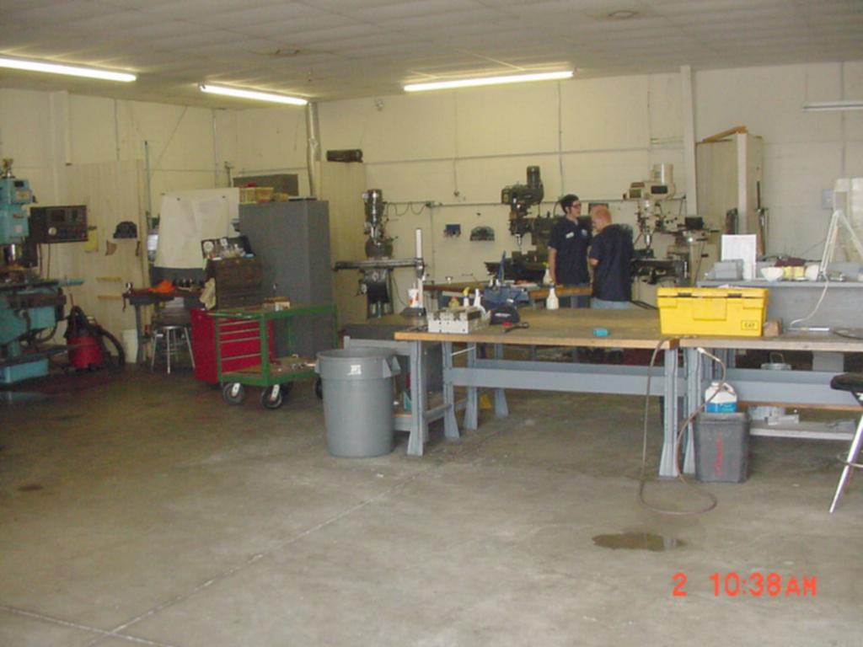
General Shop Layout

Slide 62
Controls
Welding table – kitchen type range hood
Finishing table – no LEV
Employees – respirator and welding hood

Slide 63
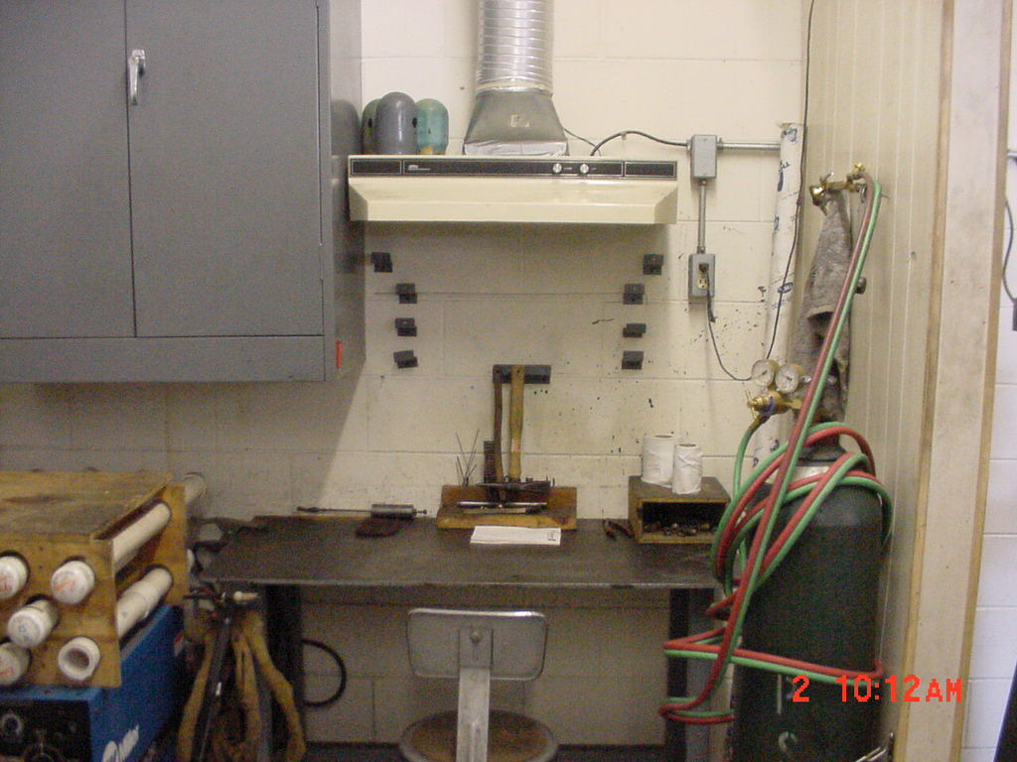
Household,
Top-of-the-Line Range Hood

Slide 64
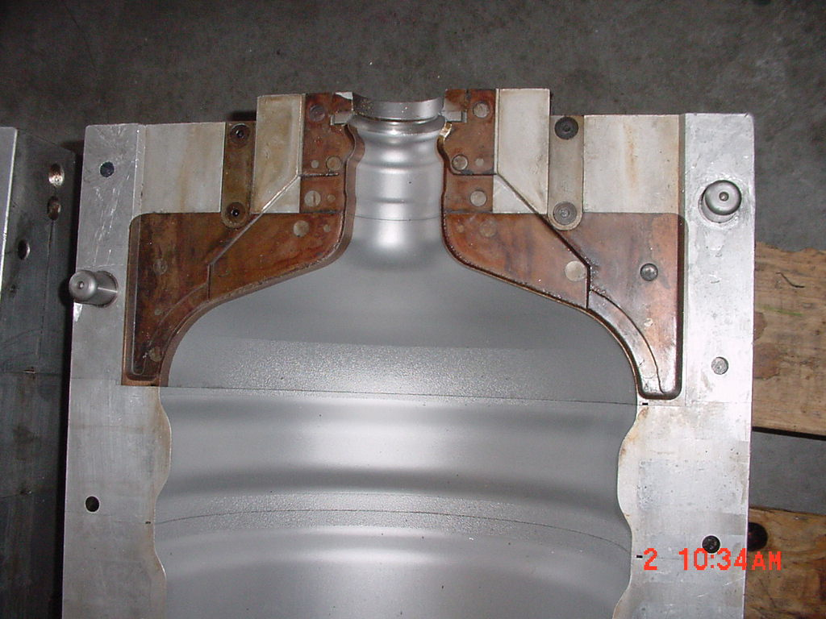
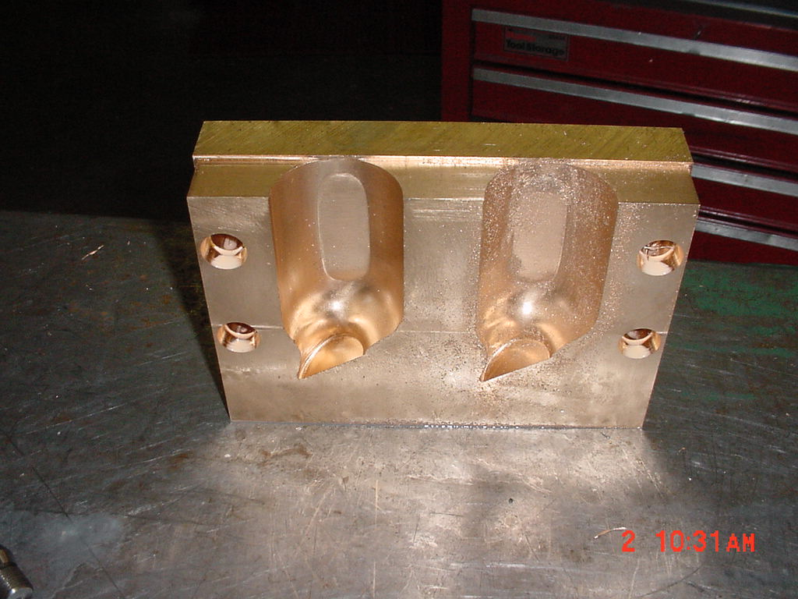
Beryllium-Copper Contact Points
Molds: 5% is a beryllium- copper component;
remainder is aluminum
BeCu components:
2% Be; 98% Cu

Slide 65
Sampling Methodology
Air Sampling
  OSHA Sampling Protocol ID-125G
  2 liters per minute with 0.8u Mixed Cellulose Ester Filters
  ICP Analysis for 13 metals
Swipe Samples
  Whatman 41 Swipe Tabs
  10cm x 10cm surface swipes with distilled water

Slide 66
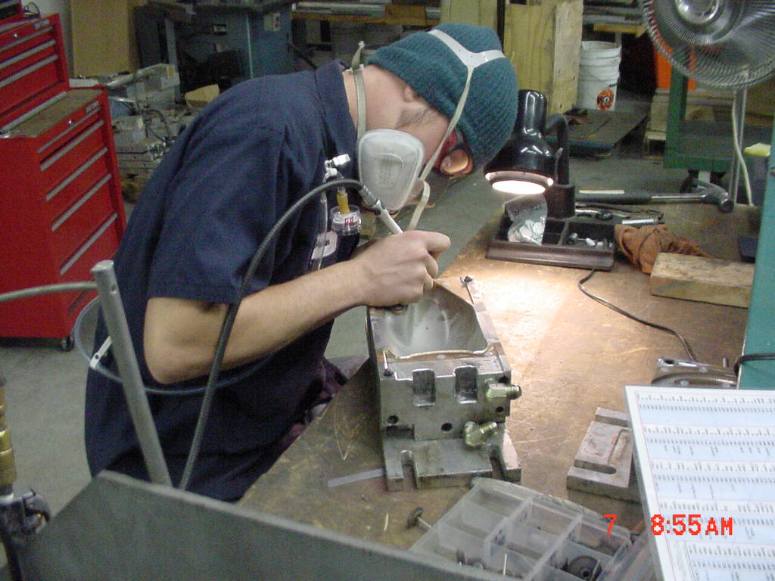
Dremel Use for Finishing

Slide 67
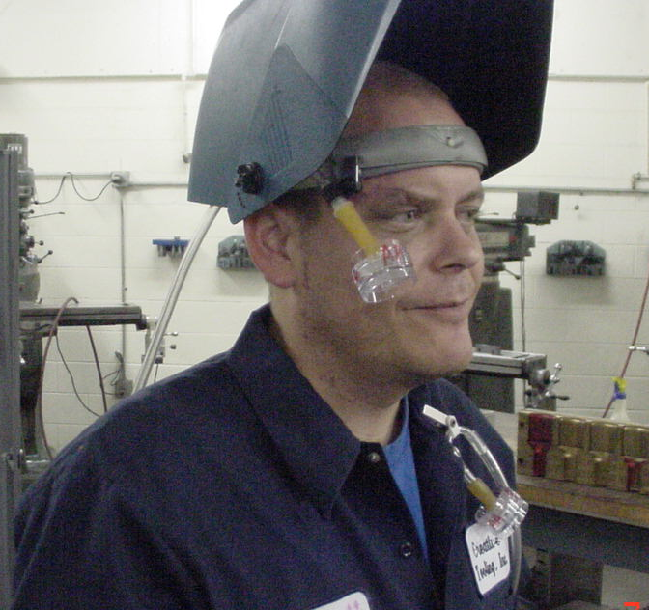
Welder, sampled inside & outside the hood for comparison

Slide 68
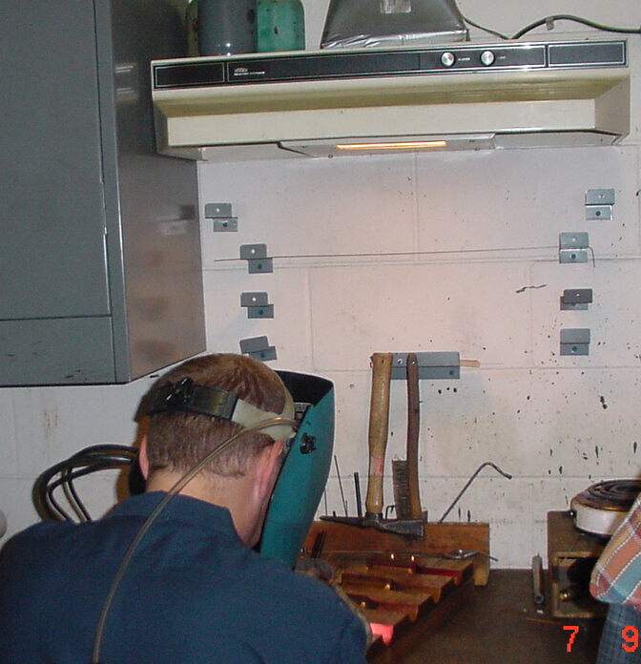
View of welder in relation to “local exhaust”

Slide 69
Air Sample Results
8-hr TWAs: PEL**(2022)
  Welder 0.18ug/m³ ^{- - - - - →} 0.2 ug/m³
  Finisher 0.0812ug/m^{3 - - - →} 0.2 ug/m³
15-min Ceilings:
  Welder* 5.6ug/m^{3 - - - - - →} 2.0ug/m³
    (*outside the hood was 13x higher)
  Finisher* 2.6ug/m³ ^{- - - - - →} 2.0ug/m³

Slide 70
Swipe Sample Results
Positive at:
  Welding table 0.48 ug/100cm²
  Dremel table 2.41 ug/100cm²
  General work bench 1.11 ug/100cm²
  Microwave table 0.153 ug/100cm²
  Water Cooler Table 0.0 ug/100cm²

Slide 71
Findings
Ventilation – Exhaust Violations
  1910.252(c)(8) No LEV for Be-based
        fillers metals
Respiratory Protection Violations
  1910.134(c)(1) No Program
  1910.134(c)(2)(i) No Appendix D
  1910.134(e)(1) No medical evaluations
  1910.134(f)(1) No fit-testing

Slide 72
Findings
Hazard Communication Programs
  1910.1200(e)(1) No written HazCom program
  1910.1200(g)(8) No MSDSs
  1910.1200(h) No training
Housekeeping Violations
  1910.141(a)(3) Housekeeping
  1910.141(g)(2) Consumption of food- beverages around toxics

Slide 73
Findings
Miscellaneous Violations
  1910.212(a)(5) Fan guarding
  1910.303(g)(2)(i) Guarding of live parts
  1910.242(b) Compressed air

Slide 74
Abatement Actions
Employer discontinued process until abatement
  Emphasis on hand, arm & face washing
  Full PPE and laundering provided
  Medical surveillance, BeBLPT
  Continuous flow air-line respirators
  LEV installed

Slide 75
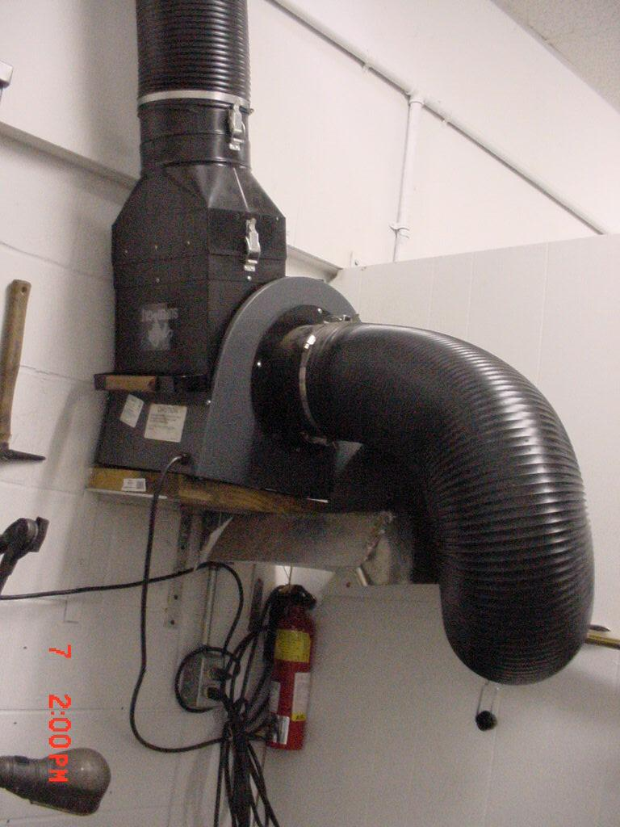
New Local Exhaust System
All welding is done within 13 inches of the hood face to ensure 100fpm

Slide 76
Follow-Up
Process Change Made
  Employer switched to a welding rod containing no beryllium
Sampling repeated, negative

Slide 77
Follow-Up
 | Ceiling Sample Results in ug/m³
 | OSHA | State Consultation
 | 03-07-01 | 07-19-01 | 08-23-01
Employee 1 | 5.6 | 4.3 | < 0.4
Employee 2 | 2.6 | 5.6 | < 0.3
 | OSHA Ceiling Limit** = 2.0

Slide 78

www.iup.edu/pa-oshaconsultation
www.iup.edu/pa-oshaconsultation

Slide 79
Contact us
Daniel Larson
dlarson@iup.edu
Pennsylvania OSHA Consultation Office
Phone: 800-382-1241
Website: www.iup.edu/pa-oshaconsultation/
Facebook: https://www.facebook.com/Pennsylvania-OSHA-Consultation-Program-548810235234647/
Twitter: https://twitter.com/search?q=PA%20OSHA%20Consultation&src=savs
www.iup.edu/pa-oshaconsultation

Slide 80
Thank You
Upcoming Webinar:
Common But Often Unrecognized Electrical Hazards in the Workplace
TBD @ 10:30am
Pennsylvania OSHA Consultation Office
Phone: 800-382-1241 or 724-357-4095
Website: www.iup.edu/pa-oshaconsultation
www.iup.edu/pa-oshaconsultation

