Slide 1
Welcome A Look at OSHA’s Recommended Practices for
Safety and Health Programs Will begin at 10:30am Presented by: Annette T. Olesen, CIH, CIT Pennsylvania OSHA Consultation Office Phone: 800-382-1241 or 724-357-4095 Website: www.iup.edu/pa-oshaconsultation

Slide 2
A Look at OSHA’s Recommended Practices for Safety and Health Programs
Webinar General Info PowerPoint Presentation Q&A Questions Chat is open to submit questions. We will be answering questions through this chat feature. If due to the technical nature of the question a more thorough response is required, we will post the answer on our website within seven days of the webinar.
www.iup.edu/pa-oshaconsultation

Slide 3
Overview
This webinar provides a look at OSHA’s Publication #3885 entitled “Recommended Practices for Safety and Health Programs.
We will discuss the different sections within the document along with the design and content.
The goal is to have the webinar attendees become familiar with the document in hopes of using it to implement safety and health programs within their own company organizations.
www.iup.edu/pa-oshaconsultation

Slide 4
Introduction
OSHA recognized a need to update their 1989 Safety and Health Program Management Guidelines due several business sector changes
The nature of work
Automation of work activities
Workforce diversity
Aging workforce
Changes for low-risk workplaces
Increase in temporary workforces
Designed to help the small to medium size workplaces in several different work environments.
Emphasizes a proactive approach to managing workplace safety and health and continuous improvement.
Discusses the Benefits of Implementing a Safety and Health Management System.
www.iup.edu/pa-oshaconsultation

Slide 5
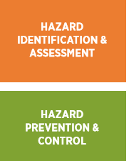
How to use the Guide
Each section contains one of the core elements considered essential to a safety and health program.
Inside the core elements are action items for employers and employees to take to establish, implement, maintain, and improve the safety and health program.
The core elements are interrelated so that one element effects another.
www.iup.edu/pa-oshaconsultation

Slide 6
Things to Remember
One size does not fit all
The Importance of Worker Participation
Dealing with more than one Employer
www.iup.edu/pa-oshaconsultation

Slide 7
Management Leadership
Action #1 Communicate Management’s Commitment to the safety and health program
Have a policy
Make safety part of business decisions
Set a good example
Action #2 Define program goals
Make goals realistic and measurable
Have an action plan
Action #3 Allocate Resources
Budget for safety and health
Allow time for employees to participate in safety and health
Action #4 Expect Performance
Establish roles and responsibilities for management, supervisors, and employees
Hold them accountable and provide positive recognition
www.iup.edu/pa-oshaconsultation

Slide 8
Worker Participation
Action #1 Encourage workers to participate in the program
Give them time to participate and acknowledge those who participate
Establish and open-door policy
Action #2 Encourage workers to report safety and health concerns
Establish a process for workers to report concerns and provide feedback
Empower workers by establishing an environment where there is no retaliation for reporting
Action #3 Give workers access to safety and health information
Information such as SDSs, Injury and Illness data, Inspection reports, Exposure Monitoring
www.iup.edu/pa-oshaconsultation

Slide 9
Worker Participation (cont’d)
Action #4 Involve workers in all aspects of the program
Setting goals, establishing safety procedures, conducting inspections, incident investigations
Action #5 Remove barriers to participation
Ensure all levels are involved no matter the skill set or language and provide feedback
www.iup.edu/pa-oshaconsultation

Slide 10
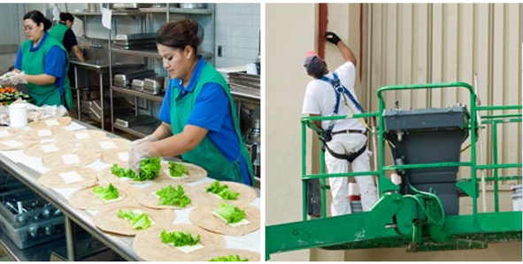
Hazard Identification and Assessment
Action #1 Collect existing information about workplace hazards
Look to OSHA, NIOSH, CDC, trade organizations for information
Evaluate previous incidents and any exposure monitoring results
Action #2 Inspect the workplace
Make them regular, document, have a checklist, watch for changes
Action #3 Identify health hazards
Chemical, physical, biological, ergonomic
Conduct exposure assessments, review medical records
www.iup.edu/pa-oshaconsultation

Slide 11
Hazard Identification and Assessment (cont’d)
Action #4 Conduct incident investigations
Have a procedure and provide training
Action #5 Identify hazards with emergencies and nonroutine situations
Fires, chemical releases, infrequently performed activities, weather, medical, workplace violence
Action #6 Characterize the nature of the hazards, interim controls, and prioritize controls
Evaluate the likelihood of occurring and the severity
www.iup.edu/pa-oshaconsultation

Slide 12
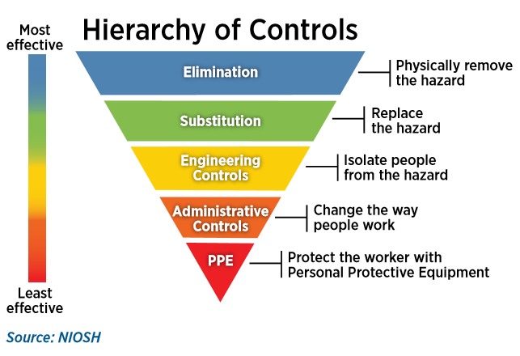
Hazard Prevention and Control
Action #1 Identify control options
Obtain employee input, seek safety and health experts
Action #2 Select controls
Use the hierarchy of controls
Action #3 Develop and update a hazard control plan
Assign responsibilities, completion dates, verify effectiveness
www.iup.edu/pa-oshaconsultation

Slide 13
Hazard Prevention and Control (cont’d)
Action #4 Select controls for nonroutine tasks and emergencies
Always consider before work begins and conduct drills
Action #5 Implement controls
Follow the established plan. Look at risks and severity for prioritization.
Action #6 Follow up and confirm that controls are effective
Involve workers to provide feedback. Modify if needed.
www.iup.edu/pa-oshaconsultation

Slide 14
Education and Training
Action #1 Provide program awareness training
On program policies, functions of the program, and who to contact with questions
Action #2 Train employers, managers, and supervisors on their roles in the program
Train on OSHA act, responses to employee concerns, what’s in place to control hazards
Action #3 Train workers on their specific roles in the safety and health program
Train on hazard recognition and controls, incident investigations, and program improvements
Action #4 Train workers on hazard identification and controls
Train on JHAs (job hazard analysis), PPE, how to report hazards, hierarchy of controls
www.iup.edu/pa-oshaconsultation

Slide 15
Program Evaluation and Improvement
Action #1 Monitor performance and progress
Track lagging and leading indicators, share results with employees
Action #2 Verify that the program is implemented and is operating
Determine progress on achieving safety and health program goals, verify key process are in place
Action #3 Correct program shortcomings and identify opportunities to improve
Evaluate workplace changes, make changes to reflect current conditions
www.iup.edu/pa-oshaconsultation

Slide 16
Communication and Coordination for Host Employers, Contractors, and Staffing Agencies
Action #1 Establish effective communication
Host employer communicates job hazards and controls, how to report hazards, what to do in an emergency
Action #2 Establish effective coordination
Have safety related specifications in bid/contract documents, harmonize safety and health policies, be prepared for staffing needs and changes
www.iup.edu/pa-oshaconsultation

Slide 17
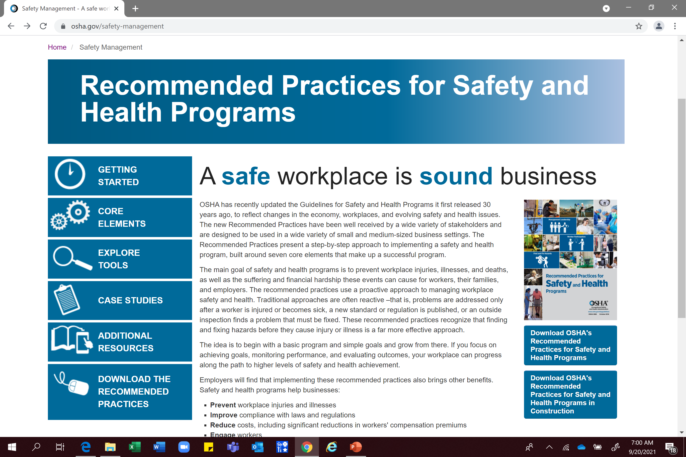
Resources
Dedicated webpage to support implementation of recommended practices
https://www.osha.gov/safety-management
www.iup.edu/pa-oshaconsultation

Slide 18
Explore Tools
Safety and Health Program Existing OSHA Standards Crosswalk
Safety and Health Program Voluntary Standards Crosswalk
www.iup.edu/pa-oshaconsultation

Slide 19
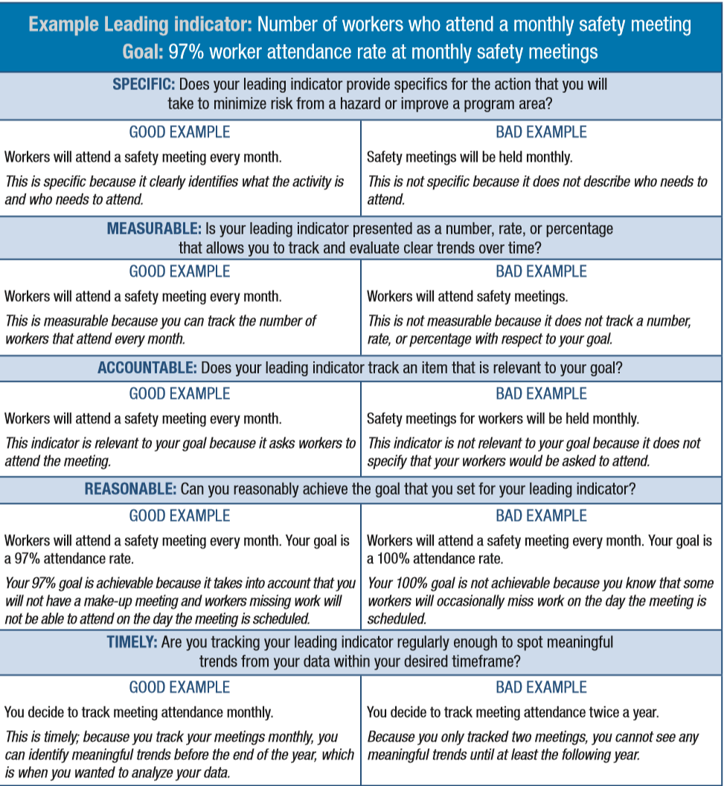
Explore Tools
Self Evaluation Checklist
Implementation Checklist
Audit Checklist
Leading Indicators Guidance
www.iup.edu/pa-oshaconsultation

Slide 20
Additional Resources
Add Text
www.iup.edu/pa-oshaconsultation

Slide 21
Summary
A Safe Workplace is a Sound Workplace
Prevent workplace injuries and illnesses
Improve compliance with laws and regulations
Reduce costs, including significant reductions in workers' compensation premiums
Engage workers
Enhance their social responsibility goals
Increase productivity and enhance overall business operations
www.iup.edu/pa-oshaconsultation

Slide 22
www.iup.edu/pa-oshaconsultation

Slide 23
Contact us
Pennsylvania OSHA Consultation Office
Phone: 800-382-1241
Web: www.iup.edu/pa-oshaconsultation/
Facebook: https://www.facebook.com/Pennsylvania-OSHA-Consultation-Program-548810235234647/
Twitter: https://twitter.com/search?q=PA%20OSHA%20Consultation&src=savs
www.iup.edu/pa-oshaconsultation

Slide 24
Thank You
Upcoming Webinar:
Safety and Health Program Assessments
December 15, 2021@ 10:30am
Pennsylvania OSHA Consultation Office
Phone: 800-382-1241 or 724-357-4095
Website: www.iup.edu/pa-oshaconsultation
www.iup.edu/pa-oshaconsultation

