Slide 2
Mental Wellness and the Effects on Employee Safety

Slide 3
Good Morning
Objective - change
The safety professional & current status
Culture
Breaking down behaviors
Mental Wellness and its effect on loss
Your story
“It’s common to define individual health as merely the absence of illness.”

Slide 4
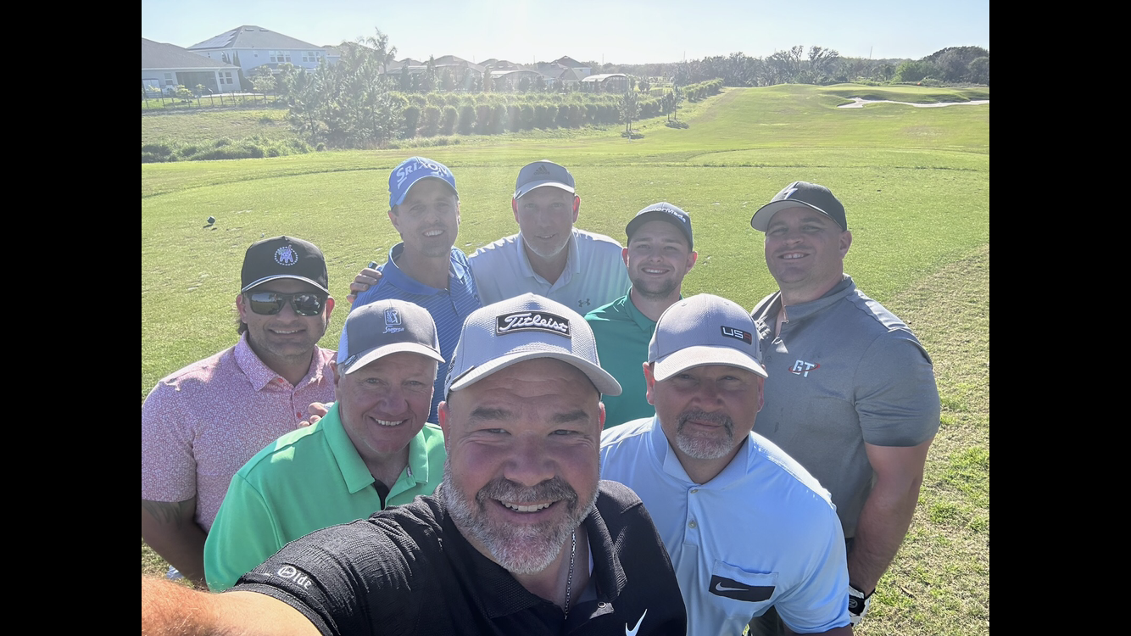
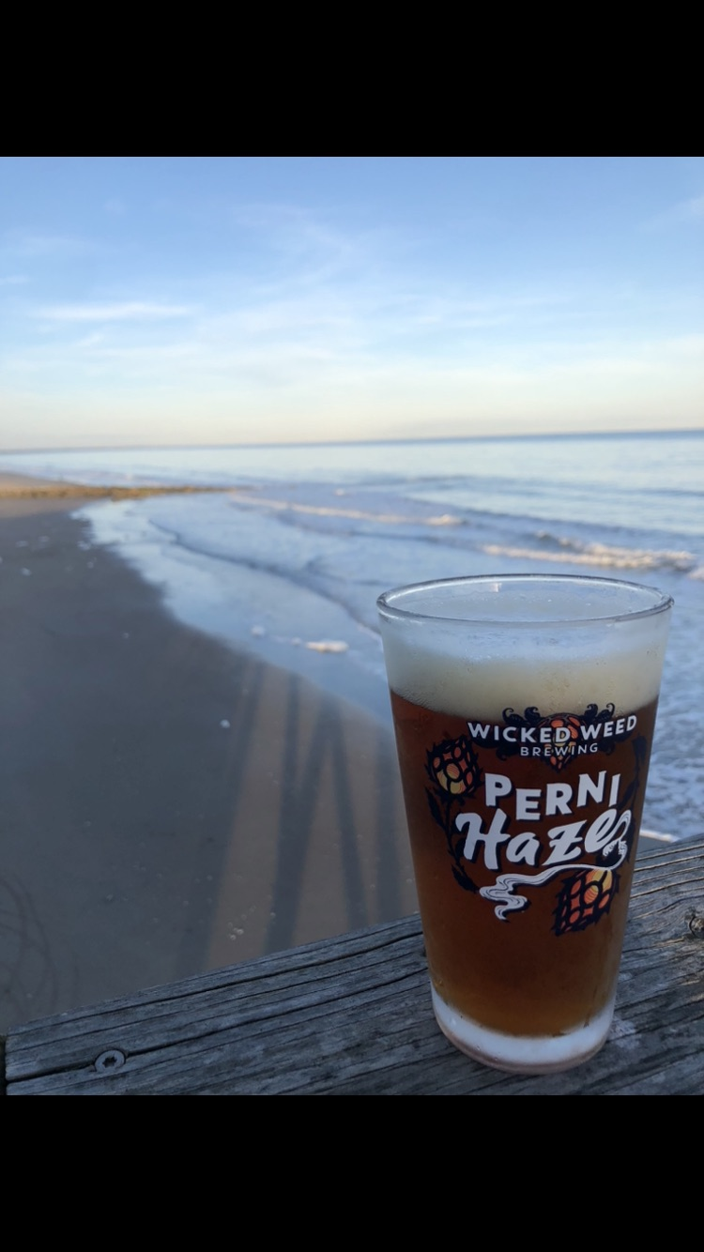
My Story

Slide 5
Let’s Start w/ a Question
Am I making a difference?
What is our role ?
See the unseen
Kinda safety
Checking the box

Slide 6
Number’s Don’t Lie
NSC – everyday, 14 occupational fatalities
5,190 workers in 21, up 8.9%
70M lost work-days
340M occupational injuries / year
718 Homicides / 15.5 suicides
$49.18 billion in direct U.S. workers compensation costs.
Why?

Slide 7
What’s Going On?
We take pride in:
Technology
Training
Equipment
Support
This Photo by Unknown Author is licensed under CC BY-SA

Slide 8
“Ideals or processes handed down from generation to generation.”
Most include
Shared values
Top down
Continuous learning – be creative
Accountability
Constant support/ team
…………..Evolving

Slide 9
A New Direction
Simple Text Message
The need for help is real
12B workdays lost due to anxiety / depression
35% increase in anti-depressant prescriptions
Construction is 2x higher than any other industry
We have lost 7 employee
Simple Text Message
The need for help is real
12B workdays lost due to anxiety / depression
35% increase in anti-depressant prescriptions
Construction- 2x higher
It’s personal to us.

Slide 10
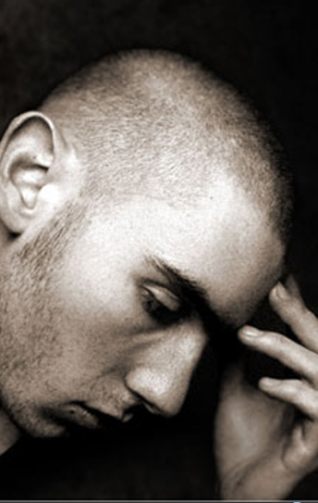
Mental Health & Safety
“….a dynamic, positive state that pertains to a person’s everyday life in various ways and reflects that ability to cope with life. It exceeds the traditional concept of “mental wellness” and is considered a proactive strategy in dealing with life.”
Rabbit hole

Slide 11
Behaviors
How many thoughts do we have a day?
How many are negative?
Negativity Bias
Defense mechanism
Companies / media are tricky
TV, radio, movies, news, social medial and video games
Smart phone / suicide

Slide 12
Defeating Negativity Bias
Be aware of your emotions
Flip it from bad to good / not easy to do
Genuinely care about change
Surround yourself w positive people
“Show me your friends and I’ll show you your future.”
Be patient
“I buried the old Jason and I don’t plan on visiting his grave”

Slide 13
Behavior Based Safety
Measuring both positive and negative outcomes
Total Worker Health / NIOSH
What influences behaviors?
Attitude
Emotion / internal and external instances

Slide 14
Mental Wellness Barriers
Break the Stigma
Education - do you know what to say
Awareness
1 and 5 of us will struggle with a mental illness
Don’t ignore the symptoms:
Alone / loss of appetite / use of drugs-alcohol / quick to anger / appearance
Taking about suicide doesn’t cause someone to commit suicide.
Action
EAP
Mentorship program / help line
Continuous Support
I did it all wrong

Slide 15
6 Baskets of + Mental Wellness
Physical – In good shape / exercise / diet
Mental – Positive state of mind / ability to cope
Emotional – Express their feelings maturely
Spiritual – Finding your purpose and meaning
Social – Enjoyment of relationships
Environmental – Your appreciation for your surroundings

Slide 16
Our Why?
The 3 Reasons Behind Our Cultural Shift
#1 Numbers don’t lie
<90% of all loss
Understanding poor behaviors
Mental Alertness
“Enhancing Buildings, Bridges & Lives.”

Slide 17
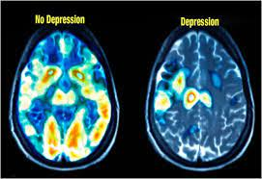
PET Scan
Decreased brain activity in depressive patients.
Reduced gray matter volume and reduced functional activity would lead to negative emotion and the inability of cognitive processing in depressive patients.

Slide 18
#2 Employee Retention
Being a part of something bigger
Being valued / appreciated
Adapt to the needs / generational
Engagement

Slide 19
#3 The Right Thing to Do
Support your values/ resources
Commitment to our employee’s & families
Work and home
Create a productive Life-Work balance
More good days than bad
This Photo by Unknown Author is licensed under CC BY

Slide 20
Ask Yourself -How Are You Doing?
100% of all of us will experience a mental wellness concern
Depression
Anxiety
Grief
Anger

Slide 21
Find Your “Why”
Ultimately, here to change the world for the better
Create instances / your book
Defeat complacently
Work / relationships / mental / physical / social
Create more baskets
What is your purpose? What do you bring

Slide 22
