Slide 1
Welcome The LOTO Periodic Inspection-
More than Just an “Annual Review” Will begin at 10:30am Presented by: Cynthia Mellen MS, CSP Pennsylvania OSHA Consultation Office Phone: 800-382-1241 or 724-357-4095 Website: www.iup.edu/pa-oshaconsultation

Slide 2
The LOTO Periodic Inspection More than just an “Annual Review”
Webinar General Info PowerPoint Presentation Q&A Questions Chat is open to submit questions. We will be answering questions through this chat feature. If due to the technical nature of the question a more thorough response is required, we will post the answer on our website within seven days of the webinar.
www.iup.edu/pa-oshaconsultation

Slide 3
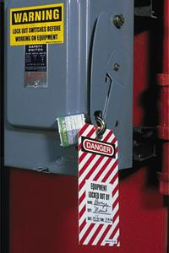
Quick Review: Lockout/Tagout 1910.147
Scope: Used when servicing OR during maintenance of machines and equipment where there may be
Unexpected energization or
Start up or
Release of stored energy
Energy Control Program: 3 Main Parts:
Energy Control Procedures
Periodic Inspections
Employee Training

Slide 4
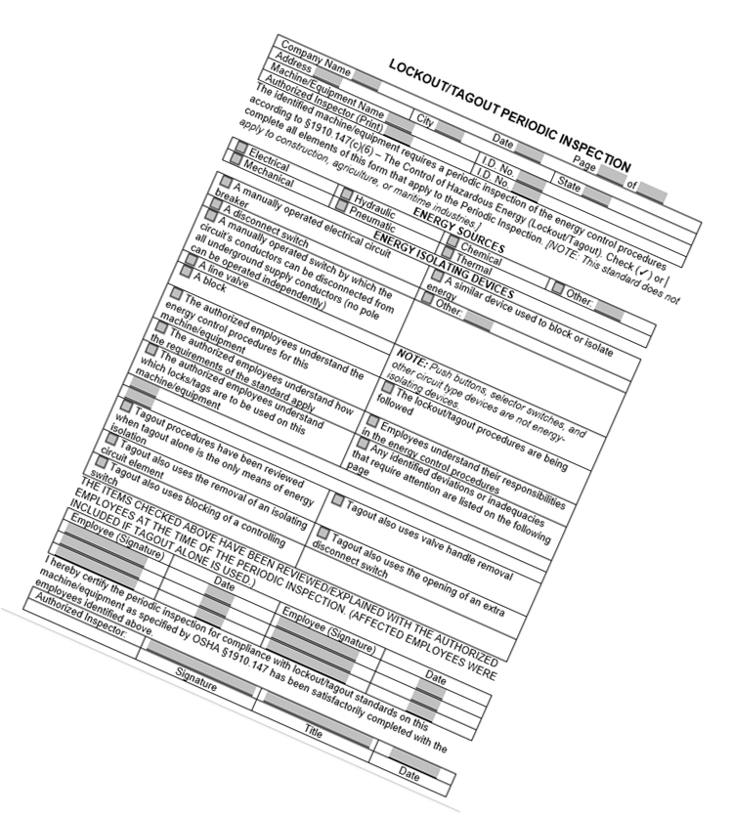
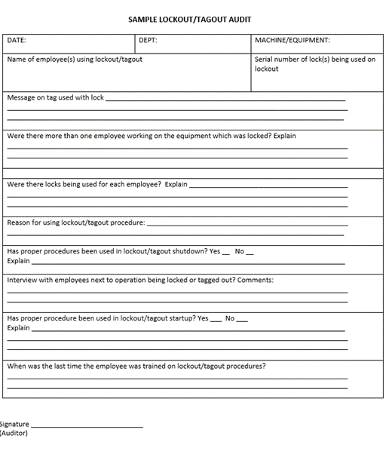
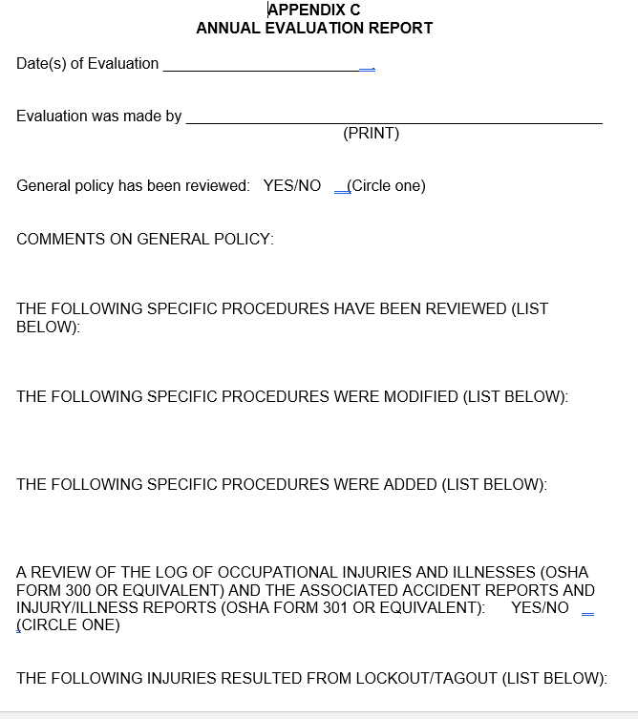
LOCKOUT/ TAGOUT: The Confusion about the Periodic Inspection 1910.147(c)(6)

Slide 5
The Periodic Inspection: References
https://www.osha.gov/laws-regs/regulations/standardnumber/1910/1910.147
https://www.osha.gov/sites/default/files/enforcement/directives/CPL_02-00-147.pdf
https://www.osha.gov/etools/lockout-tagout

Slide 6
The LOTO Periodic Inspection: THE WHAT?
Ensures procedure and requirements of standard are being met
Required annually
Conducted by authorized employee
other than the employee that utilizes that LOTO procedure
Review the employee’s responsibility under the LOTO procedure being inspected
Certify (document) the inspection

Slide 7
The LOTO Periodic Inspection: Breakdown THE WHAT?
Must contain at least TWO components:
an inspection of EACH energy control procedure required by 1910.147(c)(4) –Energy control procedures
a review of each employee’s responsibilities under the energy control procedure being inspected.
Energy control procedures that are not required to be documented, per the §1910.147(c)(4)(i) documentation exception, still need to be inspected and reviewed to ensure that they are adequate and being properly utilized.

Slide 8
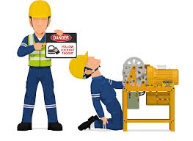
The LOTO Periodic Inspection: What it is NOT:
The Periodic Inspection is MORE than an Annual Review of the LOTO Program
The purpose is NOT Re-training on the LOTO program

Slide 9
The LOTO Periodic Inspection: Breakdown THE HOW?
By observing the implementation of the energy control procedure for the servicing and/or maintenance activities being evaluated
By talking with employees implementing the procedure to determine that all the requirements of the LOTO standard are understood and being followed by employees.
In the event a small business cannot meet this requirement, contained in §1910.147(c)(6)(i)(A), CSHOs shall evaluate the situation, on a case-by-case basis, in accordance with the impossibility affirmative defense*.
*See CPL Chapter 2, Section VI.B for additional guidance.
www.iup.edu/pa-oshaconsultation

Slide 10
According to the CPL
At a minimum, these inspections must include a demonstration of the procedures and
Must be performed while the authorized employees perform servicing and/or maintenance activities on machines or equipment.
May be accomplished at various times- through random audits, plant safety tours, or planned visual observations.
www.iup.edu/pa-oshaconsultation

Slide 11
The LOTO Periodic Inspection: Component 1 THE WHO?
1910.147(c)(6)(i)(A)
The periodic inspection shall be performed by an authorized employee other than the ones(s) utilizing the energy control procedure being inspected.
www.iup.edu/pa-oshaconsultation

Slide 12
The LOTO Periodic Inspection: Component 1 THE WHO? The Inspector
According to a 12-29-1996 Mabley /OSHA Interpretation letter:
For the purpose of complying with the lockout/tagout standard requirement:
An authorized employee is a qualified person whom the authority and responsibility to perform a specific lockout or tagout inspection has been given by the employer.
A qualified person is a person who has been trained and has demonstrated proficiency, in compliance with 1910.147(c)(7) [communication and training], to perform servicing and maintenance on the machine or equipment to be inspected.
www.iup.edu/pa-oshaconsultation

Slide 13
The LOTO Periodic Inspection: Component 1 THE WHO?
The “Inspector”
Must be an authorized employee other than the one(s) utilizing the energy control procedure being inspected.
This may be someone who previously has or currently implements the energy control procedure being inspected,
She or he must not be implementing any part of the energy control procedure while it is being inspected.
www.iup.edu/pa-oshaconsultation

Slide 14
The LOTO Periodic Inspection: Component 1 THE WHO?
The “Inspector” must be able to determine whether:
the steps in the energy control procedure are being followed;
the employees involved know their responsibilities under the procedure; and
the procedure is adequate to provide the necessary protection, and, if inadequate, what modifications are needed.
www.iup.edu/pa-oshaconsultation

Slide 15
The LOTO Periodic Inspection: Breakdown
THE WHEN?
At least annually
(based on twelve-month intervals)
Energy control procedures used less frequently than once a year (based on a twelve-month interval) need be inspected only when used.
www.iup.edu/pa-oshaconsultation

Slide 16
Hey! This will be IMPOSSIBLE- Our company has too many energy control procedures. This will be a full-time endeavor.
NO Worries-Good News!
According to §1910.147(c)(4)(i) An employer may group distinct procedures associated with similar machines or equipment and consider the group of distinct procedures to be a single procedure for purposes of conducting a periodic inspection, if the machines or equipment in the group have the same or similar types of control measures.
www.iup.edu/pa-oshaconsultation

Slide 17
GROUPING
Distinct Energy Control Procedures
to Single ones
May consider the group of distinct procedures to be a single procedure for purposes of conducting a periodic inspection (if it complies with Section IX of Chapter 3 in the CPL)
Machines and equipment must all be listed/identified in the scope
The machines or equipment in the group have the same type and same magnitude of energy
The machines or equipment in the group have the same or similar control measures.
www.iup.edu/pa-oshaconsultation

Slide 18
GROUPING
Distinct Energy Control Procedures
to Single ones
The single procedure must satisfactorily address the hazards and specify the measures for controlling the hazards.
The machines or equipment in the group can be rendered safe by using the same procedural/ sequential steps.
Machines and equipment must all have the same or similar:
steps for shutting down, isolating, blocking, securing, and dissipating stored energy;
steps for the placement, removal, and transfer of LOTO devices and the responsibility for them; and
requirements for testing to verify the effectiveness of LOTO devices and other control measures.
www.iup.edu/pa-oshaconsultation

Slide 19
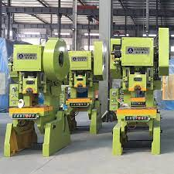
Example #1: DIE SETTING Grouping Distinct Energy Control Procedures
Group power presses with similar design characteristics and energy sources
Write a single die set procedure
This single procedure would need sufficient detail and clarity to guide a die-setter safely through the task steps when servicing each of the power presses.
Develop several separate die-set procedures for each press or each type of press.
Either method is acceptable IF the energy control procedure detail provides the authorized employees with enough information and guidance to safely accomplish all die set-up tasks
Equipment function is not significant in deciding whether machines or equipment can be covered by a single procedure.
www.iup.edu/pa-oshaconsultation

Slide 20
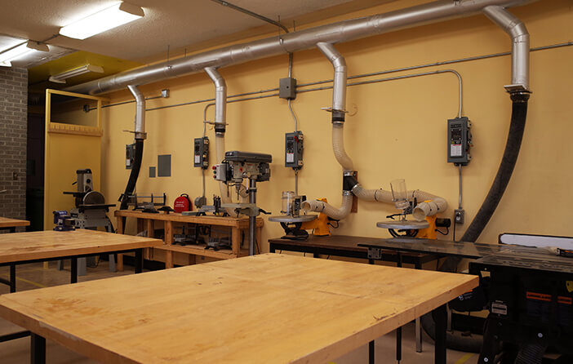
Example #2: WOODWORKING SHOP Grouping Distinct Energy Control Procedures
Machines in a woodworking shop are similar for purposes of the energy control procedure requirements because they all:
use relatively the same or similar types of energy
have the same or similar controls for isolating the machines from the energy source, and
use the same sequential procedural steps to protect employees from the mechanical hazards
A single energy control procedure may be used for this group of woodworking machines, as long as:
the procedure includes each machine within its scope and
has sufficient specificity to allow employees to effectively isolate the hazardous energy source(s) and safely return each of the machine(s) to service.
www.iup.edu/pa-oshaconsultation

Slide 21
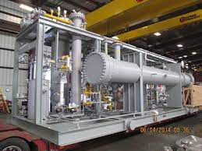
NOT PERMITTED: Grouping Dis-similar process systems
Ammonia Refrigeration System
These two systems have
different types of hazards and control step sequences
OR
unique control measures within a single energy control procedure
VS
Natural Gas Fuel Heating System
When the associated control measures are dissimilar the employer is required to:
develop more than one procedure for unique or different energy sources, or
to supplement a single, generic procedure
www.iup.edu/pa-oshaconsultation

Slide 22
When Grouping Distinct Energy Control Procedures
The MACHINES’ FUNCTIONS are NOT the significant factor
FUNCTION=different HAZARDS & CONTROLS=same
Machines that are designed to perform different production functions may be covered by a single procedure if :
the procedure clearly and specifically details the same or similar energy control measures
the authorized employees have sufficient guidance to enable them to safely and effectively utilize hazardous energy control measures for each of the machines that will be included within the procedure.
www.iup.edu/pa-oshaconsultation

Slide 23
LOTO is a PERFORMANCE STANDARD
These are standards that focus on the achievement of desired results.
However, these standards do not specify how a goal is achieved.
While there is no question about whether you must comply, it is not explicitly stated how you are going to comply.
www.iup.edu/pa-oshaconsultation

Slide 24
GROUPING Can be FLEXIBLE
Select different individual procedures (from the group of same or similar procedures) each year for evaluation
An employer may be justified in focusing more regularly on a subset of procedures that are more likely to be deficient or incorrectly implemented by employees,
These representative procedure inspections must reasonably reflect plant servicing and/or maintenance operations and practices.
www.iup.edu/pa-oshaconsultation

Slide 25
The LOTO Periodic Inspection: Component 2 THE REVIEW
with authorized employees
Inspector doesn’t have to observe every authorized employee using each Energy Control Procedures that they are qualified to use
INSTEAD, the inspector can observe and talk with a REPRESENTATIVE NUMBER in order to gain an understanding of the work practices at the site.
Must Share Results-Group Meetings
May not be practical for those authorized servicing and/or maintenance tasks employees to review every procedure, they will implement
BUT before servicing they must review the inspection results from that machine or piece of equipment
Procedure Modifications require RETRAINING
www.iup.edu/pa-oshaconsultation

Slide 26
The LOTO Periodic Inspection: Breakdown TRAINING vs. RE-TRAINING
When GENERAL LOTO Training is required:
AUTHORIZED EMPLOYEES: shall receive training in the recognition of applicable hazardous energy sources, the type and magnitude of the energy available in the workplace, and the methods and means necessary for energy isolation and control.
AFFECTED EMPLOYEES: shall be instructed in the purpose and use of the energy control procedure.
OTHER EMPLOYEES: shall be instructed about the procedure, and about the prohibition relating to attempts to restart or reenergize machines or equipment which are locked out or tagged out.
www.iup.edu/pa-oshaconsultation

Slide 27
The LOTO Periodic Inspection: Breakdown TRAINING vs. RE-TRAINING
When LOTO RE-Training is required:
deviations from the energy control procedure being implemented
inadequacies in employee knowledge regarding the energy control procedure or its application
Corrective actions (e.g., enforcement of existing procedures) need to be instituted and retraining must be performed whenever any inspection reveals inadequacies in the employee's knowledge of, or use of, the energy control procedure.
energy control procedure inadequacies IDENTIFIED
a change in an energy control procedure
A modification in the procedure necessitates additional employee retraining and certification to re-establish employee proficiency for all affected and authorized employees affected by the change in the procedure.
NEW equipment with new LOTO procedures
Employee retraining is not required when inspections do not reveal any deficiencies.
www.iup.edu/pa-oshaconsultation

Slide 28
The LOTO Periodic Inspection: Breakdown THE CERTIFICATION
What must the certification identify?
Identify machine on which the procedure was utilized
Date of inspection
Identify the employees included in inspection
Identify person who performed the inspection
Employer must certify IF training or retraining took place
What information must appear on the certificate?
Each employee's name
The dates of training and /or retraining
The inspection records provide CSHOs with a means to determine employer compliance with the standard. Most importantly, the inspection process provides employers with the assurance that employees can safely service, maintain, and repair machines and equipment.
www.iup.edu/pa-oshaconsultation

Slide 29
JUST SO YOU KNOW: ANSI: ALTERNATIVE METHODS
The American National Standard on the Control of Hazardous Energy - Lockout/Tagout And Alternative Methods
(ANSI/ASSE Z244.1-2003; Section 5.6
(a consensus standard)
Does NOT MANDATE all of the minimum requirements of OSHAs LOTO Program:
additional affected employee review requirements when tagout is used for energy control that are prescribed in the LOTO standard.
does not affect the employer's obligation to meet all of the requirements contained in the LOTO and related hazardous energy control standards.
www.iup.edu/pa-oshaconsultation

Slide 30
Lockout Tagout Periodic Inspection
SUMMARY
www.iup.edu/pa-oshaconsultation

Slide 31
www.iup.edu/pa-oshaconsultation
www.iup.edu/pa-oshaconsultation

Slide 32
www.iup.edu/pa-oshaconsultation

Slide 33
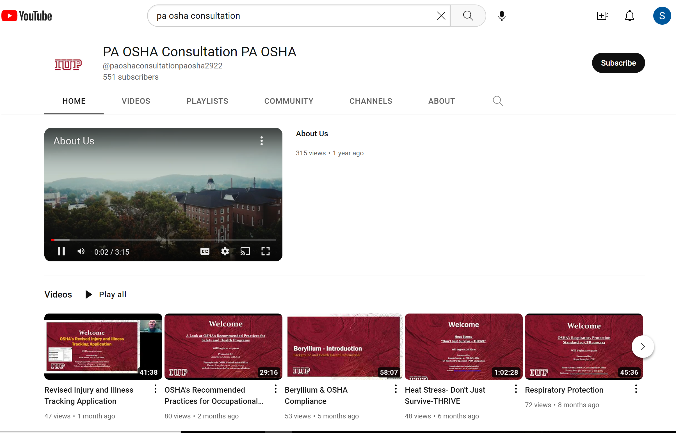
Please consider subscribing to our youtube channel to be notified of new webinars: https://www.youtube.com/@paoshaconsultationpaosha2922
www.iup.edu/pa-oshaconsultation

Slide 34
Contact us
Cynthia Mellen
cmellen@iup.edu
Pennsylvania OSHA Consultation Office
Phone: 800-382-1241
Website: www.iup.edu/pa-oshaconsultation/
Facebook: https://www.facebook.com/Pennsylvania-OSHA-Consultation-Program-548810235234647/
Twitter: https://twitter.com/search?q=PA%20OSHA%20Consultation&src=savs
www.iup.edu/pa-oshaconsultation

Slide 35
Thank You
Upcoming Webinar:
July 12th @ 10:30am
Pennsylvania OSHA Consultation Office
Phone: 800-382-1241 or 724-357-4095
Website: www.iup.edu/pa-oshaconsultation
www.iup.edu/pa-oshaconsultation

