Slide 1
Welcome
An Overview of Safety and Health Hazards in Veterinary Clinics/Hospitals
Will begin at 10:30am
Presented by:
Bryan Brougher, CSP
Pennsylvania OSHA Consultation Office
Phone: 724-357-4095
Website: www.iup.edu/pa-oshaconsultation

Slide 2
An Overview of Safety and Health Hazards in Veterinary Clinics/Hospitals
Webinar General Info
PowerPoint Presentation
Q&A
Questions
Chat is open to submit questions.
We will be answering questions through this chat feature. If due to the technical nature of the question a more thorough response is required, we will post the answer on our website within seven days of the webinar.
www.iup.edu/pa-oshaconsultation

Slide 3


Animal Handling, Restraint and Bite Prevention
Typical Animal Behavior – Expected adverse behavior
Hide or attack when approached by a stranger
React in fear to quick movements
Hear high-frequency sounds that we can't and may react to something they are sensing of which we are unaware
Have better night vision than us so may react before we see them
www.iup.edu/pa-oshaconsultation

Slide 4

Animal Handling, Restraint and Bite Prevention
Typical Causes of Aggression
Injured or in pain - Injections, treatment of wounds, and even examinations.
Nervous or apprehensive
Protecting their young
Protecting their territory or owner
Fearful - Animals will attempt to keep a stranger away when it feels it cannot avoid the situation
www.iup.edu/pa-oshaconsultation

Slide 5

Animal Handling, Restraint and Bite Prevention
Addressing aggressive behavior Develop policy/program – to protect employees, clients and animals.
Patient History - Proper recordkeeping and review – appropriate warnings of past aggression – Prominent display in charts
Observation – Observe animals when entering keeping in mind:
  Body language
  The sex
  If both sexes are present and whether they are intact
  Restraint being used
www.iup.edu/pa-oshaconsultation

Slide 6

Animal Handling, Restraint and Bite Prevention
Addressing aggressive behavior
Assistance – based on history and observation… and comfort level of those handling.
Restraint program– Identify the types being used and need for different.
  Inspections – Daily – Monthly
  Removal or repair defective
  Proper storage
  Maintain Manuals
www.iup.edu/pa-oshaconsultation

Slide 7
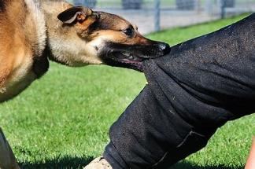

Animal Handling, Restraint and Bite Prevention
Addressing aggressive behavior
Training on animal restraint and bite prevention:
  Animal behavior
  Hazard identification
  Restraint device use and locations
  Chemical restraint
  Loss/accident history
  First aid procedures
  Recordkeeping
www.iup.edu/pa-oshaconsultation

Slide 8
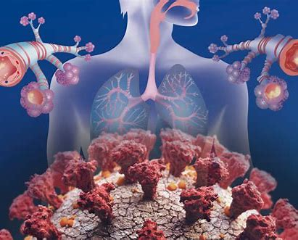
Biological Hazards
Allergens –Animal-related asthma and allergies are exaggerated reactions of the body’s immune system to animal proteins
Sources include:
  Animal dander
  Scales
  Fur
  Body wastes
  Saliva
www.iup.edu/pa-oshaconsultation

Slide 9
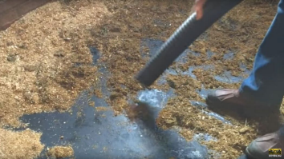
Biological Hazards
Allergens – Prevention/Control
Handlers should:
Perform manipulations within ventilated hoods or safety cabinets when possible.
Avoid wearing street clothes
Leave work clothes at the workplace
Keep cages and animal areas clean.
Reduce skin contact with animal products such as dander, serum, and urine by using gloves, lab coats, and approved particulate respirators with face shields.
www.iup.edu/pa-oshaconsultation

Slide 10
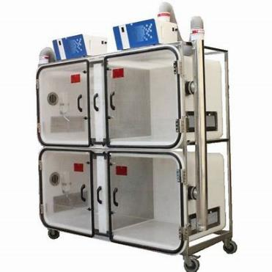
Biological Hazards
Allergens – Prevention/Control
Employers should:
Modify ventilation and filtration systems:
  Increase the ventilation rate and humidity
  Separate animal housing and handling
  Air flow direction
  ventilated animal cage racks or filter-top animal cages.
www.iup.edu/pa-oshaconsultation

Slide 11
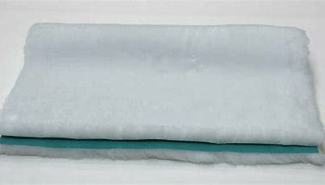

Biological Hazards
Allergens – Prevention/Control
Employers should:
Decrease animal density
Keep cages and animal areas clean
Use absorbent pads or corncob for bedding
www.iup.edu/pa-oshaconsultation

Slide 12

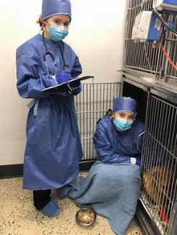
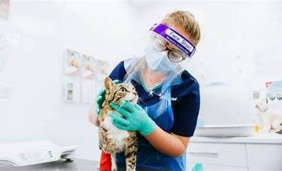
Biological Hazards
Allergens – Prevention/Control
Employers should:
Provide PPE for animal handlers
  Gloves,
  Lab coats
  Approved particulate respirators
  Face shields.
www.iup.edu/pa-oshaconsultation

Slide 13
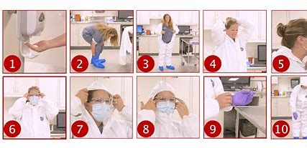
Biological Hazards
Allergens – Prevention/Control
Employers should:
Training
Health monitoring and medical follow up
www.iup.edu/pa-oshaconsultation

Slide 14
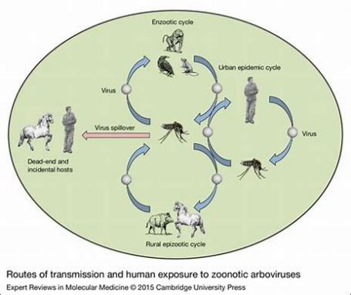
Biological Hazards
Zoonoses – Infectious diseases that spread from animals to humans
  Routes of transmission include:
    Aerosol,
    Droplet spray
    Ingestion (oral)
    Direct contact
Indirect contact (e.g., fomite)
Vector-borne
www.iup.edu/pa-oshaconsultation

Slide 15
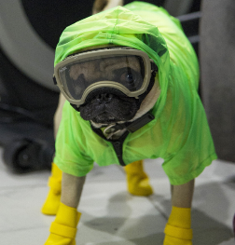
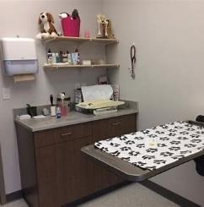
Biological Hazards
Zoonosis
Approximately 60% of the more than 1400 human pathogens are zoonotic.
About 75% of emerging pathogens are zoonotic.
www.iup.edu/pa-oshaconsultation

Slide 16
Biological Hazards
Zoonoses reported in veterinary personnel include:
Salmonellosis
Cryptosporidiosis
Plague
Sporotrichosis
Methicillin-resistant
Staphylococcus aureus (MRSA)
Psittacosis
Dermatophytosis
Leptospirosis
Q fever
Anthrax
Avian influenza
B-virus
Brucellosis
Parasite
Swine Influenza
Tuberculosis
Vector-Borne Diseases – can be zoonotic
Rabies
Toxoplasmosis.
www.iup.edu/pa-oshaconsultation

Slide 17
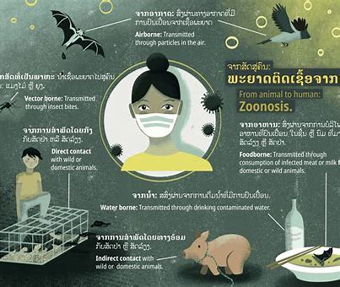
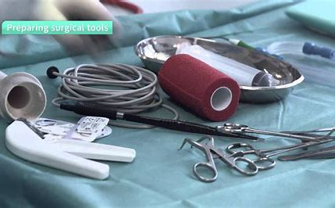
Biological Hazards
Zoonoses
  Exposure sources
    Animals
    Body fluids
    Tools
    Surfaces
    Other objects in the environment
www.iup.edu/pa-oshaconsultation

Slide 18

Biological Hazards – Prevention/Control
Hygiene - Hand Hygiene – General - Wash hands
  before eating, drinking, or smoking
  after
    using the restroom
    cleaning animal cages or animal-care areas
  whenever hands are visibly soiled.
  before and after … each patient encounter and after contact with
  Feces
  Blood
  Body fluids
  Secretions
  Excretions
  Exudates
  Articles contaminated by these substances
www.iup.edu/pa-oshaconsultation

Slide 19

Biological Hazards – Prevention/Control
Hygiene
Hand Hygiene -
  Liquid hand sanitizers may be used if hands are not visibly soiled
  Keep fingernails short
  Avoid artificial nails or hand jewelry
  Well stocked hand-washing supplies
www.iup.edu/pa-oshaconsultation

Slide 20

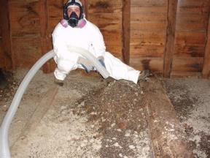
Biological Hazards – Prevention/Control
Personal Protective Equipment (PPE)
Gloves and Sleeves - Wear gloves and/or sleeves when touching:
  Feces
  Blood
  Body fluids
  Secretions
  Exudates
  Non-intact skin
www.iup.edu/pa-oshaconsultation

Slide 21
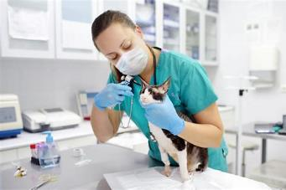
Biological Hazards – Prevention/Control
PPE – Procedural specific
General –Outerwear and gloves for all procedures especially with infectious animals and soft tissue aspirations.
Dental –Outerwear, gloves, and facial protection within range of splashes or sprays.
Resuscitation – Gloves and facial protection
www.iup.edu/pa-oshaconsultation

Slide 22
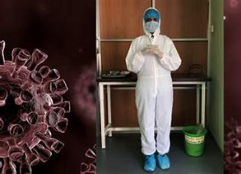
Biological Hazards – Prevention/Control
PPE – Procedural specific
Obstetrics – Gloves or shoulder-length sleeves, facial protection and impermeable outerwear
Necropsy – Cut resistant gloves, facial protection, and impermeable outwear
Diagnostic – Specimen handling –Protective outerwear and gloves.
www.iup.edu/pa-oshaconsultation

Slide 23
Biological Hazards – Prevention/Control
Procedural precautions
Intake/Reception - aggressive or potentially infectious animals
Alternate entrance, carry/cage/gurney, or direct entry to exam room
Similar precautions should be taken in large animal and equine facilities.
www.iup.edu/pa-oshaconsultation

Slide 24
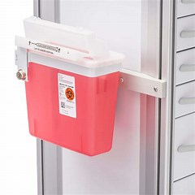
Biological Hazards – Prevention/Control
Procedural precautions
Needlestick injury prevention – See information later on – bloodborne pathogens
Do not recap needles
Do not remove an uncapped needle from the syringe by hand or place a needle cap in the mouth
Sharps disposal
Sharps container replacement
www.iup.edu/pa-oshaconsultation

Slide 25
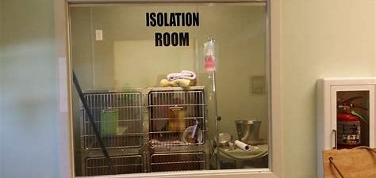
Biological Hazards – Prevention/Control
Procedures
Isolation of infectious animals
Isolate animals ASAP
Label with patient’s status, and precautions
Keep only required equipment and cleaning supplies in the isolation room
Disassemble clean and disinfect equipment removed from isolation
www.iup.edu/pa-oshaconsultation

Slide 26
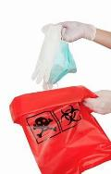
Biological Hazards – Prevention/Control
Procedures
Isolation of infectious animals
Discard gloves after use
Leave other PPE in the isolation room for reuse
Clean and disinfect or discard PPE between patients and whenever contaminated by body fluids.
Place potentially contaminated materials in bag
www.iup.edu/pa-oshaconsultation

Slide 27
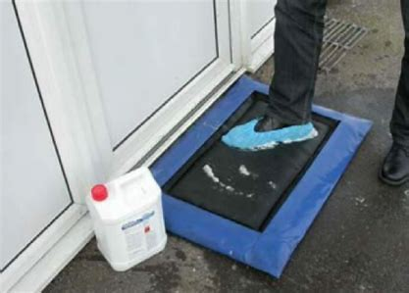
Biological Hazards – Prevention/Control
Procedures
Isolation of infectious animals
Use a disinfectant footbath at entry to isolation area.
Limit access to the isolation area.
Keep sign-in logs
Monitor air pressure
www.iup.edu/pa-oshaconsultation

Slide 28
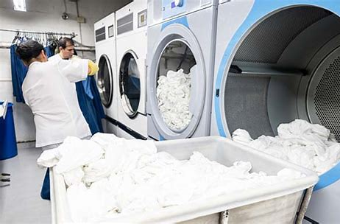
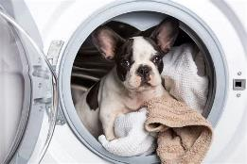
Biological Hazards – Prevention/Control
Procedures
Laundry
Wear gloves
Wash animal bedding and other laundry
Use separate storage and transport bins
www.iup.edu/pa-oshaconsultation

Slide 29
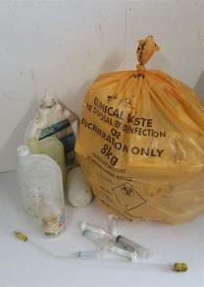
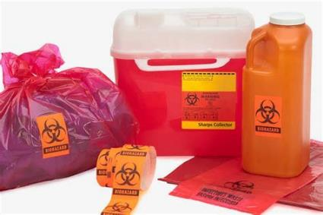
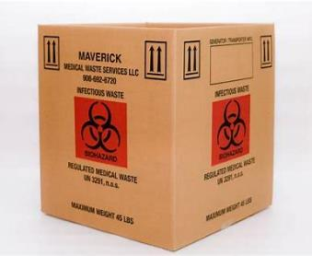
Biological Hazards – Prevention/Control
Procedures
Veterinary medical waste disposal
Follow federal, state, and local regulations for proper disposal
www.iup.edu/pa-oshaconsultation

Slide 30
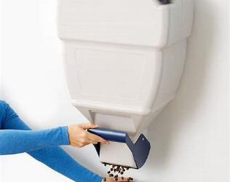
Biological Hazards – Prevention/Control
Procedures
Rodent and vector control
Seal entry portals
Eliminate clutter and standing water
Keep animal food in closed metal or thick plastic covered containers
Dispose of food waste properly
www.iup.edu/pa-oshaconsultation

Slide 31
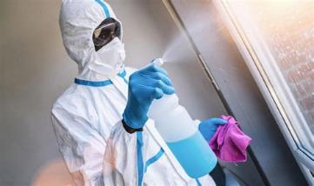
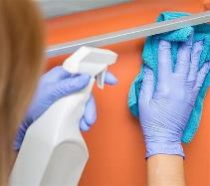
Biological Hazards – Prevention/Control
Procedures
Cleaning and disinfecting equipment and environmental surfaces
Clean surfaces and equipment
Use approved disinfectant
Mist with water or disinfectant
Clean and disinfect between uses and whenever visibly soiled
Clean litter boxes
Wear gloves when cleaning
Wash hands
www.iup.edu/pa-oshaconsultation

Slide 32
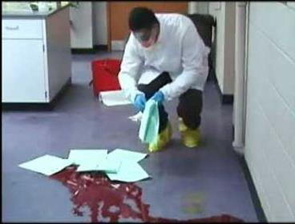
Biological Hazards – Prevention/Control
Procedures
Decontamination/Spill control response
Immediately spray a spill or splash with disinfectant and contain it with absorbent material
Wear PPE
Restrict entry to area
Seal it in a leak-proof plastic bag
Clean and disinfect the area
www.iup.edu/pa-oshaconsultation

Slide 33

Biological Hazards – Prevention/Control
Procedures
Other environmental controls
Designated areas for eating, drinking, smoking, application of make-up, and similar activities
Forbid these activities in animal-care areas or in the laboratory area
www.iup.edu/pa-oshaconsultation

Slide 34
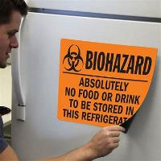
Biological Hazards – Prevention/Control
Procedures
Other environmental controls
Do not keep food or drink for human consumption in the same refrigerator as food for animals, biologics, or laboratory specimens.
Dishes for human use should be cleaned and stored away from animal-care and animal food–preparation areas.
www.iup.edu/pa-oshaconsultation

Slide 35
Hazard Communication
Written Program
Must at least describes how
labels and other forms of warning,
safety data sheets, and
employee information and training
will be met…
Hazard
Communication
Program
www.iup.edu/pa-oshaconsultation

Slide 36
Hazard Communication
Written Program
also includes the following:
list of the hazardous chemicals
non-routine tasks (for example, the cleaning of reactor vessels), and the hazards of chemicals contained in unlabeled pipes.
Other employer(s) – access to SDS and precautionary measures, in-house labeling
www.iup.edu/pa-oshaconsultation

Slide 37
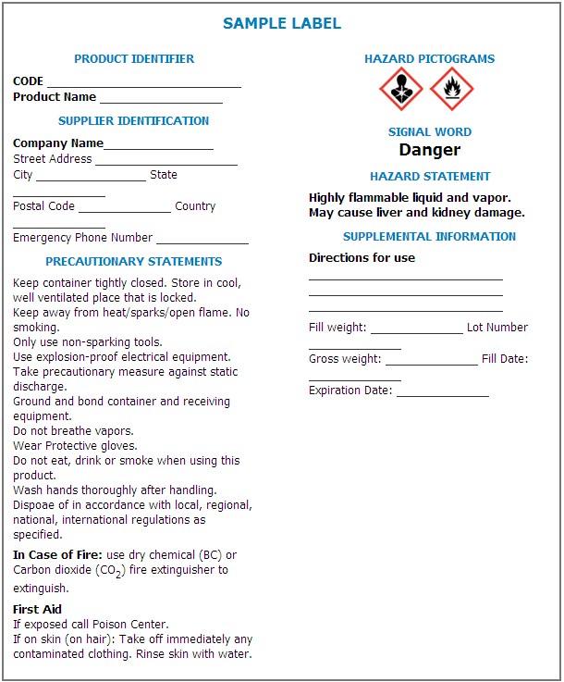
Hazard Communication
Labeling – Primary container
Label elements:
  Symbols called “Pictograms”
  Signal Words
  Hazard Statements
  Precautionary Statements
  Product Identification
  Supplier/Manufacturer Identification
www.iup.edu/pa-oshaconsultation

Slide 38

Hazard Communication
Labels: Pictograms
There are 9 pictograms.
  Health Hazards
  Physical Hazards
  Environmental Hazards
www.iup.edu/pa-oshaconsultation

Slide 39

Hazard Communication
Labeling – secondary must have
Product identifier AND words pictures, symbols, or combination which provides the same basic information.
Can use - Same information on primary container labeling OR any other labeling meeting the requirements such as
HMIS Label
NFPA Label
HEALTH
Other labels with minimal information
FIRE
OR
OR
PHYSICAL HZ
PPE
www.iup.edu/pa-oshaconsultation

Slide 40
Hazard Communication
16-Section Safety Data Sheet
Identification of the substance
or mixture and of the supplier
Hazards identification
Composition/information on ingredients Substance/Mixture
First aid measures
Firefighting measures
Accidental release measures
Handling and storage
Exposure controls/personal protection
Physical and chemical properties
Stability and reactivity
Toxicological
Ecological information
(non mandatory)
Disposal considerations
(non mandatory)
Transport information
(non mandatory)
Regulatory information
(non mandatory)
Other information including information on preparation and revision of the SDS
www.iup.edu/pa-oshaconsultation

Slide 41
Hazard Communication
Training – before employees work with chemicals
Hazard communication standard
Hazardous chemicals in workplace and specific operations used
Location of the written plan
Labels and safety data sheets
  Meaning of pictograms, signal words, precautionary statements,
  SDS format
www.iup.edu/pa-oshaconsultation

Slide 42
Hazard Communication
Training – before employees work with chemicals
Physical and health hazards in work area
How to detect presence or release of hazardous chemicals
Steps taken to prevent or reduce exposure
How employees can protect themselves from exposure to these hazardous chemicals
Explanation special labeling in the workplace
Emergency procedures
www.iup.edu/pa-oshaconsultation

Slide 43
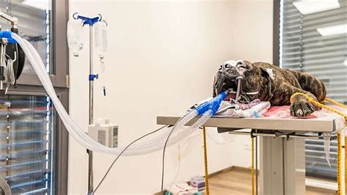
Anesthetics and Wastes
Acute effects: Drowsiness, irritability, depression, headaches, dizziness, and nausea, as well as problems with coordination, audiovisual ability, and judgment.
Chronic effects: Liver and kidney disease, and adverse reproductive effects.
Increased risk of miscarriage.
Birth defects.
Cancer.
www.iup.edu/pa-oshaconsultation

Slide 44
Anesthetics and Wastes
Generic or chemical name | Commercial name
Nitrous oxide | Fluothane
Halothane | Penthrane®
Methoxyflurane | Ethrane®
Enflurane | Forane®
Isoflurane | Suprane®
Desflurane | Ultane®
Sevoflurane
www.iup.edu/pa-oshaconsultation

Slide 45
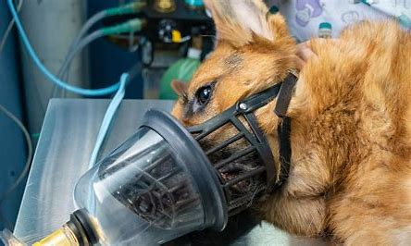
Anesthetics and Wastes
Causes of waste anesthetic gas exposure
When repositioning the patient during procedures
From the edges of a patient’s mask or around the endotracheal cuff
www.iup.edu/pa-oshaconsultation

Slide 46
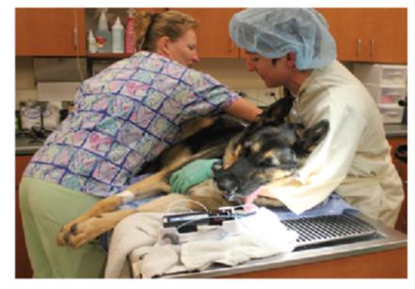
Anesthetics and Wastes
Causes of waste anesthetic gas exposure
During hookup and disconnection of the system – gas on?
From leaks in the breathing circuit -connectors, tubing, and valves - tight?
When patients are exhaling during recovery from anesthesia
www.iup.edu/pa-oshaconsultation

Slide 47
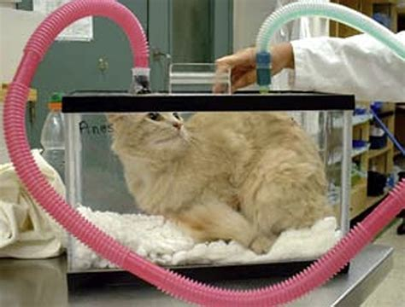
Anesthetics and Wastes
Causes of waste anesthetic gas exposure
When opening the induction box
When refilling the vaporizer
When cleaning up spills.
  Large spills can cause overexposure
  Evacuate those without respirators
www.iup.edu/pa-oshaconsultation

Slide 48
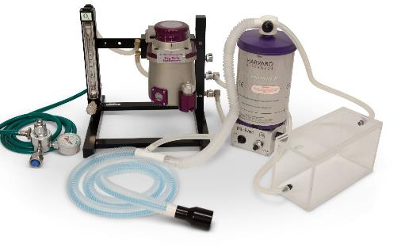
Anesthetics and Wastes
Controls – Engineering
Effective anesthetic gas scavenging systems
A nonrecirculating ventilation system
Effective HVAC systems and/or general or dilution ventilation
www.iup.edu/pa-oshaconsultation

Slide 49
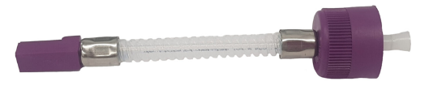
Anesthetics and Wastes
Controls – Engineering
Adsorbers to trap most excess anesthetic gases
Use a key-fill adapter when refilling the vaporizer
www.iup.edu/pa-oshaconsultation

Slide 50
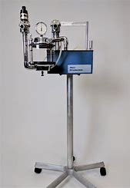
Anesthetics and Wastes
Controls – Work practices
Visually inspect all anesthesia delivery components
Leak test prior to each use of the anesthesia machine.
Weigh charcoal canister daily and cap it during storage and disposal.
Use the lowest anesthetic gas flow rate possible.
www.iup.edu/pa-oshaconsultation

Slide 51
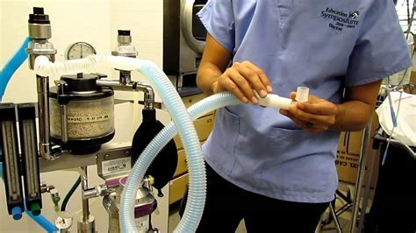
Anesthetics and Wastes
Controls – work practices
Turn off anesthetic gas flow before disconnecting patient during a procedure
Eliminate residual anesthesia - Flush systems with oxygen, before disconnecting patient from breathing system
Minimize use of face masks and induction boxes
Use properly inflated endotracheal cuffs to create a sealed airway
www.iup.edu/pa-oshaconsultation

Slide 52
Anesthetics and Wastes
Controls – Work practices
Don't use the "smell test" for assessing gas flow
Proper maintenance of equipment to prevent leaks
  Air flow measurements of ventilation
  Calibrate and P&M on anesthesia machine including leak detection
  Keep maintenance records of anesthesia machine and leak detection tests
www.iup.edu/pa-oshaconsultation

Slide 53
Anesthetics and Wastes
Controls – work practices
Periodic personnel exposure and environmental monitoring
Use of proper PPE
  Gloves, goggles, face shields, and chemical protective clothing (CPC) … respirator?
Employee training
www.iup.edu/pa-oshaconsultation

Slide 54
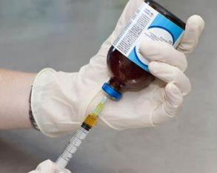

Drugs/Narcotics
Examples
Antineoplastic - animal cancer treatment
Chemicals affecting pregnant or to be pregnant
Micotil 300 – antibiotic – cause illness or death if injected or puncture wound or contact with skin or mucous membranes.
Chloramphenicol – aplastic anemia in humans
www.iup.edu/pa-oshaconsultation

Slide 55

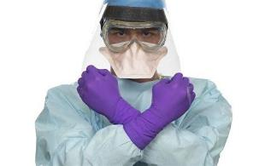
Drugs/Narcotics
Controls
Hazard communication
Labels
SDS
Training
PPE-
Chemotherapy gloves
Non-permeable gowns
Respiratory protection
Under pads and containment devices
Eye and/or splash protection
Shoe covers
Spill kit
www.iup.edu/pa-oshaconsultation

Slide 56
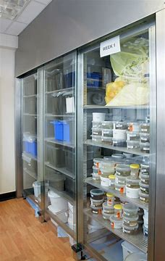
Drugs/Narcotics
Controls
Signage – Warning of hazardous drugs pregnant, breastfeeding, reproductive effects
Receiving & Storage - Inventory, proper storage
Limited access
Hygiene – housekeeping, handwashing, eating and drinking
Transportation – containers/sealed, wipe down, and labeling
www.iup.edu/pa-oshaconsultation

Slide 57
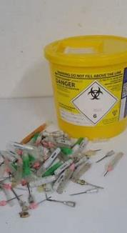
Drugs/Narcotics
Controls
Dispensing – PPE, dedicated location, IV administration and disposal, clean up
Waste cleanup – PPE – Disposal – double bag
Spill control
Medical surveillance
www.iup.edu/pa-oshaconsultation

Slide 58
Cleaning Chemicals
May cause:
Irritation – Skin rashes, URT and eye irritation
Corrosive – Skin and eye burns
Replacement/substitution
Hazard communication
Labels
SDS
Training
PPE
DO NOT MIX different cleaning products
Bleach and ammonia can cause severe lung damage or death.
www.iup.edu/pa-oshaconsultation

Slide 59
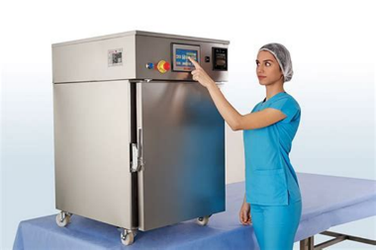
Disinfectants/Sterilant
Ethylene Oxide
Carcinogen that may cause leukemia and other cancers
Spontaneous abortions
Genetic damage
Nerve damage
Peripheral paralysis
Muscle weakness
Impaired thinking and memory
Flammable
www.iup.edu/pa-oshaconsultation

Slide 60
Disinfectants/Sterilant
Ethylene Oxide
OSHA Exposure limits –
8 hr. TWA = 1 ppm, STEL/Excursion = 5 ppm, Action level = 0.5 ppm IDLH 800 ppm
Air sampling/monitoring
Regulated areas
Engineering controls
Written program
Respirators & PPE
Emergencies/plans
Medical surveillance
Hazard communication
  Signs and Labelling
  Training
www.iup.edu/pa-oshaconsultation

Slide 61
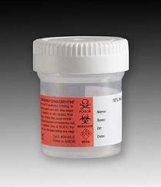
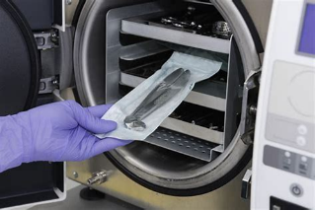
Disinfectants/Sterilant
Formaldehyde–Formalin
- also used as a preservative or tissue fixation
Carcinogen
Highly irritating to the eyes, nose, and throat
Severe allergic reactions of the skin, eyes and respiratory tract
Asthma-like respiratory problems
Itching, skin irritation, such as dermatitis itching
Ingestion can be fatal
Flammable
www.iup.edu/pa-oshaconsultation

Slide 62
Disinfectants/Sterilant
Formaldehyde–Formalin
OSHA Exposure limits –
8 hr. TWA = 0.75 ppm, STEL= 2 ppm, Action level = 0.5 ppm IDLH 20 ppm
Air sampling/monitoring
Regulated areas
Engineering controls
Respirators
PPE
Hygiene
Housekeeping
Emergencies
Medical surveillance
Hazard communication
Training
www.iup.edu/pa-oshaconsultation

Slide 63
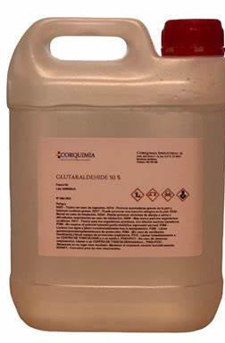
Disinfectants/Sterilant
Glutaraldehyde
Effects:
Occupational asthma
Rhinitis
Eye irritation and tearing
Contact allergen/dermatitis, and skin sensitization
www.iup.edu/pa-oshaconsultation

Slide 64

Disinfectants/Sterilant
Peracetic Acid (PAA)
Effects:
Concentrated - corrosive and exposure can cause irreversible damage to skin and eyes
Diluted - sometimes cause eye, nose, throat and respiratory irritation that usually subsides when exposure ceases
www.iup.edu/pa-oshaconsultation

Slide 65
Disinfectants/Sterilant
Glutaraldehyde
OSHA Exposure limits – None
ACGIH TLV® - Ceiling 0.05 ppm
IDLH Not established
Peracetic Acid (PAA)
OSHA Exposure limits – None
ACGIH TLV® -STEL 0.4 ppm
IDLH 0.64 ppm
www.iup.edu/pa-oshaconsultation

Slide 66
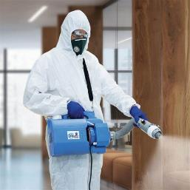
Disinfectants/Sterilant
Glutaraldehyde/Peracetic Acid (PAA), etc… all
Engineering controls
Local exhaust ventilation
General room ventilation
Transfer Procedures – automated equipment
Safety nozzles
Automated dispensing/disinfecting/washing
Mobile disinfecting stations
Facility design
www.iup.edu/pa-oshaconsultation

Slide 67
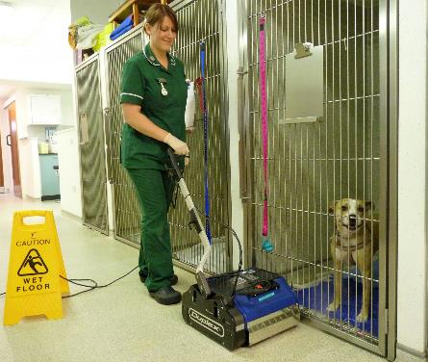
Disinfectants/Sterilant
Glutaraldehyde/Peracetic Acid (PAA), etc… all
Work Practices
Transportation and Storage
  Closed containers/tight lids
  Central location
www.iup.edu/pa-oshaconsultation

Slide 68
Disinfectants/Sterilant
Glutaraldehyde/Peracetic Acid (PAA), etc… all
Work Practices - Handling procedures
Minimize splashing using basins/reservoirs
Use safety nozzles
Cover soaking basins
Use of proper sized devices
Close doors
Use low pressure/flow when rinsing instruments
Ensure ventilation/drying agents properly used when available
Do not use or store food, drink, smoke or apply cosmetics
Immediate clean up of spills
www.iup.edu/pa-oshaconsultation

Slide 69
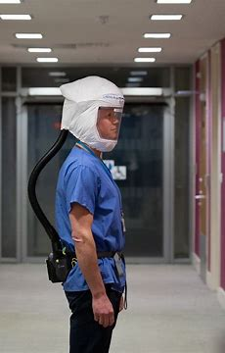

Respirators
When required
Program
Medical approval
Fit testing
Training
Voluntary
Appendix D Dust mask
Other – minimal program
  Medical approval
  Cleaning
  Storage
  Maintained
www.iup.edu/pa-oshaconsultation

Slide 70

Radiation – X-rays
Implementation of caution signs and warnings
www.iup.edu/pa-oshaconsultation

Slide 71


Radiation – X-rays
Exposure Monitoring
Appropriate PPE
Written safety and operation instructions
Temperature control
Inspection and testing of equipment
www.iup.edu/pa-oshaconsultation

Slide 72
Lasers
Class FDA | Class IEC | Laser Product Hazard | Product Example
IV | 4 | Immediate skin hazard and eye hazard from exposure to either the direct or reflected beam; may also present a fire hazard. | laser light show projectors industrial lasers research lasers medical device lasers for eye surgery or skin treatments
www.iup.edu/pa-oshaconsultation

Slide 73



Lasers
Posting with Appropriate Laser Warning Signs
www.iup.edu/pa-oshaconsultation

Slide 74

Lasers
General Requirements for Class IV Lasers
Supervision directly by an individual knowledgeable in laser safety
Restricted area
Beam stop
Diffusely reflecting materials near the beam
www.iup.edu/pa-oshaconsultation

Slide 75

Lasers
Laser eyewear
Secure and control beam above or below eye level
Cover all windows, doorways, open portals, etc.
Storage or disable lasers when not in use.
www.iup.edu/pa-oshaconsultation

Slide 76

Bloodborne Pathogens
BBP – applicable only exposure from human blood treating others and research laboratories with animals known to be infected with HIV or HBV. Otherwise, animal handling is not covered.
Exposure Control Program
Exposure determination
Compliance Methods
  Engineering controls - Sharps containers
  Work practices
PPE
www.iup.edu/pa-oshaconsultation

Slide 77


Bloodborne Pathogens
BBP – applicable only exposure from human blood treating others and research laboratories with animals known to be infected with HIV or HBV. Otherwise, animal handling is not covered.
Housekeeping - cleaning
Labeling
Waste disposal
Laundry
Vaccination
Exposure incident follow up
Training
www.iup.edu/pa-oshaconsultation

Slide 78



First aid/eyewash
First aid
  Responders
  Kits
Eyewash requirements
  Required
  Maintenance
www.iup.edu/pa-oshaconsultation

Slide 79


Exit & Route Maintenance
Signage
Illumination
Emergency lighting
Route maintenance
Alarm systems
www.iup.edu/pa-oshaconsultation

Slide 80


Emergency Action Plan
Written (oral <10) Plan
Reporting procedures
Emergency evacuation procedures & exit route assignments
Critical operations
Accounting for employees
Medical or rescue duties
Emergency contacts
Alarm systems
Training
Review
www.iup.edu/pa-oshaconsultation

Slide 81

Fire Protection Plans – as required by OSHA
Written (oral <10) Plan – when required by OSHA std
List of fire hazards
Controls
Maintenance
Fuel source control responsibilities
Training
www.iup.edu/pa-oshaconsultation

Slide 82


Other hazards
Noise
Ergonomics
Electrical
Walking working surfaces
Recordkeeping
www.iup.edu/pa-oshaconsultation

Slide 83

www.iup.edu/pa-oshaconsultation
www.iup.edu/pa-oshaconsultation

Slide 84

www.iup.edu/pa-oshaconsultation
www.iup.edu/pa-oshaconsultation

Slide 85

Please consider subscribing to our youtube channel to be notified of new webinars: https://www.youtube.com/@paoshaconsultationpaosha2922
www.iup.edu/pa-oshaconsultation

Slide 86
Contact us
Bryan Brougher, CSP
Brougher@iup.edu
Pennsylvania OSHA Consultation Office
Phone: 724-357-4095
Website: www.iup.edu/pa-oshaconsultation/
Facebook: https://www.facebook.com/Pennsylvania-OSHA-Consultation-Program-548810235234647/
Twitter: https://twitter.com/search?q=PA%20OSHA%20Consultation&src=savs
www.iup.edu/pa-oshaconsultation

Slide 87
Thank You
Upcoming Webinar:
Respiratory Hazards in the Cannabis Industry
March 2024
Pennsylvania OSHA Consultation Office
Phone: 724-357-4095
Website: www.iup.edu/pa-oshaconsultation
www.iup.edu/pa-oshaconsultation

