Slide 1
Welcome Asbestos – Best Rcommended Practice and Regulatory Requirements Webinar will begin at 10:30am Presented by: Daniel J. Larson, MS., CIH Pennsylvania OSHA Consultation Office Phone: 724-357-4095 Website: www.iup.edu/pa-oshaconsultation

Slide 2
Asbestos – Best Recommended Practice & Regulatory Requirements
Webinar General Info PowerPoint Presentation Q&A Questions Chat is open to submit questions. We will be answering questions through this chat feature. If due to the technical nature of the question a more thorough response is required, we will post the answer on our website within seven days of the webinar.
www.iup.edu/pa-oshaconsultation

Slide 3
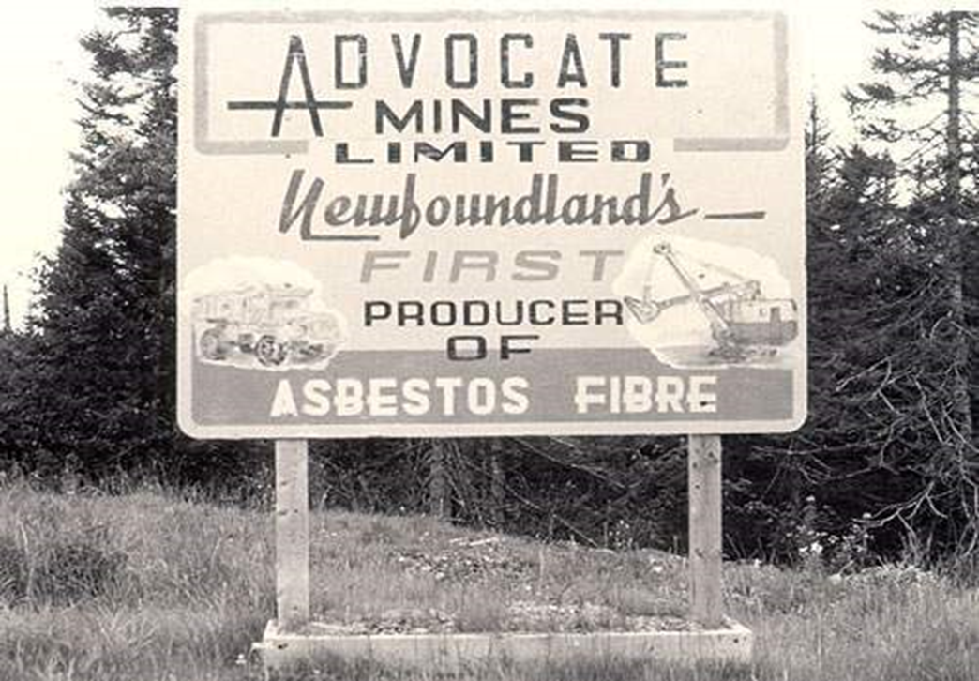
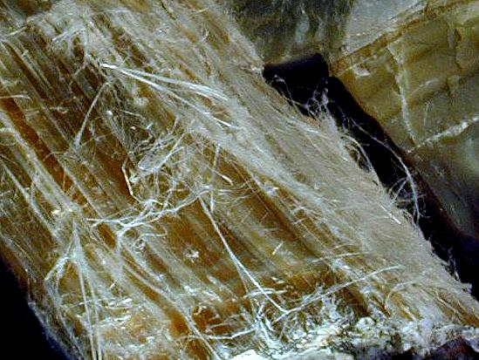
Asbestos - Background
Asbestos. What is it?
Asbestos is a naturally occurring group of minerals that can only be identified under a microscope. There are several types of these flexible, fire-resistant fibers.
www.iup.edu/pa-oshaconsultation

Slide 4
Asbestos - Background
Ancient Greeks and Romans used asbestos woven into cloth or other materials similar to cotton.
It was not available in large amounts until extensive deposits were discovered in Canada in the nineteenth century (late 1800’s).
Following this discovery, asbestos emerged as an insulating component in thermal insulation for boilers, pipes and other high temperature applications and as a reinforcement material for a variety of products.

Slide 5
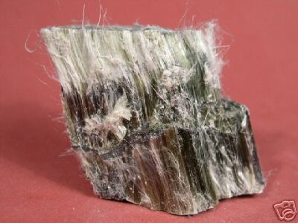
Asbestos - Backgound
Three Major Types of Asbestos:
Chrysotile is the most commonly used type of asbestos and accounts for approximately 95% of the asbestos found in buildings in the United States. Chrysotile is commonly known as "white asbestos" or named for its natural color.
www.iup.edu/pa-oshaconsultation

Slide 6
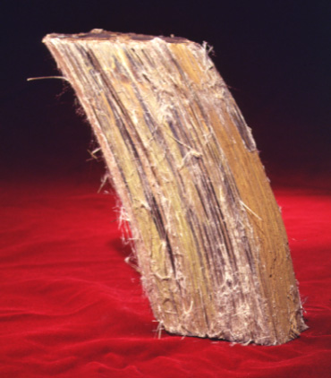
Asbestos - Background
Amosite is the second most likely type to be found in buildings, is often referred to as "brown asbestos". As you might assume, in its natural state amosite is brown in color.
www.iup.edu/pa-oshaconsultation

Slide 7
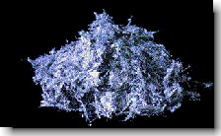
Asbestos - Background
Crocidolite, "blue asbestos" is also an amphibole. Crocidolite was used in high temperature insulation applications.
www.iup.edu/pa-oshaconsultation

Slide 8
Asbestos - Background
Why was asbestos used?
For many years, asbestos was called the magic mineral because of its unique nature and widespread usefulness. The word itself comes from the Greek word for incombustible. The mineral's fire-retardant qualities are among its most valuable characteristics. This led to its wide use in ships, buildings and theater curtains, where protection against fire was essential.
In addition to its fire-retardant properties, it has other qualities which make it useful, including: a fibrous nature, heat stability, thermal and electrical resistance, flexibility, high tensile strength and stability in acids or alkalis, Untold thousands of lives have been saved by the use of asbestos.
www.iup.edu/pa-oshaconsultation

Slide 9
Asbestos - Background
How widely was asbestos used in the United States?
Asbestos has been used extensively. Asbestos consumption jumped dramatically in the United States during World War II, because of the Navy's determination that it was an essential component of shipboard fire protection.
Up until 1976, it was required by model building codes in specific areas of buildings where protection against fire was essential. In 1973 and again in 1978, however, the EPA prohibited certain spraying of asbestos-containing materials as part of its air pollution regulations.
www.iup.edu/pa-oshaconsultation

Slide 10
Asbestos - Background
Is asbestos still used in the United States?
It is still possible to purchase building materials containing asbestos. Therefore, it is very important to specify non-asbestos containing materials when ordering building materials.
Two definitions to be aware of:
Friable – Asbestos that can be crumbled to a powder in your hand. This is the most dangerous type of asbestos because it can easily become airborne and inhaled or ingested.
Nonfriable – Cannot be readily crumbled to a powder. Example – Vinyl floor tile.
www.iup.edu/pa-oshaconsultation

Slide 11
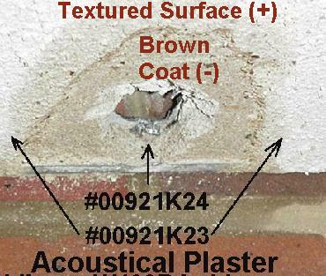
Asbestos – Examples of Use
ACOUSTICAL SOUND PLASTER

Slide 12
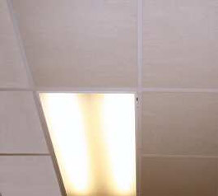
Asbestos – Examples of Use
Acoustical (Sound) Tiles

Slide 13
Asbestos – Examples of Use
Blackboard Mastic

Slide 14
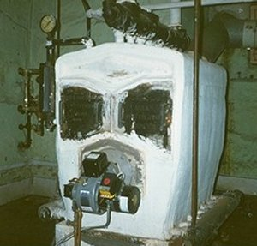
Asbestos – Examples of Use
Boiler Insulation

Slide 15
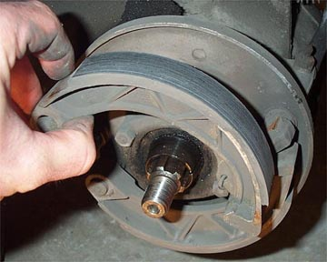
Asbestos – Examples of Use
Brake Shoes

Slide 16
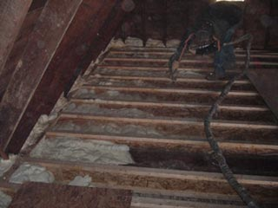
Asbestos – Examples of Use
Ceiling Insulation

Slide 17
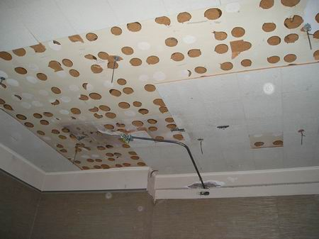
Asbestos – Examples of Use
Ceiling Tiles and Ceiling Tile Mastic

Slide 18
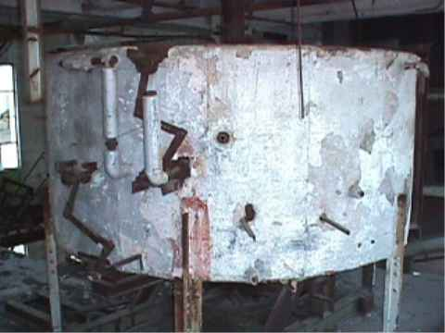
Asbestos – Examples of Use
Tank Insulation

Slide 19
Asbestos – Examples of Use
Decorative Plaster

Slide 20
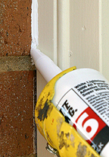
Asbestos – Examples of Use
Door & Window Caulking

Slide 21
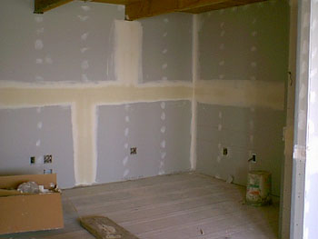
Asbestos – Examples of Use
Drywall & Joint Compound

Slide 22
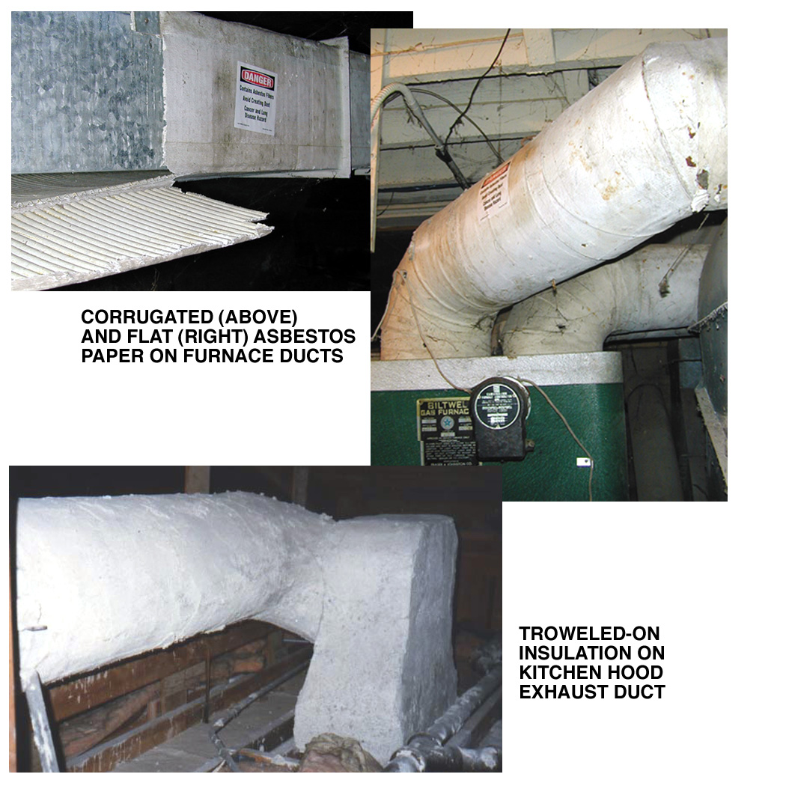
Asbestos – Examples of Use
Duct Insulation

Slide 23
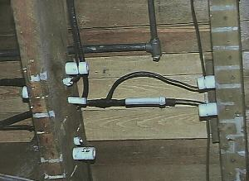
Asbestos – Examples of Use
Electrical Insulation

Slide 24
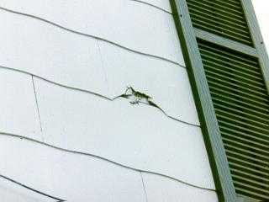
Asbestos – Examples of Use
Exterior Building Siding

Slide 25
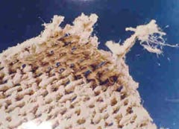
Asbestos – Examples of Use
Fire Blankets

Slide 26
Asbestos – Examples of Use
Fire Curtains

Slide 27
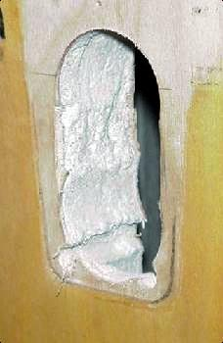
Fire Doors

Slide 28
Asbestos – Examples of Use
Fireproofing on Beams

Slide 29
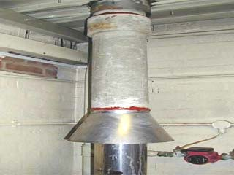
Asbestos – Examples of Use
Flue Pipes

Slide 30
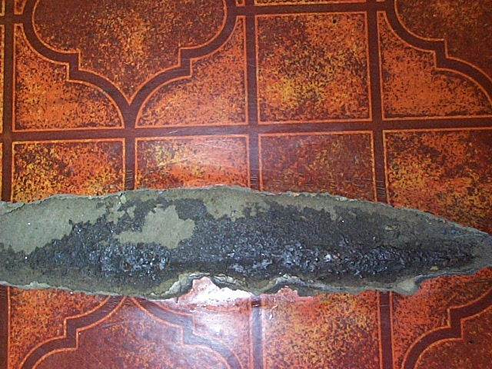
Asbestos – Examples of Use
Mastic

Slide 31
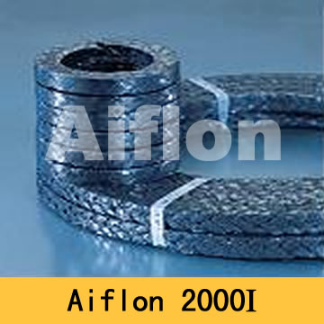
Asbestos – Examples of Use
Pipe Gaskets

Slide 32
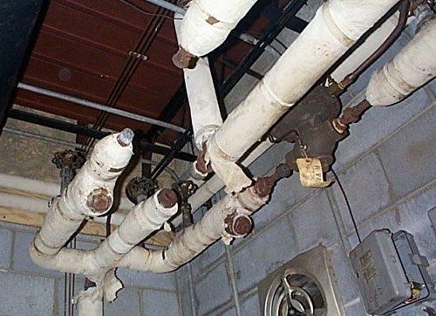
Pipe Insulation

Slide 33
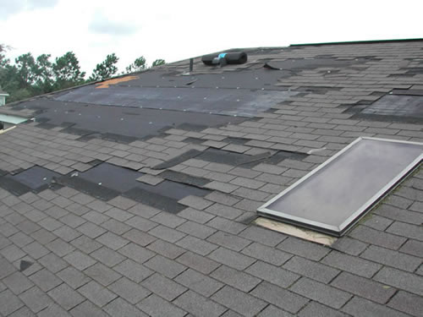
Asbestos – Examples of Use
Roofing Felts & Shingles

Slide 34
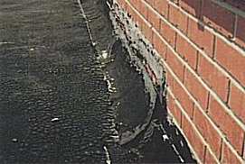
Asbestos – Examples of Use
Roofing Asphalt

Slide 35
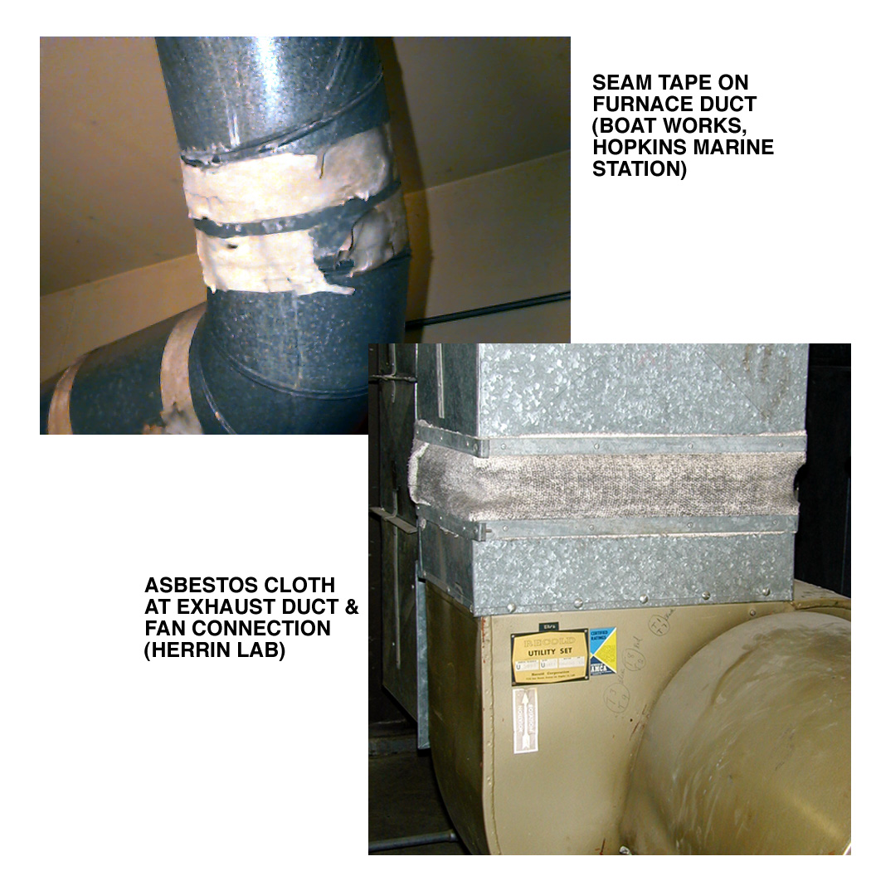
Asbestos – Examples of Use
Thermal Tape And Expansion Cloth or Vibration Dampener

Slide 36
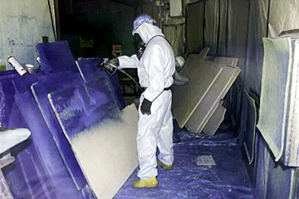
Asbestos – Examples of Use
Transite (Cement-type) Sheets

Slide 37
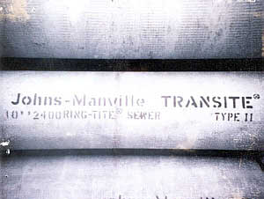
Asbestos – Examples of Use
Transite (Cement-type) Pipes

Slide 38
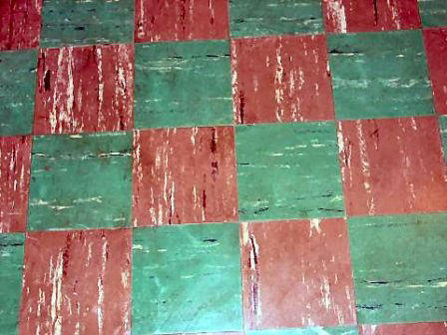
Asbestos – Examples of Use
Vinyl-Asbestos Floor Tiles

Slide 39
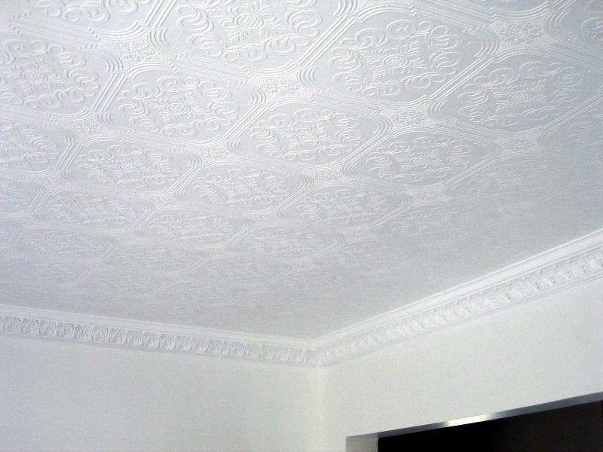
Asbestos – Examples of Use
Wall and Ceiling Plasters

Slide 40
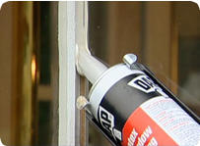
Asbestos – Examples of Use
Window Glazing

Slide 41
Asbestos – Health Effects
ASBESTOS DISEASE Key Facts
Asbestos can kill you unless you protect yourself.
Asbestos is silent and deadly. You do not know it is there. You cannot see, hear, feel, taste, smell, or touch the small asbestos fibers that enter your body. When asbestos is in the air, it gets into your body when you breathe and when you swallow.

Slide 42
Asbestos – Health Effects
Diseases
Asbestos causes four types of disease:
Asbestosis, “white lung”- a scarring of the lungs which makes it hard to breathe.
Mesothelioma, the “marker disease” – a cancer of the lining of the lungs or the lining of the abdomen. It is very rare but is typically fatal. It is not dose-related.

Slide 43
Asbestos – Health Effects
Lung Cancer (also caused by smoking) is the biggest killer of all the asbestos diseases. Asbestos workers who smoke are 80 times more likely to get lung cancer than the general public.
Other Cancers- cancers of the stomach, etc.

Slide 44
Asbestos – Health Effects
Dose-Related
The more asbestos fibers you breathe or swallow, the more likely you are to get sick. This is called a dose relationship. The higher the amount of asbestos, the greater your chances of getting an asbestos disease. Mesothelioma is the exception.

Slide 45
Asbestos – Health Effects
Latency Period
All of the asbestos diseases have a latency period. The latency period is the time gap between when you take the asbestos into your body and when you become sick. For asbestos diseases the latency period is between 10 to 40 years long.

Slide 46
Asbestos – Best Recommended Practices
How To Manage Asbestos

Slide 47
Asbestos – Best Recommended Practices
If the asbestos material is in good shape and will not be disturbed, do nothing!

Slide 48
Asbestos – Best Recommended Practices
If it is a problem or if it is going to be disturbed by renovation or demolition activities, there are two types of corrections: repair and removal. These activities must be performed by a professional trained and certified/licensed to handle asbestos safely.

Slide 49
Asbestos – Best Recommended Practices
REPAIR usually involves either sealing or covering asbestos material.

Slide 50
Asbestos – Best Recommended Practices
SEALING (encapsulation) involves treating the material with a sealant that either binds the asbestos fibers together or coats the material so fibers are not released. Pipe, furnace, and boiler insulation can sometimes be repaired this way.

Slide 51
Asbestos – Best Recommended Practices
COVERING (enclosure) involves placing something over or around the material that contains asbestos to prevent release of fibers. Exposed insulated piping may be covered with a protective wrap or jacket.

Slide 52
Asbestos – Best Recommended Practices
With any type of repair, the asbestos remains in place. Repair is usually cheaper than removal, but it may make later removal of asbestos, if necessary, more difficult and costly.

Slide 53
Asbestos – Best Recommended Practices
All of this work requires that the work area be segregated/contained to prevent asbestos fibers from being released into the rest of the building or into the outside environment.

Slide 54
Asbestos – Best Recommended Practices
The trained and certified/licensed workers performing the work must wear protective clothing and respirators designed for asbestos work.

Slide 55
Asbestos – Regulatory Requirements – General Industry 1910.1001
a) Scope and application: Applies to all occupational exposures except for construction and shipyard activities.
b) Definitions (Key Ones)
Asbestos – Includes all types (e.g., chrysotile, amosite, crocidolite, etc.)
Asbestos-containing material – Any material greater than 1% asbestos. This is an important definition.
c) Permissible Exposure Limit
0.1 f/cc as a 8-hour time weighted average (TWA)
1.0 f/cc excursion limit over a 30-minute period
d) Exposure monitoring
Must determine TWA exposures by personal air monitoring
www.iup.edu/pa-oshaconsultation

Slide 56
Asbestos – Regulatory Requirements – General Industry 1910.1001
e) Regulated area:
Required where airborne exposures exceed the TWA or Excursion Limit
Demarcation – Regulated areas must be posted
Access must be limited
Respirators required
f) Methods of compliance:
Utilize engineering controls and work practices to maintain employee exposure below the TWA and Excursion Limit when feasible
When engineering controls and work practices do not maintain employee exposures below TWA and Excursion Limit supplement with PPE (e.g., respirators).
Utilize wet methods when practicable
Do not use compressed air (unless used with local exhaust ventilation)
Implement a written compliance program in areas where exposure exceeds TWA or Excursion Limit
Brake/clutch repair – Utilize HEPA vacuum system or wet methods
www.iup.edu/pa-oshaconsultation

Slide 57
Asbestos – Regulatory Requirements – General Industry 1910.1001
g) Respirators:
Approved respirators must be provided in areas respirators are required
Must implement a full Respiratory Protection Program as per 1910.134
h) Protective clothing and equipment:
If employee exposures are above TWA and/or Excursion Limit coveralls, gloves, head coverings, foot coverings, face shields, eye protection is required
Contaminated work clothing must be removed in approved change rooms and properly laundered
i) Hygiene facilities:
Change rooms required if employee exposures are above TWA and/or Excursion Limit
Shower facilities required if employee exposures are above TWA and/or Excursion Limit
Separate lunchrooms must be provided if employee exposures are above TWA and/or Excursion Limit
www.iup.edu/pa-oshaconsultation

Slide 58
Asbestos – Regulatory Requirements – General Industry 1910.1001
j) Communication of hazards to employees:
Include asbestos in employee hazard communication program
Building and facility owners must determine the presence, location and quantity of asbestos at the work site
Utilize appropriate warning labels and signs
k) Housekeeping:
Surfaces shall be maintained as free as practicable of ACM waste and dust
Spills and sudden releases shall be cleaned up as soon as possible
Utilize HEPA vacuum for cleaning purposes
Do not utilized compressed air to clean surfaces
l) Medical surveillance:
Required if employee exposures are above TWA and/or Excursion Limit
Includes: pre-placement exam, periodic exam, medical testing
www.iup.edu/pa-oshaconsultation

Slide 59
Asbestos – Regulatory Requirements – General Industry 1910.1001
m) Recordkeeping
Maintain employee exposure records for at least 30 years
Maintain employee medical records for at least 30 years
n) Observation of monitoring
Must provide employee or their representative the opportunity to observe any monitoring
www.iup.edu/pa-oshaconsultation

Slide 60
Asbestos – Regulatory Requirements – Construction – 1926.1101
a) Scope – This regulation applies to:
Demolition or salvage of structures
Removal or encapsulation of materials containing asbestos
Construction, alteration, repair, maintenance or renovation of structures, substrates or portions thereof that contain asbestos
Installation of products that contain asbestos
Asbestos spill/emergency clean up
This section does not apply to asbestos containing, asphalt roof coatings, cements and mastics
www.iup.edu/pa-oshaconsultation

Slide 61
Asbestos – Regulatory Requirements – Construction – 1926.1101
b) Definitions
Asbestos-containing material (ACM) – Any material containing greater than 1% asbestos
Class 1 asbestos work – Removal of TSI and surfacing ACM and PACM
Class 2 asbestos work – Removal of ACM which is not TSI or surfacing material. Examples: wallboard, floor tile, sheeting, roofing, siding shingles, construction mastics
Class 3 asbestos work – Repair and maintenance operations
Class 4 asbestos work – Maintenance and custodial activities during which employees contact but do not disturb ACM
Competent person – Person who can identify asbestos hazards, select appropriate controls, has authority to take corrective action. For class 1 and 2 work must receive EPA training.
Regulated Area – Area where class 1, 2 or 3 asbestos work occurs
www.iup.edu/pa-oshaconsultation

Slide 62
Asbestos – Regulatory Requirements – Construction – 1926.1101
c) Permissible Exposure Limit
0.1 f/cc as a 8-hour time weighted average (TWA)
1.0 f/cc excursion limit over a 30-minute period
d) Multi-employer worksites
Must notify other employees on the site of asbestos activities
General contractor for site must ensure compliance with standard
e) Regulated areas
Required in Class 1, 2 or 3 work and where airborne exposures exceed the TWA or Excursion Limit
Demarcation – Regulated areas must be posted
Access must be limited
Respirators required
www.iup.edu/pa-oshaconsultation

Slide 63
Asbestos – Regulatory Requirements – Construction – 1926.1101
f) Exposure assessment:
Competent person must conduct or direct exposure assessment to evaluate employee exposure
Negative exposure assessment – Assessment demonstrates exposure does not exceed TWA or Excursion Limits
Periodic monitoring:
Class 1 and 2 Work – Daily monitoring required
Other than class 1 and 2 work – Periodic monitoring required
Notify employees of results withing 5 working days
www.iup.edu/pa-oshaconsultation

Slide 64
Asbestos – Regulatory Requirements – Construction – 1926.1101
g) Methods of compliance – Major Points
Required engineering and work practice controls
Wet methods, HEPA vacuums and prompt clean up/disposal of wastes and debris
Negative pressure containment with 4 air changes/hour
Critical barriers
Isolation of HVAC systems
Materials inside containment covered with plastic/impermeable drop cloth
Prohibitions – High speed disc saws (w/no HEPA filtration), use of compressed air, dry sweeping or dry clean up of ACM
www.iup.edu/pa-oshaconsultation

Slide 65
Asbestos – Regulatory Requirements – Construction – 1926.1101
g) Methods of compliance – Major Points/Requirements
Required engineering and work practice controls
Wet methods, HEPA vacuums and prompt clean up/disposal of wastes and debris
Negative pressure containment with 4 air changes/hour
Critical barriers
Isolation of HVAC systems
Materials inside containment covered with plastic/impermeable drop cloth
Prohibited – High speed disc saws (w/no HEPA filtration), use of compressed air, dry sweeping or dry clean up of ACM
See EPA Model Curriculum for all requirements such as worker, supervisor training requirements.
www.iup.edu/pa-oshaconsultation

Slide 66
Asbestos – Regulatory Requirements – Construction – 1926.1101
h) Respiratory protection
Employer must provide approved respirator
Respirators required:
Class 1 work
Class 2 work – when ACM not removed substantially intact
Class 2 and 3 work – when wet methods not utilized or when a negative exposure assessment has not been completed
Class 3 work – when TSI or surfacing ACM or PACM is disturbed
Any occasion employees are required to be inside a regulated area (e.g., to perform custodial duties)
Any occasion employees are exposed above the TWA or Excursion Limit
Must implement a respiratory protection program in compliance with 1910.134.
www.iup.edu/pa-oshaconsultation

Slide 67
Asbestos – Regulatory Requirements – Construction – 1926.1101
i) Protective clothing – During class 1 work, or if employee exposures are above TWA and/or Excursion Limit or if no negative exposure assessment has been conducted:
Coveralls, gloves, head coverings, etc. required
Protective clothing must be regularly inspected
Contaminated work clothing must be removed properly, bagged in impermeable containers and properly labeled
j) Hygiene facilities – Required for class 1 work
Three (3) stage decontamination area required attached to regulated area
Equipment Room/Shower Area/Clean Change Room
No smoking permitted in work areas
www.iup.edu/pa-oshaconsultation

Slide 68
Asbestos – Regulatory Requirements – Construction – 1926.1101
k) Communication of hazards to employees:
Include asbestos in employee hazard communication program
Building and facility owners must determine the presence, location and quantity of asbestos at the work site
Utilize appropriate warning labels and signs
l) Housekeeping:
Utilize HEPA vacuums
Asbestos waste, debris, etc. must be collected and disposed of in sealed, labeled, impermeable bags/containers
Asbestos waste and debris shall be promptly cleaned up and disposed of in leak tight containers
www.iup.edu/pa-oshaconsultation

Slide 69
Asbestos – Regulatory Requirements – Construction – 1926.1101
m) Medical surveillance:
Required if employees perform class 1, 2 and 3 work for 30 or more days per year
Required if employee exposures are above TWA and/or Excursion Limit for 30 or more days per year
Includes: pre-placement exam, periodic exam, medical testing
n) Recordkeeping
Maintain employee exposure records for at least 30 years
Maintain employee medical records for at least 30 years
o) Competent Person
Required on each job site to ensure worker safety and health
Performs frequent and regular inspections
www.iup.edu/pa-oshaconsultation

Slide 70
Asbestos – Other Regulatory Requirements - AHERA
Asbestos Hazard Emergency Response Act – Asbestos-Containing Materials In Schools (AHERA) – Part III 40 CFR Part 763
Regulates asbestos in public and private Kindergarten through 12th grade schools.
Enforced by EPA
Requires inspections to determine presence of asbestos-containing materials and the development of asbestos management plans
www.iup.edu/pa-oshaconsultation

Slide 71
Asbestos – Other Regulatory Requirements - NESHAP
National Emission Standards for Hazardous Air Pollutants (NESHAP) – 40 CFR 61 Subpart M.
Protects people and the environment
Enforced by EPA
Requires inspections to determine presence of asbestos-containing materials prior to demolition activity
“No visible emission of asbestos”
EPA and PA notification requirements
www.iup.edu/pa-oshaconsultation

Slide 72
Heading
Add Text
www.iup.edu/pa-oshaconsultation

Slide 73
Heading
Add Text
www.iup.edu/pa-oshaconsultation

Slide 74
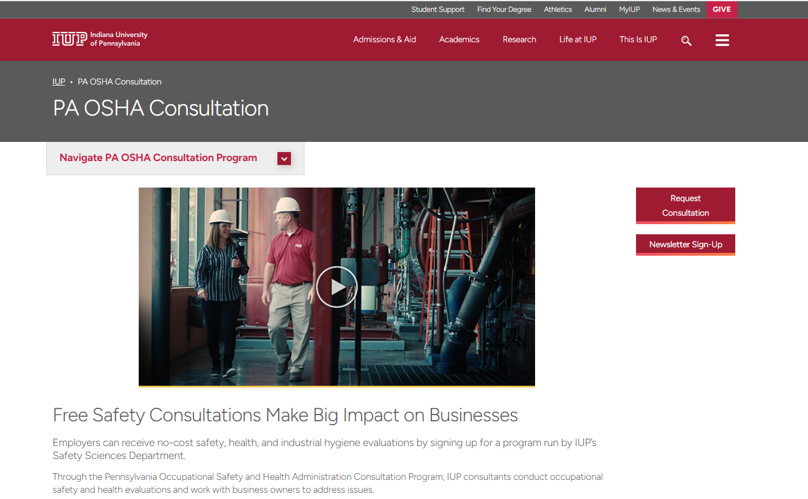
www.iup.edu/pa-oshaconsultation
www.iup.edu/pa-oshaconsultation

Slide 75
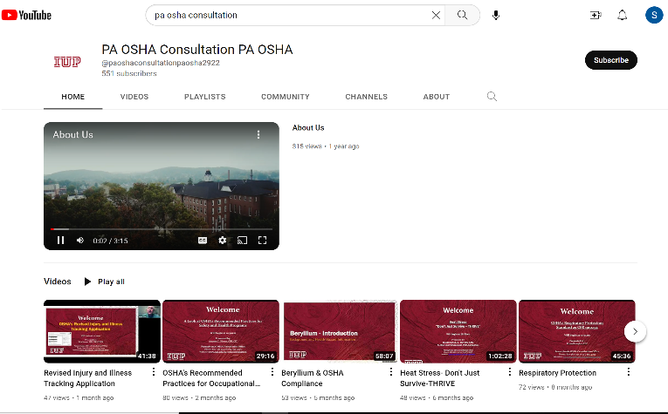
Please consider subscribing to our youtube channel to be notified of new webinars: https://www.youtube.com/@paoshaconsultationpaosha2922
www.iup.edu/pa-oshaconsultation

Slide 76
Contact us
Consultant Name
Email
Pennsylvania OSHA Consultation Office
Phone: 724-357-4095
Website: www.iup.edu/pa-oshaconsultation/
Facebook: https://www.facebook.com/Pennsylvania-OSHA-Consultation-Program-548810235234647/
Twitter: https://twitter.com/search?q=PA%20OSHA%20Consultation&src=savs
www.iup.edu/pa-oshaconsultation

Slide 77
Thank You
Upcoming Webinar:
LIST TOPIC HERE
LIST DATE HERE@ 10:30am
Pennsylvania OSHA Consultation Office
Phone: 724-357-4095
Website: www.iup.edu/pa-oshaconsultation
www.iup.edu/pa-oshaconsultation

