Slide 1
Welcome:
Training in the Modern Day Work Environment – From Learning Theory and Concepts, To Training Analysis and Evaluation
Will begin at 10:30am
Presented by:
Drew Garverick
Pennsylvania OSHA Consultation Office
Phone: 800-382-1241 or 724-357-4095
Website: www.iup.edu/pa-oshaconsultation

Slide 2
Training in the Modern Day Work Environment – From Theory and Concepts, to Training Analysis and Evaluation
Webinar General Info
PowerPoint Presentation
Q&A
Questions
Chat is open to submit questions.
We will be answering questions through this chat feature. If due to the technical nature of the question a more thorough response is required, we will post the answer on our website within seven days of the webinar.
www.iup.edu/pa-oshaconsultation

Slide 3

Introduction:
TRAINING

Slide 4

Topics:
Labor Market
Generational Preferences
Learning Principals
Andragogy
Technology
Developing Training Programs

Slide 5
Labor Market
U.S. Labor Work Force
Unemployment rate: 3.5% (As of October, 2019)
A 50 year low (Since 1969…)
20th consecutive month of unemployment <4%
Avg wage growth of 3.1% YOY
Takes on avg 93 days to fill an open production position
Takeaways:
The labor pool is tight for employer’s
It’s taking longer to find and fill positions – Let alone train and onboard these new employees
Employers are raising wages to try to attract more talent
It is crucial to have effective and efficient training programs
  It’s hard to justify hours on end of classroom training. We need to be more efficient in our approach to training
www.iup.edu/pa-oshaconsultation
https://www.recruiting.com/blog/are-your-new-hires-quitting/
https://www.bls.gov/news.release/empsit.nr0.htm

Slide 6
Injury? OSHA Inspection?
Workplace Reportable Incident
OSHA is informed
Will OSHA Visit?
Cat 1 – Reports that require on-site investigation
Cat 2 – Procedures authorize + encourage OSHA area office to inspect
What Incident Details will OSHA Gather?
Cat 3 – Inspection not warranted but Area Director will require a Rapid Response Investigation
Machinery/ equipment involved
Systems in place to prevent incident
Work rules/ Safety procedures
Employee training
On top of what has been mentioned:
What if you lack sufficient safety training programs?
Statistically, who’s the most likely to get injured?
So, now we filled a role, onboarded an ee, but then we have a reportable incident?
OSHA FY 2019 statistics:
  Reported 33,401 federal inspection’s
    More than the prior 3 years
    Their primary focus on: Trenching, Falls, Chemical exposure and Silica
  Provided workplace safety training to 1,392,611 workers
  OSHA On-Site Consultation Program identified 137,855 workplace hazards
    Protected 3.2 million US workers
https://www.osha.gov/news/newsreleases/trade/12032019
https://www.osha.gov/dep/enforcement/Interm_Enforcement_Procedures.html

Slide 7
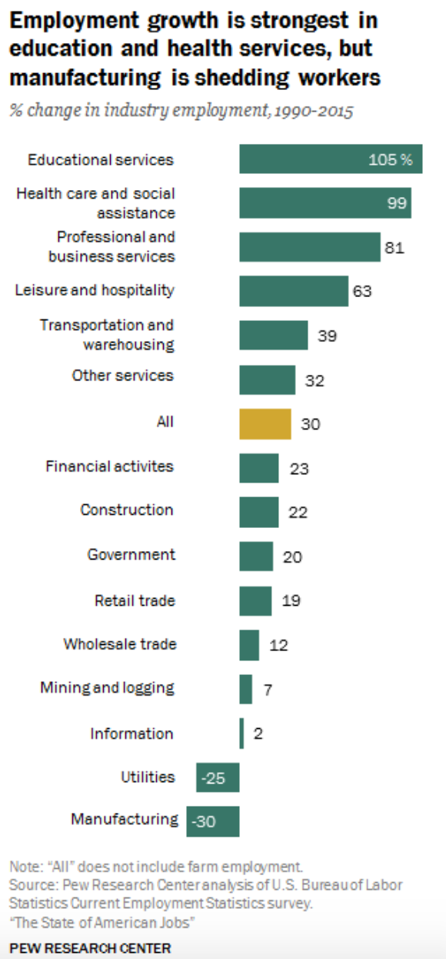
Generational Focus on Training/ Development
Training & development more important now than ever…
  WHY?
    We are experiencing a Major Shift in Workforce Skills, an Industrial Skills Gap in a highly competitive job market– More people filling management roles versus frontline roles
      Largely attributed to a generational focus on getting a higher level degree, post high-school
      If you look at the job market, Educational & Healthcare services have grown 100% to index from 1990-2015, where as manufacturing has declined by 30%. The jobs are there but pool of candidates is not for the type of positions we desire to fill.
    We have tenured, highly knowledgeable employees retiring. How do we capture that parting knowledge?
    In 2020, it is predicted that > 26% of manufacturing workers will be 55 or older
    Training is a staple in OSHA investigations – A foundational base for determining good faith and workplace culture
    It’s heavily valued by our newer generations
  WHO’s filling the shoes?
    Our Millennial and Z generation – Our two youngest generations
      Millennials (1981-1996) – Are already the largest working generation in the labor force since 2016
      Gen Z (1997-present) – Expected to make up 30% of the global workforce by 2030
www.iup.edu/pa-oshaconsultation

Slide 8
Generational Talk
  What’s the opportunity?
    With the influx of younger more tech adapt generations, it may be imperative for businesses to shift or adapt how they operate to align with newer generations needs
      https://www.youtube.com/watch?v=MajNVgTnsK4 (1:51)
      Takeaways: flexible work hours, remote offices, autonomous/ collaborative work environment, personal development
      Development, which is the basic foundation is training programs. Ask yourself, how are your current state training programs? Are they advanced, efficient and streamlined across your enterprise?
  Stats
    71% of millennials who leave their company within 2 years, leave because of how they perceive their leadership skills being developed
    On the same note, 69% of millennials aspire to be leaders within their organization within the next 5yrs
    1 in 4 new hires quit within the first 6 months
  Take away
    Millennials and gen z are generations with focus on growing their skills. They have less of a focus on making money, more of a focus on development as compared to prior generations.

Slide 9

Learning…
Think of a favorite teacher or mentor of yours
Use your LESS dominant hand and on a piece of paper:
  Write their name
  Write words that described what made them impactful

Slide 10

Let’s Talk Big Picture Learning
Visual
Learners prefer to look a pictures, diagrams, charts, graphs etc. to understand and learn main principles.
Emphasizing main points through highlighting or reviewing main points through logic trees .
Commonly used in business review calls.
Auditory
Leaners prefer to hear information presented in a lecture based format.
Emphasizing learning through debates, speeches, reading information aloud.
Think of a traditional classroom environment.
Kinesthetic*
Prefer to learn through experiencing own their own.
Think of a hands on demo – Ergonomics, fire extinguisher training, LOTO.
A relatively untapped part of trainings that often gets overlooked. A very great way to efficiently translate “new” or “desired” info to participants.
Add Text
Learning Mediums
www.iup.edu/pa-oshaconsultation

Slide 11
Now Let’s Focus on Adult Learning…
Often, trainers know their content very well, but largely fail to deliver their content in an effective and efficient manner. Sound Familiar?
Do you ever walk away from one of your own training sessions and cant help but to wonder if your training objectives got across to the audience?
Comparable example – A manufacturing company who just installed brand new, state-of-the-art, equipment that’s expected to double product output. BUT When it comes time to operate these machines they don’t have the brain power to do so..
The bottom line here: The differences an effective training can make is the difference between a loss in market share, a loss in revenue, a productivity miss or most importantly an accident that lead to severe injury or death
That’s why we should focus the development of our trainings with the adult learner in mind AKA Andragogy
Andragogy is the study of adult learning, it puts a high emphasis on relevance within trainings.
Andragogy, the adult learning theory, aims to connect the learner to the desired outcomes. We want to make measurable changes in behavior and the knowledge to do so with
www.iup.edu/pa-oshaconsultation

Slide 12
Adult Learning Theory:
Andragogy:
Adult Learning Theory – The Department of Education defines the adult learner as anyone "engaged in some form of instruction or educational activity to acquire the knowledge, information, and skills necessary to succeed in the workforce, learn basic skills, earn credentials, or otherwise enrich their lives," (NCES, 1999).
Relation to the Audience
How does this affect the participants, how is it going to relate and be useful for them to use in their job?
Importance to the Audience
If we cant justify the importance of this training to align with a true business goal – then the training should not occur
For the adult learner, they are oriented toward immediate application of “learned knowledge”
Goals of the training
Goals must be clearly defined and attainable. If goals/outcomes are not clearly understood than the audience may not stay engaged
Training must be practical
Typically, the training should be no longer than 1 hour. Attention spans, engagement and desire to learn quickly decrease
Also, we cant always expect the business to give us as much time as we want. We have to make due with what we can
Training must engage* the audience
Allow participants to facilitate their own learning experience by allowing them to share there experiences with others
Utilize technology and creative training techniques to keep the learning curve increasing versus decreasing.
Engagement is an absolute key player for delivering effective training sessions
www.iup.edu/pa-oshaconsultation
(Knowles, as cited in Forrest III & Peterson, 2006, p. 116)

Slide 13

Technology:
There is a ton of technology out there, free of charge, that can be used to create more efficient learning opportunities!
  Kahoot!
    A free, trivia based game that allows any sized group of people to “compete”
  Microsoft Forms
    Allows a presenter to easily record a groups baseline and final competency and track the improvement made
    Offers a standardized approach to administering quiz, surveys etc. and also capturing the data within to identify area’s or opportunity's, trends etc.
  Virtual Reality*
    https://www.youtube.com/watch?v=e-l4e2UhnGo
  Doopoll
  Microsoft PowerApps
  Quizlet
  mLearning (micro/ mobile learning)
  Game based Learning
  Adaptive Learning
www.iup.edu/pa-oshaconsultation
https://raccoongang.com/blog/virtual-reality-elearning-and-9-real-life-examples/

Slide 14

Learning Influences
Emotional
Provoke feelings
Understand/ relate to participants
Cognitive
Stimulate thoughts through spot checks
Tap into their prior knowledge
Behaviorally
Have participant’s teach what they learned
Organize discussions
Learn/ identify participants interests
Make relevant and practical outcomes
Provide feedback
Incorporate competition
Make connections between course material & personal interests
Incorporate modern technology*
Take away:
Engaging a participants feelings, provoking thought process and changing behavior’s through interrelated training techniques will serve to provoke a large learning curve
https://raccoongang.com/blog/how-engage-students-learning/

Slide 15
The Trainer, the Communicator:
“The only thing that counts about a person’s vocabulary, is the effect that that person’s words & phrases have on their own and others’ thinking” - David Schwartz, Ph. D.
We simply do not think in words and phrases… But rather we think in big pictures and/or images.
At its core, words are the raw materials of our thoughts. When spoken, or read, our mind transforms and converts these spoken words into pictures within our mind.
These mind pictures are modified by the kinds of words we use to name and describe things with
As a trainer, we are also a communicator. We need to ensure we delicately craft our message(s) by creating/painting positive, forward-looking, optimistic pictures in the minds of our audience
Schwartz, D. J. (2019). The magic of thinking big. London: Vermilion.

Slide 16
Andragogy - Facilitator Best Practices
Best Practices
Administer frequent contact and interactions
Encourage dialogue and cooperation among learners
Apply active learning techniques for the different types of learning
Provide feedback to reinforce the desired behavior's
(Shea, Pickett, & Pelz, 2003)

Slide 17
Practical Tips:
Have music playing to ease the tension and facilitate dialogue
Greet each member as they walk in hopes to develop a better working relation
Provide food, beverages or snacks
Make jokes, create laughter
Connect training outcomes with the audiences experiences
Provide hands-on opportunities to learn
Encourage shared perceptions
Create a safe learning environment where participants feel encouraged to share their thoughts, feelings or questions
Remember – Facilitators should create a learning environment where they act more as a mentor/ manager as opposed to one of an information deliverer or expert
(Palloff & Pratt, 2003; Robson, 2000;
Shedletsky & Aitken, 2001).
www.iup.edu/pa-oshaconsultation

Slide 18
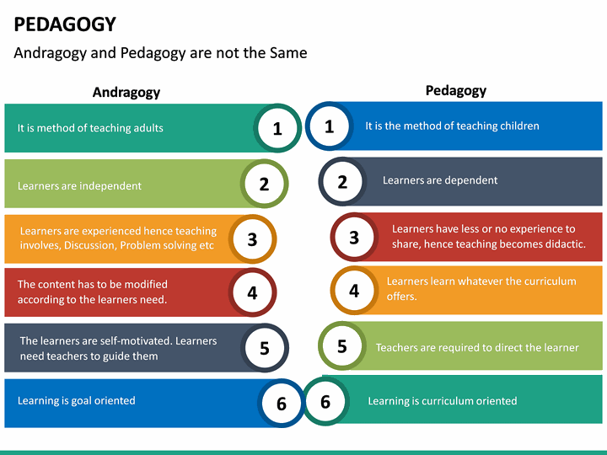
Final Take away:
Training/Learning
Traditional Model:
Teacher
Adult Model:
Instructor
Student
Relevance and Past Experiences
Student

Slide 19
Switching Gears
From:
Theory/Concepts
To:
Analysis/Evaluation
www.iup.edu/pa-oshaconsultation

Slide 20
Lets Talk Training development
Step 1
Performing Analysis:
Where is out biggest loss?
Step 2
Determining Need:
Step 3
Step 4
Step 5
Implementation:
Measuring and Improving:
Why are we experiencing this/these outcomes… What are our gaps
How are we going to build our training program to address the loss and the identified gaps?
Development:
Who are we going to target?
What is our performance/ effectiveness?

Slide 21


Training Development – Step 1: Performing Analysis (Where)
Determining our WHERE:
  Typically 2 Buckets where we see loss in:
Our rates:
  Leading indicator rates – Maybe our leading indicators (evaluations, observations, compliance levels, Safety meetings) are identifying areas of opportunity?
  Lagging indicator rates – If we are experiencing higher than normal incident rates for a specific injury classification/category or have a spike in an usual injury category it may be time to perform an analysis on our existing (or non-existing) training programs
Regulatory Requirements:
  In this bucket we want to identify what regulatory requirements are applicable and ensure we have programs in place to minimize loss (EPA, OSHA, DOT, FDA etc.)

Slide 22

Training Development – Step 2: Determining the Needs (WHY)
WHY:
Once we’ve identified WHERE our loss is coming from, we need to determine WHY we are experiencing this loss
These “why’s” should be the basis of our needs - Our main points for a new training program.
So determine what your needs are to be able to fill those identified gaps
  Ask yourself, what do we need to change or do differently?
    Program?
    Culture?
    System?
    Etc.
www.iup.edu/pa-oshaconsultation

Slide 23

Training Development – Step 3: Development (HOW)
Once we determine our WHAT and our WHY, we begin the process of implementing our “HOW”
  That is HOW we are going to develop our training program:
  It is very important that we develop programs or courses that are student-centered (Andragogy) while avoiding a teacher-centered (pedagogy) approach
We can do this by applying andragogy's main principles as noted previously and create:
  Drawing past experiences, making it relevant and having practical outcomes
During the development phase:
  It is most effective to have a cross functional team help us in the development of our training programs:
    Content expert
    Instructional designer
    Multimedia producer
    Systems analysts
    Front line associate
    Network programmer
    Contractors, etc.
(Chou & Tsai, 2002)
(Brown, 2001; Carr-Chellman & Duchastel, 2000; Chou, & Tsai, 2002; Knowlton, 2000; Pallof & Pratt, 2003)

Slide 24
Training Development – Step 4: Implementation (WHO)
WHO:
Who do we want to target?
Who is experiencing the loss?
Once we have these questions answered we implement the training program to hit these high risk groups first.
We never want to train a group where the specific loss is not attributed to them

Slide 25
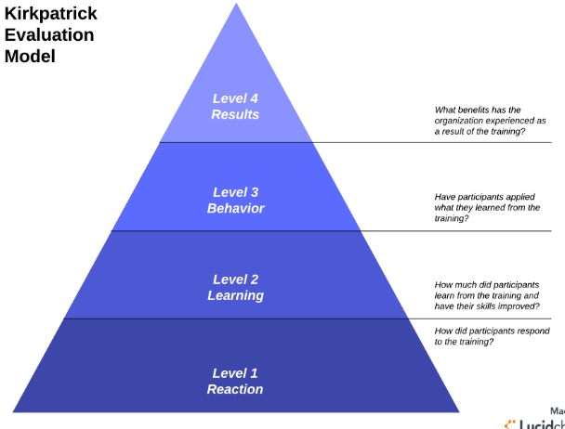
Training Development – Step 5:
Measuring and Improving (WHAT)
Kirkpatrick Model:
Level 1: Reaction – How do participants react to the training
  Measuring participants satisfaction
Level 2: Learning
  Is their increase from baseline knowledge, skills or experience?
Level 3: Behavior
  Are they utilizing the desired behavior's within the work environment
Level 4: Result's
  Are we seeing measurable positive impacts within the business (Our lagging and leading indicators)

Slide 26
RECAP:
ADDIE:
Analysis
Define Gap
Design
Your road map of the outputs
Development
Create it
Implement
Lets do it, Andragogy led
Evaluate
Is it working?
…In short, these are the building blocks to effective and efficient training programs. Now lets implement them!

Slide 27
Let’s Recap:
Labor market
OSHA Inspections
Generational Preferences
Learning Preferences
Andragogy Principals
Implementing Training Programs

Slide 28
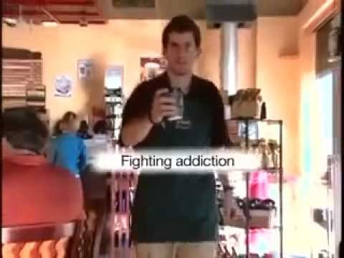
Final Takeaway
CARE:
If you don’t exude care why should your audience?
Simply caring for someone, other than yourself, may make a world of difference, not only to somebody else but for yourself as well
Great now, did that video:
Stimulate emotion?
Provoke cognitive thought-processes?
Encourage you to change your behavior?
Thank you!!
https://youtu.be/bzmWqZS1QSU

Slide 29
References
Bash, L. (Ed.). (2005). Best practices in adult learning. Bolton, MA.: Anker Publishing Company, Inc.
Johnson, S. D., Benson, A. D., Duncan, J., Shinkareva, O. N., Taylor, G., & Treat, T. (2003).
Distance learning in postsecondary education No. 2003-10-00). Columbus, Ohio: National Dissemination Center for Career and Technical Education.
Mingle, J. R., & Birkes, A. Y. (2004). Targeting the adult learning challenge in SREB states (PDF). Challenge to lead. Southern Regional Education Board.
Yoon, S. (2003). In search of meaningful online learning experiences. New Directions for Adult and Continuing Education, (100), 19-30.
U.S. Department of Commerce, Census Bureau, Current Population Survey (CPS), October Supplement, 2000 through 2017
The Condition of Education - Postsecondary Education - Postsecondary Students - College Enrollment Rates - Indicator February (2019), National Center for Education Statistics, Feb. 2019, nces.ed.gov/programs/coe/indicator_cpb.asp.
2017 Poverty Guidelines.. ASPE, U.S. Deptartment of Human & Health Services, 12 Jan. 2018.https://aspe.hhs.gov/2017-poverty-guidelines​​​​​​​
Health and Economic Costs of Chronic Disease" Centers for Disease Control and Prevention, Centers for Disease Control and Prevention, 23 Oct. 2019, https://www.cdc.gov/chronicdisease/about/costs/index.htm#ref1​​​​​​​

Slide 30

www.iup.edu/pa-oshaconsultation

Slide 31
Contact us
Pennsylvania OSHA Consultation Office
57 South 9th Street
Suite 305
Indiana, PA 15701
Phone: 800-382-1241
Fax: 724-357-2385
Web: www.iup.edu/pa-oshaconsultation/
Facebook: https://www.facebook.com/Pennsylvania-OSHA-Consultation-Program-548810235234647/
Twitter: https://twitter.com/search?q=PA%20OSHA%20Consultation&src=savs
www.iup.edu/pa-oshaconsultation

Slide 32
Thank You
Upcoming Webinar:
Multi-Employer Worksites & Independent Contractors
March 18, 2020@ 10:30am
Pennsylvania OSHA Consultation Office
Phone: 800-382-1241 or 724-357-4095
Website: www.iup.edu/pa-oshaconsultation
www.iup.edu/pa-oshaconsultation

