Slide 1
Welcome Navigating Multi-Employer Worksites Will begin at 10:30am Presented by: Kalie Hoover Pennsylvania OSHA Consultation Office Phone: 800-382-1241 or 724-357-4095 Website: www.iup.edu/pa-oshaconsultation

Slide 2
Navigating Multi-Employer Worksites
Webinar General Info PowerPoint Presentation Q&A Questions Chat is open to submit questions. We will be answering questions through this chat feature. If due to the technical nature of the question a more thorough response is required, we will post the answer on our website within seven days of the webinar.
www.iup.edu/pa-oshaconsultation

Slide 3
Objectives
Distinguish the difference between a creating, correcting, controlling, and exposing employer
Discuss the responsibilities of each employer
Identify possible OSHA citations for each employer
www.iup.edu/pa-oshaconsultation

Slide 4
Employer Knowledge
All employers that are cited through OSHA must have a knowledge of the hazardous condition.
Knowledge includes an actual knowledge or a potential knowledge of the situation
www.iup.edu/pa-oshaconsultation

Slide 5
Creating Employer
This employer created the OSHA violation.
Even if the only employees exposed are those of other employers at the site, this employer is still the creating employer.
www.iup.edu/pa-oshaconsultation

Slide 6
Creating Employer Example
Employer Host operates a factory. It contracts with Company S to service machinery. Host fails to cover drums of a chemical despite S's repeated requests that it do so. This results in airborne levels of the chemical that exceed the Permissible Exposure Limit

Slide 7
Exposing Employer
This employer is whose own employees are exposed to the hazard. They are responsible if their employees have been exposed to the hazardous conditions.
This employer is citable if they knew about the hazard or would have known if they practiced due diligence.

Slide 8
Reasonable or Due Diligence
What is reasonable diligence (also called due diligence or reasonable care)?
A fair and adequate amount of care related to a circumstance. Also called due diligence or reasonable care.

Slide 9
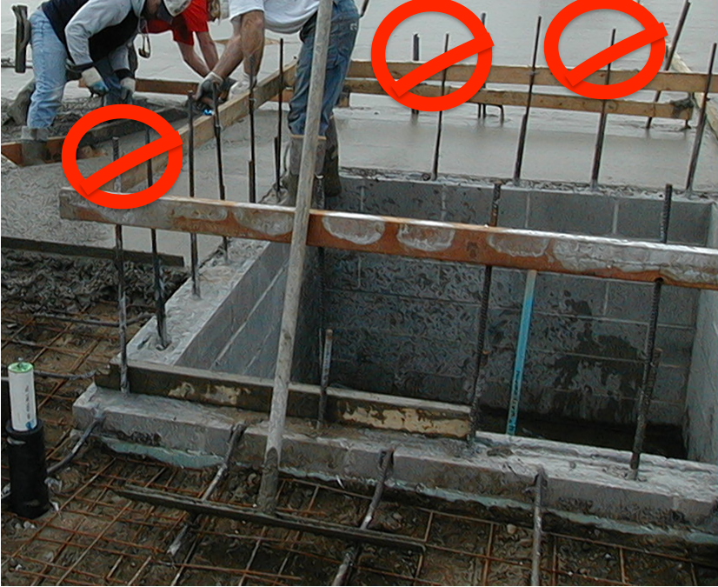
Exposing Employer Example
Unprotected rebar on either side of an access ramp presents an impalement hazard. Sub E, an electrical subcontractor, does not have the authority to cover the rebar. However, several times Sub E asked the general contractor, Employer GC, to cover the rebar. In the meantime, Sub E instructed its employees to use a different access route that avoided most of the uncovered rebar and required them to keep as far from the rebar as possible

Slide 10
Correcting Employer
An employer who is on the same worksite as the exposing employer and is responsible for correcting a hazard.
This usually occurs where an employer is given the responsibility of installing and/or maintaining equipment.

Slide 11
Correcting Employer Example
Employer C, a carpentry contractor, is hired to erect and maintain guardrails throughout a large, 15-story project. Work is proceeding on all floors. C inspects all floors in the morning and again in the afternoon each day. It also inspects areas where material is delivered to the perimeter once the material vendor is finished delivering material to that area. Other subcontractors are required to report damaged/missing guardrails to the general contractor, who forwards those reports to C. C repairs damaged guardrails immediately after finding them and immediately after they are reported. On this project few instances of damaged guardrails have occurred other than where material has been delivered. Shortly after the afternoon inspection of Floor 6, workers moving equipment accidentally damage a guardrail in one area. No one tells C of the damage and C has not seen it. An OSHA inspection occurs at the beginning of the next day, prior to the morning inspection of Floor 6. None of C's own employees are exposed to the hazard, but other employees are exposed.

Slide 12
Controlling Employer
An employer who has general supervisor authority over the worksite, including the power to correct safety and health violations or require others to correct them.
There are four types of controlling employers: control established through contract, control established by a combination of other contract rights, Architects and Engineers, and Control without explicit contractual authority.

Slide 13
Controlling Employers: Control established through contract
To be a controlling employer, the employer must itself be able to prevent or correct a violation or to require another employer to prevent or correct the violation. This can take the form of a specific contract right to require another employer to adhere to safety and health requirements and to correct violations the controlling employer discovers.
Example: Employer A contracts with Employer B to do painting work. A has the same contract authority over B. A conducts inspections that are sufficient. Further, during several inspections, A finds that B has violated fall protection requirements. It points the violations out to B during each inspection but takes no further actions.

Slide 14
Controlling employer: control established by a combination of other contract rights
Where there is no explicit contract provision granting the right to control safety, or where the contract says the employer does not have such a right, an employer may still be a controlling employer. The ability of an employer to control safety in this circumstance can result from a combination of contractual rights that, together, give it broad responsibility at the site involving almost all aspects of the job.
Example: Employer A's contractual authority is limited to reporting on subcontractors' contract compliance to owner/developer B and making contract payments. Although it reports on the extent to which the subcontractors are complying with safety and health infractions to B, A does not exercise any control over safety at the site.

Slide 15
Controlling employers: Architects and Engineers
Architects, engineers, and other entities are controlling employers only if the breadth of their involvement in a construction project is sufficient to bring them within the parameters discussed above.
Example: Architect A contracts with owner B to prepare contract drawings and specifications, inspect the work, report to B on contract compliance, and to certify completion of work. A has no authority or means to enforce compliance, no authority to approve/reject work and does not exercise any other authority at the site, although it does call the general contractor's attention to observed hazards noted during its inspections.

Slide 16
Controlling Employers: Control without explicit contractual authority
Even where an employer has no explicit contract rights with respect to safety, an employer can still be a controlling employer if, in actual practice, it exercises broad control over subcontractors at the site.
Example: Construction manager A does not have explicit contractual authority to require subcontractors to comply with safety requirements, nor does it explicitly have broad contractual authority at the site. However, it exercises control over most aspects of the subcontractors' work anyway, including aspects that relate to safety

Slide 17
Evaluating Reasonable Care and the Controlling Employer
In evaluating whether a controlling employer has exercised reasonable care in preventing and discovering violations, consider questions such as whether the controlling employer:
Conducted periodic inspections of appropriate frequency ;
Implemented an effective system for promptly correcting hazards;
Enforces the other employer's compliance with safety and health requirements with an effective, graduated system of enforcement and follow-up inspections

Slide 18
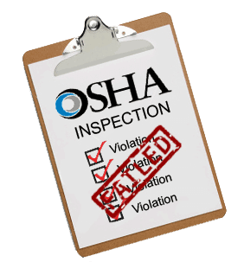
OSHA Citation Information
Can a non-exposing employer be cited?
Yes, but only if they had knowledge of the hazard. If they did not and practiced due diligence, then they may not be cited.
OSHA will go through a series of judgements to determine if the employer exhibited due diligence. This includes:
Looking at inspection records on the jobsite
Reviewing safety procedures
www.iup.edu/pa-oshaconsultation

Slide 19
OSHA Citation Information
Can an employer have multiple roles?
Yes!
A creating, correcting, or controlling employer will often also be an exposing employer.
Exposing, creating, and controlling can also be correcting employers if they are authorized to correct the hazard.

Slide 20
References
https://www.osha.gov/laws-regs/standardinterpretations/2012-07-20
https://www.osha.gov/enforcement/directives/cpl-02-00-124
https://www.shrm.org/resourcesandtools/hr-topics/risk-management/pages/osha-multiemployer-citation-policy.aspx

Slide 21
www.iup.edu/pa-oshaconsultation

Slide 22
Contact us
Pennsylvania OSHA Consultation Office
57 South 9th Street Suite 305 Indiana, PA 15701
Phone: 800-382-1241
Web: www.iup.edu/pa-oshaconsultation/
Facebook: https://www.facebook.com/Pennsylvania-OSHA-Consultation-Program-548810235234647/
Twitter: https://twitter.com/search?q=PA%20OSHA%20Consultation&src=savs
www.iup.edu/pa-oshaconsultation

Slide 23
Thank You
Upcoming Webinar:
Hearing Conservation Overview
April 15th@ 10:30am
Pennsylvania OSHA Consultation Office
Phone: 800-382-1241 or 724-357-4095
Website: www.iup.edu/pa-oshaconsultation
www.iup.edu/pa-oshaconsultation

