Slide 1
Welcome Medical Marijuana and Implications for PA Workers
Will begin at 10:30am Presented by: Christopher Jiuliante Pennsylvania OSHA Consultation Office Phone: 800-382-1241 or 724-357-4095 Website: www.iup.edu/pa-oshaconsultation

Slide 2
Medical Marijuana and Implications for PA Workers
Webinar General Info PowerPoint Presentation Q&A Questions Chat is open to submit questions. We will be answering questions through this chat feature. If due to the technical nature of the question a more thorough response is required, we will post the answer on our website within seven days of the webinar.
www.iup.edu/pa-oshaconsultation

Slide 3
Objectives of the Webinar
Brief information about Medical Marijuana
Medical Marijuana in Pennsylvania
How to handle medical marijuana in the workplace

Slide 4
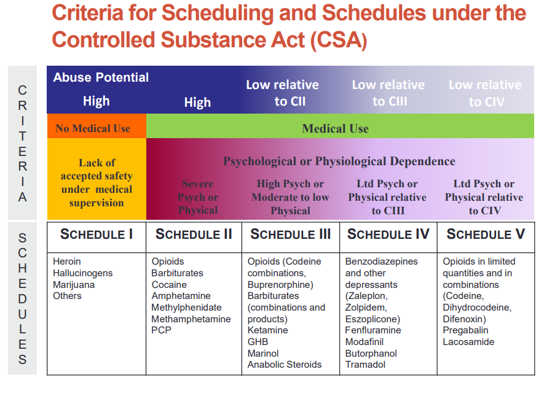

Slide 5
PA approved “Serious Medical Conditions”
Amyotrophic lateral sclerosis
Anxiety disorders
Autism
Cancer, including remission therapy
Crohn’s disease
Damage to the nervous tissue of the central nervous system with objective neurological indication of intractable spasticity, and other associated neuropathies
Dyskinetic and spastic movement disorders
Epilepsy
Glaucoma
HIV/Aids
Huntington’s disease
Inflammatory bowel disease
Intractable seizures
Multiple sclerosis
Neurodegenerative diseases
Neuropathies
Opioid use disorder
Parkinson’s disease
Post-traumatic stress disorder
Severe chronic or intractable pain of neuropathic origin or severe chronic or intractable pain
Sickle cell anemia
Terminal illness
Tourette syndrome
(medical)
www.iup.edu/pa-oshaconsultation

Slide 6
Forms Of Medical Marijuana In PA
Pill
Oil
Topical forms (gels, creams, ointments)
Vaporization (dry leaf/plant)
Tincture
liquid
Image source: theorywellness.org, weedmaps.com, vpr.org
www.iup.edu/pa-oshaconsultation

Slide 7
Side effects
Headache
Dry mouth
Dry Eyes
Lightheadedness
Dizziness
Drowsiness
Fatigue
Nausea
Paranoid Thinking
Disconnected state
Increased appetite
Coughs
Side effects vary from individual and by the amount taken

Slide 8
State Legislation

Slide 9
Court Cases – Employer
Ross v. RagingWire Telecommunications (2008)
In favor of employer and held that medical marijuana patients cannot state civil causes of action for employment discrimination
Emerald Steel Fabricators v. Bureau of Labor & Industry (2010)
Held that the employer did not act unlawfully in terminating the employee for engaging in illegal activity. The Oregon disability statue did not apply
Coats v. Dish Network (2015)
Employer could terminate an employee who uses medical cannabis program because of federal law
Barbuto v. Advantage Sales & Marketing (2017)
Denied Employer’s motion to dismiss and should have engaged in an interactive process with the employee rather than terminating her.

Slide 10
Court Cases - Employee
Barbuto v. Advantage Sales & Marketing (2017)
Denied Employer’s motion to dismiss and should have engaged in an interactive process with the employee rather than terminating her.
Chance v. Kraft Heinz Foods Co. (Delaware – 2018)
Noted that the CSA does not make it illegal to employ someone who uses marijuana, nor does it implicate to regulate employment matters. Found in favor of the employee.

Slide 11
Delaware vs. Pennsylvania
Pic Source: bankruptcyhq.com
Delaware - “Employer may not discriminate against a person in hiring, termination, or any term or condition of employment if the discriminate against a person in hiring, termination, or any term or condition of employment if the discrimination is based upon
The persons status as a card holder or
A registered qualifying patients positive drug test for marijuana
UNLESS the patient used, possessed or was impaired by marijuana on the premises of the place of employment or during the hours of employment”
Pennsylvania – “No employer may discharge, threaten, refuse to hire or otherwise discriminate or retaliate against any employee regarding an employee’s compensation, terms, conditions, location or privileges solely on the basis of such employee’s status as an individual who is certified to use medical marijuana.”
Pic Source: Castleconnolly.com

Slide 12
What does this mean for PA Employers?
Pay attention to workplace medical marijuana court cases
Policies that mandate termination for a positive test with no exception for legal off-duty medical marijuana use probably won’t hold up
Federal law argument probably won’t be enough
Shape your policies around specific job tasks that medical marijuana users would not be allowed to perform if you do not want them to be in your workplace

Slide 13
What Should Employers Do?
Establish a Drug Free Workplace
Note: qualified medical marijuana users can still be employed
Make jobs with specific safety sensitive tasks or related to public health
Have a way of tracking job performance
Have an action plan for how you will respond to an employee who is a medical marijuana user

Slide 14
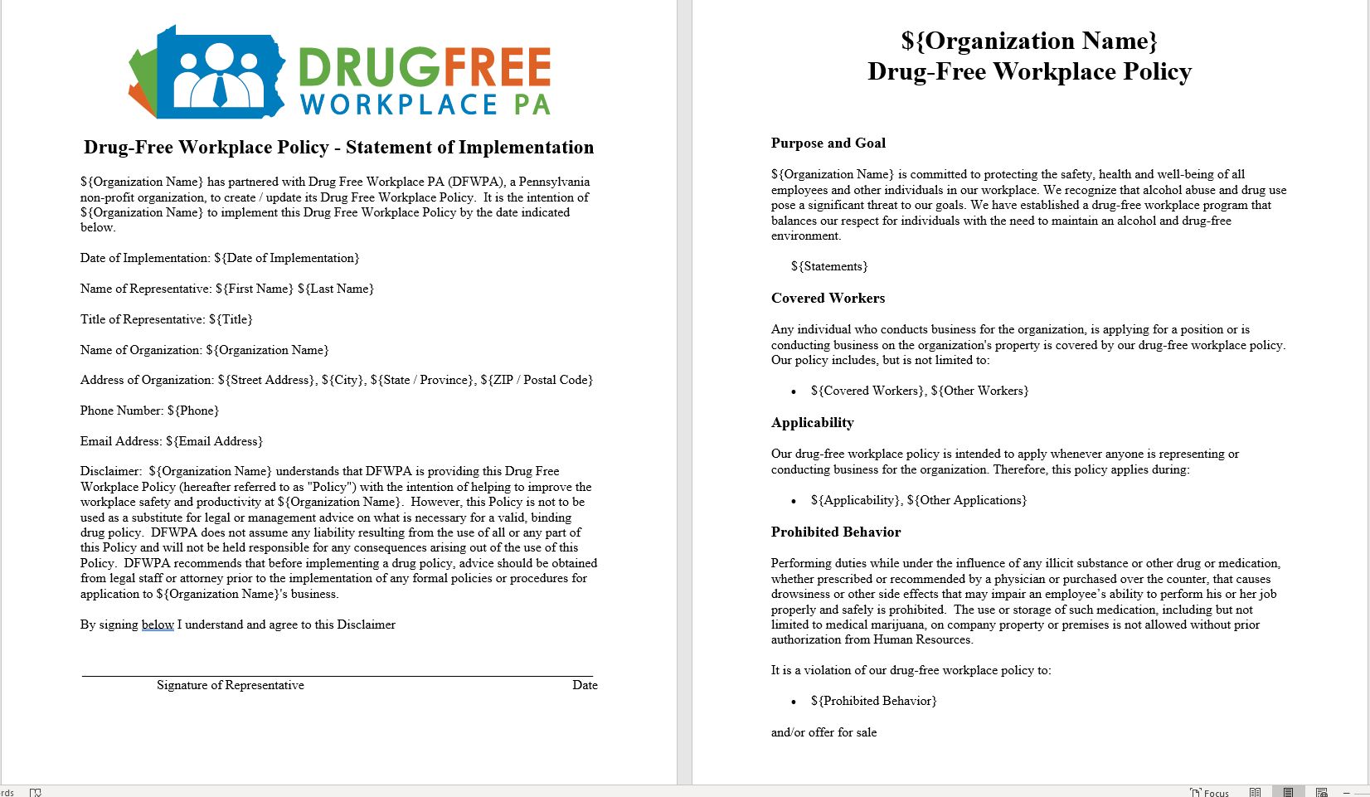

Slide 15
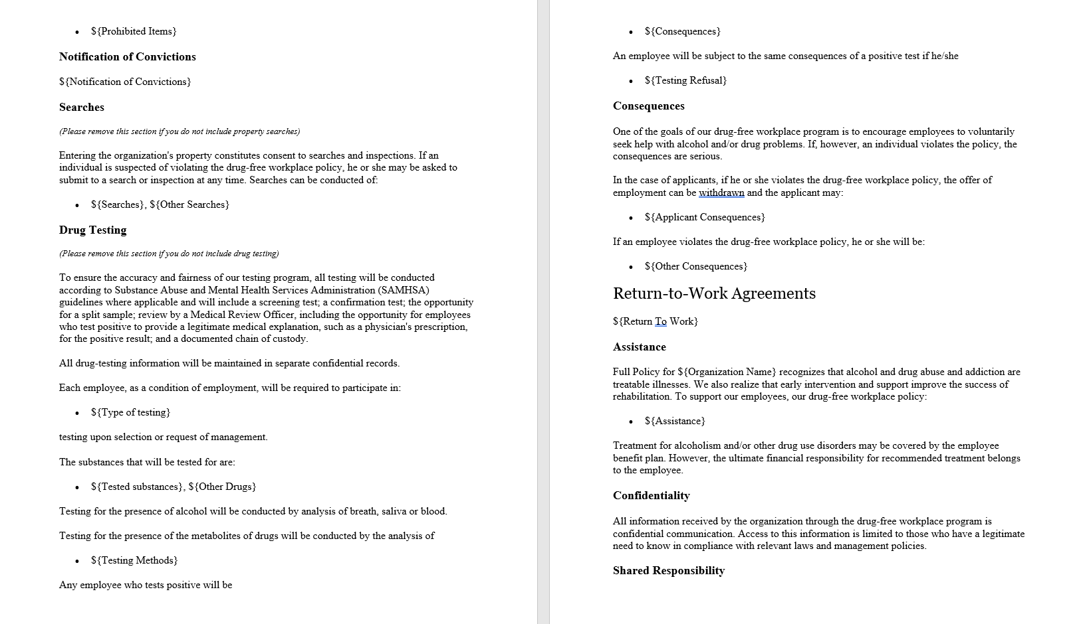

Slide 16
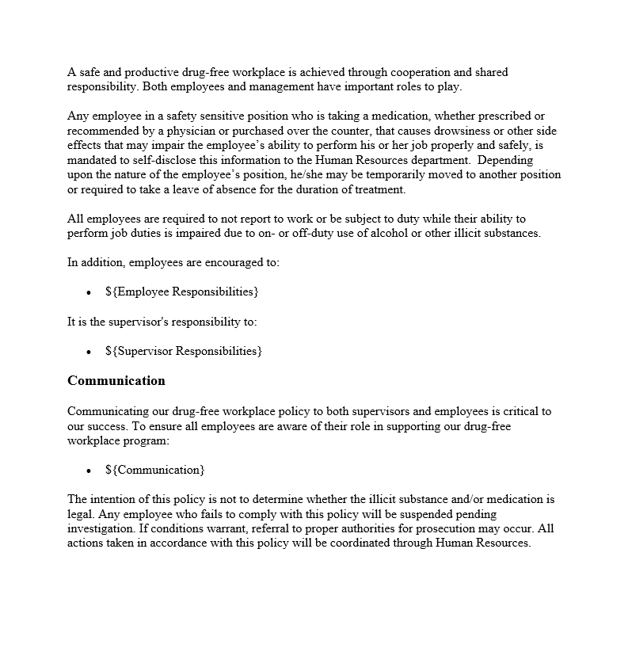
Drug Free Workplace PA
Grant Funded Program
Assists in the creation and implementation of drug free workplace programs
All services are offered for Free

Slide 17
Drug Policy
Management training pertaining to the drug policy
Access to support for employees with drug issues
Formal assistance to referral to local resources
Clear and concise possession parameters for employees
Clear rules for post-accident testing
Employee Assistance Programs are available for employees with substance abuse problems.

Slide 18
Prohibitions from Act 16
Patient may not operate or be in physical control of any of the following while under the influence with a blood content of more than 10 nanograms of active tetrahydrocannabis per militer of blood in serum:
Chemicals which require a permit issed by federal government or a state government or an agency of the federal government or a state government.
High-voltage electricity or any other public utility
A patient may not perform any employment duties at heights or in confined spaces, including, but not limited to mining while under the influence of medical marijuana
A patient may be prohibited by an employer from performing any task which the employer deems life-threatening, to either the employee or any of the employees of the employer, while under the influence of medical marijuana.
A patient may be prohibited by an employer from performing any duty which could result in a public health or safety risk while under the influence of medical marijuana.

Slide 19
Safety Sensitive
Job or position where the employee holding this position has responsibility for his or her own safety or other people's safety
Employer must be able to demonstrate that the employee's inability or impaired ability to perform job tasks could result in a direct threat to their safety or safety of others.

Slide 20
Why is Safety Sensitive important?
Layer of protection against negligent employment practices claim
Can ask questions about drug use and to test more frequently
Is the employee currently taking any prescription drugs/medications?
Has the employee taken any such drugs or medications in the past?
Monitor an employee's intake of such drugs or medications

Slide 21
Safety Sensitive
Pre-offer
ADA prohibits all disability-related inquires and medical examinations even if they are related to the job.
Post-offer
Employer may make disability-related inquires and conduct medical examinations. As long as it does so for all entering employees in the same job category
Employment
Employer may make disability-related inquires and require medical examinations only if they are job-related and consistent with business necessity

Slide 22
Tracking Job Performance
Disciplinary action can be taken if
Employee is under the influence of medical marijuana in the workplace
While working under the influence of medical marijuana, the employees conduct and/or performance falls below the normal standard of acceptable.
Employee must be under the influence at work and performance must fall below an acceptable level

Slide 23
Tracking Job Performance
Establish clear and concise duties and tasks for every position
Document that the employee understands the expectations of job
Have a way of tracking performance consistently
Performance tracking software
Create deadlines
Weekly reports
Documentation and record keeping is key!

Slide 24
Action plan
Termination?
Probation Period?
After the incident, discuss it with the employee

Slide 25
Pic Source: myidentico.com

Slide 26
References
Medical Marijuana Patient and Caregiver Resources. (n.d.). Retrieved from https://www.health.pa.gov/topics/programs/Medical Marijuana/Pages/Patients.aspx#caregiver.
NIDA. (2019, July 5). Marijuana as Medicine. Retrieved from https://www.drugabuse.gov/publications/drugfacts/marijuana-medicine on 2019, October 6

Slide 28
Contact
Pennsylvania OSHA Consultation Office
57 South 9th Street Suite 305 Indiana, PA 15701
Phone: 800-382-1241
Fax: 724-357-2385
Web: www.iup.edu/pa-oshaconsultation/
Facebook: https://www.facebook.com/Pennsylvania-OSHA-Consultation-Program-548810235234647/
Twitter: https://twitter.com/search?q=PA%20OSHA%20Consultation&src=savs
www.iup.edu/pa-oshaconsultation

Slide 29
Thank You
Upcoming Webinar:
Ergonomics
January 15, 2020@ 10:30am
Pennsylvania OSHA Consultation Office
Phone: 800-382-1241 or 724-357-4095
Website: www.iup.edu/pa-oshaconsultation
www.iup.edu/pa-oshaconsultation

