Slide 1
Welcome Workplace Ergonomics Will begin at 10:30am Presented by: Judith Smet-Weiss-OHC, CISEC
jsweiss@iup.edu Pennsylvania OSHA Consultation Office Phone: 800-382-1241 or 724-357-4095 Website: www.iup.edu/pa-oshaconsultation

Slide 2
Workplace Ergonomics
Webinar General Info PowerPoint Presentation Q&A Questions Chat is open to submit questions. We will be answering questions through this chat feature. If due to the technical nature of the question a more thorough response is required, we will post the answer on our website within seven days of the webinar.
www.iup.edu/pa-oshaconsultation

Slide 3
Training Outline
Ergonomics & OSHA Relationship
What is Ergonomics
How to Know My Company Has an Ergonomic Problem
Types of Screening/Scoring Tools
Tips for Using Screening/Scoring Tools
Musculoskeletal Disorders
General Engineering Controls
Office Ergonomics
Industrial Ergonomics-Engineering Controls
Webinar Summary
www.iup.edu/pa-oshaconsultation

Slide 4
Ergonomics & OSHA
OSHA could cite the General Duty Clause for Ergonomics Hazards
Section 5 (a) (1) requires:
Each employer furnish to each of its employees a workplace that is free from recognized hazards that are causing or likely to cause death or serious physical harm.
The standard can be cited if injuries have appeared on the OSHA Log related to the operation and the hazard(s) causing the injuries have not been controlled.
Example: An employee is required to flex both hands while holding a 25lb object in each hand, 400 times a day, or 50 times an hour. The position is entry-level and no one stays in the job longer than a month. There is no break-in schedule for the position and no rotational schedule. Employees have been notably wearing soft and ridged wrist braces they brought in from home. A Safety Professional has completed the Rapid Upper Limb Assessment (RULA) and results were a score 0f 7 out of 7, meaning engineering changes are needed immediately. This position has produced a recordable ergonomic injury on last year’s company OSHA Log.
www.iup.edu/pa-oshaconsultation

Slide 5
So What is Ergonomics?
Ergonomics: The science of fitting jobs to people. Encompasses the body of knowledge about physical abilities and limitations as well as other human characteristics relevant to job design.
Ergonomic design: The application of this body of knowledge to the design of the workplace (tasks, equipment, environment) for safe and efficient worker use.
Good ergonomic design: Makes the most efficient use of worker capabilities while ensuring job demands do not exceed those capabilities.
“Ergonomist”: One who works in the field of Ergonomics.
Industrial Ergonomics: The science of fitting jobs to people within an industrial type setting.
Office Ergonomics: The science of fitting office-type work stations to people in an office-like setting.
www.iup.edu/pa-oshaconsultation

Slide 6
Is There An Ergonomic Problem?
Look For The Following:
Employees bringing in splints/braces/back belts from home.
Employees self-medicating with daily pain relievers at work.
Company not able to keep a particular activity staffed (no one wants to perform this work). Employees “bid out” as soon as they can from this position or activity. Seniors do NOT perform this task at all.
Upon observation, employees “shift” work from one hand or side to the other to avoid over-use of preferred side or hand.
Calling in “sick” repeatedly or putting in workers compensation claims repeatedly in a particular position or activity.
Employees self-modify the task, make their own work tools, add a foot, hand, wrist, or body resting place, or physically take unscheduled breaks.
On the OHSA 300 look for musculoskeletal disorders coming from one task or department frequently.
www.iup.edu/pa-oshaconsultation

Slide 7
What are Musculoskeletal Disorders?
Musculoskeletal disorders are injuries or illnesses to soft body tissue such as:
Muscle Strains
Nerve Damage (Carpal Tunnel Syndrome-CTS, Raynaud’s Syndrome)
Tendons
Ligaments
Joints
Cartilage (Knees)
Spinal Discs
www.iup.edu/pa-oshaconsultation

Slide 8
Are There Risk Factors that Pre-Dispose Employees to Musculoskeletal Disorders?
Pre-Disposing Risk Factors:
Smoking (decreases circulation)
Medications (vasoconstrictors, estrogen replacement hormones, anti-inflammatory medications, certain ocular (eye) medications, allergy medications)
Thyroid/Circulatory Diseases (hypothyroidism, coronary artery disease, arthritis, hypertension, diabetes)
Obesity (High BMI-Body Mass Index)
Sedentary Life-style (decreases circulatory efficiency)
High salt in-take(increases blood pressure)
www.iup.edu/pa-oshaconsultation

Slide 9
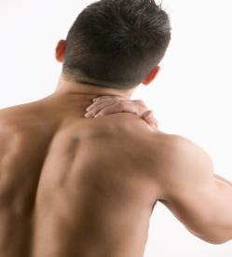
More About Musculoskeletal Disorders
MSD’s do not include injuries caused by slips, trips, falls, or other similar accidents.
MSD’s can differ in severity from mild periodic symptoms to severe chronic and debilitating conditions.
www.iup.edu/pa-oshaconsultation

Slide 10
How to Know If an operation is an Ergonomic Concern?
Screening and Evaluation Tools
Tools Are Available---www.TheErgonomicsCenter.com, North Carolina State Ergonomics Center, 800-ON-4-ERGO (offers free tools, others are available to members for a fee).
Lateral Standards:
-NIOSH Material Handling Tables---Good for evaluating large muscle groups. Limited when evaluating Upper Limb movements such as wrist, hand, fingers and forearms. Will tell you if the task generally can be performed by 75% of female workers—which is a well-known design goal in the industry. Generally 100% of Male workers can use a system engineered to the 75th percentile for women.
www.iup.edu/pa-oshaconsultation

Slide 11
How to Know If an operation is an Ergonomic Concern?
Screening and Evaluation Tools
Others Come From Well Known Ergonomists Like:
-Rodgers Muscle Fatigue Analysis (Suzanne H, 1992) and is more of a job evaluation technique
to screen out high fatigue jobs before they become injurious.
-Strain Index Scoring Sheet (Moore, JS & Garg, A, (1995, Journal of AIHA) which can analyze jobs with the risk of distal upper extremity disorders.
-RULA-Rapid Upper Limb Assessment (Mc Atamney, L & Corlett, N (1993, Applied Ergonomics) which is a great survey method for screening out future upper limb disorders in a task. Combines postures with muscle forces to give you a score for each side of the body (1-7). (Score of 7 means you must reengineer the task immediately and 5-6 scores means if you don’t reassess or redesign you will soon see injuries. A 3-4 score is a task that should be observed and possibly managed by rotation. A 1-2 is acceptable and manageable if it doesn’t change in frequency or weight.)
www.iup.edu/pa-oshaconsultation

Slide 12
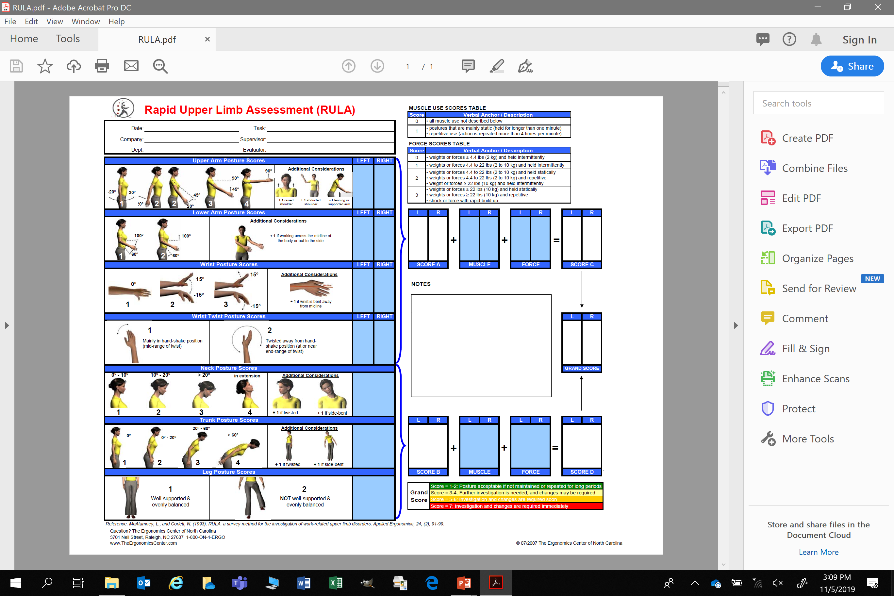
RULA –Screening Form
www.iup.edu/pa-oshaconsultation

Slide 13
Tips For Using Screening and Scoring Tools
Use the Excel sheet-not the pdf.
Make sure that the subjects understand that this is NOT a medical diagnosis but rather a screening tool.
Post results without names associated.
Sometimes one screening tool or one screening or scoring session may not be enough to show adequate results.
Find out when the task is being preformed the most and screen during those time-frames.
The weight of the tool is not always equivalent to the force applied to move it. Use a hand held dynamometer, digital force gauge, or even a fish scale in the same plane that the task is performed in to get an accurate measurement.
www.iup.edu/pa-oshaconsultation

Slide 14
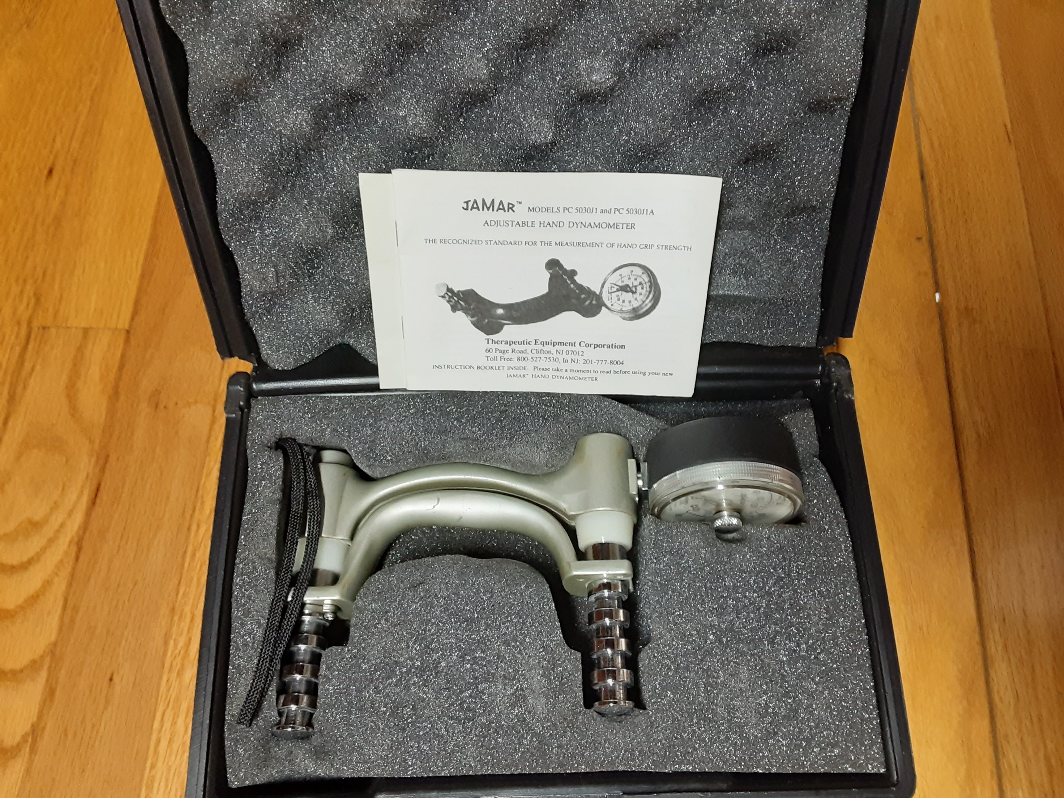
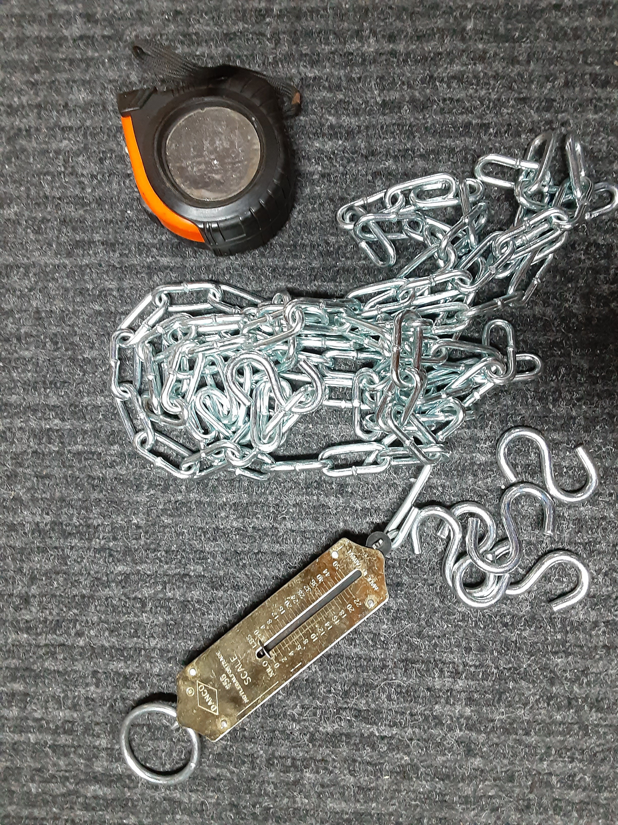
The Site Tool Kit
JAMAR Hand-Held Dynamometer
Fish Scale, 2-3’ chain sections, S-hooks, Tape
www.iup.edu/pa-oshaconsultation

Slide 15
Engineering Controls
Good Engineering Controls:
Preferred method for controlling hazards.
Make physical changes to tasks.
Act on the source of the hazard.
Control employee exposure.
Do not require “self-protective” action. (Reliance on human beings to protect themselves may result in a point failure)
Example: Relying on an employee to take a break when they feel fatigued or tired.
www.iup.edu/pa-oshaconsultation

Slide 16
Office Ergonomics
Use a straight chair with support for your lower spinal curve.
Check the seat’s height.
Adjust your seat so that your knees are equal with or slightly lower than your hips.
If the seat’s height is not adjustable use a footrest.
Keep your feet flat; avoid crossing your legs.
Keep your ankles and elbows at right angles.
With elbow at 90 degrees, keyboard should be just below the finger tips with no wrist flexion. Adjust arm rests to maintain elbow angle.
Monitor should be eye level-20-28” from the face.
When the work surface doesn’t adjust, adjust chair, use foot rest and keyboard tray with monitor stands.
www.iup.edu/pa-oshaconsultation

Slide 17
Office Environment Engineering Controls
1) Adopt a Company Ergonomic Furniture Standard to:
Avoid wasting money on “Executive” furniture that doesn’t adjust but looks great! Executives work on lap-tops remember, and will need a monitor, or more adaptions to get into a neutral position.
Standardize the “task chair, table surface (adjustable in 1” increments), monitor stand, keyboard tray and foot rests. Standing workers can’t stand a whole shift! They will either need a stool or a chair.
Avoid Divisions going “rogue” to purchase solutions that have not been approved and may not work.
Take advantage of huge cost savings from Lot Purchasing of approved furniture.
Beware! Just because the sales person says it’s “ergonomically designed” doesn’t mean it fits the task or, the person.
“Neutral” position is what you need to achieve in the set-up. Then, take breaks and stretch.
2) Install “Ergo Suite” on all Company IT-Computer Systems
(An IT solution that reminds you when to take breaks and how to stretch.)
www.iup.edu/pa-oshaconsultation

Slide 18
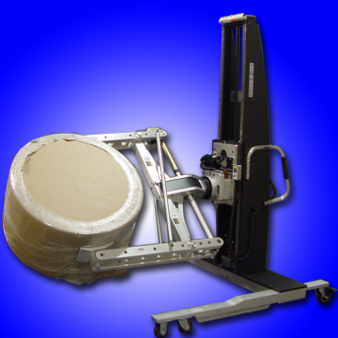
Industrial Ergonomics Engineering Controls
Make physical changes to the task (automation, conveyors, lift tables, material hoists, cranes, fork lifts, robotics, sound buffers, anti-vibration tools, natural lighting, temperature/humidity control to ANSI recommendations)
www.iup.edu/pa-oshaconsultation

Slide 19
Industrial Ergonomics
Engineering controls:
Act on the source of the hazard: (usually is NOT the employee)
Vibration (pressure may cause nerve damage and inflammation at joints)-Reduce/eliminate
- Anti-fatigue matts, anti-vibration gloves, tool substitution (pneumatic vs. electric), drill vs hammer drill, Vibram (anti-vibration) soled shoes
www.iup.edu/pa-oshaconsultation

Slide 20
Industrial Ergonomics
Engineering controls:
Material movement-beginning to end, (push instead of pull, mechanical vs. human)
Hoists, mechanical lifts, wheel barrows, lift tables, conveyors, robotics, lifts are best if performed in the knee to waist plane-avoiding low-below the knees and high-above the shoulders lifts. Use wide base of support always-no standing on one leg, standing on or climbing ladders for long periods.
Reduce or eliminate pulling, lifting and carrying and utilize mechanical advantages for material movement.
Reduce Force & Exertion by Reducing:
Weight of the object
Weight of the container
Load in the container
Size of the container
Quantity per container
www.iup.edu/pa-oshaconsultation

Slide 21
Industrial Ergonomics
Engineering controls:
Temperature (cold constricts blood flow & slows human movement and hot is exhausting),
Possible vascular and neurological damage. Workers with cold-desensitized fingers may grasp loads with more force than necessary: exposes muscles, soft tissues, and joints to increased force. Alcohol, nicotine, caffeine, and some medication increases MSD risks from cold temperatures.
(Use ASHRAE-55-2017 recommended temperature/humidity guidance).
Ideal Indoor: Winter : 68.5-75 degrees F Summer: 75-80.5 degrees F Relative Humidity : 40-60% Air Speed: 30’/min.
Clothing and level of work activity can drastically effect level of comfort
www.iup.edu/pa-oshaconsultation

Slide 22
Industrial Ergonomics
Engineering controls:
Lighting (too much or not enough light): Can Cause: awkward postures, muscle fatigue, eye strain, mental fatigue(Use ANSI IESNA-1-4 for Office Lighting Requirements)
(Use ANSI/IES RP-7-17 for Industrial Lighting Requirements) incorporated by reference by OSHA ( 1926.56 Table D-3)
 | Area or Operation
5 | General construction area lighting.
3 | General construction areas, concrete placement, excavation and waste areas, accessways, active storage areas, loading platforms, refueling, and field maintenance areas.
5 | Indoors: warehouses, corridors, hallways, and exit-ways.
5 | Tunnels, shafts, and general underground work areas: (Exception: minimum of 10 foot- candles is required at tunnel and shaft heading during drilling, mucking, and scaling. Bureau of Mines approved cap lights shall be acceptable for use in the tunnel heading.)
10 | General construction plant and shops (e.g., batch plants, screening plants, mechanical and electrical equipment rooms, carpenter shops, rigging lofts and active storerooms, barracks or living quarters, locker or dressing rooms, mess halls, and indoor toilets and workrooms).
30 | First aid stations, infirmaries, and offices.
Foot Candles
www.iup.edu/pa-oshaconsultation

Slide 23
Industrial Ergonomics
Engineering controls:
Noise- (approaching the Action Level-85 dba) Can cause increased muscle tension, quicker onset of fatigue, emotional stress, reduced concentration, diverted attention and slower post effort recovery times.
Reduce/eliminate Noise
www.iup.edu/pa-oshaconsultation

Slide 24
Industrial Ergonomics- Summary
Engineering controls:
Control employee exposure (Use of Interim Controls) such as:
Task rotation,
Mandatory break periods,
Break-in schedules,
Focus on quality vs quantity- no piece production incentives,
Stretch-flex warm-up at shift start,
Teach proper lifting techniques,
Supply the correct glove for lifting/gripping (ANSI-ISEA-105-2016),
Use of work-hardening program for those returning from injuries,
Control product demand to be greatest an hour after shift start and lowest at shift start and one hour before shift end, and
Encourage injury/illness reporting and treatment.
www.iup.edu/pa-oshaconsultation

Slide 25
Webinar Summary
Ergonomics & OSHA Relationship
What is Ergonomics
How to Know My Company Has an Ergonomic Problem
Types of Screening/Scoring Tools
Tips for Using Screening/Scoring Tools
Musculoskeletal Disorders
General Engineering Controls
Office Ergonomics
Industrial Ergonomics-Engineering Controls
www.iup.edu/pa-oshaconsultation

Slide 26
www.iup.edu/pa-oshaconsultation

Slide 27
Contact us
Pennsylvania OSHA Consultation Office
57 South 9th Street Suite 305 Indiana, PA 15701
Phone: 800-382-1241
Web: www.iup.edu/pa-oshaconsultation/
Facebook: https://www.facebook.com/Pennsylvania-OSHA-Consultation-Program-548810235234647/
Twitter: https://twitter.com/search?q=PA%20OSHA%20Consultation&src=savs
www.iup.edu/pa-oshaconsultation

Slide 28
Thank You
Upcoming Webinar:
Training in the Modern Day Work Environment – From Learning Theory and Concepts, To Training Analysis and Evaluation
February 12, 2020 @ 10:30am
Pennsylvania OSHA Consultation Office
Phone: 800-382-1241 or 724-357-4095
Website: www.iup.edu/pa-oshaconsultation
www.iup.edu/pa-oshaconsultation

