Slide 1
Welcome
HEARING CONSERVATION OVERVIEW
Will begin at 10:30am
Presented by:
Dane Sprankle, MS, CSP
Pennsylvania OSHA Consultation Office
Phone: 800-382-1241 or 724-357-4095
Website: www.iup.edu/pa-oshaconsultation

Slide 2
HEARING CONSERVATION OVERVIEW
Webinar General Info
PowerPoint Presentation
Q&A
Questions
Chat is open to submit questions.
We will be answering questions through this chat feature. If due to the technical nature of the question a more thorough response is required, we will post the answer on our website within seven days of the webinar.
www.iup.edu/pa-oshaconsultation

Slide 3
Presentation Outline
Noise Defined
Anatomy of the Ear
Types of Hearing Loss
OSHA Regulation
Controlling Exposure

Slide 4
Noise: Unwanted Sound
Sound waves - moving variations of air pressure
Develop when a vibrating surface forms areas of high and low pressure, which are transmitted as sound.

Slide 5

Noise (Cont’d)
Wavelength: The distance traveled by a sound wave during one sound pressure cycle.
The higher the frequency (pitch), the shorter the wavelength
Notes:
Distance

Slide 6

Noise (Cont’d)
The greater the air pressure variations (Amplitude), the greater the sound pressure level
Put another way, the greater the sound pressure level the louder the noise
Measured in decibels (dB)

Slide 7
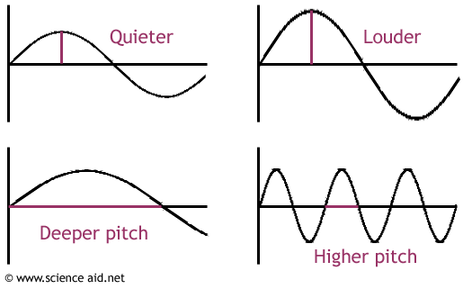
Noise (Cont’d)
Amplitude / Sound
Pressure Level
Frequency /
cycles per second

Slide 8
Noise (Cont’d)
The decibel (dB) scale is a logarithmic scale, not a linear scale…doubling every 5 decibels
83
If the 83 dBA noise source is doubled, then
88
The noise level only goes up 5 dB. The new noise level is 88 dBA.
92
dBA is TWICE the energy as
87 dBA.

Slide 9
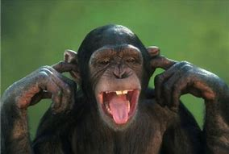
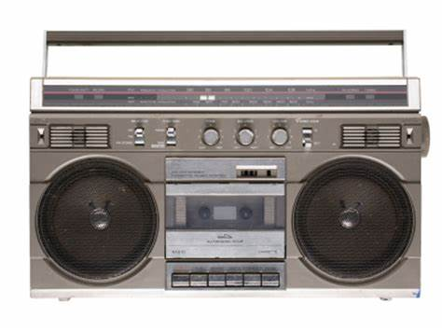

Noise (Cont’d)
Multiple Noise Sources
100 dBA
105 dBA
(due to logarithmic scale)
100 dBA

Slide 10
The Hearing Mechanism
The ear is the organ that makes hearing possible. Its three sections are:
  External outer ear
  Air-filled middle ear
    Malleus, Incus, Stapes
    Eustachian Tubes
  Fluid-filled inner ear
    Cochlea
    Semicircular canals
    Hair cells

Slide 11
Hearing Loss
Conductive hearing loss is any condition in the outer or middle ear that interferes with sound passing to the inner ear. A conductive hearing loss can result from:
  Excessive wax in the auditory canal.
  A ruptured or heavily-scarred eardrum.
  Fluid in the middle ear.
  Dislocated or missing elements of the ossicular chain.
  Eustachian tube blockage.
  Otosclerosis (an abnormal growth of bone in the middle ear).

Slide 12
Hearing Loss (Cont’d)
Work-related conductive hearing loss is not common, although it may occur occasionally as the result of accidents involving:
  An eardrum rupture or a break in the ossicular chain by a head blow.
  Explosions.
  A rapid pressure change in a decompression chamber.
  Penetration of the eardrum by a sharp object or fragment.
Many conductive hearing losses are reversible through medical or surgical treatment.

Slide 13
Hearing Loss (Cont’d)
"Sensory" hearing loss is damage to the inner ear due to a degeneration of the neural elements of the auditory nerve. It initially results in reduced ability to hear high-frequency sounds, usually at frequencies above 2,000 Hertz (Hz).

Slide 14
Hearing Loss (Cont’d)
A reversible sensory hearing loss is called a temporary threshold shift (TTS).
A permanent sensory hearing loss of 10 dB (average) at 2000, 3000, and 4000 HZ is called a standard threshold shift (STS). Occurs after repeated TTSs.

Slide 15
Other Noise Effects
Effects on communication and performance, which may include isolation, annoyance, difficulty concentrating, absenteeism, and accidents.
Other effects might include stress, muscle tension, ulcers, increased blood pressure and hypertension.

Slide 16
Noise-Induced Hearing Loss
Causes no pain
Causes no visible trauma
Leaves no visible scars
Is unnoticeable in its earliest stages
Accumulates with each overexposure
Takes years to notice a change
Is PERMANENT and 100% PREVENTABLE

Slide 17
Noise-Induced Hearing Loss, Cont’d.
Most common occupational illness in the United States.
22 million US workers are exposed to hazardous noise at work on a daily basis.
Approx. 8 million Americans suffer from noise-induced hearing loss. (Source: NIOSH, 2009)

Slide 18
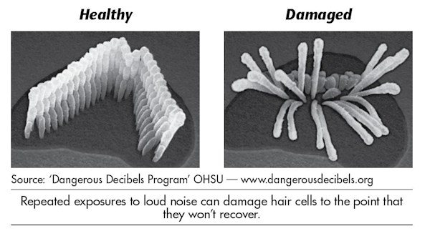
Inner Ear: Healthy Vs. NIHL
Damaged Hair Cells

Slide 19
OSHA REGULATION
29 CFR 1910.95
PEL; 90 dBA, 8-hr average
Action Level: 85 dBA, 8-hr average, triggering hearing conservation measures
Extended Work Shifts: Action Level reduced for routinely extended work shifts using formula AL = 90 + 16.61 log [50% / 12.5( X hours )], where x is the actual exposure duration in hours
  10-hr. shift: AL = 83.4 dBA
  12-hr. shift: AL = 82.1 dBA
  16-hr. shift: AL = 80 dBA

Slide 20
OSHA 29 CFR 1910.95 (Cont’d)
Impulse Limit: 140 dB
Controls: Engineering, administrative, hearing protection, annual hearing tests.

Slide 21
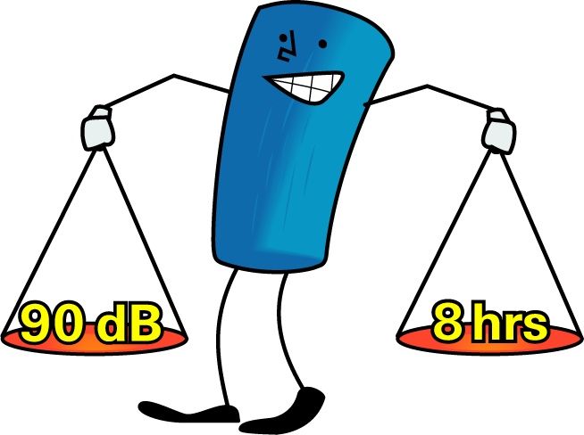
Time Weighted Average (TWA)
Permissible Exposure Limits

Slide 22
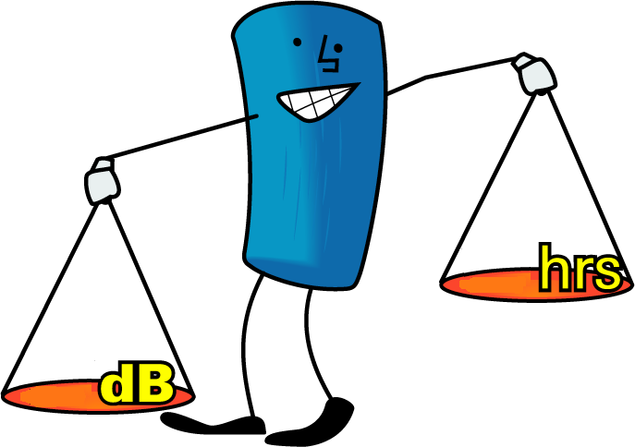
Time Weighted Average: 95 dBA = 4 hours
4
95
Permissible Exposure Limits

Slide 23
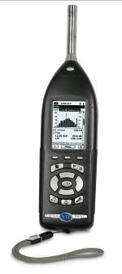
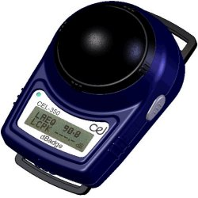
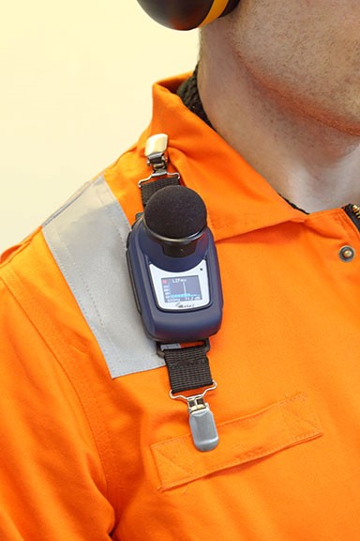
Noise Measurement Devices
SOUND LEVEL METER
Sound is measured immediately in a specific area: Used to identify noise sources/ specific equipment; map sound contours, etc.
PERSONAL DOSIMETER
Sound “averaged” throughout day for sample employee/job – preferred when exposure varies throughout workday

Slide 24
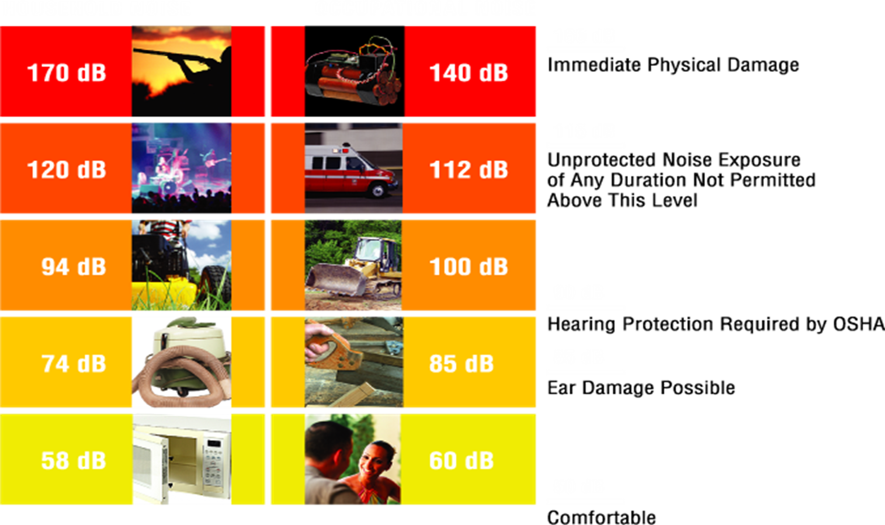
Noise level examples

Slide 25
Hearing Conservation Program
Required for all employees exposed in excess of Action Level
Includes:
  Audiometric testing
  Annual training
  Hearing protection availability
  Posting noise standard for employee review

Slide 26
Additional Requirements
Employees exposed in excess of PEL:
  Mandatory hearing protection – adequate NRR (attenuating<90 dBA)
Any employee with a confirmed, age-corrected STS in either ear must be:
  Informed
  Provided hearing protection attenuating to 85 dBA or below
  Required to use hearing protection
  Retrained in hearing protectors use

Slide 27
Hearing/Audiometric Tests
14-hr quiet period prior to the test
Baseline - within 6 months
  Mobile test van – 12 months (mandatory hearing protection interim)
Annual
Audiometer – Calibration, background levels (table D-1)
Audiogram Interpretation
Retesting – employer option – 30 days maximum
Referral – “problem audiograms” as determined by audiometric technician, physician, audiologist, or otolaryngologist.

Slide 28
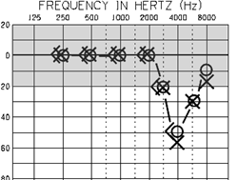
Audiogram Showing Noise Induced Hearing Loss
Characteristic “Notch” at 4000 Hz

Slide 29
Recordkeeping
If a STS reduces hearing ability to 25 dB or more above audiometric zero* in the same ear as the STS, the incident must be recorded as a hearing loss on the OSHA Form 300 (Injury Log).
  * Audiometric Zero - average hearing level at 2000, 3000, and 4000 Hz = 25 dB or more.

Slide 30
Employee Training
Initially and Annually
Addresses
  The effects of noise on hearing
  Proper selection, use, and care of hearing protection
  The purpose and procedures of an audiometric test

Slide 31
Controlling Exposures
Hierarchy of Controls
Engineering (triggered using 90 dBA threshold level and feasibility assessment)
Administrative
Personal Protective Equipment

Slide 32
Engineering Controls
Buy Quiet – Review potential new equipment
  http://buyquietroadmap.com/buy-quiet-purchasing/buy-quiet-process-roadmap/research/online-noise-databases/
Proper maintenance – lubricating, tightening bolts, etc.
Vibration pads
Enclosures – worker or source
Barriers – acoustic materials, curtains, etc.
Isolation – including distance

Slide 33
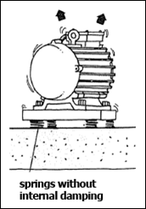
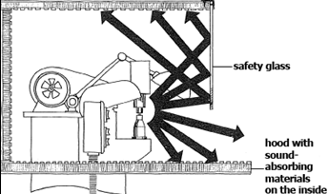
Engineering Controls (Cont’d)

Slide 34
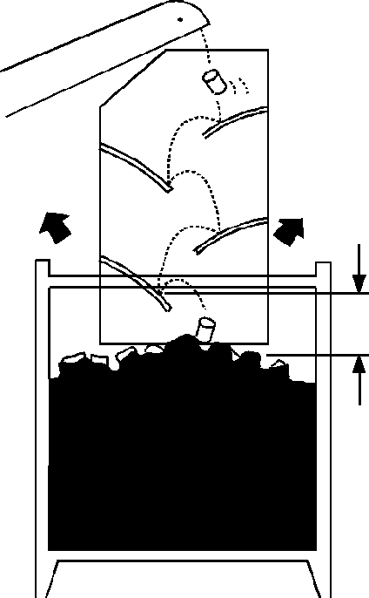
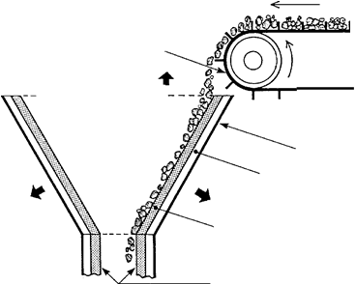
Engineering Controls (Cont’d)
Rubber Flaps
Heavy duty abrasion resistant inner skin
Low Fall Height
Resilient Damping
Layer

Slide 35
Administrative Controls
Reduce exposure duration – spread loud tasks across multiple shifts if possible
Rotate workers
Revise work practices/employee positioning
Provide training

Slide 36
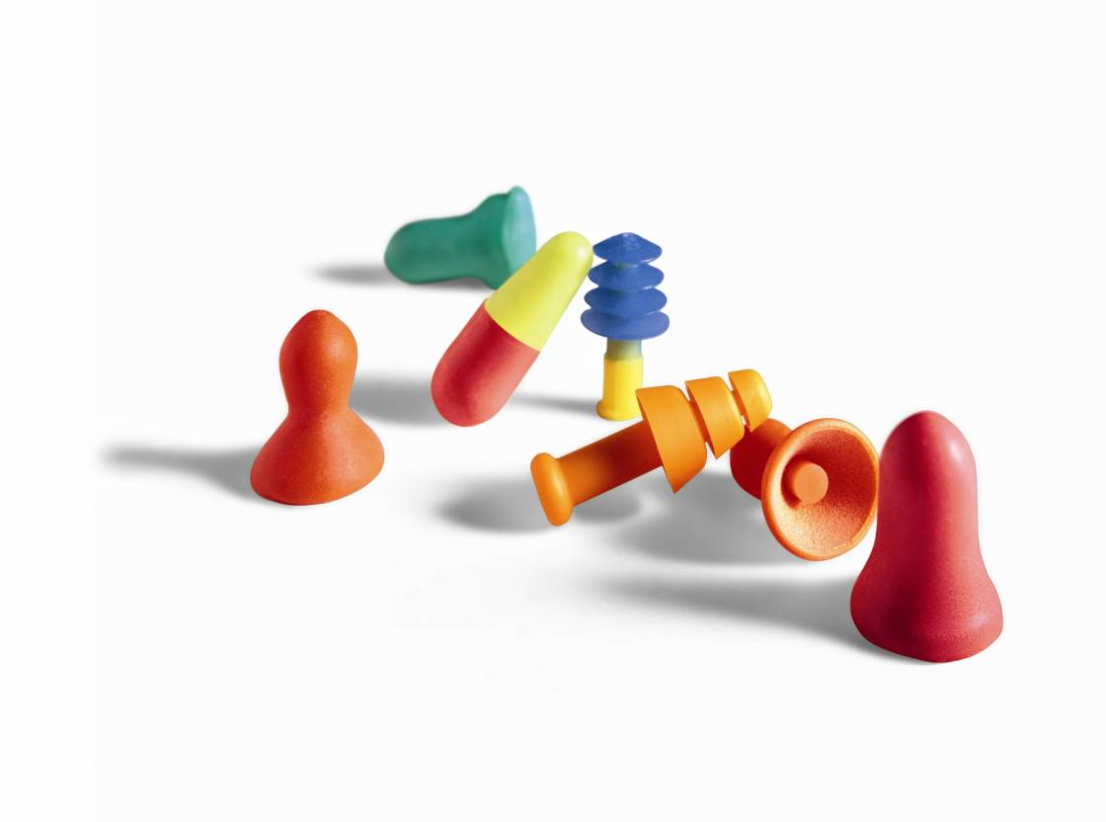
Personal Protective Equipment (PPE)
Earplugs
CARE/MAINTENANCE
Dispose single-use earplugs daily
Clean multiple-use earplugs with mild soap and water, dry thoroughly
Inspect multiple-use earplugs for dirt, cracks or hardness, replace if damaged

Slide 37
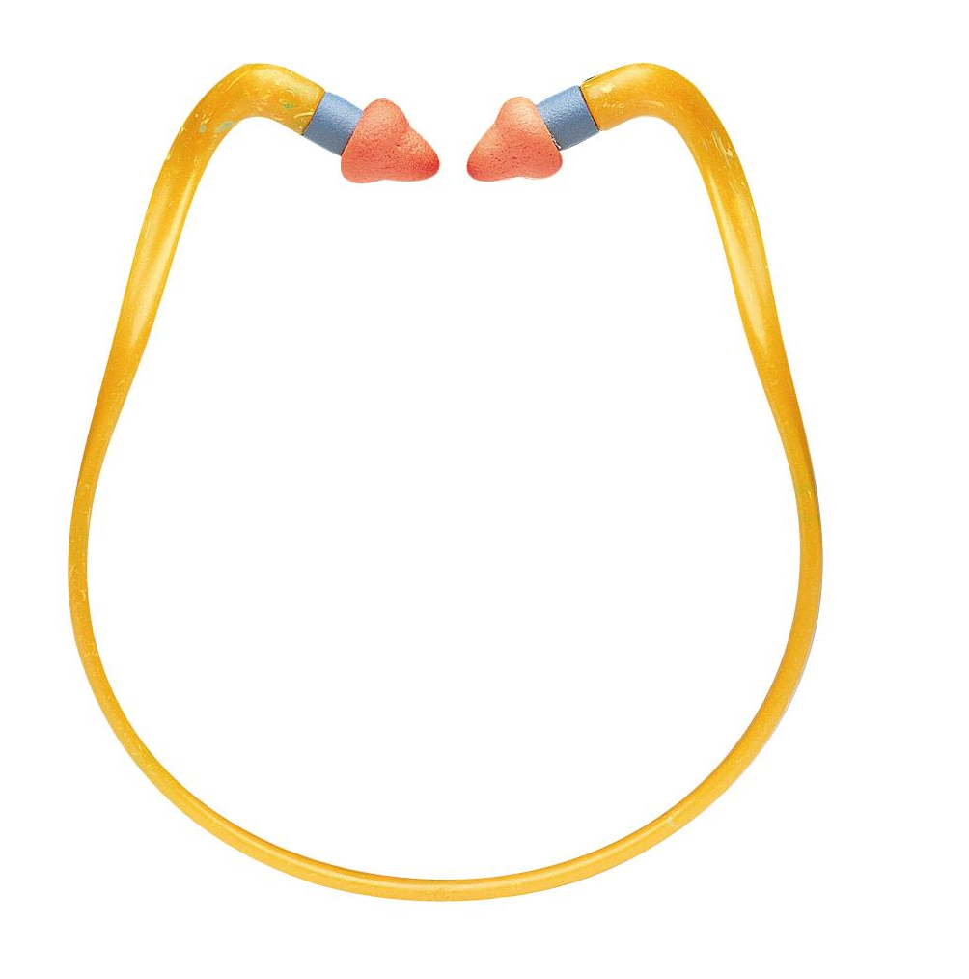
Bands
PRO
Very convenient for intermittent noise
Readily available around neck when not in use
CON
Lower attenuation than most earplugs
Some noise transmission through band

Slide 38
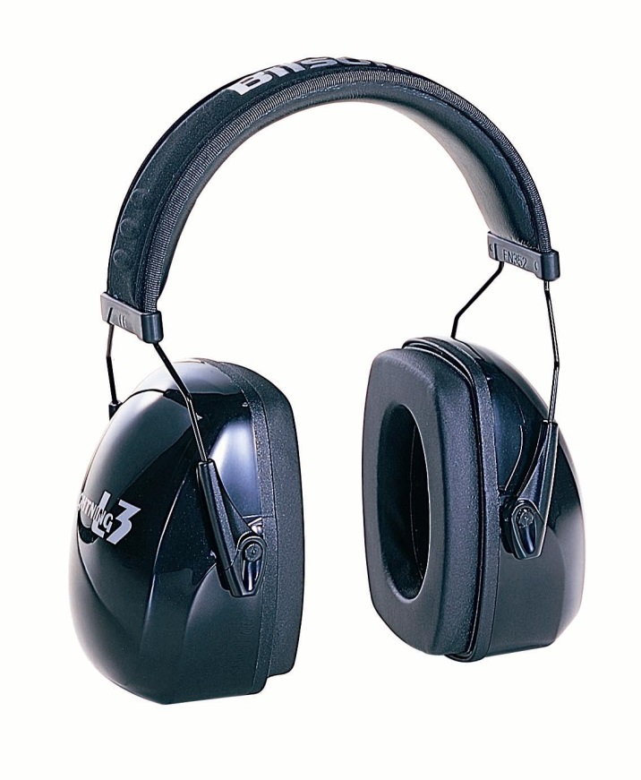
Earmuffs
PRO
Easy to get proper fit
Good for intermittent noise
Radio & electronic options
CON
Can feel hot/heavy with extended wear
Compatibility with other PPE?

Slide 39

Earmuffs
CARE/MAINTENANCE
Clean ear cushions and headband regularly with mild soap and water
Replace ear cushions and foam inserts every 4-6 months with normal wear, more often with heavy use/extreme conditions
Do not overstretch headband

Slide 40
Noise Reduction Rating (NRR)
Rating methods are based upon idealized laboratory testing
NRR has been criticized for being too generous in its prediction of noise reduction [attenuation]
Studies indicate that while some workers in real-world worksites achieve the NRR on the package or even greater protection, many workers do not
This has led to a variety of inappropriate de-rating methods for hearing protectors
Contributed too much confusion in knowing how to accurately estimate a HPD’s attenuation

Slide 41
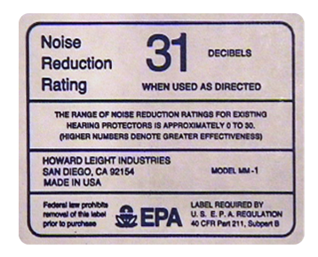
Noise Reduction Rating
A laboratory estimate of the amount of attenuation achievable by 98% of users when properly fit
A population-based rating ― some users will get more attenuation, some will get less
The NRR is only a population estimate,
not a predictor of individual attenuation.

Slide 42
De-Rating Methods to Compensate for Poor Fit
OSHA… Subtract 7 from NRR to determine adequacy (Appendix B)
… Subtract 7 from NRR, then divide by 2 to determine if hearing protection allowed in lieu of engineering and/or administrative controls
NIOSH… Earmuffs
NRR – 25%
Formable (foam) Earplugs
NRR – 50%
All Other (ribbed) Earplugs
NRR – 70%

Slide 43
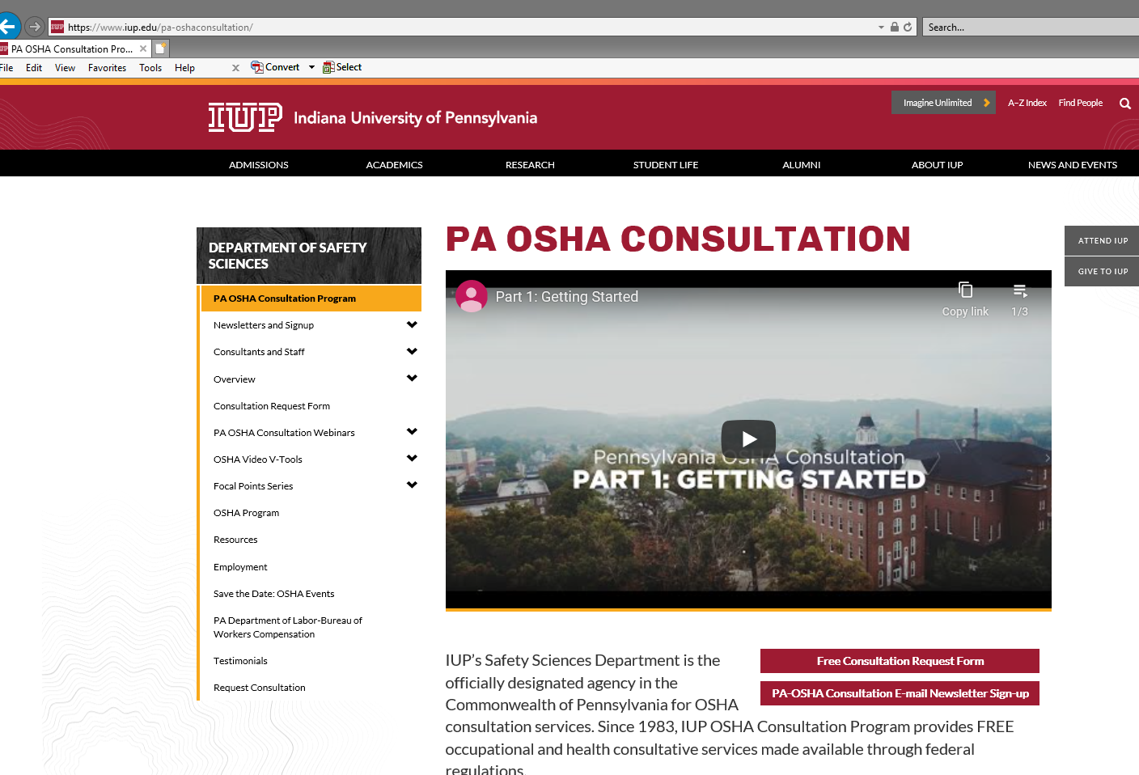
www.iup.edu/pa-oshaconsultation

Slide 44
Contact us
Pennsylvania OSHA Consultation Office
Phone: 800-382-1241
Web: www.iup.edu/pa-oshaconsultation/
Facebook: https://www.facebook.com/Pennsylvania-OSHA-Consultation-Program-548810235234647/
Twitter: https://twitter.com/search?q=PA%20OSHA%20Consultation&src=savs
www.iup.edu/pa-oshaconsultation

Slide 45
Thank You
Upcoming Webinar:
Confined Spaces in Construction
July 15, 2020 @ 10:30am
Pennsylvania OSHA Consultation Office
Phone: 800-382-1241 or 724-357-4095
Website: www.iup.edu/pa-oshaconsultation
www.iup.edu/pa-oshaconsultation

