Slide 1
Welcome
An Overview of OSHA’s Confined Space Standard for Construction
Will begin at 10:30am
Presented by:
Pamela Susi, MSPH, CIH
Pennsylvania OSHA Consultation Office
Phone: 800-382-1241 or 724-357-4095
Website: www.iup.edu/pa-oshaconsultation

Slide 2
OSHA’s Confined Space Standard in Construction
Webinar General Info
PowerPoint Presentation
Q&A
Questions
Chat is open to submit questions.
We will be answering questions through this chat feature. If due to the technical nature of the question a more thorough response is required, we will post the answer on our website within seven days of the webinar.
www.iup.edu/pa-oshaconsultation

Slide 3
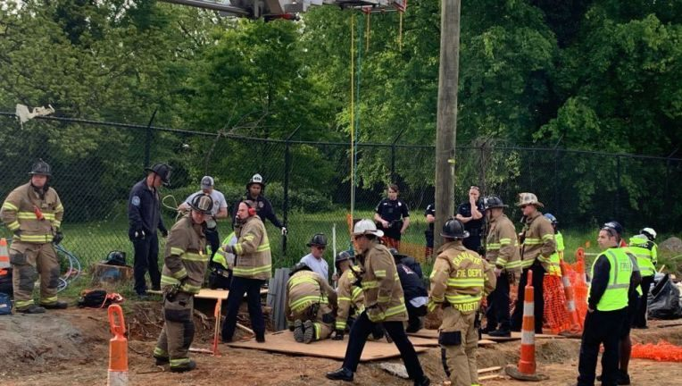
Heading
Add Text
Charlotte, NC April 2020
www.iup.edu/pa-oshaconsultation
Notes:
This confined space fatality occurred just a few months ago in Charlotte, ND. Although there were plenty of rescue seen in the picture they got there too late. It was too late. Today we’ll talk about measures that can be taken to prevent these kind of incidents.

Slide 4
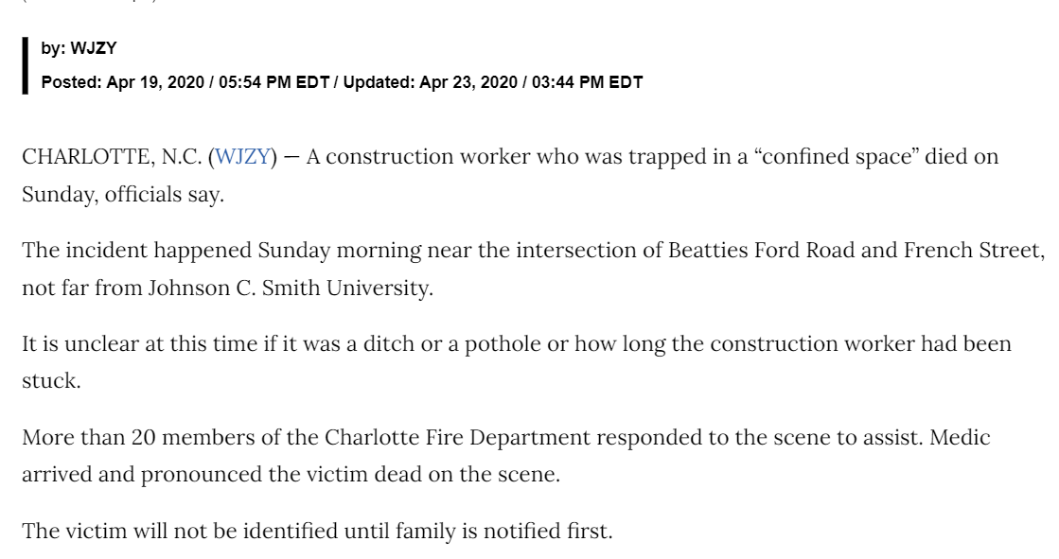
Confined space fatality
www.iup.edu/pa-oshaconsultation

Slide 5
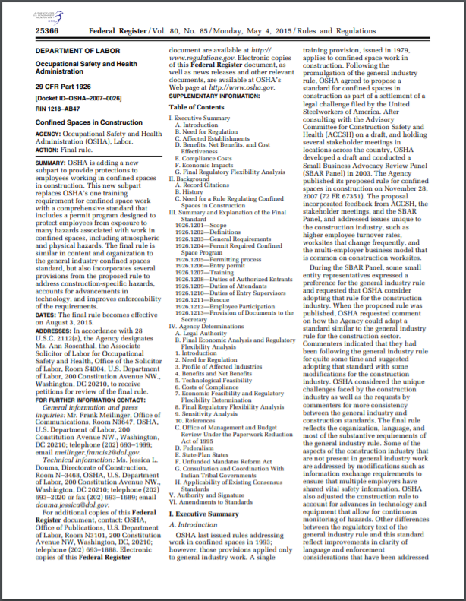
OSHA Confined Spaces in Construction Standard – 29 CFR 1926.1200-1213; Subpart A
Went into effect August 3, 2015;
Came over 20 years after a comprehensive confined space standard for general industry standard;
Replaced OSHA’s one training requirement for confined spaces with a comprehensive standard;
Has some different elements than general industry standard; and
Is expected to prevent 800 serious injuries each year and numerous fatalities.

Slide 6
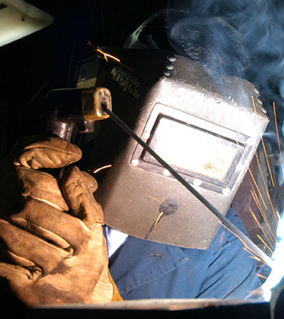
Scope of the standard
Covers all construction work except:
  Excavation work covered by subpart P
  Underground construction, caissons, and cofferdams covered under subpart S
  Diving covered under subpart Y
Where standards address confined spaces employers must comply with that provision and the provisions in the confined space standard (e.g. 1926.353 welding).
Notes:
Note for exempted activities that if employers engaged in these activities must comply with this standard if their workers are exposed to confined space hazards that are not addressed by the standards listed above. For example, the Excavation standard (subpart P) protects workers in a trench (a type of confined space) against the hazards associated with the trench itself. However, the Excavation standard would not protect workers inside a sewer line that is installed in an open trench from confined space hazards associated with the sewer line. The employer must
comply with the Excavation standard to protect workers in the trench and with the Confined Spaces standard to protect workers in the sewer line.

Slide 7
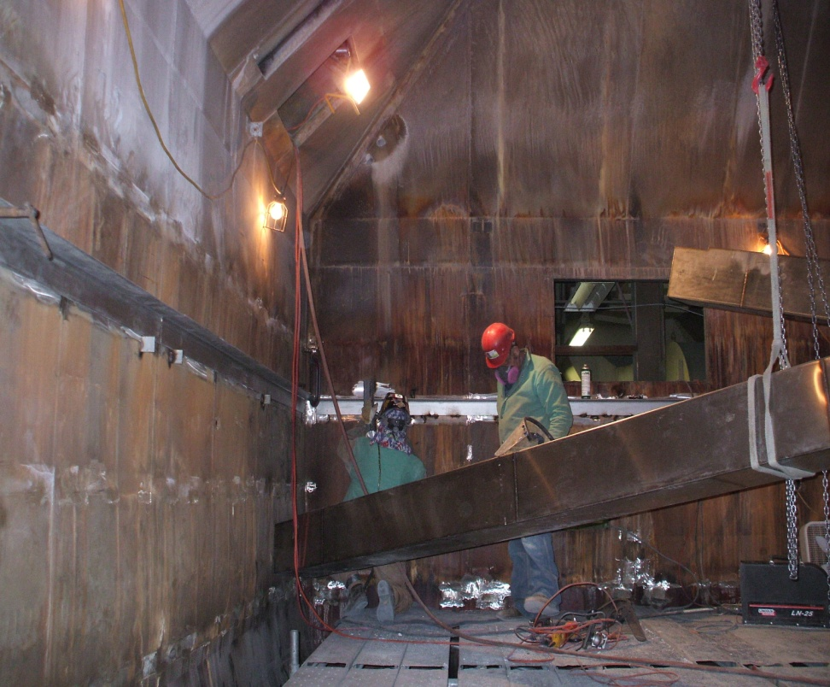
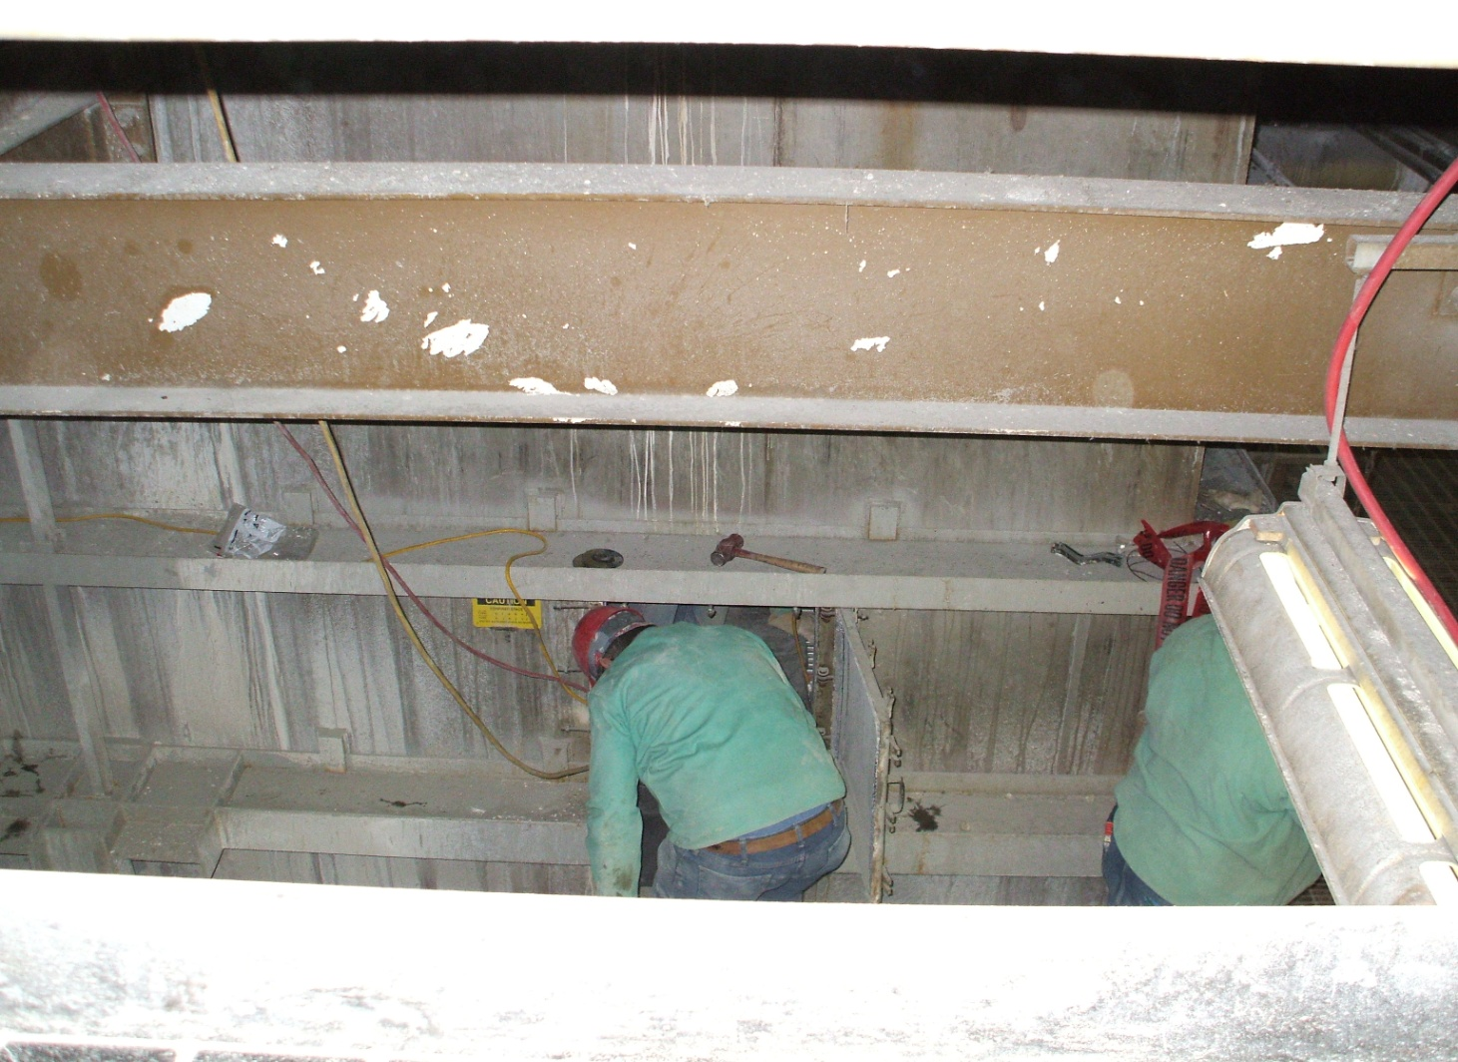
What is a confined space?
1) Large enough & configured so that a worker can bodily enter;
2) Limited or restricted means of entry and exit; and
3) Not designed for continuous occupancy.

Slide 8
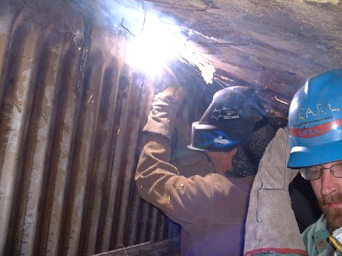
Examples of confined spaces
Manholes
Sewers, storm drains
Water mains
Boilers
Incinerators
Scrubbers & bag houses
Crawl spaces, attics and basements before steps are installed
HVAC components (air receivers/chillers & ducts)
Concrete pier columns
Transformer vaults
Precast concrete and other enclosed beams
Vessels
Boilermakers working inside a boiler at a power plant

Slide 9
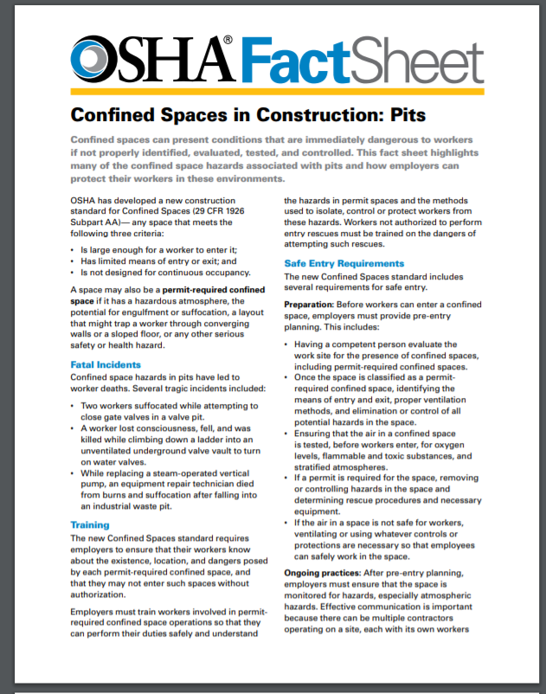
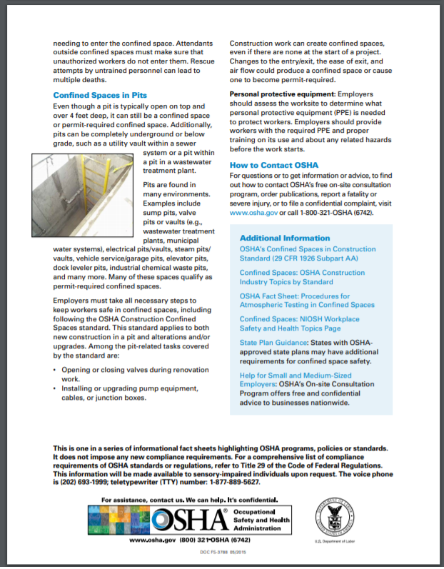
Pits can be confined spaces or permit required confined spaces

Slide 10
Characteristics of Permit-Required Confined Spaces
Contains or has the potential to contain a hazardous atmosphere;
Contains a material with the potential to engulf someone who enters the space;
Has an internal configuration that might cause an entrant to be trapped or asphyxiated by inwardly converging walls or by a floor that slopes downward and tapers to a smaller cross section; or
Contains any other recognized serious safety or health hazards.

Slide 11
Confined Space Hazards
Hazardous Atmosphere
  Combustible
  Toxic
Engulfment
Internal Configuration
Serious Safety or Health Hazards
  Temperature
  Physical
  Biological
  Ergonomic
Grain Handling Safety Coalition, Springfield, IL
Notes:
The hazards we are talking about are atmospheric hazards, engulfment potential, has an internal configuration which has sloped sides which tapers to a smaller cross section which can trap a person, and has any other serious safety or health hazards.

Slide 12
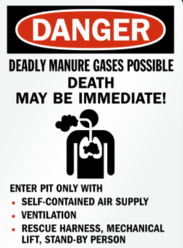
Atmospheric hazards may result in…
Death
Incapacitation
Impairment
  Ability to self rescue
Injury
Acute Illness
Grain Handling Safety Coalition, Springfield, IL
Notes:
What is a hazardous atmosphere?
A hazardous atmosphere is one which exposes employees to death, incapacitation, impairment, injury, or acute illness.
Impairment is considered the ability to self-rescue from the space due to being overcome by some type of toxic atmosphere.

Slide 13
Normal Air Composition
Oxygen Deficient <19.5%
Combustible atmosphere
  Oxygen enriched >23.5%
Toxic atmosphere
Grain Handling Safety Coalition, Springfield, IL
Notes:
There are 3 main types of atmosphere hazards – oxygen deficient, combustible and toxic.
Our normal atmosphere contains just around 21% oxygen – 20.9%.
Atmosphere hazards are caused when the normal concentration of gases in the air is upset – particularly oxygen.
Oxygen deficient with an oxygen concentration of less than 19.5%.
Oxygen – referred to as O2 , is necessary at a specific concentration range for plants, animals and humans to live.
An environment that has an oxygen concentration less than 19.5% is deficient – the amount of oxygen in the air is not enough to function normally and if the levels are very low it will cause death.
Oxygen deficiency is the primary hazard in confined spaces.
Oxygen is displaced by other gases. Other gases may push oxygen out of the way or consume it. Because of their chemical properties some gases concentrate in certain places. Heavy concentrations leave no room for oxygen. For example, if a gas is heavier than air, it will tend to settle at the bottom.
To understand what the monitor is telling you as it records numbers, it is necessary to understand the exposure threat and the signs and symptoms of exposure. These will be discussed more later.
Some have said that it does not matter if employees understand what the monitor numbers are telling them, it only matters that they evacuate when the monitor sounds an alarm. Employees MUST understand the numbers and MUST understand the signs and symptoms of exposure because equipment can fail and numbers can be within the acceptable entry range and may be dangerous.
Whenever the monitor is dropping below 20.9%, the cause must be investigated and likewise, it the oxygen level is creeping upward, the cause needs to be determined.
When the oxygen reading is not normal, consider testing for gases which could cause displacement. These concentrations could be serious even if the oxygen reading is still within an acceptable range.

Slide 14
Gas, Vapor, Dust Is Combustible
Exceed 10% LFL/LEL
  Gas, vapor, mist
  Lower flammable / explosive limit
Airborne combustible dust
  Greater than LFL
  Obscures vision ≤ 5 feet
Usually toxic
Air
Combustible Atmosphere
Gas, vapor, mist, dust
Ignition source
Ignition Triangle
Grain Handling Safety Coalition, Springfield, IL
Notes:
Combustible -A hazardous atmosphere is present when there is a flammable gas, vapor or mist which exceeds 10% of its lower flammable limit in the space.
A hazardous atmosphere is present when there is a combustible dust concentration that meets or exceeds its LFL and is approximated as in a suspended state which obscures your vision at 5’ or 1.52 meters.
Combustible atmosphere as well as oxygen enriched is when the oxygen level is above 23.5%.
Combustible atmospheres are usually toxic as well.

Slide 15
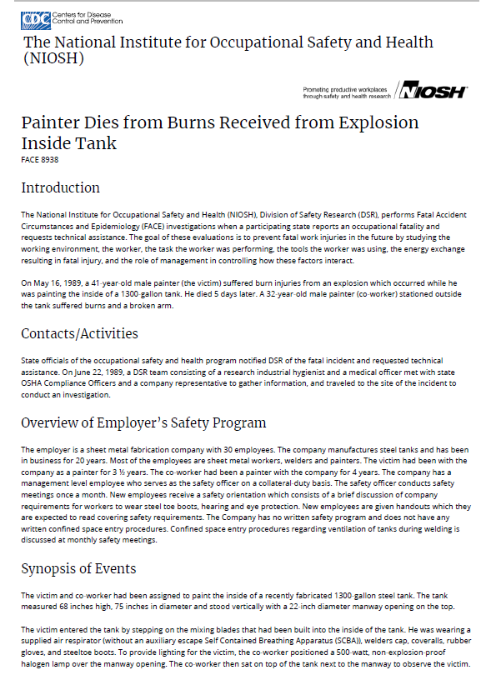
Explosion Hazard
41 year old painter was using an airless spray gun inside a 1300 gallon steel tank to apply an epoxy base coating
A co-worker positioned a 500-watt, NON-explosion proof halogen lamp over the manway opening
Spray gun nozzle hit the lamp breaking the sealed beam after sides and bottom of tank had been painted & ignited the epoxy vapors causing a flash fire explosion
The victim died 5 days later from burn complications.

Slide 16
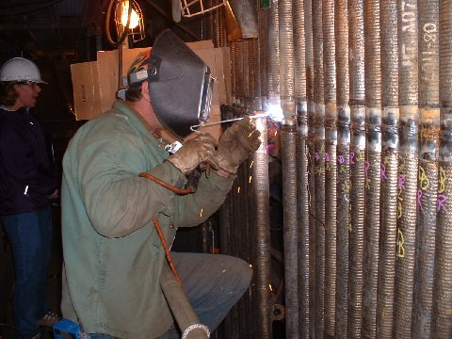
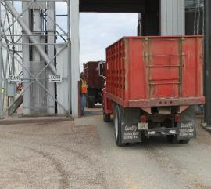
Work Activity May Make Air Toxic
Process chemicals
Decomposition
  H2S, CO2, methane
Activity in space
  Hot Work
  Painting/solvents
Outside sources
  Vehicle exhaust
  Chemical application (drift)
Grain Handling Safety Coalition, Springfield, IL
Notes:
A toxic atmosphere is when the permissible exposure limit of a chemical in the air is met or exceeded. Atmospheric concentration of any substance for which a dose or a permissible exposure limit is published in Subpart G, Occupational Health and Environmental Control, or in Subpart Z, Toxic and Hazardous Substances, of this Part and which could result in employee exposure in excess of its dose or permissible exposure limit;
NOTE: An atmospheric concentration of any substance that is not capable of causing death, incapacitation, impairment of ability to self-rescue, injury, or acute illness due to its health effects is not covered by this provision.
Toxic atmospheres can be caused by the different sources listed. Hot work, for example, uses up the oxygen in the space. Vehicle exhaust displaces the oxygen in a space. Decomposition creates gases that also displace oxygen. The wind can carry chemical applications from other places.
When planning to work in a confined space, one needs to consider how toxic gases could be in the space or be introduced into the space.

Slide 17
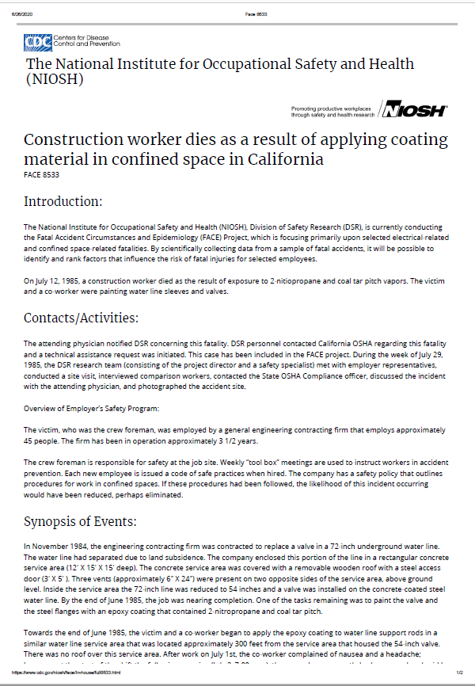
Toxic Vapors
A California contractor was replacing valves in a 72” underground waterline
A crew foreman and co-worker were tasked with painting valves & steel flanges with an epoxy coating that contained 2-nitropropane and coal tar pitch
Beginning on July 1, crew members began complaining of nausea and “fumes”, but nothing was done to correct the situation
The crew foreman was admitted to the hospital a 2nd time on July 6th and lapsed into a coma and died on July 12 of acute liver failure induced by the inhalation of the 2-nitropropane and coal tar pitch vapors.

Slide 18
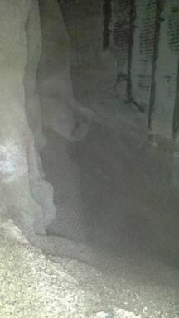
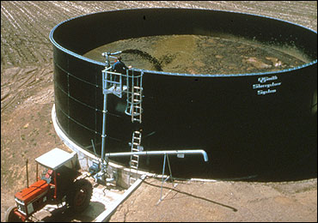
Engulfment hazards (liquids and solids)
Allow entrant to sink
Movement of fluids or solids
Bridging
Grain Handling Safety Coalition, Springfield, IL
Notes:
Confined spaces come in many shapes and forms. These spaces may hold various types of commodities, fuels, manure, or even water.
What does “the potential for an engulfment” mean? Sometimes it means you must do “XYZ” to keep from the products being introduced into the space. We eliminate the chance of this hazard occurring by blocking, barricading and locking out equipment.
Definition for Engulfment under 1910.146 - Engulfment" means the surrounding and effective capture of a person by a liquid or finely divided (flowable) solid substance that can be aspirated to cause death by filling or plugging the respiratory system or that can exert enough force on the body to cause death by strangulation, constriction, or crushing.
Engulfment hazards exist when the stored material has characteristics which allow the entrant to sink – especially to a level where self rescue is not possible.
Engulfment also occurs when the material can fall and surround the individual or it can flow/move and surround the individual.
Bridging occurs when a seemingly solid surface breaks revealing a cavity underneath.

Slide 19
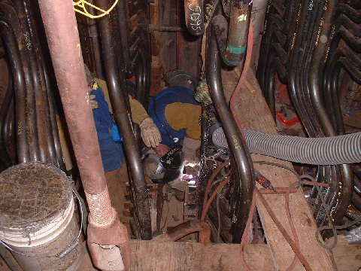
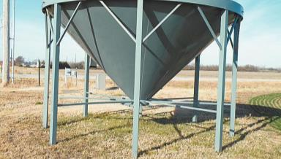
The internal configuration contributes to the hazards of a space
Inwardly converging walls
  Hopper bottom
Floor slopes - tapers to smaller cross-section
Piping and mechanical equipment, tight spaces
Boilermakers in boiler working around pipes and ventilation equipment
Picture : Grain Handling Safety Coalition, Springfield, IL
Notes:
If the space has an internal configuration such that an entrant could be trapped or asphyxiated by inwardly converging walls or by a floor which slopes downward and tapers to a smaller cross-section such as in a hopper bottom bin or a dump pit.
We must consider this hazard’s presence in addition to the engulfment and/or entanglement hazard.
How are we going to provide a stable working surface and how will we perform a rescue from these spaces?
The boiler with lots of piping and mechanical equipment also poses trip hazards and creates a lot of tight spaces that make rescue more difficult

Slide 20
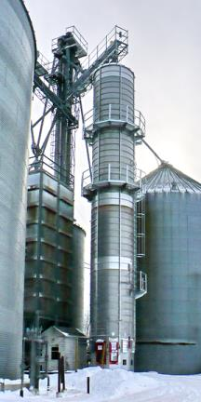

Temperature Hazards
Make sure temperatures reach ambient temperatures before entry.
Monitor temperatures during use.
Shut down & COOL DOWN before entry.
www.OSHA.gov
Grain Handling Safety Coalition, Springfield, IL
Notes:
The atmospheric temperature may increase during operation of some equipment.
Employees must wait for ambient temperature to be reached before entering so you are not overcome by the excessive heat.
Other extreme heat and cold hazards in the space also need to be considered and appropriate measures taken to reduce serious health effects and injuries.
In spaces where there is a heat stress potential, and it is not feasible to cool the area, entrants should remain hydrated and take breaks in a cooler environment. Headaches, dizziness, lightheadedness, muscle cramps, and other symptoms of heat exhaustion should be monitored.
Frigid temperatures are also a concern. Hypothermia, frost bite and other health effects can occur. Maintain body heat by covering the head; stay dry; use layers of clothes for better insulation and cover extremities/skin most prone to the effects of cold such as ears, nose, face, fingers, and toes.

Slide 21
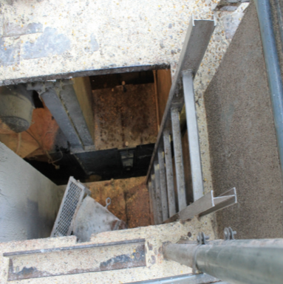
Safety Hazards
Falls
  Ladders
Lack of mechanical guarding
Electrical
Falling objects
Drowning
Grain Handling Safety Coalition, Springfield, IL
Notes:
Confined spaces often have other physical safety hazards to be aware of.
Falls across all industries is a major hazard – both same level and different level falls. Often confined spaces uses ladders or may have slick/wet surfaces. Use correct fall prevention methods as well as appropriate PPE.
Ensure any mechanical hazards present are appropriately guarded or LOTO.
Watch for falling objects – wear hard hats and when feasible, block or guard openings to prevent objects from falling.
Drowning is an issue in spaces where liquids may be present. Even if there is not much liquid, a slip or fall could render someone incapable of keeping of keeping their airway clear of liquid. Extra care should be taken when there are know liquids in a space.

Slide 22
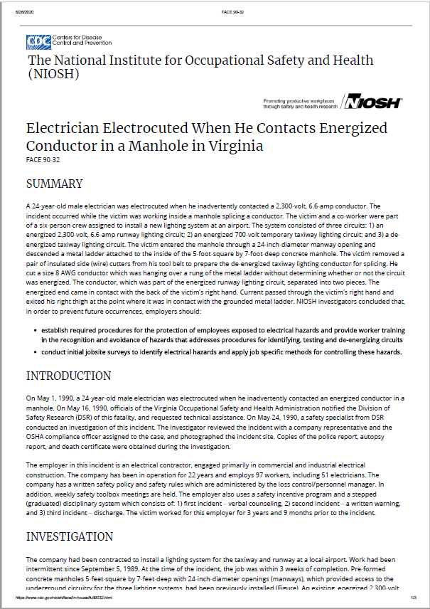
24 year old electrician
Working at an airport installing a new lighting system as part of a 6 man crew
Was working inside a manhole off a metal ladder
He used his side-cutters to cut a conductor without checking to see if it was de-energized
The conductor separated and the energized part came into contact with the back of his hand, exited his right thigh at the point where it was in contact with the grounded metal ladder
He was transported to the hospital where he was pronounced dead 45 minutes later
cause of death electrocution.
Notes:
Electrician would have been about 54 years old if he was alive today. Procedures for identifying hazards and testing, training appeared lacking

Slide 23
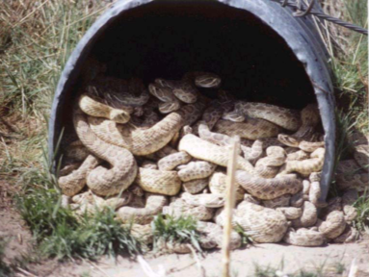
Biological and ergonomic hazards
Biological Hazards
Rodents, snakes, spiders, insects
Sewage/contaminants
Bird & animal feces
Molds, bacteria
Ergonomic
Strains & sprains
Restricted or unnatural movement
Grain Handling Safety Coalition, Springfield, IL
Notes:
Confined spaces can harbor a myriad of rodents, snakes, spiders and insects some of which may be poisonous. Wearing protective footwear, clothing, and gloves will help protect against bites.
Confined spaces may include many airborne or other health hazards. Bird and animal feces can be particularly harmful. Sewage and other contaminants could be present, especially in below level spaces after a rain if there are known leakage problems or uncovered openings. Damp places will often harbor mildew, molds, and other bacteria.
Rarely discussed, ergonomic issues are a major consideration when working in confined spaces. The need to bend, twist, stoop, possibly lay prone, climb in tight spaces, and have restricted or unnatural body movements can lead to strains and sprains. These injuries can lead to lost work time and rack up medical costs if they do not heal properly or are reinjured. It is worth considering consulting an ergonomic specialist to assist in assessing task performance when working in confined spaces is part of routine operations. There may be better tools or positioning which can be used to assist in the prevention of injuries.
Photo: Confined space PPT - Grantee Name: Georgia Tech Applied Research Corporation Grant Number: SH-16625-07 Grant Year: 2007

Slide 24
Key differences between the construction and general industry standard
More detailed provisions for coordination on multi-employer worksites.
Requirements for a competent person to evaluate the work site and identify confined spaces, including permit spaces before work begins.
Requires continuous atmospheric monitoring whenever possible.
Requires continuous monitoring of engulfment hazards. (e.g. in a storm sewer, monitoring for flash flooding from upstream storms)
Allows for the suspension of a permit, instead of cancellation, in the event of changes from the initial entry conditions or an unexpected event requiring evacuation of the space. (The space must be returned to the entry conditions listed on the permit before re-entry).
Western Iowa Technical Community College - SH-29639-SH6
Confined Spaces Hazards in Construction Instrumentation & Air Monitoring Personal Protective Equipment (PPE) for Confined Spaces

Slide 25
Key Definitions for Site Personnel/Contractor Categories (see 1926.1202)
Competent Person - means one who is capable of identifying existing and predictable hazards in the surroundings or working conditions which are unsanitary, hazardous, or dangerous to employees, and who has the authority to take prompt corrective measures to eliminate them.
Controlling Contractor - is the employer that has overall responsibility for construction at the worksite. Note: If the controlling contractor owns or manages the property, then it is both a controlling employer and a host employer.
Entry Employer - means any employer who decides that an employee it directs will enter a permit space.
Host Employer - means the employer that owns or manages the property where the construction work is taking place.

Slide 26

General Requirements
Each employer must ensure that a competent person identifies all confined spaces in which one or more employees it directs may work; and
identifies each that is a permit space by evaluating the space including testing if needed.
Notes:
Be sure that you know the limitations of the device used to monitor the air. Most multigas monitors are set up to measure oxygen levels, combustible gases and maybe one toxic gas or vapor like hydrogen sulfide. But that won’t help you f the hazardous agent is xylene of some other hazardous compound.

Slide 27
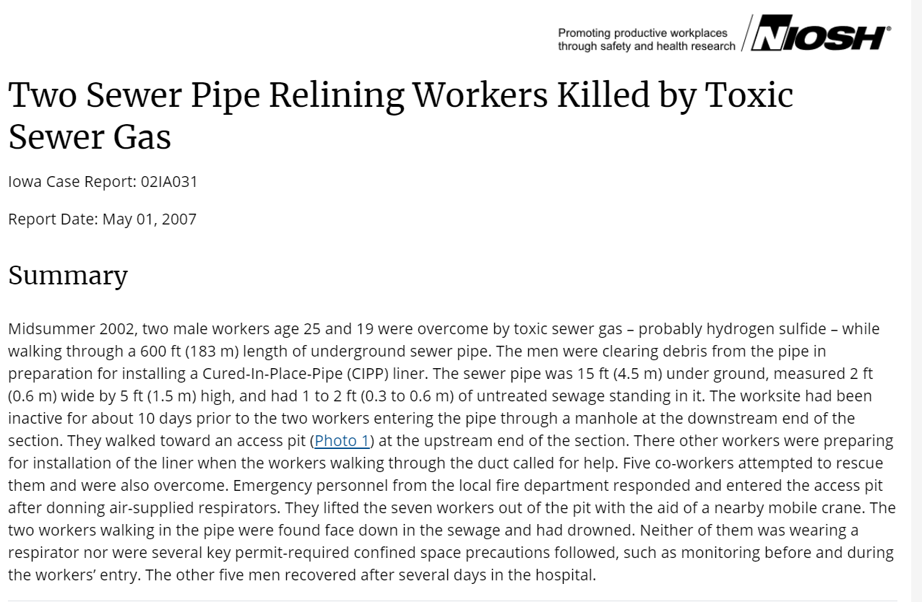
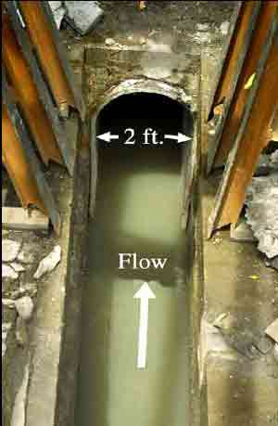
Notes:
This is an example of a Permit-required confined space – it is a confined space that the potential for a hazardous atmosphere, since hydrogen sulfide gas is known to be generated from sewage waste. But there was no air monitoring done to test the air or a confined space program in place. According to investigators, the probable cause of the incident was the release of dangerous levels of hydrogen sulfide gas from the sewer water which had been stagnant for several days before the workers entered the sewer pipe. Hydrogen sulfide is formed by microbes in the anaerobic breakdown of organic wastes. It is heavier than air, only slightly soluble in water, and is readily released when waste water containing it is disturbed. As the two victims walked through the sewer pipe, hydrogen sulfide gas was probably released increasing its concentration in the duct.
It is not known if either of the victims noticed the odor associated with low concentrations of hydrogen sulfide gas as they walked through the sewer pipe. Hydrogen sulfide has a “rotten egg” odor at low concentrations. However, odor perception is unreliable as a forewarning because rapid olfactory fatigue may develop when concentrations are high, above 100 ppm (parts per million). Concentrations above 1000 ppm may cause rapid unconsciousness and death. Consequently, both men could have unknowingly been breathing increasing concentrations of hydrogen sulfide as they approached the pit area.
The official cause of death from the autopsy report was drowning. Acute hydrogen sulfide intoxication was a probable contributing factor.

Slide 28
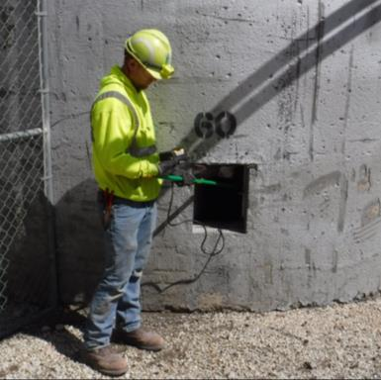
Monitoring v. Testing
Monitor or monitoring
Test or testing
Must be done before employee enters PRCS
Equipment must be calibrated and specific to PRCS hazards
Worker entering space or their rep must be provided with an opportunity to observe required pre-entry testing
Follows initial testing
Used to identify & evaluate hazards after an entrant has entered a PRCS
Used to check for any changes
Performed periodically or in a continuous manner
Notes:
The standard makes a distinction between “testing” and “monitoring”

Slide 29
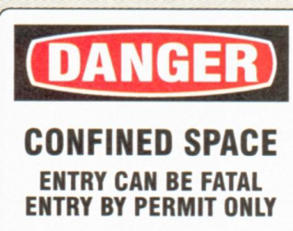
Identification of PRCS
Inform exposed employees by posting danger signs or some other equally effective means; and
Inform in a timely manner other than posting signs its employee’s representatives and controlling contractor, of existence and location and danger posed of each PRCS.

Slide 30
Programs and procedures
PRCS
Authorize Entry
Post signage & Inform
NO ENTRY
Develop written plan that complies with 1926.1204
Utilize alternative procedures

Slide 31
Alternate entry procedures – can be utilized for PRCS with atmospheric hazards
Benefits:
  Exempted from 1926.1204-1206 & 1926.1208-1211
Conditional on:
  All physical hazards having been isolated or eliminated leaving only potential or actual atmospheric hazards
  Employer can demonstrate sufficient forced air ventilation alone is enough to allow safe exit of PRCS in the event ventilation stopped working

Slide 32
Alternate entry procedures (cont.)
The employer has air monitoring and inspection data to show that ventilation is adequate
If initial entry is required to obtain the necessary data it will be performed in compliance with the full procedures of the standard (1926.1204-1211).
The collected data is documented and made available to employees who enter the PRCS and their representatives.
Entry is made following para 1926.1203(e)(2) [to be described as follows]

Slide 33
Requirements for alternative procedure
Any conditions making it unsafe to remove an entrance cover must be eliminated before removing cover
Openings must be guarded once openings are removed to protect employees from falls and to protect them from foreign objects falling into the working space
Atmospheric testing must be conducted before entry and any employees entering PRCS and their representatives must be provided the opportunity to observe testing.

Slide 34
Requirements for alternative procedure (cont.)
Verify space is safe for entry and that pre-entry measures taken are certified in writing and include the date, location of space and signatures of person providing the certification. Certification must be made before entry & be made available to each worker and their rep.
Employer must provide workers with a safe method of entering & exiting the space. Any hoisting system must either 1) be designed and manufactured for personnel hoisting; or 2) be approved for personnel hoisting by a professional engineer prior to use.
Atmospheric monitoring must be continuous unless the entry employer can show that continuous monitoring equipment is not commercially available or that periodic monitoring is sufficient to ensure the atmosphere is safe.
If a hazard is detected during entry, employers must make sure workers exit immediately, evaluate how the hazard developed and implement measures to protect workers from the hazard before any subsequent entry takes place.

Slide 35
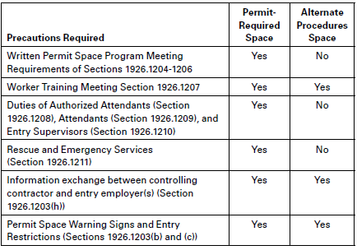
Comparison of Requirement for Permit-Required Spaced and Alternate Procedure Spaces
Protecting Construction Workers in Confined Spaces: Small Entity Compliance Guide U.S. Department of Labor
Occupational Safety and Health Administration OSHA 3825-09 2015

Slide 36
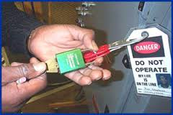
Reclassifying a PRCS to a Confined Space – Section 1203 (g)
Only applicable to physical hazards
Physical hazards must be
  Eliminated or isolated without entering the space; or
  Eliminated or isolated by entering the space using permit space procedures
Employer must document the basis for determining all hazards have been eliminated through a certification that has date, location of space, and signature of person making the determination
Must be made available to worker entering space and their representative

Slide 37
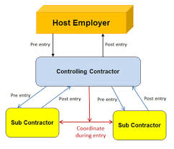
Communication & Coordination – Section 1203 (h)
Host employer must provide to controlling contractor before entry:
  Location of known PRCS
  Hazards in each
  Any precautions
Before entry the controlling contractor must obtain host info and provide to entity entering PRCS
Entry employer must obtain info from controlling contractor
Before entry, controlling and entry contractor must coordinate entry operations
Debriefing requirements after entry
Notes:
https://www.osha.gov/confinedspaces/faq.html
This flow chart is to help explain the role of communication on a multi employer worksite, and how they need to coordinate entry with each other so processes down the line aren't affected and employees remain safe.

Slide 38
Permit Required Confined Space Program Elements
An entry permit system
Identify hazards before allowing entry
Include testing & monitoring
Establish the means & procedures to eliminate or control hazards
Identify employee job duties
Provide PPE at no cost to employees
Ensure at least one attendant is stationed outside during entry ops
Implement procedures that any attendant who is required to monitor multiple spaces will follow in an emergency
Coordinate entry when employees of more than one employer are working in the permit space
Establish procedures for rescue and for making sure unauthorized personnel do not attempt rescue

Slide 39
Important elements of a confined space program
https://www.youtube.com/watch?v=vG6K-NulTok
Testing
Measures to control entry
Method to control hazard
Rescue plan & procedure
Notes:
This tragedy illustrates where several elements of a PRCS Program may have saved these men’s lives. Testing, controlling entry, ventilating the space like the firefighter mentioned and having a better rescue system in place are just 4 elements that come to mind.

Slide 40
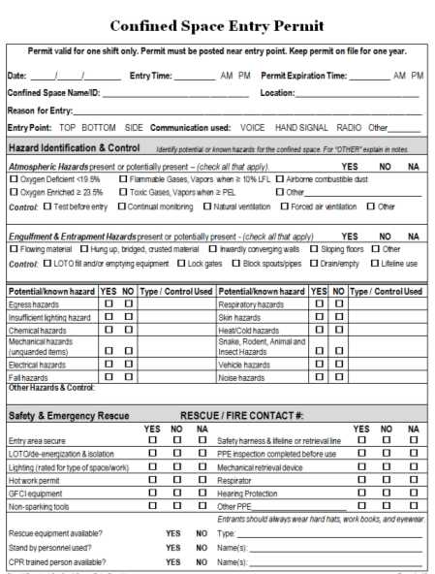
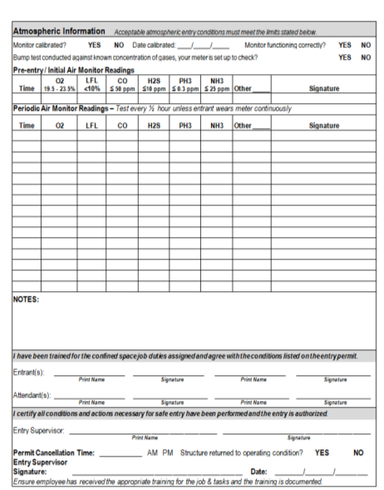
PRCS Program requires written entry permit
The elements of the permit are listed in 1926.1206
Must be posted at entrance to the space or be available to entrants and reps at time of entry
Employer must make sure they are cancelled by entry supervisor when an assignment is completed (entry no longer allowed once cancelled)
Permit may be suspended for a temporary condition in or near the space that is not expected to reoccur.

Slide 41
Entrant
Know space hazards, including routes of exposure such as inhalation or dermal absorption, signs of symptoms and consequences of the exposure;
Use appropriate personal protective equipment properly;
Maintain communication with attendants as necessary;
Exit from the permit space as soon as possible when:
  Ordered by the authorized person;
  There are warning signs or symptoms of exposure;
  A prohibited condition exists; or
  An automatic alarm is activated.
Alert the attendant when a prohibited condition exists or when warning signs or symptoms of exposure exist.
Western Iowa Technical Community College - SH-29639-SH6
Confined Spaces Hazards in Construction Instrumentation & Air Monitoring Personal Protective Equipment (PPE) for Confined Spaces
Notes:
This is the listing of the job duties of the entrant, they must listen to the orders of the attendant to ensure their own safety. Duties outlined in 29 CFR 1926.1208.

Slide 42
Attendant
Remain outside the permit space during entry operations unless relieved by another authorized attendant;
Perform non-entry rescues when specified by the employer's rescue procedure;
Know existing and potential hazards, including information on the mode of exposure, signs or symptoms, consequences and effects;
Maintain communication with and keep an accurate account of workers entering the permit space;
Western Iowa Technical Community College - SH-29639-SH6
Confined Spaces Hazards in Construction Instrumentation & Air Monitoring Personal Protective Equipment (PPE) for Confined Spaces
Notes:
These are the job duties of the attendant. This isn’t an all inclusive list but it should be noted they are responsible for the individual in the confined space and they need to ensure constant contact with them, and not perform other jobs. Duties outlined in 29 CFR 1926.1209.

Slide 43
Attendant (Continued)
Order evacuation of the permit space when:
  A prohibited condition exists;
  A worker shows signs of physiological effects of exposure;
  An emergency outside the confined space exists; and
  The attendant cannot effectively and safely perform required duties.
Summon rescue and other services during an emergency;
Ensure that unauthorized people stay away from permit spaces;
Inform authorized entrants and the entry supervisor if any unauthorized person enters the permit space; and
Perform no other duties that interfere with the attendant's primary duties.
Western Iowa Technical Community College - SH-29639-SH6
Confined Spaces Hazards in Construction Instrumentation & Air Monitoring Personal Protective Equipment (PPE) for Confined Spaces

Slide 44
Supervisor
Know space hazards including route of exposure, signs or symptoms and consequences;
Verify emergency plans and specified entry conditions such as permits, tests, procedures and equipment before allowing entry;
Terminate entry and cancel permits when entry operations are completed or if a new condition exists;
Verify that rescue services are available; the means for summoning them; making sure they are operable, and that employer will be notified as soon as services become unavailable;
Take appropriate measures to remove unauthorized entrants; and
Ensure that entry operations remain consistent with the entry permit and that acceptable entry conditions are maintained
Western Iowa Technical Community College - SH-29639-SH6
Confined Spaces Hazards in Construction Instrumentation & Air Monitoring Personal Protective Equipment (PPE) for Confined Spaces
Notes:
The supervisor must ensure the job is safe before any work is performed, and all hazards are mitigated. Duties outlined in 29 CFR 1926.1210.

Slide 45
Training
Before work in a permit space begins, the entry employer must train authorized entrants, attendants, entry supervisors & other employees with duties (e.g. those who test and monitor air) to:
  Understand hazards and methods to control hazards
  If not authorized to do rescue, the dangers of performing rescue
Must ensure workers have the understanding, knowledge & skills after training
Must keep records that show worker’s name, trainer signature or initials and dates of training.

Slide 46
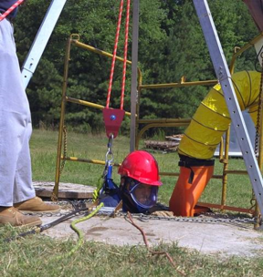
Rescue & Emergency Services
PRCS plan must include procedures for:
  Summoning rescue and emergency service (including in the event of a failed non-entry rescue)
  Rescuing entrants from permit spaces
  Providing necessary emergency services for rescued employees
  Preventing unauthorized employees from attempting a rescue
Notes:
Describe what a non-entry rescue is.

Slide 47
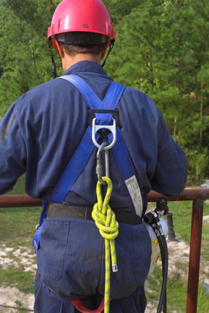
Rescue – Section 1211
Non-entry rescue required unless equipment would increase overall risk
Must confirm that emergency assistance would be available in the event non-entry rescue fails
Entrants must use a chest or full body harness with retrieval line attached at the center of the entrants back near shoulder level (more detail in the standard)
For employers designating rescue and emergency services they must
  Evaluate prospective rescuer’s ability to respond in a timely manner
  Evaluate proficiency with PRCS rescues
  Select a rescue team that is capable of reaching the victim in an appropriate time frame, is capable and has the right equipment
  Agrees to notify employer should they become unavailable
Inform each rescue team of the hazard and PRCS locations.

Slide 48
Rescue – Section 1211 (cont.)
If an employer is training their own employees, they must:
  Provide them with necessary PPE
  Train each affected employee and establish proficiency as authorized entrants
  Train each employee in basic first aid and CPR (at least one member of team must have a current certification)
  Ensure that affected employees practice making permit space rescues before attempting an actual rescue and at least once very 12 mos. by means of simulated rescue operations with dummies, manikins or actual persons.
Notes:
See paragraph (b)(4)

Slide 49

Employee Participation
Employers must consult with affected employees and their representatives in the development and implementation of all aspects of the permit space program required by section 1203 of the standard.
Notes:
OSHA Small Entity Guide is a useful resource
Make sure training is done in a language that workers understand

Slide 50
Acknowledgements
Western Iowa Technical Community College - SH-29639-SH6; Confined Spaces Hazards in Construction Instrumentation & Air Monitoring Personal Protective Equipment (PPE) for Confined Spaces
Grain Handling Safety Coalition; 3521 Hollis Drive Springfield, IL 62711
www.osha.gov
www.iup.edu/pa-oshaconsultation

Slide 51

www.iup.edu/pa-oshaconsultation

Slide 52
Contact us
Pennsylvania OSHA Consultation Office
Phone: 800-382-1241
Web: www.iup.edu/pa-oshaconsultation/
Facebook: https://www.facebook.com/Pennsylvania-OSHA-Consultation-Program-548810235234647/
Twitter: https://twitter.com/search?q=PA%20OSHA%20Consultation&src=savs
www.iup.edu/pa-oshaconsultation

Slide 53
Thank You
Upcoming Webinar:
Respiratory Protection
October 14, 2020 @ 10:30am
Pennsylvania OSHA Consultation Office
Phone: 800-382-1241 or 724-357-4095
Website: www.iup.edu/pa-oshaconsultation
www.iup.edu/pa-oshaconsultation

