Slide 1
Welcome COVID-19 Respiratory Protection Guidance for Long Term Care Facilities Will begin at 10:30am Presented by: Bryan Brougher, CSP Pennsylvania OSHA Consultation Office Phone: 800-382-1241 or 724-357-4095 Website: www.iup.edu/pa-oshaconsultation

Slide 2
COVID-19 Respiratory Protection Guidance for Long Term Care Facilities
Webinar General Info PowerPoint Presentation Q&A Questions Chat is open to submit questions. We will be answering questions through this chat feature. If due to the technical nature of the question a more thorough response is required, we will post the answer on our website within seven days of the webinar.
www.iup.edu/pa-oshaconsultation

Slide 3
COVID-19 Respiratory Protection Guidance
Guidance is designed specifically for:
Nursing homes,
Assisted living,
Other long-term care facilities (LTCFs)
Skilled nursing facilities
Inpatient hospice
Convalescent homes
Group homes with nursing care)
www.iup.edu/pa-oshaconsultation

Slide 4
COVID-19 Respiratory Protection Guidance
Why are LTCFs different than other healthcare settings?
Not only do they provide skilled nursing care
They assist residents and clients with tasks of daily living
www.iup.edu/pa-oshaconsultation

Slide 5
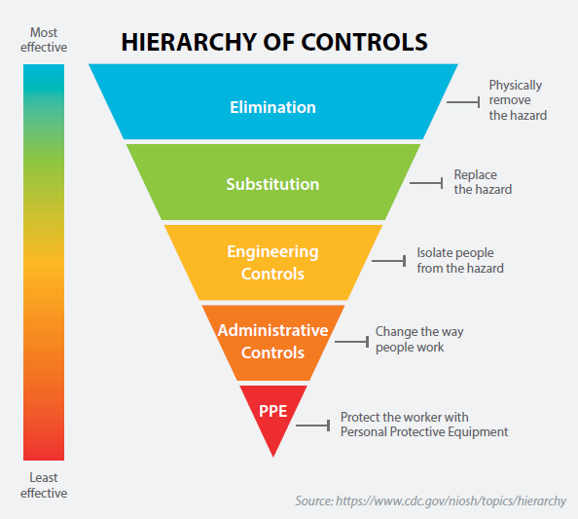
COVID-19 Respiratory Protection Guidance
www.iup.edu/pa-oshaconsultation

Slide 6
COVID-19 Respiratory Protection Guidance
Reassess:
Engineering controls (e.g., ventilation)
Administrative controls (e.g., hand hygiene, physical distancing, cleaning/disinfection of surfaces )
Identify changes to avoid over-reliance on respirators and other PPE
www.iup.edu/pa-oshaconsultation

Slide 7
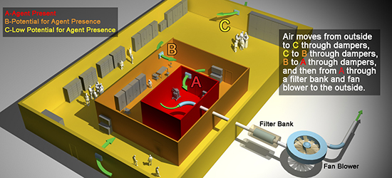
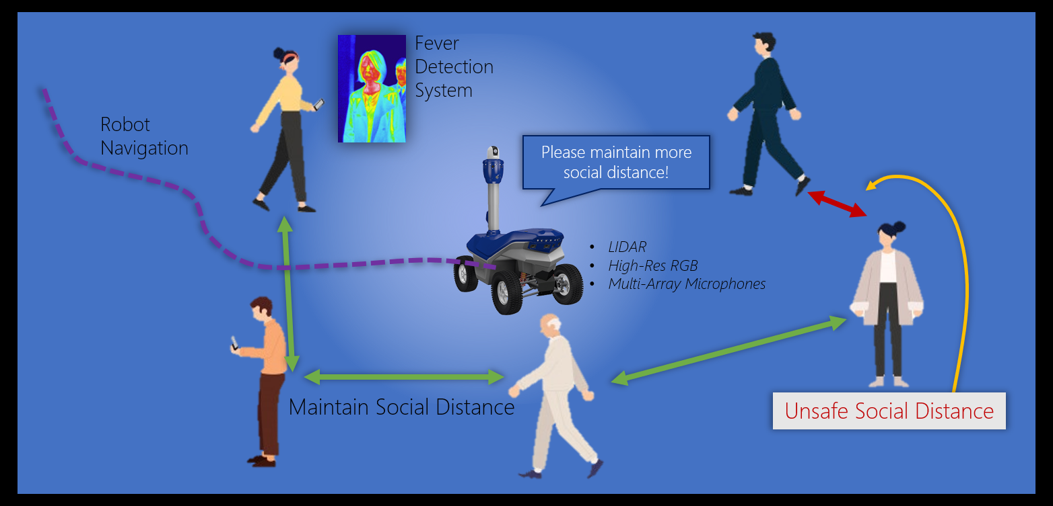
COVID-19 Respiratory Protection Guidance
CDC’s COVID-19 webpage on Nursing Homes and Long-Term Care Facilities).
Engineering and administrative controls - Vital due to supply chain demand for N95 filtering facepiece respirators (FFRs).
www.iup.edu/pa-oshaconsultation

Slide 8
COVID-19 Respiratory Protection Guidance
Additional control strategies
OSHA’s COVID-19 Guidance for Nursing Home and Long-Term Care Facility Workers
CDC’s Nursing Homes and Long-Term Care Facilities.
www.iup.edu/pa-oshaconsultation

Slide 9
COVID-19 Respiratory Protection Guidance
Close contact with people with known or suspected COVID-19 unavoidable… PPE including respirators required
www.iup.edu/pa-oshaconsultation

Slide 10
COVID-19 Respiratory Protection Guidance
Therefore written, worksite-specific respiratory protection program (RPP), including:
Medical evaluation
Fit testing
Training
Other elements
OSHA’s Respiratory Protection standard (29 CFR 1910.134).
www.iup.edu/pa-oshaconsultation

Slide 11
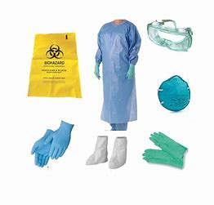
COVID-19 Respiratory Protection Guidance
See OSHA’s
General PPE standard (29 CFR 1910.132)
Eye and Face Protection standard (29 CFR 1910.133).
OSHA requirements for other PPE Requirements
www.iup.edu/pa-oshaconsultation

Slide 12
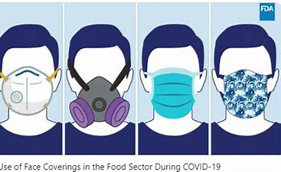
Face Coverings
Facemasks Authorized for Use as Source Control by the FDA
FDA-cleared or Authorized Surgical Masks
Respirators
There are multiple products/devices that can be used during the COVID-19 pandemic to cover a wearer’s mouth and nose, and it is important to select the right one for the situation.
www.iup.edu/pa-oshaconsultation

Slide 13
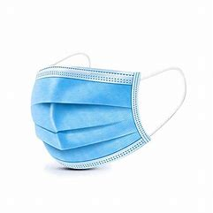
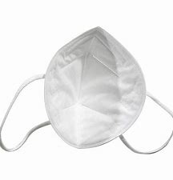
Face Coverings
Source control - products/devices reduce the spread of respiratory secretions and aerosols when that person is breathing, talking, sneezing, or coughing.
Recommend for everyone in health care facilities including LTCFs because of potential for asymptomatic and pre-symptomatic transmission.
www.iup.edu/pa-oshaconsultation

Slide 14
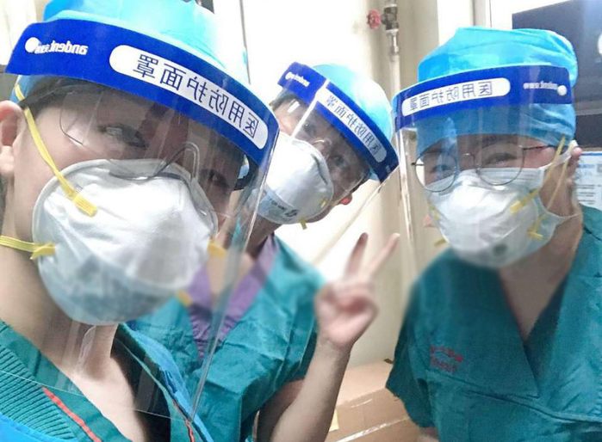
Face Coverings
When should healthcare providers wear source control products/devices?
At all times while they are in a LTCF, including in breakrooms
The source control product/device should be appropriate for the anticipated exposure(s).
www.iup.edu/pa-oshaconsultation

Slide 15
Face Coverings
Cloth Face Coverings: Homemade or commercially available products made of cloth that cover the nose and mouth.
DO NOT wear in lieu of an FDA - surgical mask - protection against exposure to splashes and sprays
DO NOT provide effective respiratory protection against airborne hazards - OSHA’s Respiratory Protection standard.
NOT considered PPE
www.iup.edu/pa-oshaconsultation

Slide 16
Face Coverings
Cloth Face Coverings:
LTCF patients and visitors should wear their own cloth face covering
No cloth face covering available – LTCF should provide a facemask, surgical mask, or cloth face covering.
www.iup.edu/pa-oshaconsultation

Slide 17
Face Coverings
Facemasks: Look similar to surgical masks, but do not provide fluid resistance.
DO NOT provide effective respiratory protection for workers when protection against airborne hazards is needed
Do not fall under OSHA’s Respiratory Protection standard.
NOT considered PPE for the wearer but can assist in source control.
www.iup.edu/pa-oshaconsultation

Slide 18
Face Coverings
Facemasks:
The FDA (not OSHA) has authorized the emergency use of facemasks for use as source control by the general public and healthcare personnel in accordance with CDC recommendations during the COVID-19 .
- i.e., KN95 respirator with ear loops instead of head straps
www.iup.edu/pa-oshaconsultation

Slide 19
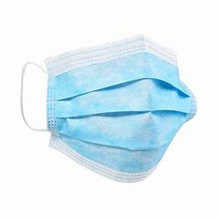
Face Coverings
FDA-cleared or authorized surgical masks: Surgical masks are cleared, or are authorized for emergency use, by the FDA .
PPE standard (29 CFR 1910.132) and
Bloodborne Pathogens standard (29 CFR 1910.1030).
www.iup.edu/pa-oshaconsultation

Slide 20
Face Coverings
FDA-cleared or authorized surgical masks:
FDA-cleared or authorized surgical masks > cloth face coverings for healthcare workers,
Offer both source control and protection for the wearer against exposure to splashes and sprays of infectious material from others.
DO NOT FALL UNDER OSHA’S RESPIRATORY PROTECTION STANDARD
www.iup.edu/pa-oshaconsultation

Slide 21
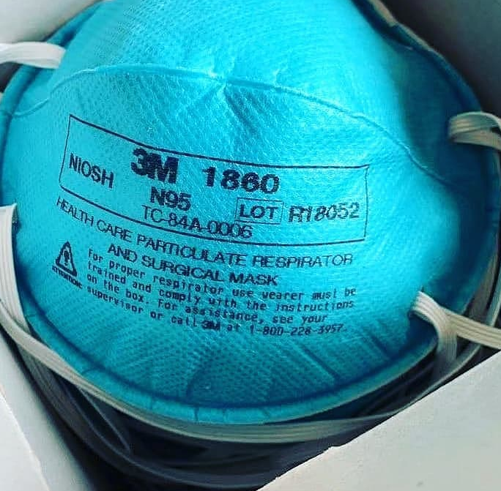
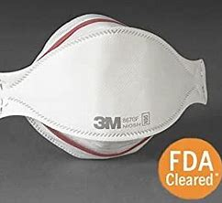
Face Coverings
Respirators (including FDA-cleared or authorized surgical N95 respirators and surgical masks N95 FFRs):
Suspected or confirmed SARS-CoV-2 - NIOSH-approved N95 FFR or equivalent or higher-level respirator (29 CFR 1910.134).
Exposure to splashes and sprays of infectious material - FDA-cleared or authorized surgical N95 FFR (29 CFR 1910.134 and 29 CFR 1910.1030).
Surgical N95 respirators = protection of N95 respirator; but also meets the FDA requirements for fluid penetration, flammability, and biocompatibility (see 21 CFR 878.4040(b)(1)).
www.iup.edu/pa-oshaconsultation

Slide 22
Face Coverings
Respirators (including FDA-cleared or authorized surgical N95 respirators and surgical masks N95 FFRs):
OSHA regulates respirators under the Respiratory Protection standard
In order for a respirator to provide the expected level of protection, must meet requirements of a respiratory protection program
www.iup.edu/pa-oshaconsultation

Slide 23
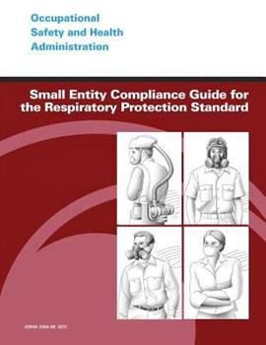
Respiratory Protection Program (RPP)
OSHA’s Small Entity Compliance Guide for the Respiratory Protection Standard - The guide includes step-by-step instructions for compliance with the standard, including:
Checklists
Commonly-asked questions,
Sample written RPP.
The key elements of an RPP the following:
www.iup.edu/pa-oshaconsultation

Slide 24
Respiratory Protection Program (RPP)
Program Administrator - Oversee all elements of the RPP.
This may be :
An infection prevention and control practitioner or a nurse administrator.
Consultant/Industrial Hygienist
Other
Contact OSHA’s On-Site Consultation Program.
www.iup.edu/pa-oshaconsultation

Slide 25
Respiratory Protection Program (RPP)
Written RPP –Details worksite-specific procedures and elements for required respirator use including:
Medical evaluation,
Fit testing,
Training,
Maintenance, etc.
Voluntary respirator use as applicable.
www.iup.edu/pa-oshaconsultation

Slide 26
Respiratory Protection Program (RPP)
Risk assessment - identify at risk workers at risk of exposure to any airborne hazards such as:
SARS-CoV-2,
Tuberculosis [TB],
Legionella,
Certain hazardous chemicals
www.iup.edu/pa-oshaconsultation

Slide 27
Respiratory Protection Program (RPP)
Such workers could include:
Staff in close contact with residents with confirmed or suspected COVID-19
Clinical staff performing aerosol-generating procedures
Cleaning staff
Maintenance staff
Visiting practitioners
www.iup.edu/pa-oshaconsultation

Slide 28
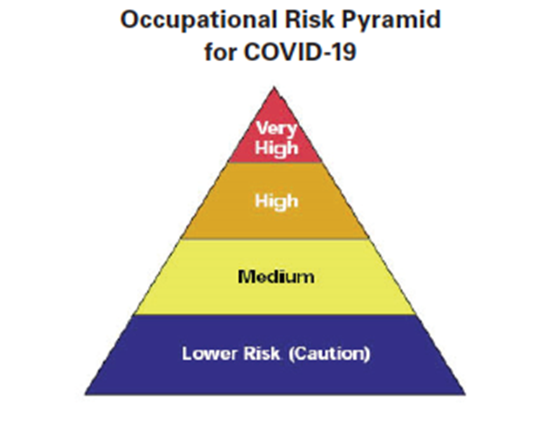
Respiratory Protection Program (RPP)
For classifying exposure risk to SARS-CoV-2, OSHA has divided job tasks into four risk exposure levels, as depicted in the occupational risk pyramid for COVID-19.
www.iup.edu/pa-oshaconsultation

Slide 29
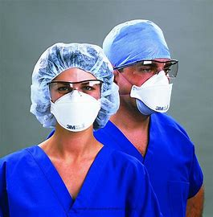
Respiratory Protection Program (RPP)
VERY HIGH EXPOSURE RISK Jobs with a high potential for exposure to known or suspected sources of COVID-19 during:
Specific medical,
Postmortem, or
Laboratory procedures.
Workers include:
Healthcare and morgue workers - aerosol-generating procedures on or collecting/handling specimens from potentially infectious patients or bodies of people known to have, or suspected of having, COVID-19.
www.iup.edu/pa-oshaconsultation

Slide 30
Respiratory Protection Program (RPP)
HIGH EXPOSURE RISK Jobs with a high potential for exposure to known or suspected sources of COVID-19.
Workers in this category include - Healthcare delivery, healthcare support, medical transport, and mortuary workers exposed to known or suspected COVID-19 patients or bodies of people known to have, or suspected of having, COVID-19 at the time of death.
www.iup.edu/pa-oshaconsultation

Slide 31
Respiratory Protection Program (RPP)
MEDIUM EXPOSURE RISK Jobs that require frequent/close contact with people who may be infected, but who are not known or suspected patients.
Workers in this category include - Those who may have contact with the general public (e.g., schools, high-population-density work environments, some high-volume retail settings), including individuals returning from locations with widespread COVID-19 transmission.
www.iup.edu/pa-oshaconsultation

Slide 32
Respiratory Protection Program (RPP)
LOWER EXPOSURE RISK (CAUTION) Jobs that do not require contact with people known to be, or suspected of being, infected.
Workers in this category have minimal occupational contact with the public and other coworkers.
www.iup.edu/pa-oshaconsultation

Slide 33
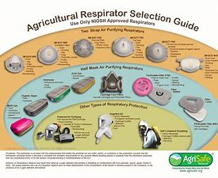
Respiratory Protection Program (RPP)
Implement procedures for selecting the appropriate type of respirator(s) for the hazard
Infectious agent (e.g., SARS-CoV-2)
and/or
Hazardous chemical.
The program administrator identifies
type(s) of respirator for hazard(s),
workplace factors, and
user factors.
www.iup.edu/pa-oshaconsultation

Slide 34
Respiratory Protection Program (RPP)
Select NIOSH-approved respirators - cautious of counterfeit respirators,
To determine if the respirator model being considered is NIOSH-approved, Access NIOSH’s
NIOSH-Approved N95 Particulate Filtering Facepiece Respirators and
Counterfeit Respirators / Misrepresentation of NIOSH- Approval
www.iup.edu/pa-oshaconsultation

Slide 35
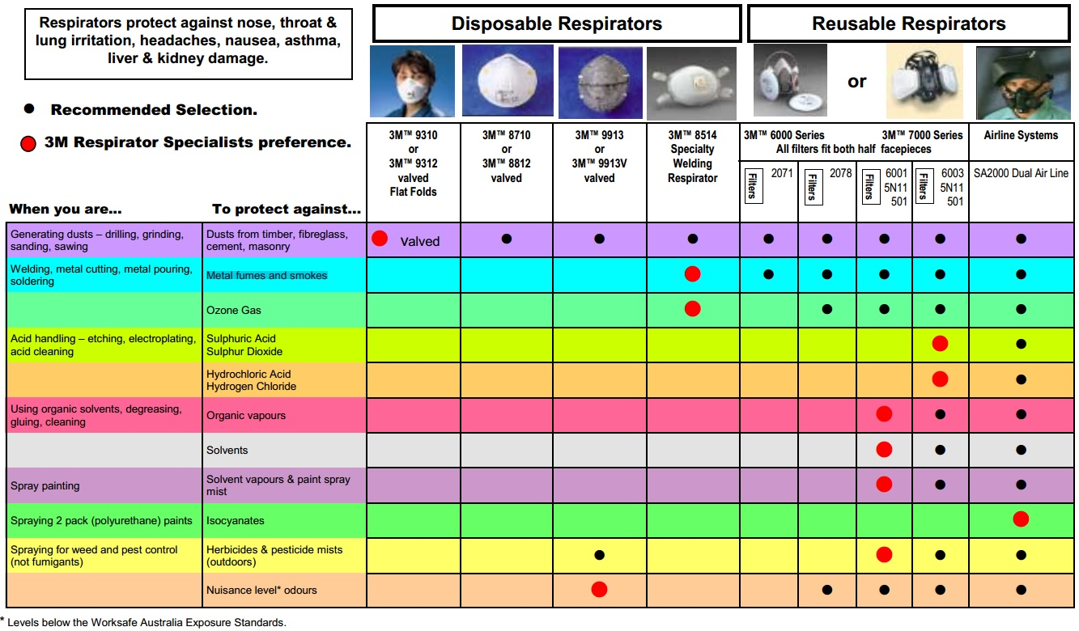
Respiratory Protection Program (RPP)
www.iup.edu/pa-oshaconsultation

Slide 36
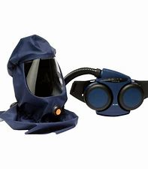
Respiratory Protection Program (RPP)
SUPPLY CHAIN: …. DEPLETED….
N95 FFRs P100 N99’s, reusable elastomeric (rubber), PAPR
Initial investment for elastomeric and PAPR > N95 FFR… but leads to cost distribution.
Loose-fitting PAPR – NO fit test required… saves time and money
www.iup.edu/pa-oshaconsultation

Slide 37
Respiratory Protection Program (RPP)
Additional information in advantages/Disadvantages
CDC’s Elastomeric Respirators: Strategies During Conventional and Surge Demand Situations
CDC’s Considerations for Optimizing the Supply of Powered Air-Purifying Respirators (PAPRs)
www.iup.edu/pa-oshaconsultation

Slide 38
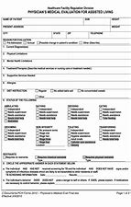
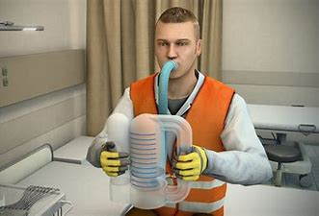
Respiratory Protection Program (RPP)
Medical evaluations needed if respirators required prior to wearing
Find a PLCHP - Physician or other licensed healthcare professional to conduct the medical evaluations and maintain confidentiality.
www.iup.edu/pa-oshaconsultation

Slide 39
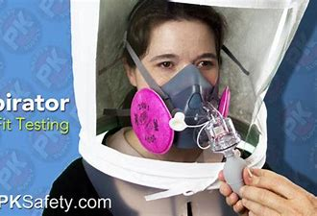
Respiratory Protection Program (RPP)
FIT TESTING – Must perform prior to requiring use of a tight-fitting respirator (e.g., N95 FFR)
Prior to initial use.
Whenever a different respirator size, style, model or make is used,
At least annually
Ensures that the size, make, and model of the respirator provides proper seal providing expected level of protection
www.iup.edu/pa-oshaconsultation

Slide 40
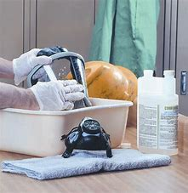
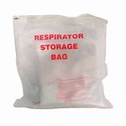
Respiratory Protection Program (RPP)
Establish procedures and schedules for the maintenance and storage procedures for ….
Cleaning
Disinfecting
Storing
Repairing
Discarding
www.iup.edu/pa-oshaconsultation

Slide 41
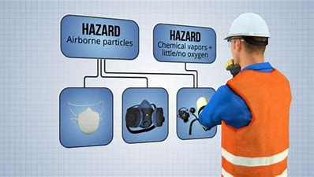
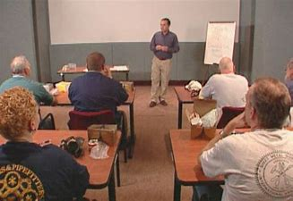
Respiratory Protection Program (RPP)
TRAINING: When respirator use is required
Training must be conducted in a manner that is understandable to workers.
www.iup.edu/pa-oshaconsultation

Slide 42
Respiratory Protection Program (RPP)
What training is required?
How to properly put them on and take them off (DON/DOFF)
How to conduct proper user seal checks
How to recognize respiratory hazards in their workplace
The limitations and capabilities of respirators
How to recognize the medical signs and symptoms that may prevent or limit effective respirator use.
Ensure that they can demonstrate the knowledge to safely and correctly use their respirators.
www.iup.edu/pa-oshaconsultation

Slide 43
Respiratory Protection Program (RPP)
PERIODIC EVALUATIONS OF:
The workplace to ensure that your written RPP is being properly implemented and is up-to-date
Ensure that workers are using their respirators properly.
Solicit input from workers (and union representatives, if applicable) to provide feedback on the program.
www.iup.edu/pa-oshaconsultation

Slide 44
Temporary Enforcement Discretion Related to the Respiratory Protection Standard During COVID-19
To keep supplies - OSHA has temporarily allows enforcement flexibility – including:
Certain fit testing provisions,
The use of respirators that are beyond their manufacturer’s recommended shelf life,
Extended use and reuse of respirators,
The use of alternative respirators certified under standards of certain other countries and jurisdictions, and
Decontamination of respirators
This is described in detail in various temporary enforcement memoranda, which can be found on OSHA’s COVID-19 webpage.
www.iup.edu/pa-oshaconsultation

Slide 45
Temporary Enforcement Discretion Related to Certain Fit Testing Provisions
Annual fit testing, 29 CFR § 1910.134(f)(2),
Good-faith effort
Only NIOSH-certified respirators;
Strategies to optimize the supply and prioritizing use;
Initial fit tests for each HCP
www.iup.edu/pa-oshaconsultation

Slide 46
Temporary Enforcement Discretion Related to Certain Fit Testing Provisions
Annual fit testing, 29 CFR § 1910.134(f)(2),
Inform employees of temporarily suspension
Perform user seal checks
Conduct a fit test if physical conditions change
Inform management if integrity and/or fit is compromised.
www.iup.edu/pa-oshaconsultation

Slide 47
Temporary Enforcement Discretion Related to Extended Use or Expired Respirators
All employers:
Extended use or reuse of N95s: Extend use/reuse of respirator, as long as:
Respirator maintains its structural and functional integrity
Filter material is not physically damaged, soiled, or contaminated
Written RPP – Details circumstances where a disposable respirator considered not available for extended use or reuse.
Extended use is preferred over reuse due to contact transmission risk
www.iup.edu/pa-oshaconsultation

Slide 48
Temporary Enforcement Discretion Related to Extended Use or Expired Respirators
All employers:
Extended use or reuse of N95s: as long as: (con’t)
Proper storage.
User seal check
Training to discard if structural and functional integrity is compromised, or user seal check failures
Training and procedures for proper donning/doffing
Appropriate sequence for donning/doffing procedures
www.iup.edu/pa-oshaconsultation

Slide 49
Temporary Enforcement Discretion Related to Extended Use or Expired Respirators
Use of expired N95s: Use of N95 FFRs beyond recommended shelf life
Only previously NIOSH-certified expired N95 FFRs
Notify Employees expired N95s use.
Do not co-mingle expired products with those within shelf life.
Employers oversite - ensure that workers visually inspect,
Employers own stored cache vs U.S. Strategic National Stockpile - seek assistance from the manufacturer or independent lab
www.iup.edu/pa-oshaconsultation

Slide 50
Temporary Enforcement Discretion Related to Extended Use or Expired Respirators
Healthcare employers only:
Expired N95s generally must not be used when HCPs
Perform surgical procedures on patients infected with, or potentially infected with, SARS-CoV-2, or
Perform or are present for procedures expected to generate aerosols
Procedures where respiratory secretions are likely to be poorly controlled.
CDC - prioritize the use of N95 respirators by activity type. When higher potential for exposure use respirators shelf life, before using respirators that are beyond shelf life.
www.iup.edu/pa-oshaconsultation

Slide 51
Temporary Enforcement Discretion Related to Respirators Certified under Standards of Other Countries or Jurisdictions
Air-purifying elastomeric respirators, and compatible filters certified under the following standards of other countries or jurisdictions provide greater protection than surgical masks
Australia: AS/NZS 1716:2012
Brazil: ABNT/NBR 13694:1996; ABNT/NBR 13697:1996; and ABNT/NBR 13698:2011
People's Republic of China: GB 2626-2006; and GB 2626-2019
European Union: EN 140-1999; EN 143-2000; and EN 149-2001
Japan: JMHLW-2000
Republic of Korea: KMOEL-2014-46; and KMOEL-2017-64
Mexico: NOM-116-2009
www.iup.edu/pa-oshaconsultation

Slide 52
Temporary Enforcement Discretion Related to Respirators Certified under Standards of Other Countries or Jurisdictions
Follow certification under the following standards to ensure similar filtration as NIOSH-certified equipment (as described in Tables 1 and 2, of the OSHA Enforcement Guidance).
Enforcement Guidance for Use of Respiratory Protection Equipment Certified under Standards of Other Countries or Jurisdictions During the Coronavirus Disease 2019 (COVID-19) Pandemic | Occupational Safety and Health Administration (osha.gov),
www.iup.edu/pa-oshaconsultation

Slide 53
Temporary Enforcement Discretion Related to Decontamination of Filtering Facepiece Respirators in Healthcare
NIOSH - Identified limited available research suggesting these methods for decontaminating FFRs:
Vaporous hydrogen peroxide;
Ultraviolet germicidal irradiation; and/or
Moist heat (e.g., using water heated in an oven).
If such methods are not available, use:
Microwave-generated steam; and/or
Liquid hydrogen peroxide.
www.iup.edu/pa-oshaconsultation

Slide 54
Temporary Enforcement Discretion Related to Decontamination of Filtering Facepiece Respirators in Healthcare
SHOULD NOT use the following methods unless objective data that sufficiently demonstrate the safety and effectiveness of such methods become available:
Autoclaving;
Dry heat;
Isopropyl alcohol;
Soap;
Dry microwave irradiation;
Chlorine bleach; and/or
Disinfectant wipes, regardless of impregnation (i.e., chemical saturation); and/or
Ethylene oxide (EtO).[10]
The NIOSH-evaluated research provides justification for each method evaluated.
www.iup.edu/pa-oshaconsultation

Slide 55
Temporary Enforcement Discretion Related to the Respiratory Protection Standard During COVID-19
To obtain enforcement discretion:
Demonstrate and document good-faith efforts
Understanding Compliance with OSHA’s Respiratory Standard During the Coronavirus Disease (COVID-19) Pandemic
OSHA’s temporary enforcement memoranda are time-limited
CDC’s Strategies for Optimizing the Supply of N95 Respirators
Enforcement discretion applies only all possible steps to comply with measures in a particular control strategy are taken.
LTCF employers should periodically refer to OSHA’s COVID- 19 webpage for enforcement discretion memoranda and guidance.
www.iup.edu/pa-oshaconsultation

Slide 56
Temporary Enforcement Discretion Related to the Respiratory Protection Standard During COVID-19
General - keep in mind there are specific requirements in each of these enforcement discretions but basically you want to ensure:
Good faith effort
Assess ongoing engineering controls, work practices, and administrative controls
Document effort to comply
Train employees
www.iup.edu/pa-oshaconsultation

Slide 57
www.iup.edu/pa-oshaconsultation

Slide 58
www.iup.edu/pa-oshaconsultation

Slide 59
Contact us
Pennsylvania OSHA Consultation Office
Phone: 800-382-1241
Web: www.iup.edu/pa-oshaconsultation/
Facebook: https://www.facebook.com/Pennsylvania-OSHA-Consultation-Program-548810235234647/
Twitter: https://twitter.com/search?q=PA%20OSHA%20Consultation&src=savs
www.iup.edu/pa-oshaconsultation

Slide 60
Thank You
Upcoming Webinar:
How to Reduce Your EMR and Impress Your Boss
March 10 @ 10:30am
Pennsylvania OSHA Consultation Office
Phone: 800-382-1241 or 724-357-4095
Website: www.iup.edu/pa-oshaconsultation
www.iup.edu/pa-oshaconsultation

