Slide 1
Welcome
CERTIFIED SAFETY COMMITTEE REQUIREMENTS IN PA
Will begin at 10:30am
Presented by:
DANIEL J. LARSON, CIH
Pennsylvania OSHA Consultation Office
Phone: 800-382-1241 or 724-357-4095
Website: www.iup.edu/pa-oshaconsultation

Slide 2

CERTIFIED SAFETY COMMITTEE REQUIREMENTS IN PA
Webinar General Info
A General Overview of the PA Requirements for Certified Workplace Safety Committees
Including Q&A
Questions
Chat is open to submit questions.
We will be answering questions through this chat feature. If due to the technical nature of the question a more thorough response is required, we will post the answer on our website within seven days of the webinar.
www.iup.edu/pa-oshaconsultation

Slide 3

Purpose of Certification
Primary Purpose - Accident & Illness Prevention
Establish Workplace Safety Committees
To Obtain Certification an Employer Must Meet Criteria Established by Commonwealth of PA
5% Reduction in Workers’ Compensation Premium
www.iup.edu/pa-oshaconsultation

Slide 4
Application for Certification - Initial
Must file: “LIBC-372, Application for Certification of Workplace Safety Committee”
One Application is Filed to Include all Employer Workplaces in PA
Initial Certification Application Must be Submitted between 90 and 30 Days prior to Annual Renewal of current Workers’ Compensation Policy, Self-Insurance Renewal or Group Self-Insurance Fund Year
Initial Certification is Good for One Year then Must Recertify
www.iup.edu/pa-oshaconsultation

Slide 5

Application for Certification - Renewal
Renewal Certification Application Must be Submitted between 90 and 15 Days prior to Annual Renewal of current Workers’ Compensation Policy, Self-Insurance Renewal or Group Self-Insurance Fund Year
Can be done online using the HandS system – Preferred Method
www.iup.edu/pa-oshaconsultation

Slide 6
Certification Eligibility Requirements
Committee must be located in PA
Committee must have been in existence and operating for six (6) consecutive calendar months prior to application submission
Committee represents all primary operations of the workplace
Committee must be composed of:
  Minimum of two employer-representatives
  Minimum of two employee-representatives
  Once 2/2 ratio is met must have more employee representatives than employer representatives
www.iup.edu/pa-oshaconsultation

Slide 7

Committee Members
Employer Representatives Definition – Authority to do one or more:
  Select or hire an employee
  Remove or terminate an employee
  Direct the manner of employee performance
  Control the employee
Employee Representatives Definition – Does not possess authority or responsibility described for the Employer
A person cannot function as both
www.iup.edu/pa-oshaconsultation

Slide 8

Committee Members
Should be “full time” – do not have “alternate” members (they are not counted)
Any non-member should be listed as a guest and does not count toward quorum
Non-members/guests are not allowed to vote
Quorum needs to be achieved for each meeting
Members can attend via conference call/ZOOM
Those attending by call/ZOOM – must be noted as such in the minutes
www.iup.edu/pa-oshaconsultation

Slide 9
Committee Formation & Membership
Single Workplace - One workplace, one committee
Centralized Workplace – More than one workplace
  One committee in a central location with representation for each outlying workplace location
Multiple Workplaces - More than one workplace
  Separate individual committees at each workplace
  Note: If one worksite committee fails an audit then the Employer loses certification for ALL committees
www.iup.edu/pa-oshaconsultation

Slide 10

Committee Formation & Membership
Must have procedures in place to retain core group of experienced members on the committee
Employee-representatives:
  Must be permitted to take reasonable time from work to perform committee duties
  May not be penalized in pay or benefits while performing committee duties
  Must join committee for a continuous 1-year term from date of first meeting
“Membership rotation procedures” are required
www.iup.edu/pa-oshaconsultation

Slide 11
Committee Responsibilities
Representing the accident and illness prevention concerns of employees at every employer workplace
Reviewing the employer's hazard detection and accident and illness prevention programs and formulate written proposals
Establishing procedures for periodic workplace inspections for locating and identifying health and safety hazards. The locations and identity of hazards shall be documented in writing, and the committees shall make proposals to the employer regarding correction of the hazards.
www.iup.edu/pa-oshaconsultation

Slide 12
Committee Responsibilities
Conducting review of incidents resulting in work-related deaths, injuries and illnesses as well as complaints regarding health and safety hazards made by committee members or other employees
Conducting follow-up evaluations of newly implemented health and safety equipment or health and safety procedures to assess their effectiveness
Establishing a system to allow the committee members to obtain safety-related proposals, reports of hazards or other information directly from persons involved in the operation of the workplace
www.iup.edu/pa-oshaconsultation

Slide 13
Committee Responsibilities
A quorum of committee members must meet at least monthly
  Quorum = Half plus 1
Develop operating procedures, such as rules or bylaws, describing the committees' duties
Develop and maintain membership lists
Develop a written agenda for each committee meeting
Maintain committee meeting attendance lists
Take and maintain minutes of each committee meeting, which the employer shall review. Copies of minutes shall be posted or made available for all employees and shall be sent to each committee member.
www.iup.edu/pa-oshaconsultation

Slide 14
Committee Responsibilities
Ensure that the reports, evaluations and proposals of the committee(s) become part of the minutes of the meeting which shall include:
  Inspection reports
  Reports on specific hazards and corrective measures taken
  Reports on workplace injuries or illnesses
  Management responses to committee reports.
Make decisions by majority vote
www.iup.edu/pa-oshaconsultation

Slide 15
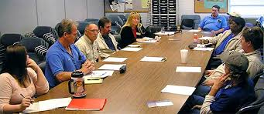
Committee Responsibilities
Committee records must be maintained for a minimum of five (5) years
  Membership lists
  Meeting agendas
  Minutes
  Attendance records
  Training documentation
www.iup.edu/pa-oshaconsultation

Slide 16
Management Responsibilities
Provide Support – Time, Effort, Money
Promote positive effects of Committee
activities on individual basis or at group meetings
Support training for Committee members
Enforce safety policies and procedures
Attend Committee meetings
www.iup.edu/pa-oshaconsultation

Slide 17

Employee Responsibilities
Follow safe practices/procedures
Identify safety and health hazards
Report all unsafe conditions and practices
Make suggestions for improving workplace safety
www.iup.edu/pa-oshaconsultation

Slide 18
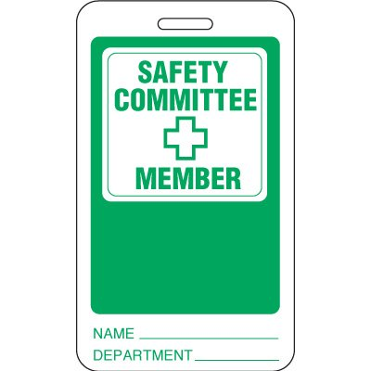
Member Responsibilities
Attend meetings
Notify all employees in your area that you are the
representative on the Committee
Be watchful for unsafe conditions and acts and
report them
Be responsive to employee concerns; follow up
Ask employees for safety suggestions and concerns
Discuss safety issues with employees
www.iup.edu/pa-oshaconsultation

Slide 19

Committee Chairperson Responsibilities
Accountable to top management
Facilitates meetings
Ensures agenda is followed
Ensures everyone is heard
Chairperson rotation (monthly/
quarterly/yearly)
www.iup.edu/pa-oshaconsultation

Slide 20
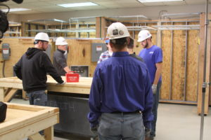
Safety Committee Activities
Review & update safety training
Develop safety work practices
Recommend use of safety equipment/devices
Incident report reviews
Action items from reports & safety inspections
Avenue for employee safety-related issues
www.iup.edu/pa-oshaconsultation

Slide 21
Committee Member Training
Employer must provide adequate, annual training for all committee members
  Workplace Safety Committee – Initial Certification Training (required)
  Workplace Safety Committee – Annual Recertification Training (required)
Minimum required annual training to include:
  Hazard detection and inspection
  Accident and illness prevention and investigation, safety committee structure and operation
  Must include substance abuse awareness and prevention training
  Any other safety and health concerns specific to the business
  Must be provided by PA Bureau of Workers Compensation certified/recognized trainer – e.g., PATHS
  Trainer qualifications/documentation must be included with Application
www.iup.edu/pa-oshaconsultation

Slide 22


Committee Member Training
Certified/Qualified Trainers Examples (Not all Inclusive)
  Medical Doctor
  Certified Industrial Hygienist(CIH)
  Certified Safety Professional (CSP)
  Industrial Hygienist in Training (IHIT)
  Associate Safety Professional (ASP)
  Formal degree (e.g., bachelor’s, masters, etc.) in Safety or Engineering
  Certified Occupational Health Nurse
  Advanced Safety Certificate from National Safety Council
  Associate in loss control management
  Associate in risk management
www.iup.edu/pa-oshaconsultation

Slide 23

Committee Member Training
Written records of safety committee training must include:
  The names of committee members trained
  The dates of training
  The training time period
  The training methodology
  The names and credentials of personnel conducting the training
  The names of training organizations sponsoring training, if applicable
  The training location
  The training topics
www.iup.edu/pa-oshaconsultation

Slide 24

Committee Member Training
Training Resource – Approved/Qualified Training at No Cost
PA Training for Health & Safety (PATHS)
  Bureau of Workers’ Compensation
  1171 South Cameron Street Room 324
  Harrisburg, PA 17104-2501
  717-772-1635
  RA-LI-BWC-Safety@pa.gov
  www.dli.pa.gov/Businesses/Compensation/WC/safety/paths
www.iup.edu/pa-oshaconsultation

Slide 25
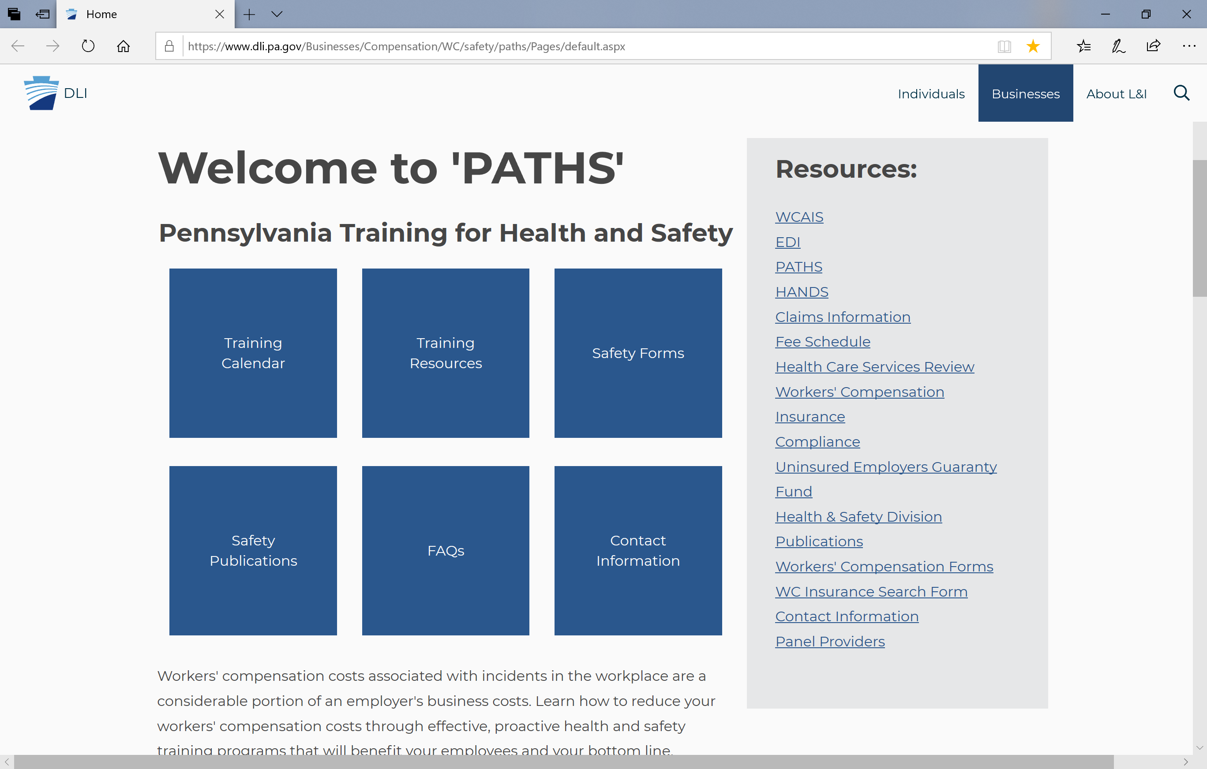
Committee Member Training - PATHS
www.iup.edu/pa-oshaconsultation

Slide 26
Committee Member Training
PA Training for Health & Safety (PATHS)
Workplace Safety Committee – Initial Certification Training (required)
Workplace Safety Committee – Annual Recertification Training (required)
Creating Effective Safety Committees
Incident Investigation
Hazard Identification
Effective Safety Committee Communication
Near Miss
www.iup.edu/pa-oshaconsultation

Slide 27

Committee Member Training
PA Training for Health & Safety (PATHS)
Opioid Use Disorder
Medical Marijuana
Job Safety/Hazard Analysis
Safety Culture
Safety for Supervisors
Workplace Safety Committee Leadership
www.iup.edu/pa-oshaconsultation

Slide 28
Certification
Employer submits initial application to PA Bureau of WC
Bureau of WC will review application and if the employer’s committee(s) meet the requirements will grant certification approval
Employer must agree/certify to operate workplace safety committee, as required
Letter of certification approval is then submitted to the employer's insurer (or group self insurance fund) to receive an initial 5% reduction of workers’ compensation premium
Reduction is effective at the next policy renewal period following the date of certification
Bureau of WC will notify the PA Compensation Rating Bureau of approved employer
www.iup.edu/pa-oshaconsultation

Slide 29

Certification
If application is disapproved, employer will be notified of the specific reason(s) for disapproval
May submit a corrected application for reconsideration
May challenge the disapproval determination
Most common reasons for application disapproval:
  Application not submitted in the defined timeframe
  Committee must be in existence and operating for six full, consecutive calendar months prior to submission of application
  Committees missing a monthly meeting or not holding a qualifying meeting with a quorum
www.iup.edu/pa-oshaconsultation

Slide 30
Certification
Most common reasons for application disapproval (continued):
  Every committee member must receive adequate committee training prior to submission of application
  Certified committees must be comprised of at least four members-2 employer, 2 employee
  Agendas submitted within Initial Application should be an outline of topics for an upcoming meeting
  Committees are responsible for conducting a review of incidents
  Committees are responsible for performing periodic workplace inspections to locate and identify hazards
  The application must include workers’ comp policy details for the current policy period
  Job titles provided in the application should indicate the position held within the company by each member
www.iup.edu/pa-oshaconsultation

Slide 31
Certification Renewal
Submit LIBC-372R – Certification Renewal Affidavit of Workplace Safety Committee to the Bureau of Workers Compensation
Affidavit must be submitted between 90 and 15 calendar days prior to annual renewal of workers compensation policy, self insurance renewal year or group self-insurance fund year
If additional safety committees have been established (by the employer) but were not previously certified, an application must be submitted and approved by the Bureau of WC before certification renewal is granted
Audits - Auditors normally ask for three (3) years of records to ensure necessary information is in place
www.iup.edu/pa-oshaconsultation

Slide 32
COVID-19
Workplace Safety Committees and COVID-19
Employers are not penalized if their business is temporarily closed and meetings cannot be conducted
Virtual meetings recommended if workforce is teleworking or they can otherwise hold meetings
If business is closed and cannot hold meetings answer “no” when recertifying to the question asking if all meetings were held. Explain why (e.g., COVID-19) in block provided.
When evaluating compliance with the regulations, the safety committee process is evaluated for a three-year period.
Late submissions of applications accepted if deadlines fall during the “defined crisis period”. Contact BWC once your company resumes daily operations.
www.iup.edu/pa-oshaconsultation

Slide 33

COVID-19
Workplace Safety Committees and COVID-19
If you want to continue to have safety committee meetings and would like guidance on adapting to the use of technology for meetings, send an email to RA-LI-BWC-Safety@pa.gov for assistance
www.iup.edu/pa-oshaconsultation

Slide 34
Summary – Why it Makes Sense to Pursue a Certified Safety Committee at your Facility
Increased Awareness of Safety
Identify Risk(s) and Create Plan to Correct Them
Facilitates Co-operation in Developing and Carrying Out Measures to Improve Safety
Integrate Safety and Health Priorities into Corporate Culture
Employees Practice Safe Work Habits
www.iup.edu/pa-oshaconsultation

Slide 35
Summary – Why it Makes Sense to Pursue a Certified Safety Committee at your Facility
Employees Demonstrate Increased Productivity
Reduction in Lost Time Due to Work-Related Injuries/Illness
Reduction in Cost Due to Work Related Injuries/Illness
Reduction in Liability Due to Work Related Injuries/Illness
Encourage Safety Training for Employees and Management
5% Discount on Workers’ Compensation Insurance Premium
www.iup.edu/pa-oshaconsultation

Slide 36
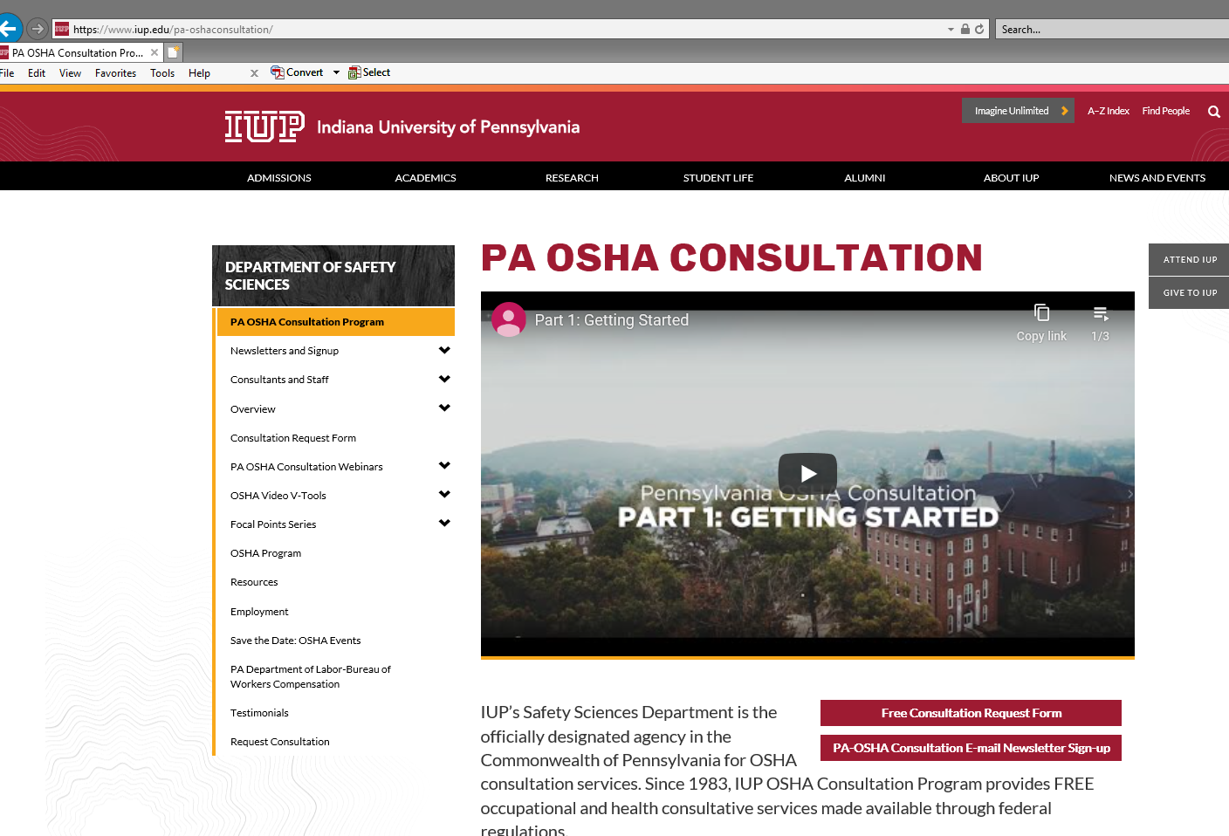
www.iup.edu/pa-oshaconsultation

Slide 37
Contact us
Pennsylvania OSHA Consultation Office
Phone: 800-382-1241
Web: www.iup.edu/pa-oshaconsultation/
Facebook: https://www.facebook.com/Pennsylvania-OSHA-Consultation-Program-548810235234647/
Twitter: https://twitter.com/search?q=PA%20OSHA%20Consultation&src=savs
www.iup.edu/pa-oshaconsultation

Slide 38
Thank You
Upcoming Webinar:
RESPIRATORY PROTECTION – NURSING HOMES, ASSISTED LIVING AND OTHER LONG-TERM CARE FACILITIES
February 10, 2021 @ 10:30am
Pennsylvania OSHA Consultation Office
Phone: 800-382-1241 or 724-357-4095
Website: www.iup.edu/pa-oshaconsultation
www.iup.edu/pa-oshaconsultation

