Slide 1
Welcome Exposure Assessment –
When, Why & How Will begin at 10:30am Presented by: Pamela Susi, MSPH, CIH Pennsylvania OSHA Consultation Office Phone: 800-382-1241 or 724-357-4095 Website: www.iup.edu/pa-oshaconsultation

Slide 2
EXPOSURE ASSESSMENT – WHEN, WHY & HOW
Webinar General Info PowerPoint Presentation Q&A Questions Chat is open to submit questions. We will be answering questions through this chat feature. If due to the technical nature of the question a more thorough response is required, we will post the answer on our website within seven days of the webinar.
www.iup.edu/pa-oshaconsultation

Slide 3
Why we do Exposure Assessment – the big picture
So workers and their families can go home healthy and live long lives free of occupational illnesses and disease
5333 workers were killed on the job in 2019
95,000 workers are estimated to have died from occupational diseases in the same year*
We do it to PREVENT disease, illness and unnecessary deaths.
* AFL-CIO. Death on the Job. Washington, D.C. 2021
www.iup.edu/pa-oshaconsultation
Notes:
Talking about how ultimately – on a macro scale all exposure assessment is aimed at making sure workers go home safe and are able to live a long, healthy life well into retirement age. Unfortunately, hundreds of thousands workers have had lives shortened due to occupational diseases like asbestosis, silicosis, bladder and lung cancer other diseases which could have been prevented.

Slide 4
Stop Silicosis – US DOL

Slide 5
Pennsylvania, 2019
Occupational fatalities – 154
137,000 illnesses/injuries
Ranked no. 8 (no. 1 being best)
Notes:
Bad news – fatalities and illnesses and injuries;
Good news – we are right behind California in being the best in terms of lowest fatality and illness/injury rates.

Slide 6
Recognizing Health Hazards – major categories
Physical hazards
Chemical hazards
Particulates (fumes & dusts)
Vapors (solvents)
Gases (methane, welding gases)
Biological hazards (e.g. legionnaires disease & infectious disease)
Notes:
Major health hazards that we focus on when doing exposure assessment are…..

Slide 7
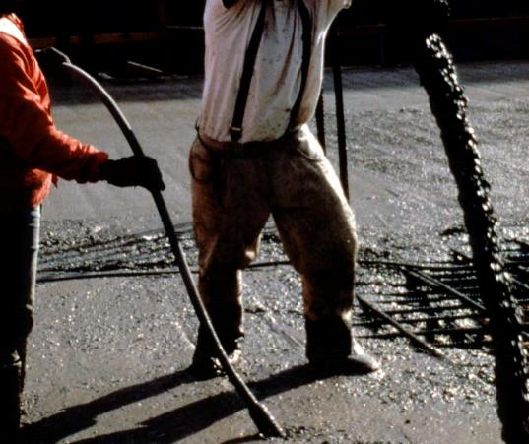
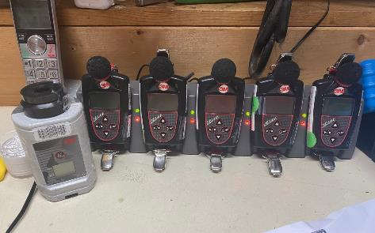
Major Physical hazards
Ergonomics
Noise
Thermal stress
Radiation
Notes:
Physical hazards include…

Slide 8
What is exposure assessment (EA) ?
The process of occupational EA includes
identifying & characterizing workplace exposures;
evaluating their significance; and
developing estimates of exposures to individuals or groups of workers, which may be used in risk estimates or exposure-response studies.
Notes:
NIOSH Publication 2002-126 is available for from NIOSH. Provides some good information and definitions on exposure assessment. They encompass exposure assessment from the ground up – identifying and characterizing exposures at the job site, evaluating what we fnd and using those results to conduct larger population studies looking at exposure-response or risk assessments.

Slide 9
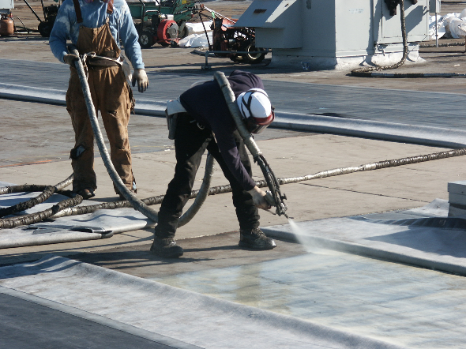
Why we do exposure assessment
Surveillance – tracking occupational disease and evaluating risk
Epidemiology studies
Risk assessment
Compliance –
Fumes, mists and vapors ( OSHA Z-Tables)
Comprehensive health standards require initial & periodic exposure assessments
Respirator standard (must do an assessment to evaluate respirator needs)
Diagnostic purposes
Evaluating engineering controls
Identifying “hot spots” or sources of contaminants

Slide 10
History of Occupational Health
Workplace illnesses & deaths preceded the practice of exposure assessment
Bernardino Ramazzini (1633-1714) while at Univ. of Modena visited workplaces & talked to workers about their illnesses, what they did in a systematic way
1700 penned De Morbis Artificom Diatribe (“Diseases of Workers”)
Known as the Father of Occupational Medicine
Notes:
Before we did exposure assessment and environmental monitoring, physicians began observing their patients were getting sick and the source of their sickness was work. Although there were individuals going back to ancient times that make the association between illness and environmental exposures like lead, Bernardino Ramazzini is credited with being the Father of Occupational Medicine.
His renowned book De Morbus Artificum Diatriba – Diseases of Workers describes diseases among 54 different occupations.

Slide 11
“[I have seen] workers in whom certain morbid affectations gradually arise from some particular posture of the limbs or unnatural movements of the body called for while they work. Such are the workers who all day stand or sit, stoop or are bent double, who run or ride or exercise their bodies in all sorts of [excess] ways. ... the harvest of diseases reaped by certain workers ... [from] irregular motions in unnatural postures of the body.” -- Bernardino Ramazzini
Notes:
Ramazzini also observed the role forceful, repetitive motions and awkward postures played in worker illness, what we now call cumulative trauma disorder or repetitive motion injuries.

Slide 12
Alice Hamilton & the Principles of Industrial Hygiene
…protection of the health and well-being of workers and the public through anticipation, recognition, evaluation and control of hazards arising in or from the workplace.
Excerpt from “The Occupational Environment: It’s Evaluation, Control and Management (AIHA)”
Alice Hamilton (1869-1970) Physician and early
founder of industrial hygiene
Notes:
Alice Hamilton – an American is nown as the mother of Industrial Hygiene. She was also a physician who spent lot of times in factories. She was the first woman faculty member at Harvard in 1919.
A great book to read if you want to learn more about her is: Exploring the dangerous trades; the autobiography of Alice Hamilton, M.D
.
Author / Creator
Hamilton, Alice, 1869-1970

Slide 13
Milestones Pre-OSHA
1919 – Dupont Chamberworks in Deepwater, NJ produces benzadine & BNA
1895 – A German doctor reports 3/45 dye workers with bladder cancer (rare disease)
ILO follows in 1921 with monograph – Cancer of Bladder among workers in Aniline Factories
Benzidine & benaphtalamine (BNA) suspect agents
Internal memo describes poor handling of materials/no controls
1932 – Dupont docs see first bladder cancer cases
1936 – 83 bladder cancer cases had developed
Notes:
The twentieth century was a period of industrial growth and the associated illnesses became gradually became evident as the years went on. One of the more tragic examples was clusters of bladder cancer among dye workers which was first documented at the end of the 19th century in Germany and then documented by the ILO in a 1921 monograph which associates benzidine and benaphtalamine with bladder cancer among workers in aniline dye factories.
In 1919 Dupont opened their Chamberworks facility, that anyone driving over the Delaware Memorial Bridge from Delaware to NJ can still see. They began producting benzadine and BNA. Internal memos described poor handling of these chemicals and poorly controlled processes. The first bladder cancer cases were seen in 1932 and by 1936 they had 83 cases. This number, as high as it is, is magnified by the fact bladder cancer is considered to be a rare disease.

Slide 14
Milestones Pre-OSHA
1938 - US PHS Asbestos Survey
NC asbestos textile plant
69/150 fired employees screened for asbestosis
43 had asbestosis
68% exposed > 10 years to 5-10 mppcf had asbestosis
1968 – Mt. Sinai School of Medicine
Dr. Irving Selikoff conducts study of Asbestos Workers
Finds rate of lung cancer 7 times what would be expected for similar matched group.
Notes:
Another industrial/occupational health tragedy that is still playing out is asbestos. In 1938 the US PHS went down to NC to screen workers in an asbestos textile plant for asbestosis. But by the time they got there the employer had fired 150 of the employees. They still managed to track down 69 of the fired employees and screen them. 43 ( or 62%) has asbestosis> They found that 68% of workers exposed to asbestos in concentrations of 5-10 millions of particles per cubic feet of air for more than 10 years had asbestosis.
Thirty years later traveling north, in NYC Dr. Irving Selikoff an occupational health physician conducted a study of asbestos workers and found that they were 7 times more likely to die of cancer than what would be expected. The asbestors workers union approached Dr. Selikoff because their pension fund was too flush – too many members were dying before they made it to retirement age.

Slide 15
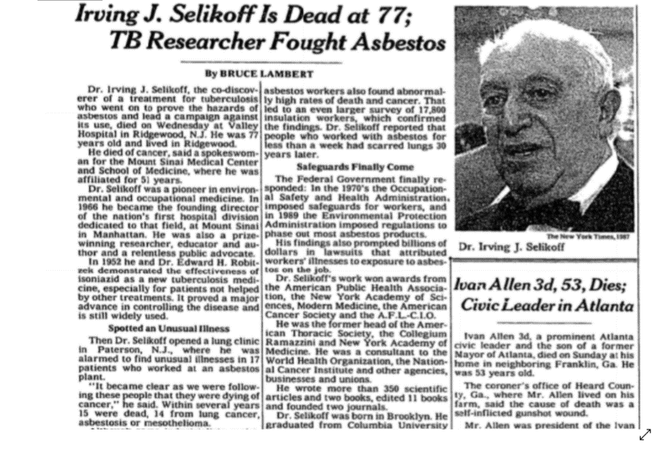
Dr. Irving J. Selikoff
1915 – 1992
1987
www.iup.edu/pa-oshaconsultation
Notes:
Dr. Selikoff was highly respected in the field of occupational health. In his obituary they talk about a “lung clinic” he opened up for workers from Paterson, NJ. It was there that he saw illnesses in 17 workers from an asbestos plant; within a few years 15 would die – 14 from lung cancer, asbestosis or mesothelomia. His much larger study of insultors involved 17,000 workers and found lung scarring among workers who had worked with asbestos for less than a week.

Slide 16
OSHA is signed into law in 1970 and rapidly developed standards, enforcement, consultation & training programs
But the job of keeping occupational health hazards in check was far from over…..
Notes:
Finally, in 1970 there was bi-partisan support for an Occupatioanl Safety and Health Agency and the OSH Act was signed into law by Richard Nixon in 1970. It went into effect in 1971. The agency rapidly adopted volumes of standard including comprehensive standards for lead, carcinogens and cotton dust; set up the OSHA Training Institute and established the OSHA Consultation Program which provides the funding that allows us to put on things like this webinar and conduct visits to assist PA employers in complying with OSHA standards and strengthening their S&H programs.
But they were far from done and are constantly working to protect workers on the job and it’s not always easy.

Slide 17
Benzene – OSHA Rule-Making (1978)
Benzene can cause leukemia, aplastic anemia and possibly lymphoma
In 1978 OSHA published the Benzene Standard lowering the PEL from 10 parts per million (PPM) to 1 PPM
Court decisions between 1975-1990 ruled there must be “significant” risk for OSHA to lower a PEL
For carcinogens, the court viewed that as 1 case per 1000 workers exposed over 45 years
The Fifth Circuit Court of Appeals stayed the OSHA Rule, saying insufficient evidence of significant risk
In 1987 the PEL was lowered back to 1 PPM
Notes:
One of the most significant Post-OSHA cases which also provide an example of how exposure data is used in risk assessment/dose response studies and how important those studies are in the overall scheme of worker health is Benzene. It also illustrates the obstacles OSHA faces in the rule-making process and why it takes so long to update standards.

Slide 18
Real-World Risk Assessment Study(1989)
Nicholson & Landrigan study looks at risk of leukemia resulting from 9-year delay in a reduced PEL
Based on 238,000 workers exposed in 7 occupational categories from 3 epidemiology studies, an elevated risk of 44 to 152 times unexposed workers is expected among workers exposed to 10 PPM of benzene over a 45 -year working lifetime.
Using those elevated risk rates, they estimate 30-490 excess leukemia cases due to the court delay.
Notes:
When the courts stayed the benzene standard for 9 years, the put a pause on worker protections. Nicholson & Landrigan looked at how many additional cased of leukemia were likely to have occurred using risk estimates derived during rule-making.
Based on their calculations, they estimated an additional 30 to 490 workers were likely to have developed leukemia due to lack of protections that would have reduced their exposures to benzene.
As a point of information – the courts in general as part of OSHA rule-making and challenges have stated they view 1 cancer case per 1000 workers a reasonable risk. However, even at 1 PPM, with 238,000 workers exposed – in this case that would result in 238 cases of leukemia given there are an estimated 238,000 worker exposed to benzene that would be allowed to be exposed up to 1 PPM. .

Slide 19
Who does Exposure Assessment
Occupational physicians
Epidemiologists & biostatisticians
Industrial hygienists

Slide 20
Epidemiologists
“When disease outbreaks or other threats emerge, epidemiologists are on the scene to investigate. Often called “Disease Detectives”, epidemiologists search for the cause of disease, identify people who are at risk, determine how to control or stop the spread or prevent it from happening again. Physicians, veterinarians, scientists, and other health professionals often train to be “Disease Detectives” - CDC
Notes:
This is how the CDC describe epidemiologists
Sometimes people medical school graduates become epidemiologists. They look at large populations or workers and study exposure over time generally measured in years or a lifetime. They have study methods and employ statistical tools and survey methods in data gathering and analysis. Epidemiologists were active during the pandemic in studying trends and patterns of Covid-19.

Slide 21
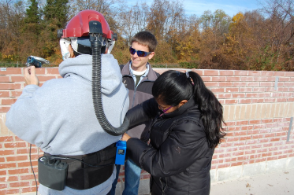
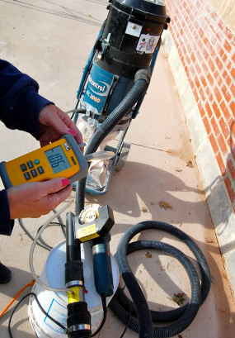
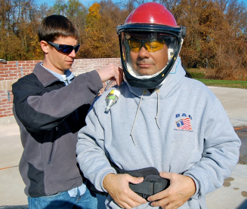
Industrial hygienists
Professional industrial hygienists (IHs) typically have
At least a bachelors degree in sciences or engineering, with course work in industrial hygiene
At least 4 years of professional experience
They usually
Gather or supervise the gathering of exposure data in the field
Evaluate exposure data
Implement/evaluate controls
Notes:
Industrial hygienists are involved in the anticipation, recognitions, evaluation, control and prevention of health hazards on the job. They are collecting exposure data on sites, recommending engineering controls and should be evaluating how well they work and talking to workers about what they do and what hazards or of concern to them.

Slide 22
Why and when we do exposure assessment
Surveillance – tracking occupational disease and evaluating risk
Epidemiology studies
Risk assessment
Compliance –
Fumes, mists and vapors ( OSHA Z-Tables)
Comprehensive health standards require initial & periodic exposure assessments
Respirator standard (must do an assessment to evaluate respirator needs)
Diagnostic purposes
Evaluating engineering controls
Identifying “hot spots” or sources of contaminants

Slide 23
Setting exposure limits
OSHA sets Permissible Exposure Limits (PELs) for chemicals in the workplace
These are the “legally” allowable levels of exposure, but often not adequately protective
Most were adopted from recommended limits that were in place in 1970 when OSHA was created
OSHA has only updated 16 PELs since 1970 and only has about 500 PELs for the thousands of chemicals in use
PELS are based on exposure-response (or risk assessment) studies which assume 45 years of exposure
Notes:
One of the biggest challenges is setting Exposure Limits – what OSHA calls PELs, or Permissible Exposure Limits. These are the values OSHA uses to evaluate if exposures for a particular chemical are too high in a workplace. First of all, there are only about 500 of them despite the fact there are thousands of chemicals in use and the list is growing; secondly, when OSHA came into existence, they had to quickly get up to speed so they adopted existing recommended exposure limits which were the ACGIH Threshold Limit Values (to be discussed in detail later) from 1970. That was ok in 1970, but unfortunately, they are still being used now for most chemical agents meaning PELS in use are over 50 years old and, in many cases, not offering adequate protection. Only 30 PELS have been updated as part of comprehensive health standard rule-making and each of those standards have been long, drawn-out processes which routinely involve legal challenges.

Slide 24
Exposure Assessment - Compliance
Most PELs were adopted from the Walsh-Healy Public Contracts Act which were based on 1968 Threshold Limit Values (TLVs®) of the American Conference of Governmental Industrial Hygienists (ACGIH®).
Employers must do air monitoring to make sure exposures are below the PELs and implement engineering or administrative controls if they aren’t
If not feasible, protective equipment/measures must be taken
Industrial hygienists or technically qualified person must be involved in approval of equipment or technical measures used for control measures.
Most of OSHA’s approximately 500 PELs that are over 50 years old appear in what are called “Z-tables” in the OSHA Standards.
https://www.osha.gov/laws-regs/regulations/standardnumber/1910/1910.1000
Notes:
OSHA Z Tables contain a list of air contaminants for which there are PELs. These are the 1968 TLVs which were legally adopted by OSHA when it came into existence. Employers have to do air monitoring to make sure they are not exceeding the PELs and implement engineering controls if they are out of compliance.
1910.1000(e)To achieve compliance with paragraphs (a) through (d) of this section, administrative or engineering controls must first be determined and implemented whenever feasible. When such controls are not feasible to achieve full compliance, protective equipment or any other protective measures shall be used to keep the exposure of employees to air contaminants within the limits prescribed in this section. Any equipment and/or technical measures used for this purpose must be approved for each particular use by a competent industrial hygienist or other technically qualified person. Whenever respirators are used, their use shall comply with 1910.134.

Slide 25
OSHA Recommends Employers Consider Other Criteria in Evaluating Workplace Exposures
California Division of Occupational Safety and Health (Cal/OSHA) Permissible Exposure Limits (PELs).Cal/OSHA has established an extensive list of PELs (Cal/OSHA AC-1 Table. Of all the states that have OSHA-approved State Plans, California has the most extensive list of OELs.
National Institute for Occupational Safety and Health (NIOSH) Recommended Exposure Limits (RELs). NIOSH is a federal occupational safety and health research institute established by the OSH Act to make recommendations to OSHA on standards. They evaluate all available medical, biological, engineering, chemical, and trade information relevant to the hazard when considering recommended exposure limits.
ACGIH® Threshold Limit Values (TLVs®) and Biological Exposure Indices (BEIs®).ACGIH® is a private, not-for-profit, nongovernmental corporation. Threshold Limit Values (TLVs®) refer to airborne concentrations of chemical substances and represent conditions under which it is believed that nearly all workers may be repeatedly exposed, day after day, over a working lifetime, without adverse effects based on available studies.
They also publish Biological Exposure Indices (BEIs®) which are guidance values for assessing biological monitoring results – which are concentrations of chemicals in biological media (e.g., blood, urine).
Notes:
Beginning with OSHA during the David Michaels era – there was a recognition from OSHA that in many cases teir PELS were not adequately protecting workers and other occupational exposure limits should be considered.
CAL –OSHA updated their PELs, draws from TLVs.
NIOSH does health-based reviews and recommendations and prepares “criteria documents”. These are excellent sources of information and the RELs are better OELs but they do no put many new ones or update them frequently.
ACGIH is a private, non-profit that has a volunteer committee that generates TLVs based on scientific reviews. These committees must be made up of a majority of representatives from government and academia.
It should be noted that workers are generally viewed as a “healthier” segment of the population and that the studies on which TLVs are based are often somewhat limited by populations studied.

Slide 26
Evaluating exposure levels – TLVs® and BEIs®
TLVs® and BEIs® are health-based values and are not intended to be used as legal standards
Reviewed and updated more frequently than other sources
ACGIH publishes detailed documentation of basis of TLV
Were the basis of original PELs
OSHA tried to update PELS with current ACGIH TLVs in late 1980s but lost court challenge
www.acgih.org
www.iup.edu/pa-oshaconsultation

Slide 27
OSHA Annotated PEL Tables
https://www.osha.gov/annotated-pels/table-z-1

Slide 28
OSHA Standards that Require Exposure Assessment
Comprehensive health standards (16)
For example - lead, silica, benzene, methylene chloride, hexavalent chromium
Comprehensive standards typically require an initial exposure assessment followed by periodic exposure assessment requirements dependent on the outcome of the initial EA
A couple of the construction standards have presumptive exposures built in (lead, asbestos, silica).
Respiratory protection
1910.134(d)(1)(iii)The employer shall identify and evaluate the respiratory hazard(s) in the workplace; this evaluation shall include a reasonable estimate of employee exposures to respiratory hazard(s) and an identification of the contaminant's chemical state and physical form. Where the employer cannot identify or reasonably estimate the employee exposure, the employer shall consider the atmosphere to be IDLH.
Notes:
You must know the exposure level for respirator use to know if the APF is adequate.

Slide 29
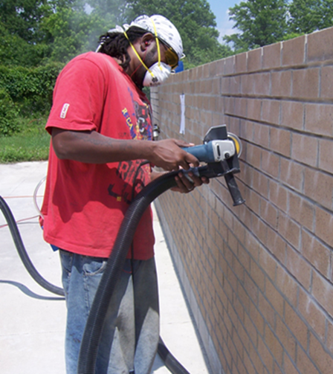
Why and when we do exposure assessment
Surveillance – tracking occupational disease and evaluating risk
Epidemiology studies
Risk assessment
Compliance –
Fumes, mists and vapors ( OSHA Z-Tables)
Comprehensive health standards require initial exposure assessment
Respirator standard (must do an assessment to evaluate respirator needs)
Diagnostic purposes
Evaluating engineering controls
Identifying “hot spots” or sources of contaminants

Slide 30
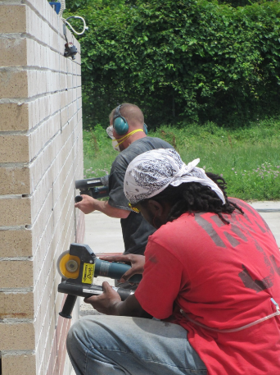
Diagnostic exposure assessment

Slide 31
Measuring exposure – the mechanics & how we do exposure assessment
Notes:
The most basic and common way we do exposure monitoring is with a simple pump which we calibrate so we know the exact flow rate (liters of air being drawn in per minute). The pump draws air some type of sampling media – typically a cassette of some type for particulate or a glass tube for solvent vapors. A cassette is visible on the right attached to a cyclone device which is used to separate larger particles from respirable particles. A tube connects the sampling media to the pump so that the mass of particulate is collected on the sampling media at a known flow rate through the pump.
At the end of the day – we can use the total sample time in minutes, along with the flow rate in liters of air per minute to calculate the total air volume sampled. We then send the cassette to the lab and direct them to analyze for whatever we are interested in – in this case it was silica and particulate (respirable because we separated out the non-respirable particulate in the field). When the lab sends us our results in micrograms of respirable silica or quartz, we can use that as our numerator along with our volume of air to come up with a result in units X micrograms of silica per cubic meters of air. We just need to convert liters to cubic meters.

Slide 32
The mechanics of exposure assessment
There are methods and equipment for monitoring
Chemical agents; and
Physical agents (e.g. noise, heat, ergonomics, radiation)
Industrial hygienists concentrate mostly on chemical agents, noise and heat with regard to quantitative measurement.
https://www.cdc.gov/niosh/nmam/default.html
Notes:
NIOSH and OSHA publish standardized, validated methods for hundreds of chemical agents.

Slide 33
Sampling methods
Sampling methods provide instructions on sampling media
Pump flow rate plus min & max volume
Sample is sent to lab to get mass or volume of contaminant (numerator)
Air pulled through pump provides volume of air collected in the field (denominator)
Results are presented as a concentration, in the case of lead = X micrograms or milligrams of lead per cubic meter of air.
For example, the lead PEL is 50 micrograms /cubic meter (ug/m³⁾ of air.
Notes:
These provide minimum and maximum flow rates, sample media, maximum air volumes and much more. But for the industrial hygienist those 3 pieces of information are the most important items.

Slide 34
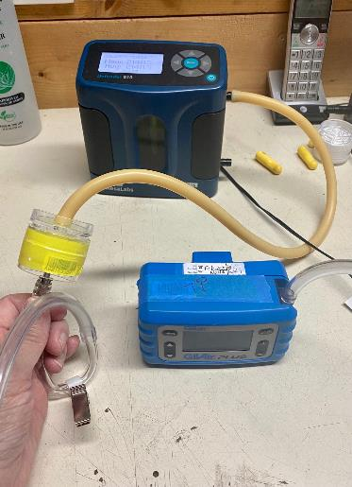
Air monitoring equipment

Slide 35
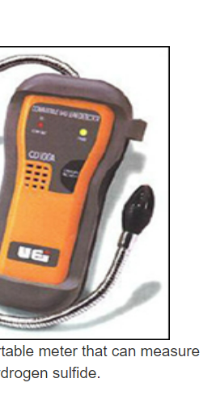
Tools of the trade – additional considerations
Direct reading v. continuous sampling
Quantitative v. qualitative information
Active v. passive dosimetry
Wipe sampling v. air sampling

Slide 36
Qualitative descriptive data on exposure variables are important to document – workers are important sources for that information.
Notes:
Both quantitative and qualitative data is collected. This approach was applied to welding first, then In 97, we revamped survey materials to focus on silica exposure primarily among painters and bricklayers. Data collection involves personal air monitoring in conjunction with collection of very detailed information on T-BEAM Survey forms for task variables

Slide 37
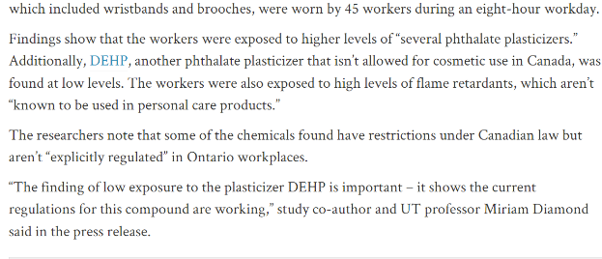
What if there are no limits?
Passive dosimetry may work better in some circumstances (less common/less validated methods)
No OELS – compare to background levels
Notes:
There are over 85,000 chemicals according to EPA that are available for commercial use, but only about 1000 have been assigned any reliable OEL.
This short article describes exposure to phthalate plasticizers among nail salon workers. Here they used passive dosimetery, no pumps which is nice because this uses little badges and here they even had wristbands which are smaller, less bulky and don’t make noise like pumps which would not be ideal in a salon with customers. However, there are less validated methods.
There are no OELs for these type of customers – so they use exposures in homes and facilities where they may see exposures as a point of comparison and saw exposures that were 30 and 10 times higher respect ively.

Slide 38
Exposure Banding
Provides an approach for the very large number of chemicals that lack OELs.
“Occupational exposure banding uses limited chemical toxicity data to group chemical substances into one of five bands, ranging from A through E. These bands, or OEBs, define the range of air concentrations expected to protect worker health. Band E represents the lowest exposure concentration range recommendation.”
DHHS (NIOSH) Publication No. 2019-132
https://www.cdc.gov/niosh/docs/2019-132/pdfs/2019-132.pdf?id=10.26616/NIOSHPUB2019132

Slide 39
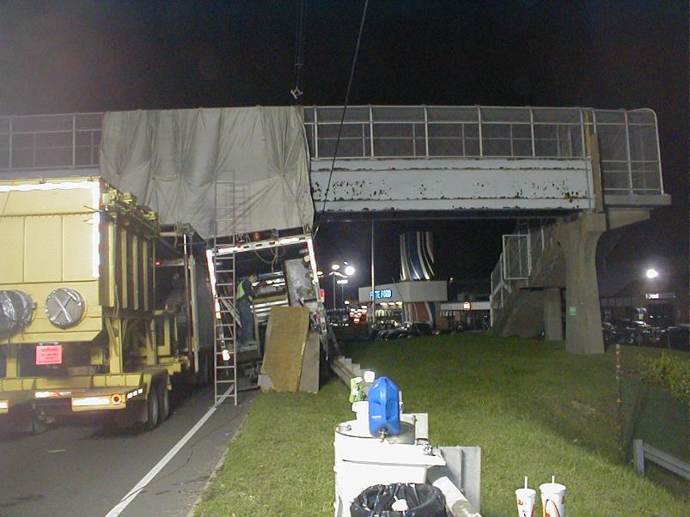
Lead Paint Job – wipe sampling may be needed in some cases
Handwashing
Station
Notes:
Containment and site monitored in 2003

Slide 40
OSHA Monitoring
OSHA's data
OSHA compliance officers do not:
Take representative samples of every employee and every activity on every day.
OSHA compliance officers do:
Target and visit certain industries based on National and regional emphasis programs.
Have limited time to conduct an inspection and cannot completely characterize all exposures for all employees, every day.
Use professional judgment and often attempt to evaluate worse case chemical exposure scenarios.
OSHA Chemical Exposure Health Data
https://www.osha.gov/opengov/health-samples
Notes:
This language was extracted from the OSHA Web sites
OSHA compliance data is not necessarily “representative” data
They look for what they think is the “worst case”

Slide 41
Worst case v. representative sampling
Compliance v. epidemiology/risk
How do we know we captured the worst?
Random samples needed to conduct representative sampling and characterize population exposure distributions (means and standard deviations)
Notes:
Sampling for compliance is different than sampling to understand what your true exposure risk is; To understand what your true exposure is you want to understand the full exposure distribution – the range of exposures. The first rule of statistical sampling is to randomly select your samples. You are trying to use your samples to get a glimpse of the whole population of actual samples. So you need those samples to be randomly selected from the whole population – you don’t want to skew it.
The other problem with “worst case” is we aren’t very good at capturing it. If we sample in the summer time when the garage bay door is open we probably won’t catch the worst case. In general, we’ll never know if we caught the worst case.
This picture looks like the worst case but that puff of dust may have lasted 1 minute and on the other side of the building there is another tuck-pointer who will be generating a bigger cloud for an hour.

Slide 42
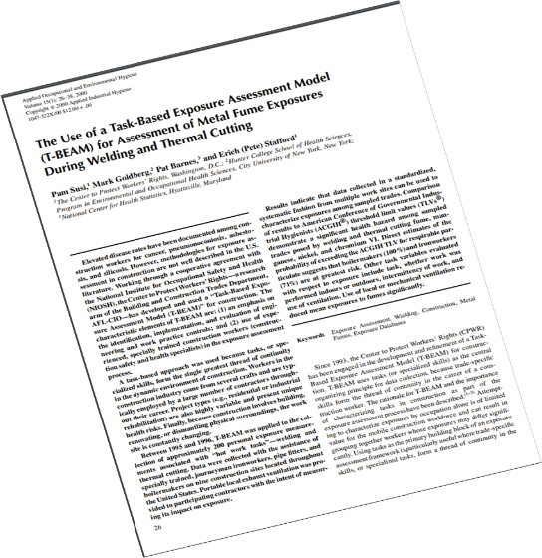
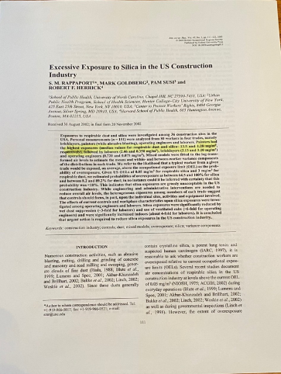
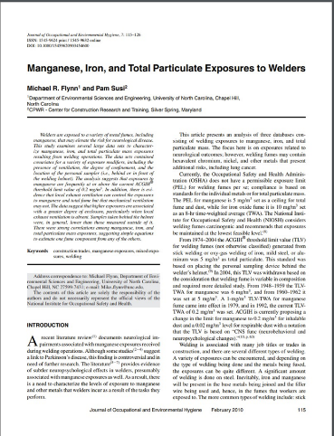
Exposure Analysis & Studies
Exposures may vary substantially
Engineering controls reduce not only magnitude of exposures but variability
For welding – LEV reduces manganese exposure but mechanical ventilation may not.
For silica:
233 workers exposed to silica on 59 sites had range fold of 101-5190 within trades
44% exceeded the TLV for silica
Notes:
One of the reasons it’s hard to get a “worst –case” exposure measurement” – or know if you did, is because exposures vary so much.
For example in a study looking at silica exposure in construction trades, Stevre Rappaport, the lead researcher looked at 233 workers across 4 trades on 59 construction sites. The trade with the highest exposure (painters) had a ratio of over 5000 when you compared the highest measured exposure to the lowest. In other words there was a greater than 5000 fold difference in silica exposure just among painters .

Slide 43
Evaluating exposure data https://expostats.ca
Collect random samples if you can’t sample the whole group
Can use free on-line tools to estimate probability of exceeding occupational exposure limit
Jérôme Lavoué, University of Montreal
IRSST- conducts & funds research in occupational health & safety
Notes:
Typically, where exposure monitoring occurs, there may only be a few measurements available from which to determine if workers may be at risk of an over-exposure to an OSHA Permissible Exposure Limit. The problem is exposures may vary by 10 fold or more. The green dots represent actual measurements taken over time and the black dots represent exposures that don’t get measured.
How do we address this given there aren’t enough resources to collect the amount of samples we’d like to get a full representation of what exposures are in the workplace.
There are now free on-line tools available that can be used to estimate exposures given a few measurements to start with. The following few slides were provided by or based on information provided by Dr. Jerome Lavoue, who was the lead researcher, who developed, with colleagues, a program called “Expostats”. He is a professor at the Univ. of Montreal and has worked with IRSST for many years. He is a leader in the field of exposure assessment and analysis.

Slide 44
Exposure evaluation tool
Input data from small sample sizes
Based on statistically informed decisions
Provides evaluation of the probability of the 95th percentile of exposure data exceeding the occupational exposure limit
> 30 % poorly controlled
5 – 30% moderate risk of over-exposure
< 5% controlled
Notes:
<These web-based tools used statistical approaches to augment sample sample sizes collected in the workplace to create exposure.
We’ll walk-through some of the underlying statistics – but you don’t have to understand or know how to “do” statistics to use the web site.
The end output is information on how well exposures are controlled in your workplace.
The possibilities are poorly controlled, needs improvement or controlled.

Slide 45
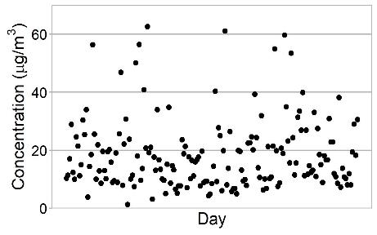
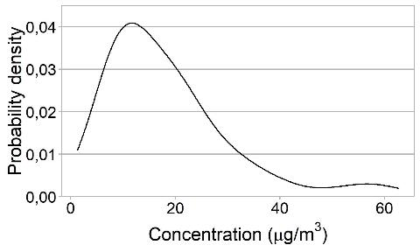
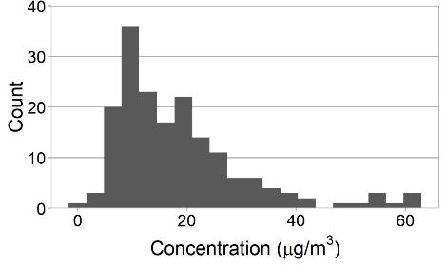
How it works - uses statistical models that take into account exposure variability
Simple scatterplot
Probability density curve
177 lead exposure measurements on six workers performing the same tasks for one year in the gasoline additive manufacturing industry
Histogram
Notes:
The next few slides describe some of the statistics and assumptions underlying Expostats.
Statistics are not the easiest thing to get through – but as Dr. Lavoue tells his students – ‘”unlike safety professionals, industrial (or occupational hygienists as they are called in other parts of the world) will never know if they got it wrong”. If someone dies of a chronic illness 10, 20 or 30 years from now we won’t be there to know about it. For our counterparts who are Certified Safety Professionals if there is a missing Lock-out/Tag-out program and some-out is electrocuted they will find out as soon as it happens. So we have to figure out ways to estimate risk as best we can and take the appropriate actions to limit those risks.
So we have to use the tools that are available and try to get as close as we can in accurately estimating risk while building in a reasonable margin of safety given the natural variability of how exposures occur.
So to get started we’ll use the example of 6 workers who work in a plant that manufactures lead additive.
The top left graph looks just like the one we just looked like earlier – randomly distributed exposures most below the OSHA PEL of 50 micrograms per cubic meters of iar.
In the bottom, center we see 177 measurements are plotted as a bar graph we call a higtogram. This just involves counting measurements by concentrations groups (X measurements in the concentration range of 0-3 ug/cu.m, and so on and so on), entering it into a spreadsheet and making a bar graph out of it. By doing that you can see that most of the exposures lean toward the smaller concentrations – less than the PEL, but there are still several above the PEL.
Expostat and industrial hygiene statistics looks at the WHOLE graph – the whole distribution. From an OSHA POV – if they measure a single measurement, you can be cited. So you want to reduce the probability that OSHA will measure an exposure over 50 ug/cu. m.
From a health point of view and in general – we aren’t as interested in “single” exposure measurements – we’re interested in the whole distribution and reducing the probability of overexposure in general using a number of statistical parameters.
The graph top right is a probably density curve which is used more commonly in sampling statistics – It can be read just like the histogram. Notice both the histogram and probability density curve look very similar in shape and both are skewed with more measurements to the left.

Slide 46
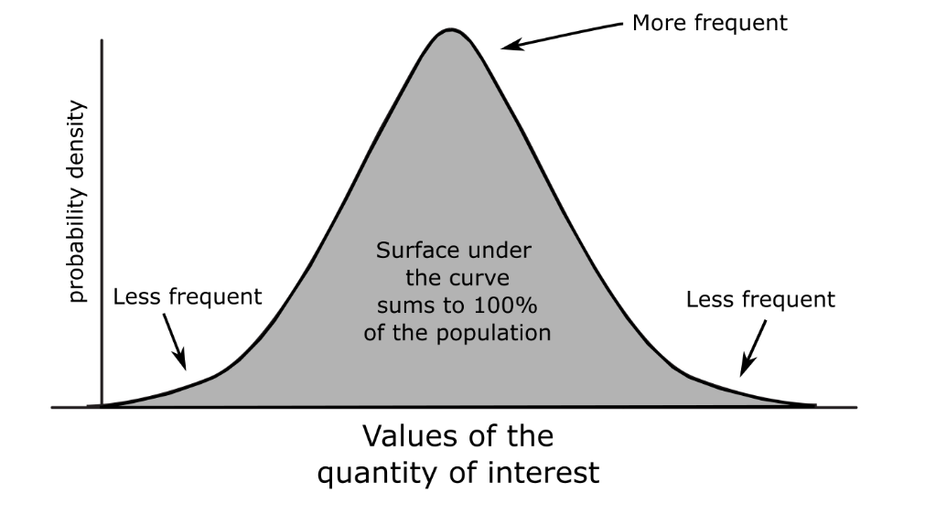
Interpreting a probability density curve is just like interpreting a histogram
Notes:
You can look at a probability density curve just like a histogram –
Everything under the line/curve represents exposure
There are less exposure measurements out in the tail areas left and right (at very low and very high concentrations
The most frequently measured concentrations are in the middle in the higher points of what looks like a hill

Slide 47
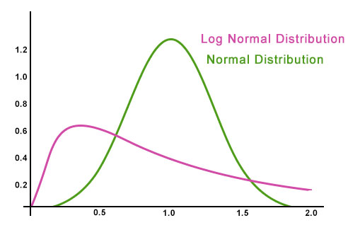
Log-Normal Distribution
Source: Log Normal Distribution (wallstreetmojo.com)
https://www.wallstreetmojo.com/log-normal-distribution/
Notes:
For those who took statistics in high school or college, you might recall the “bell curve” . What we just looked at was the normal bell curve when we talk about statistics. You can use statiics and the normal bell curve to make a lot of reasonable estimates that could come in handy it estimating the likelihood of exceeding an exposure limit like an OSHA Permissible Exposure Limit or PEL. The green line shows you the Normal distribution and the bell curve.
The problem is, exposure data – like lots of natural phenomenon such as human heights, tend to lean left. There are only a handful of men tall enough (let alone good enough) to play in the NBA relative to the general population. They follow what is called a log-normal distribution. The pink line represents the “log-normal” distribution and curve.

Slide 48
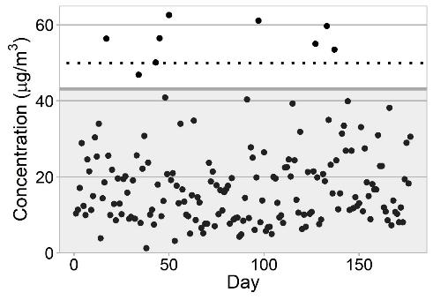
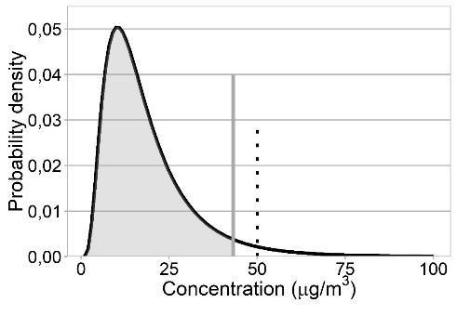
95th percentile
Sequential graph
Density curve
OEL
95th percentile
95th percentile
OEL
Lead exposure measurements in the battery manufacturing industry (n=177)
Notes:
So going back to our lead additive plant example – here is the data shown another way – on the left is a scatter plot with the PEL pictured as the dotted horizontal line labeled OEL. You can see a few exposure dots are above it. However, the 95th percentile (which would be 2 s.d. from the mean is less than the OEL, so that’s a good thing.
Looking at it with a probability density curve it’s a little easier to see statistically. The PEL is 50 ug/cu. m. The 95th percentile is drawn at the vertical line that divides the gray area and the white area. That little sliver of the whit log normal graph represents the probability of over-exposure – it is there, but it is very small and it is less than the OEL.

Slide 49
Risk and control recommendations based on sample analysis
Notes:
So this is NOT the lead data – this is just a screen to show you what Expostats looks like
With expostats you enter an exposure limit and your data points (the measurements you have).
The end product of Expostate is a “Decision on risk”
It shows the probability that 95th percentile (that high region to the far right of the exposure distribution curve) will exceed the OEL.
We aren’t measuring a single measurement exceeding the OEL or PEL, or a mean or average measurement exceeding the PEL – we are measuring the probable likelihood that the highest exposures we are likely to measure are above the PEL or whatever OEL we are using as our limit.
This application then compares that statistical probability against 3 possible categories. The long blue needle that looks like a gas gage provides the probability we are looking for – in this case it is 51.2% which falls in the “poorly controlled” region. Note that even though all of our exposure measurements were below the OEL, the probability that the 95th percentile would exceed the OEL was still unacceptably high. This has a lot to do with how variable the exposures are which is an indicator the actual exposures are likely to exceed the OEL and that exposures overall are not well controlled.

Slide 50
Notes:
The applications takes a middle-ground approach. The traditional approach which only allows for a 5% probability of overexposures (the 95th percentile being to the left of the OEL) is the safer threshold but more difficult to achieve. French and British organizations have proposed allowing a 30% probability of over-exposures as a pragmatic approach of avoiding the risk of declaring too many exposures that may actually be under the OEL as above it.
The compromise here is to create 3 cut points that incorporates both approaches – probability less than 5% poses very low risk of over-exposure, thus well under control; between 5 and 30% risk is moderate; the situation is under control with minimal safety margins; and if risk of overexposure is greater than 30% then it is unacceptable, and intervention is required.

Slide 51
www.iup.edu/pa-oshaconsultation

Slide 52
Contact us
Pamela Susi, MSPH, CIH
psusi@iup.edu
Pennsylvania OSHA Consultation Office
Phone: 800-382-1241
Website: www.iup.edu/pa-oshaconsultation/
Facebook: https://www.facebook.com/Pennsylvania-OSHA-Consultation-Program-548810235234647/
Twitter: https://twitter.com/search?q=PA%20OSHA%20Consultation&src=savs
www.iup.edu/pa-oshaconsultation

Slide 53
Thank You
Upcoming Webinar:
Workplace Safety and Automotive Lift
MAY 11, 2022@ 10:30am
Pennsylvania OSHA Consultation Office
Phone: 800-382-1241 or 724-357-4095
Website: www.iup.edu/pa-oshaconsultation
www.iup.edu/pa-oshaconsultation

