Slide 1
Welcome to the
2027 Fusion Fellowship Kickoff Event!
Dr. Kelly Heider, Fusion Fellowship Program Coordinator

Slide 2
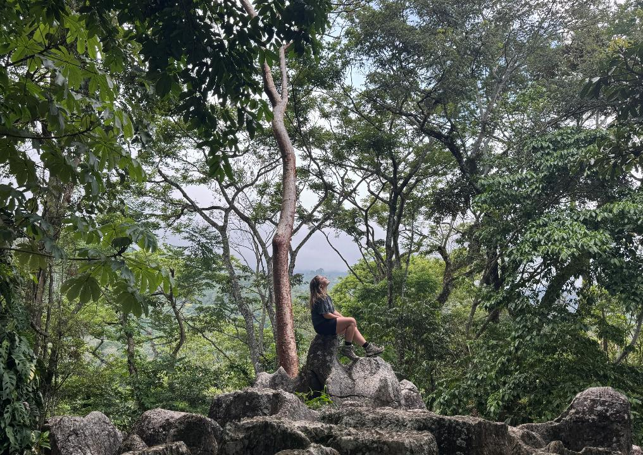
2026 Fusion Fellows: Connecting Ideas, Disciplines & Communities
Geophysics and Oral History
  Madilyn House-Groff & Jocelyn McCray
  Faculty mentors- Dr. William Chadwick, Dr. Erin Conlin & Dr. Ben Ford
Conserving Honduras: The People Behind the Process
  Serena Aumick & Riley Whiskeyman
  Faculty mentors- Stephanie Keppich & Dr. Josiah Townsend

Slide 3
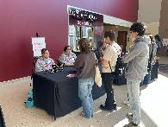
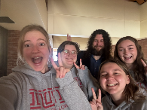
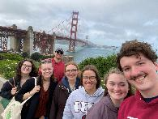
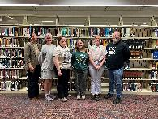
Spring 2026 Professional Development Activities
February 2026
All 4 fellows had a Common Hour consultation with Dr. Paul Hawkins, Director and Executive Research Associate of the Applied Research Lab.
March 2026
All 4 fellows had a Common Hour consultation with Carrie Bishop, Access Services Librarian, and Dr. Chris Clouser, Electronic Resources and Systems Librarian.
April 2026
Serena presented at Scholars Forum and Riley, Maddie, and Jocelyn worked at the Scholars Forum.
May 2026
Maddie attended the 91st Annual Meeting of the Society for American Archaeology in San Francisco.

Slide 4
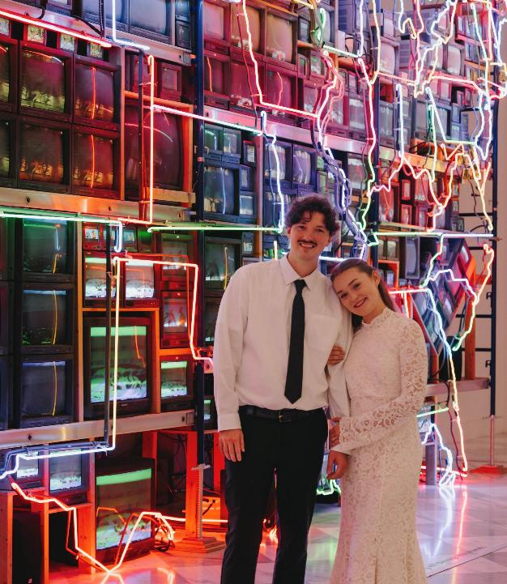
May 2026: Congratulations,
Mrs. House-Groff!

Slide 5
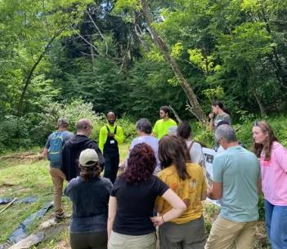
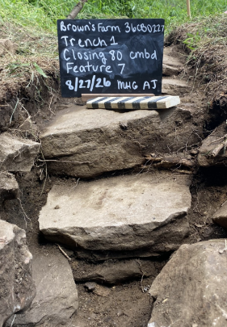
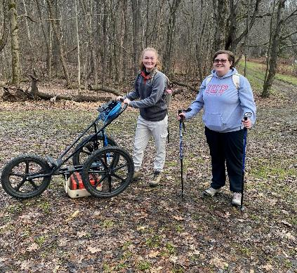
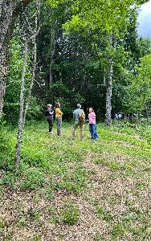
Uncovering Brown’s Farm
Madilyn House-Groff & Jocelyn McCray
SCIENCE + HISTORY + COMMUNITY
GPR → Identifying the possible farmhouse foundation
Oral History → Preserving descendants' stories
Engagement → Reconnecting families to place
Summer Milestones:
Brown's Farm Family Day
GPR discovery
Oral histories underway
Preserving history beneath the ground—and in the stories of the people who lived it.

Slide 6
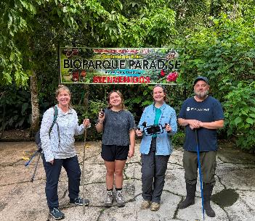
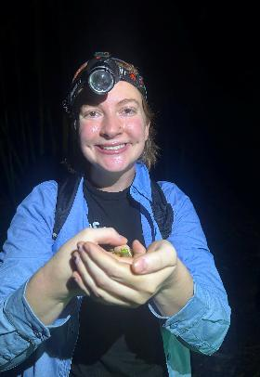
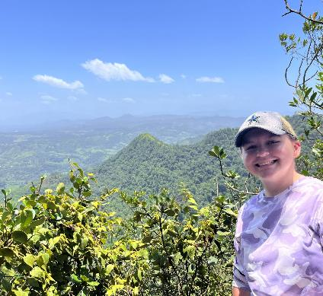
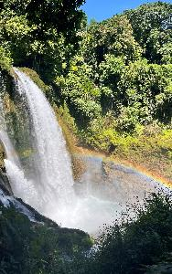
Telling the Story of Honduras
Serena Aumick & Riley Whiskeyman
JOURNALISM + FILM + CULTURE + ENVIRONMENT
Six locations → Landscapes and communities across Honduras
Eight interviews → Voices of key stakeholders
Two languages → English + Spanish
One documentary in production:
Rough draft of script complete
Rough cut of film underway
Documenting the people, places, and conservation efforts shaping the future of Honduras.

Slide 7
Fall 2026 Professional Development Activities
October 2, 2026- Pittsburgh field trip!
  WQED- Ryan Rust, executive producer and award-winning documentary filmmaker
  Heinz History Center- Sierra Green, senior outreach archivist
    Melissa Marinaro & Alonna Carter- extensive experience in oral history, exhibit development, and community engagement (Alonna is an expert in local African American history.)
October 10, 2026- “Brown’s Farm Showcase” as part of Community Archaeology Day sponsored by the Public Archaeology (ANTH 625) class
November 9, 2026- Common Hour consultation with Dr. Dana Driscoll, Director of IUP’s Center for Scholarly Communication

Slide 8
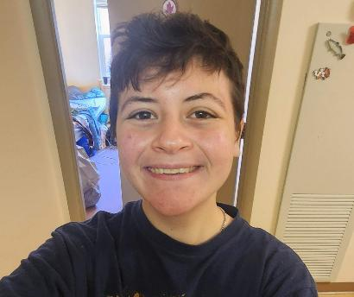
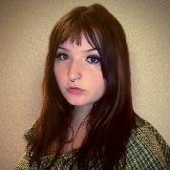
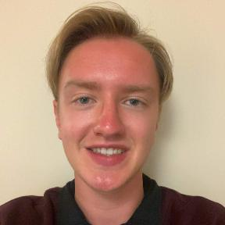
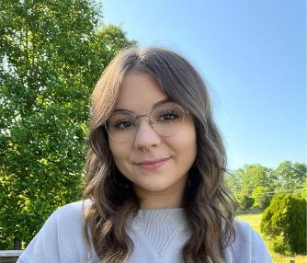
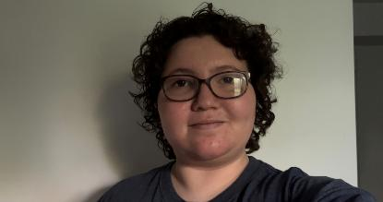
Introducing the 2027
Fusion Fellows: Exploring Connections, Creating Impact
Interface and Interpretation in Electronic Literature
  Tanner Braniff, Daniel Raynes & Remy Radwane
  Faculty mentors- Dr. Samuel Grieggs & Dr. Ken Sherwood
Daily Life Through Time in Indiana County
  Abigail Hutchins & Jenna LaGesse
  Faculty mentors- Dr. Francis Allard, Sean Derry, Dr. Lara Homsey-Messer

Slide 9
Interface and Interpretation in Electronic Literature: Reimplementing a Classic Hypertext
The Challenge
M.D. Coverly’s Egypt relies on discontinued Shockwave technology and is no longer accessible on modern systems.
The Project
Fusion Fellows will:
  Analyze the original work and its interface
  Rebuild it using modern web technologies
  Preserve its accessibility, structure, and reader experience
  Document best practices for digital preservation
Why It Matters
An interdisciplinary project connecting literature, digital humanities, computer science, and preservation.
Outcomes
Reimplemented Egypt • Preservation documentation • IUP exhibit • Publication through The NEXT

Slide 10
Daily Life Through Time: Rethinking Indigenous History Through Exhibition Design
The Challenge
Presenting almost 16,000 years of Indigenous history in a small, community-based museum space requires an approach that highlights personal connection and continuity across time. The Project
Fusion Fellows will:
  organize exhibit content around recurring aspects of daily life.
  develop interactive and hands-on exhibit experiences.
  create points of entry for visitors to connect objects and experiences across time.
Why It Matters
An interdisciplinary collaboration connecting archaeology, art history, and design to implement an engaging and responsible exhibit about Indigenous history in a small museum space.
Outcomes
Permanent HGSIC exhibit • Interactive opportunities • Thematic connections

Slide 11
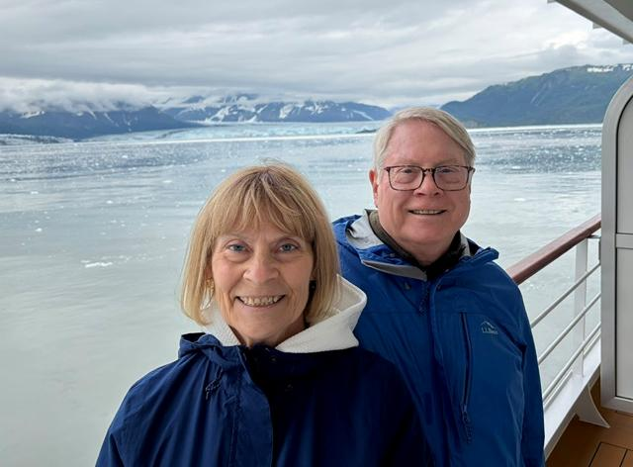
Our Thanks
Our sincere thanks to Tim and Deb Cejka for making the Fusion Fellowship program possible! Their vision and generosity are helping IUP’s students connect ideas, disciplines, and communities through transformative research experiences.

