Slide 1
Variations on a Theme
By Sierpinski
Presentation to IUP
Pete Vanden Bosch
22 Oct 2014

Slide 2
Overview
Background
Construction of Sierpinski
Four alternative constructions
  Each more astonishing than the last
Variations
Connection to random walks
Proof

Slide 3
Waclaw Sierpinski
1882-1969, Polish mathematician
known for contributions to set and number theory
The Gasket

Slide 4
Usual Algorithm for Construction
(More of a deduction than a construction)
  Start with a solid equilateral triangle. Call it the current set.
  For each triangle in the current set, connect its midpoints. Remove the triangle defined by these midpoints.
  This creates new solid triangles. Replace the current set with these triangles.
  Return to step 2.

Slide 5
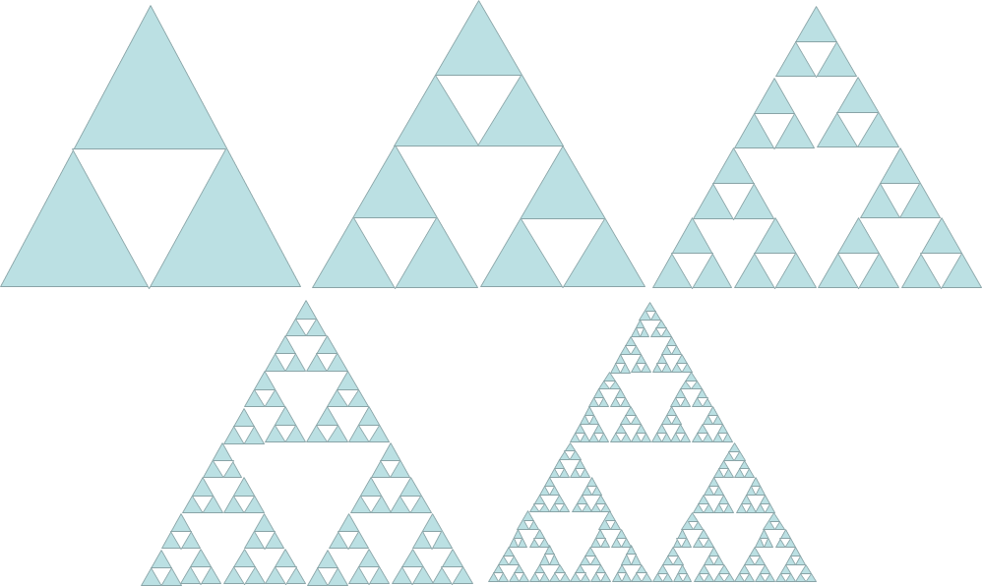
Construction (Deconstruction?) #1
This link is a more impressive demo

Slide 6
Construction #2
Hard to implement previous algorithm. Easier:
Construct an equilateral triangle.
Copy the entire construction twice and rearrange the three sets so their “vertices” are connected.
Resize if desired.
Return to step 2.

Slide 7
Construction #2 Without Resizing

Slide 8
Construction #3: Bitwise AND Algorithm
Label points in a square by binary fractions. “Color in” each point if the bitwise AND of x and y is TRUE.

Slide 9
Construction #4: “Color in” the odd numbers of a Pascal Triangle

Slide 10
Construction #4: Pascal Triangle

Slide 11
Construction #5: Stochastic
Designate the vertices of an equilateral triangle (target vertices), and also designate an arbitrary starting point inside the triangle.
Pick one of the target vertices at random and travel halfway to it, placing a point.
Starting at that new point, return to step 2.
This is the construction we’ll focus on today
Again, Wikipedia has a better animation than I can hope to produce

Slide 12
How Might We Revise This Algorithm to Create Other Fractals?
Stochastic Algorithm:
Designate the vertices of an equilateral triangle (target vertices), and also designate an arbitrary starting point inside the triangle.
Pick one of the target vertices at random and travel halfway to it, placing a point.
Starting at that new point, return to step 2.
Notes:
At this point I will transition to the excel spreadsheet that constructs these gaskets. I will modify the spreadsheet according to the audience suggestions. There are three variations I already have anticipated:
Vary the starting point
Vary the number of target vertices
Vary the fraction of the distance to be traveled

Slide 13
Is it a Fractal?
Original algorithm with v = 4, 5, and 6. Clearly not space-filling, but not obvious we have a fractal, either.

Slide 14
Is It a Fractal?
In these four, v=5, and f is set to 0.4, 0.5, 0.6, and 0.7.

Slide 15
Is It a Fractal?
Here, v=8, and f is set to 1.2, 1.3, 1.4, and 1.5.

Slide 16
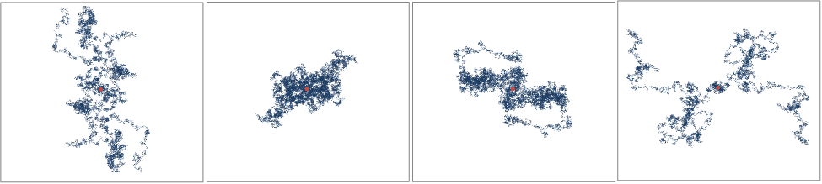
What?
For each of these, v = 8 and f=2.
The only difference is the random number seed.

Slide 17
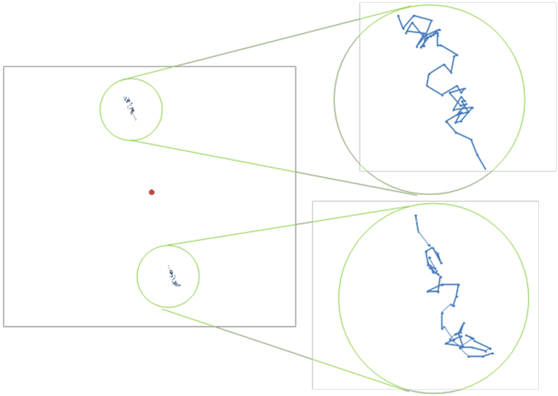
Symmetry?
Notes:
The last 100 points of one set of 10,000 iterations with v=8 and p=2. The 180 degree rotational symmetry is not precise, but it is close enough to give that impression, especially when the entire set of points is displayed.

Slide 18
Why Not Perfect Symmetry?

Slide 19
Equivalence of Stochastic and Bitwise Algorithms
x
x
y
y

Slide 20
Parting Thoughts
Implementing an idea leads to new ideas.
  Can’t play without a playground
Mathematical play is important to developing solid analysts.
Fractals may be far more plentiful than we can detect.
  Being plentiful makes it harder to find them!

Slide 21
Reference
Peitgen, H.-O., Jürgens, H., Saupe, D., Maletsky, E., Perciante, T. Fractals for the Classroom: Strategic Activities, Vol. 1. (Berlin: Springer, 1991).

Slide 22
BACKUP

Slide 23
Closer Look at the Bitwise Algorithm

