Slide 1

Quantitative Career Paths in Government
Pete Vanden Bosch
22 October 2014

Slide 2
Disclaimer
May be too intense for some viewers. This product is meant for educational purposes only. Any resemblance to real persons, living or dead is purely coincidental. Void where prohibited. Some assembly required. Batteries not included. Contents may settle during shipment. Use only as directed. No other warranty expressed or implied. Do not use while operating a motor vehicle or heavy equipment. Apply only to affected area. This end up. Handle with care. Not responsible for personal belongings. No user-serviceable parts inside. Freshest if eaten before date on carton. Subject to change without notice. Close cover before striking. Keep out of the reach of children. Slippery when wet. Shake well before using. Substantial penalty for early withdrawal. Avoid contact with skin. Slightly higher west of the Mississippi. Employees and their families are not eligible. You must be present to win. Use only in a well ventilated area. Keep away from fire or flames. Approved for veterans. Not recommended for children. Objects in mirror may be closer than they appear. Do not fold, spindle or mutilate. Package sold by weight, not volume. Your mileage may vary. This supersedes all previous notices.
Any opinions expressed in these slides are solely mine

Slide 3
Overview
Some demographics regarding quant careers
A little about operations research as a career
A little about my own career
Seven analytical lessons

Slide 4
The Big Picture of Math Careers
Post-secondary education: 1.3 million
Engineering and computer-related
US Employment:
150 Million
other
actuary
ops
analyst
63,000
Professional fields:
31 Million
statis-
tician
Math fields:
116,000
Notes:
Professional fields:
Comp (orange): 3424K
Phy sci (

Slide 5
USAF Quant Jobs -- Big Picture
Total 473,000
enlisted
other officer
S&E officer
S&E civilian
other civilian
Engineer,
Scientist, 1111
13353
Quant analyst,
1247
Comp sci, 1340

Slide 6
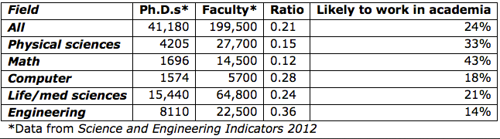
Supply vs Demand - Academia
From http://sciencecareers.sciencemag.org/career_magazine/previous_issues/articles/2013_07_24/caredit.a1300150

Slide 7
What is OR?
Operations research is the application of advanced analytical methods to help make better decisions.
  Which option should I choose?
  What’s the optimum?
  What’s going to happen, and can I affect it?
  How much risk am I going to incur?
  What are the tradeoffs?

Slide 8
OR Toolkit:
-- Statistical analysis -- Decision analysis
-- Experimental design -- Modeling and simulation
-- Optimization -- Database manipulation
-- Forecasting -- Classification
-- Programming -- Data reduction
-- Network analysis -- Scheduling and sequencing
-- Queueing theory -- Stochastic process analysis
-- Data display -- Functional relationships
above all: Critical Thinking about Quantitative Problems

Slide 9
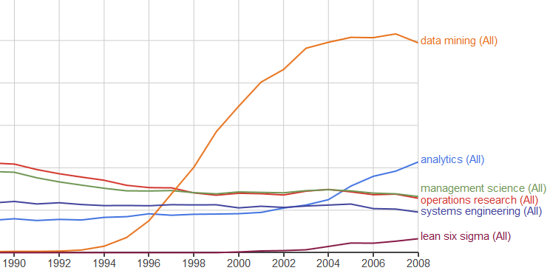
The Names Change…
Data Mining
Management Science
Operations Research
Systems Engineering
Lean Six Sigma

Slide 10
Summary
The main demand for strong math skills is in engineering and computer sciences
Smaller but still significant are the analytical career fields, mainly OR and statistics
Lots of rebranding – watch for the names
OR attracted me because:
  it’s interdisciplinary,
  there’s always something new,
  strong demand,
  and it was occasionally a lot of fun.

Slide 11
My Own Career Path
1977-1984 high school physics & math teacher
1984-2010 Air Force officer
1984-87 physicist
1987-90 nuclear launch officer
1990-91 materials engineer
1992-93 staff officer
1993-94 air-to-air modeler
1994-97 PhD student
1998-01 personnel analyst
2001-04 test and evaluation analyst
2004-06 chief of USAF development analysis
2006-08 chief of staff, chief of exercises
2008-10 chief of analysis, science advisor
2010-2013 homeland security analyst
2013-present adjunct math professor
Education
Quant
Ops
Quant
Staff
Quant
Quant
Quant
Quant
Staff/Quant
Staff
Staff/Quant
Quant
Education

Slide 12
A Few Lessons

Slide 13
Lesson 1: You never know until you try
I never thought I’d
Become an Air Force officer
Work anywhere but a lab
Work in a foreign country
Become a nuclear launch officer
Earn a PhD
Have anything to say worth publishing
Do “soft” analysis

Slide 14
Students from my 1979-81 calc classes – what are they up to now?
SN – Owns software company, author of Writely (GoogleDocs)
DF – Genome sequencing
SP – global information systems
TA – math teacher
ES – public opinion research
SS – researcher for Amazon
RN – HS physics teacher, was USAF pilot
ES – financial executive
RD – dentist, owns a supply company
EB – principal oboist for major orchestra, director of a smaller orchestra
MM – executive at an ivy league university
MM – director of several social services programs for State of CA
KN – executive for US department of Agriculture
PS – English professor/poet at an ivy league university

Slide 15
Lesson 2: Everyone needs good analysis.

Slide 16
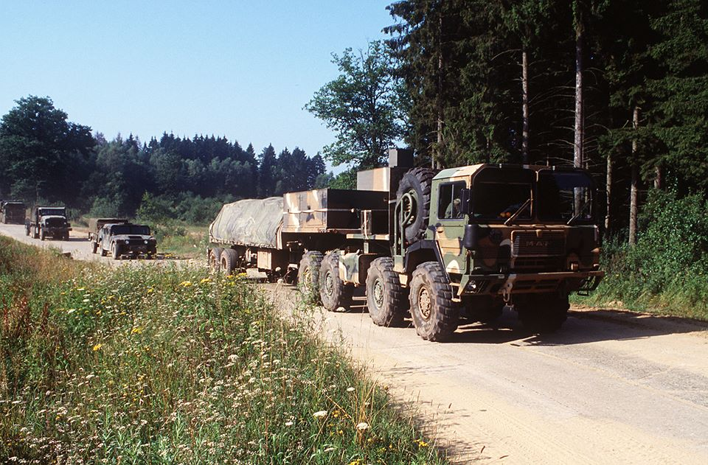
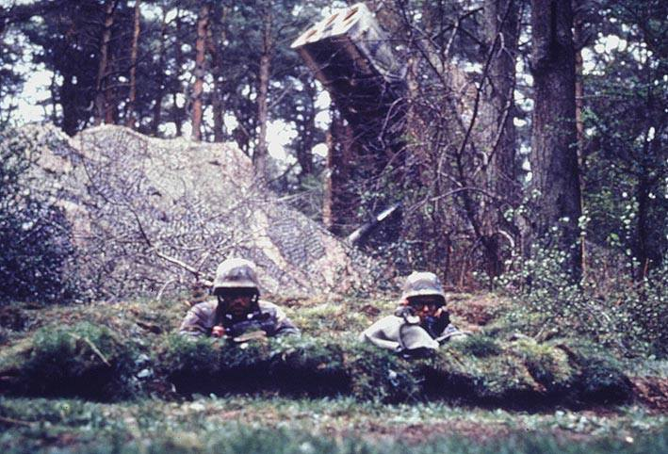
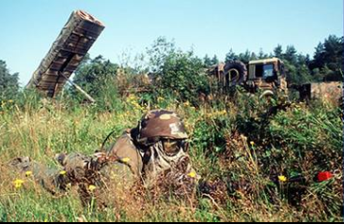
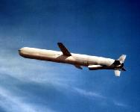
Ground Launched Cruise Missiles
Nuclear warhead, “dial-a-yield,” intermediate range
Deployed to England, Belgium, Germany, and Italy in 1980s
Dismantled as part of the Intermediate Nuclear Forces (INF) Treaty ~1990

Slide 17
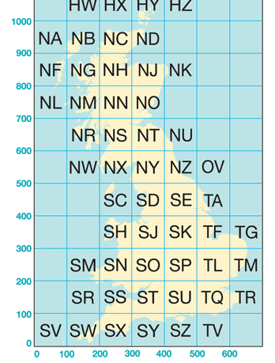
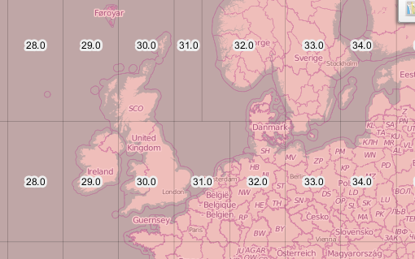
Transforming Coordinates
British National Grid System
Universal Transverse Mercator System

Slide 18
Lesson 3: Beware the vividness of transient events

Slide 19
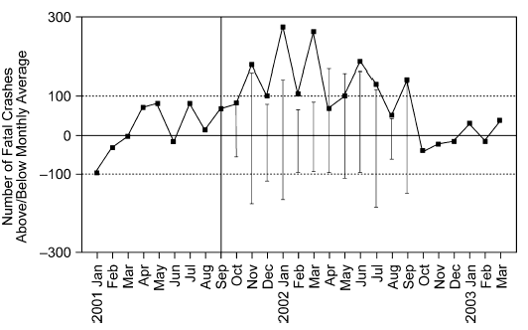
9/11
Road fatalities increased by 1,595 over the seasonal average
!
!
!
!
!
!
Terrorism
Alerts
!
Prof. Alison Jones
University of Newcastle
Australia
Gerd Gigerenzer, “Out of the Frying Pan into the Fire”, Risk Analysis, Vol. 26, No. 2, 2006, pp. 347-351

Slide 20
Lesson 4: Goldilocks is wrong more often than she’s right.

Slide 21
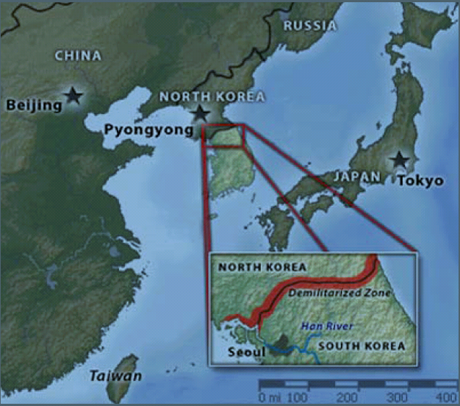
OR Example – DMZ Surveillance

Slide 22
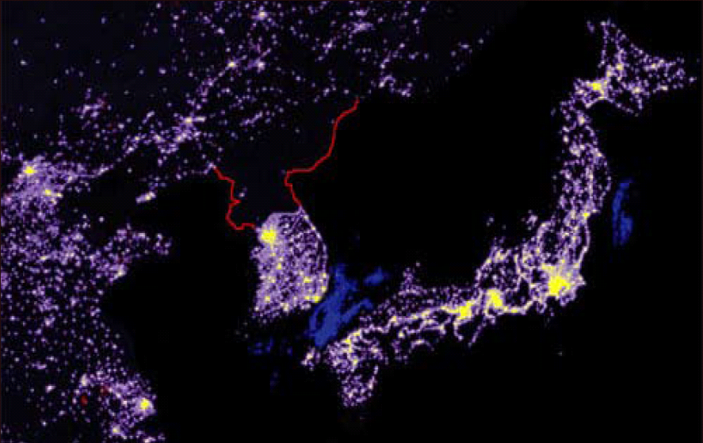
NE Asia at Night

Slide 23
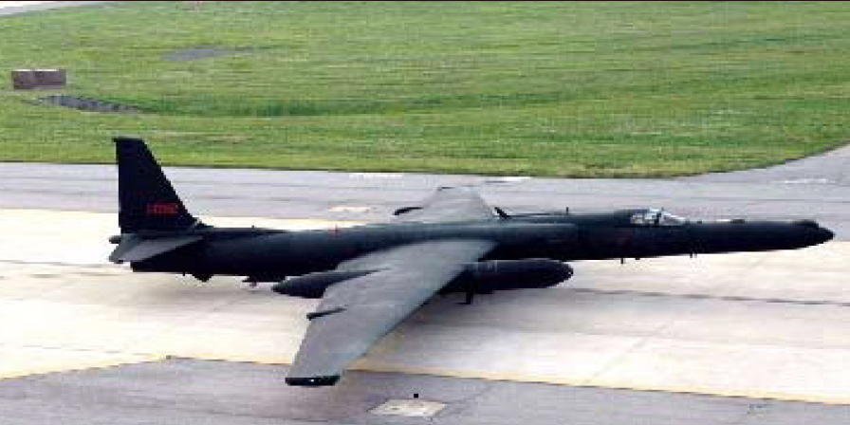
U-2 Reconnaissance Plane

Slide 24
Best Orbit?
Option A: 5 miles from border. Best coverage, but most dangerous
Option B: 15 miles from border. Poor coverage, but fairly safe from SAMs
Option C: 10 miles from border. Moderate coverage, moderate safety
Notional Only

Slide 25
Lesson 5: I’m just the analyst
Analyst life cycle:
You come up with the most cogent, inspired analysis ever.
The big guy takes your advice or he doesn’t.
He takes the heat or gets the credit.
You move on to the next project.

Slide 26
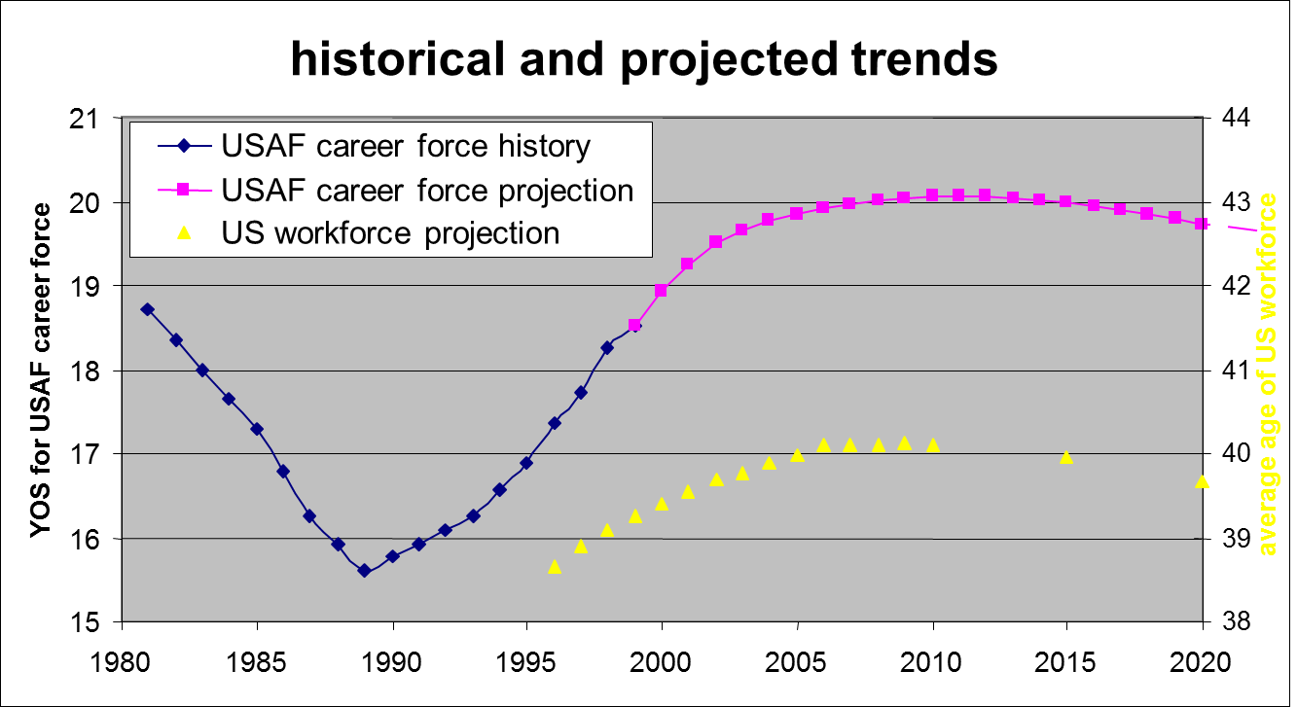
Notes:
This shows the USAF civil service situation in 1998. This 140K force had been ageing quickly as you can tell by the years of service (YOS), the number of years on average that someone had been a civil servant. Covered up are both the projection and some earlier data we eventually found. On the basis of the data shown, would you project a continuing rise in years of service without bound? We originally had to do battle with a set of researchers who provided a straight-line projection, and you can see that would result in the average employee having over 20 years on the job by 2020 – highly unlikely – and result in ridiculous forecasts after that.
Now remove the left square block to see some more past data, uncovered from the Reagan Buildup years, before data were computerized. Why was the force getting so young so fast? The answer is that we were hiring lots and lots of people, which brought the average down. That should clue us that the reason the force was ageing so fast in the 1990s is the reverse: we were hiring far fewer people. We’d had to take massive cuts (part of VP Gore’s Reinventing Government initiative), and we were doing our best to take those cuts by letting people retire or separate normally and just not replacing them.
Good, We have a PROCESS insight. No longer do we need to just rely on the shape of some past data to project the future. See next…

Slide 27
Two More I Can’t Leave Out
Lesson 6: Seek professional help
  First task always: Find who already solved your problem
Lesson 7: Don’t spin
  Don’t know? Say so. Can’t help? Say so. Be honest!
  If you tell the boss what he wants to hear, you are zero value added
  “Help me get rid of the weasels”

Slide 28
Summary
You never know what you’ll be doing next.
Everyone needs analysis. Not everyone knows it.
Beware the vividness of transient events.
Goldilocks is wrong more often than she’s right.
You’re just the analyst.
Seek professional help
Don’t spin

