Slide 1
Financial Literacy

Slide 2
Life After College How do you envision your future? When will you graduate? Where will you live? Will you have roommates? Will you have a car? Will you get married? Will you have student loans to pay? What happens if you can’t find a job?

Slide 3
Planning for the Future
You must make a financial plan, just like you do an academic plan
Set goals for your LIFE – not just for school
Think about your goals and how you are going to accomplish them
Goals must:
Be realistic
Be specific
Have a timeframe

Slide 4
Setting Realistic and Specific Goals
Bad Examples
Good Examples
Unrealistic Goals
Win the Lottery
Be a YouTube star
Non-specific Goals
Save money
Don’t charge anything
Realistic/Smart Goals
Get a part-time job while attending school
Build positive credit while in school
Buy a car on my own
Buy a house one day
Specific Goals
Save $30 a month
Have an emergency fund of $500
Never charge more than I can afford to pay off in a month on a credit card

Slide 5
Term Based Goals
Short-term goals: within the next few months
Spring break trip, new shoes, textbooks
Medium-term goals: within the next three years
Graduation, wedding, new car, new computer
Long-term goals: beyond three years
Pay off student loans, save for a down payment on a house, save for retirement

Slide 6
Assess Your Current Finances
To put a financial plan in action you need to assess your current financial situation:
How much income do you have?
How much do you spend?
How much can you save?
What changes are necessary to meet your goals?

Slide 7
Create a Spending Plan
Keep track of your daily spending
Estimate your monthly income and expenses
Look for ways to decrease spending and increase income

Slide 8
Income
This can be money you receive from:
Financial Aid
Loans
Allowances
Jobs
Other Sources

Slide 9
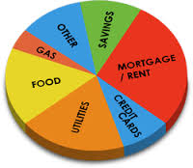
Expenses
Items and services you spend money on
Tuition
Bills
Entertainment
Food
Transportation
Housing
Healthcare
Other expenses

Slide 10
Wants vs. Needs
Wants
Needs
Entertainment
Convenience
Newest clothes
Hobbies
Transportation
Food
Shelter
Clothing

Slide 11
Wants vs. Needs Continued
Item | Need | Want
Housing | Dorm or a shared apartment | Apartment alone
Food | Groceries or dining hall | Eating out
Transportation | Public transportation or bike | Car with insurance, gas, etc.
Clothes | The basics | Trendy styles & brands
Telephone | Basic service | New phone with large data plan
Entertainment | Rent movies, buy used games or books, entertain at home | Movies, new video games, parties or bars

Slide 12
Living Within Your Means
Track your daily spending
Determine your monthly expenses
Estimate your monthly income
Expenses > Income = Living Over Your Means

Slide 13
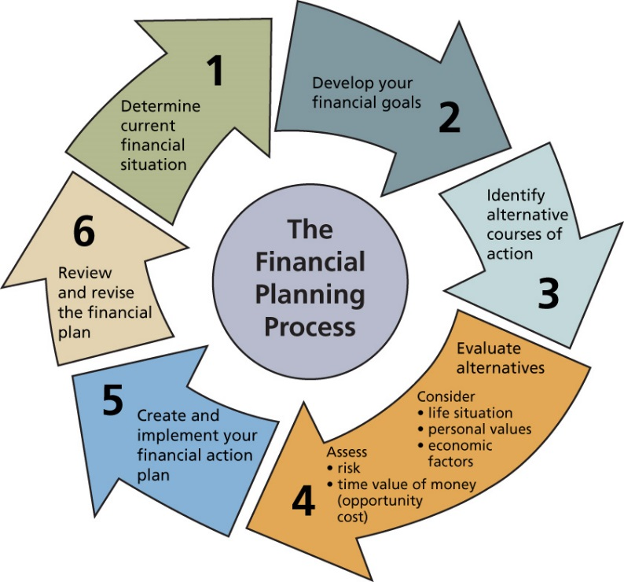
Start Your Future Now!
Set goals and make a plan for your future
Create a budget and stick to it
Make good financial choices to set yourself up for success

Slide 14
Financial Aid Tips

Slide 15
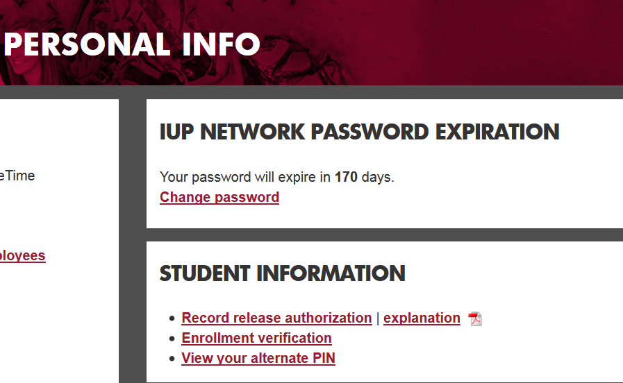
Record Release Authorization
If you want someone to be able to call on your behalf about your financial aid, they must be “AUTHORIZED”
MyIUP
Personal Info
Record Release Authorization
Set up KEYWORD & PHRASE
When they call we will need banner ID, Keyword & Phrase

Slide 16
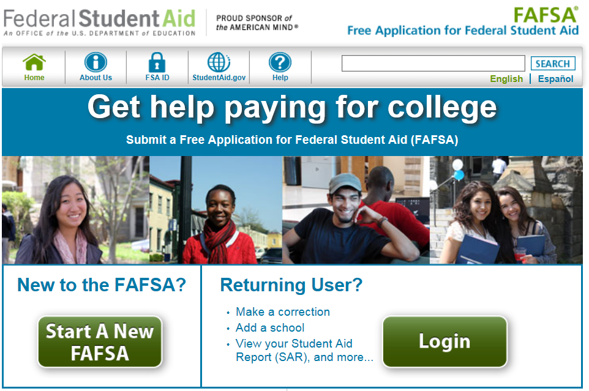
Financial Aid Tips
Everyone, complete your FAFSA early (beginning in October)
https://fafsa.ed.gov/
Use the IRS DRT (data retrieval tool)
Avoid errors
Save time

Slide 17
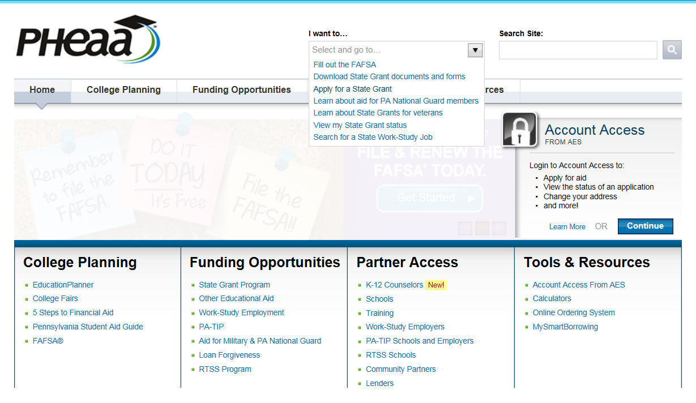
Financial Aid Tips (cont.)
If Pennsylvania resident
Complete PHEAA application (prior to May 1st)
www.pheaa.org
Under the section I want to….
Select Apply for a State Grant
When finished you must
Print the signature page
Sign the signature page
MAIL it to them

Slide 18
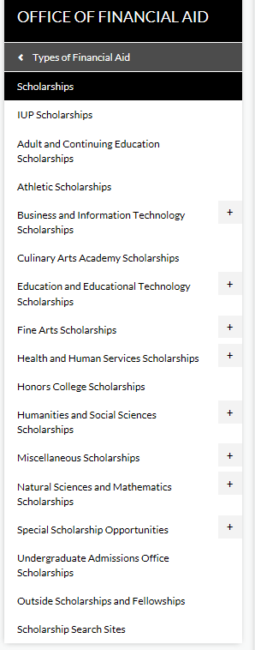
Financial Aid Tips (cont.)
Search for Scholarships
Check with your department (beginning in November)
IUP Website for outside scholarships
http://www.iup.edu/scholarships/
Broken down by Colleges and Other types
Check your local organizations such as clubs (American Legion, Moose, Rotary, etc.)
Check your parent’s work place

Slide 19
Financial Aid Tips (cont.)
Watch for announcements in the Beak
(daily e-mail
newsletter for students)
Check your IUP Email on a regular basis

Slide 20
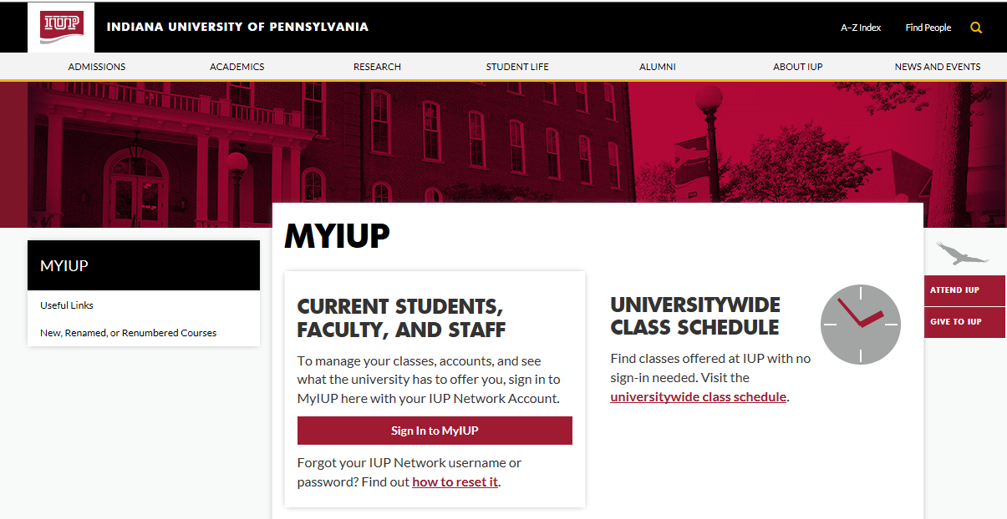
MyIUP
Check your MyIUP account for:
Financial aid requirements
Financial aid awards
Billing/EasyPay
Grades/Transcripts
And many others
www.iup.edu/myiup

Slide 21
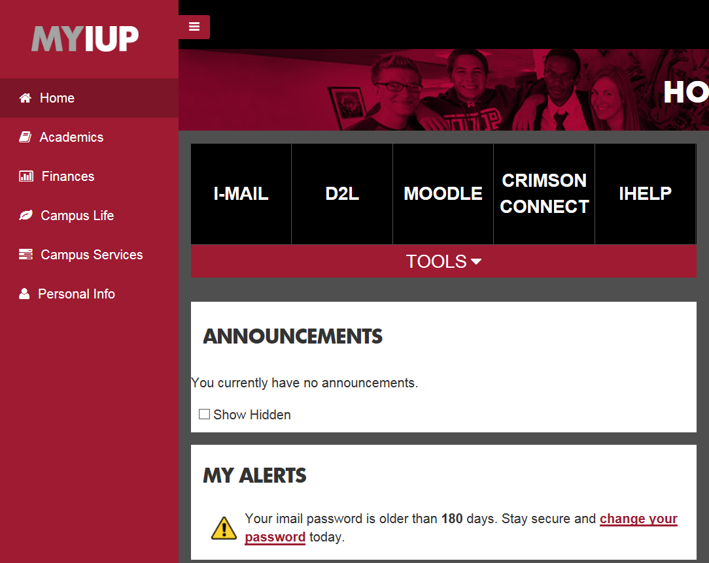
Important Alerts
Once logged into MyIUP
HOME tab
My Alerts
If there is something that
needs your attention you can
see it here.

Slide 22
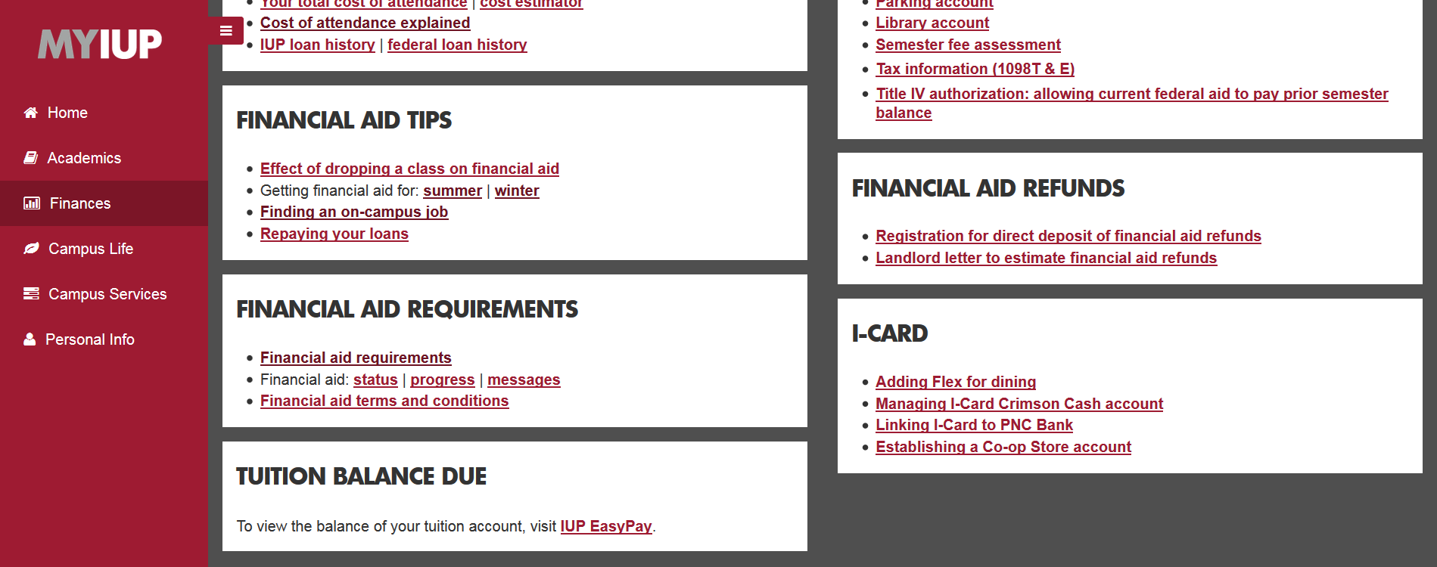
Financial Aid Requirements
If you have outstanding items, such as verification, satisfactory academic progress, loans that need accepted, etc., you can find them here.
Once you click on this link, it will take you to the list of items.
If it is completed, a date will be shown.
If no date is shown, the item needs addressed.
These can delay in financial aid processing and/or refunds.
LANDLORD LETTERS

Slide 23
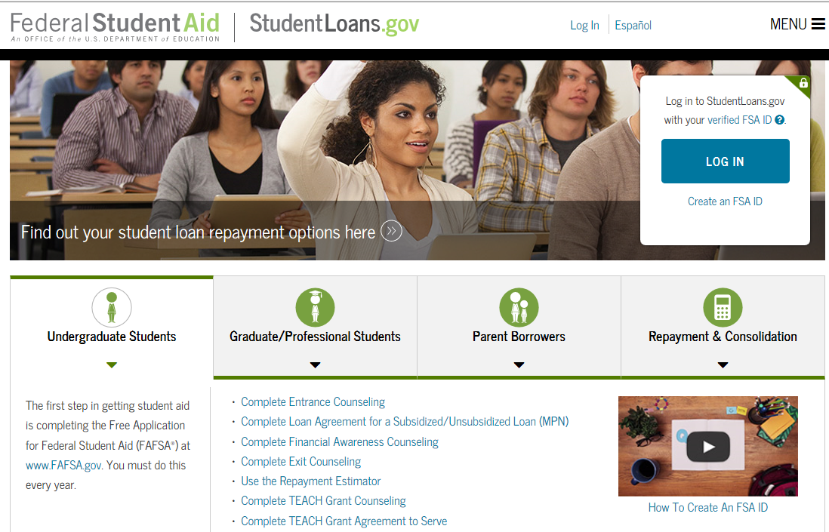
Requirements for aid to “PAY”
Students need to complete the following requirements in order for the Federal Direct Subsidized and Unsubsidized loans that appear on your award letter to pay to your account.
Incoming (Accepting the federal loans)
Log on to https://studentloans.gov
Complete the following:
Direct Loan Entrance Counseling
Master Promissory Note (eMPN)
Graduating (Exit Counseling)
Log on to https://studentloans.gov
Complete Direct Loan Exit Counseling

Slide 24
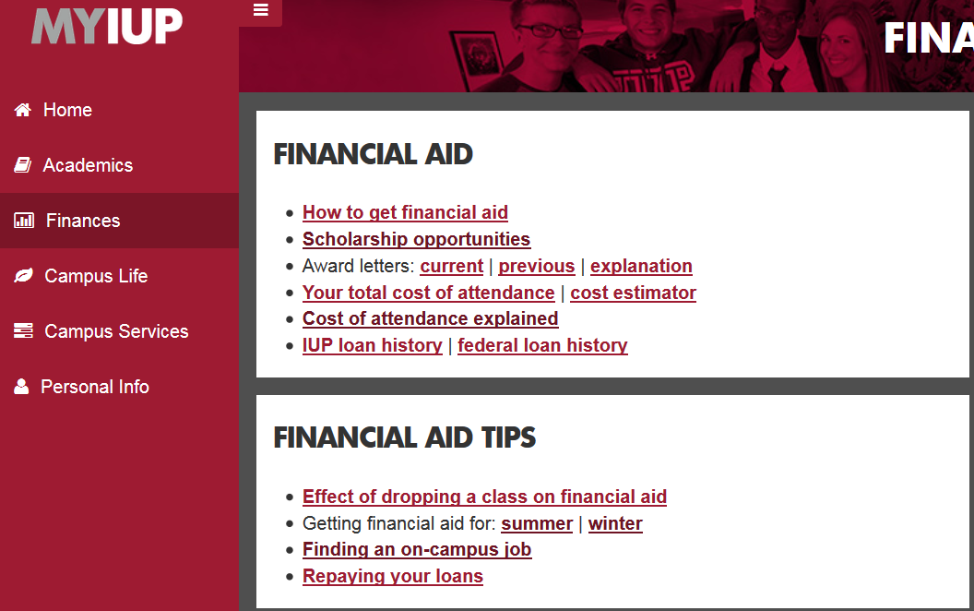
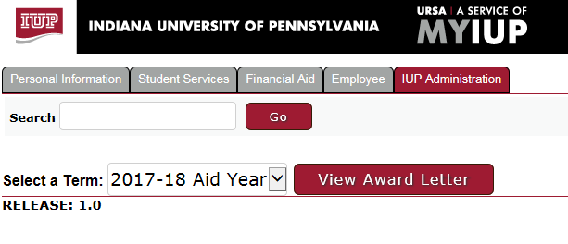
Financial Aid Awards
Once logged into MyIUP
FINANCES tab
FINANCIAL AID section
Award letters:
Select current or previous
Select a Term: select term
Click View Award Letter
This will bring up an award letter

Slide 25
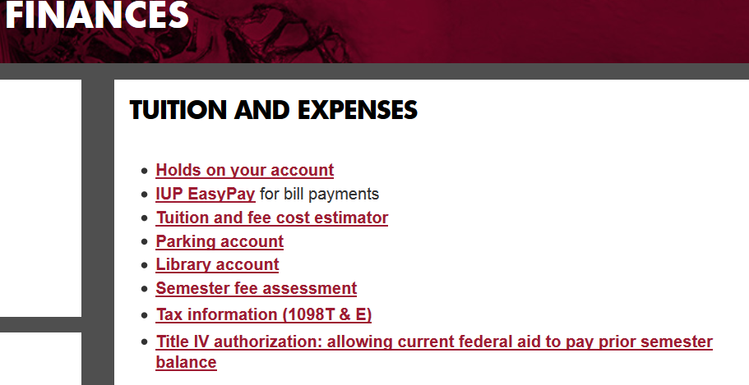
Billing/EasyPay
BURSAR office 724-357-2207
Billing
Payments
1098 T Forms
No paper bills are mailed
Once logged into MyIUP
FINANCES tab
TUITION AND EXPENSES section
IUP EasyPay

Slide 26
Billing/EasyPay (cont.)
Brings up important information

Slide 27
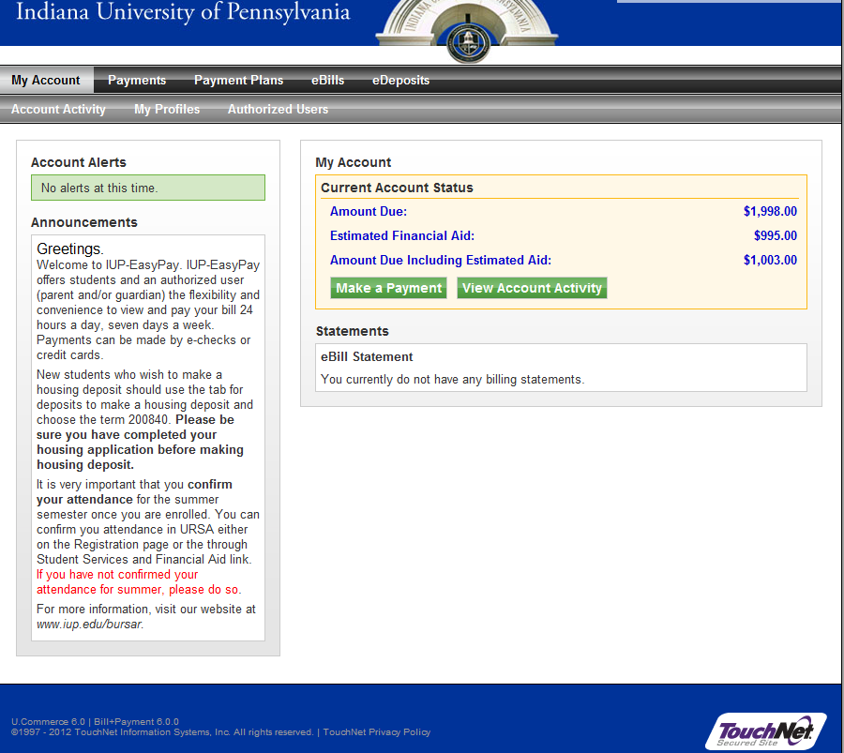
Billing/EasyPay (cont.)
Click on IUP EasyPay button to view bill
Amount Due:
Estimated Financial Aid:
Amount Due Including Estimated Aid:
If a negative amount (refund-more aid than
total cost)
If a positive amount (amount due IUP not
covered with awarded aid

Slide 28
Satisfactory Academic Progress (FEDERAL)
Academic Progress affects your financial aid
Assess yearly after Spring grades post
Students are notified prior to start of Summer and/or Fall term if they have a FAFSA on file
If no FAFSA on file at time of assessment, student is notified once a FAFSA is received
Withdrawing from courses affects your financial aid
Withdrawals count as attempted but not passed credits
IUP offers an appeal process, must meet ALL requirements for an appeal

Slide 29
Satisfactory Academic Progress (FEDERAL)
Federal Law 668.34
Students must pass 67% of their attempted credits (PACE)
Passed credits divided by Attempted credits = PACE (%)
Examples:
Students must maintain an overall cumulative GPA of 2.0 or higher as an undergraduate student
Students must also not exceed 150% maximum timeframe to complete degree
Example: If your degree requires 120 credits, your maximum attempted credits would be 180.
120 x 150% = 180
Passed | Attempted | Pace
36 | 85 | 42%
45 | 85 | 53%
60 | 85 | 71%

Slide 30
Financial Aid Academic Progress (STATE) (PA residents only who receive the PHEAA state grant)
Must earn 24 new, non-remedial credits for each academic year State Grant funding was received
New – not a course you previously earned a grade of “D” or better in
Non-Remedial – a course number of 100 or greater
Making Progress Examples
Not Making Progress Examples
 | Term | Fall | Wint | Spr | Sum | Total
Student A | Credits Attempted | 15 | - | 12 | - | 27
 | Credits Earned | 15 | - | 12 | - | 27
 | Student A attempted and earned 24 credits
Student B | Credits Attempted | 12 | 3 | 12 | - | 27
 | Credits Earned | 12 | 3 | 9 | - | 24
 | Student B still earned 24 credits
 | Term | Fall | Wint | Spr | Sum | Total
Student C | Credits Attempted | 12 | - | 12 | - | 24
 | Credits Earned | 9 | - | 12 | - | 21
 | Student C attempted 24 credits but only earned 21 credits
Student D | Credits Attempted | 12 | 3 | 12 | 6 | 30
 | Credits Earned | 9 | 3 | 6 | 0 | 21
 | Student D attempted 30 credits but only earned 21 credits

Slide 31
Avoid Default
Limiting borrowing
Pay “optional” interest charges on unsubsidized Direct Loans during in-school deferment period
Completing the program and graduating
Keeping in touch with the loan servicer and paying on time
www.nslds.ed.gov to determine who your servicer is and your loan history
Trouble making payments
Deferment and forbearance
Changing repayment plan
Loan forgiveness, cancellation, discharge
Consequences of delinquency and default
Retaining loan records and resolving disputes
Loan consolidation

Slide 32
Federal Financial Literacy Information
http://www.iup.edu/financialaid/financial-literacy/
https://studentloans.gov/myDirectLoan/index.action
http://www.fdic.gov/consumers/consumer/moneysmart/
http://www.mymoney.gov/Pages/default.aspx
http://www.consumer.gov

Slide 33
IUP Financial Aid Office
200 Clark Hall 1090 South Drive Indiana, PA 15705
Phone: 724-357-2218
Fax: 724-357-2094
Email: financial-aid@iup.edu
Facebook: @IUPFinancialAidOffice
Service Counter Hours
Monday through Friday
8:00 a.m.–4:30 p.m.
Summer Hours
8:00 a.m.-4:00 p.m.
When in doubt, contact us!!

