Slide 1


Writing reports that work
Maddie Hornstein
Kathleen Jones White Writing Center at IUP
August 2018
Notes:
Hello and welcome to this writing center tutorial, “Writing Reports That Work.” Important decisions are made by government leaders, business leaders, and other groups every day. But how do these decisions get made? Reports and recommendations are central to decision-making. But what makes a report successful? And what makes a good recommendation? In this tutorial, we will introduce you to the basics of writing reports that lead the reader to take action.

Slide 2



Situations for making recommendations
Making strategic decisions
Persuading an organization
Policy decision making
Notes:
First, let’s talk about when you might write a report with recommendations and why. These types of reports are common in industry and business where management needs to make strategic decisions, in nonprofit organizations who wish to persuade the government, public, or industry to take action, and in government organizations who need to proceed with policy decisions.

Slide 3
Convincing others of your stance
Make a recommendation
Support your proposition
Notes:
When you write a report with recommendations, you have two goals – to make a recommendation and to make that recommendation in a way that is supported by research (That’s where the report piece comes in). Recommendations propose solutions to a problem, and the report includes information to justify those claims. At the end of the day, the goal of a report with recommendations is to help companies or organizations to make decisions. Thus, these reports are intended to persuade the reader using research and evidence.

Slide 4
Parts of a Report
Executive Summary
Introduction
Problem
Possible Solutions
Recommended Solutions and Action Steps
Conclusion
Works cited
Notes:
Executive summary—this should provide a brief summary of the overall report
Introduction—here, provide background information that frames your problem and solutions
Problem—in this section, describe the context of the problem. State your purpose here.
Possible solutions—describe solutions explored, but not recommended. Make sure to be clear as to why you are not recommending these options. Not all situations require this section, and it ultimately depends on your context and company or organization.
Recommended solutions and action steps—Detail your proposed solution here. Make sure to fully describe your rationale using data, figures, and charts wherever necessary. Also provide action steps to help give readers an idea of how to implement your solution
Conclusion—frame your recommendations in a larger context. How is this going to fulfill the role of your team or department? How is this going to increase profits or cut costs? Tell how your work fit into the larger picture.
Keep in mind, though, that these sections may change depending on the situation. Some companies even have templates that they give employees to use when writing reports. If you don’t have a template through your company, you can start by writing the parts above and then catering the report to your audience

Slide 5
An example report
Executive Order 13800 asked government officials to “assess the scope and sufficiency of efforts to educate and train the American cybersecurity workforce of the future, including cybersecurity-related education curricula, training, and apprenticeship programs, from primary through higher education.”
52-page report gives findings, in-depth analysis, and recommendations
https://www.nist.gov/sites/default/files/documents/2018/07/24/eo_wf_report_to_potus.pdf
Notes:
We’re going to take a look at an actual report written by the secretaries of commerce and homeland security. This report was written in response to an executive order, and **read bullet point**
Like many reports, this one is rather in depth at 52 pages. We’re just going to look at some of the pieces. Here is the URL if you’d like to read the full report.

Slide 6
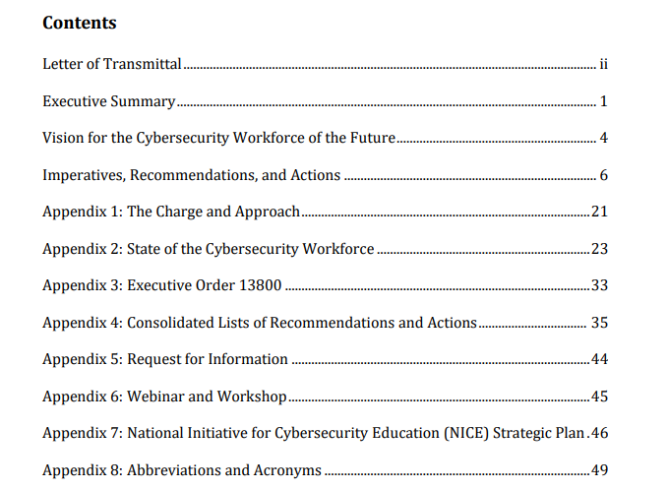
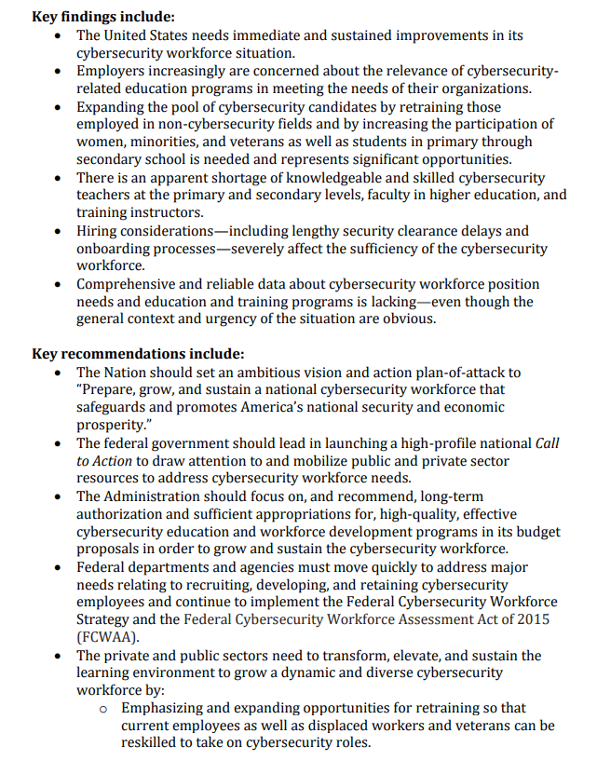
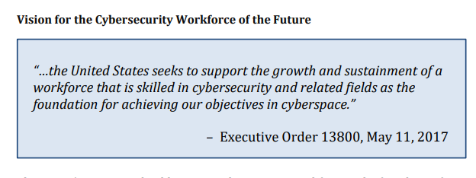

Example pieces of a report
Notes:
Here is the table of contents of the report. Let’s examine the parts of this report. Notice that at first, it doesn’t seem exactly follow the parts we discussed earlier. It does begin with an executive summary, but the titles of each subsequent section are consistent with the content of the report. This is very common—many times, the content of each of the parts of the report aligns with these parts we discussed earlier. When you delve into a report, you will often find that the information in the report follows the outline of the parts we discussed earlier, even if it doesn’t have explicitly labeled sections. In long reports like this one, sometimes a vision statement is included at the beginning to help focus the entire report on the problem it aims to solve. *. Now, let’s jump to another part of the report. These are some of the key findings and recommendations. In long reports like this one, it’s common to include a summary of key findings and recommendations in the executive summary. The detailed findings and recommendations are usually towards the end of a report.

Slide 7
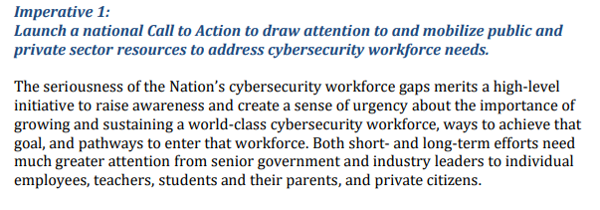
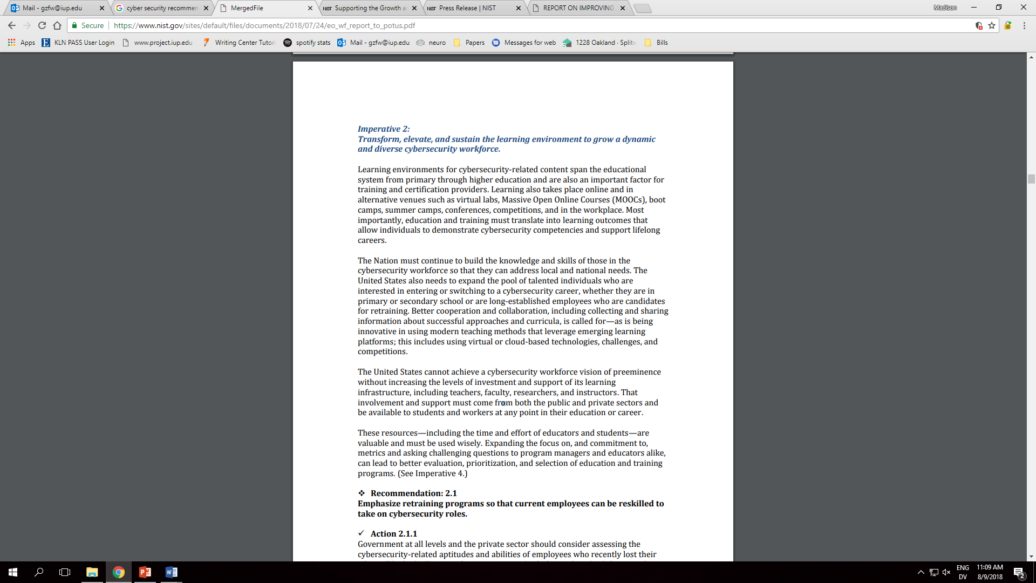
Supporting your claims
Notes:
This is an excerpt from the recommendations. Notice that the suggestion is supported by a justification. Each recommendation made is supported by a line of evidence. This helps add weight and credibility to the recommendations made.
Notice the use of strong verbs like transform, elevate, sustain, and emphasize. All of these action words help lead the reader to act.

Slide 8
Strategies for writing reports
Know the parts of the report
Use a persuasive, professional tone
Use action verbs to lead the reader to act
Notes:
When writing your own report, it may be hard to know where to begin. Here a few strategies to help.
First, you need to know the parts of the report. Knowing what information goes in which piece of the report will help you to organize your ideas in an effective manner.
Second, you should use a persuasive, but professional tone. A report is a formal means of written communication, and the tone you use should reflect that. Additionally, recommendations are typically written to persuade the reader into taking action.
You should use strong, active verbs to help lead you reader to act.

Slide 9
Thanks for watching
iup.edu/writingcenter
Notes:
Thanks for watching this video about writing reports that work! For more information on this and other writing topics, visit our website at iup dot edu slash writing center.

