Slide 1
Writing Professional Memos
Naria Willis
and Savannah Thorpe

Slide 2
What is a Memo?
A note, document or other communication that helps announce information
(Business) - an internal method of communication within one company

Slide 3
General Guidelines
Informal and friendly but professional
(Ex: I am writing to inform you)
One or two pages long
Be concise
Easy to read
Specific
Informative
Know your audience

Slide 4
Choosing Your Audience
Ask Yourself:
Is a memo necessary? Could an email suffice?
Memo
Email
If a physical record is needed
Ex: list of procedures or instructions
Formal information
Ex: Corporate policies, Official communications, employment decisions
Short messages
Report a change in time or change in meeting place
Requesting information from colleagues

Slide 5

Memos v. Letters
Memo
Letter
Notifications sent inside company
Begins with what the purpose for the memo is
Ex: I am writing to inform…
Little detail, simple information
End with “call to action” not a summary
Formal documents sent outside of company
Begins with greeting
Finishes with a conclusion and thanks

Slide 6
When to Write a Memo
Make announcements
Discuss procedures
Report recent activities
Inform employees
Bring attention to problems
Communicating to a small group

Slide 7
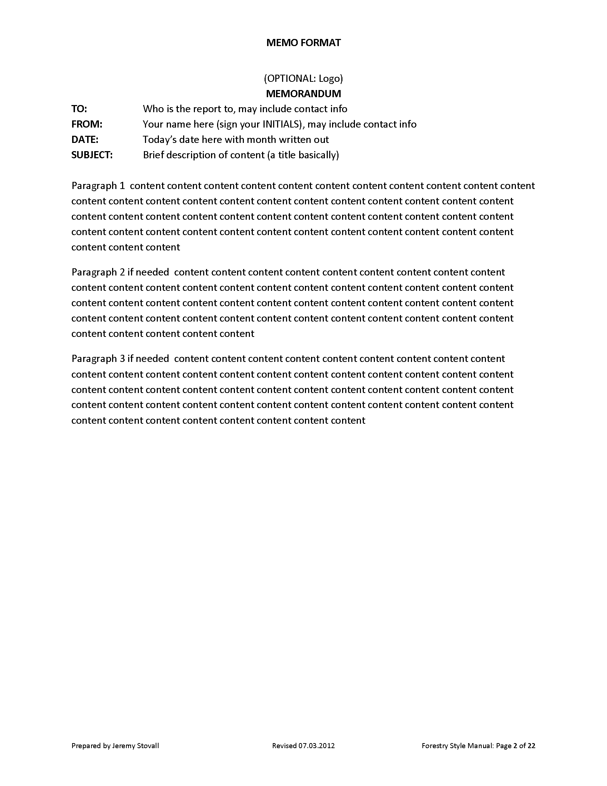
Setting up a Memo
Header
Opening, Context and Task
Summary or Discussions
Closing Attachments

Slide 8
Header
To: Professor Smith
From: Naria Willis
Date: September 1, 2013
Subject: Writing Center
Recipient: Left aligned at top of the page
The sender: Left aligned, below recipient
Date: Left aligned below sender
Subject: Left aligned, below date
Remember: All parts should be aligned using tab and the header is double spaced

Slide 9
Format
Single spaced
1 or 1.5 inch margins
Left justified
Skip lines between paragraphs
Don’t indent new paragraphs
Use headings or lists if needed

Slide 10
Body: How Your Memo Should Read
Put most important information should be in your first few sentences or paragraph
Detailed and concise
Give reader most information in smallest space
Being Concise
Use lists to draw attention to center of memo
Avoid paragraphs if possible
Use bullets to keep information short

Slide 11
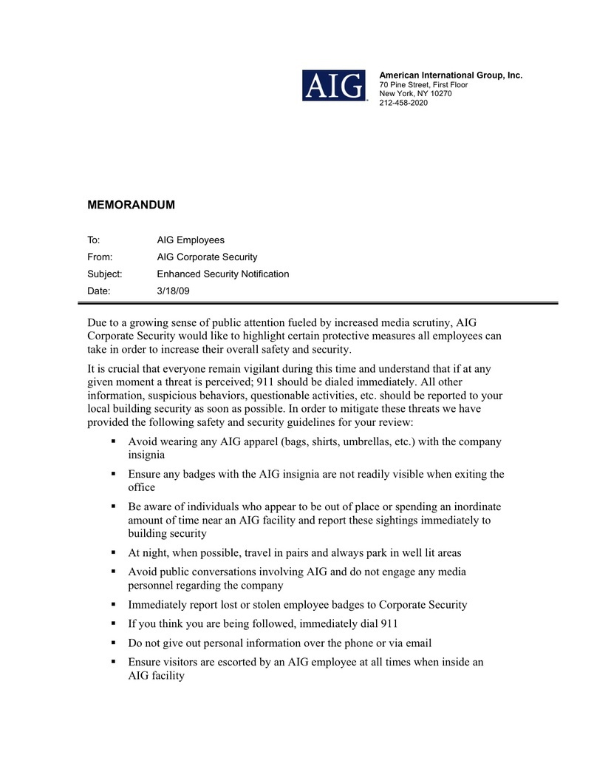

Slide 12
What Not to Do
Put the main point last (always begin with main point)
Use fluff/Over-explain (Remember: less is more)
- Ex: Bill will not be attending today’s meeting on the policy changes due to a slight inconvenience that was caused by failing health earlier this week
- Instead: Bill will not be at today’s meeting
Use slang
- Ex: Hey what’s up

Slide 13
Conclusion
When Using Headings
When using headings be specific about what you intend to talk about. Do not list “Policy Change” as your heading, be direct about what you intend to talk about.
Ex: Policy Change Regarding Dress Attire
Ending
Contain a call to action (Ex: Have ideas ready for the meeting on Tuesday) and mention any attachments
Remember: Do not indent new paragraphs, skip lines, and make your body paragraphs single spaced

Slide 14
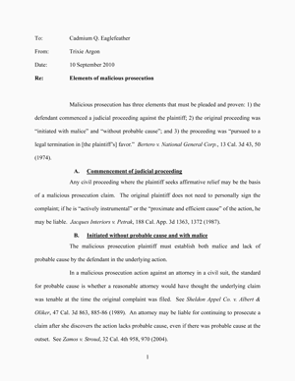
Bad Examples
Do not bold
Do not indent
Do indent headings

Slide 15
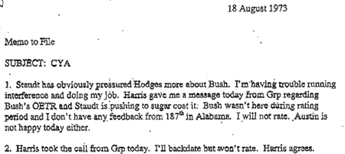
More Bad Examples

Slide 16
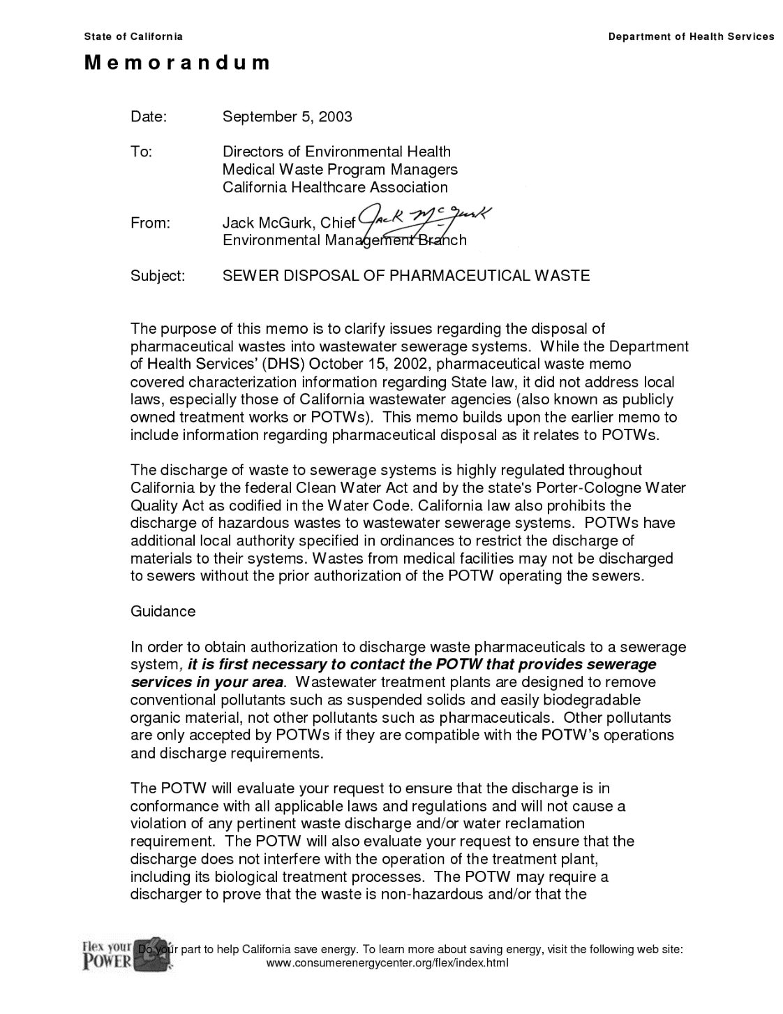

Slide 17

Professional Emails
Sort of an electronic memo
Used to disseminate small or moderate amounts of information

Slide 18
Subject Lines
Tell your readers what the emails concerns
Gives reader reason to open and invest time in the email
Keep it short, but cover the basics
Does not have to be a complete sentence
Prepare your reader (words like “Long” or “No Action Required”)
Good Examples
Bad Examples
Discussion related to management policy and reminder for deadline due.
Some points to discuss
Hello!

Slide 19
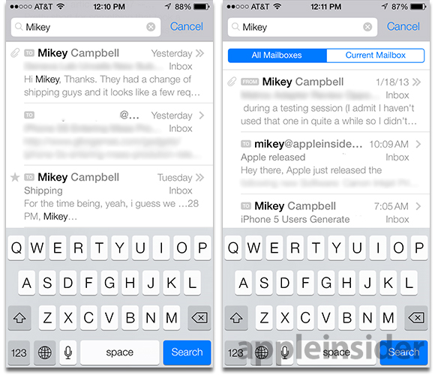
Content and Structure
Always include some sort of greeting
Keep language conversational yet formal
Use proper grammar, spelling, capitalization, and punctuation.
Avoid slang, emoticons, and profanity
Keep a neutral tone
If there are paragraphs, no need to indent

Slide 20
Staying Concise
Keep your content organized and on-topic
Try to avoid multi-paragraph emails (3 max)
If paragraphs are absolutely necessary, they should be no longer than seven lines of text
Opening paragraph should cover the Five Ws
Try to avoid having to send attachments to large groups
Summarize and stay brief
  Your reader is lazy and will skim if the email is too long and boring
  If your email gets to be too long, consider a meeting

Slide 21
Technicalities of Emails
Choose a simple font (Times, Garamond)
Type in black (no funky colors, etc)
Use exclamation points very sparingly
For emphasis, you may want to bold, italicize, or underline a word
Do not change colors or fonts, and DO NOT TYPE IN ALL CAPS. IT LOOKS LIKE YOU’RE SHOUTING.
Avoid big blocks of text; readers tend to skim long emails
Remember: Readers are lazy.

Slide 22
Salutation and Signature
Professional emails should always contain some sort of salutation
  Best,
  Yours,
  Take Care,
Include your name, position, and affiliation
All relevant contact information
  phone number
  website
  street address

Slide 23
When not to use Emails
Sharing delicate, personal, or confidential information
  emails are NOT confidential and are easy to bring up in law suits or investigations
Sharing a lot of information
  To disseminate a lot of info or talk about an topic that may elicit a lot of questions, call a meeting
Avoiding personal contact
  It’s easy to hide in this digital age, but emails are not always the most effective means of communication

Slide 24
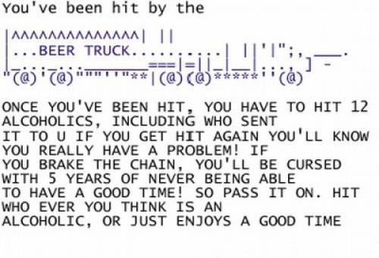
When not to use Emails
Knee-jerk, angry reaction to something
  type the email, save it to drafts, and re-think it in an hour
Content with a non-neutral tone
Chain emails, virus warnings, etc
Last-minute plan changes
  Courtesy says to call the person
Remember: People tend to over-estimate the efficienty and power of an email. How often do you just skim text, delete emails on a whim, etc?

Slide 25
Emails to Groups
CC
BCC
Stands for “Carbon Copy”
All your recipients see the list of recipients
Generally preferred
Stands for “Blind Carbon Copy”
Prevents your recipients from seeing who else received the email
Good if sending message to large group

Slide 26

Replying to Emails
Be timely
Change the subject line if necessary
Beware the “Reply All” button
Evaluate the importance of your response
Avoid one-liners like “Thanks!” or “OK”
If you have a lot of questions on clarification or technicalities, call or visit the sender in person
Quickly reread and revise your message

Slide 27
Practice
As a safety science professional, you will often develop reports and submit critical information to groups and individuals who may not fully understand the detail of your topic. (Lab assignment)
At IUP many students often get hit by drivers, and drivers often grow frustrated with jaywalking students. Write a memo describing what students and drivers can do to change this problem.

