Slide 1


MLA
DOCUMENTATION
8th Edition
Brought to you by the tutors at the Kathleen Jones White Writing Center at Indiana University of Pennsylvania
The Kathleen Jones White Writing Center
Revised August 2017
Notes:
Welcome to the writing workshop brought to you Kathleen Jones White Writing Center at Indiana University of Pennsylvania. My name is Krista Sarraf, and today’s topic is MLA style. As a student, I use MLA style when I write papers related to the liberal arts and humanities. There are some important updates to MLA style, since the guide that MLA used for years was taken out of print in the summer of 2016. In April 2016, MLA introduced the eight edition of the MLA handbook, which is now the source that writers use for MLA. Today, I’ll share how to cite using the 8th edition of MLA. But first, a word about the Writing Center.

Slide 2


Welcome to the Writing Center!
Find helpful writing resources online at www.iup.edu/writingcenter
Prewriting
Drafting
Revising
Notes:
The Writing Center frequently helps students with citation, including MLA. But
Writing Center tutors can help with every part of the writing process.
Our Online Writing Center lets you meet with a tutor. You’ll also find handouts and videos to help you with your writing assignments. If you find this video helpful and want to see what else we can help you with, visit www.iup.edu/writingcenter

Slide 3
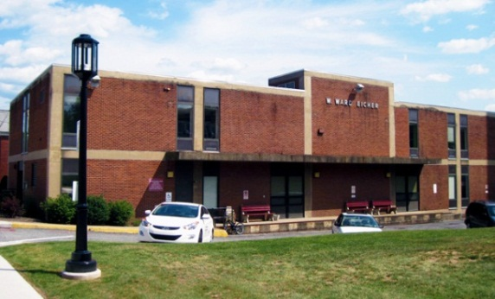


Get help online or on campus
218 Eicher Hall
Meet Us Online
Talk to a tutor through WebEx (like Skype).
Schedule an appointment at iup.edu/writingcenter
Stapleton Library
Monday - Thursday 9:00 am to 8:00 pm
Friday 9:00 am to 3:00 pm
Monday - Thursday 8:00 pm to 11:00 pm
Sunday 5:00 pm to 10:00 pm
Notes:
There are three ways to get help with your paper. The Writing Center is located on campus at Eicher Hall, but you will also find us in Stapelton Library or online. Plus, videos like this one are housed on our website and on YouTube alongside our handouts.

Slide 4
Today you’ll learn…
Integrating quotes
In-text citations
Works Cited pages
Notes:
Today you’ll learn how to integrate source material, including how to use in-text citation, MLA style. We’ll also discuss how to create a works cited list at the end of your paper in MLA style. If you don’t have time to watch the whole video or if you know exactly what you want to learn , you can easily move around this video by scrolling until you see a section that interests you. We’ve included the time stamps in the video description so that you can quickly jump from section to section.

Slide 5

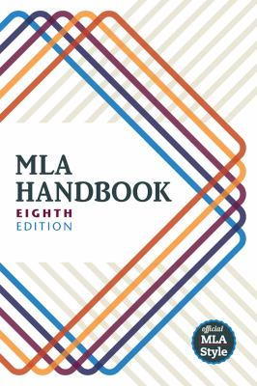
What is MLA Style?
Notes:
MLA style is used primarily in the humanities.
You may have heard of MLA or other style manuals such as APA, and maybe you’re wondering why there are different kinds of style manuals. The purpose of using one style manual for your paper is consistency. Think of your citations as a roadmap. Readers of your paper may want to find out where you got your sources, and it would be confusing if each reference was formatted differently. Readers might not know which part of the citation refers to the article title and which part of the citation refers to the journal title, for example. By working with one style guide throughout your paper, you ensure that you present your sources consistently so that readers can trace your sources.

Slide 6
Part 1
Integrating Quotations
Notes:
The first part of this video reviews how to integrate quotations in your paper.

Slide 7
Integrating sources
signal phrase + outside material + parenthetical reference
Notes:
There are three parts to integrating sources into your paper: a signal phrase that appears before the outside material, the outside material which you borrowed from another source, and the parenthetical reference which tells your reader where you found the outside material.

Slide 8
Integrating Sources
Voice
Flow
Works Cited
Notes:
A signal phrase is not always required, but you should avoid “dropped quotations,” quotations that are just dropped into the text with no introduction from you. Signal phrases help you in several ways. They allow you to prepare readers for a change of voice in outside material, identify sources of outside material without interrupting the flow of reading, refer readers who want additional information about the source to the Works Cited list at the end, and to keep the parenthetical references short.

Slide 9
Integrating Sources
signal phrase + outside material + parenthetical reference
Example
As Jerry Rumble points out, “autumn is a time for reflection” (102).
Notes:
Here’s an example of a signal phrase. In this example, “As Jerry Rumble points out” is the signal phrase because it appears before the outside material.

Slide 10
Use a variety of verbs
argues
asserts
believed
claims
illustrates
Implies
reports
suggests
Notes:
When you use a signal phrase, it’s important to also use a strong verb to lead into the outside material. Here are some examples. Can you think of other strong verbs that you might use?

Slide 11
Outside Material
signal phrase + outside material + parenthetical citation
Quotation
Paraphrase
Summary
Notes:
We just reviewed signal phrases, so not let’s talk about how to include outside material in your paper.

Slide 12
Outside Material:
Quotation
signal phrase + outside material + parenthetical citation
As Dober argues in the conclusion of her book, “My experiences, after all, are a prime example of how race and class issues overlap” (40).
Notes:
In the outlined box, we have an example of an in-text citation in an MLA paper. Notice the outside material in blue. Because the writer used the author’s last name – Dober – in the signal phrase, the reader can easily identify that the quoted material belongs to Dober. Keep in mind, though, that MLA requires you to use the author’s full name the first time you mention the author. For example, if this were the first time you were quoting Dober, you would write, “As Alice Dober argues in the conclusion of her book” so the reader has the author’s full name. One more thing to notice on this screen: the outside material fits nicely with the signal phrase. In other words, the grammar works as do the ideas. If you cannot find a way to use the author’s original words because they don’t fit with the grammar of your signal phrase, you might consider paraphrasing the author instead.

Slide 13
Outside Material:
Paraphrase
signal phrase + outside material + parenthetical citation
Dober argues in the conclusion of her book that many of her experiences reflect both class and race issues (40).
Notes:
Now, let’s look at paraphrased material. The difference between quotation and paraphrase is that quotation uses the author’s exact words, while paraphrase captures the author’s ideas but uses the student’s own words.

Slide 14
Long quotations
Signal phrases
Colons
Block quotations
Indentation
Quotation Marks
Periods
Notes:
There are several things to remember when integrating long quotations into papers that use MLA style. Even for long quotations, be sure to introduce the quotation with a signal phrase or sentence followed by a colon. Be sure to use block quotation form when quoting 4 lines or more, indent one inch (1”) from left margin, omit quotation marks, and use a period at the end of the quotation - not after the page number.

Slide 15
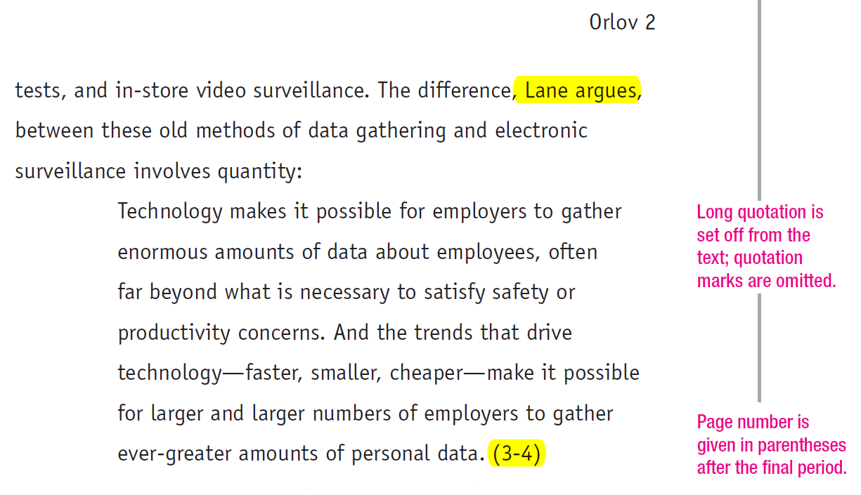

Notes:
Note the introducing sentence and colon
*Example taken from Rules for Writers, Hacker and Sommers

Slide 16
Altering a quotation
Use brackets
As Dober suggests in chapter two of her book, “Many [minorities] share stories of prejudice” (15).
Notes:
In this example, the writer added the word “minorities” to clarify to the reader the subject that shares stories. The bracketed text is helpful because otherwise the reader might not know who “many” refers to.

Slide 17
Deleting part of a quotation
Use ellipses
As Dober suggests in chapter two of her book, “Many people share [stories] of prejudice…which suggests that race and class issues are more prevalent than previously imagined” (15).
Notes:
A question we frequently get in the writing center is this: is it okay to delete words from a quote? The answer is yes, so long as you don’t alter the meaning. You may want to delete words for a number of reasons: for example, maybe only some of the quote is relevant to your point; maybe you want to add emphasis; or maybe you’re looking for a way to increase clarity for your readers.

Slide 18
Part 2
In-Text Citations
Notes:
We just discussed signal phrases and integration quotes using MLA. Now, let’s discuss MLA in-text citation.

Slide 19
What are in-text citations?
“Citation”
Borrow words
Borrow ideas
Notes:
The parenthetical reference, along with the signal phrase, serves the purpose of citation. We also include something at the end of the sentence to show the reader exactly where the borrowed words or ideas come from. This is called citation. You must include a parenthetical citation and/or a signal phrase when you borrow words from any source by quoting, whether a key word, a phrase, a sentence or multiple sentences. You must also cite when you borrow ideas from a source by paraphrasing or summarizing parts of it, pulling statistics or facts, or using information from tables, graphs or diagrams.

Slide 20
Why we use in-text citations
Give credit
Enhance credibility
Avoid plagiarism
Locate sources
Notes:
There are several reasons why you should cite sources: To give credit to those whose words and ideas you have borrowed, built upon or argued with, to enhance your credibility and situate yourself as a member of a specific academic community, to practice academic integrity and avoid plagiarism, and to enable your readers to locate sources referred to in your text.

Slide 21
signal phrase + outside material + parenthetical citation
As Rumsteine argues, “Dooliza’s examination of primates in the former century is wildly outdated" (722).
As some argue, “Dooliza’s examination of primates in the former century is wildly outdated" (Rumsteine 722).
Notes:
Here’s an example. Note that the signal phrase already gives the name of the author being cited. If you don’t include the author’s name in the signal phrase, you include it in the parenthesis.

Slide 22
A text by two authors:
Some reporters claim that, “the Pittsburgh region is an ideal place to study" (Forest and Klutz 49).
A text by three or more authors:
Others argue that, “the best educational experiences occur not at one’s university, but during study abroad trips” (Gear et al. 9).
Notes:
Sometimes you’ll need to cite a text written by two authors. If so, include both author’s names in the in-text citation like the example on the screen. The second example on the screen shows you how to cite a text by three or more authors. Note that you include the last name of the first author listed and then the words et al.

Slide 23
Quoting a source that you found in another source
According to Mueller and Oppenheimer, "This is suggestive evidence that longhand notes may have superior external storage as well as superior encoding functions" (qtd. in Doubek).
Notes:
When a writer’s quoted words appear in a source written by someone else, begin the citation with the phrase “qtd. in”

Slide 24
Part 3
The Works Cited Page
Notes:
We’ve talked about how to integrate quotations and how to use in-text citation. Now, let’s talk about creating a works cited list at the end of your paper using MLA style.

Slide 25
Use your Works Cited list when you…
Borrow words
Borrow ideas
Notes:
You need to use a works cited list when you borrow words or borrow ideas. Note that this is the same as for the parenthetical citation. You are listing the sources you cited in the text—and ONLY the sources that you cited (not all the sources you might have consulted).

Slide 26
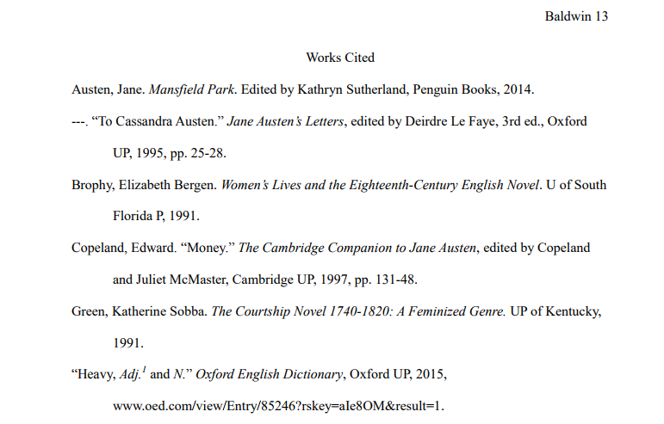
Formatting your Works Cited List
Notes:
Here’s an example of a works cited list. Notice the following items:
Works Cited is written at the top
The sources are sorted in alphabetical order by last names
The first line of each entry is flush left
And a hanging indent is used for subsequent lines within the entry
By the way, the source of this example is a sample paper from mla website found at style.mla.org

Slide 27
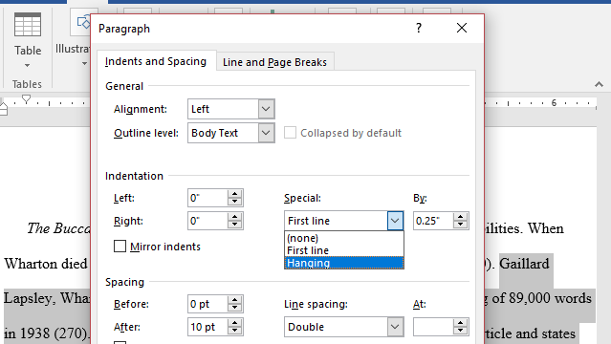
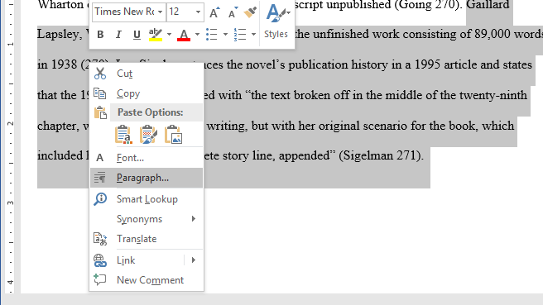


The hanging indent
Notes:
It’s easy to use hanging indents in your paper. First, open a word document and highlight the text that you wish to illustrate. Then, right click and select “Paragraph.” On the window that pops us, look for “indentation,” then “special,” and select “hanging” from the drop down menu.

Slide 28
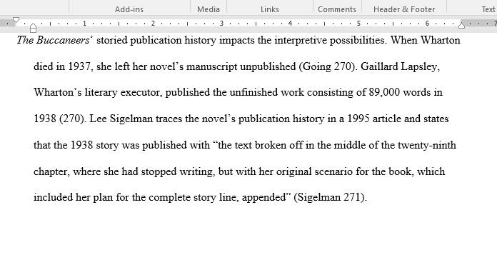
The hanging indent
Notes:
Here’s what a hanging indent looks like in a paper. Notice that the first line is not indented but all the other lines area indented.

Slide 29
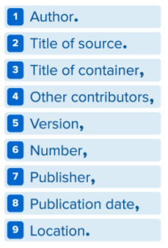
MLA core elements
Notes:
At the beginning of this video, I mentioned that MLA underwent changes in 2016. There is a new MLAs style based on a template that can be adapted to any use. It is based on a list of core elements that are given in a specific order. Not all texts will have all the elements. Note that the 8th edition just came out in spring 2016. Therefore, handbooks such as early editions of the book Rules for Writers may be out of date. If you use a citation machine like EasyBib, you’ll also want to double check to be sure that you’re using the 8th edition of MLA. The online writing center at Purdue University also shares the 8th edition of MLA, and you can access that website at owl.purdue.edu.

Slide 30
Books
  Author (Last, First).
  The Book Title.
  Publisher,
  Year.
Grimm, Nancy. Good Intentions: Writing Center Work for Postmodern Times. Boynton/Cook, 1999.
Notes:
MLA is no longer organized by publication type. However, students may still find it useful to approach documentation within the framework of commonly used source types. Using the general template allows us to create a more specific template for books, articles, websites. But there are many other possibilities, so be prepared to use the template and make decisions. There can be more than one “right” way to cite each source. For example, on the screen I’ve shared how to cite a book.

Slide 31
Articles
Author (Last, First).
“Title of the Article.”
Journal Name,
Volume, (vol.)
5. Number, (no.)
6. Date,
7. Pages. (pp.)
8. Database,
9. URL or doi.
Cameron, Deborah. “Language, Gender, and Sexuality: Current Issues and New Directions.” Applied Linguistics, vol.26, no.4, Dec. 2005, pp. 482-502. ERIC, doi: 10.1093/applin/ami027.
Notes:
Here’s an example of how to cite an article. DOI = Direct Object Identifier, often provided on the first page of the document. Leave out the DOI if you went to the library to read the actual journal. If you look back at the template I shared, you’ll see that the journal is the first container on the template and the database is the second container.

Slide 32
Web sources
Author
“Title of Article.”
Title of website,
Publisher (if different from the website name)
Date of publication,
Location (URL).
McWhorter, John. “Americans Have Never Loved Poetry More.” The Daily Beast, IAC, June 29, 2014, thedailybeast.com/ articles/2014/06/29/-americans-have-never-loved-poetry- more-but-they-call-it-rap.
Notes:
Here’s an example of how to cite a web source. By the way, this is Example 5 page 7 in the MLA Handbook.

Slide 33
Need more examples?
The Purdue Online Writing Lab (OWL)
english.purdue.edu/owl
The MLA Style Center
style.mla.org
Notes:
If you need more examples, you can find them on the Purdue online writing lab or the MLA style center. Keep in mind that you’ll want to double check any other handbooks you have to make sure that you’re using the 8th edition.

Slide 34
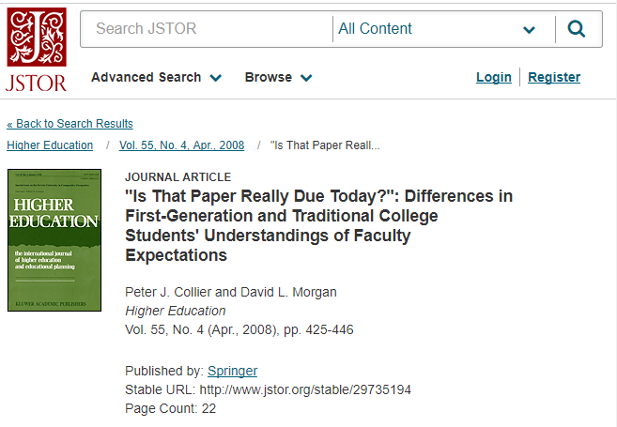
Your Turn: Creating Works Cited Entries
Imagine you found this article on JSTOR:
Notes:
Okay, let’s practice. On the screen is a screenshot of an article found on the database JSTOR. How would you cite this source? You might want to pause the video here and compare the information on this screen to an example of a journal article citation from the MLA 8th edition on the MLA website or on Owl.purdue.edu.

Slide 35
Your Turn: Creating Works Cited Entries
Article
Your citation
Collier, Peter J., and David L. Morgan. ""Is That
Paper Really Due Today?": Differences in
First-Generation and Traditional College
Students' Understandings of Faculty Expectations.“
Higher Education, vol. 55, no.4, April 2008, pp. 425-
46. JSTOR, jstor.org/stable/29735194.
Notes:
Here’s the proper citation for this article.

Slide 36
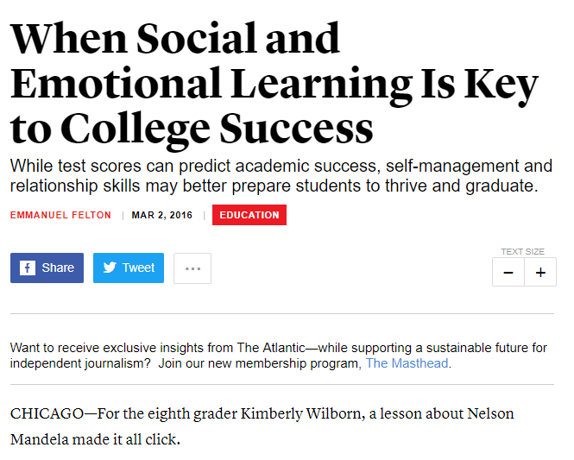
Your Turn: Creating Works Cited Entries
Websites:
https://www.theatlantic.com/education/archive/2016/03/when-social-and-emotional-learning-is-key-to-college-success/471813/
Notes:
Now, let’s imagine you want to create a works cited entry for this website. I’ve included the URL on the screen since you’ll need to include a URL in your citation. You also need the author’s name, the title of the article, the title of the website (which is the Atlantic), and the date of publication.

Slide 37
Your Turn: Creating Works Cited Entries
Website
Your citation
Felton, Emmanuel. “When Social and Emotional Learning Is Key to College Success.” The Atlantic, 2 March 2016, theatlantic.com/education/archive/2016/03/when-social-and-emotional-learning-is-key-to-college-success/471813/.
Notes:
Here’s the proper way to cite this website. Note that on your computer, you’d also want to include a hanging indent for the second through sixth lines.

Slide 38
Let’s recap
Integrating quotes
In-text citations
Works cited pages
Notes:
Okay, so we covered a lot of material today. Let’s review. We discussed why signal phrases and quotation marks are important in MLA, how to cite sources in your text using MLA, and how to create a works cited list at the end of your paper using MLA.

Slide 39
Get help online or on campus
218 Eicher Hall
Meet Us Online
Talk to a tutor through WebEx (like Skype).
Schedule an appointment at iup.edu/writingcenter
Stapleton Library
Monday - Thursday 9:00 am to 8:00 pm
Friday 9:00 am to 3:00 pm
Monday - Thursday 8:00 pm to 11:00 pm
Sunday 5:00 pm to 10:00 pm
Notes:
If you have questions or would like one of our trained tutors to consult with you about your paper, you can reach us on Indiana University of Pennsylvania’s campus or online.

Slide 40
Questions?
Comments?
Contact us at http://www.iup.edu/writingcenter/
W-Center@iup.edu
Notes:
Thank you for tuning in for this workshop from the Kathleen Jones White Writing Center at Indiana University of Pennsylvania. We’ll see you again soon, and in the meantime, happy writing.

Slide 41
Works Cited
MLA Handbook. 8th ed, Modern Language Association of America, 2016.
“The MLA Style Center.” Modern Language Association of America, 2016, style.mla.org/?gclid=CJ30- ksyo8MwCFYMehgodQ 2sGYA.

