Slide 1
Introduction to the Writing Center
Created by tutors at the IUP Writing Center

Slide 2
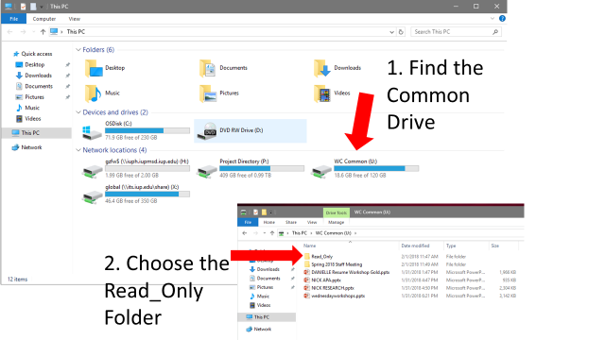

Slide 3
Today you’ll learn…
Basic information about the Writing Center’s services and three locations
What tutoring is like and how it can help you while you’re at IUP
Some of the college-level writing skills that you can get help with at the Writing Center

Slide 4
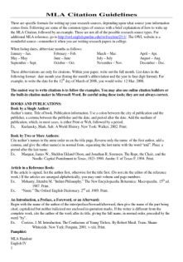
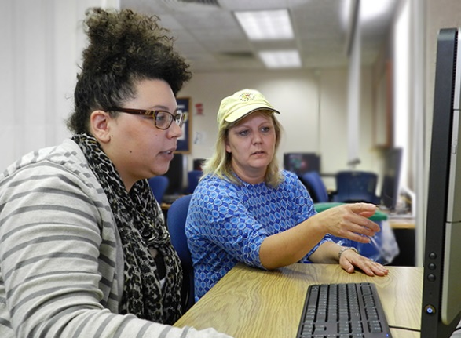
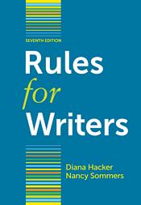

Welcome to the Writing Center!
We also have books and free handouts with information on writing strategies and formatting.
Writing Center tutors can help with every part of the writing process.
Prewriting
Drafting
Revising

Slide 5
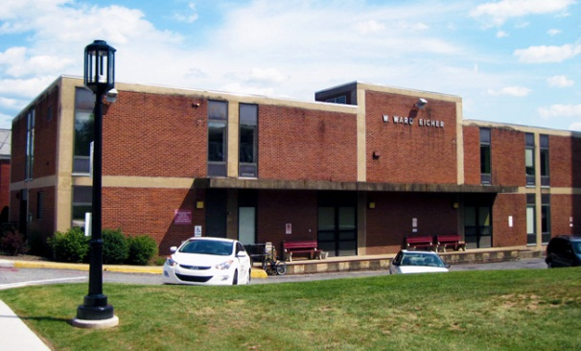
What is the Writing Center?
A comfortable place to work on writing assignments by yourself
A free service that offers peer tutoring sessions to all IUP students (you already paid for this service!)
Enter Here
Notes:
The IUP Writing Center is specifically designated (designed?) to work on writing projects. Students are welcome to come to the Writing Center to both utilize our peer tutoring service and work on assignments independently.
This service is included in educational service fees, so it is best to take advantage of this money you have invested.

Slide 6


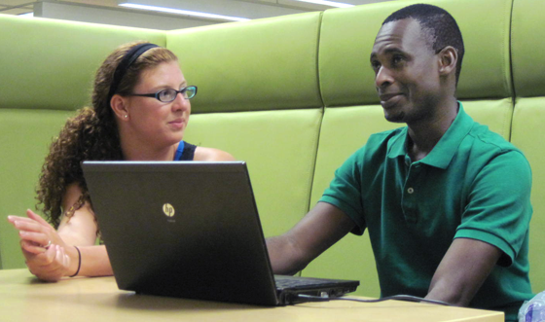
Get help online or on campus
218 Eicher Hall
Meet Us Online
Talk to a tutor through WebEx (like Skype).
Schedule an appointment at iup.edu/writingcenter
Stapleton Library
Monday - Thursday 9:00 am to 8:00 pm
Friday 9:00 am to 3:00 pm
Sunday
5:00 pm to 10:00 pm

Slide 7
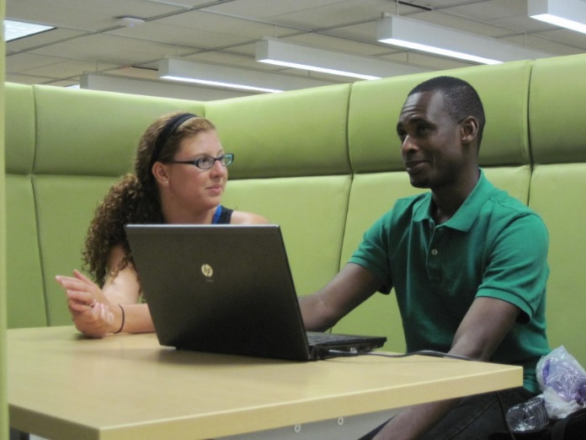
The Library Satellite
Perfect for late-night writing!
First floor of Stapleton Library
Some reference materials available
Notes:
Two good things to mention about the Library Satellite:
The hours are later, so if you’re working on a paper at night, you can still get help.
It’s very helpful to have the library’s resources and our resources in one convenient location.

Slide 8
The Online Writing Center
Meet with a tutor for a one-on-one session from any location
The tutor can see your paper as it appears on your screen
Book an appointment at least 24 hours ahead of time. Just visit iup.edu/writingcenter and click “Meet us Online”
Notes:
Students do not need to physically be at the Writing Center to utilize our services. If they are not around IUP or do not feel like leaving their house (especially during the winter months), we also offer the Online Writing Center. These sessions allow students to meet one-on-one with a tutor from your computer screen. Students are able to share your screen with a tutor. Just book an appointment 24 hours ahead of time by visiting iup.edu/writingcenter and follow the instructions to prepare for your session.

Slide 9
Today you’ll learn…
Basic information about the Writing Center’s services and three locations
How tutoring can help you while you’re at IUP
Some of the college-level writing skills you can get help with at the Writing Center

Slide 10
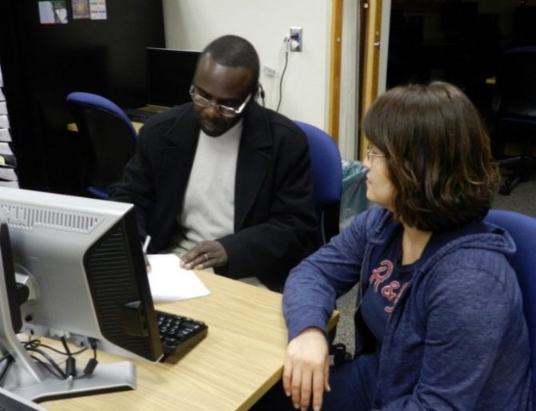
What happens in a tutoring session?
30-45 minutes
Your tutor will collaborate with you to help you find the best way to put your ideas onto paper
What to bring to a session:
The assignment from your professor
The syllabus if it contains guidelines
Notes, rough drafts, outlines, etc.
Notes:
Peer tutoring is a unique way of collaborating on writing projects. During a peer tutoring session, tutors will sit with you one-on-one to offer their complete attention and feedback on your work.
You could point toward the picture: it’s not easy to tell right away which person is the tutor and which person is the student. It’s a good example of how tutoring is collaborative and how the student takes ownership of the revision or writing that happens. The student on the left is the writer. Kay, on the right, is the tutor.

Slide 11

How can we help you?
With a tutor, you can…
Get help at all points in the writing process, from understanding the assignment to proofreading
Work with common genres like résumés, cover letters, research papers, poetry, email
Develop different writing styles (e.g. academic, professional, creative)
Learn to document sources in MLA or APA
Notes:
On this slide, you could also provide a brief example of a tutoring session that was productive and explain what happened in terms of the goals you set and what you did with the student. You might ask students to describe what MLA and APA are in case they haven’t heard of it before.

Slide 12

How can we help you?
Additional Resources
Tutors
Workshops
Computer lab
Black and white printer
Scanner
Reference books
Coffee, tea (occasionally snacks!)
Notes:
On this slide, you could also provide a brief example of a tutoring session that was productive and explain what happened in terms of the goals you set and what you did with the student.

Slide 13
Today you’ll learn…
Basic information about the Writing Center’s services and three locations
What tutoring is like and how it can help you while you’re at IUP
College-level writing skills you can get help with at the Writing Center

Slide 14
Writing in college
Writing at the college level presents new requirements and challenges. As you draft and redraft essays, professors will expect you to…
  Plan and organize your ideas using brainstorming, outlining, and library research
  Write clearly and concisely
  Use critical thinking to analyze concepts on your topic
Notes:
These three things (prewriting, writing concisely and analyzing concepts) are good skills to develop in college. Tell students you’re going to help them start developing them right now, in this very workshop. And, if they ever struggle with these things, they can come back for one-on-one help with them.

Slide 15
Prewriting strategies
You’ve got your assignment.
Now what?
Use brainstorming to get your ideas on paper.
Technology
Steve Jobs
Facebook
Microsoft
3D Printing
E-Books
A mind map can be useful for identifying main topics and how they relate to one another.
Notes:
Ask students to identify some ways to get ideas down on paper quickly. Possible answers: free-write for 5 minutes, make a list, talk with a tutor
Certain brainstorming strategies lend themselves to specific assignments. For example, this chart lets you explore various aspects of a central theme. If you liked one of the things in the smaller bubbles, you could zero in on that and make a new diagram based on that.

Slide 16
Brain-storming
Completing a writing assignment is usually easier when you have lots of ideas to work with.
Involving other people (like tutors!) can be really helpful for generating ideas.
Let’s see an example of this on the next slide….
Notes:
While brainstorming by yourself can work, it is beneficial to collaborate with others to generate ideas. This gives you a wide array of ideas to work with and choose from.
Don’t believe me? Let’s do an activity demonstrating how many ideas and words we can generate as a group. You’ll see that in a group, you’ll generate way more ideas than you can on your own.

Slide 17
Try it: Brain-storming
In only one minute, list as many uses for this object as possible.
Rules
1. All ideas are good (we’re going for quantity, not quality).
2. Shout out anything you think of.
Notes:
Grab the workshop room’s trash can and set it on the table for everyone to see. Assign a student to keep time (or the professor).
Open up a Microsoft Word document and start typing their ideas. You may want to have one ready to get the ball rolling.

Slide 18
What’s the point of brain-storming?
To get lots of ideas to work with, try to get outside of your own head and involve other people…like tutors.
Notes:
The point of this brainstorming activity is to demonstrate that you can get more ideas with another person than you can on your own.
That’s why the Writing Center is a helpful resource to use before students even begin a writing assignment!

Slide 19
Brain-storming in sessions
Your tutor will have more ways to brainstorm ideas than the ones we’ve seen today.
Tell your tutor you want to brainstorm ideas at the beginning of your session.
Notes:
You’ve looked at a few ways to brainstorm, but writers might need help with it when it comes time to actually write a paper. If that happens, tutors can help! They’ll will use various techniques to help guide the brainstorming process.

Slide 20
Writing in college
  Plan and organize ideas
  Write clearly and concisely
  Use critical thinking to analyze concepts on your topic
Notes:
These three things (prewriting, writing concisely and analyzing concepts) are good skills to develop in college. Tell students you’re going to help them start developing them right now, in this very workshop. And, if they ever struggle with these things, they can come back for one-on-one help with them.

Slide 21
Clear and concise writing
Once you have ideas to write about, you must communicate them clearly and concisely.
Let’s look at what that means.
Notes:
After brainstorming possible ideas, you must communicate these ideas to your reader clearly and concisely. We will discuss a few methods you can utilize in order to develop this type of writing.

Slide 22
Clear and concise writing
con·cise (adj.): giving a lot of information clearly and without unnecessary words; brief but complete.
Concise writing is not necessarily fewer words. It is the efficient use of words.
Notes:
Concise doesn’t mean short, so students shouldn’t worry that concise writing won’t meet their length requirements.

Slide 23
Clear and concise writing
When you write concisely, you can provide more information and reduce repetition.
Writing concisely will also help you cover a lot of information in just a few words. Let’s give this a try…
Notes:
Giving more information and reducing repetition makes readers happy – it’s not difficult or tedious to read concise writing.
Writing about a lot of information in just a few words is helpful when doing things like summarizing in a research paper or writing an abstract or a literature review.
And outside of traditional academic writing, being able to write clearly and concisely is important for things like resumes, cover letters, lab and field reports, marketing reports, social media marketing, etc.

Slide 24
Clear and concise writing
Can you make this paragraph more concise?
There is a university in Indiana, Pennsylvania, that is called the Indiana University of Pennsylvania. It is a large university that has many students. There are more students at the Indiana University of Pennsylvania than there are at all but one other university in PASSHE.
Notes:
Giving more information and reducing repetition makes readers happy – it’s not difficult or tedious to read concise writing.
Writing about a lot of information in just a few words is helpful when doing things like summarizing in a research paper or writing an abstract or a literature review.
And outside of traditional academic writing, being able to write clearly and concisely is important for things like resumes, cover letters, lab and field reports, marketing reports, social media marketing, etc.

Slide 25
Here’s what we came up with.
There is a university in Indiana, Pennsylvania, that is called Indiana University of Pennsylvania. It’s a large university that has many students. There are more students at Indiana University of Pennsylvania than there are at all but one other university in PASSHE.
(42 words)
Indiana University of Pennsylvania, a public university located in Indiana, Pennsylvania, is the second largest university in the Pennsylvania State System of Higher Education and the commonwealth's fifth largest university, with close to 13,000 undergraduates as of 2011.
(39 words)
Notes:
Now that they’ve done it, take a look at a sample. Notice that we’ve included more information than the original in roughly the same number of words.

Slide 26
Clear and concise writing in sessions
When you want to work on making your writing clear and concise with a tutor, you’ll likely spend more time on a specific part of your paper rather than read through the entire assignment.
Once you’ve practiced with a tutor, it will be easier to finish the rest of the paper on your own.

Slide 27
Writing in college
  Plan and organize ideas
  Write clearly and concisely
  Use critical thinking to analyze concepts on your topic
Notes:
These three things (prewriting, writing concisely and analyzing concepts) are good skills to develop in college. Tell students you’re going to help them start developing them right now, in this very workshop. And, if they ever struggle with these things, they can come back for one-on-one help with them.

Slide 28
Analysis
College-level analysis involves deeper levels of critical thinking than you might have encountered before. Luckily, tutors have lots of practice with it and can help you out.
But first, let’s talk about what analysis means.
What is analysis? What is summary? How do they differ?
Notes:
College-level analysis is nothing to be scared of. Let’s first work on understanding what it means. Analysis is closely related to the concept of summary. Ask the audience if they know what analysis means and how it differs from summary.

Slide 29
Summary | Analysis
Both require that you understand the text or concept.
A brief description of the whole | Breaking an idea or concept down into smaller parts and explaining the relationship between these parts and the whole.
Shorter than the original work | Can be any length, even longer than the original work
Highlights important words and ideas | Incorporates ideas beyond what is presented
Notes:
In high school, you may have concentrated more on summary, but at the college level, we add analysis to that. Summary comes from an already-written text; analysis requires you to dig up the texts.
An example of a text that a student could summarize is song lyrics, and an example of a concept that a student could analyze is beauty.

Slide 30

Analysis is like what we do after a meeting…
What do most people do after a meeting?
Analyze it! We draw meaning out of the details, who said what to whom, etc.
Think about the difference between telling your friend what happened in the meeting (summary) and telling your friend how the meeting went (analysis).
Notes:
Often the purpose of analysis is to answer a question. This usually happens by drawing meaning from important details. Emphasize that analysis includes both elements of summary and interpretation in that you must systematically break down the concept (in this case, the image) and interpret what the important details means. The summary supplies the important details that you will analyze later. The analysis offers interpretation and meaning from those details.

Slide 31
How’s this meeting going?
Notes:
Often the purpose of analysis is to answer a question. This usually happens by drawing meaning from important details. Emphasize that analysis includes both elements of summary and interpretation in that you must systematically break down the concept (in this case, the image) and interpret what the important details means. The summary supplies the important details that you will analyze later. The analysis offers interpretation and meaning from those details.
For summary, you’re looking for an answer like: one person is having an interview with four interviewers. One interviewer is smiling, three are not.

Slide 32
Now that you get the basic concept, let’s look at an example of how analysis works in a real piece of writing.
Notes:
Often the purpose of analysis is to answer a question. This usually happens by drawing meaning from important details. Emphasize that analysis includes both elements of summary and interpretation in that you must systematically break down the concept (in this case, the image) and interpret what the important details means. The summary supplies the important details that you will analyze later. The analysis offers interpretation and meaning from those details.
For summary, you’re looking for an answer like: one person is having an interview with four interviewers. One interviewer is smiling, three are not.

Slide 33
Consider this excerpt from a cover letter, for example:
How can I contribute to this company’s collaborative culture? As a strong team player, I believe one of the most important characteristics of an employee is the ability to listen and really hear others. For example, as the philanthropy chair of my sorority, I was in charge of organizing our annual fundraiser for the American Heart Association. While we had always sold heart-shaped cookies in the past, a new member thought it would be a good idea to sell Valentines online and in person. I was hesitant at first, but after hearing her out, I realized we could reach a broader audience and spend less to make more for our organization. By listening to others, I realized that not every idea is good, but a good idea can come from anyone.
Notes:
Now that everyone gets the basic concept of analysis, let’s look at an example of how it works in a piece that students might be expected to write. Here’s a sample paragraph from a cover letter. Read through it with the students.
Make sure to emphasize that they won’t be evaluating/analyzing the argument itself – they’re going to be dissecting this paragraph to see how it functions as an analysis.

Slide 34
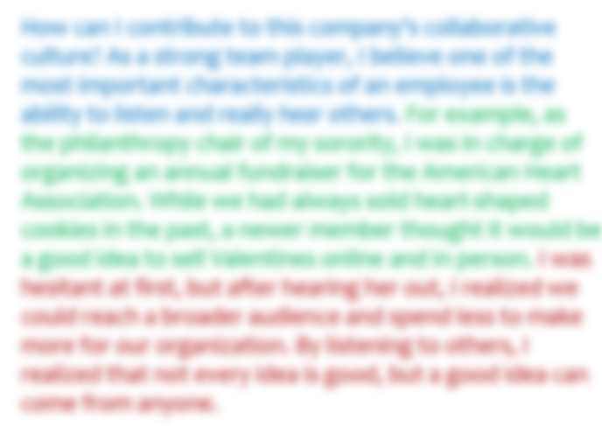
This is the analysis
The writer makes a claim.
The writer summarizes an example.
The writer makes connections to show how the example supports the claim. Notice how the first sentence explains how the anecdote shows listening skills, and the second shows why this skill is beneficial.
Notes:
Use this slide to demonstrate that the analysis exists in the breakdown of the cover letter. In other words, we are not saying that the author is using analysis; we are showing our analysis of the argument’s structure.

Slide 35
How can I contribute to this company’s collaborative culture? As a strong team player, I believe one of the most important characteristics of an employee is the ability to listen and really hear others. For example, as the philanthropy chair of my sorority, I was in charge of organizing an annual fundraiser for the American Heart Association. While we had always sold heart-shaped cookies in the past, a newer member thought it would be a good idea to sell Valentines online and in person. I was hesitant at first, but after hearing her out, I realized we could reach a broader audience and spend less to make more for our organization. By listening to others, I realized that not every idea is good, but a good idea can come from anyone.
The writer makes a claim.
The writer summarizes an example.
The writer makes connections to show how the example supports the claim. Notice how the first sentence explains how the anecdote shows listening skills, and the second shows why this skill is beneficial.
Notes:
Model for students how we analyze writing—and in this case, a claim + support.
Again, make sure you point out that what makes this an example of analysis is that it has all three components: the claim, the example, and the explanation of how the example supports the claim.
It might also be helpful to explain that there are multiple ways to analyze—not every analysis will look like this or sound like the analysis of the date in the previous example.

Slide 36
Can you think of another way to analyze the argument in this paragraph?
How can I contribute to this company’s collaborative culture? As a strong team player, I believe one of the most important characteristics of an employee is the ability to listen and really hear others. For example, as the philanthropy chair of my sorority, I was in charge of organizing our annual fundraiser for the American Heart Association. While we had always sold heart-shaped cookies in the past, a new member thought it would be a good idea to sell Valentines online and in person. I was hesitant at first, but after hearing her out, I realized we could reach a broader audience and spend less to make more for our organization. By listening to others, I realized that not every idea is good, but a good idea can come from anyone.
Notes:
While we talked about analyzing an argument’s structure in terms of its claims and support, there are other ways to analyze an argument. Prompt the students to think of other ways. For example, they could analyze the argument by discussing the strength of the supporting statements (Are they fact-based? Did the writer really do what he or she says? Are these supports strong enough to support the claim and conclusion? ). Remember, analysis does not mean simply telling whether you agree or disagree with someone’s argument. Instead, it means taking apart the person’s argument and discussing its structure, or validity, or missing parts.

Slide 37
Tutors can help you write an analysis
Analysis can be tricky, and each assignment will present new challenges.
When working with a tutor on analysis, the session will be specific to your assignment. For instance, you may need to spend more time talking through ideas (kind of like in-depth brainstorming), or you might make an outline to help clarify your analysis.
Basically, no two sessions are alike!
Notes:
If the students seem a little lost, remind them that analysis is tricky, and that the process will be different for every piece of writing, so it’s okay if they don’t get it right away. That’s what tutors are for! When a tutor helps with analysis, the session can take many different forms. Sometimes it’s helpful just to talk things through, and other times they’ll want to do some writing or cutting and pasting.

Slide 38
Let’s recap
Basic information about the Writing Center’s services and three locations
What tutors do and how they can help you while you’re at IUP
Some of the college-level writing skills you can get help with at the Writing Center:
Planning and organizing ideas
Writing clearly and concisely
Writing an analysis

Slide 39
What if I need help with other kinds of writing?
We just skimmed the surface of what writing is and what tutors can do.
Tutors are ultimately problem-solvers, so if you encounter something that we didn’t cover today, we can probably still help. ☺
Notes:
We picked three important writing skills (prewriting, writing concisely, and analyzing) but that doesn’t mean that we can only help with these things.
Students can drop by for help with many writing issues, and if they’re not sure exactly what they need to work on, we can help them figure it out, too.

Slide 40
Get help online or on campus
218 Eicher Hall
Meet Us Online
Talk to a tutor through WebEx (like Skype).
Schedule an appointment at iup.edu/writingcenter
Stapleton Library
Monday - Thursday 9:00 am to 8:00 pm
Friday 9:00 am to 3:00 pm
Sunday
5:00 pm to 10:00 pm

Slide 41
Contact us
Feel free to…
  Walk in to either location – no appointments needed!
  Give us a call during business hours at (724) 357-3029
  Email us at w-center@iup.edu
  Reach us on Facebook or Twitter
  Visit our website: iup.edu/writingcenter
Notes:
If students need to get a hold of us, there are many ways to do so!

Slide 42
Copy and paste this URL into a browser to take a quick survey on today’s workshop:
http://bitly.com/WCWorkshopSurvey

